Slide 1
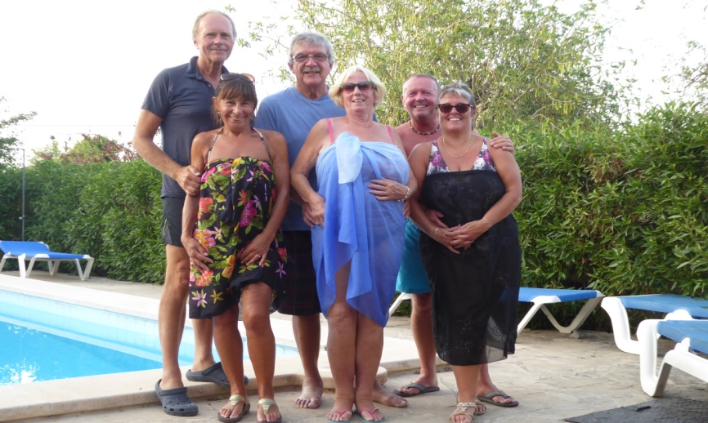
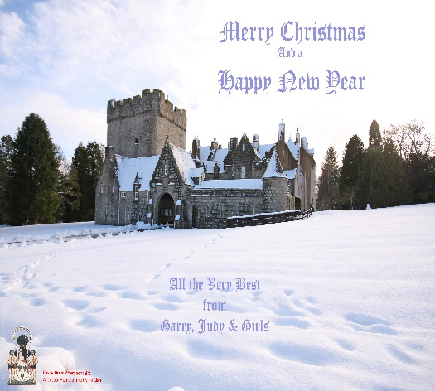
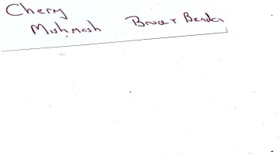
PORTHOLE #489
Nov/Dec
2018
The Rotary Club of the Island and Royal Manor of Portland {Register Charity Number: 1032098}
President: Garry Urwin Vice Pres: Elizabeth Hardy Secretary: Peter Burrows
Meetings: Tuesdays 6:30pm, Including Guest Night At the AQUA SPORT HOTEL
Margaret and Alan send their best wishes for Christmas and the year to President Gary and all members and their families.
Chrissie & Brian
Merry Christmas and another
Happy New Year having fun in Rotary
Love and Best Wishes Elizabeth

Slide 2
Sarah and Brian wish all Rotary friends and family a wonderful Christmastime. And a very happy and healthy New Year.
Like many people of my age, I have just received the notice that the
Government heating allowance payable to pensioners is on its way.
It amounts to £200, though half of it is paid to my wife even though I pay
all the bills !
We again, like many people, do not really ​need it but we accept it each
year without much thought. Others, perhaps less fortunate than us,
​probably do need it and possibly could do with a little more. And so each
year we faintly wonder whether we should send it back or make a
donation to charity of an equal amount . But we never do anything about it.
Recently I came across another person's solution to what he called a moral
dilemma. He was aware that about 75% of the cost of a bottle of whisky
goes to the government in tax. He has resolved that on receipt of the £200
(assuming that is he can get the wife's £100 from her) he will drive to his
local supermarket and spend £266.67 (75% of which is £200) on bottles of
whisky. In that way the government will get back in whisky duty the £200
it had paid him in heating allowance!
Should be a (very) merry Christmas - Alan
Elizabeth giving the good news after the Treasure Hunt
Janet & Lee would like to wish you all a very merry Christmas and a fabulous new year

Slide 3
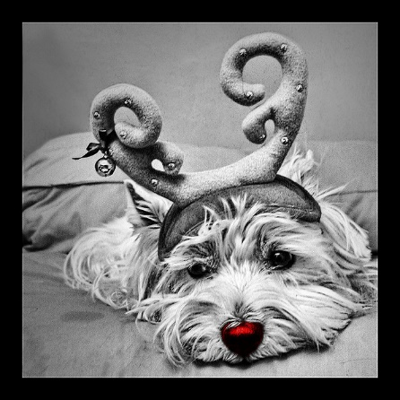
FROM SUE & LOLA
XX
“Christmas is a special time for family and friends
So May Peace and Joy and Happiness
Bring a love that never ends.”
Sincere greetings to all, Julia.
Keith and Judy wish all their friends a Wonderful Happy Christmas and we hope you have a Healthy, Peaceful,
Polio-free 2019.
With best wishes for Christmas and the New
Year from Pat
Peter and Rosemary wish all their friends in Rotary a Merry Christmas and a very Happy New Year
Merry Christmas + A Happy New Year
To all my Rotary friends and their families
From Diane and Dad (Richard) XXXXX

Slide 4
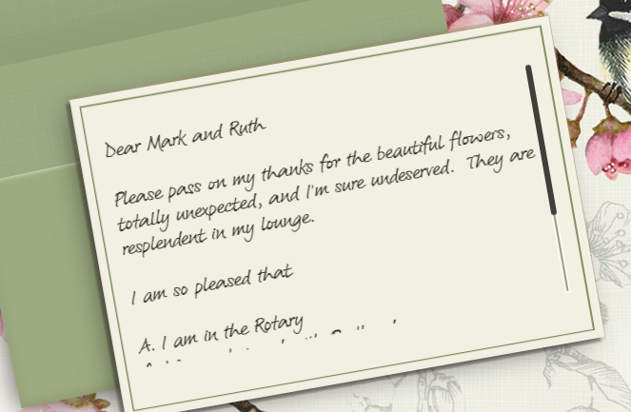
Best Wishes for Christmas and a Happy New Year to all members and families of Portland Rotary. We also wish the club a successful 2019. Mark & Ruth
WITH VERY BEST WISHES THIS CHRISTMAS AND A HEALTHY NEW YEAR TO ALL OUR ROTARY FRIENDS
IAN & JENNY xxxx
Picture from Sarah

Slide 5
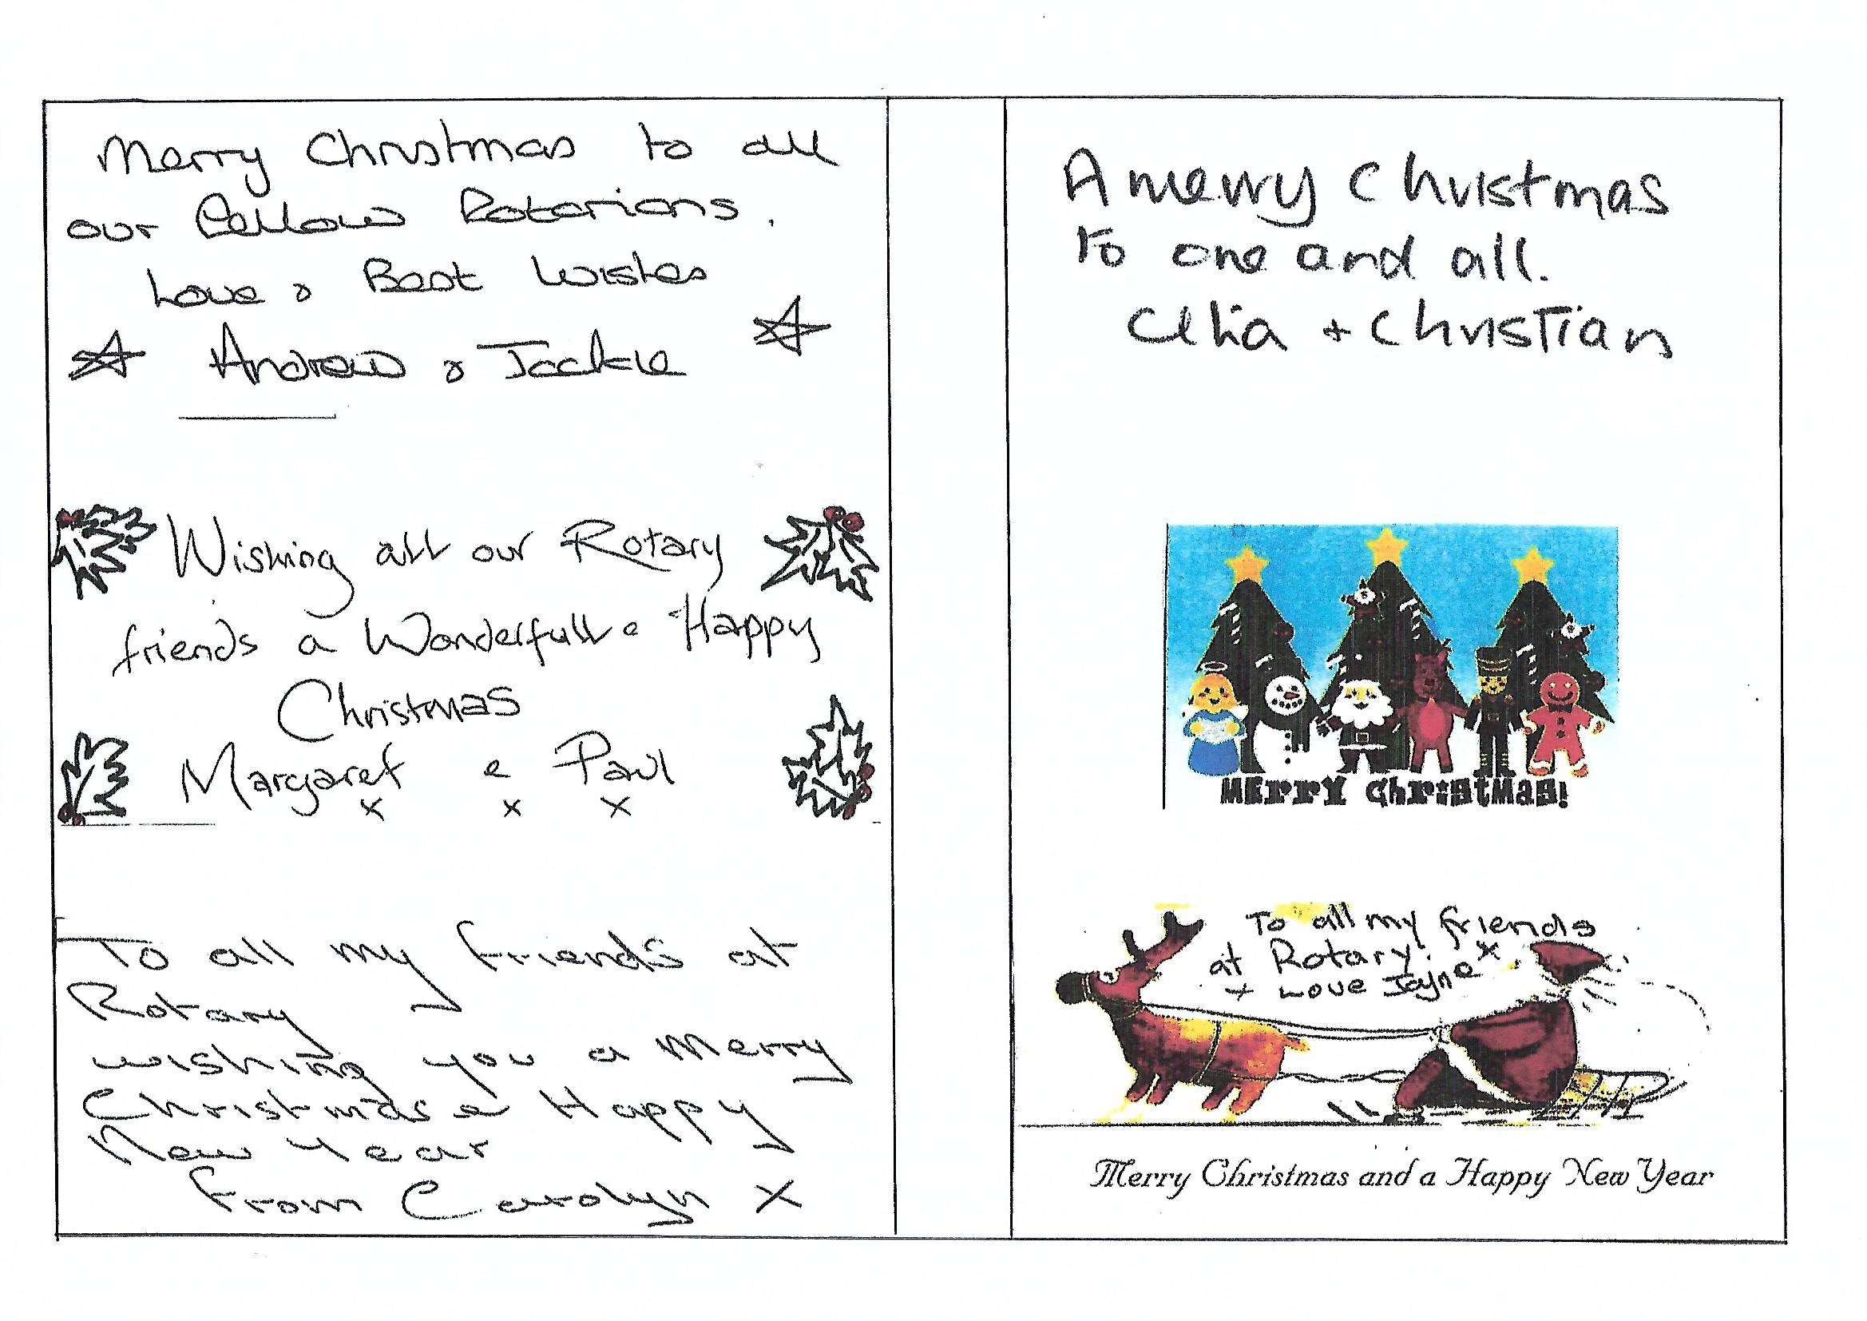

Slide 6
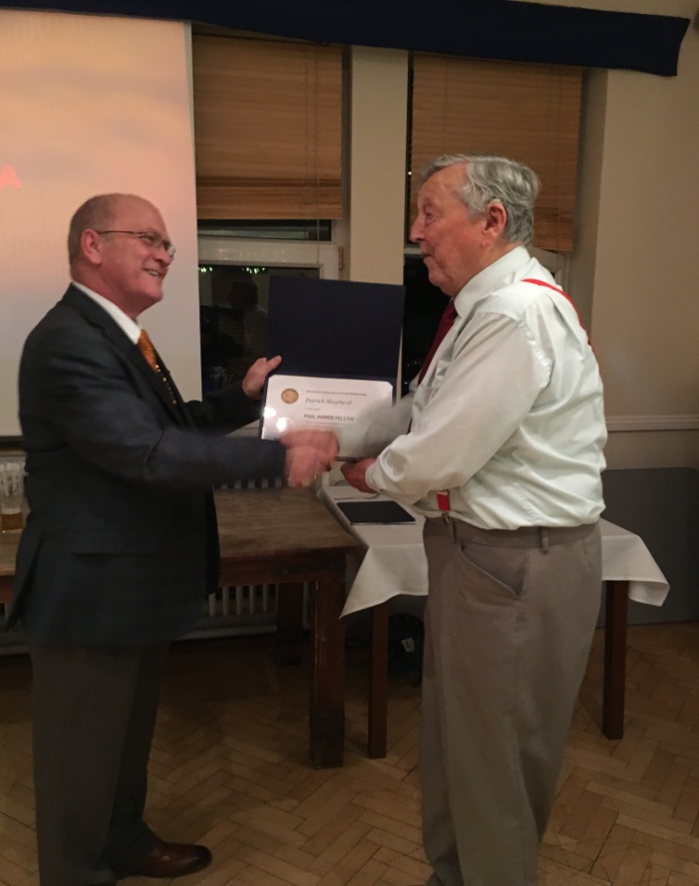
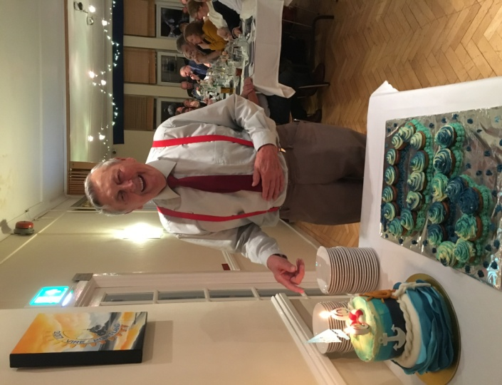
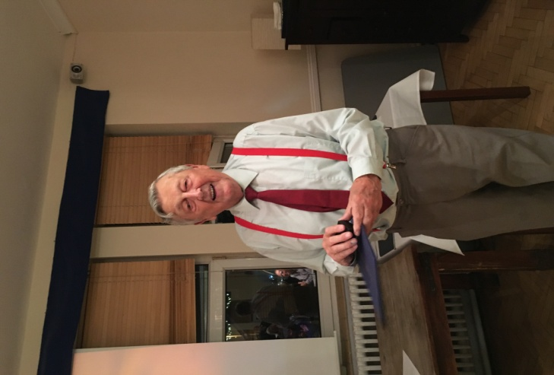
Pat Shepherd 90th Birthday and Paul Harris Fellowship Award
The Paul Harris Fellow Recognition acknowledges individuals who contribute, or who have made contributions made in their name to the Rotary Foundation of Rotary International.
It was established in 1957 to show appreciation for and encourage substantial contributions to what was then the foundations only program.
It has also been recognised as a club’s accolade to meritorious service to Rotary, the community and service above self.
Our latest recipient to gain this award, has been spoken about and written about by the late Hilda Swinney who was a long-standing Dorset Echo Reporter on the Island.
He Trained as a Chemist, an Engineer, a School Governor, Board of Visitors member at HMP The Verne for 19 years and of course Rotarian and member of the Dorset National Deaf Children’s Society.
Born in Southampton, our recipient for many years made a day trip to Portland, and little did he know he would return with his wife Sheila and his family of two sons and a daughter Paul, David and Sarah.
Pat Shepherd lived and worked on the Island, working for FOST and ARE and serving the community as a Rotarian. Pat Joined Portland Rotary in March 1985 left in 2006 and re-joined and has been an active member ever since, he can be seen with Father Christmas on Christmas morning delivering Christmas presents amongst other projects throughout the year.
Pats interests include building, flying and repairing radio-controlled model aircraft, classical music, reading and astronomy.
It gives me great pleasure to announce a worthy recipient and on his 90th Birthday, our latest Paul Harris Fellow.
I give you…. Rotarian Pat Shepherd
(Speech given by Pres. Gary on Tuesday 27 November)
.

