Slide 1
Create Hope in the World

Slide 2
Better Together

Slide 3
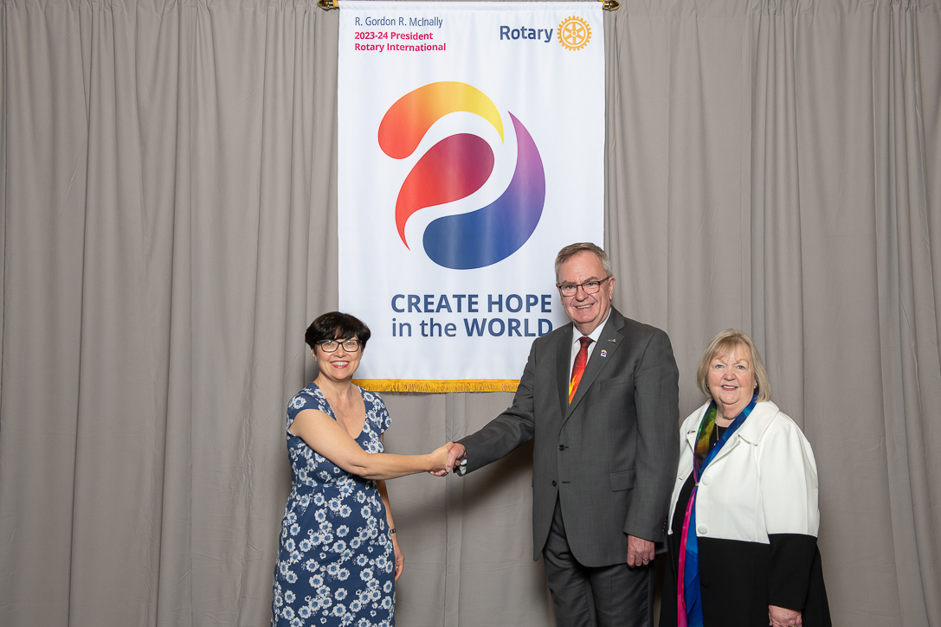
Introducing Gordon McInally

Slide 4
Create Hope in the World
Peace
Mental Health
Create Hope

Slide 5
Continuity
Empowering Girls
Diversity Equity and Inclusion
Rotaract
Polio

Slide 6
Rotary’s Vision Statement
“Together, we see a world where people unite and take action to create lasting change – across the globe, in our communities, and in ourselves”

Slide 7
Our Action Plan

Slide 8
My Vision
Continuity
Membership
Diversity, Equity and Inclusion
Mental Health
Foundation
Rotary can no longer be the best kept secret

Slide 9
My Charitable Focus
Environment
Foundation
Mental Health

Slide 10
Rotary and Mental Health
Rotarians 4 Mental Health
Rotary partnership with Bipolar UK
Mental Health Initiatives Rotary Action Group Toolkits and Fundraising ideas

Slide 11
How can we get clubs to embrace Mental Health Initiatives?

Slide 12
Summary
Increase diverse Membership
Show our success stories
DISTRICT TEAM ARE HERE TO SERVE YOU

Slide 13
Lets Make a Difference in 1090
Service & Foundation
Social Media
Diverse
Membership

Slide 14
Important Dates
Saturday 30th September in Benson
How to make your Rotary Club Sizzle!
Thursday 5th October via zoom 7pm - 8pm
GB&I Membership Lead - Steve Martin
Saturday 4th November via zoom
Puzzling for mindfulness/mental health. The aim is to demonstrate how enjoyment of
solving puzzles can alleviate anxiety
Sunday 17th December Carol Concert - 2pm - 3pm - TBC

Slide 15
Important Dates 2024
Saturday 10th February in Benson
Rotary Village / House of Friendship – showcase of our clubs
TBC March Interactive event
A Live stream event
Tuesday 16th April
Race Against Dementia
Monday 10th June
District Golf Day at Temple Golf Club
Saturday 6th July
Centenary Celebration

Slide 16
Better together!
Kate.rotary1090@gmail.com

Slide 17
Thank You!

