Slide 1
Challenging harm & abuse of older people

Slide 2
Over 500,000 older people in the UK are abused each year
The majority of victims are women over the age of 70
5 common types of abuse:
physical
sexual
psychological
financial
neglect
Financial abuse and neglect most common types of abuse

Slide 3
What is ‘elder abuse?’
Action on Elder Abuse definition:
“Abuse is a single or repeated act or lack of
appropriate action occurring within any
relationship where there is an expectation of trust, which causes harm or distress to an
older person….”

Slide 4
The Abusers
UK Study of Abuse and Neglect of Older People - 2007
40
35
33
35
% of all respondents who had experienced abuse in the last year
30
25
%
20
20
15
9
10
3
5
0
Partner
Other family
Paid carer
Friend
Neighbours &
Acquaintances

Slide 5
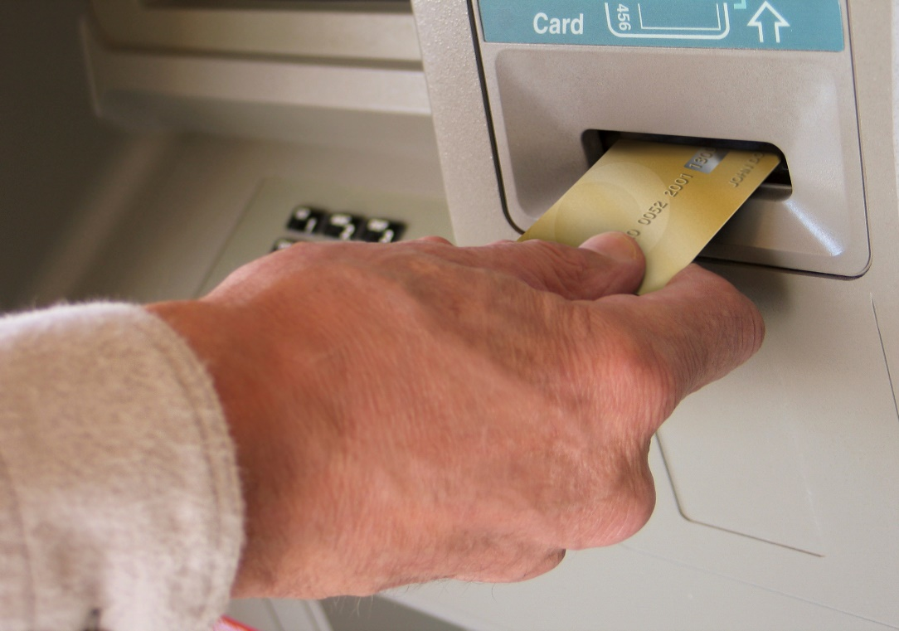
Financial abuse / harm
May include:
theft
fraud, forgery or embezzlement
feeling under pressure to hand
over money or possessions
exploitation of property or welfare benefits
stopping someone getting their money or possessions

Slide 6
Neglect (intentional)
Failing to provide basis necessities, such as:
food, clothing, hygiene, heating and mental stimulation
denying medical or physical care, medication, or access to a doctor or other services
denying privacy or dignity

Slide 7
Physical & sexual abuse
May include:
physical injury or mistreatment
over-medication or withholding of drugs
sexual assault
rape
sexual harassment
Physical and sexual abuse are always crimes, but are not always prosecuted.

Slide 8
Psychological / emotional abuse
May include:
threatening
bullying
isolating
shouting
blackmailing
blaming

Slide 9
Staying safe
reporting to council or other agency
legal issues – wills, power of
attorney, property, etc
money matters
neglect - housing and care needs
keeping safe from doorstep crime
domestic abuse
staying connected

Slide 10
How can Action on Elder Abuse help?
freephone confidential helpline
information leaflets
raising awareness of elder abuse
information sessions and seminars
lobbying and campaigning work

Slide 11
We can give advice on….
how to spot abuse
what to do about it
the reporting process
signposting to local
support groups
We can also just be someone to talk to or listen to your concerns.

Slide 12
Interested in getting involved?
Seeking helpline volunteers in Fife
Peer support projects for victims of elder abuse
Help us spread the word!

Slide 13
Elder Abuse Helpline
0808 808 8141
Lesley Carcary
Director, Action on Elder Abuse Scotland
lesleycarcary@elderabuse.org.uk

