Slide 1
Södertälje Rotary Club visiting Beckenham Rotary Club September 2-5 2015
Presentation outline
Who we are
Södertälje
Club merge
Members
Club board
Committees
Projects
Twinning clubs
Vision

Slide 2
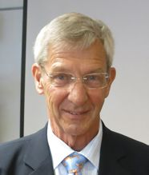
WHO WE ARE
Vigo Löfcrantz
Youth and International matters
Wife: Gunilla
Torgny Carlsson Bukavu project
Wife: Meggi Bergström
Peter Viridén Past president
Archives
Wife: Kerstin
Inga Lundblad
Past past president
Book reading project
Åke Persson President 2015-16
Wife: Margareta

Slide 3
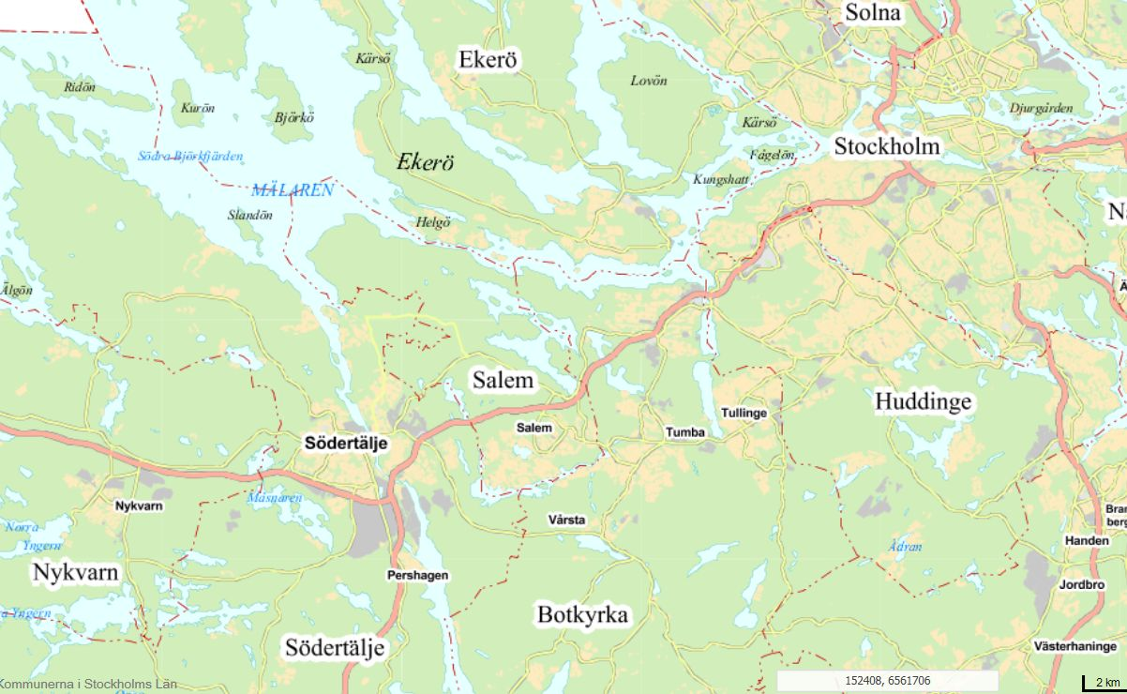
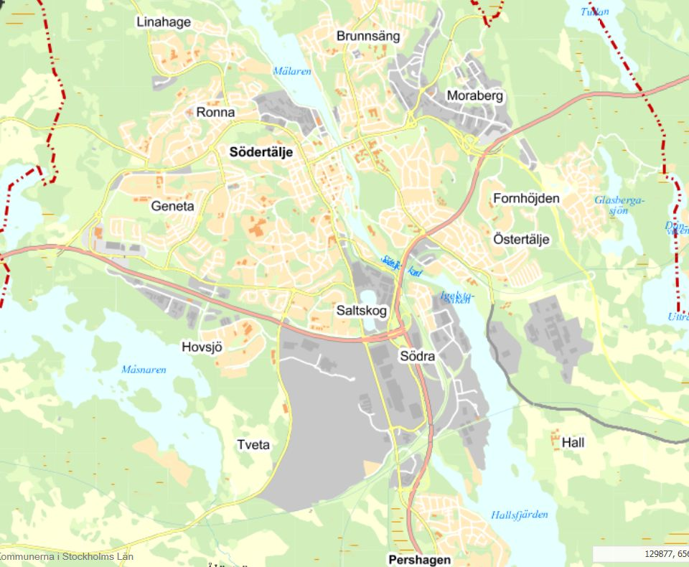
SÖDERTÄLJE
35 km SW of Stockholm
90 000+ citizens. 50% immigrants

Slide 4
CLUB MERGE
Södertälje R.C.
Chartered 1943
Södertälje Östra R.C.
Chartered 1966
Södertälje-Mälaren R.C.
Chartered 1972
Järna R.C.
Chartered 1973
Nykvarn R.C.
Chartered 1986
July 1, 2015
Södertälje R.C.
Chartered 1943

Slide 5
MEMBERS
Södertälje Rotary Club 2015-09-02
Number of members: 56
Number of women 12 (21%)

Slide 6
CLUB BOARD
President Åke Persson
Vice president Vigo Löfcrantz
Past president #1 Peter Viridén
Past president #2 Anders Granéli
Incoming president Conny Åkerblom
Secretary Jan Bergström
Treasurer Bengt Sjögren
Club administrator Bo Gallon

Slide 7
COMMITTEES
Club administration Chair: Bo Gallon
Program, social events, tours
Membership committee Chair: Karin Eklind
Recruiting, member care
Society sevices committee Chair: Inga Lundblad
Local and international projects
Profession committee Chair: Kennedy Cankalp
Information to high school classes
Youth and international committee Chair: Vigo Löfcrantz
Student exchange, twinning clubs

Slide 8
PROJECTS
LAV in Bukavu, Eastern Congo Project leader: Torgny Carlsson
Education support to war time traumatic children
Book reading, Södertälje Project leader: Inga Lundblad
Reading support to children in 2nd and 3rd classes with many immigrants
El Sistema, Södertälje Project leader: Inga Lundblad
Development and integration by learning to play music together
Math groups, Södertälje Project leader: Anders Granéli
Mathematics home work support

Slide 9
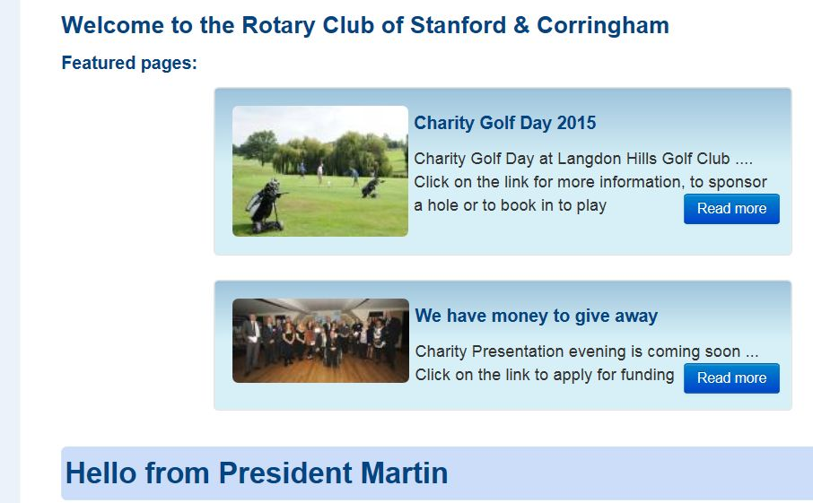
TWINNING CLUBS

Slide 10
VISION FOR 2015-16
The two-club-merger will turn out to be successful: members will feel at home and proud
At least 50% of the members are involved in club activities
The number of members will grow to 60
The number of women members will be at least 25%
Twinning club contacts will grow and include common activities

