Slide 1
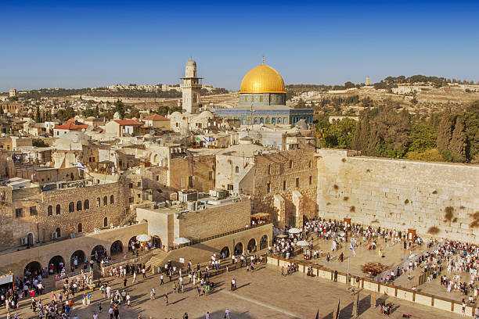
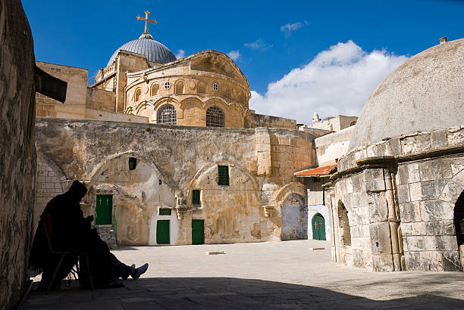
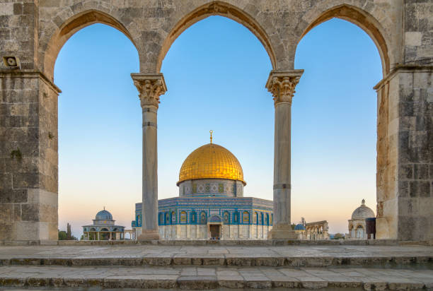
MIDDLE EAST HISTORY
AND ITS EFFECTS ON PRESENT DAY PALESTINE
A talk by Fuad Ramadan :
Thursday 25th July 2024
Wailing Wall - Jerusalem
Church of the Holy Sepulchre – Jerusalem
Al-Aqsa Mosque – Jerusalem

Slide 2
History of Fuad Ramadan
Father was born in West Didsbury , Manchester , UK in 1920 and Grandfather arrived in UK in 1878
Father is Mr Jamil Ramadan MBE who served as a British Diplomat from 1943 till 1978 in Lebanon ( Vice Consul & Second Secretary )
Father the worked in the F&CO ( London Based ) from 1980 till 1990
I was Born as a British National In Beirut, Lebanon in 1957
I was brought up in a British Boarding School in Lebanon and in the late sixties till Mid-seventies where many of the Middle East Royal Families and business leaders and USA and British Expatriates educated their children
Attended Trent University of Nottingham to undertake studies as an accountant from 1976 till 1980
I joined Crown Agents for Overseas Governments and Administrations in 1980 till 1993 where I managed part of the British Government Overseas aid to the Middle East which included the Kurdish Refugee crisis in North Iraq as well as efforts re supply goods and equipment to Kuwait following the re instatement of the Kuwaiti Royal family and Government at the conclusion of the first Iraq war. I also managed all Medical equipment sales to The People's Democratic Republic of Yemen ( Communist ) for many years, but this was government to government work but not UK aid
I then undertook various consultancy roles, and this included dealing with Chinese manufacturer of vehicles and household equipment with the help of China North Industries Corporation ( Chinese Army ) as the army factories were being switched from military use to making trucks and 4-wheel drive vehicle's etc in the early 1990. This was mainly to guide and then set up distribution networks for these manufacturers in Yemen
In 2000, I joined SLE Limited in full time employment as their Export Administration Manager ( medical Manufacturers in Croydon in 1999 ) to help set up all their international export operation . The exports have grown from £ 1 Million to the current £ 21 Million a year )
Because of the Mongol invasion Turkmens started migrating into Anatolia in great numbers. The Mameluk sultan gave them the right to settle from Antioch to Gaza. In return Turkmens became a great help in battles against Crusaders and Mongols.
As a result of Ebu Said Bahadir Khan's death, Turkmens turned their eyes on Cilicia and they started to settle the provinces which they captured. With the help of the Mameluks in 1360 Adana and Tarsus were captured, leaving only a few castles to the Armenians. Ramazan Bey, from the Yuregir clan of Oghuz Turks had founded the emirate and made Elbistan the capital. However after the conquest of Elbistan by the Emirate of Dulkadir, the capital was moved to Adana.
In 1375, Ramadanids destroyed the Armenian Kingdom of Cilicia in the name of the Mamluk sultan of Egypt, this became the core territory of the Ramadanids.
After the death of Ramazan Bey, his son Ibrahim Bey made alliance with the Karaman Emirate. Alaeddin Bey and Ibrahim Bey together tried to break the Mameluks' might in the province. After this alliance a great Mameluk army moved in and began to plunder but Ibrahim Bey's army achieved a great victory against the Mameluks in Belen. Also in this battle Temur Bey, the general of the Mameluks, had been captured. Yilboga, the amir of Aleppo moved on to the Turkmens after this defeat and he conquered Misis Castle.
The Ramadanids played an important role in 15th century Ottoman-Mamluk relations, being a buffer state located in the Mamluk al-'Awasim frontier zone.
In 1516, Selim I incorporated the beylik into the Ottoman Empire after his conquest of the Mamluk state. The beys of Ramadanids held the administration of the Ottoman sanjak of Adana in a hereditary manner until 1608, with the last 92 years as a vassal of the Ottomans.
The dynasty remains prominent in Turkish society to this day.
Pre Ramadan Emirate from 704 AD
Alughazlar Clan ( 704 AD In Anatolia – (Turkmen) One of the first Muslim Clans from Turkistan that settled in Turkey in 704 AD fought with the Abasites against the Bizantians )
Fakhad Alushuk Clan
Albuaklur Clan ( Split into three separate Emirates 1- Ottoman Emirate and founder Ottoman son of Urtugal; 2- Ramadan Emirate and and founder Price Yuregir ;3 – Dukadrizin Emirate but it ended quickly.
Ramadan Emirate
1 - Yuregir clan of Oghuz Turks ; 2- Ramazan Bey (1352-1378) 3- İbrâhim Bey (1378-1383); 4 -Şihâbeddîn Ahmed Bey (1383-1416); 5- İbrâhim II Bey (1416-1418); 6 - İzzeddîn Hamza Bey (1418-1426); 7 - Mehmed Bey (1426-1435); 8 - Eylûk Bey (1435-1439); 9 - Dündar Bey (1439-1470); 10 -Ömer Bey (1470-1485); 11 - Gıyâseddîn Halil Bey (1485-1510); 12 - Mahmûd Bey (I. 1510-1514- II. 1516-1517); 13 - Selim Bey (1514-1516); 14 - Kubad Paşa (1517-1520); 15 - Pîrî Mehmed Paşa (1520-1568); 16 - Derviş Bey (1568-1569); 17 - İbrahim III Bey (1569-1589); 18 - Mehmed II Bey (1589-1594); 19 - Pir Mansur Bey (1594-1608)
Then moved to Lebanon ; 20 - Beiri Mansour Basha Ramadan 1608; 21 - Ibrahim Ramadan; 22 - Ahmed Ramadan; 23 - Mohamed Ramadan; 24- Najib Ramadan ( My Grandad ); 25 - Jamil Ramadan ( My Dad ); 26 - Fuad Ramadan ( ME)

Slide 3
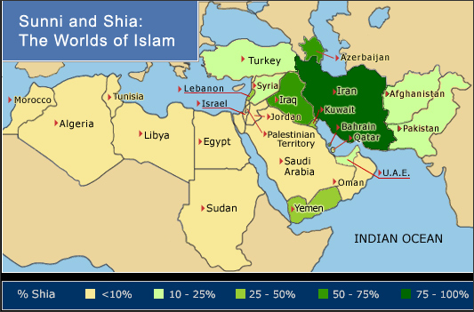
The Middle East
Definition from WIKEPEDIA :
Home to the Cradle of Civilization, the Middle East has seen many of the world's oldest cultures and civilizations. This history started from the earliest human settlements, continuing through several major pre- and post-Islamic Empires through to the modern collection of nation-states covering the Middle East today.
7/26/2024

Slide 4
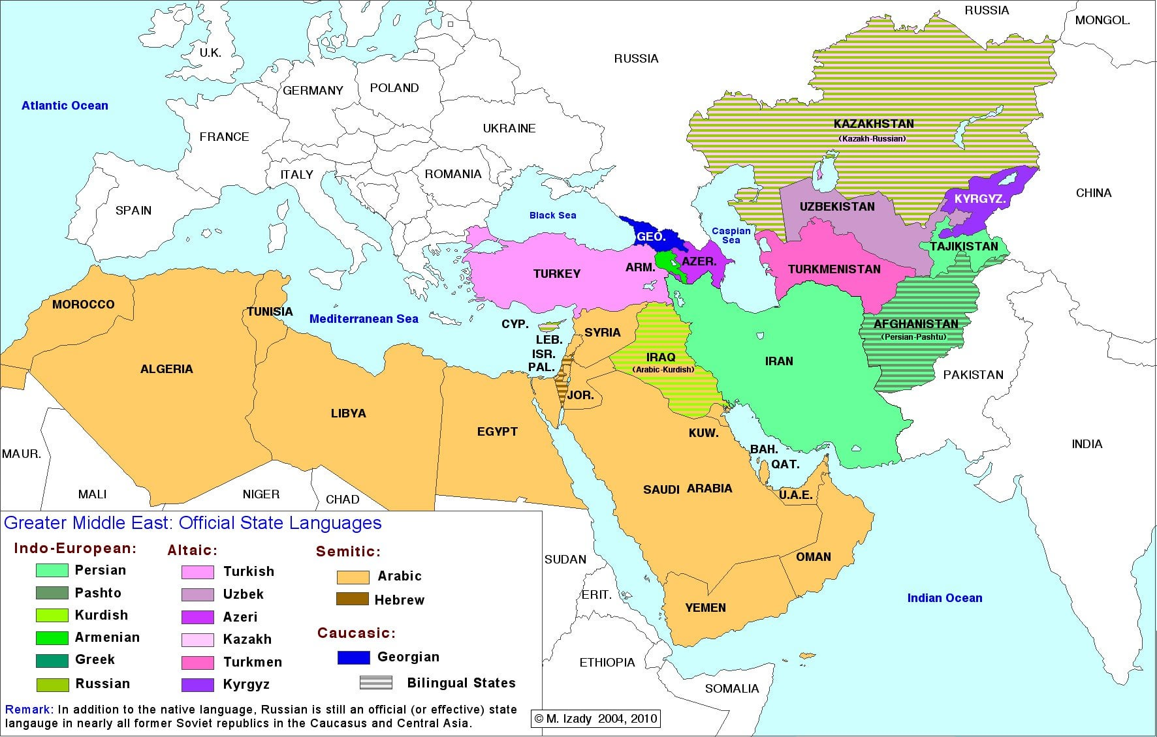
Middle East is not one country or one religion or one culture or one history.
Different languages from Arabic to English, French, Farsi ,Urdu, Turkish etc
Different political systems
Different Wealth levels
Different Economies based on Oil, Gas, Tourism and Aid
Different country history from ex colonies to ex communist
Kingdoms, revolutions , various struggles and causes etc
Different religions from Sunni & Shiaa Muslims, Christians of various denominations, Druz, Qobtis , etc
Different cultures from Arabic , Turkish, Kurdish , Burburs, etc

Slide 5
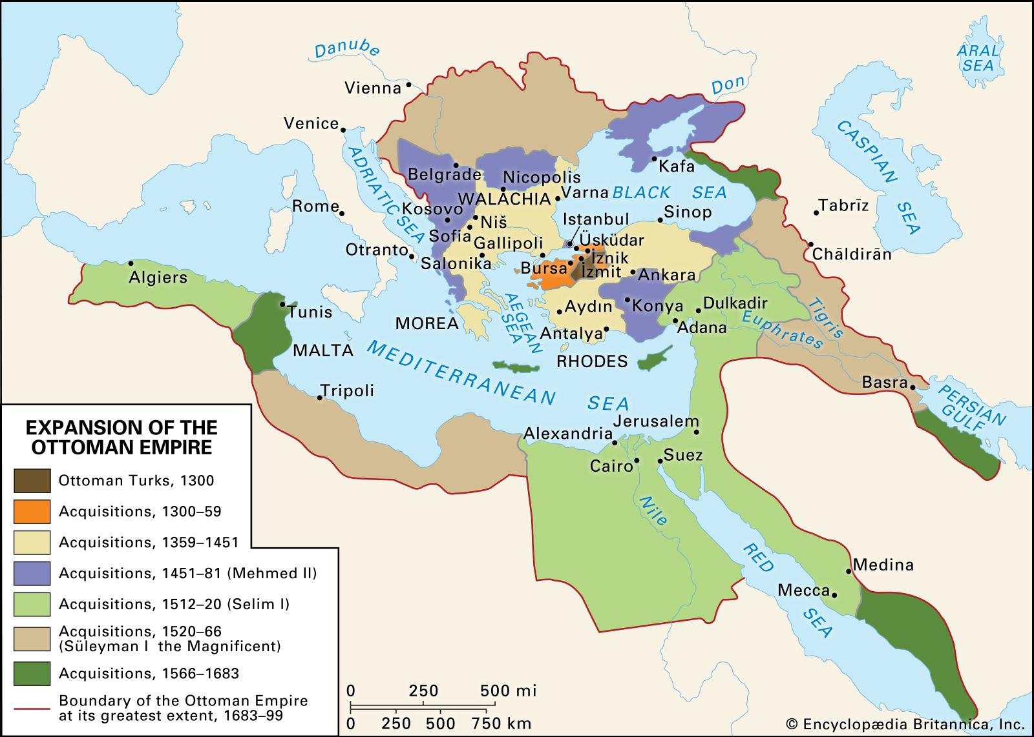
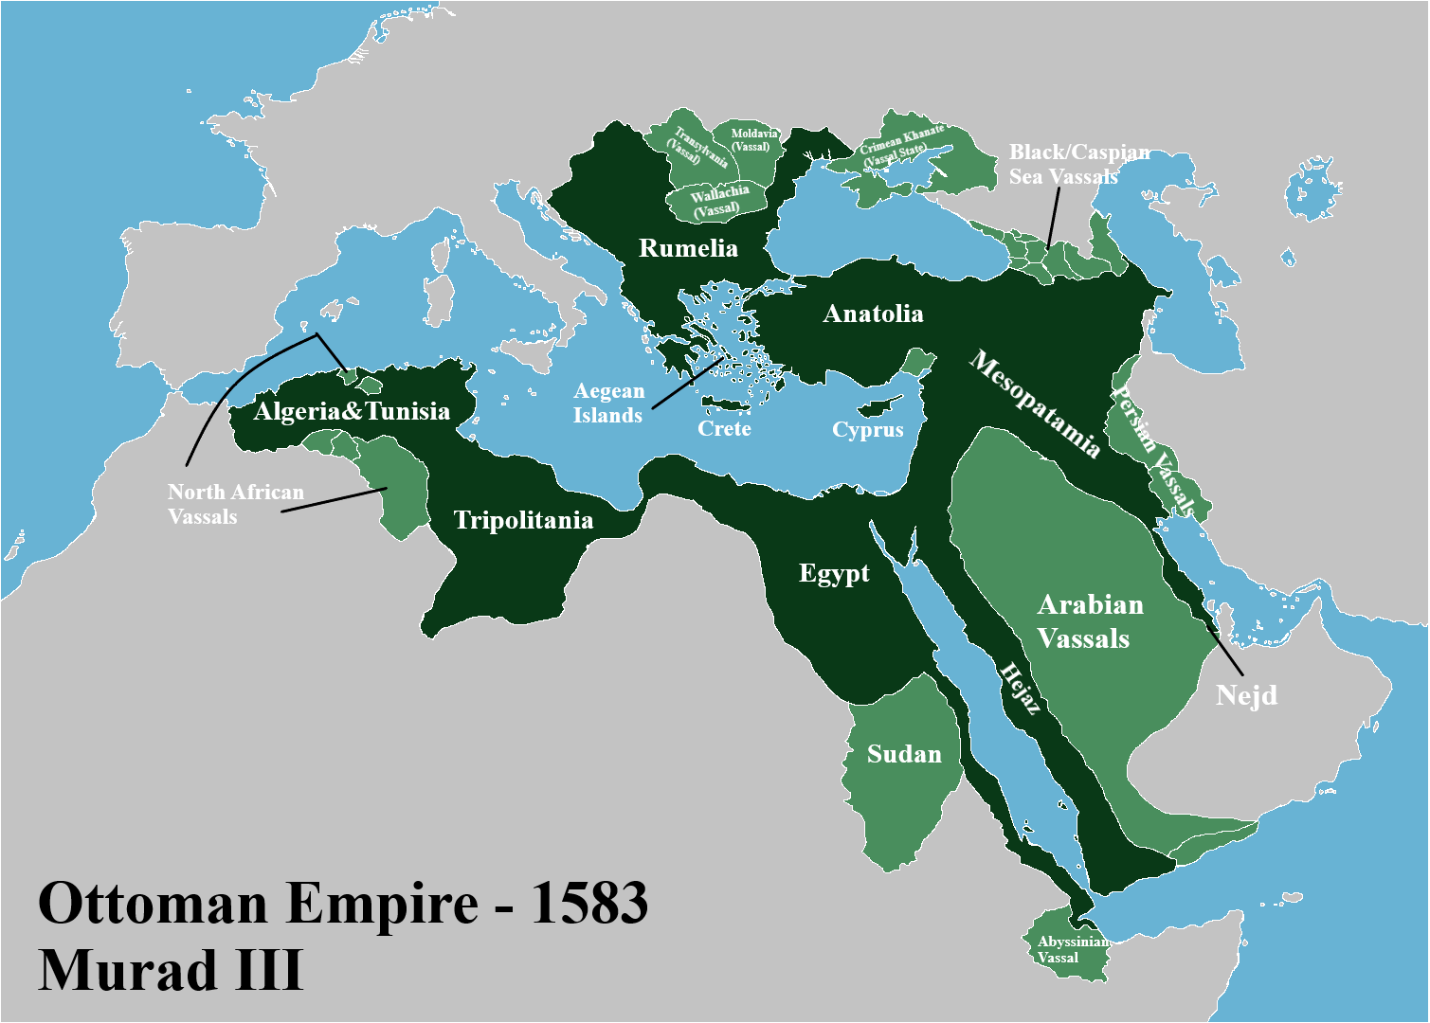
Middle-Eastern Empires and Muslim religious battles and their origins
The origins of Islam following the death of the Prophet Mohammad , split into Shia and Sunni Muslims
Sunni Islam took over from the death of the Profit and various factions from Syria, Egypt, Saudi ( Wahabis) took turns to rule the Islamic world leaving Shai to become a side sect mainly based in Iran and spoke Farsi
In the 1300 AD came the ottomans from central Turkey ( as we now know it today) and their concurs took them to the gates of Vienna and Europe, India in the east, and the whole of North Africa
First, they tackled the various Turkish tribes within central and western Turkey followed by Constantinople itself ( now Istanbul) and then to the Christian holy lands and crusaders. From there, they turned their attention to the various Islamic states and started with the Shai in Iran and quickly followed by the Egyptian Royals takeover and the crushing of the Wahabis in Saudi Arabia and thus taking over the Islamic holy lands as well. To keep control of this vast empire from the 1300 s to the early 1900 ie over 590 years , they created a twin system of government and power.
They allowed the local religious leaders and tribes to keep their law but then invented a system where the final laws once debated by the local sheikh and mullah and tribal leaders , would have to be authorised by the Ottoman local rulers. Therefore, they allowed a certain degree of local autonomy in the regions they controlled but always had a final say in the major decisions.
This included Jews and Greeks, Christians, Arabs, Farisis, etc, thus so ironically local uprisings were rare , until the last days of the Ottomans towards the end on the 1890s
Then came the period of decline which ended with the fall of the Ottoman Empire in 1900 till 1918 and its split and division by the west with the Balfour Declaration

Slide 6
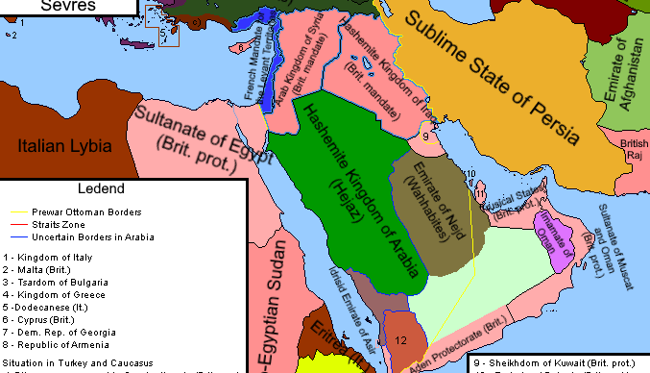
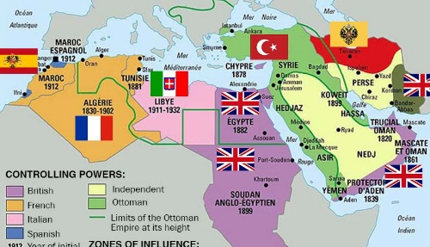
Belfour Declaration and its effect of the Middle East today
The declaration is a famous declaration where most Arabs point the finger at for all their troubles and where they believe , all western conspiracy theories start from and continue to date
The West wanted to reward the allies that helped them get rid of the ottomans and allow for the protection of Christians in the area within a democratic framework
Iran is mainly a Shia Muslim state, and this would be ruled by the Shahs of Iran , who would apply western culture on Shia Muslims. However, this led to Shah opulence the wealth display which dismayed some of his western supporters and hence some support switched to the Ayatollahs at the end of the seventies
The House of Saud were based in Riyadh Area as tribal leaders and were asked to rule the whole of Saudi Arabia under the influence and pressure from the USA
The other GCC countries like Oman and UAE and Bahrain and Kuwait were under the UK influence
The UK via the empire , started the supply and delivery of oil by the setting up of Refineries in Iran and Aden, South Yemen and Oil found in Dubai and Bahrain and Kuwait.. This is when the migration of so many Shia from Iran took place ( Iran had the population and education ) would move the work in UAE and Bahrain and Kuwait and even Eastern Saudi Arabia where OIL was located. This is why you have a Shia population in these countries that are now seen as a threat to the Sunni world such as Bahrain and UAE and Kuwait

Slide 7
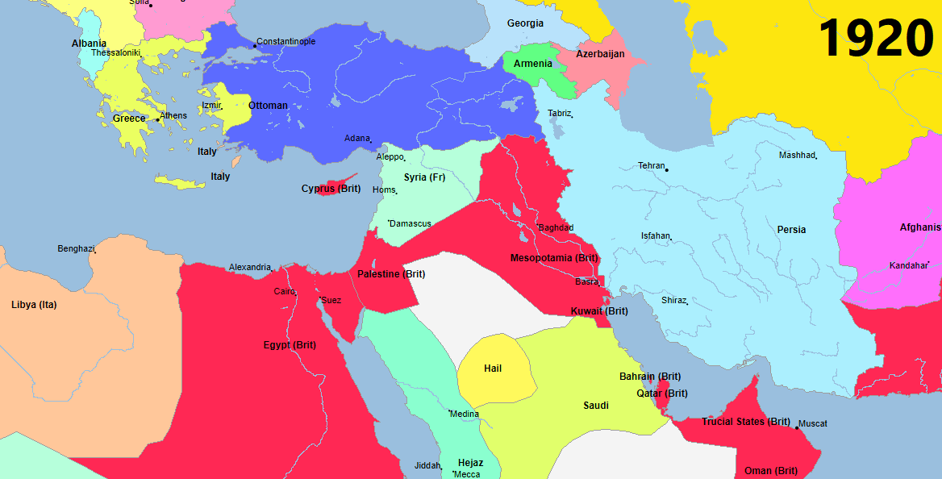
Belfour Declaration and its effect of the Middle East today
The Hashemites originally from the Hijaz area ( Eastern Saudi Arabia , Jeddah, Mecca ) of Saudi Arabia and they were asked to Rule over Jordan and Iraq where King Hussein , his father and now his Son Abdullah remain in control of Jordan, and this was the solution to reward both tribes that helped the west vs ottomans
Syria and Lebanon were left in the hands of the French, and they allowed Lebanon based on their Christian majority to take charge with Sunni Muslims whereas in Syria , the Christians and Shia were put in charge to avalise the majority of the Sunnis and this remains the problem issues to this very day in both countries
Turkey was handed over to General Ataturk and now called Turkey , in order to create a secular state and this is now beginning to fall apart with the new president to Turkey being more religious than previous leaders and joining the Sunni religious regions and anti secular movement.
Egypt again was put in the hands of Western supporting Royals which collapsed in the fifties and early sixties and remains in the hands of the army and alliances with Russia initially, and then the West more recently.
Libya and Tunisia and Morocco and Algeria were all put in the hands of Rulers with French and UK influences and Tunisia is the start of the Arab Spring
Overall , the Balfour declaration was all about inserting western influences which the west were hoping would lead to democracies to spread from there. However most turned back to their tribal, religious and army power basis and moved away from western values in almost all the Middle East

Slide 8
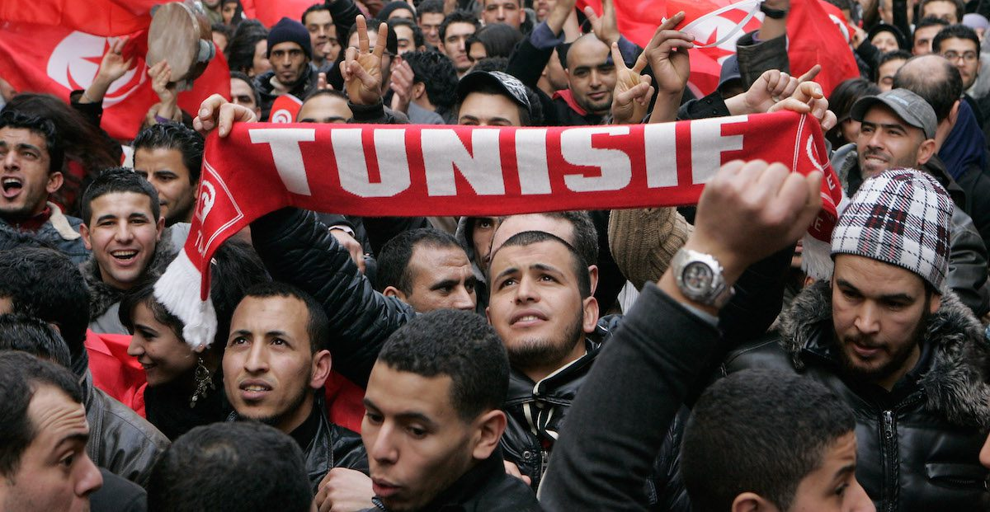

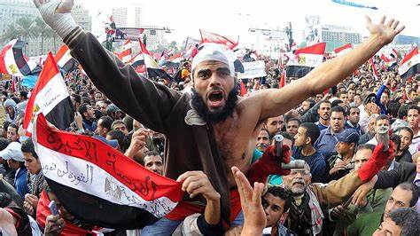
Arab Spring, its routes and why it failed
This started in Tunisia and was an attempt by the general people and Middle Class of the Arab nations to remove their strong leaders and take the nation again into a democracy and this was heavily influenced by the social media
It started uprisings in Algeria, Morocco, Libya , Syria, Egypt, Bahrain, Oman, Saudi, Kuwait etc
In Libya for example, it caused a complete collapse of Gadhafi, but the vacuum was filled by religious fanatics whereas in Algeria, Morocco, Bahrain, Oman, Kuwait, Saudi ….. it was quickly stopped
However, in Egypt, the Army used it to get rid of a potential Mubarak dynasty who was originally from the army. The Army allowed the Arab spring and so-called democracy to shape itself. This unfortunately allowed the elements of the Muslim religious factions of Egypt ( The brotherhood) to take over and affect all manner of revenge on the Middle Classes that started the Arab Spring initially, but they were the first to be targeted for their wealth and this was followed by attacks on Churches ( there are 10 Million Christian in Egypt )
The Army then re intervened and took over to control this Muslim religious backlash
The Syria revolt started to loosen freedoms in Syria by the Asaad regime and at best the Asaad dynasty . The Asaads were Aloyts and this is a sect belonging to Shia, but Asaad regime is primarily a secular by nature and has Christians as their supports and some Sunnis as well. The Arab Spring there escalated well beyond its objectives and became a Sunni Islamist takeover with assistance of finance from Wahabi financial support from Qatar and Saudi Arabia . The Turks turned a blind eye to this battle and so did the west in general. With ISIS and Qaeda fanatics established in Syria and this embarrassed the west and the west and Russia realised that turning a blind eye was dangerous .
The ISIS group let's say for short, found fertile ground in their fight against Shia in Iraq too , so much so that part of Sunni Iraqis initially joined them and hence the fall of some of Iraq until they were ruled by ISIS, did they realise that this was a mistake
BUT in short, the Arab spring has only succeeded to open up more fanaticism and more religious splits and opened up closed wounds within the Middle East and this in turn, created the situation we see today
I believe and have done so for a very very long time, the Middle East is still very tribal and lead by tribal influences and nowhere near ready for democracy and the various attempts to introduce democracy have only made the matter worse. A Middle Eastern Democracy has to be born from a powerful leaders influencing their people to education and healthcare etc , whilst not allowing for a dynasty to establish itself and this has been the problem

Slide 9
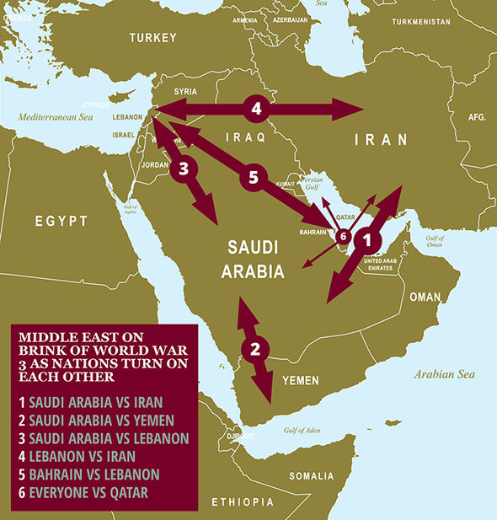
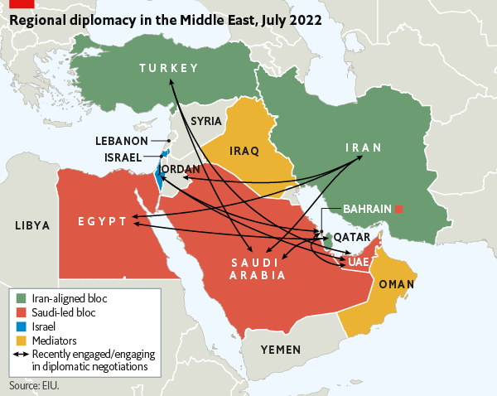
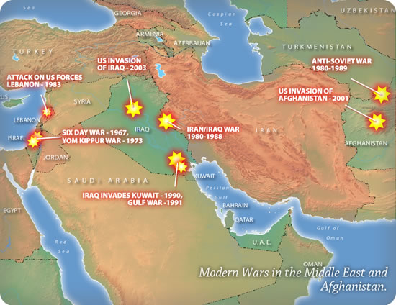
Middle East Today
The ongoing Cold War between Sunni and Shia
What's is the current make of the Middle Eastern Countries ….Dictatorships , Army controlled democracies , Tribalism Controlled Areas within countries
BUT THE MAIN DRIVING FORCE BEHIND THE MIDDLE EAST SINCE THE EARLY SEVETIES IS THE COLD WAR BETWEEN SUNNI AND SHIA AND THE STUGGLE OF THE EXTREMES RIGHT AND LEFT OF CENTRE GROUND OF THIS ETERNAL BATTLE
IRAQ AND IRAN WARS
KUWAIT INVASION SADAM VS KUWAIT
IRAQ WARS 1 AND 2 SADAM VS THE WEST
ARAB SPRING (EGYPT) SUNNI BROTHERHOOD VS ARMY
THIS IS DRIVING THE CONFLICTS BETWEEN SAUDI AND YEMEN
AFGHANISTAN DEMOCRACY VS TALABAN
CONFLICT IN SYRIA ( SHIA AND CHRISTIAN VS SUNNI) COUPLED WITH ISIS EXTREMISTS AND SECULAR DICTARORSHIP
CONFLICT IN IRAQ ( SUNNI VS SHIA)
CONFLICT IN LEBANON since 1975 ( I say 1970) RECENTLY …SOME SUNNI AND CHRISTIAN VS SHIA AND SOME CHRISTIANS
I COULD GO ON …BUT …..THE COLD WAR HAS NOW MOVED ONCE AGAIN TO THE ARAB CAUSE …PALESTINE AND WHO CONTROLS THE AGENDA ON THE ARAB CAUSE IS WHAT IS A DRIVING FORCE FOR POWER IN THE MIDDLE EAST …

Slide 10
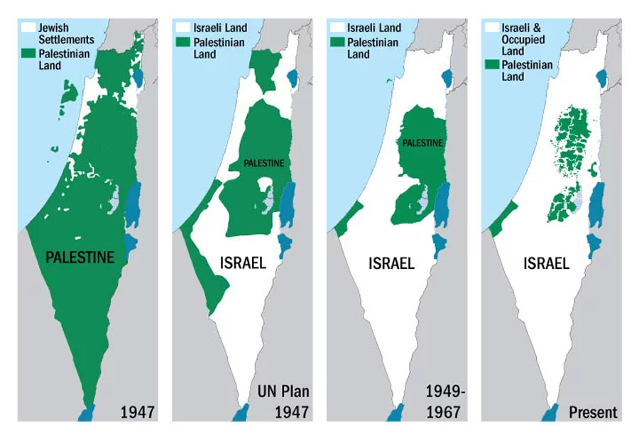
The Palestinian / Israeli conflict
All that I mentioned previously in the Middle East, I deliberately ignored one of the main ARAB CAUSE that evokes a lot of feeling against the west for all Arabs specifically and the whole Middle East in general
If you want to unite the Middle East…this is the CAUSE that will divert their attention from their own internal divisions
In the sixties and early Seventies, the army takeovers in Syria, Iraq, Egypt , Syria had promised Arabs the return of Palestine to the Palestinians, and a victory in the Arab Cause
The Israeli victories in these wars has led to change of alliances such as Egypt that now turned to the West and finally made peace with Israel with the help of the USA
Syria and Iraq still held ambitions of helping the ARAB CAUSE, but Syria then introduced Shia Power in Lebanon at the doorstep of Israel as well as PLO members and this destabilized Lebanon and lead to a 17-year civil war there …..
Saddam with his battles with Shia still held ambition to return to the ARAB CAUSE once he managed to control Iran power, but he was removed of course in the second Iraq war
Peace between Egypt and Israel gave the Palestinian partial control of the West Bank which has developed well under the Palestinian Authority , and the return of Sinai under the control of Egypt & Gaza under the Palestinian authority in return for peace . The 2 weak points for the Arab cause remained in the form of 2 sticking points …….Settlements in the west bank and Jerusalem ….and no bridge to Gaza

Slide 11
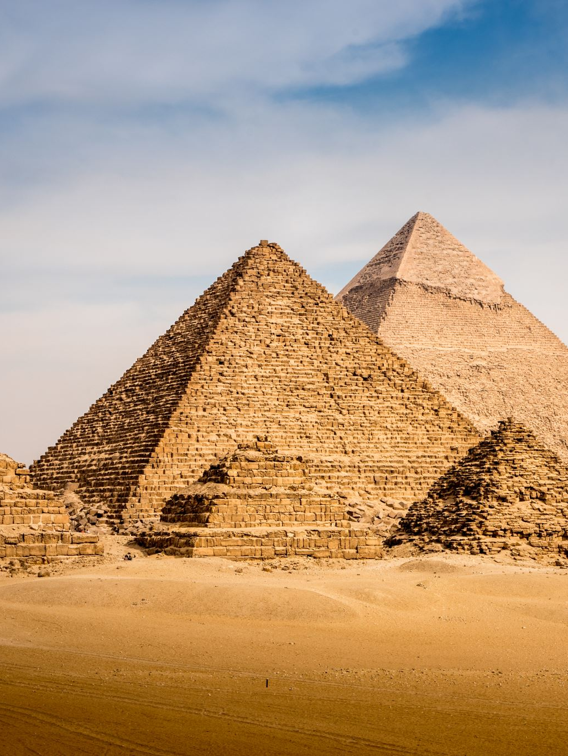
Gaza
The new Arab Cause –
Causes and Effects
Cause 1
Upon the takeover of the Army of the brotherhood era in Egypt , it left the brotherhood with the help of Hamas members fighting the Egypt Army for years in Sinai and I believe the Egyptian Army suffered significant losses during this struggle …we only saw or heard of a glimpse of this secret war during the bombing of the hotels in Sinai beach resorts .
This is when Army stepped it up and drove the brotherhood and Hamas member into Gaza where they ousted and took control of Gaza
Hamas then controlled the whole territory, and the Palestine authority had no power at all , and because the lack of the bridge, from the West Bank, they could do nothing about it .
Effect : Hamas ( mainly Sunni) allied itself with Iran ( Shia ) to receive weapons and funds so that Iran can expand its power in Gaza added to Iraq , Syria, Lebanon and Yemen
Cause 2
Various Arab countries like UAE and Bahrain made official peace with Israel along with Jordan and Egypt , Turkey and others like Kuwait and Oman remained neutral but peace neutral if you see what I mean ( All the above were at war with Iran in Yemen Shia called Hootis along with Saudi which is of course one of the main Sunni players in the Middle East
Effect : Liberal Israel felt more secure with peace with so many countries and its relationship with Palestinian Authority was getting better .
Cause 3
For the last 3 years , Saudi has embarked on a modernisation of its country at an unbelievable speed frankly ….no more religious police, no more forced closure of restaurants 5 times a day for prayer, no more segregation of women and families from restaurants and mauls ….entertainment for Saudis is growing by the minute and we see that in sport and shows. I could not believe it during my last visit to Saudi …
Effect : Saudi wants to open a very western style liberal location near the Red Sea next to Aqaba, and to that effect with the war in Yemen stable and liberation project going well, they started talks with Israel for peace to join the others . This would mean all the Sunni world at peace with Israel with few exceptions leaving Iran and Shia very vulnerable as Israel will then be free to drive out Iran from Lebanon, Syria and Iraq

Slide 12
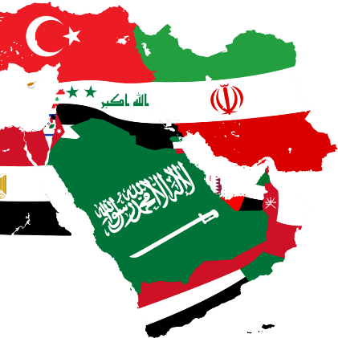
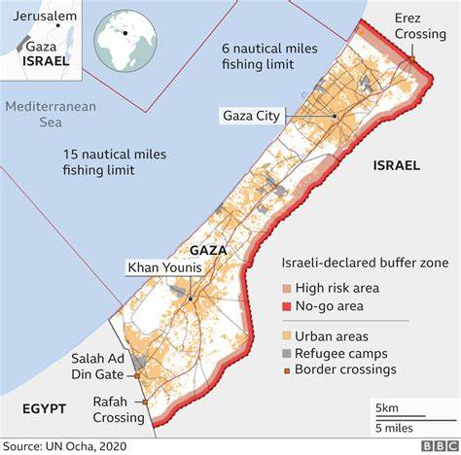
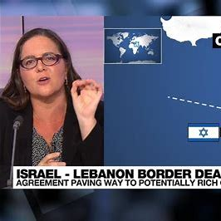
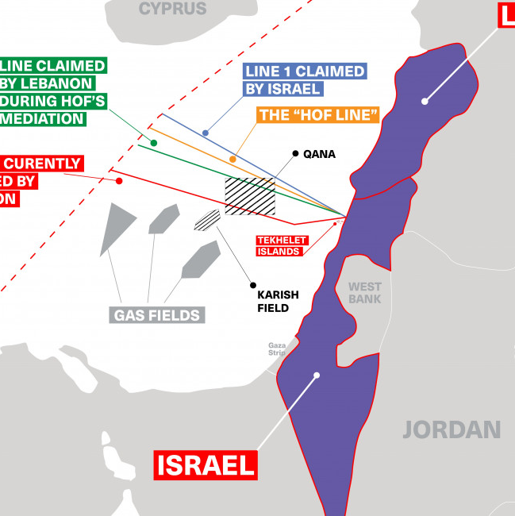
Gaza
The new Arab Cause –
Causes and Effects
Cause 4
.Oil was discovered in large quantities some 10 years ago in the Mediterranean of the coast of Syria/Lebanon and Israel
Effect 4 : Following years of war between Hozb Allah in Lebanon and Israel and as they control Lebanon now, a couple a years ago, Lebanon signed a treaty of none war with Israel to allow the oil exploration off the coast of Lebanon and Israel
Cause 5
Iraq Shia worked with Iraq Sunnis to drive out ISIS out of Iraq which in turn is now leaving Iran behind and they want Iraqis to control Iraq .
Effect : Iran has lost Power in Iraq as well
With Iran losing control of all the countries but still controlled Hamas in Gaza. Israeli feeling more confident with peace with Saudi …this was a ticking time bomb waiting to happen
With Israeli right wing also losing power to liberals as a result ……..Natanyahu was on the verge of collapse and had to use the far-right wing element of Israelis to cling to power another ticking time bomb for the right wing of Israel and their settlements in West Bank
Iran played its last trump card …Hamas …and the effect was to unleash the fanatics in Israel to the fore and put the peace back many years
Israel and the right-wing element will not stop or spare innocent Palestinians as they want the west bank back as well and Iran/ Hamas want to claim some victory that they are the controllers of the Arab Cause and get the West Bank back for Arabs
All this puts Peace back 10 years I feel and meanwhile these poor innocent Palestinians about 1.9 Million of them are caught in this struggle whereas the Hamas members with Brotherhood and various supported only number about 30,000 max holding hostages not just the Israelis from October 23 but all the 1.9 Million of its people as they know Israel right wing will continue the campaign

Slide 13
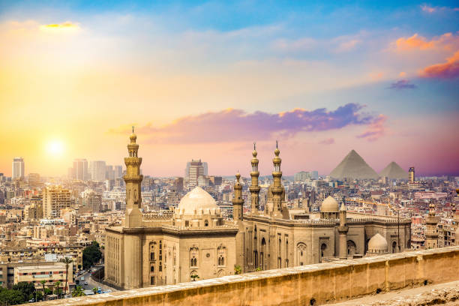
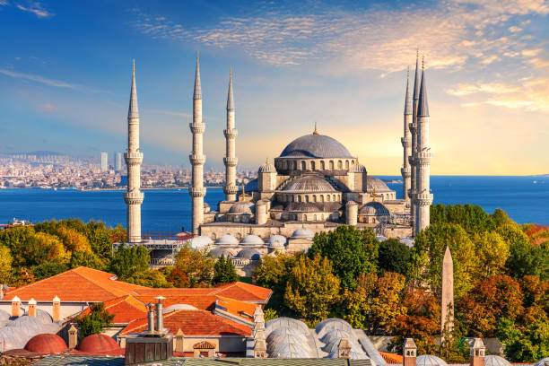
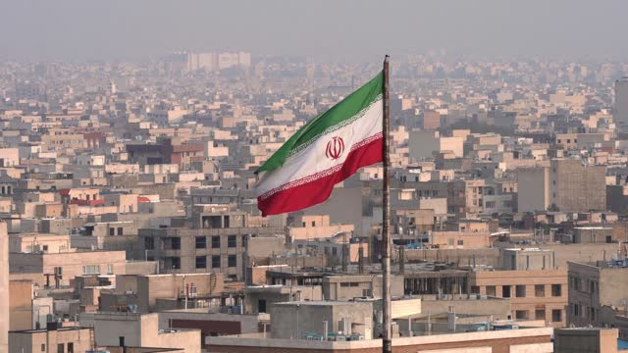
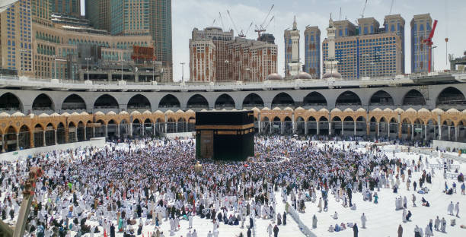
Lessons from History
Palestinians and Hamas knew how to build tunnels as this was done in the seventies in Lebanon at the beginning of the civil war there .
We also know from history….that Israeli show no mercy in clearing these tunnels as they did in Lebanon
The other lesson from Palestinians leaving Jordan , then Lebanon and Syria , is they were asked to be evacuated by sea to Tunisia and Libya so I suspect the same will need to happen for Hamas …..but where will they be sent …?
Which Arab Country will take them ……the only one I can think of is Yemen which will ignite that war again with Saudi and Arab States
AND THE MIDDLE EAST TURN AND TURNS ……PEACE BETWEEN SUNNIS AND ISRAEL WAS CLOSE …AND REMAINS A TARGET ..BUT IRAN WILL NOT SAIL GENTLY INTO THE WIND

Slide 14
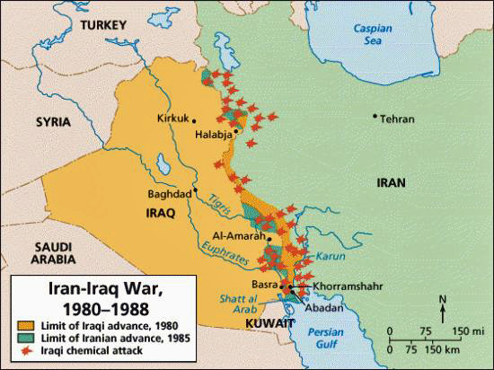
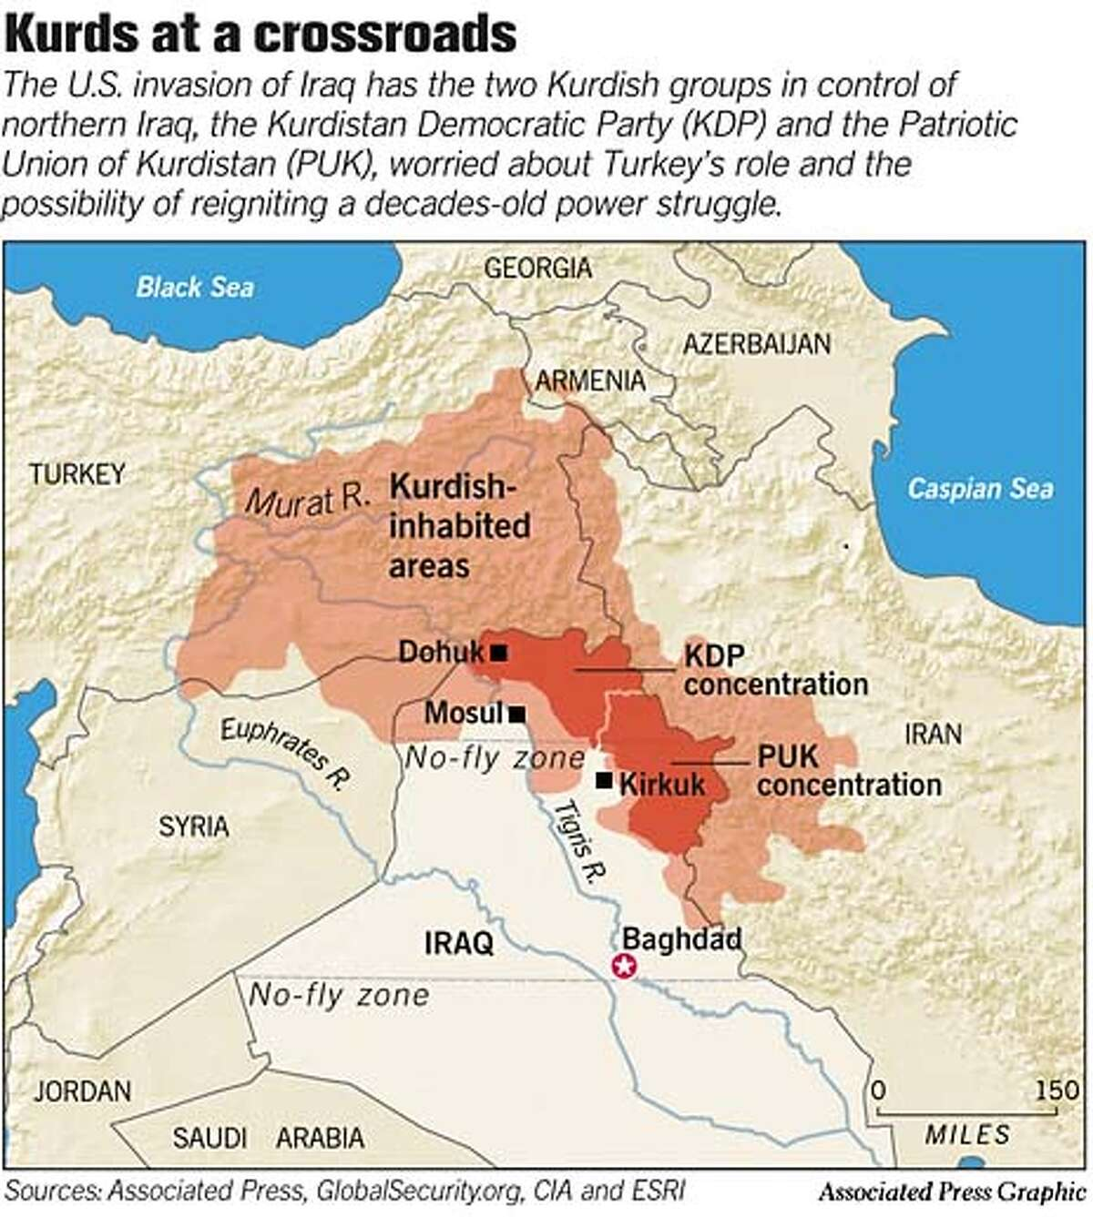
How Allies become Enemies and vise Versa in the Middle East ( examples that will shock you )
During the Iraq/ Iran war …Iran had no spares for their US tanks and equipment due to the sanctions by USA on Iran . Israel came to the assistance of Iran but supplying the spares via Hezbollah in Lebanon ….sworn enemies
Turkey continue to attack Kurdish forces that are fighting Isis as the Turks don’t want a strong Kurdish force on their boarder as this may lead to demands from Turkey’s own Kurdish population and demands by all the Kurdish peoples for an independent state
In Lebanon, the Christian work with Sunni to battle the Shia and Hezbollah whereas the Christian are generally with the Asaad regime against the majority Sunni population there
Turkey allowed their boarders to be open to allow many refugees to go from Syria to Europe and especially Germany in revenge to Germany not allowing Turkish citizens that have been living and working in Germany for years and years , not to have a nationality and some had to leave Germany …this is before Mrs Merkel decided to allow 1 million refugees
In Libya , Gadhafi was advised to hide his money in Qatar before the revolution there and not keep it in the west , and the assets were used by the Wahabis in Qatar to fund arms to be sent to the ISIS style groups in Libya with arms being bought from Turkey and being delivered by Turkish ships and airlines to Libya
In the peace treaty between Israel and Egypt, the Egyptian Army guaranteed the security of Suez canal in return for 3 Billion dollars a year and this is why Sinai & Gaza were returned to Egypt by Israel. This is why the army in Egypt stood aside initially during the Arab spring and allowed the politics to develop as USA wanted democracy in Egypt but when the Morsi regime of Islamic brotherhood came in and financed by Qatar. The Army stepped back in gained the removal of the Mubarak dynasty as well as adhering to the peace treaties they signed up to with Israel. They are also now seen as the defending force for the Christians in Egypt as well and moderate Sunni businessmen ( There are 10 Million Christians in Egypt and they control most of the business and economy there )

Slide 15
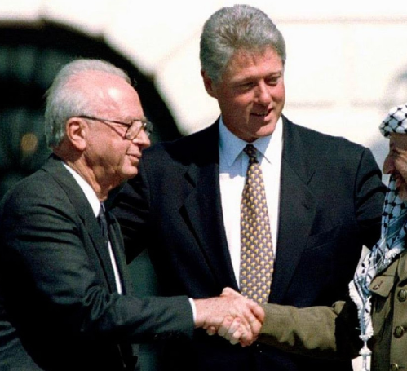
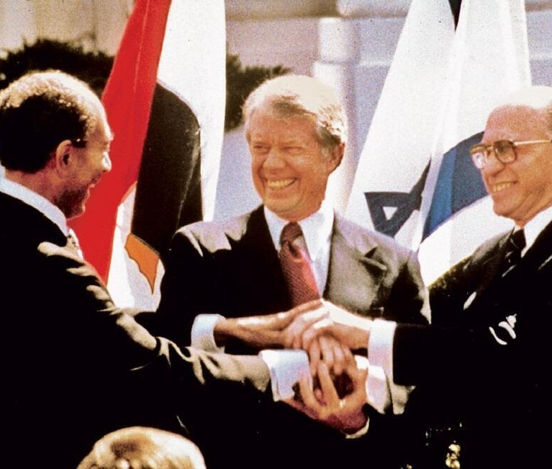
CONCLUSION
All the attempts at installing democracy in the Middle East have failed because in truth, the factions in the Middle East are mainly still very tribal to date
The solution ( in my opinion ) is to allow the powerful tribes to continue to control the religious fanaticism of all sorts whilst the west encourages slow freedoms and education and healthcare to the people and peace to built with Israel one country at a time
The recent example is Saudi Arabia recently allowing Women to no longer cover their heads in public and women will soon be allowed to drive. Saudi has now allowed Cinemas and Parties and with women and men to enjoy the party together and in Riyadh. Unheard of 3 years ago. Oman , UAE , Kuwait, Bahrain , Qatar …are adapting slowly …let's not rush them and blame them for what they have not done but encourage the changes they are making
The same should be encouraged in Iraq and Syria and Lebanon …a slow path and a move away from tribalism with education and healthcare and equality of freedom to all and the west can play a part in that……but not shock and awe, and Arab spring , and Gaza geocide…anti Asaad …ISIS friends or enemies ….if the target is peace in the Middle East , then tribalism has to disappear slowly and replaced with equality and healthcare and education …
Keep tribalism for sport

