Slide 1
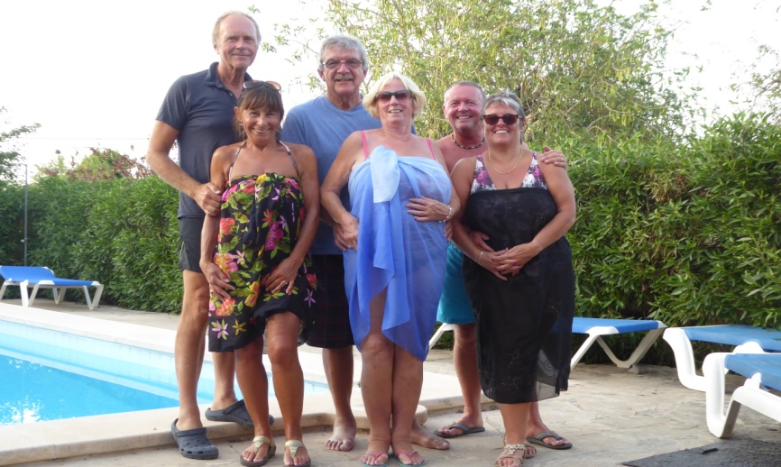
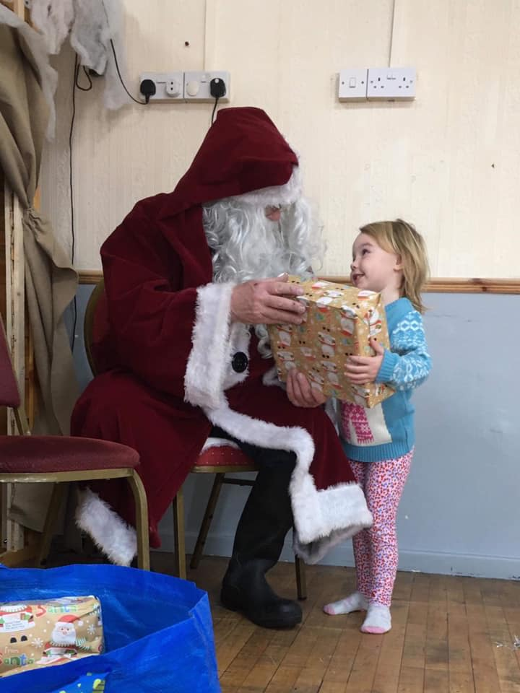
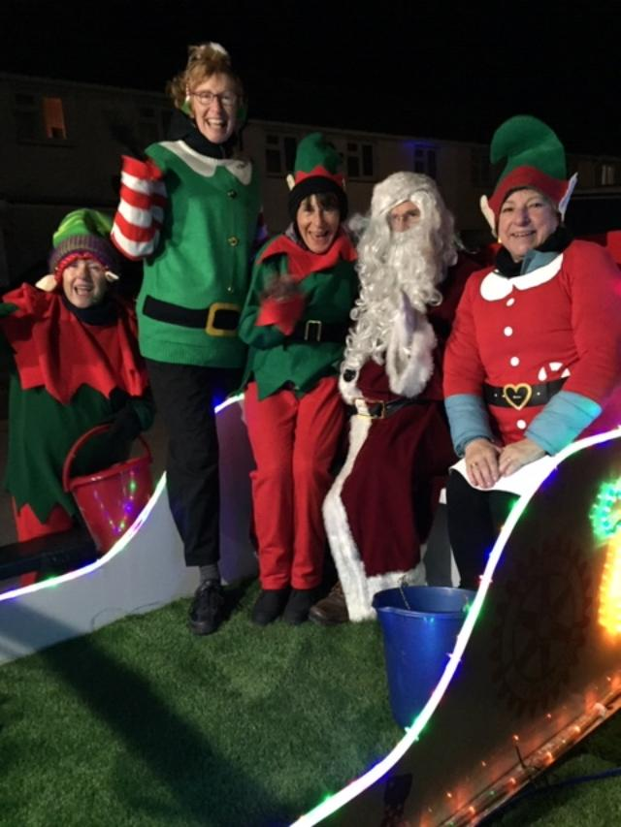
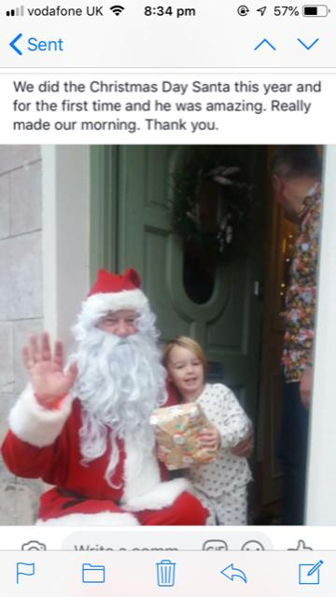
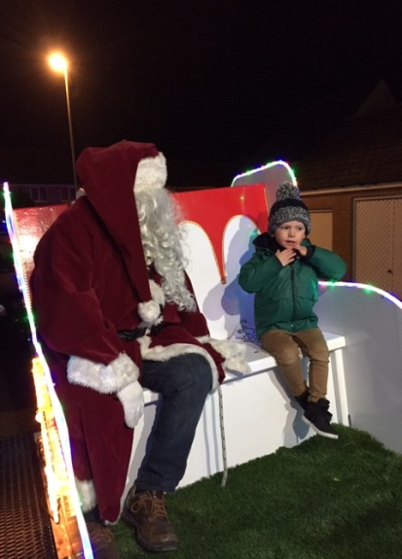
PORTHOLE #490
January
2019
CLUB DIARY for FEBRUARY
The Rotary Club of the Island and Royal Manor of Portland {Register Charity Number: 1032098}
5th 6.30pm Aqua Hotel – COMMITTEES & COUNCIL
Coq au Vin with Hassleback Potatoes & Vegetables
Vegitarian Wellington with Hassleback Potatoes & Vegetables
Cappuccino Mousse or Fruit Salad
GRACE/GREETER – SARAH CUTIS
FINANCE – CELIA CANTER
9th TABLE TOP SALE – C2000
For Jacob Newport & Fellow Scouts off to the World Scout Jamboree in the USA
9th Stan & Sarah’s Soup Supper from 6pm at 157 Faversham
In aid of Anne-Marie’s Mistletoe Treatment Fund
12th 6.30pm Aqua Hotel – SPEAKER
Toad in the Hole, Mashed Potatoes, Vegetables & Onion Gravy
Toad in the Hole (Vegetarian Sausage), Mashed Potatoes, Vegetables & Onion Gravy
Dorset Apple Cake & Custard or Fruit Salad
GRACE/GREETER – ROSIE SANKEY
FINANCE – LIZ CLARKE
19th 6.30pm Aqua Hotel – BUSINESS MEETING
Baked Gammon with Duchess Potatoes & Vegetables
Stuffed Mushrooms & Duchess Potatoes & Vegetables
Spotted Dick & Custard or Fruit Salad
GRACE/GREETER – DAVE SHAW
FINANCE – ANDREW HARVEY
26th 6.30pm Aqua Hotel – GUEST EVENING
SPEAKER - PAUL MASON On his Charity Bike Ride
Sweet Chilli Chicken Thighs with Jacket Potato & Vegetables
Vegetarian Wellington with Jacket Potato & Vegetables
Pineapple Upside Down Pudding & Custard or Fruit Salad
GRACE/GREETER – ANDREA SHEPHERD
FINANCE – CAROLYN HUMPHRIES
MEMORIES
OF CHRISTMAS PAST
President: Garry Urwin Vice Pres: Elizabeth Hardy Secretary: Peter Burrows
Meetings: Tuesdays 6:30pm, Including Guest Night, At the AQUA SPORT HOTEL
Contact Margaret Thomas to book your meal. Or, order from the bar at the Aqua as early as possible

Slide 2
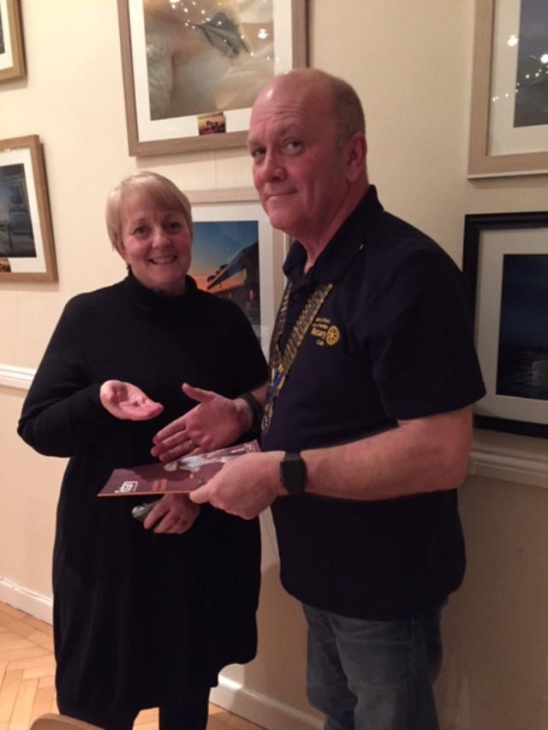
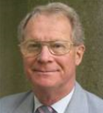
WHO SAID DISTRICT COUNCIL MEETINGS WERE BORING? (OR – DO YOU LIKE DRONES?)
If you wanted to know all about drones, their uses, the law, and and the problems they can cause, you should have been at the District Forum on Saturday.
A fascinating presentation on the uses of, and the reasons for having, drones (as well as an actual drone to look at). Brightened up my day no end.
I learned a lot and it certainly made a change from Rotary, Rotary and more Rotary.
Not that the Rotary side was ignored, because it was not.
With presentations about the forthcoming Convention in Hamburg, the next District Conference (and we are hoping to take a large party to Southampton for that), plus a whole variety of different club projects, we were spoiled for choice.
For some daft reason a District Council meeting has been renamed a District Forum. A forum is defied as a meeting where people can exchange views.
For the last 20 months all the District meetings have not had break-out groups where the grass roots Rotarians have been able to share their views and discuss matters that concern them.
On Saturday things happened.
Not only did we have a group meeting for the in-coming Presidents (essential), but we also had a Foundation group meeting as well – not badly attended considering the fact that many did not even know it was on the agenda.
When we changed the venue from Street to Shepton Mallet, the numbers attending from the south of District have dropped dramatically, partly because of the extra distance to travel, but partly due to the fact that Rotarians had no real opportunity to express their views.
Yes, in the past there have been a number of tables jammed into the upstairs room with a few chars around them, but there were many people in the room chatting and drinking coffee and this rather stops conversation as nobody can hear what is going on.
A lot of questions were asked in the Foundation Group, so much so that the Governor has agreed to have another Foundation Group in March as well. We are hoping for more groups too.
The other bit of good news is that our A.G. (Michael Fernando from Yeovil) was elected, unopposed, to be our District Governor in 2021-2022. We have Dennis Stevens (also from Yeovil) starting in July and then Rory O’Donnell from Taunton Vale in between those two.
For those of you who have not met Michael on his visits to our club he is young, articulate, positive and dynamic. He is very keen on Rotary and I am sure, will go a wonderful job and District will have a great year.
DATES FOR YOUR DIARIES
The next District Forum will be on Saturday 23rd. March and District Conference will be on 11th. – 13th. October.
Why not come along?
As well as learning something more about Rotary, you might even enjoy it!!
Keith
Judy Urwin
I felt very honoured this evening when I was asked to introduce Judy as a new member of our club.
Judy was one of the stalwarts of Portland Hospital – she was there many, many years ago when the GPs ran the unit (she was very young then of course), she was there when I retired 20 years ago, and she was still there when they closed down the hospital ward last year because of “a lack of nurses”.
Judy could have run the ward by herself, but, sadly, that is an impossible task for one person alone - obviously.
I was at the public meeting when the decision to close was announced. Everyone there was saying that they wanted to die in Portland Hospital, that we needed beds on the island etc. but to run a hospital understaffed on the nursing side is positively dangerous but nobody seemed to pick up that point.
Perhaps I could put this another way and that is – if Judy had not been working there, the ward would have closed a lot earlier. The Portland people owe her a lot.
Hopefully she can now divert her caring energy into looking after those millions of people around the world who desperately need our help.
Welcome to Rotary Judy.
Keith
District Governor Stewart Cursley
Elizabeth giving the good news after the Treasure Hunt

Slide 3
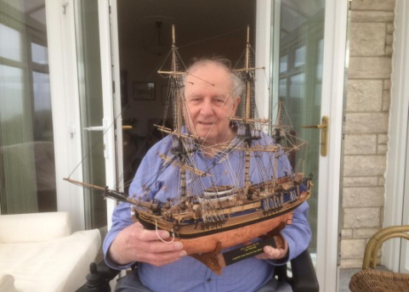
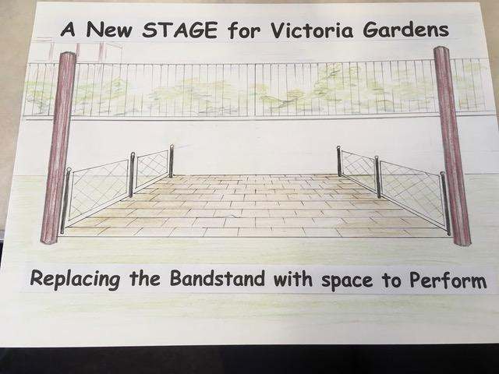
John Heather P.H.F. – died November 2018
John was one of the best.
He joined our club in 1984 – just a few years after the club was formed, though I had known him personally before that date, and he became one of the best friends that anybody could have.
We went on holiday together, to meetings, to parties and visited each other’s houses regularly.
For those who did not know him you missed a great entertainer because John was never happier than when he was the life and soul of a party, and, of course, was one of the stalwarts of the Royal Manor Theatre.
But John was more than that – when I needed to learn more about computers it was John to whom I turned for help – and he was always there when I needed him. When I needed someone to do all my secretarial work when I was the RIBI President, it was John to whom I turned. He also, at work, trained many, many apprentices at D.R.A., A.U.W.E. or whatever it was called at the time – so not just a comedian but a man of many talents
He was a friend, advisor, and someone to whom we all turned when we needed cabarets in the club. He never failed us. I shall never forget rehearsing our lines for a Two Ronnies sketch – we both laughed so much it was a miracle that we ever managed to get in front of our public.
Sadly he had a number of health problems and three of the club visited him in hospital before he lost one of his legs. The nurse was horrified when the three of us discussed, with John, how we would share out his belongings if he didn’t make it – one of us would get his car, one would get his house, and I got the jackpot because I got Rosemary. John thought it was hilarious and joined in with gusto – in spite of his impending operation. It was that sort of relationship. The nurses never looked at me in the same way again.
Unfortunately when John became wheelchair-bound having lost his second leg, he thought it would be better if he resigned from the club because he felt that he was no longer able to put as much into being a Rotarian as he would have liked. He was inordinately proud of being a Paul Harris Fellow, and, perhaps even more so, an Honorary Member of our club.
However I still saw John at home and though the end was inevitable, he and I shared many funny moments on the last occasion that we met. You could not keep him down.
I will miss him. We will all miss him. They don’t make ‘em like that any more
Keith
EDITOR’S NOTE
ianmcpheat@aol.com. Pictures need to be in jpg format if possible.
NEW PLANS FOR VICTORIA GARDENS: REQUEST TO VOTE USING BAGS FOR LIFE TOKENS AT LOCAL TESCO STORES.
Each year Rotary donates money to the Friends of Victoria Gardens for purple crocus as part of the End Polio Now campaign. This year we are being asked to vote at Tesco as well, using the Tesco Bags for Life tokens for a new performance space in Victoria Gardens. So let us rally around and vote for their new stage which will use panels from the old bandstand.
Elizabeth

Slide 4
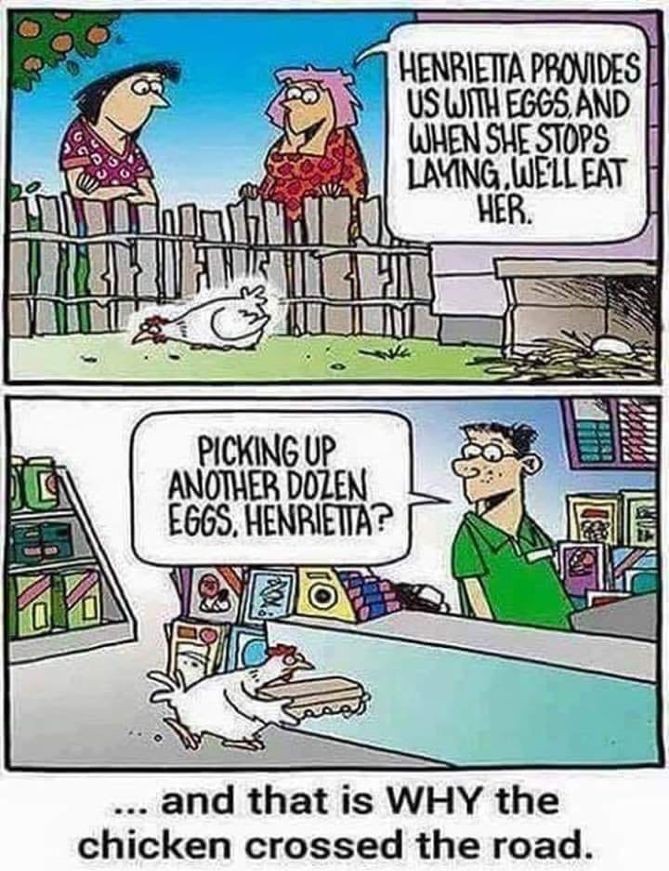
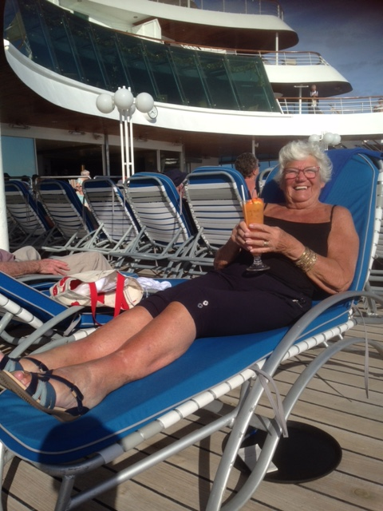
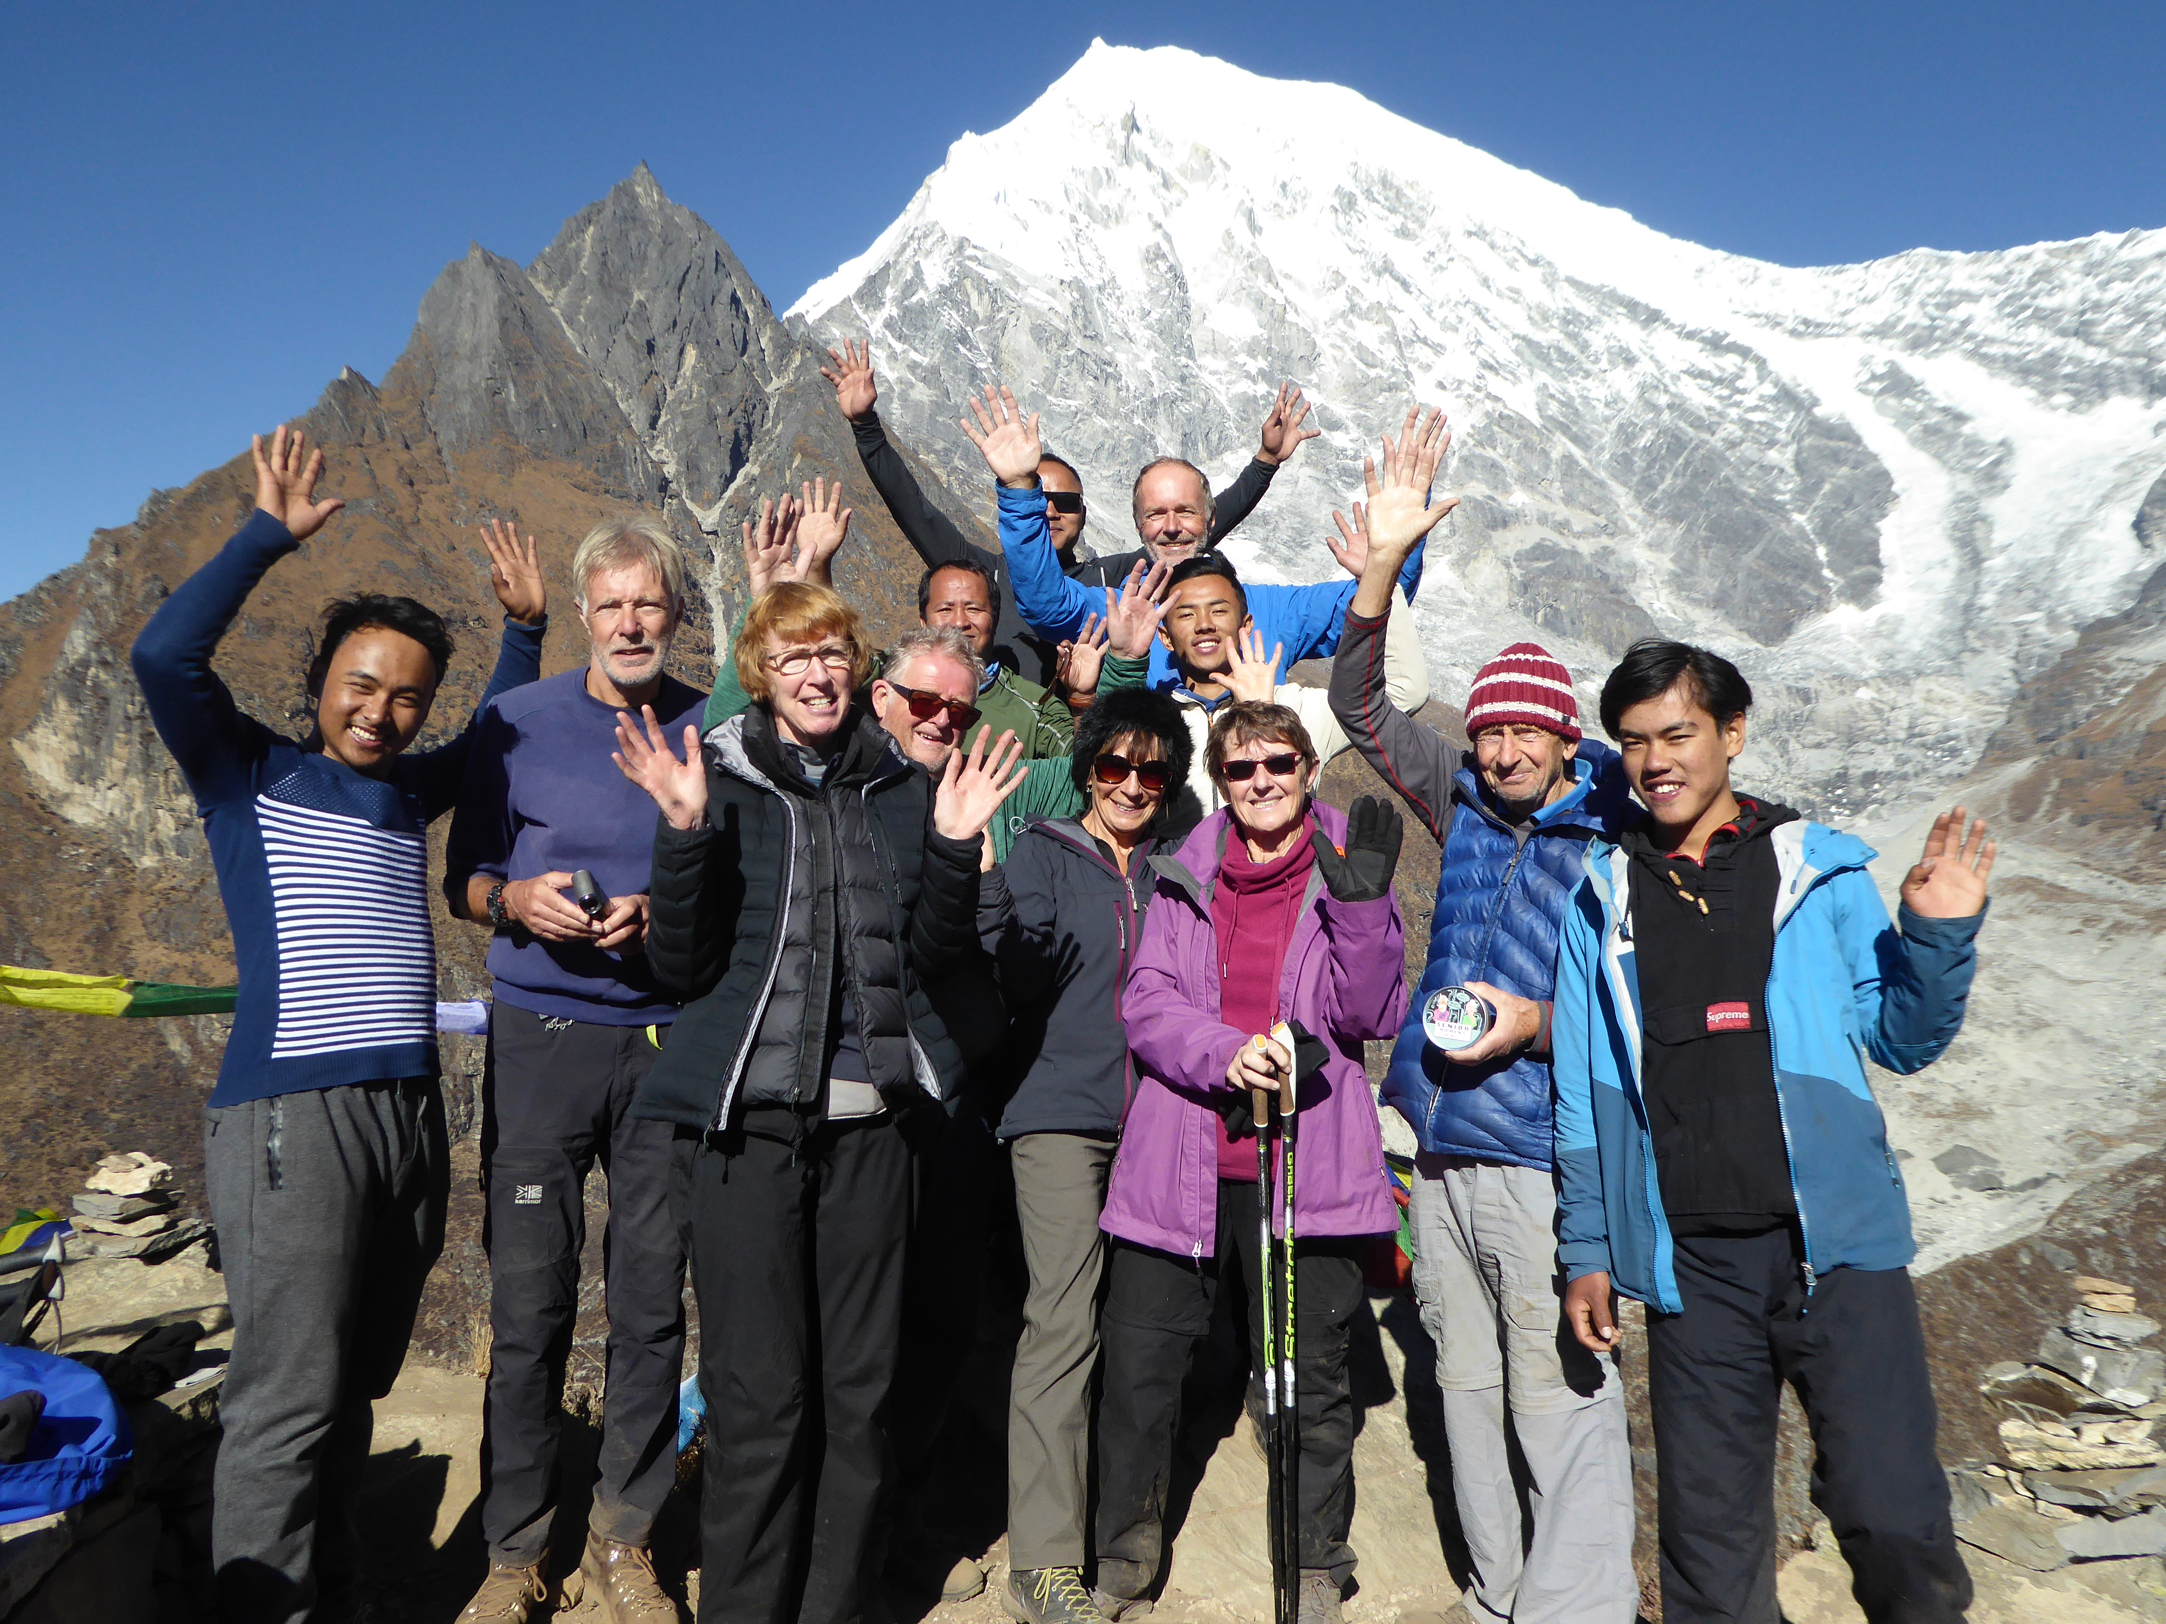
E-mail to the Editor
Happy new year to all Ian.......this was en route to the Canaries over Christmas and the new year .......so you if you have a spare corner in porthole - Julia
You may like the team on the summit of Kyanjin Ri
Best wishes
Mark
Ed note: From one extreme to the other!!

Slide 5
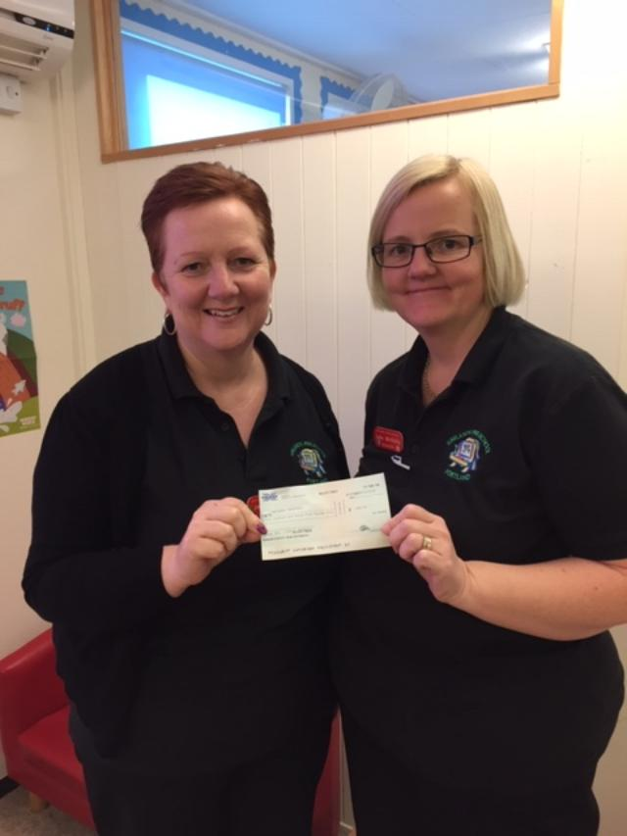
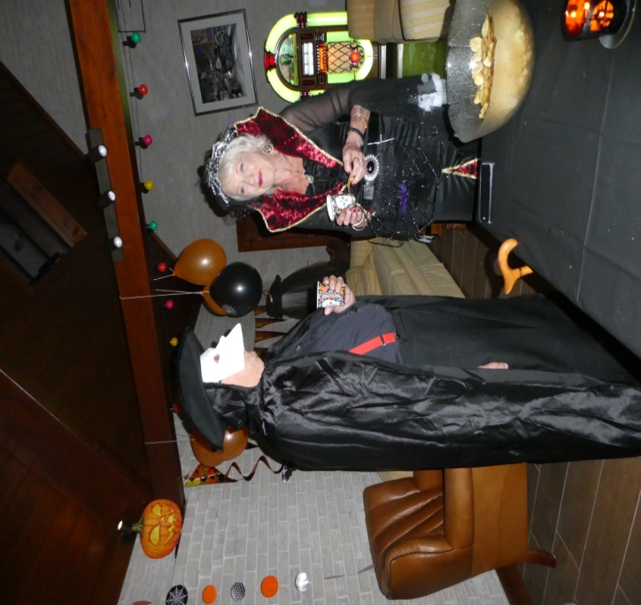
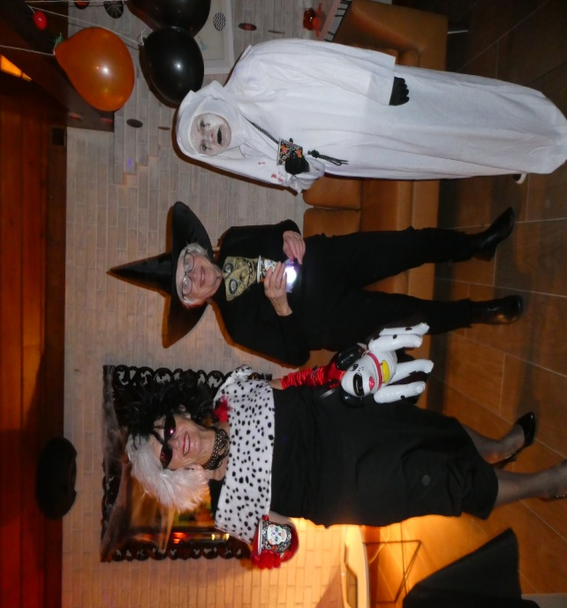
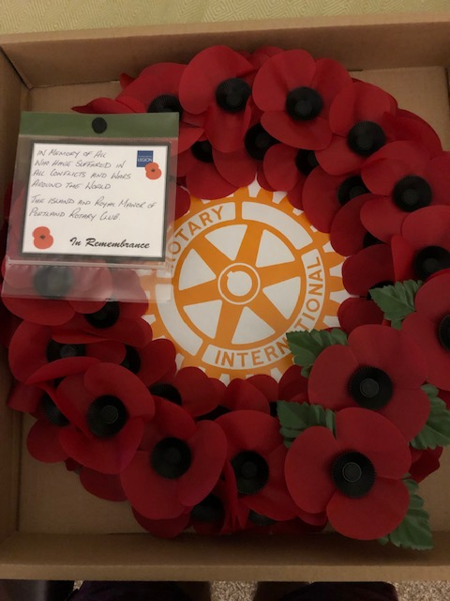
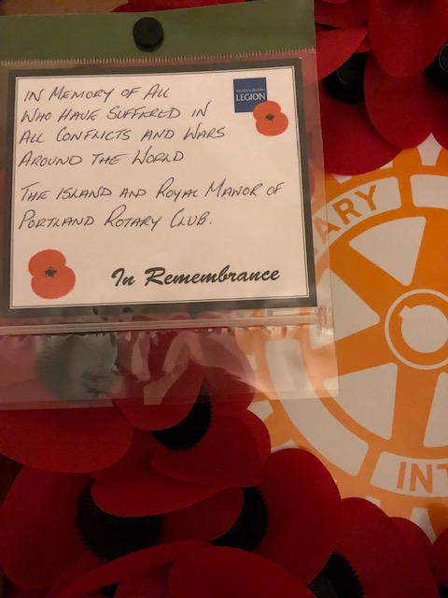
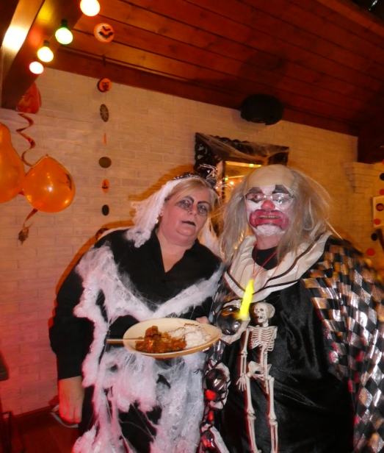
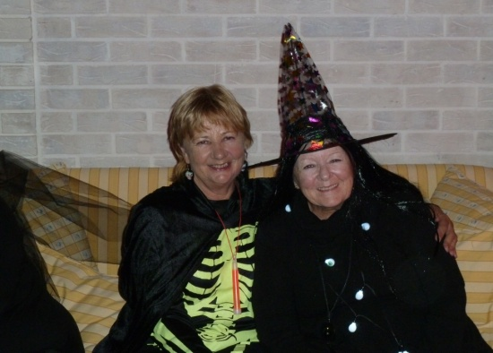
Cheque for £465.00 handed to Haylands Preschool from the recent coach trip to Longleat.
A SPOOKY MEMORY
Remembrance Sunday 2018

Slide 6
NEWS FROM PORTLAND MUSEUM
A recent Rotary donation to the Museum has been put towards improving the lighting environment, replacing old neon tubes with LED batons. The Trustees are very grateful and are looking forward to the completion of this project before re-opening on March 10th. The Museum is also looking forward to welcoming Portland Rotary Club to a Museum Quiz Night, planned for the evening of Tuesday 23rd April.
During the closed season we’ve been very busy and lucky enough to have hands-on-help and advice from National Trust Archaeologist, Nancy Grace. Replete with a glut of goat hair brushes and a mass of microfibre cloths, Nancy has been a wonderful source of information on how to best care for the artefacts in our collection.
You may have seen, via our social media pages, that we are searching for more help in preparing for opening on March 10th. Specifically, we will be looking for volunteers to assist us clean the cottages and galleries in the week beginning 25th February. If you think you may be able to help out then give us a call on 01305 821804 or email us at portlandmuseum@gmail.com.
We’re also looking for the loan of a mobile scaffolding unit to help us meet the vertical challenges of ‘Avice’s Cottage’. For those of you looking for further roles at the museum, we will once more be seeking front of house and gardening volunteers for this year. We offer great training, (which will be taking place during the first week of March) the chance to meet lots of different people and make new friends, the opportunity to share knowledge of Portland Museum and Portland’s heritage, as well as the right environment to learn new skills and share your ideas.
Moving on to new exhibitions, for those of you interested in the old Portland railway line, we will be hosting a new display this year put together by Martyn Mullender.
‘When the railway ran to Portland. What do you remember?’ is a Heritage Lottery project that has collected the oral histories of local people, when the railway still ran from Weymouth through to Easton. Few can now call to mind when passengers travelled the line, though Martyn has been lucky enough to record some pre-war recollections, including at least one resident who could describe distant memories of Merchant’s Railway. The fireman on one of the final specials has also recorded an interview recalling the last days of the line and, along with his brother, memories of wartime damage in the Weymouth area.
Finally, we have a huge stone block with a dinosaur footprint, located rather inconveniently at the top of the garden. If anyone knows anyone who could move this down the garden with a forklift, when the ground is hard and dry, please contact the Museum!
Lucy Watkins (Museum Manager) and Elizabeth Hardy

