Slide 1
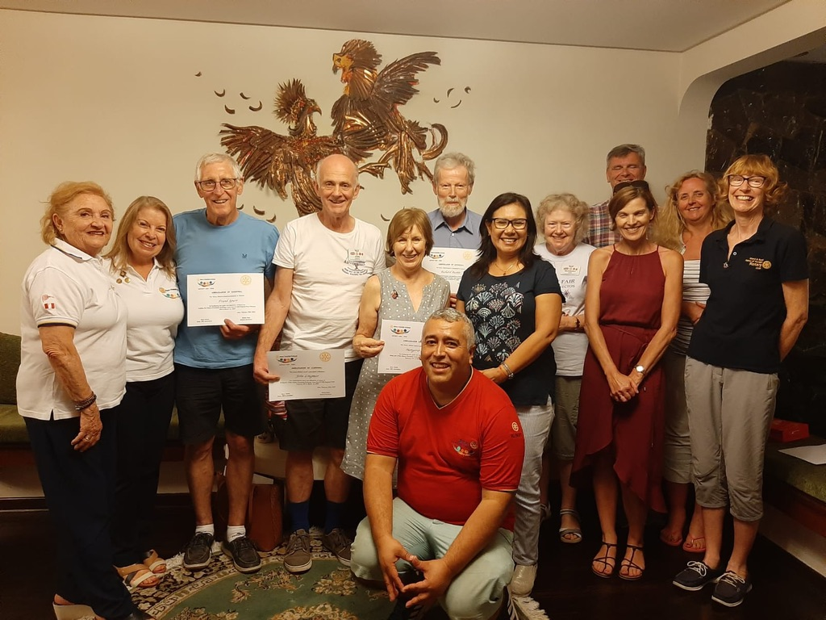
Feb/March RIFE 2020
Richard
Kathryn
Margaret
Clive
Districts 1200 and 4455
Nora
Frank
John
Norma
Rosanna
Margaret
Ruth
Albert

Slide 2
The District teams meet-up at the Casa Andina Hotel, Lima

Slide 3
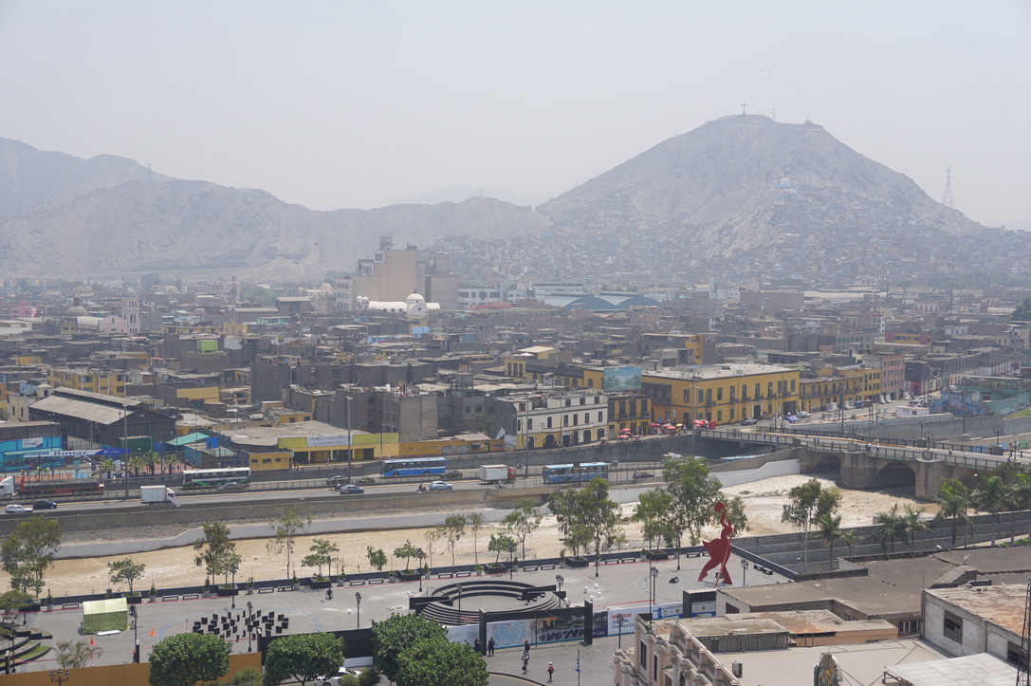
Lima: hot, hazy, 11 million people,
ringed by shanty towns

Slide 4
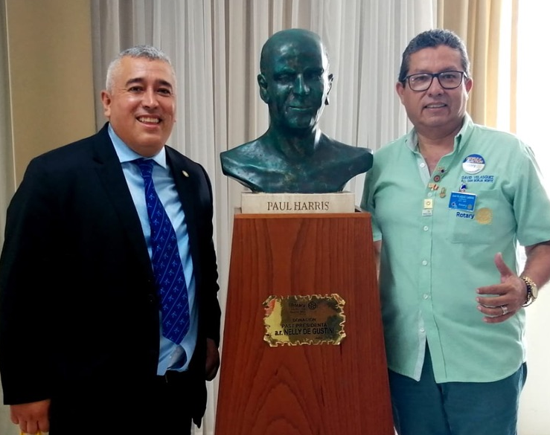
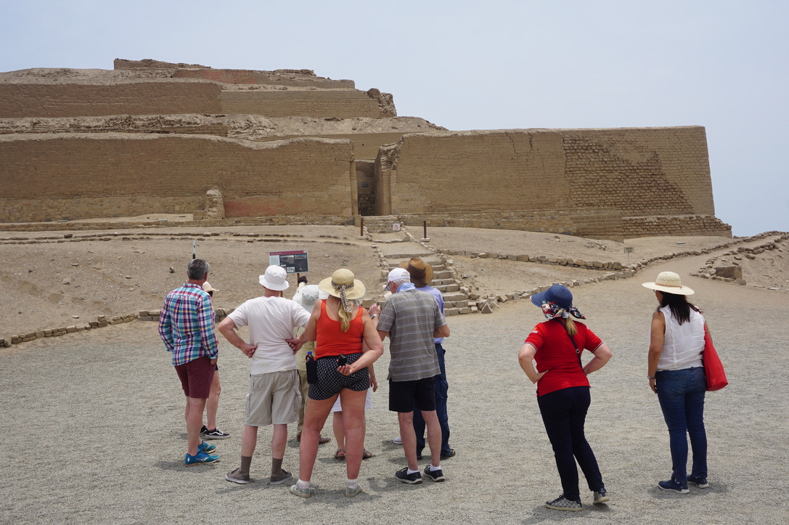
Lima Memories
Albert gets Paul Harris award

Slide 5
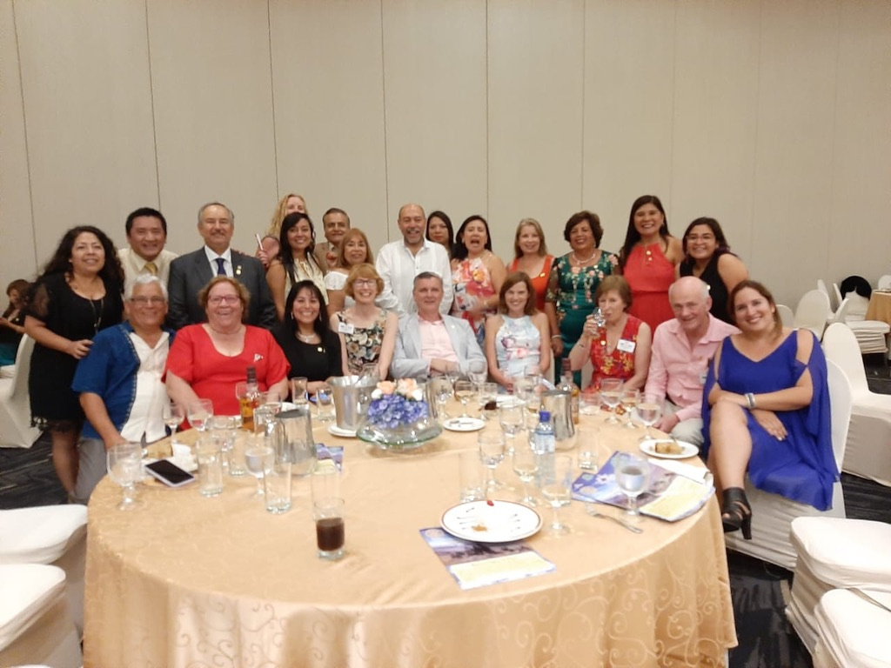
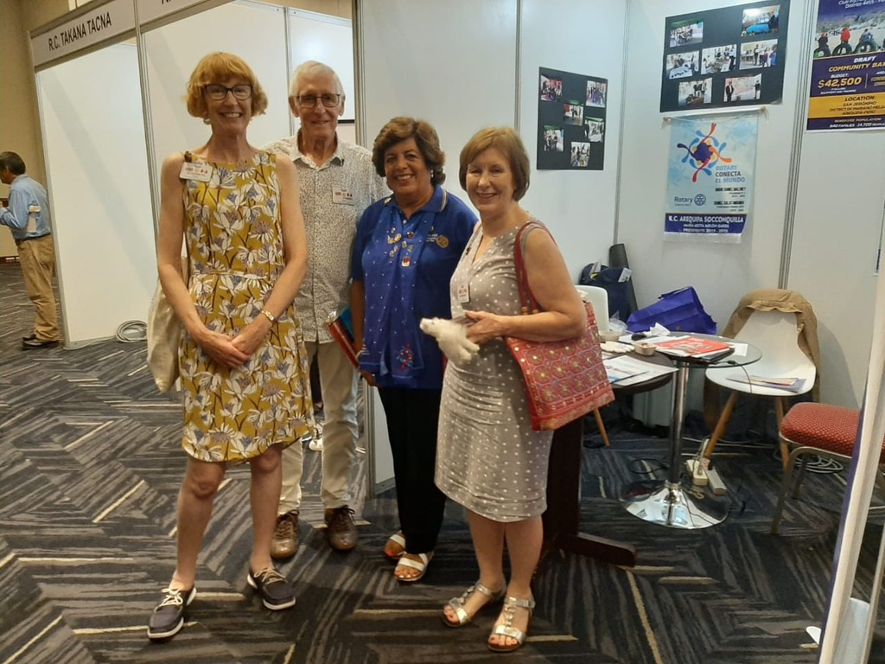
Amazing Salsa dancers
Nora
Adita
Rosanna
Saturday Night Gala Dinner to celebrate
115th Birthday of Rotary International
Adita from the Arequipa Club
Saturday Project Fair
District 4455
All Clubs show-off
their projects

Slide 6
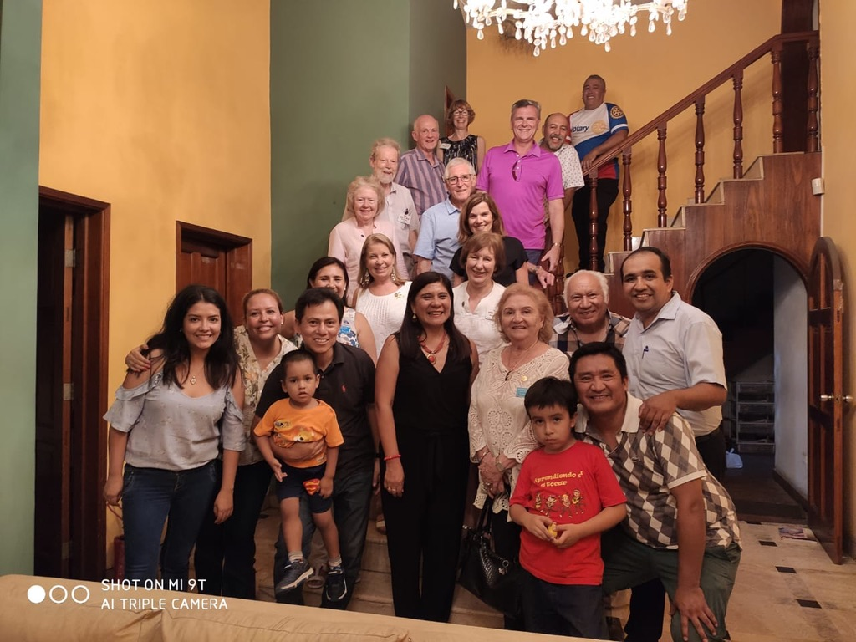
Singing and Bingo Evening at Albert’s house
Albert

Slide 7
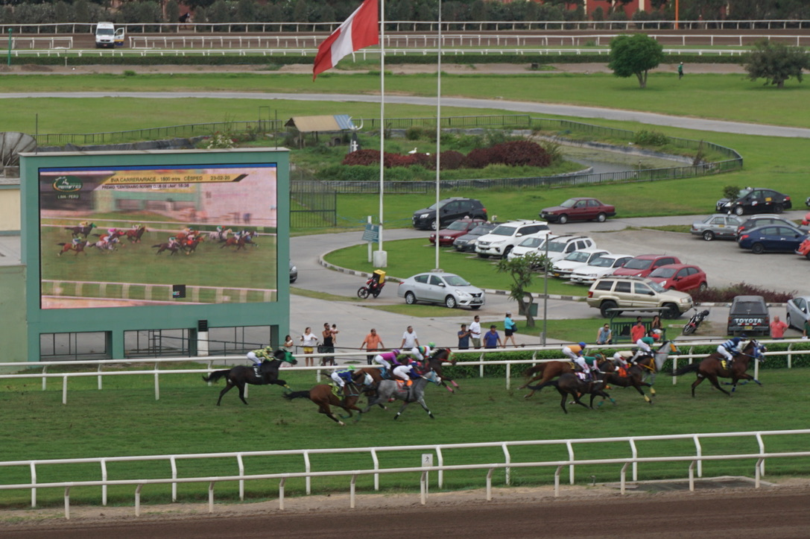
Day at the Races
Rotary Sponsored Races at Lima Race Course
to celebrate 115 years of Rotary International,
and the 100th birthday of the oldest Club in
Peru: betting included!

Slide 8
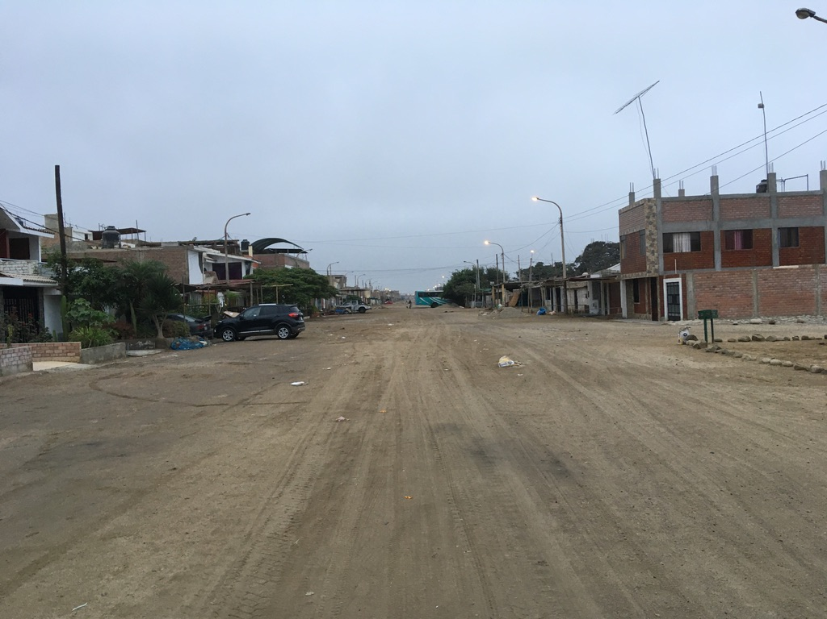
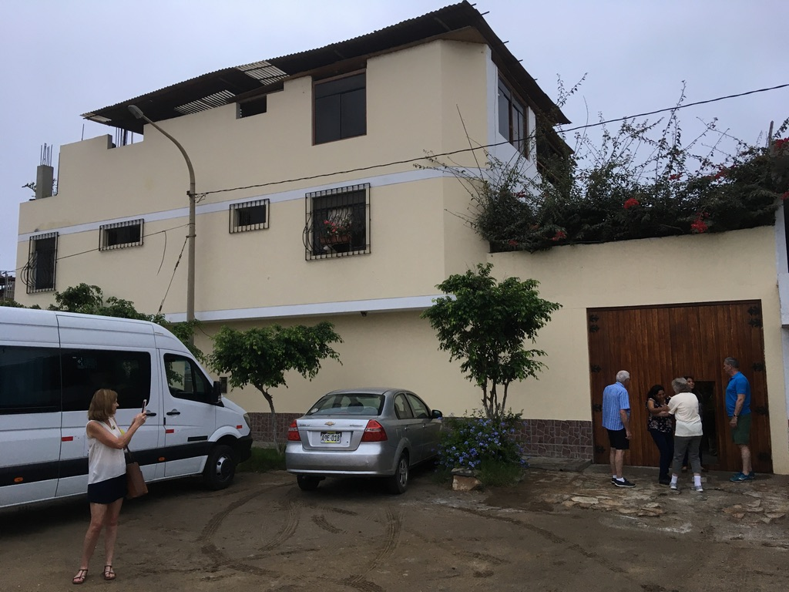
Chincha Rotary Club – Monica’s Street and house
Chincha was close to the epicenter of the 2007 earthquake,
many buildings were destroyed.

Slide 9
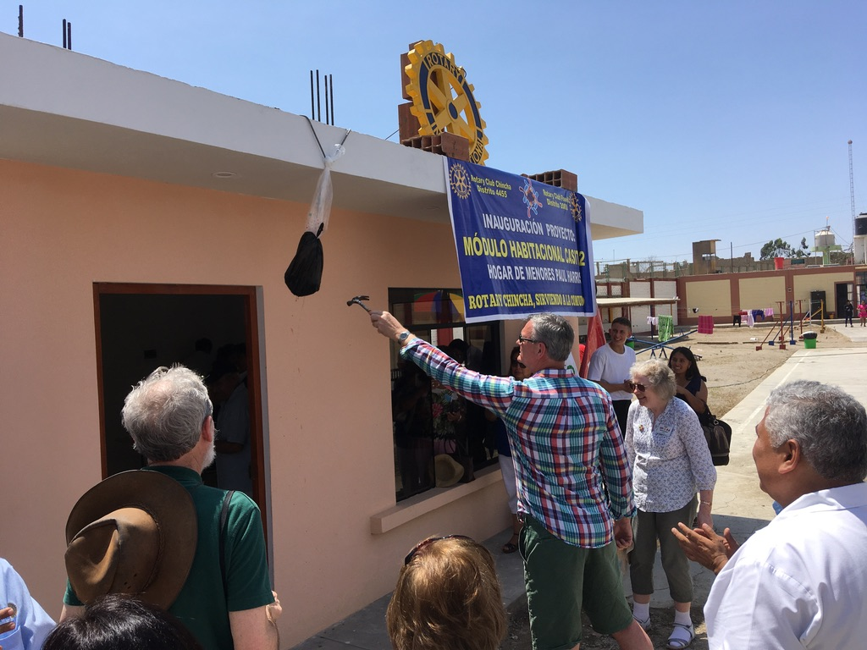
Clive ( Yeovil Club President) opens the new wing of the Paul Harris Girls’ Orphanage run by Chincha Rotary Club

Slide 10
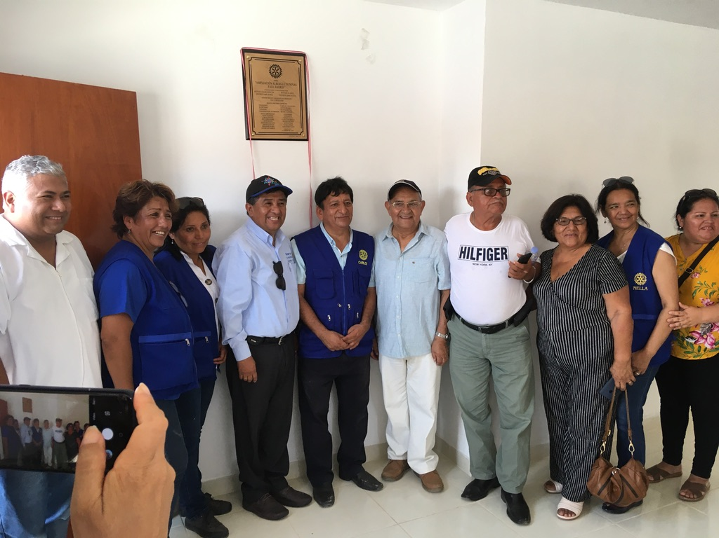
Chincha Rotary Club Community Committee responsible for building the girls’ orphanage
celebrating with the 4455 District Governor

Slide 11
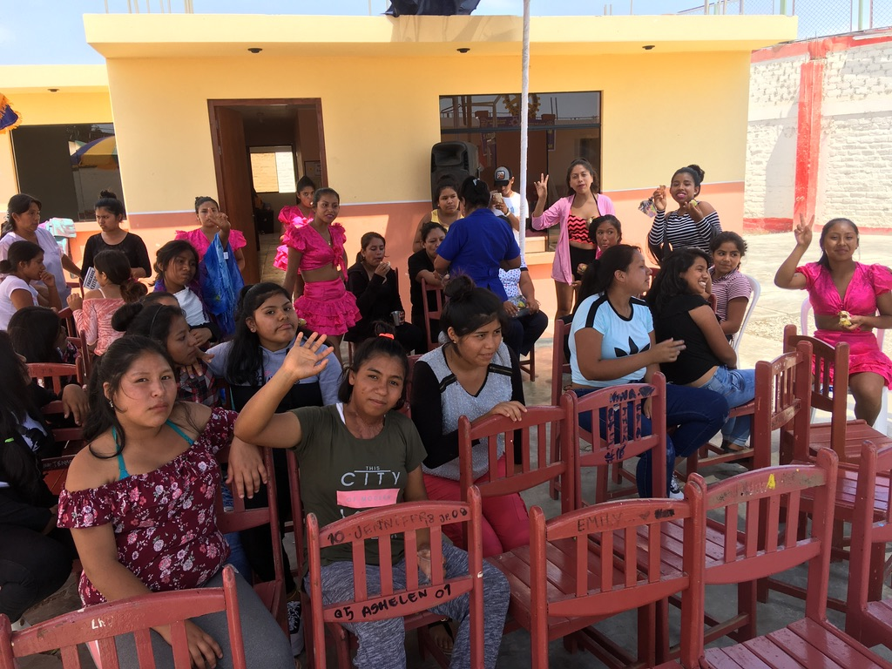
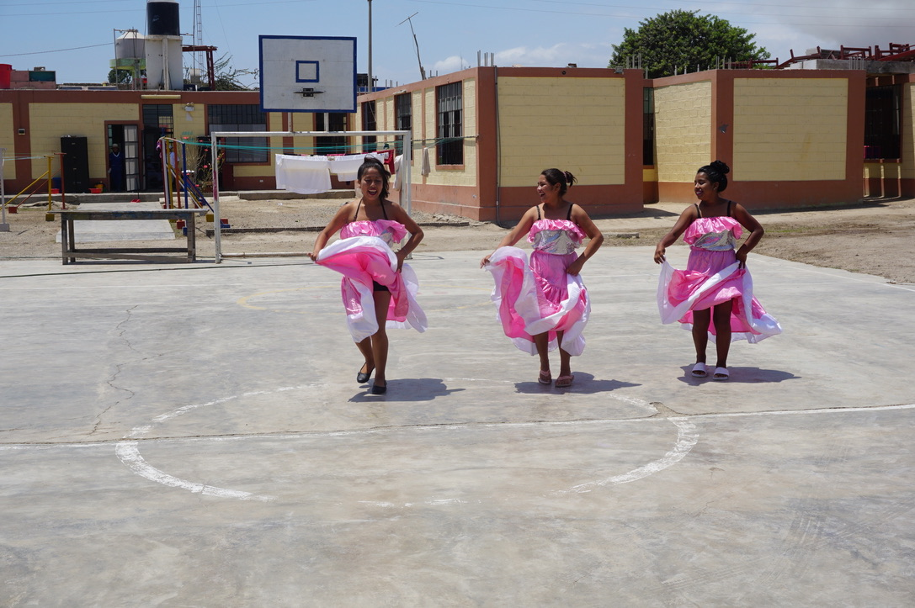
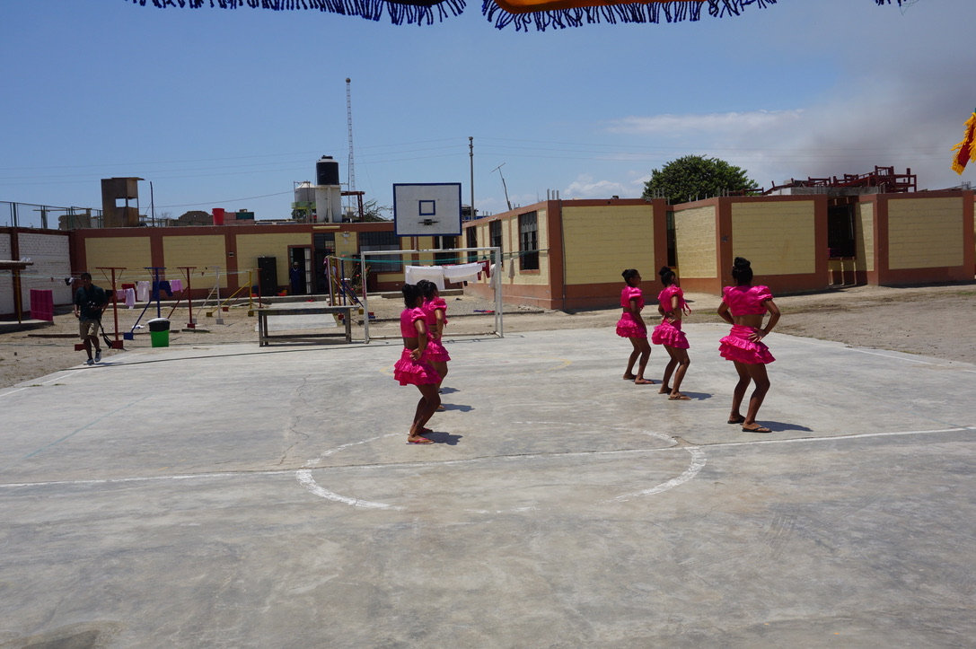
Girls’ Orphanage Chincha Rotary Project
Opening Dancing
Opening dancing

Slide 12
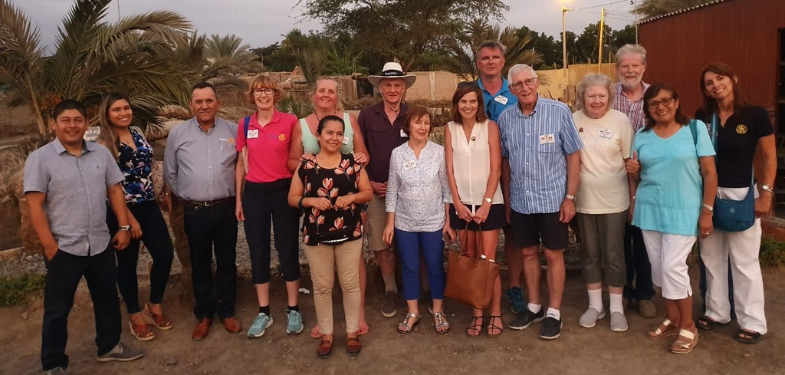
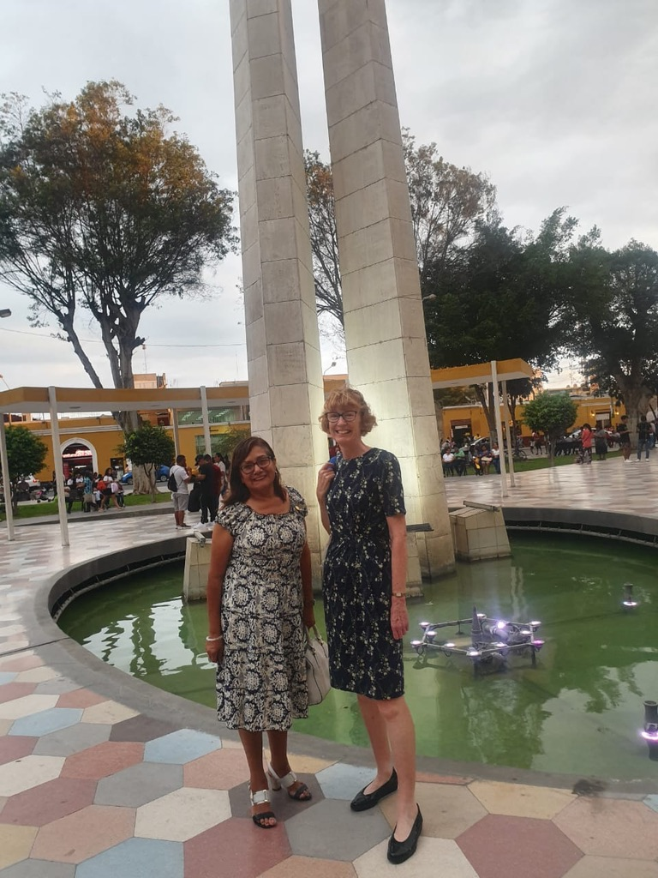
Olga Marie
MEMORIES OF
ICA Rotary Clubs

Slide 13
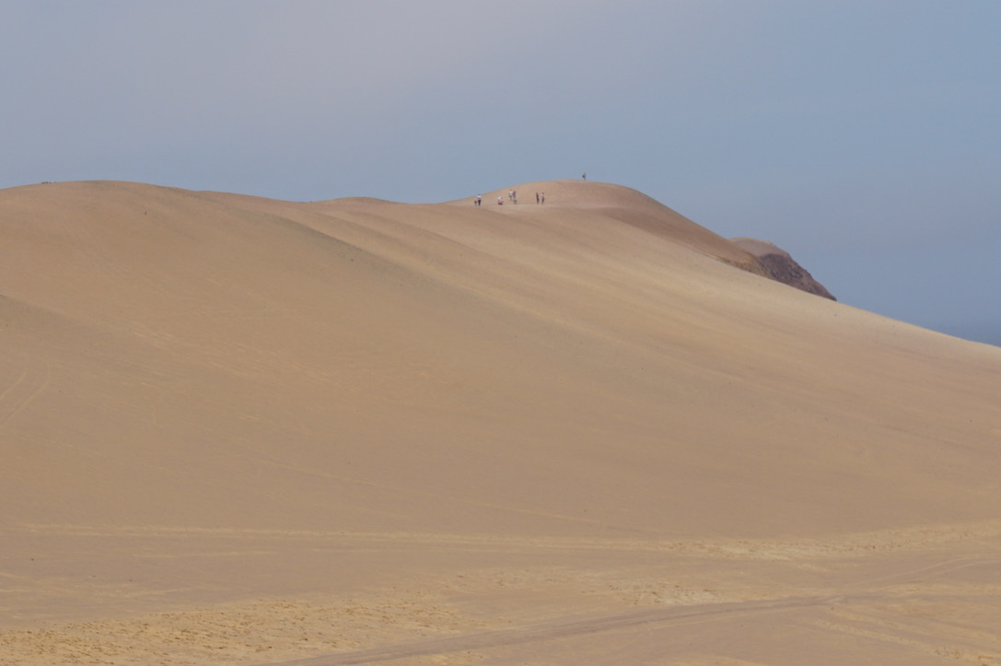
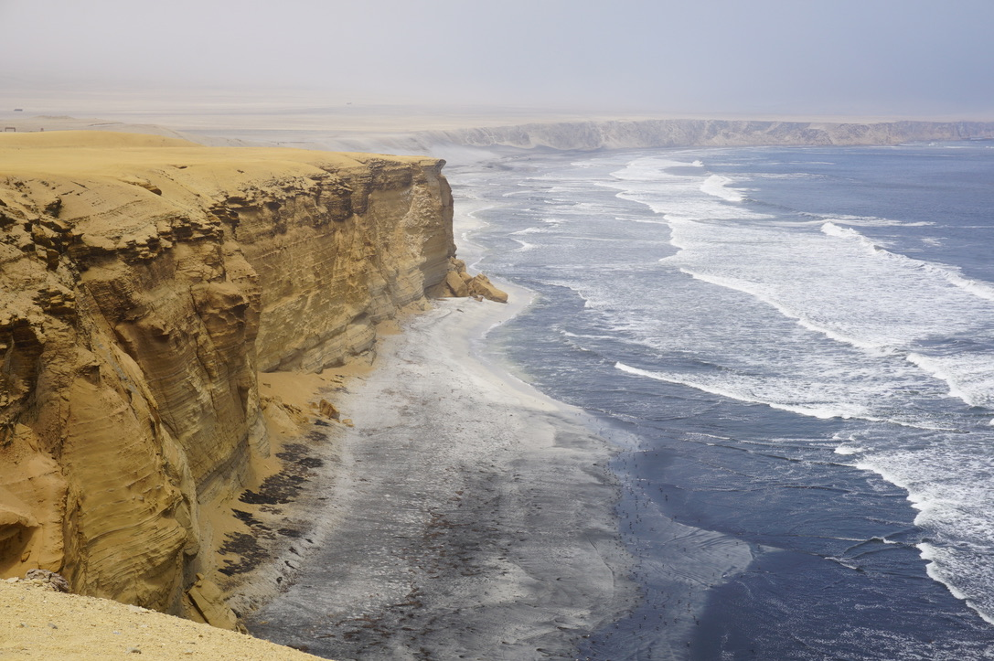
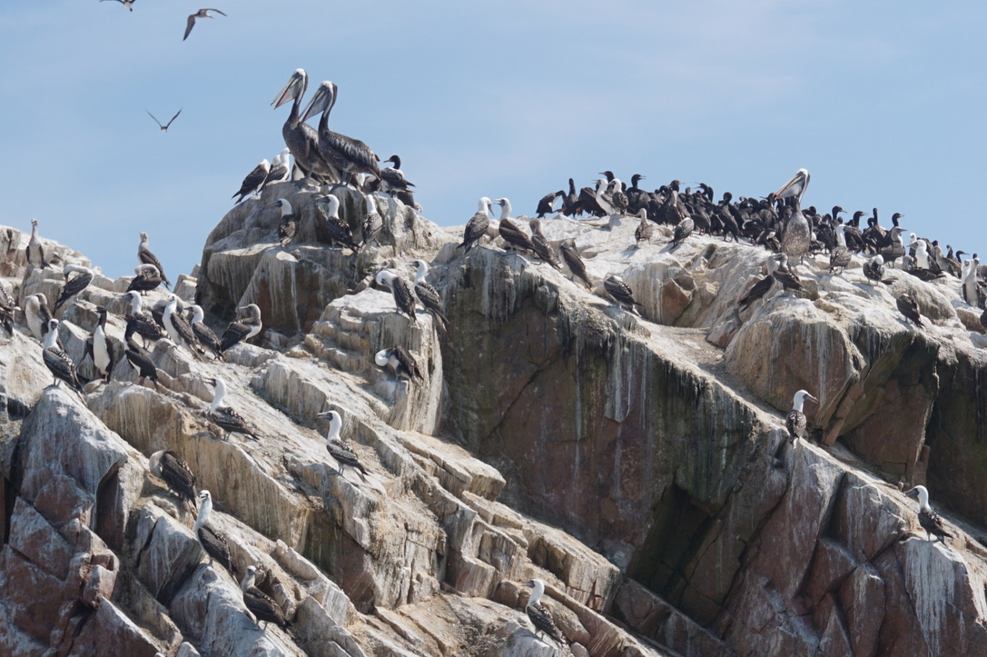
Pisco: Desert and Coasts

Slide 14
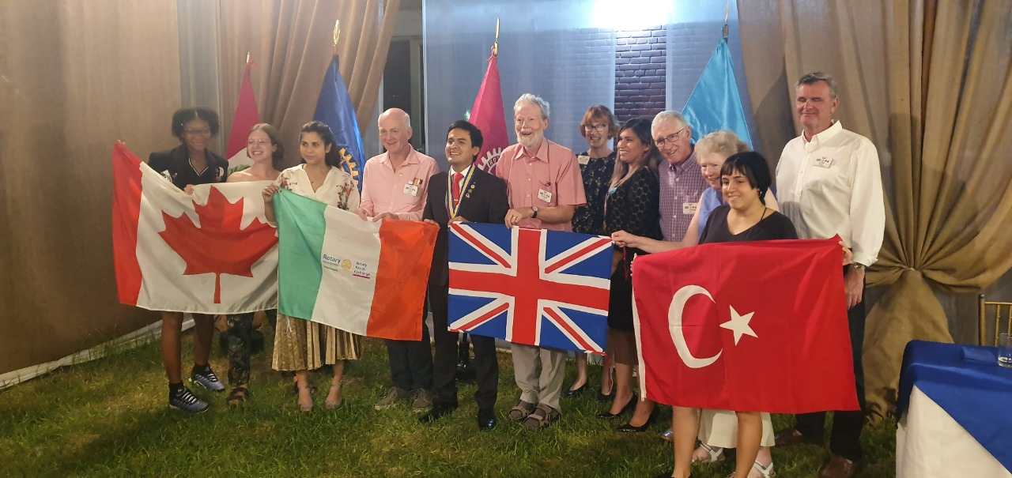
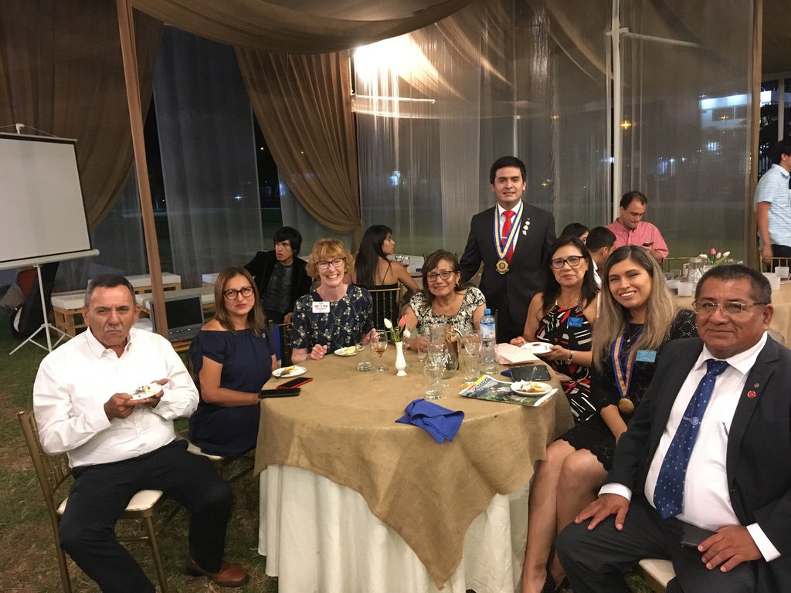
The two Rotary Clubs in Ica hosted us, the RIFE Exchange team met with four Rotary International Exchange students hosted by the Ica clubs from Turkey, Canada, Italy and Switzerland.
Ica Rotary Meetings end by celebrating Birthdays and eating cake
My host Olga Marie

Slide 15
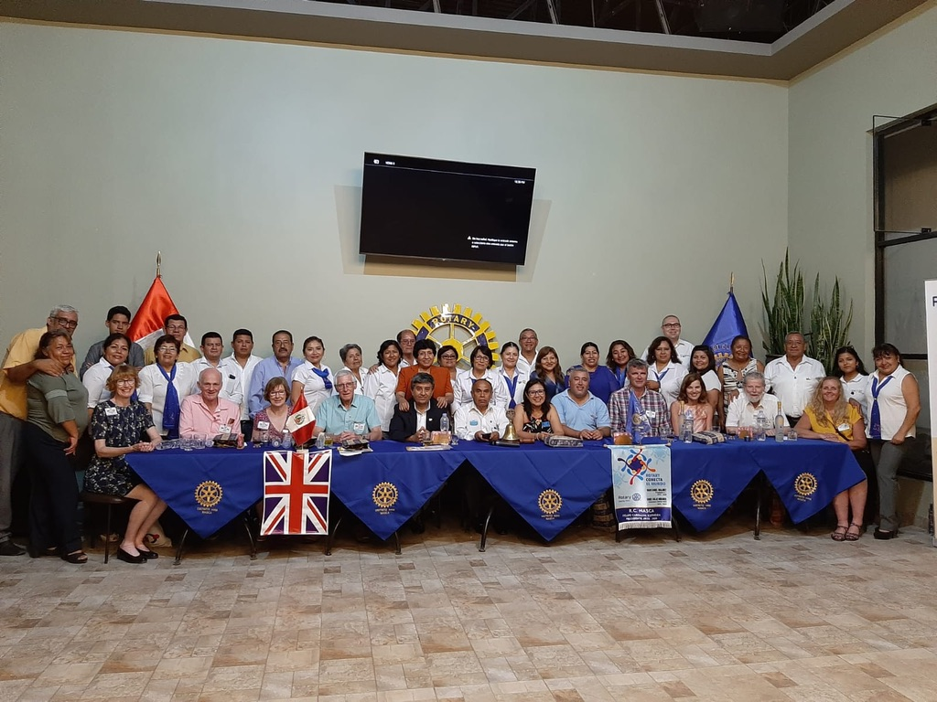
The Rotary Club of Nazca with
the 4455 District Governor and
the 1200 District team

Slide 16
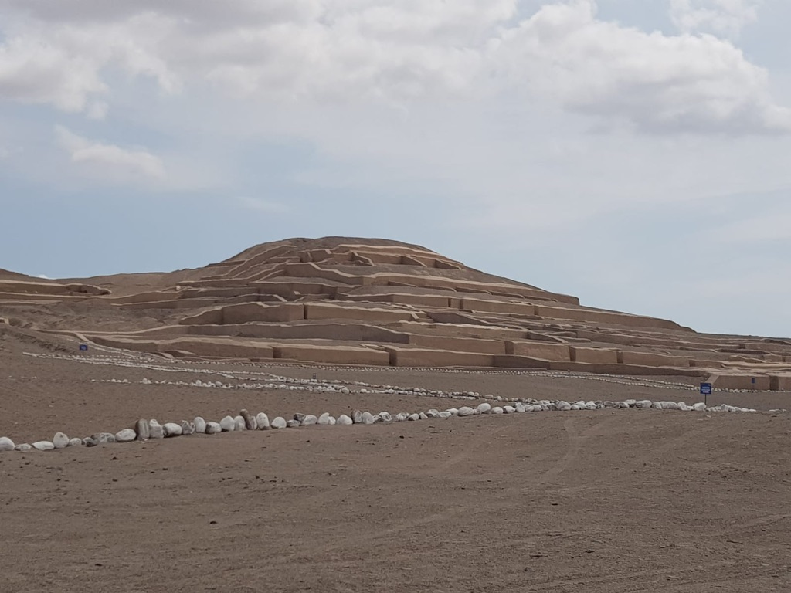
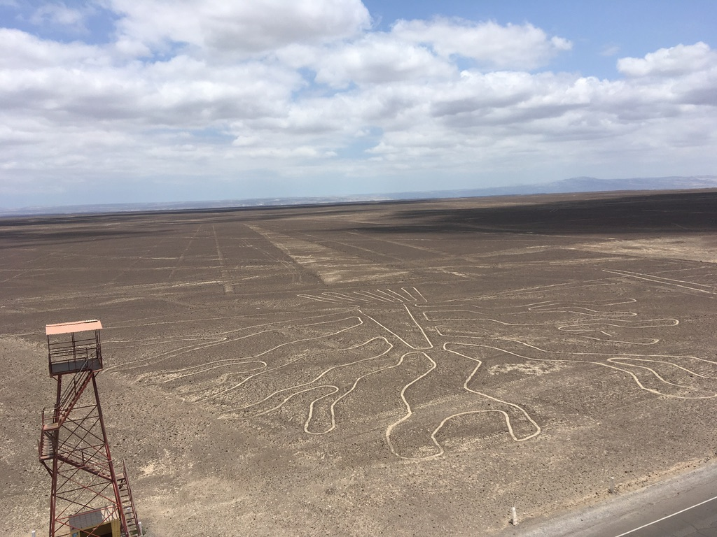
The Nazca Lines viewing
platform
Nazca: 2000 year old mud-brick
Pyramids

Slide 17
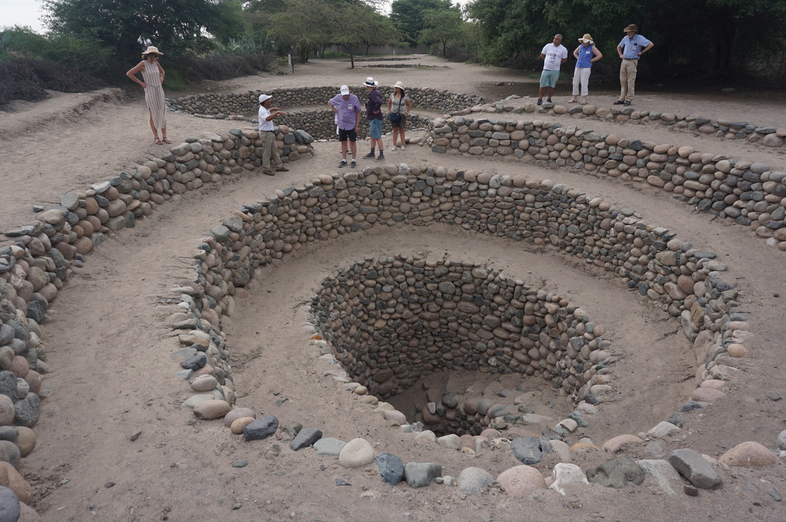
Nazca Rotary Club:
Desert heat and archeological wonders
Access point to underground water supply channels feeding Nazca town
Built 1,000 BC to AD750
The Nazca Lines
Flight over desert reveals
2000 year old images of birds and animals only visible from the air

Slide 18
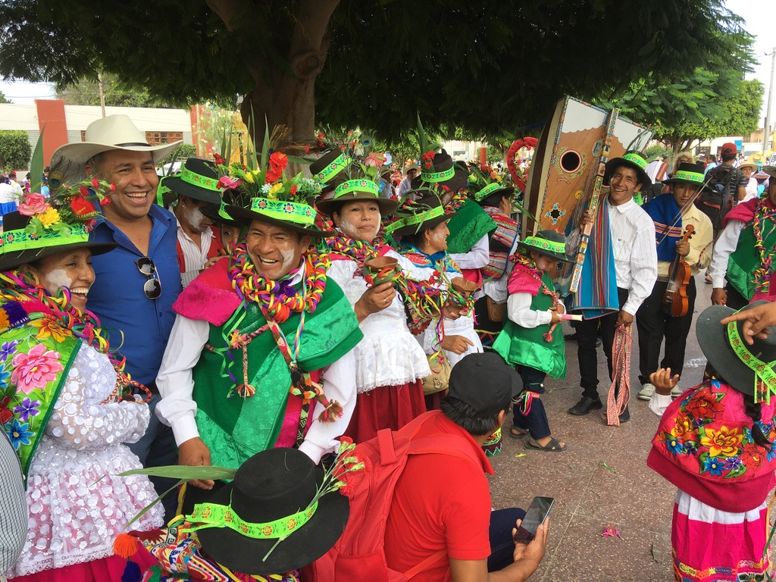
Nazca: Carnival Day for the Hill tribes – final day

