Slide 1
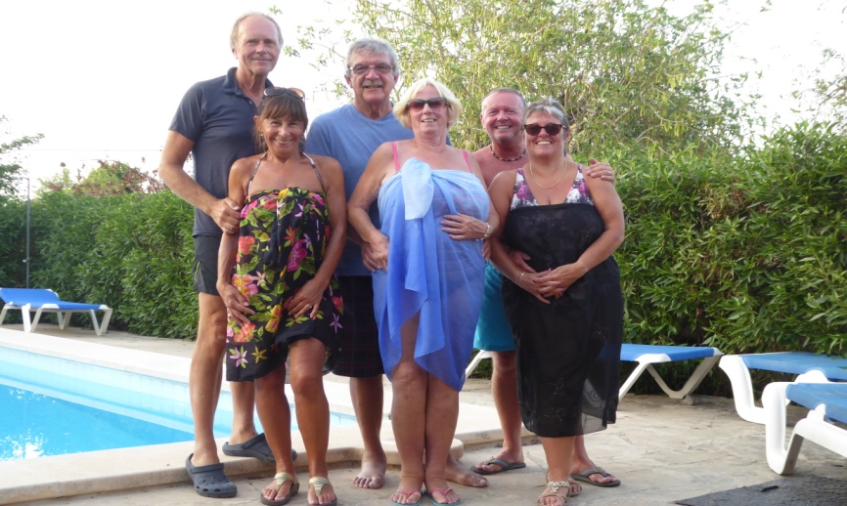
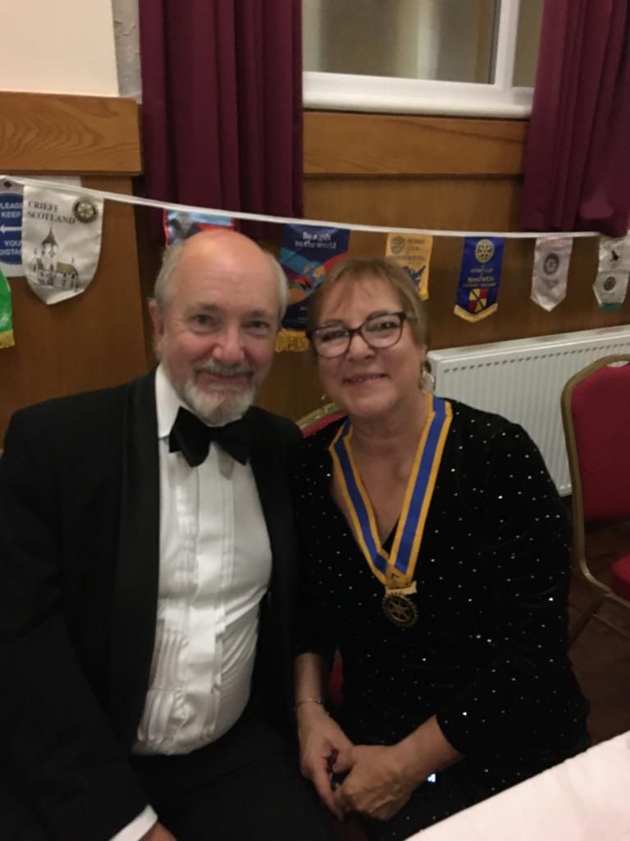
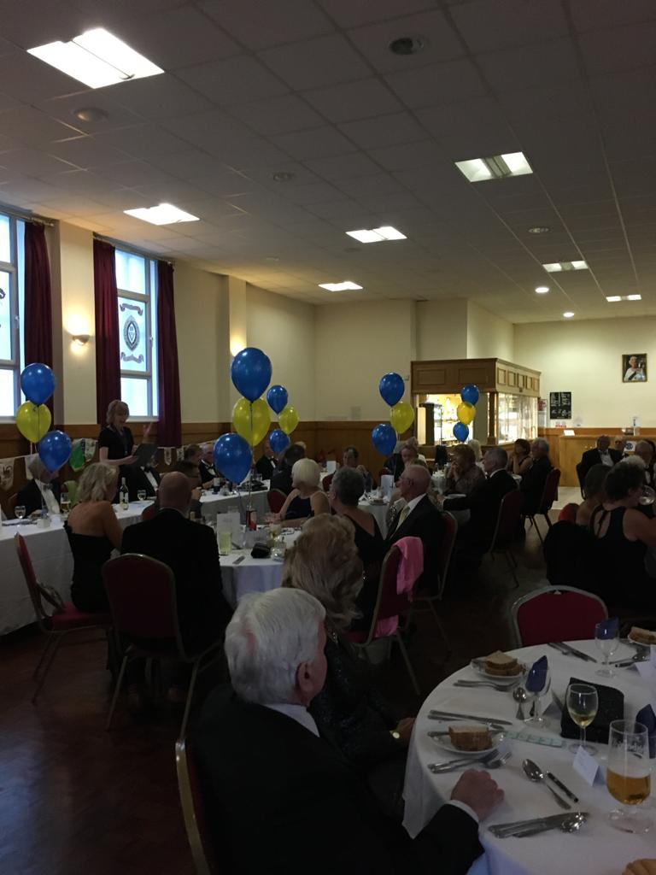
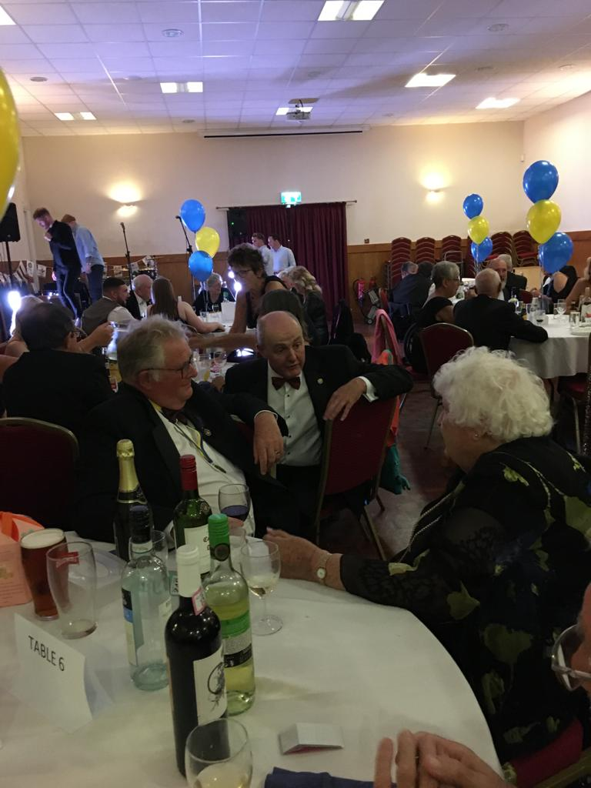
CLUB DIARY for OCTOBER
PORTHOLE #510 Sept 2021
The Rotary Club of the Island and Royal Manor of Portland {Register Charity Number: 1032098}
5 Oct No weekly Club meeting
Council Meeting at 7.15 pm by Zoom
Committee meetings to be arranged by
Chairman at any time during the week before.
9 Oct Table Top Sale
12 Oct Speaker – Aqua
GRACE/GREETER – VALERIE McGOWAN
FINANCE – MARK TOWNSEND
15-17 Oct DISTRICT CONFERENCE Plymouth
19 Oct Business Meeting – Aqua
GRACE/GREETER – IAN McPHEAT
FINANCE – ROBERT GRIGSBY
26 Oct Guest Evening - Aqua
Speaker: Tom Shippey
“The Vikings and a Dorset Hero”
GRACE/GREETER – LORRAINE BECKETT
FINANCE – ELIZABETH HARDY
President: Celia Canter Secretary: Peter Burrows Editor: Ian McPheat
PRESIDENTS NIGHT

Slide 2
SEPTEMBER 2021 : PRESIDENTS DIARY
PRESIDENTS NIGHT
What a fabulous night we had celebrating three presidents – Past President Garry, Past President Elizabeth and myself. We were joined by Rotary colleagues from Casterbridge, Dorchester, Poundbury, Weymouth and Melcombe Regis clubs for a night of dining, dancing and generally catching up with each other following a prolonged period of Zoom meetings. A number of our intrepid trekkers to Nepal also joined in the evening, and it was so lovely to see so many familiar faces. We danced to Chief Lazarus, a local band, who played covers and got us all up dancing. We held a raffle in aid of our Nepal projects and raised £367 plus donations of £150 – a wonderful £517 for the Nepal account.
B-SIDE FESTIVAL
We were asked to marshall at the first ever B-Side parade. B-side is an annual event on the island which showcases local and national artists. This year, for the first time, a parade took place from Easton Gardens to the Museum and back. Many colourful ‘paraders’ in costumes danced and sang their way along the route and a truly festival atmosphere pervaded the community. We marshalled the traffic diversion to ensure the safety of the parade and would like to thank drivers in the area at the time for their patience and understanding.
Table Top Sale
We resumed our table top sales on 11 September, which was in aid of Hedgehog Friendly Portland. This was a great success, not least due to the wonderful array of cakes on sale! Thanks to everyone who took part and supported this event. The next table top sale is on 9 October 2021 in support of Portland Carers Support Group.
Community Award
Nominations are being sought for a community hero or heroine – the closing date is 2 October so please nominate those who have gone the extra mile this year – there must be many!
Speaker
Francisca Veale from the Greyhound Rescue Association is speaking at our meeting at the end of the month and we look forward to hearing all about the work of this group.
Something for seniors to do to keep those "aging" brain cells active! And for you younger ones, to get them growing!! 1. Johnny's mother had three children. The first child was named April. The second child was named May. What was the third child's name? 2. There is a clerk at the butcher shop, he is five feet ten inches tall and he wears size 13 sneakers. What does he weigh? 3. Before Mt. Everest was discovered, what was the highest mountain in the world? 4. How much dirt is there in a hole... that measures two feet by three feet by four feet? 5. What word in the English Language... is always spelled incorrectly? 6. Billy was born on December 28th, yet his birthday is always in the summer. How is this possible? 7. In California, you cannot take a picture of a man with a wooden leg. Why not? 8. What was the british Prime Minister's Name...in 1975? 9. If you were running a race, and you passed the person in 2nd place, what place would you be in now? 10. Which is correct to say, "The yolk of the egg are white" or "The yolk of the egg is white"? 11. If a farmer has 5 haystacks in one field and 4 haystacks in the other field, how many haystacks would he have if he combined them all in another field?
Elizabeth giving the good news after the Treasure Hunt

Slide 3
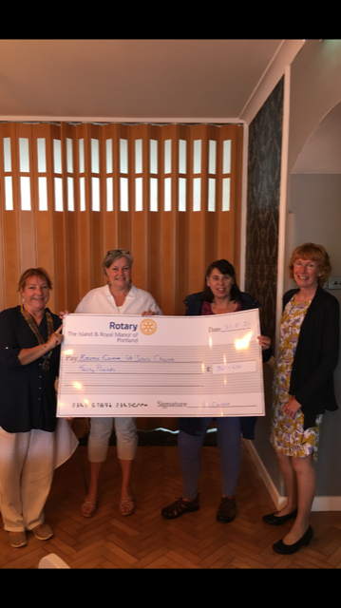
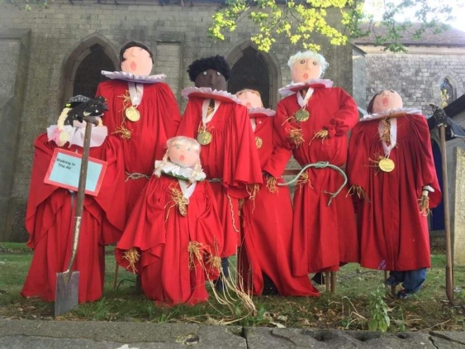
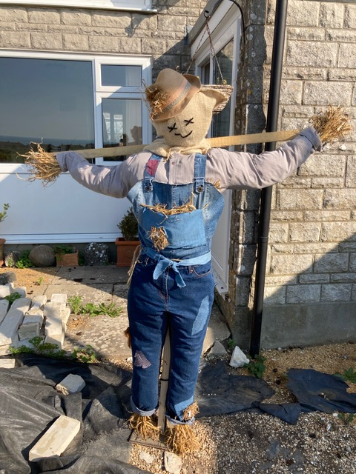
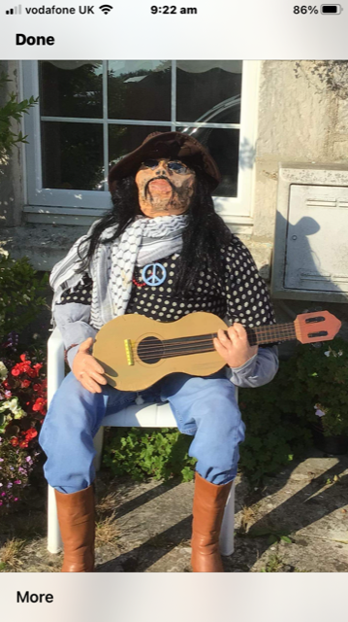
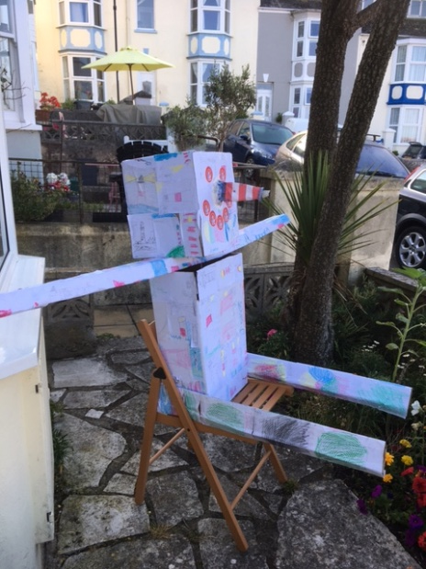
An Apology I have already been taken to task because there was no Rotary article in the last Free Portland news. My apologies. I have checked to see what I did wrong - Was I too late for publication? It was sent at the start of the month. Was it not received and so still in the ether? My p.c. tells me it was received Was it not suitable? For once I was not controversial (or so I thought) Did the editor not agree with anything that I had written? He always likes what I write. In fact none of this applies because the answer is very simple - the last edition was a very small one and too many articles had been sent in so it was not possible to include them all. While most of you will agree that my articles are so good that they could not possibly to be left out, Roland had to make a decision and so Rotary (and many others) missed out as well. I have been assured that this last month's offering would be included. So to my sole fan, this is the reason and I hope that you will accept my apologies. Keith
SCARECROW COMPETITION WINNERS
Karen Gomm and Cilla Osborne from St John’s church
Elizabeth giving the good news after the Treasure Hunt
Thanks to all the entrants

Slide 4
Changing Membership?
There has been much talk recently, and there will soon be more, about different types of Membership, perhaps in an attempt to make Rotary more attractive. If it helps, here is a brief summary of the possibilities.
Friends of Rotary.
These are people who, for whatever reason do not want to commit to becoming Rotarians but are prepared to help out at events – e.g. Table Top Sales, parking or setting up fetes and stalls. They may attend some meetings e.g. on Guests’ Nights, but do not pay dues, sit on committees, nor hold office.
Associate Members.
These are “Rotarians in waiting” and attend meetings but pay no RI or RIBI dues as they are not full Rotarians, though, perhaps, they may pay club dues. It is anticipated that they will become Rotarians within two years.
Normally they will sit on Committees but will not hold club office.
Current members cannot drop down to become Associate Members
Corporate Membership.
This is for a company or organisation to select up to 4 employees to attend meetings. The club would not pick those members.
The organisation would pay affiliation fees etc., and the classification would be that of the organisation – e.g. Plumbing.
Members would sit on, and could chair meetings of, a committee, and as full Rotarians could vote.
If an employees want to become a members in his or her own right at any time that is perfectly acceptable.
Family Membership.
Usually a spouse or younger member of the family signs on, often at a reduced rate, but has the same privileges as a full Rotarian.
Younger Professional Membership.
Offered at a reduced rate and a more flexible expectation of involvement
THE THEME As you know, Rotary's motto is Service Above Self, but for many, many years, successive Presidents of Rotary International have introduced a theme as well. For many this simply means yet another phrase to remember in Rotary's already overcrowded vocabulary. However, when going around talking to clubs or Conferences, or even for club Presidents, it is very useful to be able to have a different emphasis each year. So one year the emphasis may be on Health, the next on Peace, and then on the Environment etc.. It is a lot better sitting in a club listening to someone talking about Health, or Peace, or the Environment etc. rather than Service Above Self, and Service above Self, and Service Above Self. Consequently this year's Internal President, Shekhar Mehta, an accountant from Calcutta, has chosen the Theme of - Serve To Change Lives. This brings the emphasis on the effect that Rotarians have on the world at large, rather than saying Let's help someone. This is the first RI President that I do not know, and I am not sure if I have ever met him, but with the Indian Rotary population growing rapidly, it was inevitable that another Indian would reach the top again soon. Now that clubs are starting to meet again, it will be interesting to see how Shekhar gets his message over to the Rotary world. Sadly it has been announced that Carlo Ravizza, a Past President from Italy whom I last met on stage in India when we were talking about Rotary in India, has died and now we have an Indian in charge. The King is Dead, Long Live the King
Elizabeth giving the good news after the Treasure Hunt

Slide 5
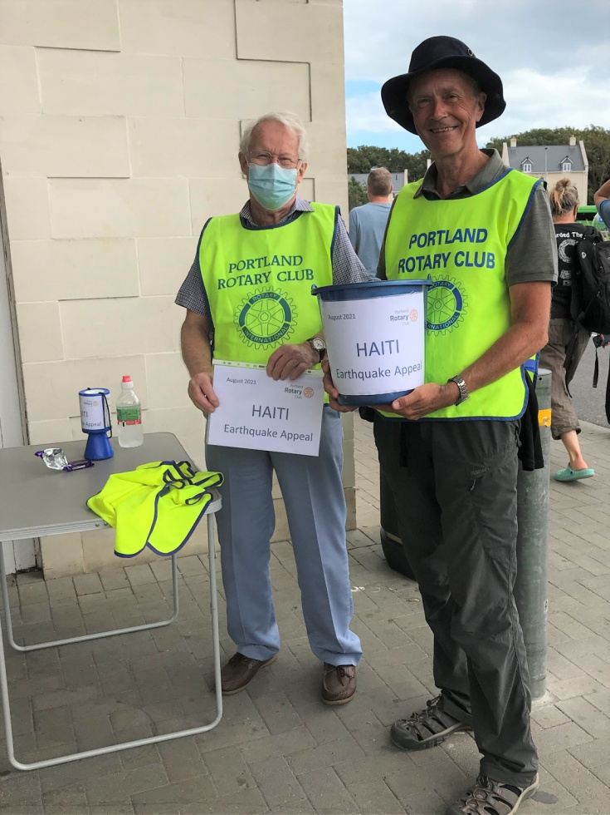
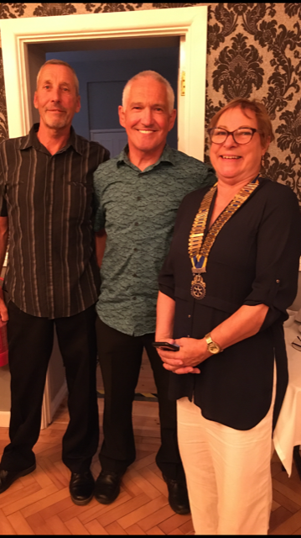
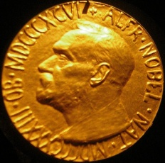
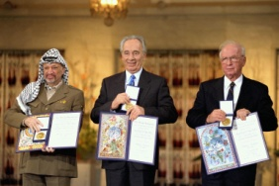
If you're not familiar with the work of Steven Wright, he's the famous Erudite scientist who once said: "I woke up one morning, and all of my stuff had been stolen and replaced by exact duplicates."
His mind sees things differently than most of us do. Here are some of his gems-:-
1 - Borrow money from pessimists -- they don't expect it back. 2 - 99% of lawyers give the rest a bad name. 3 - 827% of all statistics are made up on the spot. 4 - A clear conscience is usually the sign of a bad memory. 5 - The early bird may get the worm, but the second mouse gets the cheese. 6 - OK, so what's the speed of dark? 7 - How do you tell when you're out of invisible ink? 8 - If everything seems to be going well, you have obviously overlooked something. 9 - When everything is coming your way, you're in the wrong lane. 10 - Hard work pays off in the future; laziness pays off now. 11 - I intend to live forever... So far, so good. 12 - If Barbie is so popular, why do you have to buy her friends? 13 - Eagles may soar, but weasels don't get sucked into jet engines. 14 - What happens if you get scared half to death twice? 15 - My mechanic told me, "I couldn't repair your brakes, so I made your horn louder." 16 - Why do psychics have to ask you for your name? 17 - If at first you don't succeed, destroy all evidence that you tried.
18 - A conclusion is the place where you got tired of thinking. 19 - Experience is something you don't get until just after you need it. 20 - The hardness of the butter is proportional to the softness of the bread. 21 - The colder the x-ray table, the more of your body is required to be on it. 22 - Everyone has a photographic memory; some just don't have film.
And the all-time favourite -
24 -I'd kill for a Nobel Peace Prize.
Tesco collection raises £603.83 for Shelterbox
Tim Ellis and Eddie Ette from Portland are no strangers to endurance challenges. They joined our meeting on 31 August, along with their wives, to give us an informative and humourous presentation on their exploits to date.
In 2006 they ran 35 miles over the pebbles of Chesil Beach in 11 hours. They have both completed the Enduroman ‘Arch to Arc’ Triathlon between London and Paris. They have also kayaked from Cherbourg to Portland, and set the kayaking record for the 100 mile circuit of Lanzarote in the Canary Islands.
They picked up their paddles once again in May this year to kayak non-stop from Alderney, in the Channel Islands, to Weymouth, all to raise money for Weldmar Hospicecare.
We wish them well with future adventures.
Celia

Slide 6
Portland Rotary Club helped steward the 2021 b-side festival
Rocca Holly-Nambi, Director of b-side and the b-side team would like to thank to thank Portland Rotary Club for marshalling the Portland Community Parade this year. Rocca will be speaking to the Club in November and would like to have more Rotary and b-side collaborations in the future.
One of the fun aspects of being President is to represent Rotary in various settings, and Celia asked me to do the opening b-side tour on her behalf. We were taken on a tour of several b-side art installations, ending up with an outdoor film viewing of the 1963 Hammer horror “The Damned”, in the garden of Pennsylvania Castle. Wow!
The Rufus Castle Light Show: Of Sea and Stone
As part of this year’s b-side festival, The Portland Museum Trust applied for an Arts Council grant to fund a project re-telling the story of Church Ope Cove. We set-up a group of volunteers to research the stories, the myths and legends of the area around the Museum and this research was then used by Dan Shorten of the Guild Hall Live Events team. He created an amazing music and light show, beamed onto the cliff face and side of Rufus Castle.
The images were sharp, detailed and very colourful; it was awe inspiring and very similar to a fireworks display, but all done through an animated digital film projection. Set within the context of the location, it was a magical night-time ten-minute experience, giving a real sense of the geography and history of the place. The audience gathered to watch the show on the ammonite platform, at the head of the Church Ope steps.
A smaller version of the lightshow was also made available in the Museum. It is beamed onto the ceiling and walls of Avice’s Cottage, one of the galleries inside the Museum.
1 . HOW DO YOU DECIDE WHO TO MARRY? (written by kids) You got to find somebody who likes the same stuff. Like, if you like sports, she should like it that you like sports, and she should keep the chips and dip coming. -- Alan, age 10 No person really decides before they grow up who they're going to marry. God decides it all way before, and you get to find out later who you're stuck with. -- Kristen, age 10 2. WHAT IS THE RIGHT AGE TO GET MARRIED? Twenty-three is the best age because you know the person FOREVER by then.. -- Camille, age 10 3. HOW CAN A STRANGER TELL IF TWO PEOPLE ARE MARRIED? You might have to guess, based on whether they seem to be yelling at the same kids. -- Derrick, age 8 4. WHAT DO YOU THINK YOUR MOM AND DAD HAVE IN COMMON? Both don't want any more kids. -- Lori, age 8 5. WHAT DO MOST PEOPLE DO ON A DATE? Dates are for having fun, and people should use them to get to know each other. Even boys have something to say if you listen long enough. -- Lynnette, age 8 (isn't she a treasure?) On the first date, they just tell each other lies and that usually gets them interested enough to go for a second date. -- Martin, age 10
Elizabeth giving the good news after the Treasure Hunt

Slide 7
Question - why do we need new members? We are ALL getting older We need new blood We need new ideas We need more Father Christmasses We need more helpers for Table Top Sales We need more volunteers We need Committee members We need Committee Chairpersons We need future Presidents We need new friends We need to give others the opportunity of finding out if Rotary is for them. Remember - Whenever new Rotarians are asked why they did not join Rotary earlier, the answer is almost always "Because nobody asked me!" Remember - If nobody had asked you to join you would not be a Rotarian now. Remember - A larger stronger club means more friends for us, and more people we can help. Remember - To ask someone else to join. Remember - If they try it and do not like it that is fine. At least they have had the opportunity to experience what Rotary means. Remember - If you do not ask them, they will never know if they would enjoy Rotary. It is very simple - Ask Someone
KBJ
The show told the story of Church Ope Cove, linked to objects displayed in the Museum. One of our most famous fossils, found in Albion Stone Quarry is the Jurassic turtle. And there it was, a huge, beautiful projection of it swimming in Jurassic Seas! Then Ammonites squirted along by jet propulsion, followed by huge rock falls and tectonic contortions, as the Island of Portland was created. Viking Long Ships sailed into the cove, shipwrecked sailors drowned, smugglers rolled barrels to Tophill, and Sir Christopher Wren’s St Paul’s Cathedral loomed tall as the quarrymen gave up their stone.
“Of Sea and Stone” was the title Dan Shorton gave his Rufus Castle sound and light show. Dan won the contract by competing with over 50 candidates, his was the most visionary and exciting idea, with huge entertainment value.
Elizabeth
Portland Museum Trustee
Elizabeth giving the good news after the Treasure Hunt
Two things to make your day better:
1 – Do not watch the news
2 – Stay off the bathroom scales
A man gets up from his hospital bed and walks out the hospital front
door, pulling his drip along, still in his gown.
He walks into the pub opposite and says to the barman, "I'll have a
double whisky please."
The barman gives it to him. The man knocks back the whisky in one go and
says to the barman, "Of course, I shouldn't be having this with what
I've got.”
"What have you got?" says the concerned barman.? 10p

Slide 8
CADRE What exactly is the Cadre?. This was the question that President Elizabeth asked Mark after he had given his very, very good resume of Global Awards last evening. As almost half the club members were not present to hear Mark's exposé, I thought that a short explanation might help those who missed it to better understand how our money is spent. If a Foundation Grant is for, say, $1000, to send someone abroad at a cost of, perhaps $500 just to check that project is ridiculous, but when perhaps a million dollars of our - yours and mine - money is involved we need to ensure that that money is not being wasted. Hence the Cadre. The Cadre is a body of Rotary Volunteers each of whom has, perhaps some knowledge of one or more of the seven Areas of Focus for Foundation Grants 1. Peace and conflict prevention/resolution 2. Disease prevention and treatment 3. Water and sanitation 4. Maternal and child health 5. Basic education and literacy 6. Economic and community development 7. Supporting the Environment Mark and I have both volunteered to work under the second and fourth areas for obvious (I hope) reasons. Before a project is allowed to go ahead, that project is vetted and assessed by the Foundation staff in Evanston. With bigger grants, often a member of the Cadre is asked to help at one, or more, of four stages. 1. To read all the paperwork (at home) and give an opinion as to whether the project is in fact viable in the first place, whether there is a need for it, to see if it is well thought out, and has Rotary and Community involvement. 2. To travel to the site of the project for 2-3 days, interview the Rotarians involved, talk to the people who will benefit, talk to cooperating organisations, and ask a lot of questions.
3. To travel to the project site for 2-3 days during the project to ensure that the project is running to time, and according to plan, and, if needed, to answer questions or help with problems. 4. After the project is completed, to ensure that the project was completed as planned and on time, that the money was spent according to plan, that a proper financial report is available, and to report on whether targets have been reached. Perhaps in another edition of Porthole I will give details of projects with which I have been associated, but all sorts of problems can arise, fortunately very rarely - misuse of monies, lack of support from the local Rotarians or other organisations, failed targets, missed deadlines, or even that the project does not exist!! That has happened. The Cadre member can help in many ways. But it is not just medical volunteers who are wanted. Engineers (building toilet blocks in schools), Administrators, financial experts (bankers or accountants), lawyers, town planners, teachers, or environmental "experts" can all be of use. Simply read about the Foundation Cadre on the website, decide if you can help in one or more of the Areas of Focus, and how, fill in the application form and wait for a message from Evanston asking you to go to - - - -wherever. Someone asked about the cost to the Rotarian - zero. Travelling is covered, as is a basic housing allowance. You will not become a millionaire in 3 days, but you should not be out of pocket. The benefits - seeing the real world and learning about life, ensuring fair play, helping to make sure that our money is well and properly spent, helping whole communities to gain from projects that would not be possible without our/your help, and, above all, getting the feeling that you have done something useful to help humanity. Interested? Thanks you Mark for inspiring us and for whetting our appetites.
Elizabeth giving the good news after the Treasure Hunt

