Slide 1
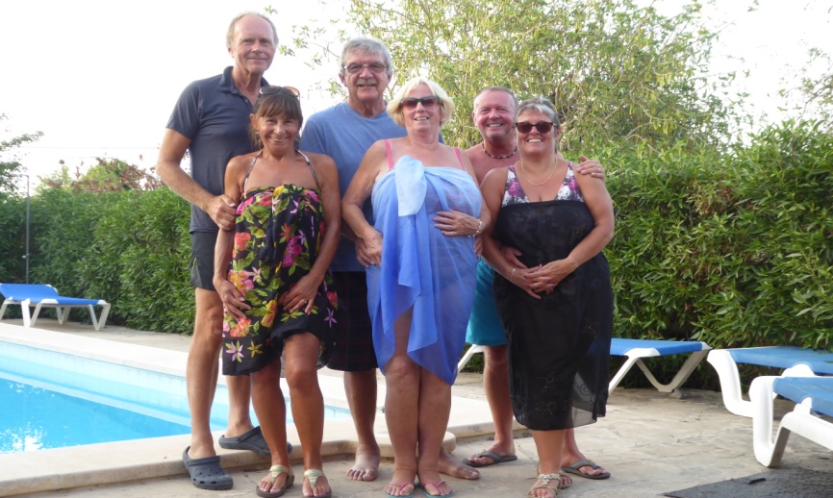
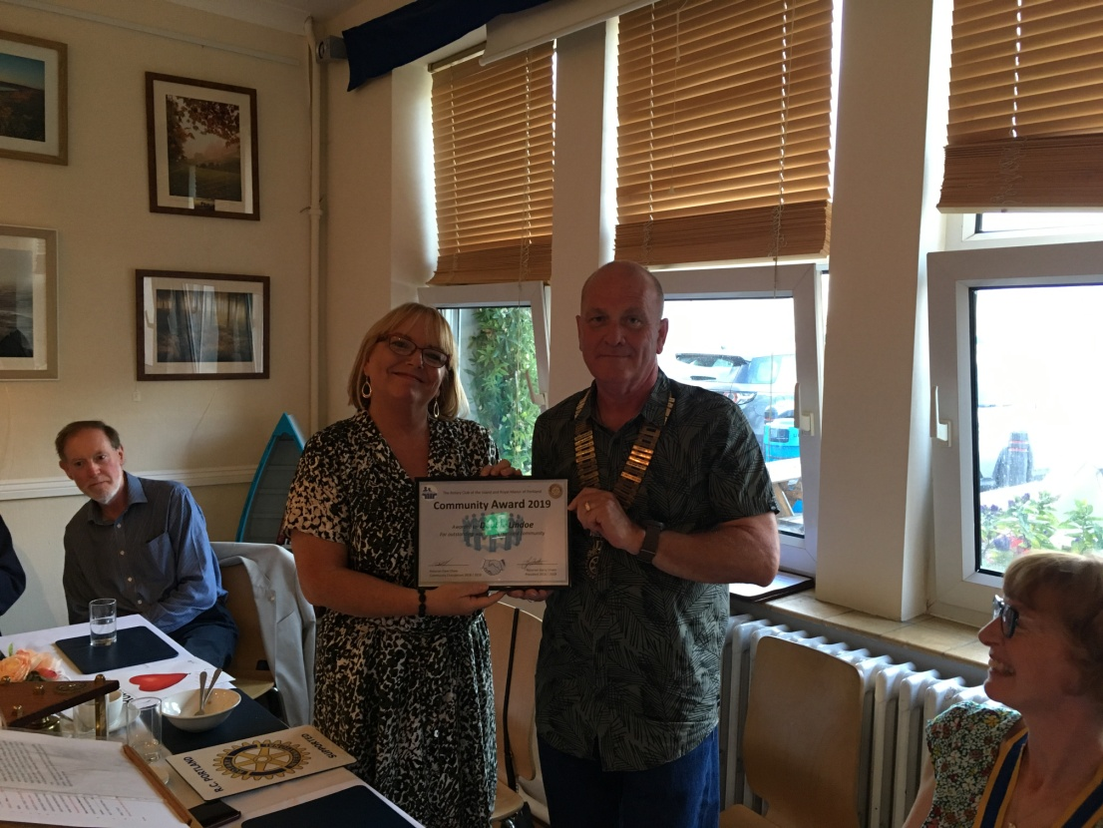
CLUB DIARY for SEPTEMBER
PORTHOLE #495
AUGUST
2019
The Rotary Club of the Island and Royal Manor of Portland {Register Charity Number: 1032098}
President: Garry Urwin Secretary: Peter Burrows Editor: Ian McPheat
Meetings: Tuesdays 6:30pm, Including Guest Night, At the AQUA SPORT HOTEL
3rd 6.30pm Aqua Hotel – COMMITTEES
Roast Beef/Turkey or Nut Roast with Roast Potatoes & Vegetables
Coffee Ricotta Creams or Fruit Salad
GRACE/GREETER – MARGARET THOMAS
FINANCE – JANET KENCH
10th 6.30pm Aqua Hotel - SPEAKER FOLLOWED BY COUNCIL
Speaker: Leanne Colverson – Dorset & Somerset Air Ambulance
Pork Stroganoff, Rice & Stir Fry Vegetables
Mushroom Stroganoff, Rice & Stir Fry Vegetables
Pears Bonne Helene or Fruit Salad
GRACE/GREETER – SARAH CURTIS
FINANCE – STANLEY KNIGHT
14th TABLE TOP SALE for FRIENDS OF VICTORIA GARDENS –C2000
14th 8.45 -12.30 DISTRICT 1200 FORUM
BATH & WEST SHOWGROUND, SHEPTON MALLET
17th 6.30pm Aqua Hotel – BUSINESS MEETING
Moroccan Lemon Chicken, New Potatoes & Salad
Leeks & Goats Cheese Tart, New Potatoes & Salad
Eves’ Pudding & Custard or Fruit Salad
GRACE/GREETER – JAYNE URQUHART-SIMS
FINANCE – JILL LAMING
20th – 22nd OUR TWIN CLUB VIRE VISITS US
24th NO MEETING
Debbie Lindoe receiving our Community Award for 2019, for her hard work in the community outside her normal hours at Tescos. Well done Debbie!
Contact Margaret Thomas to book your meal. Or, order from the bar at the Aqua as early as possible

Slide 2
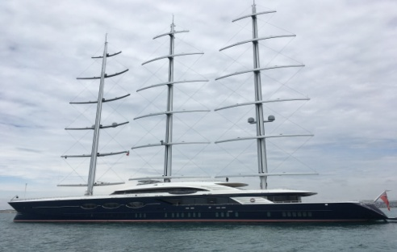
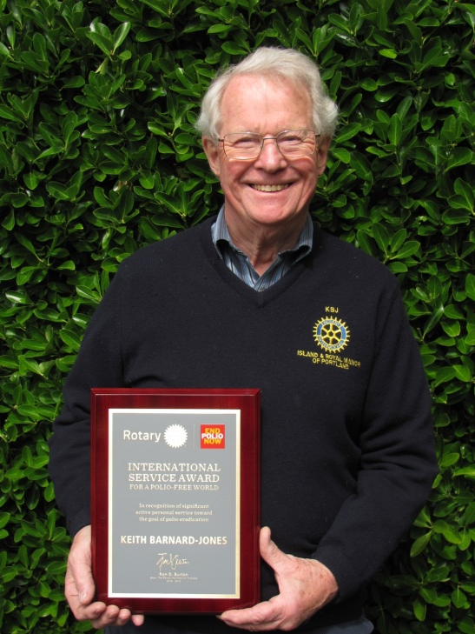
WELL, WELL, WELL
Many moons ago, before many of you were born, it was suggested that we might like to put a Wishing Well at Portland Bill to get contributions from all the visitors that flock there throughout the year.
We applied to the Council who, in its wisdom, turned us down on the grounds that, if we had a well there, other organisations might well want similar facilities.
End of story.
At least until the Court Leet became involved.
In 2005 we discovered, eventually that the Court Leet had a final say on what happened on their property, not the Council.
This was the 100th. Anniversary of the founding of Rotary and that may have helped
So an approach was made to the Court Leet, drawings were produced, and permission was granted.
Wonderful.
Having designed a very simple round well, (more difficult to vandalise), we needed someone to build it so, in stepped Trevor and his company made us a wonderful grill with an opening flap in it to allow us to collect the money.
Sarah had some workmen working on her small house at the bottom of Wakeham and she very kindly volunteered them to build the well for us.
Apart from renewing the plaque telling people about our 100th Anniversary and that donations were to help others, the well has sat there for the last 14 years, giving us a steady annual income.
While little money comes in over the winter months, the summer is busy and so the well needs to be checked every week or two.
In hot weather the water in it will evaporate so it is topped up regularly
MEETING DARCY, OUR SPONSORED STUDENT
Portland Rotary Club has sponsored a Y12 Portland business studies student to attend a career enhancing course arranged through the Social Mobility Business Partnership Scheme. Darcy attends the sixth form at Budmouth School and was formally at Atlantic Academy. I met her on the last day of the three-day course with 7 other students. They had had talks on confidence building, leadership skills, problem solving, networking in the business world, influencing and presentational skills, and even how to dress professionally. They had discussed the roads to becoming a lawyer, how to access business apprenticeships and achieve a university degree with on the job training. There was also a section entitled how to have difficult conversations: resilience training, or how to survive difficult people and difficult situations. Sounded really useful.
Next is to arrange a visit for Darcy to come to one of our meetings, along with Elliot Glover, the SMBP scheme district organiser. The aim will be to learn more about the SMBP from Elliot Glover and hopefully build Darcy’s confidence with lots of encouragement through our support of her, and hopefully give her a positive public speaking experience.
Elizabeth giving the good news after the Treasure Hunt
We had a trip around the outside of Black Pearl currently anchored in Weymouth Bay. What a yacht! Sails have solar properties and it is said they could make it across the Atlantic using no fuel at all. Next stop Russia. Sarah and Brian
To date the total raised in 14 years is heading towards the £5000 mark.
As this is nearly all from visitors to the island it is a source of income that we would not have had without the help of Trevor, Sarah and, of course, the Court Leet.
I was asked about the history of the well – now you know.
EDITOR’S NOTE
macmolly10@gmail.com Pictures need to be in jpg format if possible.

Slide 3
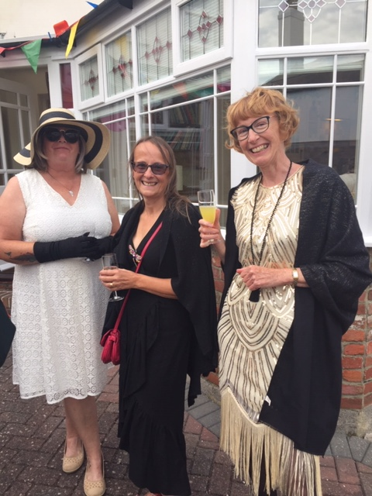
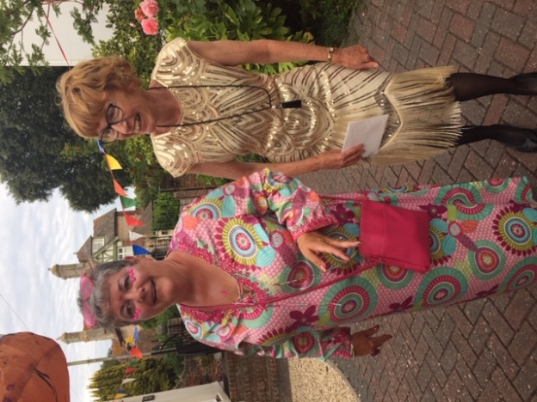
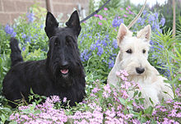
LIFE ON THE CRESTA RUN
As you all know we have now acquired a down-sized Scottie.
As you also know we have now acquired some wild goats on Old Hill to keep down the undergrowth - all safely tucked up behind a fence where they can chew away to their hearts’ content every day.
That is until a down-sized Scottie decides that she can get under the gate to play with the goats.
This morning she went under the gate and down the slope like a toboggan down the Cresta Run – as did the goats in front of her. And disappeared. No amount of calling had any effect.
Half an hour passed with nothing happening so home I went and changed into old clothes somehow managed to clamber over the gate and headed down the slippery slope calling for the dog. Oh yes, I forgot to say that it was raining as well which added to the danger of the ice fall as well as to my general discomfort.
Some of the goats eventually came back, quite contentedly and were chewing the leaves and saying hello to me. Having got to the bottom of the slope by hanging on like grim death to the wire netting, the dog then appeared, playing happily with the other goats and looking very pleased with herself. Eventually, after much slipping and sliding I got hold of her. But trying to drag something like four and a half stones of super-charged hound up the Cresta Run when all she wanted to do was to go down to the bottom again was a nightmare.
It was at this stage that I heard the police sirens and feared the worst – I had been reported to the police. So I put my pacemaker into overdrive and plugged on up the muddy path. The dog wanted to play with her new-found friends and was having none of it. I pulled so hard that her collar shot off and so there I was, flat on my back in the mud, with the dog loose again, police sirens going and a useless lead and collar in my hand. It was at this stage that one of the goats decided to head-butt me – not once, but many times. It is difficult to attach a collar and lead to a recalcitrant pooch when a hircine maniac is determined to push me back down the path.
Eventually, after almost an hour, I managed to climb Everest, with said canine juvenile delinquent in tow and managed to push her under the gate onto the path, much, I think, to the disappointment of dog and goats one, of which helped me up and over with another jab from the horns. Luckily the sirens had stopped, there were no police around. I had got away
with it!
We are now looking for a cat to do a part-exchange with.
Any offers?
Keith
HAPPY BIRTHDAY ELIZABETH

Slide 4
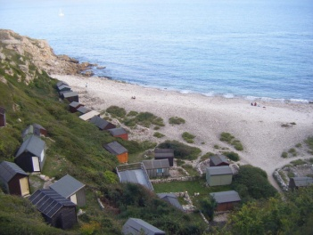
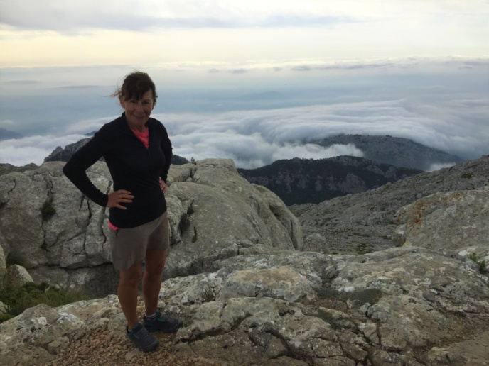
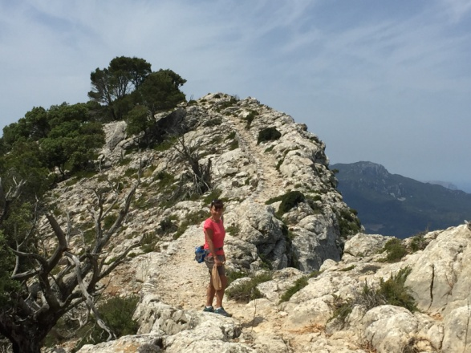
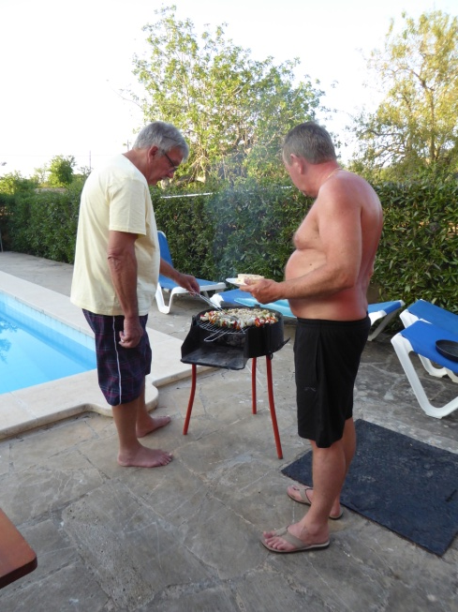
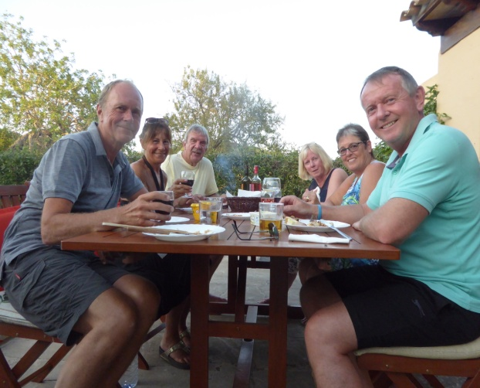
Heritage Community Project Centred on
Church Ope Cove Starts
MALLORCA WITH PETER & GILLIAN, ANDREW & JACKIE
Ruth walking the vertiginous section of the Arch Duke Path
A bid by Portland Museum to Arts Council England has resulted in an exciting award of £27,600 to research and reveal the dramatic history, myths and legends of Church Ope Cove.
Working in partnership with b-side and help from the local community, the project will lead to greater understanding of the original gateway to the island and enhance the strong community ties built by both bodies. The result of the work will culminate in a legacy for future islanders by improving the sustainability of the museum through increasing footfall, improved interpretation, redesign of our website, and an exciting work of art that will feature in b-side’s 2020 arts festival and beyond.
The project will begin with a series of community workshops led by Bea Moyes who headed the research into Portland Pathways, last year. Research by local residents will lead to the production of a report which will be drawn upon to inspire a number of imaginative activities including the design by the island’s children of a donation box to be made by island community members.
Church Ope Cove is a place often forgotten for its central role in some of the most dramatic and culturally relevant history in the country. The original landing of the first recorded Viking invasion, the peaceful and serene atmosphere of the bay belies its bloody and lawless past. At one time, the only landing point for shipping on the island, its many tales of smuggling and pirates suffuse the local folklore.
The Museum is looking forward to working with all members of the community to explore, reveal and disclose this vital part of the island’s history.
If you are interested in joining the research group do get in touch: portlandmuseum@gmail.com
Above the clouds
at the summit of
Mt Massalena
Pete and Andrew tackling the BBQ by the pool and the food was successful by chef Andrew

Slide 5
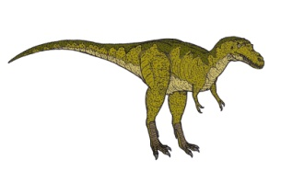
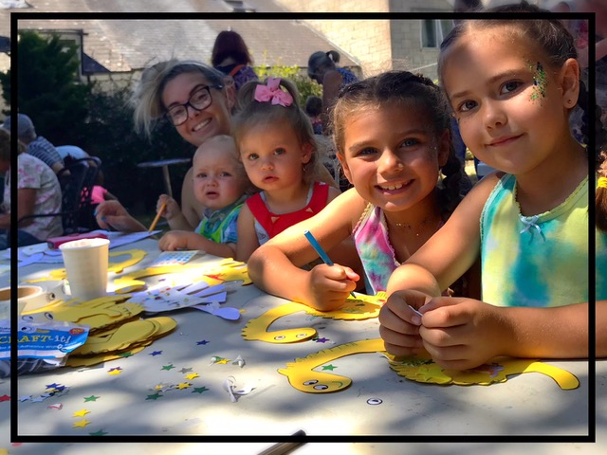
COASTEERING AT THE BILL:
a new experience and possible Rotary adventure?
DINO DAY AT THE MUSEUM
Coasteering is a combination of scrambling, climbing and swimming through sea caves and jumping from an ever-higher series of ledges and cliff platforms. It seemed like a good idea to try it out, especially as I had heard the fossils inside the sea caves on the eastern side of Portland Bill were particularly interesting. Having chosen one of the hottest days in July, my nephew James and I went with “Adventure4All”, a company run by an extremely fit former PE teacher, who used to work at Wey Valley School. We changed into wet suites at the Bill car park, and with life jackets and helmets, walked, climbed and finally jumped into the sea at Butts Quarries, just below the Lower Lighthouse. The caves here at Broad Ope are wide and high and as the swell surged in and out, we floated on our backs; it was like being inside a washing machine. It was totally exhilarating. And yes, there are some good fossils in the ceiling. We had to clamber out repeatedly as we moved down towards to the Bill, climbing onto low ledges, walking round the base of the cliffs, all whilst the sea continued to smash and roll all around us. There was a bit underwater too, swimming under an archway left by quarrymen, then climbing up and rolling down into the next cave, jumping down a hole into the next cave, to swim out. Finally, we swam round to the Red Crane, where there was a series of climbs and ever higher jumps; not being a climber, this was challenging, but once the jumps got over 4 metres, I let James take all the glory. It was too dangerous to take a camera – so sorry, no exciting pictures!
Please form a queue - the next Rotary trip is Coasteering at the Bill?
The sun shone and the dinosaurs came out at Portland Museum. For the young at heart, you could get involved making a dinosaur mosaic, decorate edible dinosaurs, hunt down dinosaurs, and even make vegosaurs out of oddly shaped vegetables. Exhausting, but fun! Thank you Sue for your lovely cake contribution!
Elizabeth
(All given permission for photo to be used)
The last Coach Trip raised £349.50 for Nepal - many congratulations Janet et unum omnes!

Slide 6
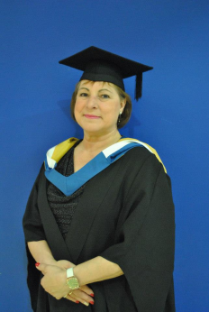
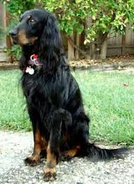
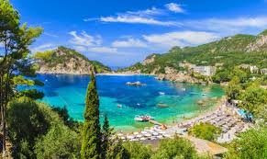
GETTING TO KNOW – Celia Canter
Celia & I met for coffee on a very warm and windy Wednesday at the Boat That Rocks
Do you have any pets or animals?
Not at the moment but I used to live on a farm and I bred golden retrievers. I lost my last one a few years ago. I had cats, chickens, ducks, all sorts. But my life is different now and we both like to travel so until we both retire it is on the cards to have a dog and Christian has in his back pocket an IOU to get a Gordon Setter at some point.
Where were you born and do you have any siblings?
Weymouth, I’ve lived here all my life except for a couple of years when I lived in Poole, that’s where my daughters were born. I have two sisters and I have thought about moving away loads of times to somewhere sunny and warm but life never turns out that way.
What about hobbies, what do you like to do?
I love gardening and I have an allotment at Wyke Horticultural Society. I’ve had it just under a year and I grow lots of different vegetables, it’s my relaxation. I like walking and anything creative. I like upholstery and I have done it in the past as a ‘work at home’ job when the children were small. I also enjoy cooking simple food that’s well presented. Christian and I have done lots of cookery courses and we both like to cook, especially with a nice glass of wine and gin. In my youth I used to work for a local Brewery in the office and the boss would buzz me through in the morning and say “Good morning Celia can you come in and bring a glass with you”, it was brilliant! We like making our own gin of various flavours.
What about reading?
I don’t do as much reading as I would like, I don’t have the time or I don’t make the time. I like doing crosswords.
TV programmes and movies?
We do go to movies but not very often and we don’t watch a great deal of TV. I do like the cookery shows such as The Bake Off also The Repair Shop and of course gardening programmes with Monty Don, things where I can get some new ideas.
Do you like travelling and where?
We have done a lot of cruises. One of my favourite destinations is Corfu. But recently we have been to Italy, Tuscany is beautiful and I would like to see a bit more.
I have still got my ‘bucket list’ holiday to do. I have always wanted to go on a safari but not doing the typical touristy thing. Anything to do with nature I would love. I love Scotland, and would like to explore Wales a bit more. Never been to Ireland but would like to.
Why Rotary, how did it all start?
Steve Cole what did it! Before Steve there was my boss Maggie,who was a member at Swanage and we got talking about Rotary and she told me all about the sort of things she was doing, travelling to India etc and I thought this was the sort of thing I’d like to do, travel abroad and do some good. She put me in touch with Steve and he asked me along to Portland Rotary. At the time I was a single girl and where can you go as a single woman and mix with like minded people and make a new circle of friends and have a bit of a social life - Rotary ticked all of those boxes. I’ve been to Nepal twice and made lots of new friends.

