Slide 1
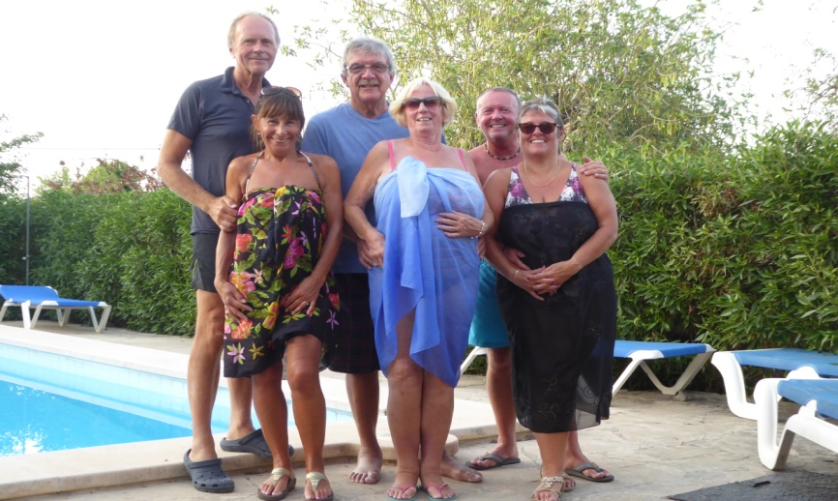
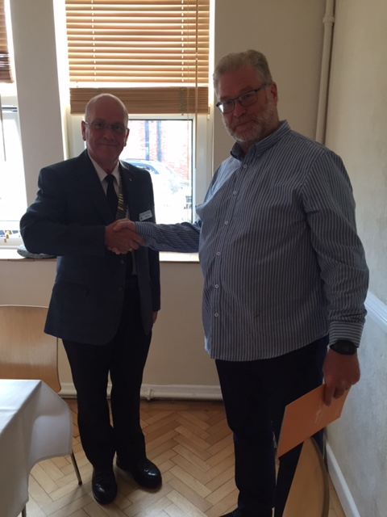
CLUB DIARY for AUGUST
PORTHOLE #494
JULY
2019
The Rotary Club of the Island and Royal Manor of Portland {Register Charity Number: 1032098}
President: Garry Urwin Vice Pres: Elizabeth Hardy Secretary: Peter Burrows
6th 6.30pm Aqua Hotel – COMMITTEES
Chicken Chow Mein with Noodles, Spring Rolls and Salad
Vegetable Chow Mein with Noodles, Spring Rolls and Salad
Whole Orange Cake and Cream/Fruit Salad
GRACE/GREETER – TREVOR PRIMETT
FINANCE – MARK TOWNSEND
13th 6.30pm Aqua Hotel - SPEAKER FOLLOWED BY COUNCIL
Speaker: Andy Price, Veterans Hub W&P
Braised Steak, Mashed Potatoes and Vegetables
Vegetarian Moussaka with Baked Potato and Vegetables
Apple Pie and Ice Cream/Fruit Salad
GRACE/GREETER – DAVE SHAW
FINANCE – ROBERT GRIGSBY
20th 6.30pm Aqua Hotel – BUSINESS MEETING
Speaker – Steve Rayner – The Solar System
Chicken Curry with Rice and Naan
Vegetarian Curry with Rice and Naan
Lemon Cheesecake/Fruit Salad
GRACE/GREETER – PAT SHEPHERD
FINANCE – ANDREW HARVEY
27th 6.30pm Aqua Hotel – GUEST EVENING
Speaker: Cath Brew
“Drawn to a Story: Learning to Live Elsewhere”
Spaghetti Bolognese with Salad and Garlic Bread
Vegetable Spaghetti with Salad and Garlic Bread
Treacle Tart and Cream/Fruit Salad
GRACE/GREETER – ANDREA SHEPHERD
FINANCE – CAROLYN HUMPHREYS
Meetings: Tuesdays 6:30pm, Including Guest Night, At the AQUA SPORT HOTEL
Contact Margaret Thomas to book your meal. Or, order from the bar at the Aqua as early as possible
President Gary welcomes our new member Robert Grigsby

Slide 2
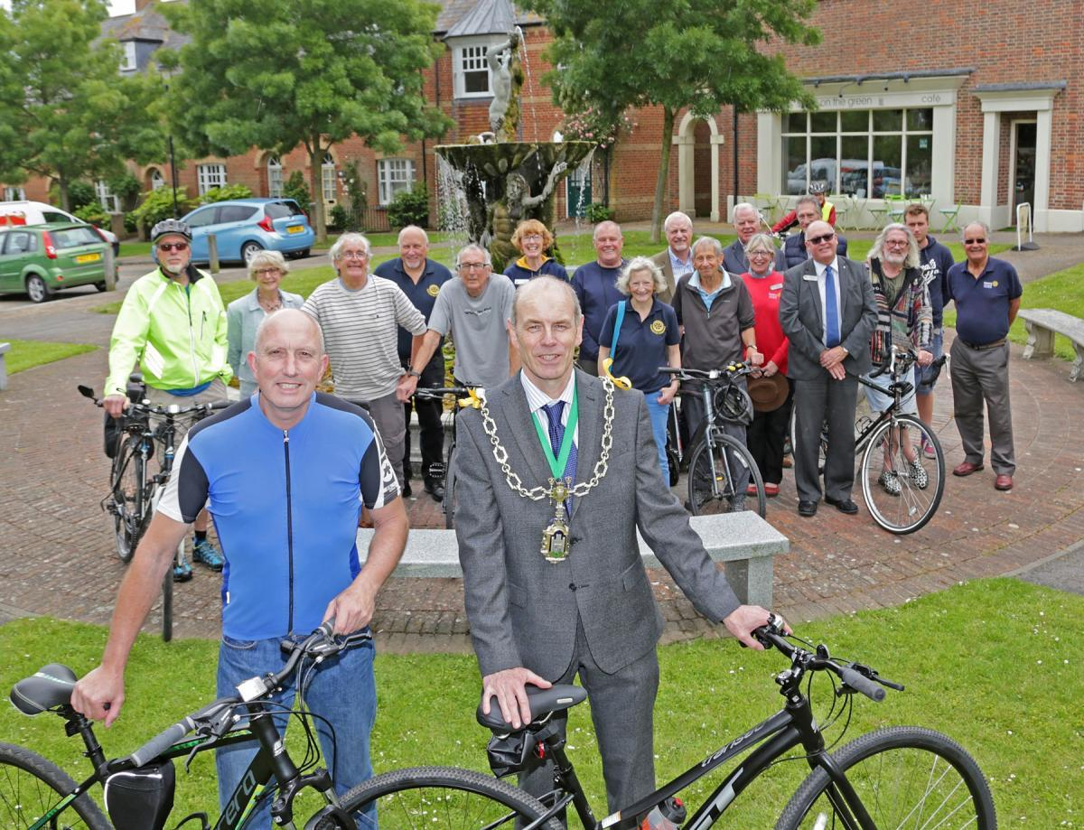
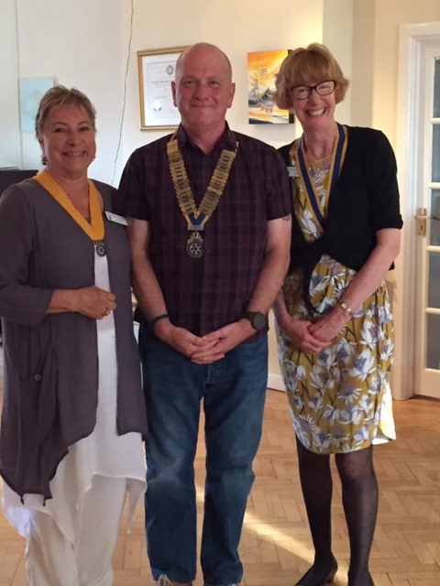
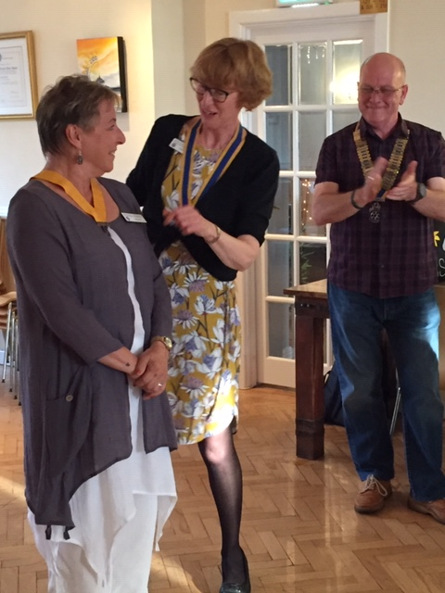
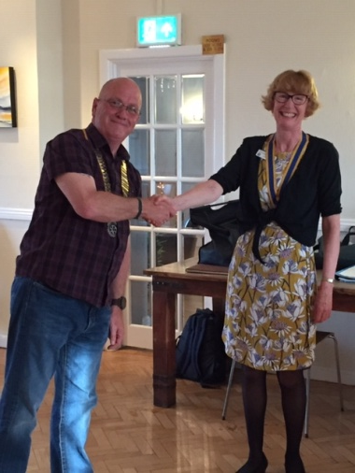
HANDOVER 2019/20
Our new team:
Gary, Elizabeth & Celia
Elizabeth giving the good news after the Treasure Hunt
ELIZABETH’S CYCLE RIDE WITH POUNDBURY ROTARIANS TO BAYEUX RAISES FUNDS FOR DORSET AND SOMERSET AIR AMBULANCE
The event began on Thursday, June 20, with a gathering of the participants at Café on the Green in Poundbury before an early ferry journey the next day. Cyclists were wished bon voyage and good luck by the Mayor of Dorchester Cllr Richard Biggs, and local adventurer Steven Howard who had just returned from running the Namib Desert. Boarding the Poole ferry next morning, we arrived in Cherbourg mid-afternoon to cycle to St Mere Eglise for the night. Unfortunately the van with the bikes had broken down at Bere Regis and had failed to catch the ferry! So we had a leisurely afternoon visiting one of the D-Day Museums, instead of cycling. Next day we started in earnest, the replacement van had travelled in overnight, so we were able to cycle the 40 miles to Bayeux; it was a beautiful scenic route through the Normandy countryside, arriving in time for a civic reception with the Mayor of Bayeux at the Town Hall. Afterwards we had a wonderful meal, with copious imbibing. The Poundbury Rotarians were great fun, it was a brilliant trip and one very pleasant surprise was that Richard Backwell joined us in the line-up. Richard is our Nepal trip guru, Peter Harris Fellow and last year named “God of the Mountain” by the Nepalese. Poundbury Rotarians tell me the cycling trip should raise more than £1,000, for the Dorset and Somerset Air Ambulance, but the total won’t be known until all donations have been totalled.
Reply Reply All Forward
EDITOR’S NOTE
macmolly10@gmail.com Pictures need to be in jpg format if possible.

Slide 3
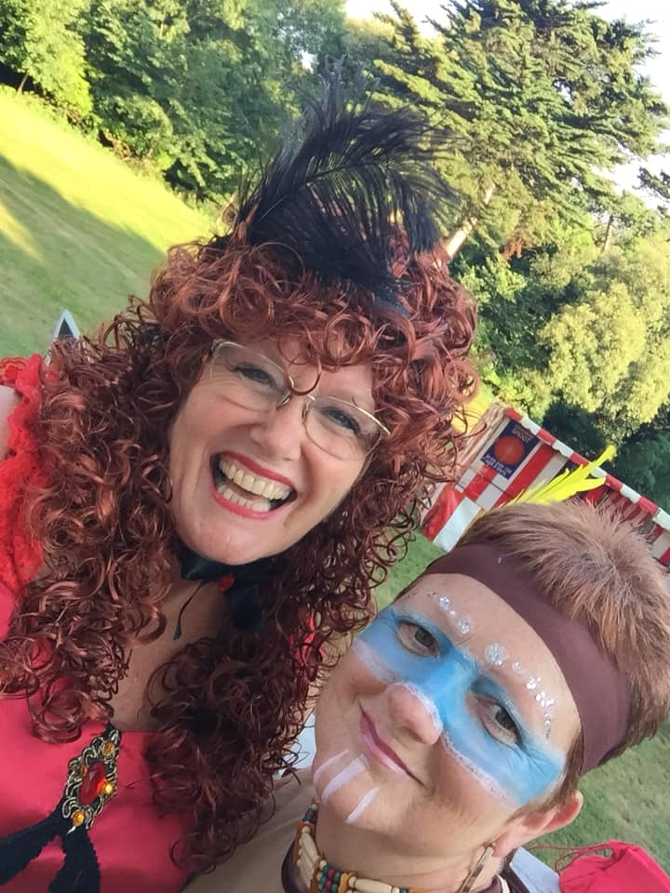
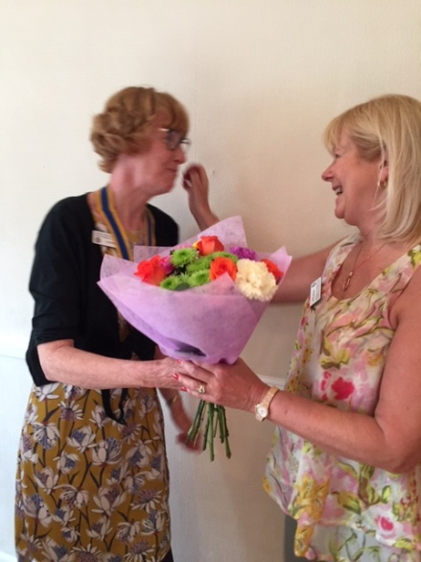
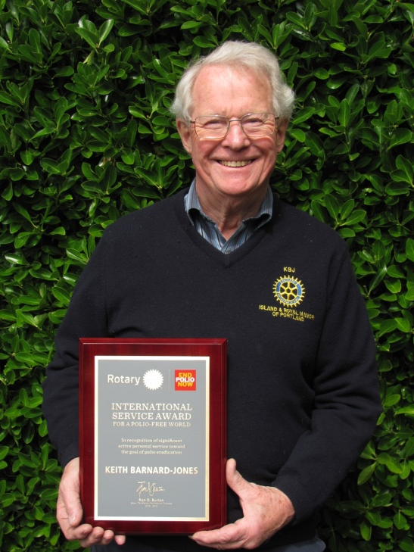
A big thank you from the Club to Margaret for organising a very successful Membership promotion evening.
Morris , an 82 year-old man, went to the doctor to get a physical. A few days later, the doctor saw Morris walking down the street with a gorgeous young woman on his arm. A couple of days later, the doctor spoke to Morris and said, 'You're really doing great, aren't you?' Morris replied, 'Just doing what you said, Doc: 'Get a hot mamma and be cheerful.'' The doctor said, 'I didn't say that..
I said, 'You've got a heart murmur;
be careful.'
The birthday girl with an Havasupai girl wearing beads

Slide 4
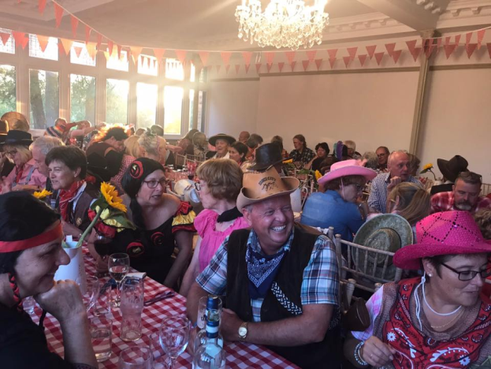
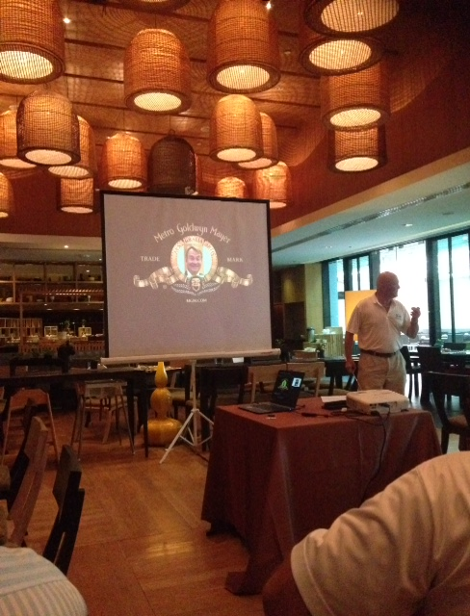
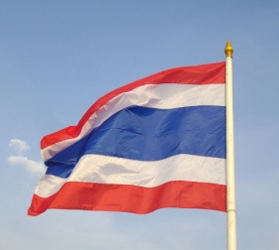
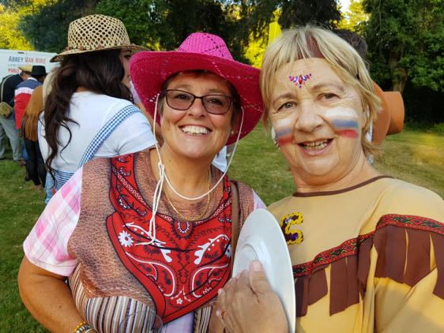
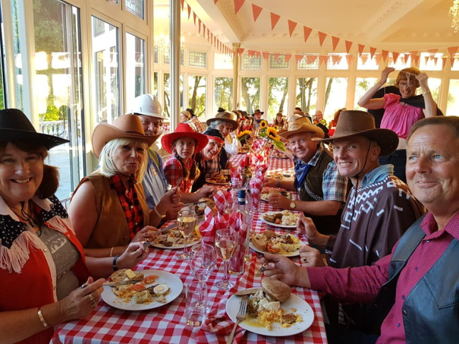
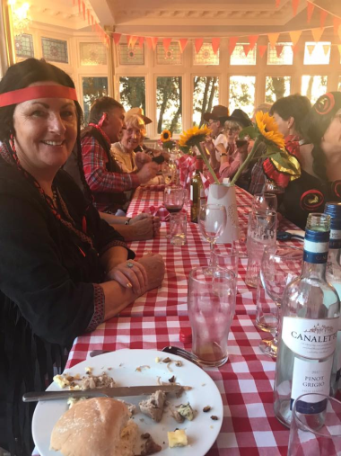
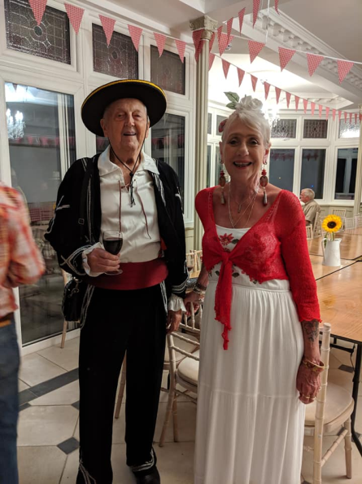
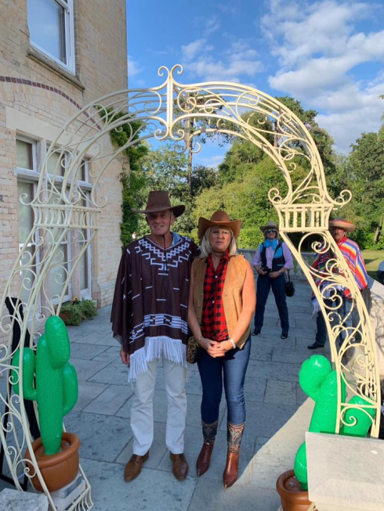
You may not know but Margaret and I were on holiday in Thailand and we went to a Rotary club meeting at one of the hotels we are staying in.
One of the club members is most likely going to visit our club in August, So I hope we have a banner available if he shows up.
A few thoughts from a recent 60 year old!!
C
E
L
E
BRA
T
I
ON
100 years ago everyone owned a horse and only the rich had cars. Today everyone has cars and only the rich own horses.
If you replace "W" with "T" in "What, Where and When", you get the answer to each of them.
In 2/2/22 falls on a Tuesday, we'll just call it "2's Day".

Slide 5
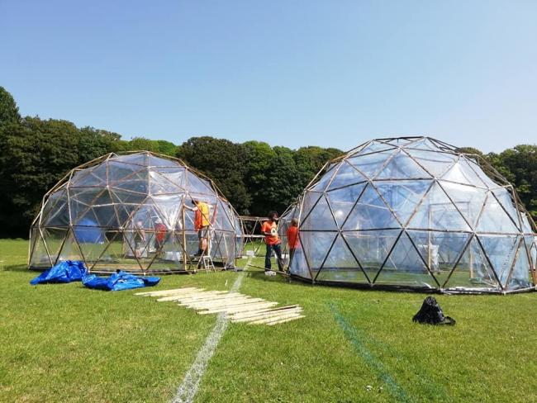
B-SIDE POLLUTION PODS AND EXTINCTION REBELLION
Since our Government and Portland Town Council declared a “climate emergency” the next step is deciding what further action is needed to limit carbon emissions, to reverse the effects of climate change. Some Portlanders, including Rotarians, joined several Portland Town Councillors at a first Portland Extinction Rebellion meeting, a call to action, held at the Community Hub, Fortuneswell. Supposedly non-political, Extinction Rebellion is a radical green movement, responsible for bringing much of London to a stand-still on April 30th. Extinction Rebellion uses non-violent resistance to protest against climate breakdown, biodiversity loss, and the risk of social and ecological collapse. We came away from the meeting thinking how surely being socially responsible, applying Rotarian principles is better than being socially disruptive, to make a point.
Meanwhile, b-side (with Rotarian help) set-up some striking mini-dome air pollution pods in the Grove Football Stadium at the end of June. This rather terrifying and striking art installation collaborated with climate science to enable visitors to walk inside pods and experience the smell, heat, and haze of four notoriously polluted cities: London, New Delhi, Beijing, and Sao Paulo. The exhibition has recently been on tour around Europe and is the brainchild of artist Michael Pinsky. We are so lucky to have fresh, clean air on Portland and it certainly highlighted the point: we need to be more aware of how and why we pollute our atmosphere and our planet, and we do need to consider how our actions contribute to climate change, and what we must do to limit our impact on the planet’s climate and biodiversity. Have you seen David Attenborough’s Climate Change: The Facts – it’s on iplayer?
HAS HE BEEN THERE?
If you speak to him and tell him about a club you have visited K B-J can usually retort “I’ve been there” and can then prove it by producing a Rotary Banner.
I am taking a guess however that the Rotary Club of Esperance WA (chartered in 1964?) and 7 hours drive from Perth, has not been graced by Keith’s presence well; I could not find any evidence he has visited it.
Although I did not go to a Rotary meeting I was impressed with the visual publicity that rotary has obtained in the town.
All visitors / tourists are likely to visit Dempster Head which is situated on one of the high points just above the town. Rotary in conjunction with others have constructed a viewing stage, similar to that at the end of Weymouth stone pier. There are stunning views from this viewing platform of outstanding beaches with pure white sand, turquoise sea and large waves gentling rolling in. There are also views of some of the 1500 islands just off the coast.
I had to smile as there is a wishing well at the site but, it has had to be modified to deter individuals who obviously felt that they could find the most appropriate use for any donations – Again it resembled the wishing well at Portland Bill in construction and other aspects. The rotary club has also devised 2 rotary walks of 20 and 30 minute durations from this viewing platform.
Why not we thought! We’ll do the 30 minute walk. Big mistake, as after going progressively down hill for over 10 minutes and with the temperature 21 degrees, the path slippery and the fact we had already walked up several hills we turned round and did not complete the walk. Wimps, I know.
All in all this viewing spot is in a super location which rotary has developed for the benefit and enjoyment, not only of visitors but locals as well. It is a real credit to the local club and rotary in general.
On wandering back to town, (population 12145), I noticed that rotary have also installed a beautiful sun dial on the promenade which is much more attractive than some of today’s modern statues that I see elsewhere.
If by some faintest chance K B-J has visited the RC of Esperance perhaps I could write about the rotary club in the Bay of Islands in New Zealand and table top days they hold, if he has not been there?.
Mike Duthoit
01.07.19

Slide 6
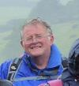
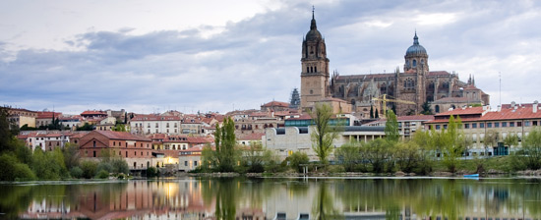
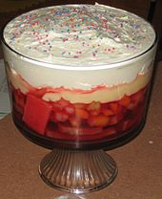
GETTING TO KNOW – Bruce Bonwell
Bruce and I met at my house on a beautiful Wednesday morning.
Do you like travelling and to where?
I don’t like sitting in the sun doing nothing. When Brenda and I were younger we used to go down to the beach and I’d dump her and go off and do things. I like travelling and visiting places. I like going abroad as well as travelling at home. We spent nearly a month travelling around France, Spain and Portugal which was very enjoyable and we came across some little gems on the way. Including Salamanca a 12th century university town, beautiful buildings, Roman bridge and a cathedral. I also love the Indian sub-continent. I worked in Pakistan for a month.
What is your earliest memory and do you have any siblings?
I was born in Harrogate, North Yorkshire. I was an only child and my earliest memory was with my granddad, he died when I was about 6. He was a lovely man, a retired railway signalman. He used to take me every day in my push chair to a meeting place with his old workmates on a bench overlooking the Stray a grassy area in Harrogate, watching the world going by and chatting. All of them used to give me sweets.
What are your spare time activities, what do you like to do?
I like to walk, not as often as I would like. I’ve never really had a hobby as such. The one thing I like to look out for is brewery jugs, I have about 7 or 8 now. Not really interested in antiques but I like the stories behind them. I also used to play golf and was a keen attendee at Southampton Football Club.
Favourite books?
I like British crime novels. Ian Rankin’s my favourite. Stuart MacBride is another, his books are based in Aberdeen and I like the humour in his books.
TV programmes and movies?
I try and avoid the soaps but it’s difficult!! One thing I’ve been watching recently is Summer of Rockets. This is the story of a family caught up in the tensions of the Cold War in the early 60’s
I don’t go to the cinema nowadays. Did go for a mad month in February just after I retired, but I’m not a great film-buff.
Why Rotary, how did it all start?
Sarah Curtis brought me into Rotary. We met when Brenda, Sarah and I were working together with Cancer Care Dorset, and it was from there that Sarah brought me along to a meeting. Rotary can be frustrating at times but when you see the amount of funds we raise for both home and overseas it makes it all worthwhile. It’s the doing bit of Rotary that I like much rather than the meetings.
.
Salamanca
What food do you like?
I like most foods. There’s not a lot I don’t eat. I suppose my two favourite things are apple pie and a really nice home-made trifle.
Editor Note:
For Bruce’s eyes only!!

