Slide 1
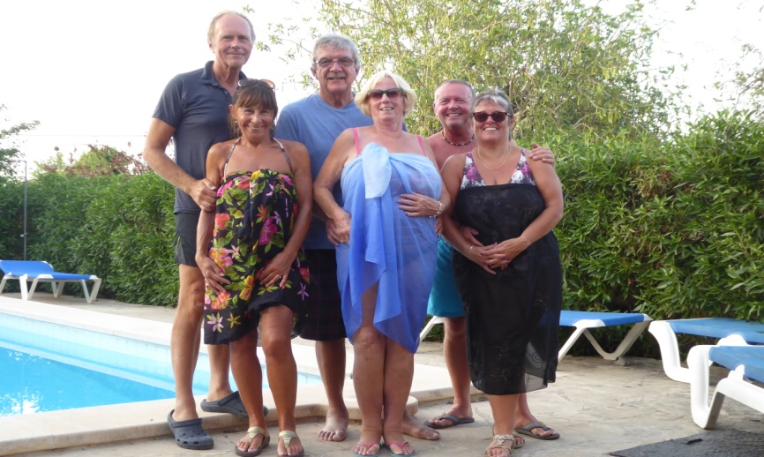
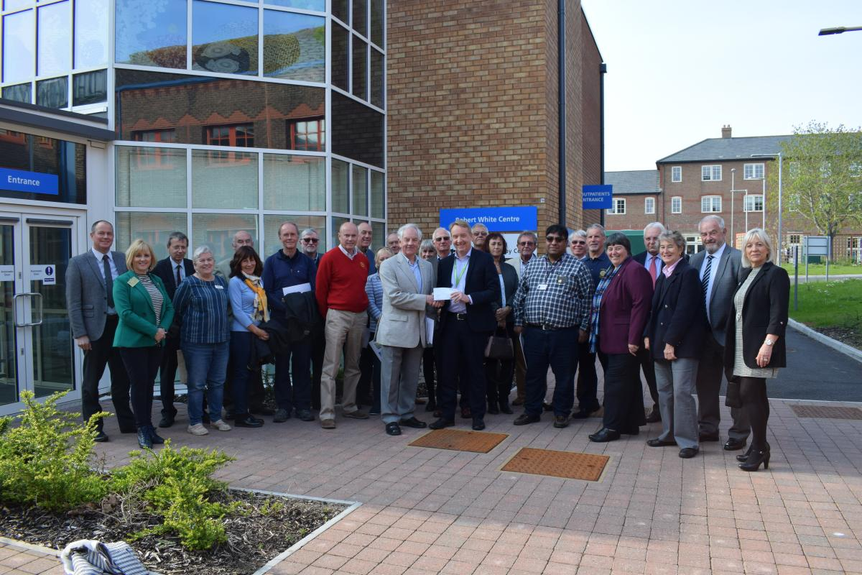
2nd 6.30pm Aqua Hotel – CLUB ASSEMBLY
Potato Topped Fish Pie & Vegetables
Potato Topped Vegetarian Pie & Vegetables
Apple Crumble & Custard or Fruit Salad
GRACE/GREETER – JILL LAMING
FINANCE – KEITH BARNARD-JONES
9th 6.30pm Aqua Hotel – QUIZ NIGHT Compiled by Quizzie Wilkinson
Lasagne with Garlic Bread and Salad
Vegetable Lasagne with Garlic Bread and Salad
Chocolate Mousse / Fruit Salad
GRACE/GREETER – SUE LEACH
FINANCE – MARK TOWNSEND
13th TABLE TOP SALE for Island Community Action
16th 6.30pm Aqua Hotel – COMMITTEES followed by COUNCIL
Pork in Pepper Sauce with Mashed Potatoes & Vegetables
Vegetable Gratin with Mashed Potatoes, Vegetables
Sticky Toffee Pudding / Fruit Salad
GRACE/GREETER –
FINANCE – PETER BURROWS
23th 6.30pm Aqua Hotel – BUSINESS MEETING
Quiche Lorraine with New Potatoes & Salad
Vegetable Quiche with New Potatoes & Salad
Jam Sponge with custard / fruit salad
GRACE/GREETER – ALAN NEWBERRY
FINANCE – CELIA CANTER
27th COACH TRIP TO LONDON
30th 6.30pm Aqua Hotel – GUEST EVENING
Speaker – Steve Rayner – The Solar System
Baked Gammon with Duchess Potatoes and Vegetables
Stuffed Mushrooms with Duchess Potatoes and Vegetables
Spotted Dick & Custard or Fruit Salad
GRACE/GREETER – DIANE PARRY
FINANCE – ELIZABETH CLARKE
PORTHOLE #493
JUNE
2019
CLUB DIARY for JULY
The Rotary Club of the Island and Royal Manor of Portland {Register Charity Number: 1032098}
President: Garry Urwin Vice Pres: Elizabeth Hardy Secretary: Peter Burrows
Meetings: Tuesdays 6:30pm, Including Guest Night, At the AQUA SPORT HOTEL
Members of Rotary throughout D1200 were able to visit the new Radiotherapy Centre at DCH. With the aid of a Global Grant Rotary was able to make a significant contribution to clinical equipment for the consulting rooms
Contact Margaret Thomas to book your meal. Or, order from the bar at the Aqua as early as possible

Slide 2
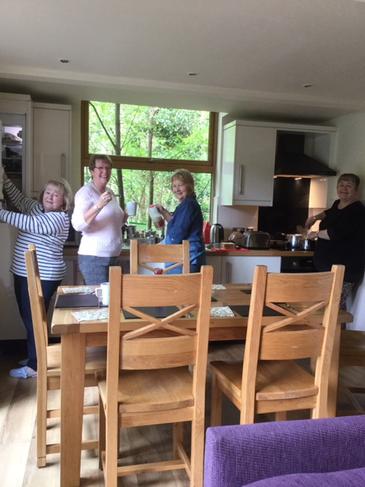
Portland Museum’s Monthly Article for June 19
Saturday May 11th saw the first of the museum's Island Heritage Days and the public viewing of the commemorative Reeve Staff presented to Queen Victoria by the Court Leet. It was a tremendously successful day with a great number of visitors. We were lucky enough to have Philip George from the Court Leet available to answer questions about the Reeve Staff, and boy, was he busy! Arriving at just after 11:00 am to view the staff and perhaps take some photos, I had to join a queue of people just to talk to Philip who was fielding enquiries on a whole host of subjects relating to the history and company of the Court Leet.
The Reeve Staff itself looked exquisite and our photos probably don't do it justice (all the more reason to come in for a viewing when it's next on display on Saturday June 8th). Again, we will have a member of the Court Leet available to answer questions about the staff and the role of the court on the island. We hope that the combined team of museum volunteers, trustees and the Court Leet make a welcome contribution to placing Portland Museum where it aspires to be: embedded in the heart of the community.
Another successful evening took place at The Girt Hall earlier in the month where local railway enthusiast and historian Brian Jackson presented his talk, ‘The Weymouth and Portland Railway 1865 to 1965 - A Reappraisal’. Once more, the hall was packed to the rafters as Brian educated and entertained the audience with his knowledge of a subject that never fails to stir memories and capture the imaginations of people on the island.
For those of you interested in Portland Museum's founder Dr Marie Stopes, it's worth pointing out that we are exhibiting a new display featuring artefacts not, perhaps surprisingly, related to Stopes' better known (and enduringly controversial) role as birth control pioneer, but that of her lesser known role of palaeobotanist. Stopes' interest and study of palaeobotany was behind her original move to Portland and the new display highlights some fascinating pieces from her original collection as well as showing an excellent timeline of her life and achievements. The display was brought about by a collaborative project between Portland Museum Trust and AsOne Theatre Company to research and present a new play and bring a living legacy of Marie Stopes to a wider audience.
Girlie trip to the forest in Cornwall
Elizabeth giving the good news after the Treasure Hunt
EDITOR’S NOTE
ianmcpheat@aol.com. Pictures need to be in jpg format if possible.

Slide 3
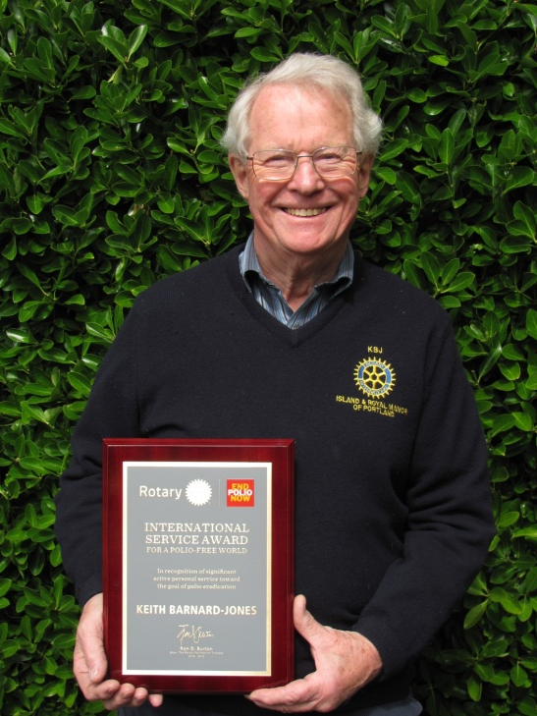
Life on the Cresta Run
As you all know we have now acquired a down-sized Scottie.
As you also know we have now acquired some wild goats on Old Hill to keep down the undergrowth - all safely tucked up behind a fence where they can chew away to their hearts’ content every day.
That is until a down-sized Scottie decides that she can get under the gate to play with the goats.
This morning she went under the gate and down the slope like a toboggan down the Cresta Run – as did the goats in front of her. And disappeared. No amount of calling had any effect.
Half an hour passed with nothing happening so home I went and changed into old clothes somehow managed to clamber over the gate and headed down the slippery slope calling for the dog. Oh yes, I forgot to say that it was raining as well which added to the danger of the ice fall as well as to my general discomfort.
Some of the goats eventually came back, quite contentedly and were chewing the leaves and saying hello to me. Having got to the bottom of the slope by hanging on like grim death to the wire netting, the dog then appeared, playing happily with the other goats and looking very pleased with herself. Eventually, after much slipping and sliding I got hold of her. But trying to drag something like four and a half stones of super-charged hound up the Cresta Run when all she wanted to do was to go down to the bottom again was a nightmare.
It was at this stage that I heard the police sirens and feared the worst – I had been reported to the police. So I put my pacemaker into overdrive and plugged on up the muddy path. The dog wanted to play with her new-found friends and was having none of it. I pulled so hard that her collar shot off and so there I was, flat on my back in the mud, with the dog loose again, police sirens going and a useless lead and collar in my hand. It was at this stage that one of the goats decided to head-butt me – not once, but many times. It is difficult to attach a collar and lead to a recalcitrant pooch when a hircine maniac is determined to push me back down the path.
Eventually, after almost an hour, I managed to climb Everest, with said canine juvenile delinquent in tow and managed to push her under the gate onto the path, much, I think, to the disappointment of dog and goats one, of which helped me up and over with another jab from the horns. Luckily the sirens had stopped, there were no police around. I had got away with it!
We are now looking for a cat to do a part-exchange with. Any offers?
Keith
Polio Eradication
I have been asked about the award that was presented to me at the district Assembly.
Each year the International Polio Plus Committee, as part of the GPEI – Global Polio Eradication Initiative – presents a number of international awards to people who, in their opinion, have done something to help fight polio.
I actually sat on the Awards Committee when I was a member of the IPPC for six years. I have since moved on to another Committee designed to oversee the final phases of the fight to eradicate polio.
I don’t normally like showing off awards, but I was asked about this one and we do need to keep putting over the twin messages of Polio still exists and Polio is only a plane-fire away.
It only needs one child incubating the disease to travel to a country or community where the immunisation levels are low (and there are lots of them) and, bingo, a polio epidemic exists.
Happy viewing. Keith

Slide 4
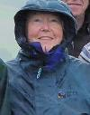
GETTING TO KNOW – Liz Clarke
Down at the Museum:
Sponsored by Portland Rotary Club
July and August are going to be lively months here at the museum with a great variety of events planned for everyone. Once again, our annual Dino Day is coming up on the 7th August. There will be a fantastic array of dinosaur themed crafts for children to get involved in and for those of you who remember how busy we were last year (and those of you who don’t) we are asking everyone to give us a call just to let us know how many of you are coming. The prices will be the same - £4.00 per child, adults free, and the day will run from 10:30 am – 4:00 pm.
The museum is excited to announce a unique project from Tuesday 9th July: Heart of Stone: A Writing Residency at Portland Museum. The museum is working with poet, writer and creative facilitator, Sarah Acton, to bring to life the heritage of Portland’s stone quarries, including real and imagined lives shaped by Portland Stone past, present and future, through creative writing, poetry and performance.
The project, in partnership with Jurassic Coast Trust Volunteer Network, takes inspiration from Portland’s local poet and stone mason, Cecil ‘Skylark’ Durston and his observational poems about working the stone, and life on the Island before mechanisation of the quarries. The first discussion will be Tuesday 9th July, 11:00 am – 12:00 pm and the first poetry garden Friday 19th July 2:00 pm – 4:00 pm. For further details of all the dates when Sarah is in residence, please give us a call or check our website and/or social media for regular updates.
Early in June, we learned, with sadness, that Mary Stopes-Roe had passed away. Mary had the distinction of being connected to two icons of the 20th century – Barnes Wallis and Marie Stopes. Barnes Wallis was Mary’s father. He invented the bouncing bomb, destroying the Mohne Dam during the Dambusters raid. Mary’s other famous connection was with Marie Stopes, the founder of Portland Museum. Mary married Marie Stopes’ only child, Harry Stopes-Roe, a union that was disowned by Marie Stopes, who disapproved of Mary because she was myopic and wore glasses! Marie’s son, Harry, was written out of her will.
On Friday 5th July, Friends of Portland Museum invite you to another event at the museum: An Illustrated Talk on the Nothe Fort by Ian Brooke. Doors open at 6:30 pm for a 7:00 pm start. Tickets are available on the door only and are £3.00 for FoPM members and £4.00 for non-members (this includes light refreshments). If you enjoy military history then please come along and enjoy this wonderful presentation.
For further information on all these events and other posts relating to local history, please check our website: portlandmuseum.co.uk; our facebook page: facebook.com/PortlandMuseum and our Twitter site: @PortlandMuseum1
Lucy Watson – Museum Manager
Liz and I met at my house after she had finished her morning shift at the Health Centre. Her first words to me were “this won’t take long, I’m so boring”. As it turned out she was anything but:
What is your earliest memory and do you have any siblings?
I can remember sat in my pram in a hop field in Hereford and it was in the Hospital in Hereford I did my nursing training and later my midwifery training in Worcester. I have an older brother and a younger brother with me in the middle. I still keep in touch with them, my older brother is in Devon, he’s ex-navy, and my younger brother is still in Hereford. We all get on well, sad when families don’t get on well isn’t it?
What are your hobbies and what do you like to do?
I love going to the theatre. I’m a keen walker. I read and like eating out at my favourite places L&Os and the Crab House. Very fond of fish especially lobster thermadour ooo love it! And a crab sandwich.
Favourite book/magazines?
I read trashy stuff, not Mills & Booth, not that Trashy. My favourite author is Jody Picoult.
(Editor’s Note
Jodi Lynn Picoult is an American writer. She was awarded the New England Bookseller Award for fiction in 2003. Currently approximately 14 million copies of her books are in print worldwide, translated into 34 languages. She writes about family, relationships, love & more)
Magazines?
Don’t like the trashy ones. I like to glossy ones which we have in the Doctor’s Surgery
Favourite movie/TV?
The Sound of Music, went to the singalong at the Royal Manor Theatre. Went with Steve and found out that he had never seen it, can you believe that? Sitting next to me was maybe not a good idea as I love singing but I can’t sing a note.
For TV I like watching interesting documentaries as you can always learn something. I like Coronation Street and Real Housewives with anyone you like! I like The Chase, I sometimes get it right but not often.

Slide 5
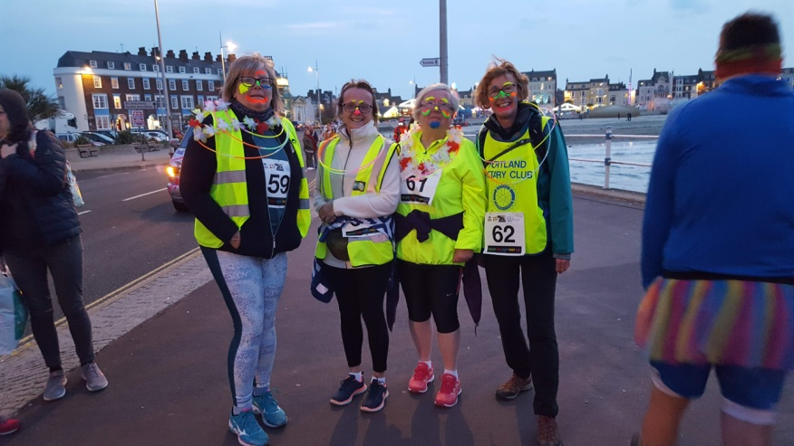
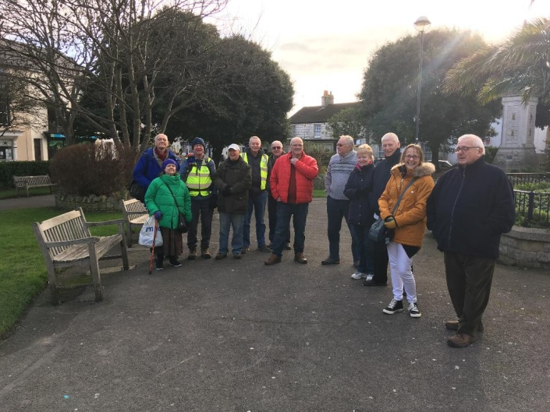
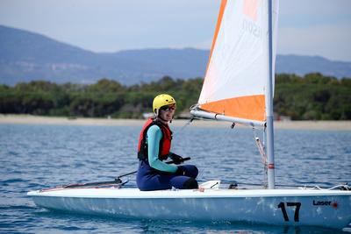
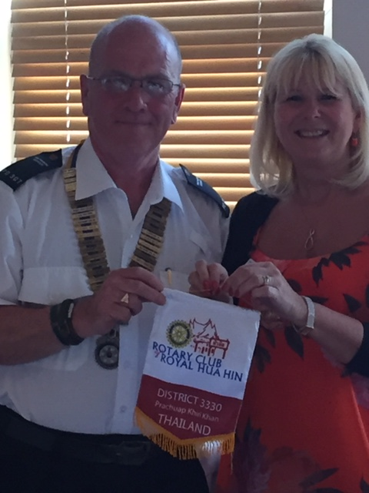
Favourite music and musicals?
Les Miserables. I’ve seen it half a dozen times in the theatre but would suggest seeing the film first as I understood the musical more having watched it.
What sports do you enjoy?
At school I quite liked rounders and net ball although I wasn’t very good. I like running. I can do 5K but you could probably walk faster than I can run. I try to run most weeks and I have done the Park Run in Weymouth.
Why Rotary?
We moved in next door to Chrissie Wilkinson and she made every difference to how we settled in here and she invited us to a couple of Rotary things. Steve became a member for a little while but it wasn’t for him but I didn’t want to lose being part of the community. I like to help with anything but I can’t take charge of anything. I have been to Nepal twice and will be going again. Was an experience to see other people, how the live etc. The countryside is beautiful and the group we were with were friendly and nice.
Elizabeth, Liz and I ran 5K along the Esplanade in aid of Bright for Sight. It was a very cold and dingy evening, but we brightened the place up with our smiles and face paints and we were soon warm.
Medals were well deserved by all.
Margaret handing over a banner from her holiday trip to Thailand.
Can anyone guess who is in the holiday snap above?
Liz helps to lead a WALKING FOR HEALTH group on Portland (attended by some Rotary Members).
They meet in Easton Gardens every Monday. It is to encourage people to be active in a safe environment, and to enjoy a social coffee and chat afterwards.
Anyone interested or want more details please have a chat with Liz.

Slide 6
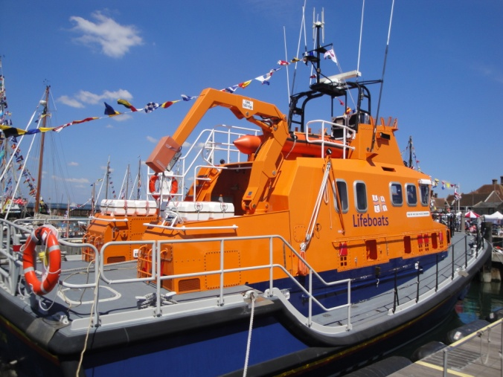
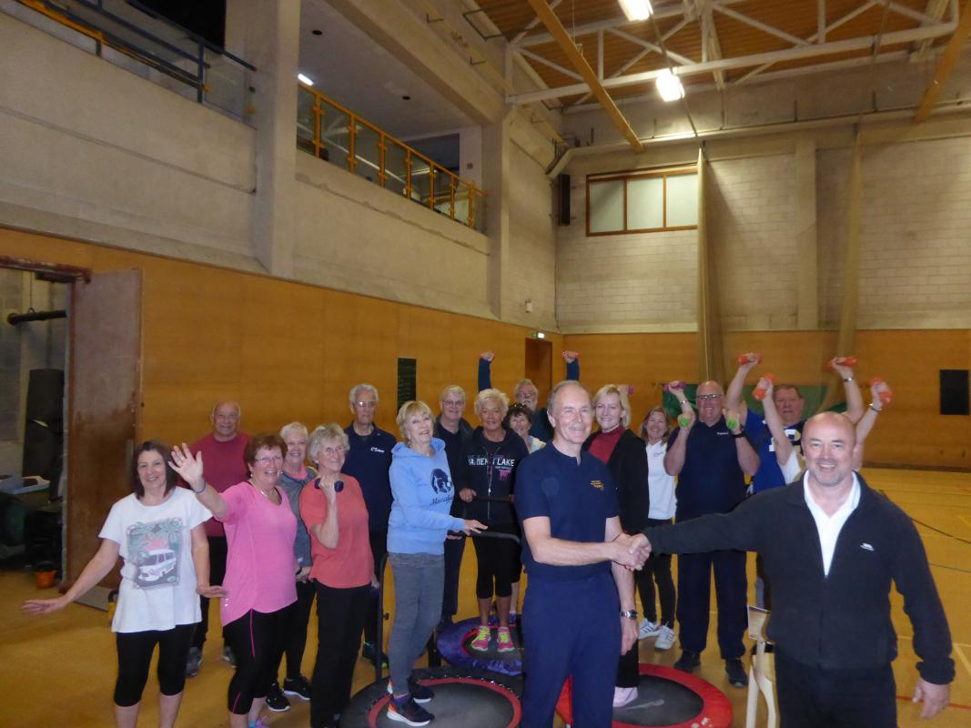
Dr Paul Mason gave an excellent talk on his charity bike ride form Gibraltar to Portland to support Osprey. Rotary gave a donation to buy equipment for the Osprey Leisure Centre. Presented to John, the manager
R.N.L.I.
I had planned on writing something about Kids Out but I got waylaid.
The Casterbridge Club had a trip planned to the R.N.L.I. HQ at Poole Quay and, as their numbers were down and they had committed to a minimum number, I was volunteered to attend
If you have not been there, it is well worth a trip and the Club might like to consider making this an official visit.
ALL the new lifeboats are now built in-house – for all the R.N.L.I. stations around the UK.
Moreover all the major repairs and up-gradings of existing vessels now take place at Poole so there are masses of lifeboats of all shapes and sizes to be seen in various stages of building and repair.
I last went there a few years ago but now the set-up is massive covering many acres.
From memory we took an hour and a half to wander round it with the expert attention of a volunteer guide who was able to answer al our many questions.
I thought, in my usual naive way, that the ladies might not have been as interested as the men would. How wrong I was! The questions and comments kept coming.
I am sure that those of you who have been there recentlywill agree wit my comments and my enthusiasm.
If you haven’t, and want to go, I am sure something could be arranged
Keith
Attending a wedding for the first time, a little girl whispered to her mother,
'Why is the bride dressed in white?'‘
The mother replied, 'Because white is the colour of happiness, and today is the happiest day of her life.‘
The child thought about this for a moment then said,
'So why is the groom wearing black?'

