Slide 1
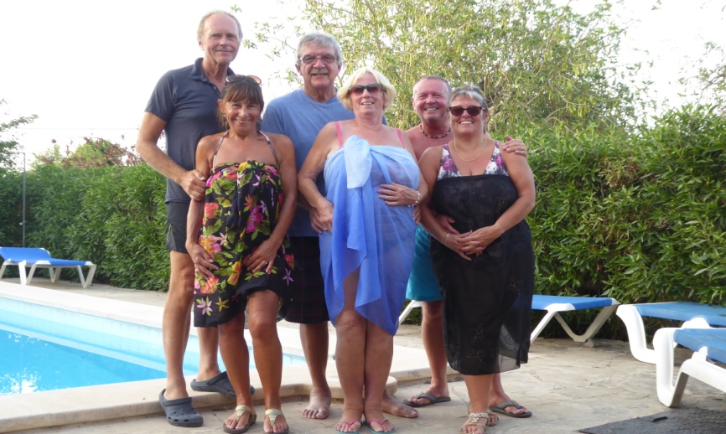
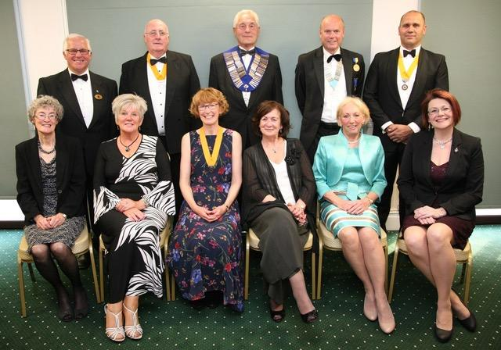
CLUB DIARY for JUNE
PORTHOLE #492
MAY
2019
The Rotary Club of the Island and Royal Manor of Portland {Register Charity Number: 1032098}
4th 6.30pm Aqua Hotel – COMMITTEES & COUNCIL
Pork Stroganoff, Rice & Stir Fry Vegetables
Mushroom Stroganoff, Rice & Stir Fry Vegetables
Cherry & Vanilla Clafoutis or Fruit Salad
GRACE/GREETER – MARGARET THOMAS
FINANCE – ANDREW HARVEY
11th 6.30pm Aqua Hotel – BUSINESS MEETING
Beef, Mushroom & Cumin Pie, Pomme Anna Potatoes & Vegetables
Vegetables & Cumin Pie, Pomme Anna Potatoes & Vegetables
Salted Caramel & Chocolate Pots or Fruit Salad
GRACE/GREETER – MARK TOWNSEND
FINANCE – CAROLYN HUPHREYS
12th KID’S OUT at Crealy Park
15th TABLE TOP SALE for Portland St John Badger Unit
18th NO MEETING
20th EVENING GARDEN PARTY at Queen Anne House
25th 6.30pm Aqua Hotel – GUEST EVENIING
SPEAKER - JOHN TWEED, Chesil Sailing Trust
Roast Pork/Beef with Roast Potatoes & Vegetables
Nut Roast with Roast Potatoes & Vegetables
Trifle or Fruit Salad
GRACE/GREETER – JO WAY
FINANCE – STANLEY KNIGHT
President: Garry Urwin Vice Pres: Elizabeth Hardy Secretary: Peter Burrows
Meetings: Tuesdays 6:30pm, Including Guest Night, At the AQUA SPORT HOTEL
Well I survived Ladies Night - it turned out to be President’s Night in reality although they seem to be very old fashioned having allowed women in only 3 years ago with Rose Bruce - who sends her very best wishes. There were a few Portlanders there too thankfully: Sarah and Brian, Jo Way and Carolyn. So best wishes from President Roger Fry and the Weymouth Club. They gave me a bunch of flowers at the end!
Table Table from back left: Kevin Brookes Vive President Weymouth and Portland Lions, Graham Morrison Vice President Melcombe Regis Rotary Club, President Roger Fry Weymouth, Stewart Cursley District Governor, Joe Swindell President Elect Weymouth
Seated: Anne Brookes, Carol Morrison, EH, Maureen Fry, June Cursley and Jane Bincombe, Weymouth Town Council Town Clerk ( as the Mayor has not yet been appointed).
ELIZABETH
Contact Margaret Thomas to book your meal. Or, order from the bar at the Aqua as early as possible

Slide 2
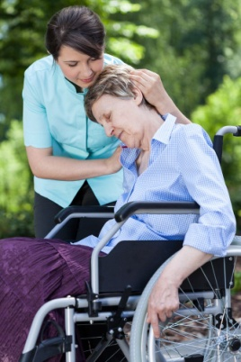
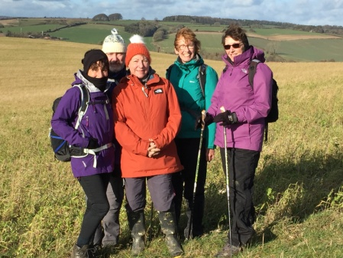
25 YEARS OF HOSPICECARE FOR DORSET
Weldmar Hospicecare is the largest independent charity i
n Dorset, and we are all familiar with their work that
provides end of life care for people living in our county
who need specialist support. Their compassionate
approach supports patients and their families, medically
and in other ways, in the community, at Trimar Hospice,
or and at home. On Saturday 26th January a thanksgiving
service at Milton Abbey church marked the Silver
Anniversary of Weldmar Hospicecare, so I went along
representing Portland Rotary Club. The Abbey church was packed out with service organisations and benefactors.
The Weldmar Community Choir sang “You Raise me up” and during the service 25 candles were lighted in commemoration. The Bishop of Sherborne, The Right Reverend Karen Gorham reflected on the founder of the modern hospice movement, Dame Cisely Saunders and what makes a good death. Dame Cisely was born in 1918, trained as a nurse, a medical social worker and finally as a physician, she pioneered palliative care through her research of pain killers. Originally the three charities, CancerCare Dorset (formerly West Dorset Macmillan Service), Joseph Weld Hospice and Trimar Hospice merged between 2003-2004 to form Weldmar Hospicecare Trust. The NHS contributes 25% towards the costs of running Weldmar Hospicecare, leaving Weldmar to fund the rest to provide their free of charge services for the people of Dorset. Most conspicuously fundraising is through the chain of twenty-six charity shops, but funds also come from legacies and local fundraising activities with the Friends of Weldmar Hospicecare. In the future Weldmar aims to provide more home visiting community nurses and extend day services at their centres.
Elizabeth
Rotarian Andrew keeps Queen Elizabeth’s Keys safe
If there were a set of keys that could open every door in Portland, what a formidable responsibility that would be! This idea is essentially what the “Ceremony of the Keys” is about, a symbolic annual event where the Mayor of Portland, for the Town Council hands over the Island’s keys to the Court Leet, as they have guarded the rights and privileges of the Island and Royal Manor since “time out of mind”.
Portland Rotary Club is invited to this annual event, and this year Charlie Flack, Mayor of Portland (recently “freed”, as it was pointed out, from mainland ties) handed over the keys to Rotarian Andrew, Foreman of the Court Leet. The ceremony, held at Easton Methodist Church was heralded by the Town Cryer and a bugle solo. A messenger bringing the keys approaches the doors, the entrance is immediately slammed shut by the Guard at Arms, but once it is established the keys are “Queen Elizabeth’s Key’s”, the Guard at Arms escorts the Messenger to the Town Mayor, who accepts them and then hands them to the Foreman of the Court Leet; Andrew had four large keys presented to him on a beautifully embroidered cushion, flagged by the staff holding Court Leet Chief Constable.
Chatting to members of the Court Leet afterwards, I discovered the ceremony was previously held at Portland Castle when the Navy were on the Island. The Court Leet and Portland Museum are looking forward to the four Portland Heritage Days, when the unique Queen Victoria’s Reeve Staff will be on display in the Museum, on a special loan from the Court Leet. Members of the Court Leet will be at the Museum with the Reeve display.
2019 Portland Heritage Days at Portland Museum – Free Museum Entry days!
11th May, 8th June, 6th July and 10th August 2019 between 10.30 am and 4.00 pm
Elizabeth giving the good news after the Treasure Hunt
Here is photo of Elizabeth Jo Celia Ruth Chris.
Jane from Poundbury Rotary joined us for
the first half of the walk but had to return home
after lunch. We walked from Winterbourne
Abbas cross country to Frampton seeing many
snowdrops, and several deer. The weather
prediction was to be gale force winds and rain
but clearing by ten. And it did! Sunny cloudy for
the rest of the day. After a pleasant lunch at the
Saxon Arms it was a short return to the cars,
clocking up nearly 10 miles. Mark

Slide 3
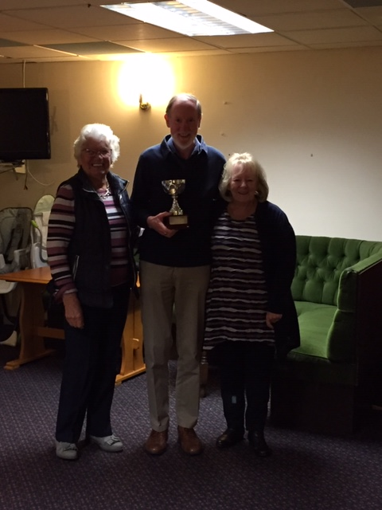
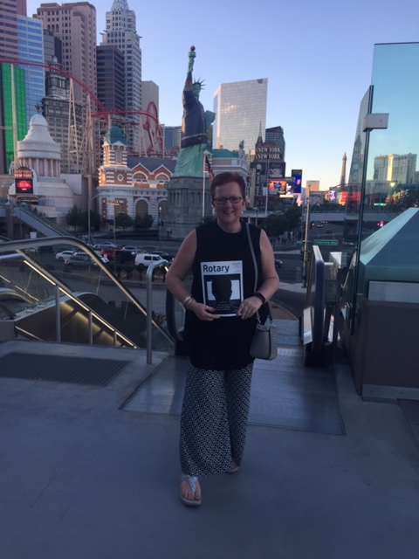
1. My first job was working in an Orange Juice factory, but I got canned . Couldn't concentrate . 2. Then I worked in the woods as a Lumberjack, but just couldn't hack it, so they gave me the axe . 3. After that, I tried being a Tailor, but wasn't suited for it, mainly because it was a sew-sew job. 4. Next, I tried working in a Muffler Factory, but that was too exhausting. 5. Then, tried being a Chef - figured it would add a little spice to my life, but just didn't have the thyme. 6. Next, I attempted being a Deli Worker, but any way I sliced it.... I couldn't cut the mustard. 7. My best job was a Musician, but eventually found I wasn't noteworthy. 8. I studied a long time to become a Doctor, but didn't have any patience. 9. Next, was a job in a Shoe Factory. Tried hard but just didn't fit In. 10. I became a Professional Fisherman, but discovered I couldn't live on my net income. 11. Managed to get a good job working for a Pool Maintenance Company, but the work was just too draining. 12. So then I got a job in a Workout Centre, but they said I wasn't fit for the job. 13. After many years of trying to find steady work , I finally got a job as a Historian - until I realized there was no future in it. 14 My last job was working in Starbucks, but had to quit because it was the same old grind. 15 . SO, I TRIED RETIREMENT AND I FOUND I'M PERFECT FOR THE JOB!
MY JOB SEARCH
Guess who won the friendship cup?
Look what Janet found!!
History of the Rotary Bell: 🔔
In 1922, U.S. Rotarians organised an attendance contest; the challenge was that the losing clubs would join in giving the winning club a prize.
The Rotary Club of New York City was declared the winner and to them was awarded as a prize a bell from a popular patrol boat, which was placed on wood that came from HMS "Victory", Admiral Nelson's vessel at the battle of Trafalgar.
Since then, the bell used in Rotary meetings started to represent, as on the ships, order, discipline and the time to guide us through the weekly hour and a half meetings. The bell informs us with its sound the beginning of the Rotary meeting, other club rituals and of course the closure of the regular club meeting.
Janet Kench
EDITOR’S NOTE
ianmcpheat@aol.com. Pictures need to be in jpg format if possible.

Slide 4
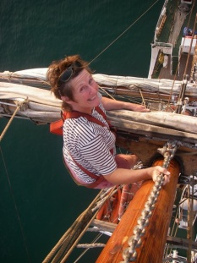
GETTING TO KNOW – Jo Way
Jo and I met for a very pleasant cuppa at Vintage 7 cafe.
After much messing about getting the dictation machine
to work I asked her a series of questions, here are her replies:
Where were you born, have you any siblings, and what is
your earliest memory?
I was born on Portland and I have one sister, Pauline. My earliest memory is driving a little car through the pub where we lived. The pub was called “The Crown Inn” at the bottom of High Street, which was pulled down to alter the road as it was a dangerous bend.
What are your hobbies and what do you like to do?
I like talking, keeping fit & healthy, badminton, sailing (I have a sailing boat “Owaissa” moored in Weymouth Marina. I also like Nordic Walking, great for the upper arms and body.
Favourite book?
I like a good novel that’s easy. Lynda Le Plante I like. I like a simple plot not too complicated. Also Jodi Picoult is a good novelist on awkward topics that need to be addressed, such as ADHT, racism etc.
Favourite movie?
I don’t go very often to the cinema as I don’t like to go on my own. I like ‘get your own back’ movies like “Man on Fire” and “Taken”. I definitely don’t like unnecessary violence. On TV I like “Shetland” and “Baptiste”.
Favourite music and musicals?
I like soul, blues, rock & roll, 60’s and Queen. At Christmas our family liked “Chitty Chitty Bang Bang” I also belong to a group who go to watch a musical in Southampton. I recently saw “Miss Saigon”. I like anything really just nice to be involved.
What sports do you enjoy?
Talking, a lot!! I used to play hockey for Weymouth. Of course badminton, keep fit and sailing.
Why Rotary?
Many years ago I was employed by Rotarian Vic Wells to help in his garage and after many years he asked me if I would like to join Rotary. At that time I was busy doing other things. Years later my son got through to RYLA and I was very impressed with that. I have always had an interest and now that I am own my own I decided the time had come to join.
WHITE STONE’S CAFÉ: OPENING NEW STUDIO AND ECO- ACCOMMODATION
President Garry was invited to the official opening of the new buildings at the back of White Stones Café – but it was all happening on Portland that morning: Garry had to attend the opening of the Jail House Café, so I was lucky enough to go instead and shared in the breakfast pastries and Buck’s Fizz. The Portland Mayor Charlie Flack opened the studio and made a short speech about the new facilities built by David Nicholls, the owner and artist funded by a Dorset Council Leader Grant.
The Studio has been designed to offer a light and airy space – it is a highly sustainable eco building, for artists and tutors to work in. They are offering workshops in mosaics, stone carving, wax painting, painting, meditative therapies and silver jewellery.
The three eco-accommodation hubs built along-side the studio nestle together in a peaceful and secluded area at the back of the White Stone’s Café; each unit is finished to a very high standard as a retreat, living space for visiting artists or as holiday accommodation.
I recommend you all visit and explore the new buildings and the opportunities they offer. Elizabeth
Attending a wedding for the first time, a little girl
whispered to her mother, 'Why is the bride dressed in white?''
The mother replied, 'Because white is the color
of happiness, and today is the happiest day of her life.'
The child thought about this for a moment then said,
'So why is the groom wearing black?'

Slide 5
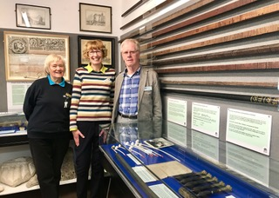
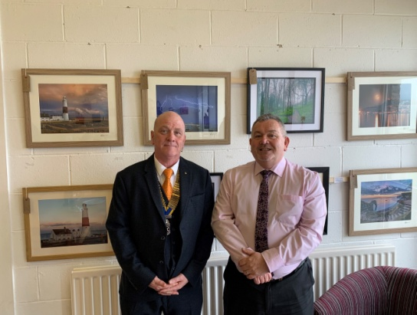
JAILHOUSE CAFE HMP THE VERNE RE-OPENING.
I have today 4th March 2019, been invited to represent The Rotary Club of the Island and Royal Manor of Portland, to the Grand Re-opening of the Jailhouse Cafe at HMP The Verne.
Expia the charity group that runs the Jailhouse Cafe at HMP Guys Marsh and now Portland has taken the opportunity to re-open.
The Jailhouse Cafe employs prisoners, who have been cleared and are safe to be released on temporary licence (ROTL) to work in the community, and serve in the cafe.
The Governor of the HMPYOI PORTLAND Steve Hodgson, praised the work of Expia and the staff of the Jailhouse and more importantly the ROTL,s that will be working there.
Martyn Underhill the Dorset Police Crime Commissioner, a fellow Rotarian pictured below who has provided the project with various grants to support this worthwhile project, and was keen to point out that this is the kind of thing Rotary is good at as well, and has even offered a talk at our club.
One of the Jailhouse cafe success story is Darren. Darren helped out as a ROTL the last time the jailhouse was open and gained various catering qualifications, then upon his release settled locally, heard the Jailhouse was re-opening applied for a job and has been successful in gaining full time employment with the project.
Once up and running the Jailhouse is hoping to sell Birdboxes, Bug Hotels and other garden ornaments all locally produced at HMPYOI Portland.
The jailhouse also sells photographs and prints from local Photographers as well as the popular Mugs, bags and preserves with the Jailhouse logo.
The event was attended by other
PORTLAND clubs as well as the
court leet, although there was a
strong presence of senior
management mainly from the
HMPYOI Portland.
A very good and well represented
event.
ISLAND HERITAGE DAY
There is a rare chance to view a unique collection of Portland history over four days this summer. In association with the Court Leet the Silver Reeve Staff presented to Queen Victoria in 1849, the Chief Constable’s Staff and a Court Leet Ledger are on display at Portland Museum during free entry Island Heritage Days. On the 11th May members of the Court Leet answered questions at the museum about their work. The next free entry Island Heritage Day is Saturday June 8th
The photograph shows Jill Proctor, Museum Volunteer with Elizabeth and Philip George from the Court Leet
The children had all been photographed, and the teacher was trying to persuade them each to buy a copy of the group picture. 'Just think how nice it will be to look at it when you are all grown up and say, 'There's Jennifer, she's a lawyer,' or 'That's Michael, He's a doctor.' A small voice at the back of the room rang out, 'And there's the teacher, she's dead.’
ADVANCE WARNING
On 12th. October we will be holding our Table Top Sale to help the Easton Community Group.
However this is the weekend of our annual District Conference and several of our regular helpers will be at Southampton that weekend.
So if there are other helpers available in October – you have several months to prepare yourselves for the challenge!! – your Club and community need you please.
Keith

Slide 6
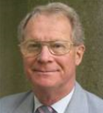
Insanity
Club members will know that Judy and I have been dog lovers for 50 years and many of you will have met one or two of our hounds when visiting our home during that time.
Sadly Bonnie, one of our Scotties died last May – peacefully in her sleep, and her sister, Flissie died, probably of a broken heart a few weeks later. That was it. We were now too old to look after yet more dogs. We cannot be walking them in all weathers, cannot afford kennel fees, and need a little bit of freedom, without being tied.
BUT – when we came home there was no welcome, no grunts and snuffles, no banging against the kitchen door as we came through the front door. It was lonely. So, change of heart. Let’s downsize and get a smaller dog. Great. The trouble is that any reputable breed costs a fortune nowadays – dog breeding is a big business and we did not really want to go through training a puppy again. OK so what about a rescue dog? There aren’t any. Well, there are if you want a greyhound, a lurcher or a mongrel crossed with another mongrel, but no nice small well-behaved dogs.
We tried all the local homes – no small dogs at all and eventually contacted Battersea Dogs’ Home – there are three, one in Brands Hatch, one in Old Windsor and, of course, one in Battersea. So we filled in the application form and went up to Old Windsor. There was a lovely Yorkie but so in-bred that its joints were collapsing, a lovely small something or other with massive emotional problems and that was that. They had a number of larger dogs, but not what we wanted. While I was chatting to the staff about the dogs that we had in the past, Judy wandered. “She’s got lovely eyes” said Judy. “Who has?” I asked. “That black dog we passed”. “Where?” “I’ll show you” So we found this thing. A massive 25Kg. 18 month old black lump of Old Tyme Bulldog. A bit like a Boxer, but bigger and more lethal. “She’s enormous!!” “Yes, but she is lovely”.
Anyway she was not ready for re-homing having had a few small operations a few days before so we escaped and went home.
Next morning the phone rang. “Battersea Dog’s Home here. Lyla is all yours if you want her”. “Who?” “ Lyla – the Old Tyme Bulldog”. “But she’s not ready” “No, but you are a doctor and nurse and you are used to bulldogs. You can cope”. So back to Windsor. “Take her for a walk”. “OK” “ But don’t let her get near other dogs!” Have you ever tried to control a 25Kg maniac who is determined to play with every human and other animal or bird she sees? “But she is lovely” insisted the deputy boss of our household. So we got her. She had been found a month before wandering round the streets of Windsor. No collar. No chip. No history. No idea of any training. No name (the home had called her Lyla – so we carried on with that). Nothing known about her. “It will be fun getting to know her” said my first wife.
Apart from the species of animal life already mentioned, Lyla loves water. When walking through the quarries, if she sees a puddle she’s gone. Imagine an elephant, hitting a pool at close to Mach 2 and you get the picture. “That’s OK” said my dear wife, “You can walk her and I’ll dry her when she gets home”. She has now decided which chair is hers, the dog I mean, where her favourite spots are on the floor (and that seems to be anywhere), and she liked leaping onto table tops and working surfaces. Not so much a leap as a glide – but devastating just the same. So we now have to keep everything locked down. She came to greet us today with her red ball – only we discovered it was a plum, not a ball. The dish was empty. Drop a piece of broccoli stalk and it’s hers – well she think so. Luckily she does not like onions.
Does she still chase dogs? Not now because I hold her in a grip like a Scotsman on a £5 note. I let her off the lead once and she had gone - off to see her friend that she had smelled 800 metres or more away another large dog. By the time I had walked after her (pacemaker not up to running) she and Buster were happily ensconced in a large puddle with no Plimsoll Line showing on either animal. Judy did bath her when we got home but most of the mud had come off in our car by then.
She has pulled Judy over and broken a tooth (Judy’s) and Judy has tripped over her in the dark hall – black does not show up at night.
Regrets. No, of course not. |The loneliness has gone, and I am walking 1-2 miles with her every day which my doctor tells me is very good for me. I have met lots and lots of other dog owners, most of whom reckon I am mad, and Lyla is blissfully ignorant of the chaos she is causing in what was
once a fairly civilised household and a fairly stable marriage.
Divorce now beckons. How life has changed!! Keith

