Slide 1
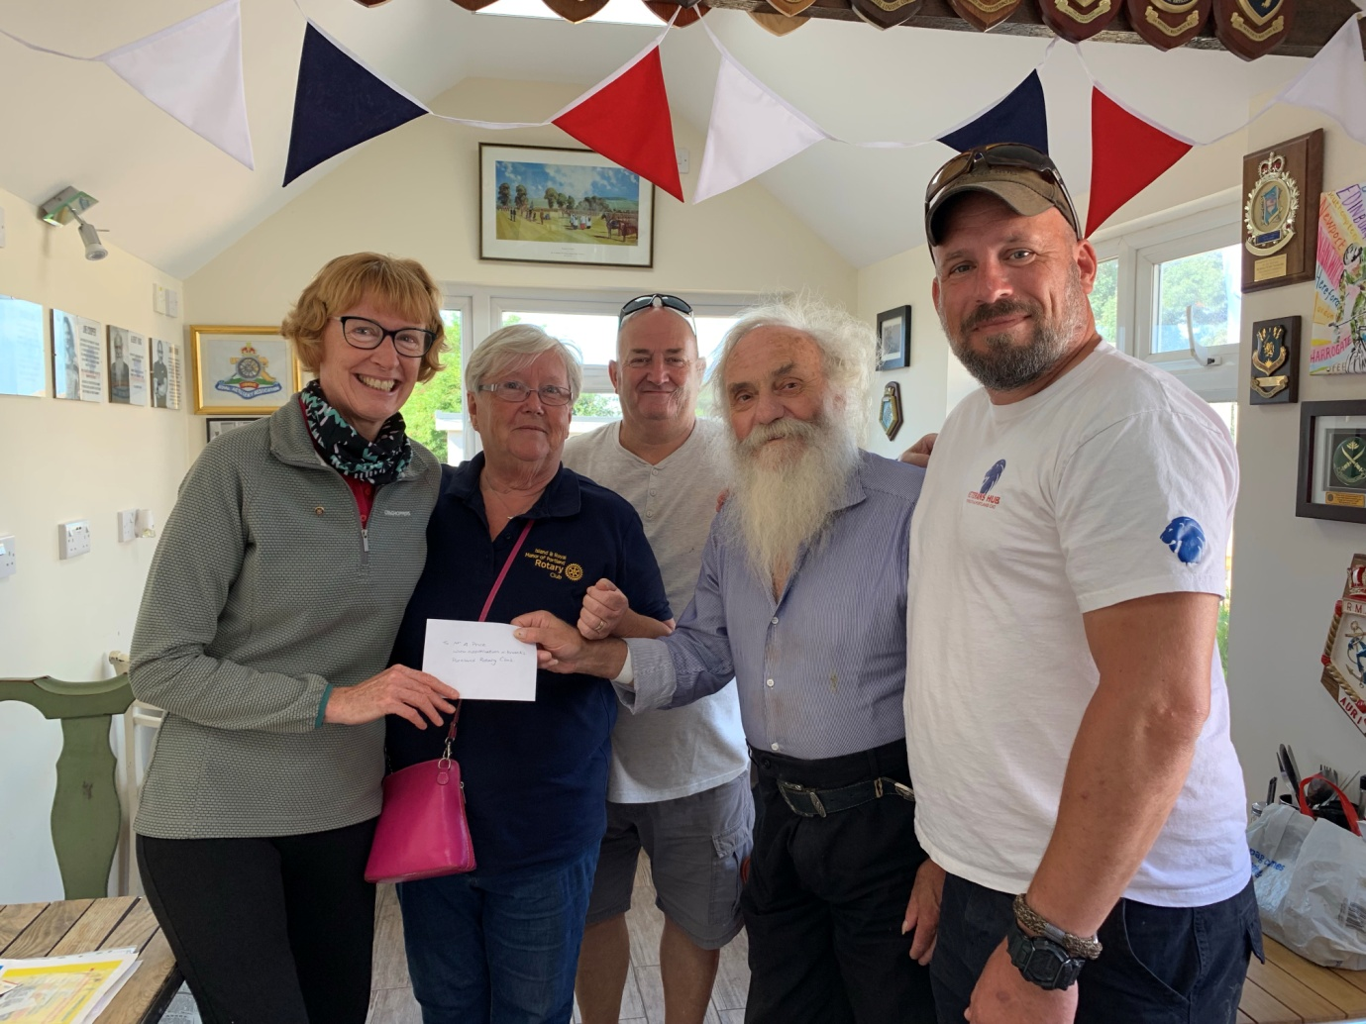
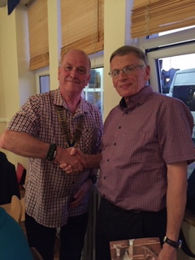
PORTHOLE #497
October
2019
The Rotary Club of the Island and Royal Manor of Portland {Register Charity Number: 1032098}
President: Garry Urwin Secretary: Peter Burrows Editor: Ian McPheat
Meetings: Tuesdays 6:30pm, Including Guest Night, At the AQUA SPORT HOTEL
Visit to the Portland and Weymouth Veterans' Hub
Following our fascinating talk from Andy Price, the founder of the Portland and Weymouth Veterans' Hub, Liz, Sue and Elizabeth popped into the Hub for a coffee and to hand over the Portland Rotary Club donation. Andy gave us a tour of the impressive facilities that have been recently added, all dedicated to support veterans: a new gym (not quite finished), raised vegetable beds and a retreat area, with a small building for therapy, rest and relaxation. We can thoroughly recommend the coffee shop too, it is open to the public and funds the work of the Hub by selling food as well as drinks. The supportive and therapeutic purpose of the Hub and the strong sense of community created are demonstrated all round the walls: there are pictures of veterans, flags from conflicts, plaques, paintings and many photographs. There is a memorial wall too, with photographs of veterans from the Second World War as well as from more recent conflicts. Tony, one of the volunteers, said this place was established to make better futures for veterans, to fill gaps, to drive away loneliness, depression and aid readjustment, re-creating a sense of purpose. It actually does a lot more than that: the work of this place benefits all the community through example.
Our new member – Richard Sladden

Slide 2
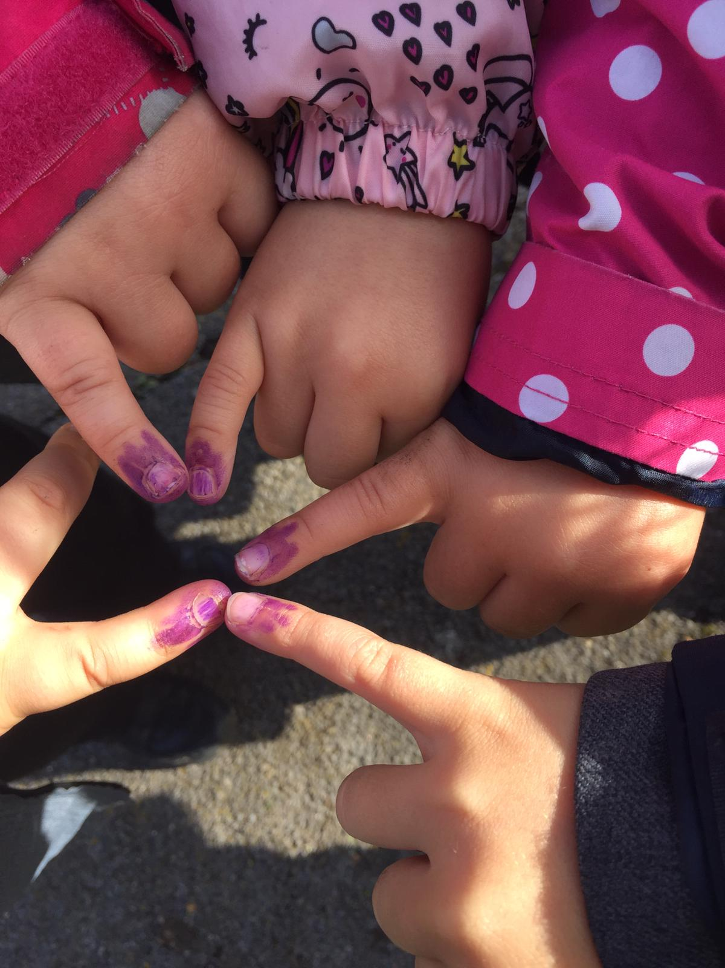
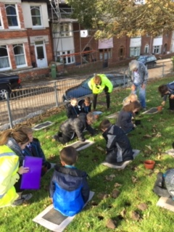
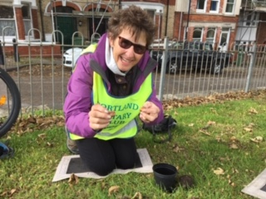
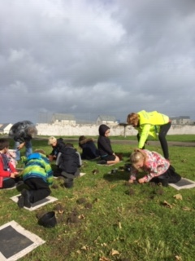
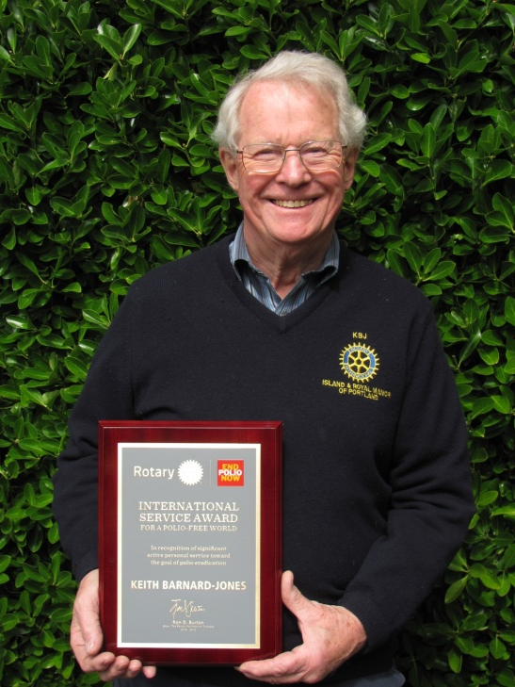
FAREWELL, SORT OF, TO PORTLAND As I believe you now all know, at long last we are moving to 12, Eldridge Close in Dorchester - near the Winterborne Hospital. If anyone is passing and would like a coffee (£2 black, and £2-50 with milk/sugar), the postcode is DT1 2JS Having said that, this is purely a move of house. Neither of us is changing Rotary Club - sorry about that! And I fully intend attending all our club events, as at present. We first floated the idea of moving before the Weymouth & Portland Olympics and have had continuous interest However, we have only had one offer. Nearly all claimed they knew Portland very well. Most of them knew the house and the view and wanted it. However, we never heard back from most of the dozens who came unless we chased them to find out why not. The answers varied - Too big: Too small!! Too modern: Too conventional!! Garden too big Garden too small!! Only one road onto the island. (What did they expect?) Too much noise from the traffic Out of their price range (Why bother to come in the first place) Too many steps (what do you expect on a hill?). Don't like the hill behind (it is called Old Hill!!) Too dark - lots of windows everywhere etc.etc. We think the problem was really that they did not want to be stuck out in the channel, or, maybe, they were just being nosey. The new couple who are coming here are Emma Pitcher - her working name = and her husband Gautam Bhattacharya - two high powered international lawyers. At the time of writing we have only met her and two of
her three children, and she is a delightful lady with a
lovely family. We wish them well on Portlland and hope they will be
as happy here as we have been for the last 51 years
Elizabeth giving the good news after the Treasure Hunt
Y2 Polio crocus planting with Atlantic Academy.
EDITOR’S NOTE
macmolly10@gmail.com Pictures need to be in jpg format if possible.

Slide 3
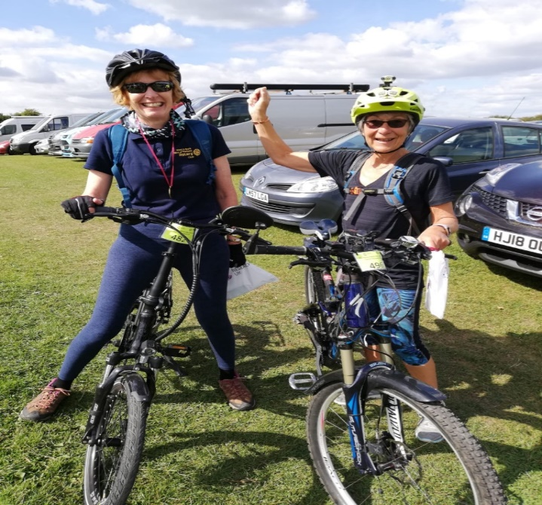
NEW WISHING WELL OPERATIVE Many congratulations (and thanks) to Liz for volunteering to carry on the well collections after my move to Dorchester. She is a lot younger and fitter than I am, and will do a great job. In fact she has volunteered Steve to help as well, but I am not sure if she has told him yet! I have perfected the technique of head down into the well with legs in the air. Very effective and useful, but not to be recommended when there are lots of tourists nearby. I wish Liz the best of luck when she empties out the money and, I am sure, if anyone really wants a laugh and is prepared to take a video camera along, Liz will perform for you!! Keith
WHAT DO PRESIDENT-ELECTS DO ON A SUNDAY?
President-Elect Jan from Wimbourne Minster Rotary Club and I, took part in The Rotary Dorset Bike Ride. Previously, we had cycled in Poundbury Rotary Club’s Normandy adventure, in aid of the Devon and Dorset Air Ambulance. This time Westbourne Rotary Club was the lead organising club, attracting over 500 cyclists, raising funds for Cancer Research UK. Starting at a camp site near Bovington, we joined hundreds of lyra-clad riders; there were 8 routes to choose from and we opted for the 35-mile route taking in Wool, Wareham, Bere Regis, Moreton, Clouds Hill, back to Bovington circuit. Beautiful weather and no wind helped, and of course, so did my ebike.
En-route I met Casterbridge Rotary Club running one of the food stops. Rachel was in charge and I congratulated her and Mike, admiring her lovely new engagement ring, then chatted to President Richard Brind marshalling the route, he is joining us on the Nepal trip in November. I also spoke to Pauline from Westbourne Rotary Club: she has never been to Portland and was very keen to visit us with President Martin Underhill next April.
A little girl was talking to her teacher about whales. The teacher said it was physically impossible for a whale to swallow a human because even though it was a very large mammal its throat was very small. The little girl stated that Jonah was swallowed by a whale. Irritated, the teacher reiterated that a whale could not swallow a human; it was physically impossible. The little girl said, 'When I get to heaven I will ask Jonah'. The teacher asked, 'What if Jonah went to hell?' The little girl replied, 'Then you ask him‘.

Slide 4
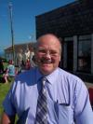
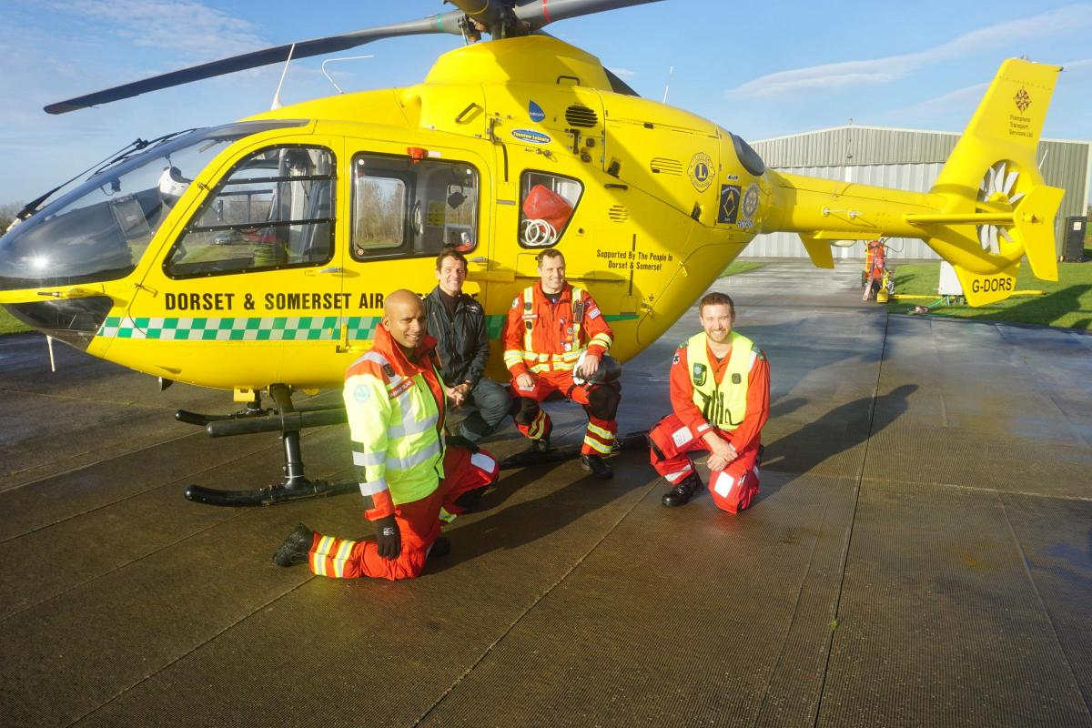
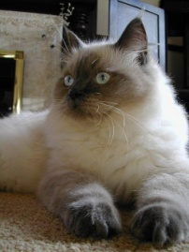
GETTING TO KNOW – Dave Shaw
Dave & I met at his house on a chilly day and he took a
break from getting in his new fencing.
Where were you born and do you have any siblings?
I was born in Wimbledon. I have a mixture of brothers
and sisters, six in all, although one is not with us
anymore. I was only in Wimbledon a short time as we
moved around a lot in the south west, Rohampton and Tooting.
What about work?
After school I planned to go into the Royal Marines but this never materialised as I met a young lady and that was that! Then I saw, on a visit the Job Centre, the Ambulance Service were looking for drivers, so I applied and got the job, that was in Surrey. Eventually I trained and qualified as a Paramedic. I am now semi-retired.
What about hobbies, what do you like to do?
I enjoy a bit of fishing. I enjoy holidays with my family, I have three sons. I like travelling and caravanning mainly in England. Gardening is not my greatest love but I enjoy getting out there now and again. I like DIY and have done this for a long time – saves money!
Do you have any pets or animals?
We have had cats, reptiles and a bunny . We’ve never
had a dog, I’m not a great dog lover. At the moment we
have Lillibut our Ragdoll breed cat. She is a beautiful and
a lovely pet. She has blue eyes and in the evening she’ll
lie there and look at you and her eyes will go red which is
an indication that she wants to play. The breed is
renowned for being cuddly and love to be petted.
TV programmes and movies?
I like black & white films especially war films. I also like history and documentary programmes.
What about reading & magazines?
Only read something I occasionally pick up and take a fancy to. I am not a regular reader.
What sort of food do you like?
I love Indian food. I like to try different things and I enjoy cooking. I do most of the cooking since Andrea had her back operation. I usually enjoy doing Christmas dinner.
Start a What’s App Portland Rotary group, more immediate than emailing for all those last-minute questions, reminders for everyone and pictures to share the fun.
All new members must bring a friend.
Start a satellite informal club at the local sports centre for the under 40s: they do not want to mix with their parents’ age group! Their focus is on just one or two community projects, they have a monthly “social” meeting and use social media to organise everything. They pay a basic £7 a month fee to be Rotarians.
A Date for your diary: Following Leanne Colverwell’s excellent talk about The Dorset and Somerset Air Ambulance, their airbase open day is scheduled for either Saturday 14th or Sunday 15th March 2020. An invite will go out about 6 weeks before the event via email to Elizabeth, we will then need you to confirm 10 attendees and place them on the guest list.
A police recruit was asked during the exam,
'What would you do if you had to arrest your own mother?'
He answered, 'Call for backup.'

Slide 5
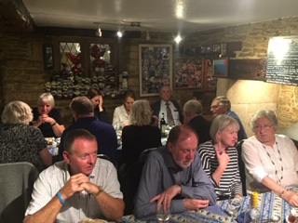
September’s District Assembly: networking to combat loneliness and to improve environmental awareness
The District Assembly is all about getting more out of Rotary, getting the big picture and sharing good ways to have more fun in Rotary. The event is made up of a series of talks and “break-out” sessions to discuss and share good ideas.
The Youth Group launched this year’s District 1200 competitions, there are more competitions than ever to get involved with. We need to get the Schools on board immediately, sign up and pay or apply for a District grant to cut the cost by half. This is a new payment procedure, as John Marchon explained.
Justin Sergent’s talk about combating loneliness was based on the work of the Somerset Community Foundation, who channel over £700,000 a year into a network of various charities to support homeless, rough sleepers and the hidden rural lonely. It would be interesting perhaps to get The Dorset Community Foundation to come and speak to us about their work.
Perhaps not everyone’s cup of tea, but another talk was about the work of the Somerset Waste Partnership and how they are lowering the communities carbon footprint. I wondered what the Dorset Waste Partnership does? Would you like a talk from the Dorset Waste Partnership and a field trip to visit a Dorset facility? Reduce, renew and recycle! Not all of us are putting out food waste into the correct bin and young people are some of the worst recyclers!
Best Rotary Networking Ideas picked up in no particular order:
Although men-only clubs have long been unacceptable, it was suggested they start mixed satellite clubs.
Adopt a footpath, beach or community facility that is in-need of TLC, and with the help of the community, tidy it up. Great publicity!
Hire a magician for our next Membership drive party, Rotary will be seen as more fun, not just about fundraising.
Have a breakfast meeting once a month to pick-up new/wider membership who cannot get to all the evening meetings.
Why Rotary, how did it all start?
Helen Allen was the one who introduced me to Rotary. We met through our jobs and she invited me along to a meeting. I didn’t know there was such an organisation that helped these issues. From then I was made welcome and she suggested I sit and just listen and I thoroughly enjoyed it. Good company and interesting, Polio being one. Didn’t know there was such a thing till I heard it here.
Raising funds now is hard and we need to be more willing to do things so that we can fund things that we want to support. However, we are still managing to do a fair amount to help.
Sugar loaf meeting 1st October
DID YOU KNOW!
The song Auld Lang Syne is sung at the stroke of midnight in almost every English-speaking country in the world to bring in the new year.

Slide 6
The 2019 District Conference was F.U.N. and we must tell people about our “dogoodery”
Attending this year’s Conference, the Portland crowd was buzzing, celebrating the F.U.N. being Rotarians and by dancing the night away. We gathered on Friday evening in Southampton’s city centre Grand Metropol Hotel (after indulging in retail therapy). F stands for Fellowship: we met, made connections between clubs, shared ideas and found old friends. On Saturday the best speaker (who Janet jumped up to grab a selfie with), was Evan Burrell, an Aussie with great dress sense. Rotarians, he said, are truly modern-day superheroes. Each of us has the power to do good in the world and to make a difference. A Rotarian from Turramurra in D9685 Sydney, he joined Rotaract at 18 and is now an actor (was in Neighbours as Toadie’s friend). Here’s our 2019 District Governor, Dennis Stevens with Evan.
Forum on the move?
At the recent District Executive meeting, I am given to understand that a lot of dissatisfaction was expressed about the District Forum meetings over the last few years and, in particular, the venue - The Bath & West Show Ground. I have to say that I agree entirely. Apparently moves are afoot to find some more suitable venue in the New Year because - I. The Show Ground is not in the centre of District - so representation from the clubs in the South of District, apart from two P.D.G.s, is non-existent or appalling 2. The theatre for the Plenary Sessions is limited in the number it can hold. 3. The only real breakout room is a good walk away, and is difficult for older Rotarians to get to if that have limited mobility. 4. There are not enough break-out rooms for all and most attendees want to talk, participate and feel part of the meetings. 5. Trying to hold meetings around small tables, sited close together in the same room, and in a room where others are drinking coffee and chatting is a recipe for disaster. Nobody can hear what is going on. 6. The a.v. set-up is not exactly ideal, however hard the Rotarians try. 7. I have some reservations personally about the content of the Plenary Sessions as well, but, maybe that is just me being fussy. To sum it up, numbers have been dropping and dropping - just over 70 at the last meeting out of the whole District. That has to say something doesn't it? We used to get 150 -200. If people do not want to attend a District Meeting, why have the meeting in the first place? Answer? Because our rule book says we must. To add insult to injury, so many clubs do not bother to send representatives that the Mailing system whereby leaflets, letters etc. for each club were put on a table for collection by the delegates, has been stopped.. Result? They have to be posted - an extra cost to us all. The bottom line is that, if we are not giving Rotarians what they want, they will not come - a four hour round-trip has to be meaningful, particularly on a Saturday.. When I was a young Rotarian, in the last Millennium, we used to get a Governor's report at each meeting - so that we knew what was going on in other clubs, and we were told about our finances. We had large Group Meetings (50-70 attendees). Now the number is around 0-8. The representatives used to bring back the information from each Group Meeting. They cannot if they do not attend. We had reports from the various Committee Chairs. Nowadays often the only contact a club may get with District is when we have a DG's visit, or a visit from the Chair of a particular District Committee. I have to say that I have found some of the meetings disappointing and, occasionally, embarrassing. PDG is often interpreted as being Past, Dead, and Gone, and there may be some truth in that. A PDG should be seen but not heard = a bit like Past Presidents in a club, but, occasionally, experience and knowledge is very, very useful. It will be interesting to see, if we do change venues, whether the numbers will increase. If not, we need to ask ourselves why? Keith
His message was to make Rotary Fun, Update and spread the message, talk about what we do and create New Clubs, like Rotakids: school clubs for Primary-aged children, each with a link-Rotarian and a supporting teacher. He also highlighted how Rotary meals always seem to involve chicken, and more significantly the Six Areas of Rotary Focus.
Another key message was what inspires people to make a difference and how do they approach challenges? Speaker Bonita Norris explained why she climbed Everest, and Assistant District Governor Dr Michael Fernando why he loved being a member of Rotary: because through Rotary he could initiate the rebuilding of a school in the Helambo District of Nepal and help set-up neonatal care training projects in Pakistan. We also heard from Yeovil Rotarian Dr Yinka Ossoba and how her RI Friendship Exchange (RIFE) led to the funding of the Nethra Eye Project, a mobile eye clinic in Kerala, southern India. So much is possible through Rotary!
It’s all about Service Above Self. Be proud and tell people why you love being a Rotarian.

Slide 7
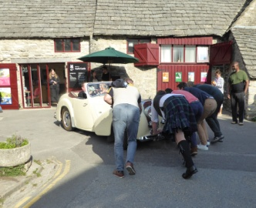
PORTLAND MUSEUM IS LOOKING FOR RESEARCHERS
In September we are asking Islanders to become researchers to take part in the History, Myths and Legends of Church Ope Cove Project. Funded by Arts Council England and run in partnership with b-side, we’ll be researching the exciting history of Church Ope Cove, a place often forgotten for its central role in some dramatic moments in our history. From Vikings to pirates, landslides to local folklore…
We’re looking for members of the community to explore, reveal and share this vital part of the Island’s history. Participants will play a crucial role in the research and will be given training in research methods and skills, along with site visits and group trips to local archives and museums. All workshops will take place in October and November 2019, led by the research co-ordinator Bea Moyes, and the groups’ research will feed into an artist’s commission for b-side festival in 2020.
The introduction workshop, which we hope all participants can attend, will be on October 17th. If you’re interested in joining the research group, please email us at portlandmuseum@gmail.com or call 01305 821804. Deadline for applications is September 30th, 2019.
Our poet-in-residence, Sarah Acton, is keeping her Heart of Stone writing project moving along with great momentum. The number of participants for Sarah’s discussion cafes has been outstanding and on more than one occasion we have been privileged to have been joined by three members of Portland’s pre-mechanisation quarrying community. The lads brought with them memories and genuinely awesometales of working in the quarries, based around the methods of breaking up the stone and its extraction (of particular interest to the more challenged of us ‘how-on-earth-do-you-do-that-without-a-machine?’ types) and very funny stories on the social side of working as a team. Will they be back? These great raconteurs, with their rare skills and unique pasts, are fast becoming the rock stars of the local community and we can only hope they drop in on us once again.
Sarah will next be joining us Tuesday September 3rd from 12:00 pm – 3:00 pm after her poetry walk in Easton Gardens. To keep abreast of her autumn dates and other events taking place here at the museum, please check our website: portlandmuseum.co.uk; our Facebook page: facebook.com/PortlandMuseum and our Twitter site: @PortlandMuseum1. Lucy Watson – Manager Portland Museum
A newlywed couple were about to leave Corfe for their reception, however their classic car stubbornly refused to engage reverse gear. After several minutes of trying and much embarrassment, Rotary stepped in and members from both clubs helped the best man to push the car round so that it faced the right direction! Rotary in service again!
The evening took the form of a Gala dinner at the Heights which was attended by over fifty members and guests.
Elizabeth and Jerome both made excellent speeches. Elizabeth’s French pronunciation was particularly good and with Sue helping with the grammar she impressed both the French and the English alike.
Sadly, we had to say goodbye to our guests on Sunday. Sarah and Brian held a farewell brunch at their house with crumpets and teacakes whilst we watched a cruise ship entering Portland harbour.
After flowers, presents, banner exchanges (the very first presentation of our new banner) and farewells our visitors left for Portsmouth and their voyage home. We look forward to meeting them again next year when it is the turn for our club to visit Vire.
The weekend whilst enjoyable for hosts and visitors alike served to strengthen friendships between both our clubs. The bonds have grown stronger over the many years of our twinning and in fact, this is the 41st year of our ‘Jumelage’.
In Rotary one of our goals is to promote friendship and our exchange visits certainly do this.
However, Rotary is above all a Service Organisation. In fact, our Guiding Principles state that “The object of Rotary is to encourage and foster the ideal of Service” and in order to enable this “develop acquaintance as an opportunity for service”
Portland Rotary Club has a long history of undertaking International projects such as providing water systems to poor villages in Nepal. Indeed, members of the club will be visiting some projects recently completed in November 2019. It was therefore a true delight that during this visit both clubs have had discussions on international aid and our colleagues from France have expressed a desire to take part and we have agreed to work together on these International projects.

Slide 8
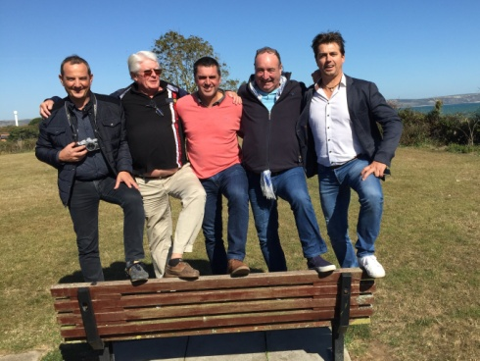
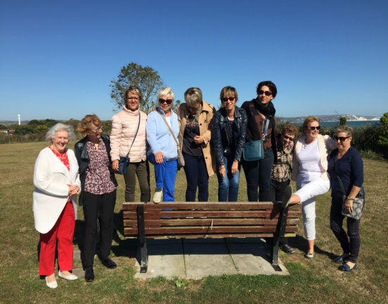
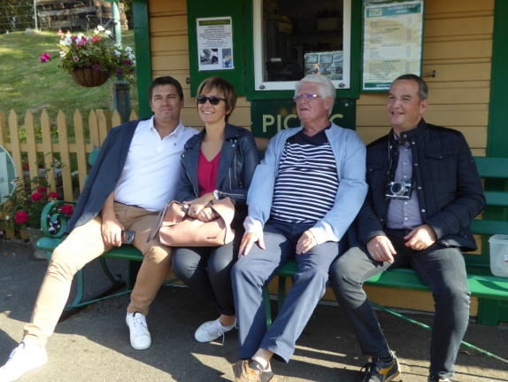
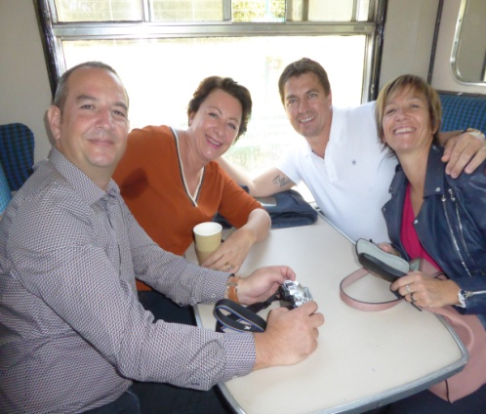
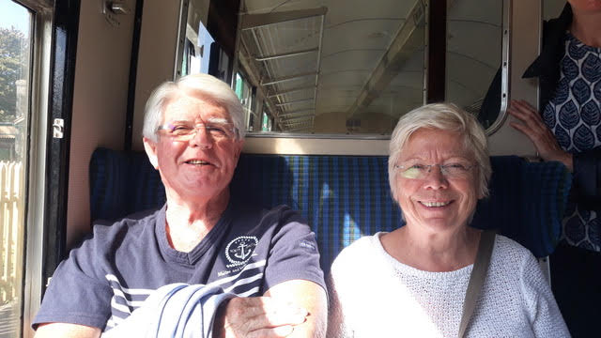
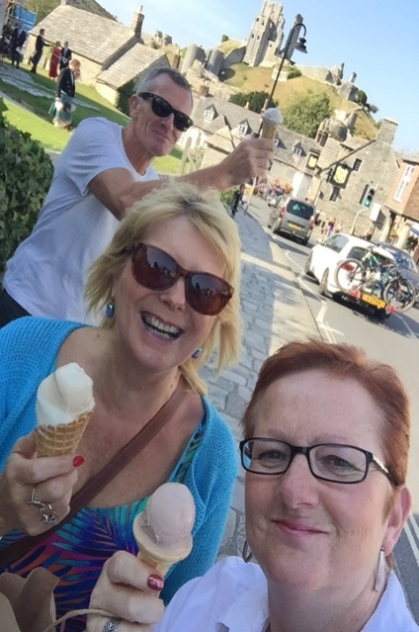
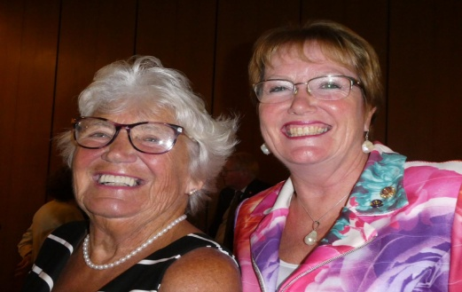
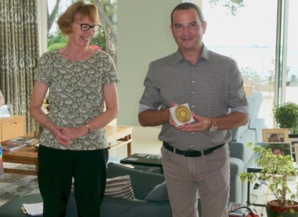
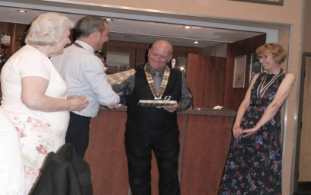
Vire Exchange Visit 2019
The members of Portland Rotary Club were delighted to be able to host twelve friends from our twinned club of Vire et le Bocage, Normandie who travelled here from France for their biennial visit.
Our visitors took the overnight ferry to Portsmouth from Ouistreham. Everyone met at Mark and Ruth’s to welcome them and for a light breakfast of teacakes and homemade scones before going to individual homes to settle in after the long journey. However, our guests took us by surprise, arriving early, even before any of the hosts. They were working on French time not English!
President elect Elizabeth and her sister Sue not only looked after President Jerome and his wife Nadine, but also Stephan and Carole. Jim and Gisella were with Chrissie and Bryan, Franck and Valerie with Celia and Chris, Olivier and President Elect Fabienne with Richard and Frances and Claude and Marie-Thé with Mark and Ruth.
We were fortunate as the weather was kind – warm and sunny. This allowed a pleasant walk for everyone in the afternoon around Bincleaves Green, Nothe Gardens and Weymouth harbourside. Everyone returned to Mark and Ruth’s for more refreshments and bubbly.
The evening we divided into smaller groups of eight for dinner. Each with four Portland club hosts entertaining four French.
Saturday was again a beautiful day and many members of our club joined our visitors on the Swanage Railway from Norden to Swanage. For those interested it was the Southern Region “unrebuilt” Battle of Britain class locomotive 34072 - 257 Squadron, built in 1948, later rescued from Barry scrap yard in Wales and beautifully restored by the Swanage Railway that hauled the train.
We took a leisurely stroll along the sea front and out to Swanage pier, then took the return train to Corfe for lunch at the Fox Inn. After a long lunch the plan had been to visit Corfe Castle, but due to slippage of time we merely admired it from a distance and returned by train to Norden and thence home.
Cont. Next page

