Slide 1
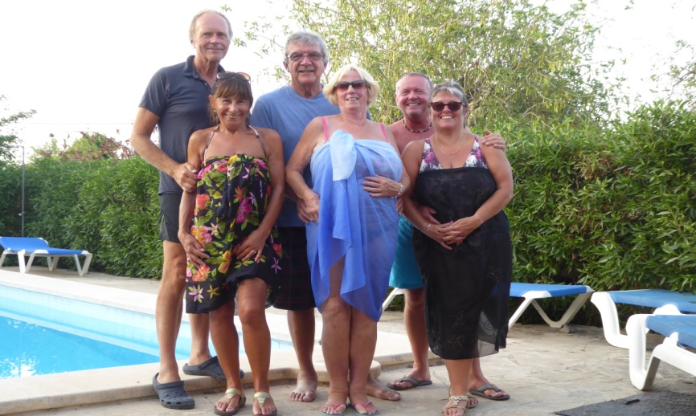
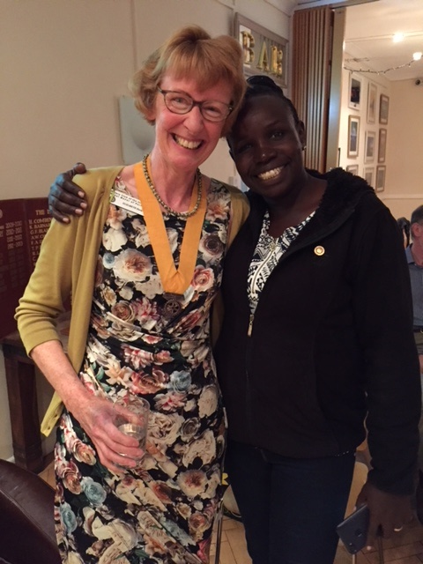
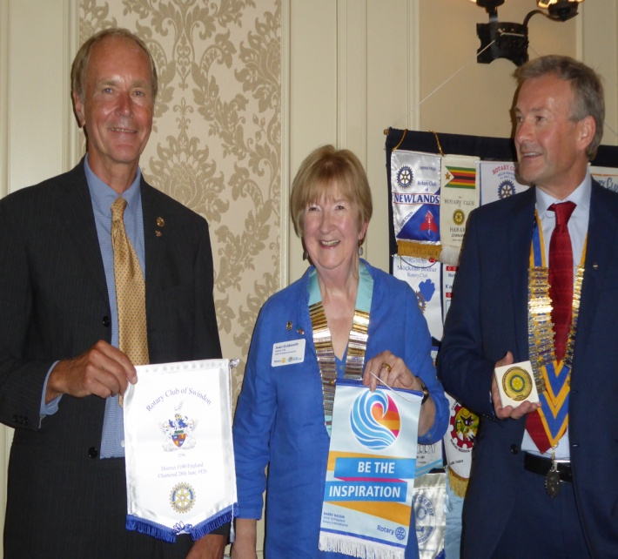
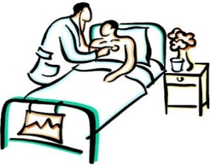
PORTHOLE #487
September
2018
I visited Swindon for an Advance Site Visit on behalf of RI (TRF) for their global grant application to help fund a linear accelerator for their new radiotherapy centre.
Patients in Swindon have an arduous journey to Oxford which can be 5 days a week for up to 8 weeks. A journey that can be an hour and a half each way.
This project will allow patients to be treated locally.
Pictured with District 1100 DG Joan Goldsmith and President of Swindon Martin Groombridge exchanging banners.
A coincidence as we in district 1200 are also applying for a global grant to equip the new radiotherapy centre in Dorchester.
The Rotary Club of the Island and Royal Manor of Portland {Register Charity Number: 1032098}
Club Diary.
Sat 13th October:
Table Top Sale for Portland Carers Group.
Frid 19th October:
Portland ‘Hardy Walk’ with Tom Fincham & Elizabeth from Portland Museum.
Sat 20th October:
Community Day Tea at W.I. Hall, Wyke Regis.
Thurs 25th October:
Theatre trip to see WICKED at Southampton £64.
Sat 27th October:
Fancy-dress Halloween Party in aid of SCMF at Sarah & Brian’s hose.
President: Garry Urwin Vice Pres: Elizabeth Hardy Secretary: Peter Burrows
LOOK WHO CALLED IN
Meetings: Tuesdays 6:30pm, Including Guest Night, At the AQUA SPORT HOTEL
Apologies/Menu choices: to Margaret Thomas. If ordering from the bar, give as much notice as possible.
Club Programme:
{Duties = Grace / Finance}
Tues 9th October 6.30 pm:
A Life Education Lesson with
Diane and Elizabeth followed
By Council
???/DAVE SHAW
Tues 16th October 6.30pm:
Business Meeting
???/ANDREA SHEPHERD
Tues 23rd October 6.30PM:
Guest Evening: Speaker
Chrissie Payne, MV Freedom
???/PAT SHEPHERD
Tues 30th October 6:30pm:
Speaker TBA
ANDREW HARVEY/ROSIE SANKEY
PLEASE REMEMBER it is the duty of the Grace/Greeter to put out the bell / lectern / banners etc.
THIS IS FLORANCE A VISITOR TO OUR CLUB FROM MOMBASA WITH ELIZABETH

Slide 2
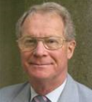
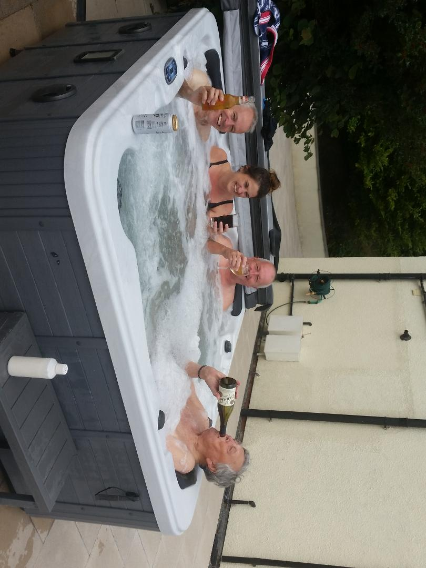
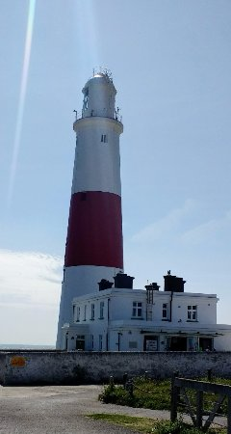
Meal Cost is £12.50 =
Main, Sweet +Tea/Coffee.
£6 salad option
Menus
9th October
Spaghetti Bolognaise or Vegetable Spaghetti with Salad and Garlic bread.
Treacle Tart & Cream or Fruit Salad.
16th October
Potato topped Fish or Vegetarian Pie & vegetables.
Apple Crumble & Custard or Fruit Salad.
23rd October
Chicken & Ham or Vegetable Pie with Pomme Anna Potatoes & Vegetables
Strawberry Mousse or Fruit Salad.
30th October
Pork in Pepper Sauce or Vegetable Gratin with Mashed Potatoes and Vegetables.
Sticky Toffee Pudding or Fruit Salad.
Contact Margaret Thomas to book your meal. Or, order from the bar at the Aqua as early as possible
Elizabeth giving the good news after the Treasure Hunt
KBJ
Which one is the Rotarian??
A New York attorney representing a wealthy art collector phoned his client. He said, "Saul, I have some good news and I have some bad news.” The art collector replied, "I've had an awful day, let's hear the good news first.” The lawyer said, "Well, I met with your wife today, and she informed me that she invested $5,000 in two pictures that she thinks will bring a minimum of $15-20 million. I think she could be right.” Saul replied enthusiastically, "Well done! My wife is a brilliant businesswoman! You've just made my day. Now I know I can handle the bad news. What is it?” The lawyer replied, "The pictures are of you and your secretary!”
PORTLAND POEM
Pointing out so bold and grand
Only a small strip of land
Rising high above the sea
Towering up majestically
Laden with ponderous stones
And her eolithlic bones
Name oh name that land to me
Dear old Portland thou art she
Kindly sent in by Alan
?? WHAT IS THIS ??
Last week’s answer: Staples

Slide 3
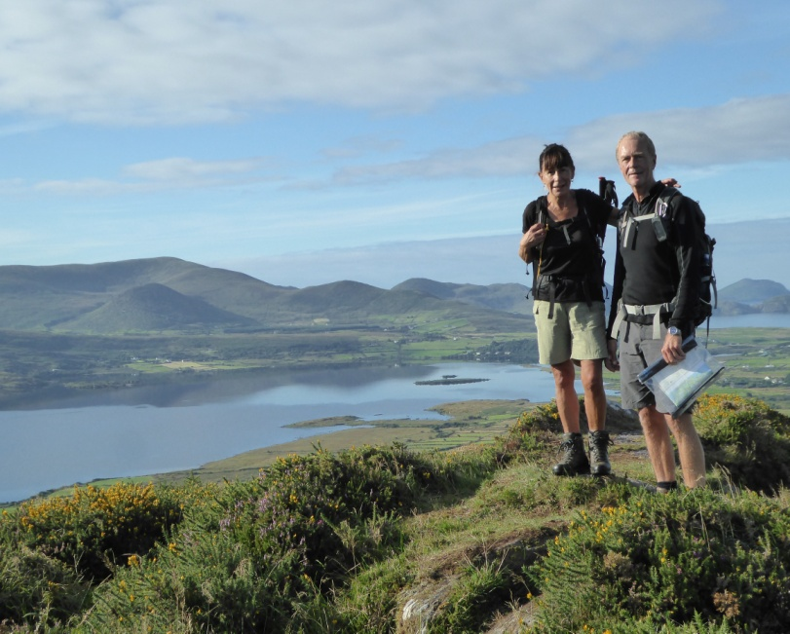
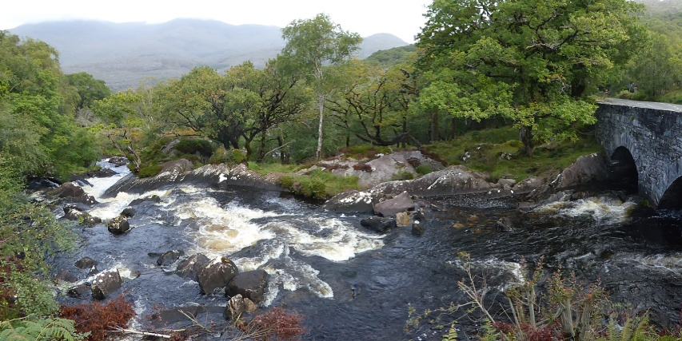
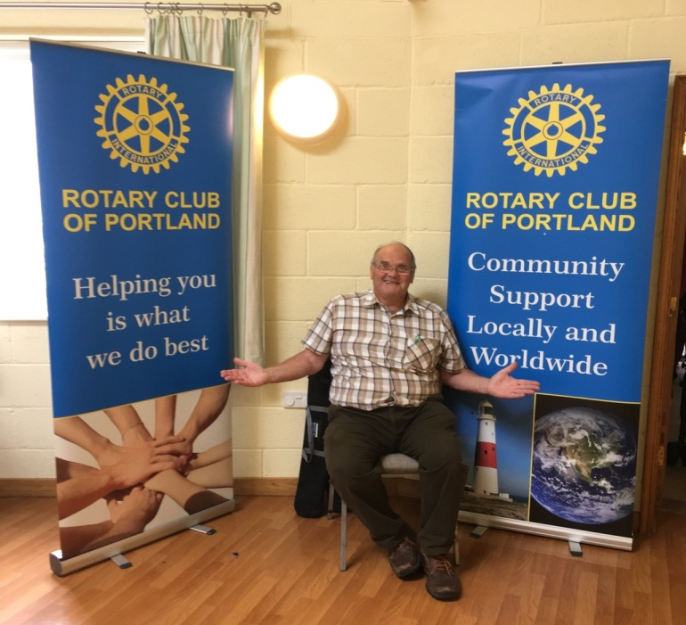
Galways Bridge: See Mark & Ruth’s article further on.
Mark & Ruth in Ireland
Ruth and I spent 9 days walking the 220km Kerry Way in the south of Ireland. A beautiful though fairly hard walk through the most amazing scenery. Ranging from coastal and valleys to hills and mountains with ridges and remote passes to cross.
We flew to Dublin and experienced the Brexit effect where our first pint of Guinness and a glass of house wine was almost 15 euros!
It was a pleasant journey to Killarney on their express train. It took 3 hours. The rail services are on time and very efficient.
We stayed in B&Bs and had our bags carried on each day. Our longest day (34 km!) was from Waterville to Caherciveen which was stunning. Climbing out of Waterville we walked north east along a ridge for 5 km with views of Loch Luioch on one side, Ballingskelligs Bay behind us and the mountains of An Traigh, Tteermoyye and Moingan tSamhaich in front. We then dropped down into the valley and then climbed up to another 6 km ridge going north west across a series of small peaks. The day was mostly in sun though by the end the wind became stronger and colder and the rain started for the rest of the walk. The mix of sun, shower and persistent rain was fairly typical. The accommodation was great throughout and the friendliness of the Irish was amazing. The Seafood Chowder was our favourite on the menu. The Guinenss was excellent, as were the real ale brews at the Killarney brewery!
Our Dave ‘flying the flag’ at a Table Top

Slide 4
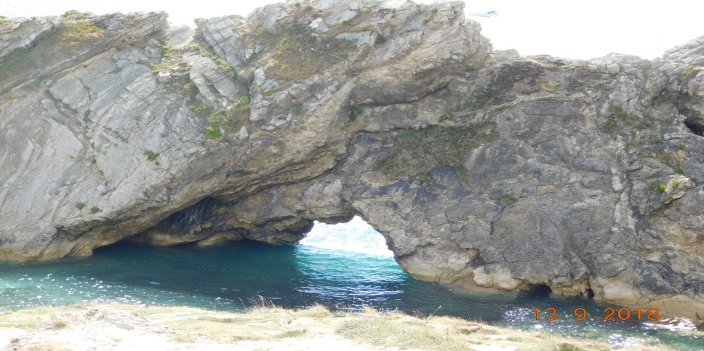
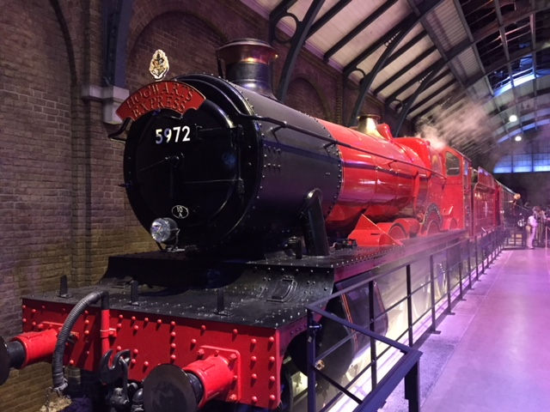
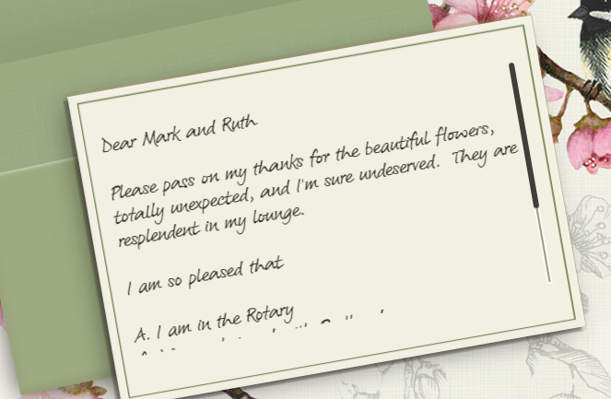
Next train to Waterloo?
Having lived in the area for nearly 10 years now, I have visited a lot of places being a grockel, one of them being Lulworth Cove. On a nice day last week I decided to take the dog for a walk and revisit Lulworth. I parked in the usual place, went down the ususl path, but then I noticed people on the edge of the cliff path, where I'd never ventured. So off I went to be met with this vision. (Stair Hole) How did I not know this was there?
So people, venture off the usual path, take the alternative route and you may well be surprised.
Sue Leach
A MESSAGE FROM PRESIDENT GARY
See your name in lights ... Contribute to Porthole
(or the website ... or Facebook ...)
Thanks this month go to:
JANET, MARK, SUE, KBJ, GARY, ELIZABETH, ANDREW & SARAH
Hi Ladies and Gentlemen,
We have arrived back home from Newcastle, and everything went according to plan and all the family were there and mam had a great send off.
Whilst checking our mail, there was a lovely condolences card from you all in the Rotary club, which was amazing.
We would like to take this opportunity to thank you all and we feel really humbled to have so many friends that have sent messages.
Thank you all.
Garry.

Slide 5
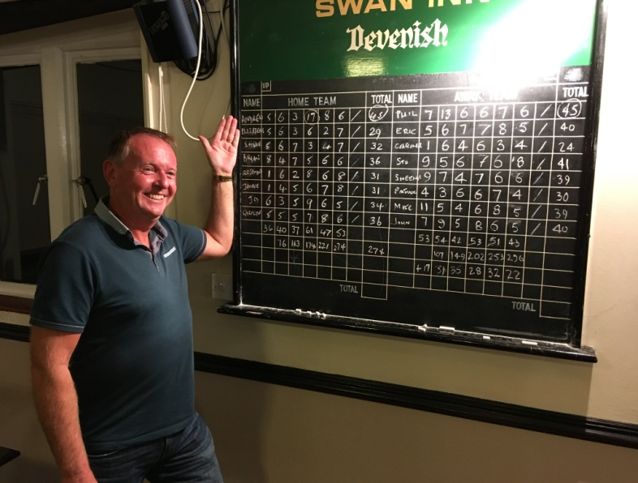
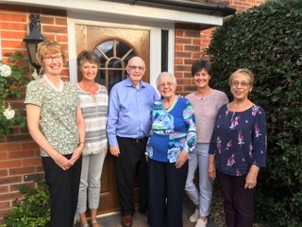
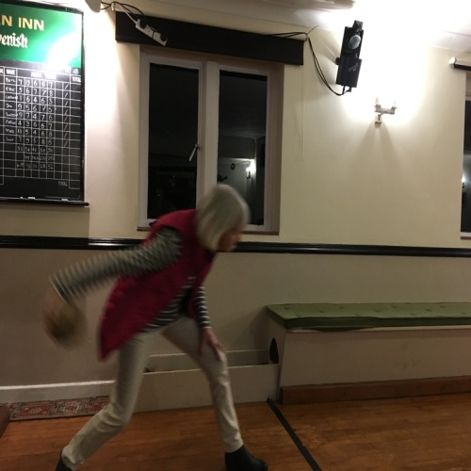
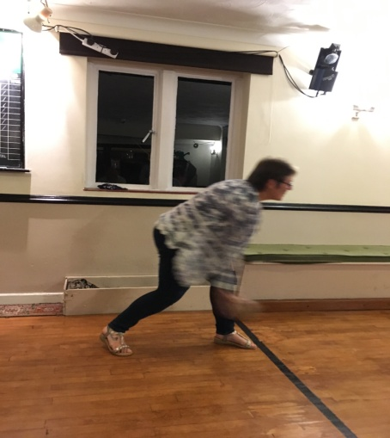
This picture represents a piece of Rotary history, August 23rd 2018 was the 30 year reunion of first all-female Group Study Exchange Team to represent our District 1200 in District 9670 Northern New South Wales, Australia. During this trip of a lifetime the team discovered the magic of Rotary fellowship, within District 1200 as well as whilst visiting Australia during it’s special Bicentenary year. The then District Governor Keith Barnard Jones wrote in 1988 that following a friendship started in Nashville with District Governor Ray Norris of 9670, he sent the 1200 Group Study Team, a group of young professionals selected to promote international understanding, as part of the service, goodwill and educational activity of Rotary Foundation. The four team members, along with Rotarian John Pargeter and his wife Audrey toured a vast Australian District 9670 over 6 weeks. We gave speeches to the Rotary Clubs we visited each evening, who during the day in turn took us around schools, a university, a large range of cattle and sheep stations, a coal mine, wineries, a waste disposal plant, even an astronomical observatory. We were so privileged being the house guests of Rotarians as we travelled around the District, learning so much about life in Australia from the inside. It brought us all together, and many of the Rotarians we met in Australia visited us in the UK in subsequent years. As a group we met up regularly despite us all moving away from the District as our careers progressed; the trip represents an anchor of friendship and fun. The team from left to right: Elizabeth Hardy, Reverend Jane Wright, Rotarian John Pargeter, Audrey Pargeter, Jeanette Mcphail (who Portland Rotarians know as Life Education Chief Executive) and Tish Nichol ( the honorary member of the group joining us later after Isobel Coleman, the fourth member of the team, emigrated to Australia).
Elizabeth
EDITOR’S NOTE
ianmcpheat@aol.com. Pictures need to be in jpg format if possible.
SKITTLING FUN

Slide 6
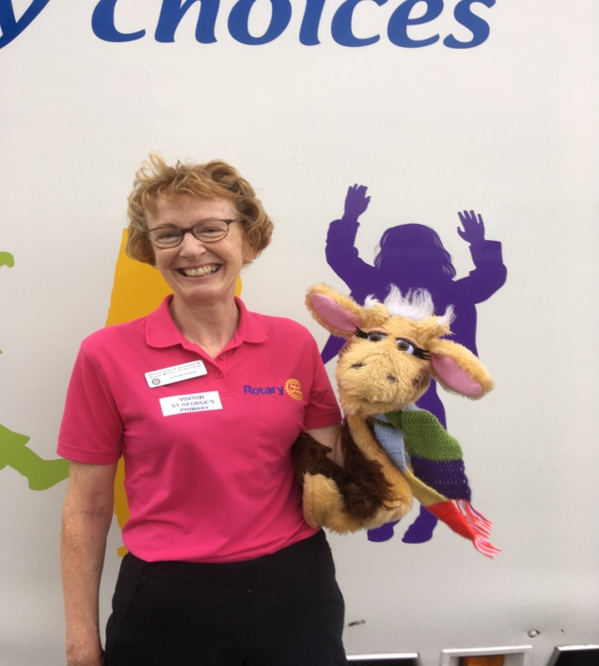
TUESDAY 18th Sept 2018 ELIZABETH’S VISIT TO
ST GEORGE’S, PORTAND
Aims and Objectives: to observe the teaching of S.C.A.R.F. which stands for Safety, Caring, Achievement, Resilience and Friendship – or the PSHE programme provided by the charity Life Education, in the primary sector. The curriculum also covers the teaching of wellbeing and aims to develop personal resilience. Teachers are given online material for planning and assessment as support in delivering effective wellbeing and PSHE programmes throughout the school.
Reception Class (4 to 5 year-olds): 2 weeks into the new term their behaviour was very good: they got excited, some shouting out, but it was dealt with effectively by the excellent teacher.
The children met Harold the Giraffe puppet, integrated with BBC video snippets, it was almost interactive: Harold is very excited about going to his grandparents’ house and the children help him check he has everything in his bag including the items in his wash-bag. Using a body tunic the children learn about the functions of some major internal organs. One of the children dons the tunic and they take turns placing where they think the heart, lungs, stomach and intestine should go – by sticking them on (with velcro) onto the special tunic.
Next Harold got plenty of exercise at the park and the children all join in exercising their bodies too. Now for the well-being section: Back at his grandparents’ house Harold is feeling fed up and phones the Life Education Centre classroom for ideas to cheer him up. The children think up ways of helping Harold: cuddling a teddy, reading a book, talking to an adult, going out to play with friends. They talk about medicines: how parents give out medicines and why children should not. Everyone feels a lot better after a sleep under the star-lit ceiling with relaxing music and Harold comes out to thank everyone for their help before singing one of his favourite songs about being happy and healthy.
Year One (5 to 6 year-olds):
The children learnt about the major food groups before looking at TAM (the large interactive body model) which graphically shows the inner body organs, which light up to show the position of heart, lungs, stomach and intestine. They learnt how food, water and oxygen get into the body to give it energy. Harold the Giraffe wakes up after a good night’s sleep and checks his lunch box for school but there is something missing! They quickly spotted the lunchbox had no fruit or vegetables. The children work out what he needs to have a balanced meal in his lunchbox before setting off to the school garden which gives them all plenty of exercise.
Friendship and well-being was dealt with at the school garden (video snippet), where they meet Harold’s friend Kiki the Kangaroo, who tries to help Harold find some fruit for his lunchbox but upsets their friend Derek the Penguin by mistake – by taking a banana from Kiki’s fruit sculpture. The children gave ideas about how to sort everything out: Derek apologies and so does Kiki for getting cross and up-set, before Harold returns to sing them his special song about different foods.
Conclusions:
These were two extremely well-organised and presented lessons: fantastic resources, the audio-visual component integrating puppetry and video-use was excellent inside the specially designed mobile classroom. Classroom movement was good shifting orientation around front side and back walls of the space; sticking Velcro images onto the stick-on walls, revealing from behind a curtain the model body with organs, along with video snippets, it was all very creative. There was no sense that we were inside the interior of a small container lorry with no windows! The teaching was appropriately pitched to the level and ability range: no one was struggling - the less able and special needs children felt safe and were part of the whole lesson. Praise was well-used and the most able were allowed to shine as well.
This is an outstanding, really worthwhile charity to support. It should receive our support as it underlines healthy eating, drug education (addressing smoking, alcohol and illegal substances in Y5 and Y6), wellbeing, as well as helping to develop resilient relationships and friendships, as well as personal resilience under stress. It addresses many of life’s negative situations and helps children devise positive coping mechanisms. Furthermore, it helps teachers and schools to effectively cover the whole school Personal Health and Social Education curriculum.

