Slide 1
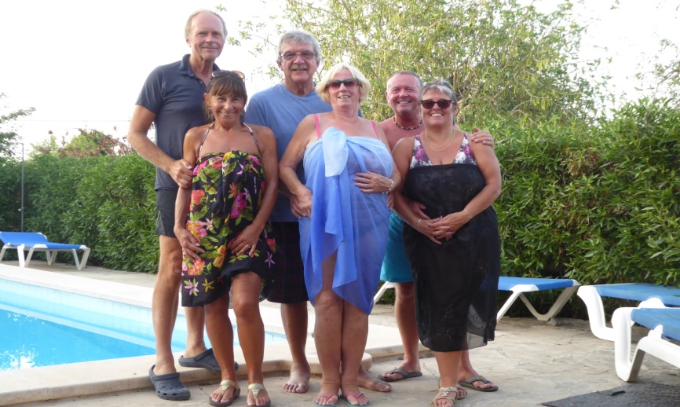
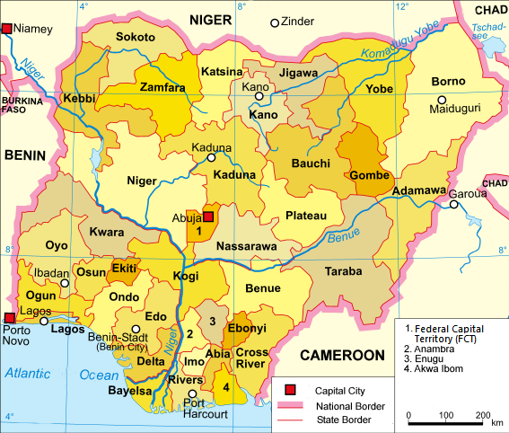
PORTHOLE SUPPLEMENT SUPPLEMENT
JUNE
2019
2019
The Rotary Club of the Island and Royal Manor of Portland {Register Charity Number: 1032098}
President: Garry Urwin Vice Pres: Elizabeth Hardy Secretary: Peter Burrows
Meetings: Tuesdays 6:30pm, Including Guest Night, At the AQUA SPORT HOTEL
NATIONWIDE FAMILY PLANNING CAMPAIGN IN NIGERIA
by Mark Townsend

Slide 2
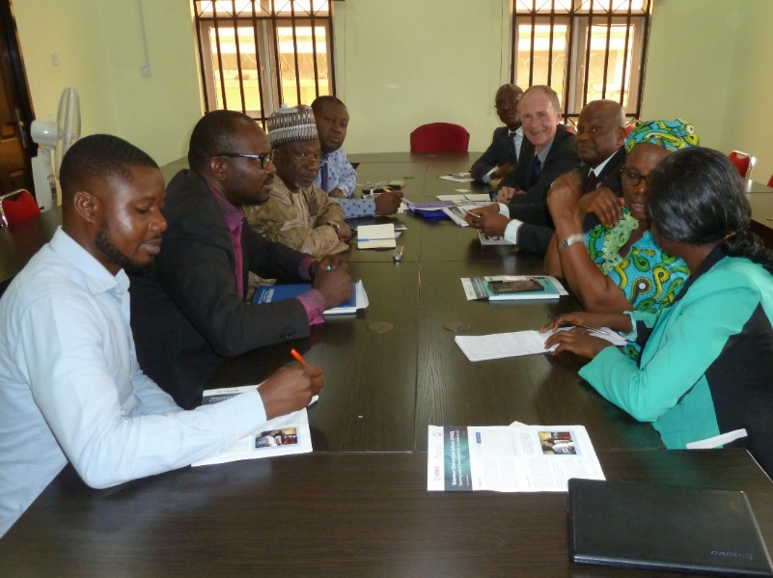
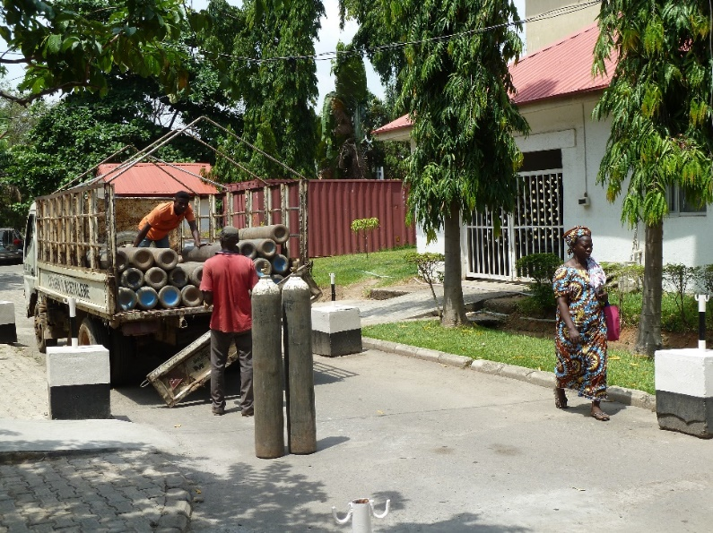
I recently visited Abuja, the capital of Nigeria on behalf of TRF in Evanston, Illinois, to review a large project that the Rotary clubs of Abuja wish to undertake in conjunction with support from all clubs and districts in Germany and Austria plus many in Switzerland. The project is called the Nationwide Family Planning Campaign in Nigeria and in two phases will reach out to all 37 States and to all women, even in the most remote regions. The funding comes from clubs and districts in Germany Austria and Switzerland and with added funding from the German Government. It is hoped there will be a successful Global Grant application. Due to the size of the grant requested TRF asks someone to represent them and visit the site and assess the project.
The current population of Nigeria is 198,916,208. It is projected to double in 20 years and increase by 146 percent by 2050. Nigeria is predicted to move from its current position of the seventh most populous country in the world to become third, displacing the USA by the end of this century. The consequences of a population growth faster than the economy are poverty and unemployment.
Behind this are high fertility and birth rates, with preferences for large families. There are also high maternal mortality and child mortality rates. In Nigeria a mother dies giving birth every 15 minutes. This means over 40,000 lives are lost each year. Although there is a high awareness of contraception (92%) the contraception prevalence rates are low (only 13.8% compared to 84% in the UK) and the unmet need for contraception is high.
The Nigerian Government is acutely aware of this, as are many international agencies. The Federal Government has the following goals:
Achieve accelerated economic growth, eradicate poverty, protect the environment, and provide high-quality social services.
Achieve balance between population growth and available resources.
Improve the reproductive health of all Nigerians.
A comprehensive Family Planning campaign would help to achieve all these goals.
There are three main problems to address:
Community - Lack of adequate knowledge of birth spacing and unmet need for contraceptives.
Management - Poor monitoring of services including providers, frequent stock-outs
Elizabeth giving the good news after the Treasure Hunt
One of many meetings, this one with the Society of Obstetricians and Gynaecologists of Nigeria
Oxygen delivery – the oxygen generating plant has broken down

Slide 3
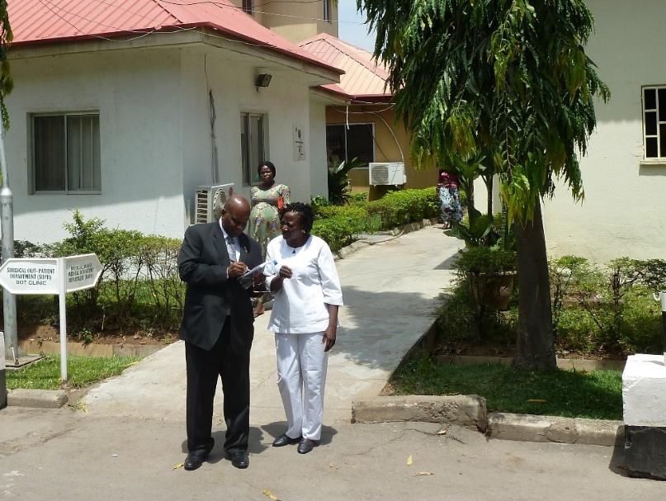
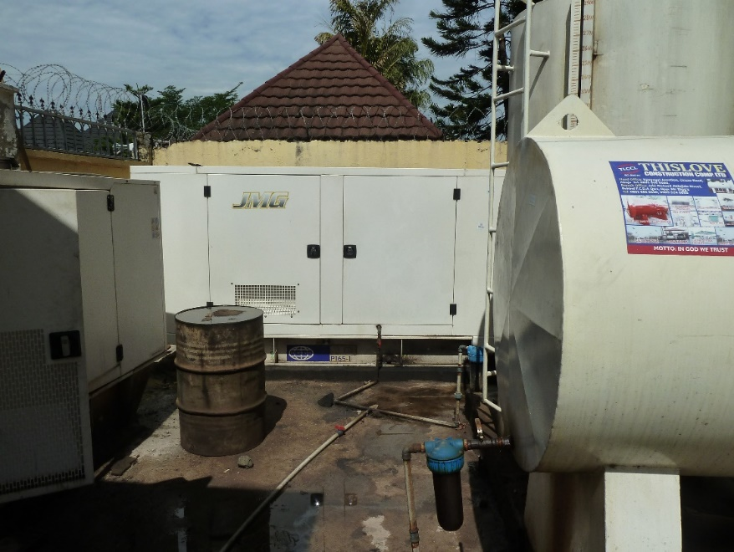
Clinicians - Failure of hospitals, lack of and poorly trained family planning service professionals .
The project will address all of these factors:
Community –
Education via a high profile national media campaign (TV, press and radio)
Community Dialogues. These will be held throughout the whole country. They are held in areas of highest need. Health care professionals, doctors and nurses, the project midwife, Traditional Leaders, Religious Leaders, local officials, organising Rotarians and up to 400 members of the community attend and are educated on general wellbeing and health, reproductive health, nutrition in pregnancy, antenatal care and family planning. There will be the special focus on Family Planning and how to obtain it.
Clinicians – There is a clinical training programme for doctors and nurses, again nationwide.
Management – There is currently a computer system that is helping to reduce maternal deaths. A bolt on to this is a family planning module and with installation of and training in the powerful and user-friendly Family Planning Dashboard will
Allow monitoring and quality analysis. This will enable intervention in poor performance and identify areas of lack of facilities
Improve stock control to avoid shortages.
The goals are to:
Double the current rate of contraceptive prevalence to achieve the national goal of 36%
Slow population growth
To reduce the Maternal Mortality Rate by 30%
Reap the benefits of the Demographic Dividend with increased economic growth, reduced poverty and less unemployment.
My role was to visit Abuja and meet with the Rotarians sponsoring the project. Ibadan-Jericho Metro is the main club involved and undertake the day to day running of the project, though Rotarians will be involved throughout the country.
Family Planning Centre Asokoro Hospital
PDG Emmanuel Lufadeju and FP Nurse Adejuyitan Foluke
All the hospitals run on generators for most of the time as the electricity supply is intermittent

Slide 4
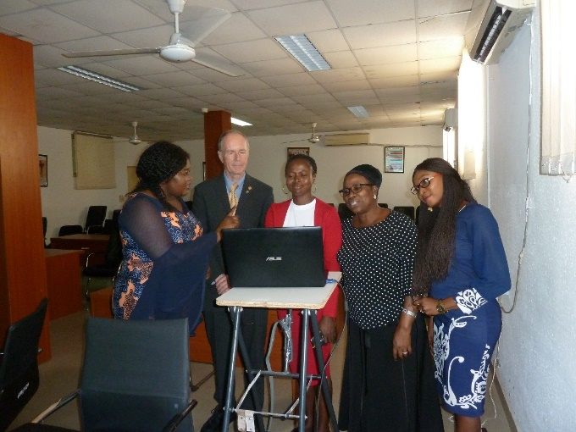
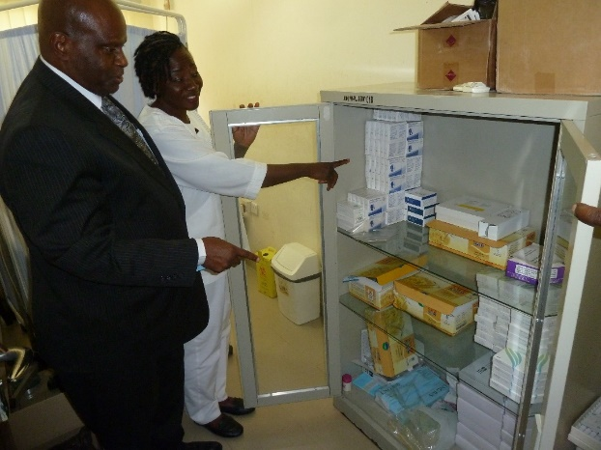
The Rotary Action Group for Population and Development (RFPD) plays a high-profile role. I was hosted by PDG Emmanuel ‘Dolapo’ Lufadeju who escorted me everywhere.
The visit was for three days and after an overnight flight it was straight into the first meeting where I met the Minister for Health and the Director of Reproductive Health who strongly support the project. The Federal Ministry of Health is underfunded and is dependent upon outside help for projects like this. Rotary has worked very closely with the FMOH in the past and the introduction of the maternal mortality initiative has saved countless lives. I visited Nigeria last in 2015 to review a project to supply hospitals with equipment and clinical training and educate women into taking up antenatal care with remarkable results.
I also met with several charitable organisations who will be giving support to the project including Pathfinder International, the Nigeria Population Council, National Media Centre, USAID, Society of Obstetricians and Gynaecologists of Nigeria and more!
I was also able to go to the hospitals and see how the project would work on the ground.
This is an amazing project. It is both ambitious and on a huge scale to cover a whole country. The local Rotarians and the RFPD are so dedicated and enthusiastic. The overseas Rotarian support is equally impressive, not just financially but via their expertise and hands on locally.
I hope the project succeeds as it will give both women and men universal access to contraception, giving them the ability, their right, to choose when and how many children to have. It has the potential to reduce maternal deaths by up to 15,000 per year. It will help the population crisis that if unchecked will result in poverty.
Foundation is our own charity.
This year our club has received grants via District which are helping us with water in Nepal and Life Education.
Global Grants - this project in Nigeria and the recent appeal for the radiotherapy centre in Dorchester, make a huge difference in our communities.
It is not just our financial contribution but also the expertise and manpower of Rotarians around the world that makes this happen.
A demonstration of the new computer system by the medical record officers at Asokoro Hospital
PDG Emmanuel Lufadeju and FP Nurse Adejuyitan Foluke showing their Family Planning stocks

