Slide 1




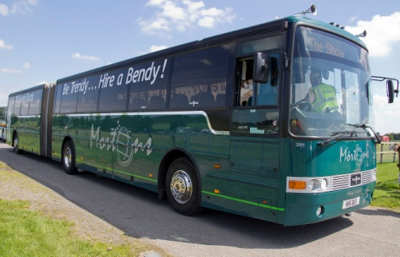
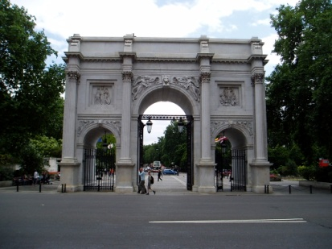
CLUB DIARY for JUNE
PORTHOLE #517 June 2022
The Rotary Club of the Island and Royal Manor of Portland {Register Charity Number: 1032098}
President: Celia Canter Secretary: Peter Burrows Editor: Ian McPheat
7 June No weekly Club Meeting
Council Meeting at 7.15 pm by Zoom
Committee Meetings to be arranged by Chairs
at any time during the week before.
8 June KIDS OUT – Crealy Park
11 June TABLE TOP SALE for the Leg Club
14 June CLUB ASSEMBLY
Grace/Greeter – CAROL HUMPHREYS
Finance – ROBERT GRIGSBY
21 June Business Meeting
Grace/Greeter – JANET KENCH
Finance – ELIZABETH HARDY
28 June Guest Evening
Grace/Greeter – STAN KNIGHT
Finance – CAROLYN HUMPHREYS
EDITOR’S NOTE
I am extremely short of articles. Just send them to me at macmolly10@gmail.com. Pictures need to be in jpg format if possible.

Slide 2

POLIO BACK IN PAKISTAN
Members will be aware of the case of polio imported into Malawi a few weeks ago.
This was an old virus which is still present in water samples after 18 months, and a child who was incubating the virus flew to Malawi where she developed polio.
Consequently this is classified as an imported case and not Polio In Africa again.
However, last week a child in Pakistan did contract polio and we have just heard today that there is a second case just turned up.
This is not really surprising considering the immunity level in a lot of Pakistan is nowhere near 100%, their general health and hygiene is not as good as children in this country, nor is their diet.
Having said that it is very disappointing have just got through 18 months with no case at all in Pakistan. We simply have to start again and hope there is no more spread.
Obviously the volunteers have descended en masse and have immunised anything that moves in that area so we await, with trepidation, further announcements.
Keith
Elizabeth giving the good news after the Treasure Hunt
Rotary Community Award 2022
Do you know someone who has ‘gone the extra mile’ within the Portland community over the last year? Perhaps they have made someone’s life better or improved the community for others.
Say ‘THANK YOU’ by nominating them for the Rotary Community Award for 2022
THE AWARD IS OPEN TO BOTH VOLUNTEERS AND PAID WORKERS
THE WINNER WILL RECEIVE A FRAMED CERTIFICATE AND A CHEQUE FOR £150.00 TO BE GIVEN
TO THE CHARITY OF THEIR CHOICE
PLEASE SEND YOUR NOMINATIONS TO: Community Award. 4 Briar Close, Weymouth, Dorset DT4 0EP or Email cantercelia2@gmail.com . Closing date for nominations is 30 June 2022.
# Please include your name and contact details
# The nominees name address and contact details
# Your reasons as to why they deserve the award

Slide 3
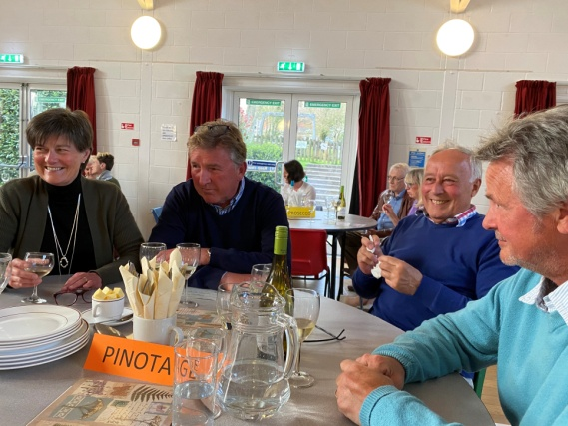
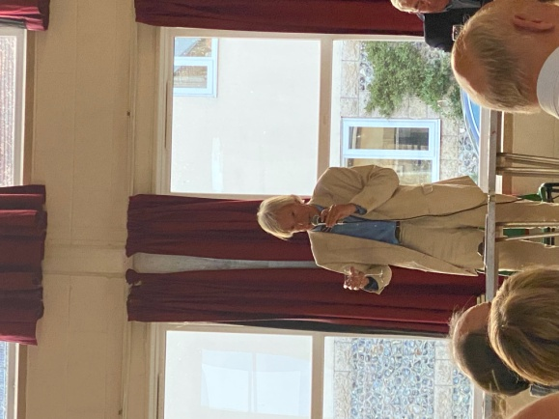
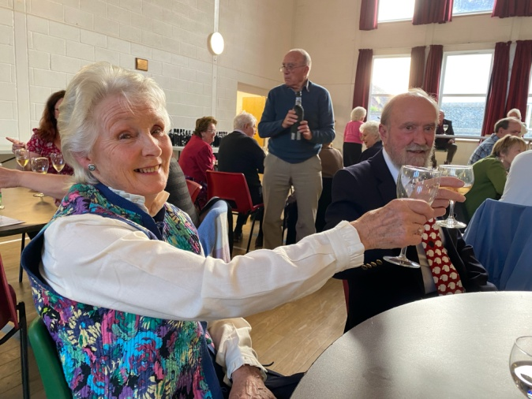
EQUALITY?
We have received a message from Shekhar Mehta (The President of Rotary international who is reporting on the recent D.E.I. survey (he quotes it as diversity, equity, and inclusion). but I think that the second word should be equality from his further comments
He goes on to say
Simply put, the DEI Code of Conduct asks you to:
Use respectful language
Be supportive
Foster a welcoming and inclusive environment
Celebrate diversity
Just thought that members might like to know!!
Keith
CALL MY BLUFF WINE EVENING
Our table 'Pinotage' had the honour of winning a bottle of a lovely red wine at the very funny Call My Bluff evening in Stratton. Barrie, Mike and Mike from Casterbridge Club gave sometimes hilarious comments as to which wine was actually we were drinking. All this was accompanied by a delicious casserole which, of course, was Rotary chicken! The fact that we had the scorer on our table had nothing to do with winning! Good fun was had by all, especially the table behind us who giggled all evening. Thank you to Casterbridge for the invitation with monies going to Age UK and Rotary charities.
Confucius Did Not Say
Man who wants pretty nurse must be patient.
Passionate kiss, like spider web, leads to undoing of fly.
Lady who goes camping with man must beware of evil intent.
Man who leaps off cliff jumps to conclusion.
Man who eats many prunes get good run for money.
War does not determine who is right; it determines who is left.
Man who fights with wife all day get no piece at night.
Man who drives like hell is bound to get there.
Man who stands on toilet is high on pot.
Wise man does not keep sledge hammer and slow computer in same room.
Man who lives in glass house should change clothes in basement.
And,Confucius Did Not Say. . ."A lion will not cheat on his wife, but Tiger Wood!"

Slide 4

Voices to Stone FB/FPN/Wensite/Porthole
Hannah Sofaer is a well known artist on the Island and has been putting stone sculpture at the foremost of the Portland Stone Quarry Trust at the Drill Hall in Easton . Hannah showed slides of the advancement of projects over the Island which included the Standing Stones at the top o' the hill which will have Bluetooth technology to enable people to hear about the interactive and interpretive Gateway. There was also information of Timeline showing a geological walk through time over millennia through the strata of the stones and also the future amphitheater to eventually be sited near Church Ope on East Weares.
Speaking alongside with Hannah was Eva, a young artist who, over Easter has been working with youngsters creating masks from the discarded stone dust, making moulds from the sea bed and other fascination finds in the stone.
They are holding several events at various places for the Queen's Jubilee Weekend:-
2 Performances at significant sites tba
3rd June National Coastwatch Portland Bill
4th June Memory Stones
5th June Jubilee Tea Party at the Drill Hall
It is because of wonderful people like these who are dedicating their time to Portland stone that we are able to continue finding out about our fascinating Island.
An amazing evening.
Kind regards
Sarah

Slide 5
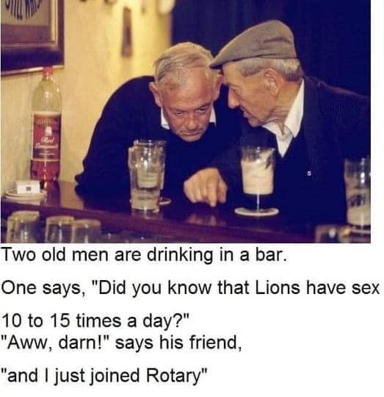


Imagine Rotary
You cannot imagine the past as it has already happened but you can imagine and change the future by your action. That paraphrases next year’s theme from Rotary International proposed by Jennifer Jones the first lady to be President of Rotary International since our inception in 1905.
I have just switched off from the annual District Assembly and thought I should add my comments while the memories are still fresh, and my overall impression was that it was like the curate’s egg, but I have to confess that I would not like to stand up and try and motivate and inspire members of District 1200 just on Zoom. It is a very useful communication tool when members cannot meet, but, to me, to inspire and motivate people means eyeball to eyeball contact.
We were shown a clip from Jennifer speaking at the on-line International Assembly which, if one listened underneath the external talking that was going on was very good, but, unfortunately, one of the Zoom listeners was not muted and had a telephone conversation with someone else while Jennifer was talking. I worked with Jennifer in Sao Paulo four years ago and she is a very capable, dynamic, interesting, motivational speaker, but talking to a static camera on Zoom, with outside interference did not do her any favours. Having said that, I believe that Rotary is heading for one of its best years for a long time now that the Covid restrictions are lifting.
However, for me the highlight of the District Assembly was the wife of Past District Governor Rory – Julie O’Donnell - who has a young mum, Olga, and her family from Ukraine staying with them. Hearing of the problems there, first hand, was emotional and humbling.
You do not want me to list all the various Chairs etc. who were introduced, all very briefly luckily, but perhaps it is worth noting that our Governor next year, Ric Canham, has picked, as the District’s charity for the year, our only charity – the Rotary Foundation - and has challenged us to match whatever our club can donate with an equal donation from the public. A golden opportunity to inform the public about what we are doing.
The Assembly finished with a plea for support for our District Conference. Those experienced conference-goers among you will remember weekend parties in Plymouth, Bristol, Torquay, Southampton and all stations north and east, but members have been asked what they want in a District Conference and the answer was – somewhere close, not too long, and not too expensive . So we have a Conference in Westlands at Yeovil on Saturday 15th. October from 10.00 a.m. to 5 p.m. At just £40 per person this could be a very interesting day where we can learn about the workings of Rotary, saving young Thai footballers from flooded caves, the Paralympics, as well as making new friends and meeting old ones, with just an hour’s car ride to Yeovil. Make a note of the date and let’s see if we can once again get up a large party to support President Mark and Ruth, and have a great District Conference – for our club.
Elizabeth giving the good news after the Treasure Hunt

Slide 6
MEET AND MEAT
I understand that our editor is short of copy for Porthole so I thought I would tell you of 46 years of Rotary experience with meetings and the meals therein.
I can remember our club members walking out of the Pennsylvania Castle Hotel the year after I was president because of the stewed sprouts (and other things), and I remember Hans, the chef, walking out of the Portland Heights Hotel in tears because most of the Rotarians did not like his meat balls and caper sauce. Billed as a conference centre it did not even have a slide projector at that time. Then we were persuaded to leave there and meet in the restaurant at the Southwell Business Park where we could have our own room and lots of facilities. We thought we had hit the jackpot. Only that, too, did not last and we ended up meeting in one end of the restaurant with other diners in the same room listening to, or trying not to listen to, our speakers. I found that incredibly embarrassing. At least that does not happen with Zoom.
I once sat at a table in Portland, Oregon with another 11 people on the table and, as we introduced ourselves to each other I realised that it was members of the club who were introducing themselves to each other because they had not met one another before even though they were in the same club (but they did have something like 800 members when they all attended). In the London club the last time I went, which was many moons ago, and cost, from memory in those days £30, most attendees were guests. Several new Ambassadors were inducted and that was the last time they would be seen. They paid their subs and went on their various ways as Rotarians – in theory. Prestige was what mattered.
Elizabeth giving the good news after the Treasure Hunt
One of the big problem that all Rotary venues are experiencing at present is the difficulty of finding chefs and catering staff – when my daughter trained for 4 years in Hotel Management and catering, not one of her year was going into the catering industry – long hours, poor pay and the prospects of promotion are not good. Of course Covid has not helped either as we have discovered.
Most club have a set meal, though nowadays there is often a vegetarian option, but that is it. No choice of different salads, alternative meals etc.. We have been very lucky. But just imagine a small restaurant with one chef dishing up 30 different meals for his or her customers – difficult at the best of times which of course is why most restaurants want their diners to turn up at different times to make it easier on the chef(s). But to do 30 (or more with partners perhaps) different meals at a set time takes some planning and some doing. It is, of course, a lot easier in a large establishment with a number of different chefs but in a small family run hotel that is almost impossible.
Wiveliscombe used to have a lovely buffet – all set out on arrival and the staff left us to it as we simply helped ourselves, but of course, it does take time to prepare.
In the good old days when Rotary took two hours at lunchtime, the boss left work to the other staff, but times have changed and many people work right through lunchtime nowadays which is why our club changed to evening meetings a long time ago. Most clubs in the UK now meet in the evening and I do not think there has been a new lunch-time club in the UK and Ireland for many, many years. With many Rotarians having partners who also work, the Rotary dinner becomes the main meal of the day as Rotarians do not want to work all day and then go to a meeting with no meal only to have to cook on arriving home late in the evening.
Yes, as you can see times have changed, as have the expectations of Rotarians. I find it fascinating attending other clubs to see how they run their meetings – why not try it sometime? It is a very good way of learning what should, or, sometimes, what should not happen. I could write a book on that, but not for the moment.
Keith
And Judy and I have attended several clubs in India where the ladies met in one room (Rotarians) and drank tea, while the men (also Rotarians) met in the next room and drank whisky. It’s a good thing I prefer whisky! And in St.Lucia six visitors (Judy and I were two of them) met three of the St. Lucian Rotarians, outnumbering them 2:1. I understand that the club folded the next year.
More problems occur in Rotary clubs over the food than any other topic – a salutary thought. Many Rotarians want a five star meal but expect to pay a one star price. Our costs are on a par with, or slightly less than, other local clubs although Poundbury with a breakfast club is a lot cheaper but they do get a cooked breakfast on the last Friday of a month for which they pay a little more.

