Slide 1
Community Champions Overview September 2022 Sarah E Clarke Public Health Healthy Communities Lead Stockport Council

Slide 2
What are community champions?
Community champions –are people who want to help improve peoples health and wellbeing
How?
By sharing information about health and wellbeing - vaccine info, cancer prevention, how to be more active, where to get help if feeling low, struggling with money and much more
Finding out what people and communities need and what their questions are and feeding them back to Public Health.
Helping to shape Stockport's services so that they are easier to use. Helping to understand where there are gaps in support.
Sharing stories of what our community champions and communities are doing to improve people's health and wellbeing

Slide 3
About the programme
Set up in 2021 partnership between Council and voluntary Sector - original aim to connect to people most at risk from Covid19 to reduce the impact of the pandemic on themselves and those around them. Now focus on general health and wellbeing ​
All welcome to become community champions. Individuals can join but if possible we like them to be supported by a Community Champion Organisation.
We recruit Organisations to become Community Champion Organisations (see next slides)
Particularly want to connect to people who support our local ethnically diverse communities; ​​disabled people;​​ carers;​​ refugees + asylum seekers,​​ at-risk elderly community; ​​at-risk young people​
Its informal, flexible and designed to work alongside any other work and volunteering commitments

Slide 4
A community champion organisation commits to ...
support Community Champions to promote health and wellbeing by ....
Being a trusted point of information
Helping to share this amongst your community champions – whether workers or volunteers
Promote the Champions scheme to encourage others to become Champions
Share local insight and experience from your Champions
Support your champions (workforce and volunteers) to attend a welcome session and any further training​ champions are interested in
Help shape how health and wellbeing messages are developed and delivered
Provide feedback on Champions
Programme
Notes:
Only use this slide if training being delivered by a CCO
Being a trusted point of information and help share this amongst your workforce and volunteers.
Promote the Champions scheme to workforce and volunteers and encourage them to become Champions.
Share local insight and experience as a Champion Organisation.​
Support your workforce and volunteers to attend training and contribute to their training, support and development.​
Help us shape how information about COVID-19 and wider health and wellbeing messages are developed and delivered.​
Provide feedback so we can continuously improve.​
You will be supported through a Champion Network with tools and resources, including training for Champions.​

Slide 5
We can support you.... Public health provide the messages, materials and named contact for any support needed or feedback you want to give.
Sharing your messages, questions, request for comments and insight with our Champions network. ​
Notes:
Only use this slide if training being delivered by a CCO
Being a trusted point of information and help share this amongst your workforce and volunteers.
Promote the Champions scheme to workforce and volunteers and encourage them to become Champions.
Share local insight and experience as a Champion Organisation.​
Support your workforce and volunteers to attend training and contribute to their training, support and development.​
Help us shape how information about COVID-19 and wider health and wellbeing messages are developed and delivered.​
Provide feedback so we can continuously improve.​
You will be supported through a Champion Network with tools and resources, including training for Champions.​

Slide 6
Just some of our champion organisations
Notes:
Welcome and Introductions and opportunity for organisations to promote their work

Slide 7
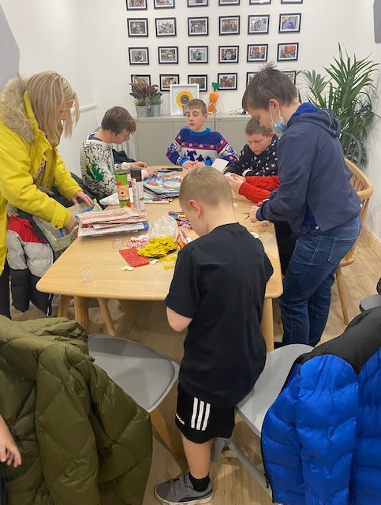
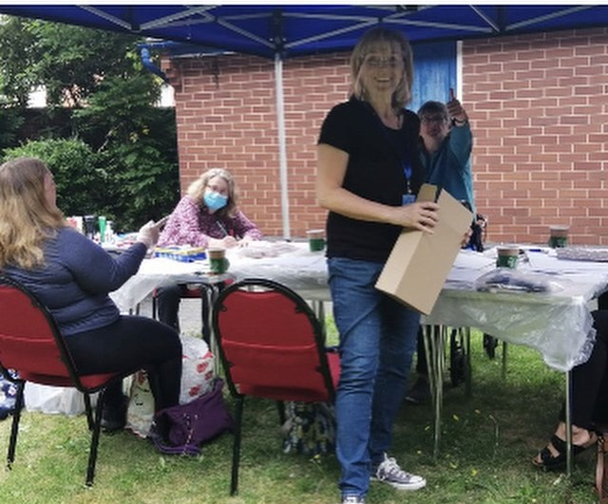
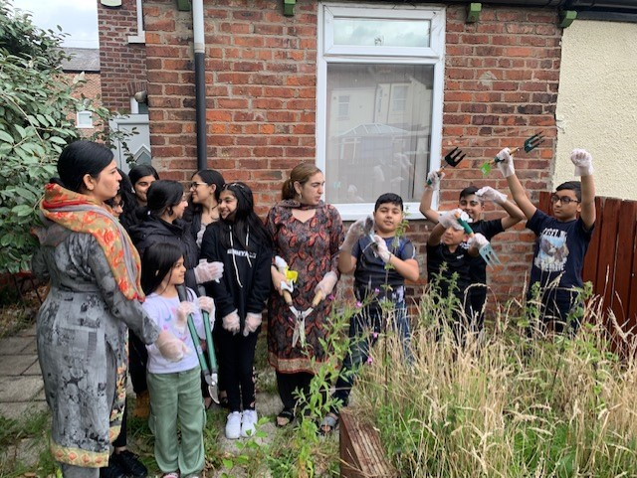
Who is involved and what have they been doing?
46+ organisations involved – from larger “anchor” organisations to small community groups.
Activity has included: developing borough-wide networks for communities, proactive wellbeing checks with people on wating lists for counselling or who have disengaged from services such as SPARC; community advice drop ins; radio broadcasts produced by young people; social groups; cooking, art and gardening activities; new sports activities for young people; outreach to local community through leaflet drops.
Lots of scope for different activities under community champions umbrella

Slide 8
Some Public Health Priorities
What are your priorities? how can we help you?
Warm Winter
Covid and flu
Active comm-unities
Early intervention and prevention
Strengthen neighbour-
hood level
Strengthen links with VCFSE
Mental wellbeing
Notes:
All of this info is taken from the VIG

Slide 9
Can you help support a Warm and Welcome Stockport this Winter?
As part of the upcoming One Stockport winter campaign, Stockport Council are looking to create an interactive map of all the warm spaces available for people to attend for free between November 2022 and March 2023.
To draw people in, ideally these spaces will offer free warm drinks and/or focus on an activity or event.
Grants of up to £1,000 – to set up, provide refreshments/activities or sustain activity for longer time
More info available next week
Add your warm space/event to our map
Don’t need a grant? Please fill out this form with information about your warm space/event to add it to the map.
If you have any other questions, please email Imogen Fox.

Slide 10
Just some of our champion organisations
Please join us
communitychampions@stockport.gov.uk
Tel 07800 617535
Thank you
Notes:
Welcome and Introductions and opportunity for organisations to promote their work

