Slide 1


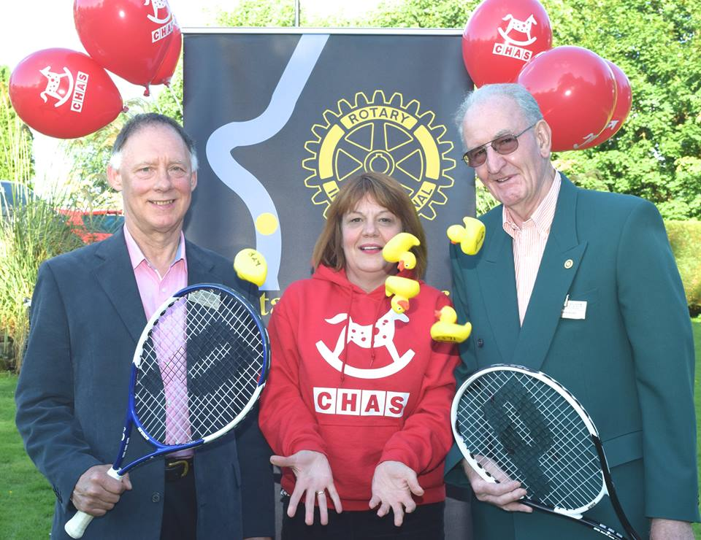
Notices 13 July 2017
Chas
Update from Alison Rennie

Slide 2
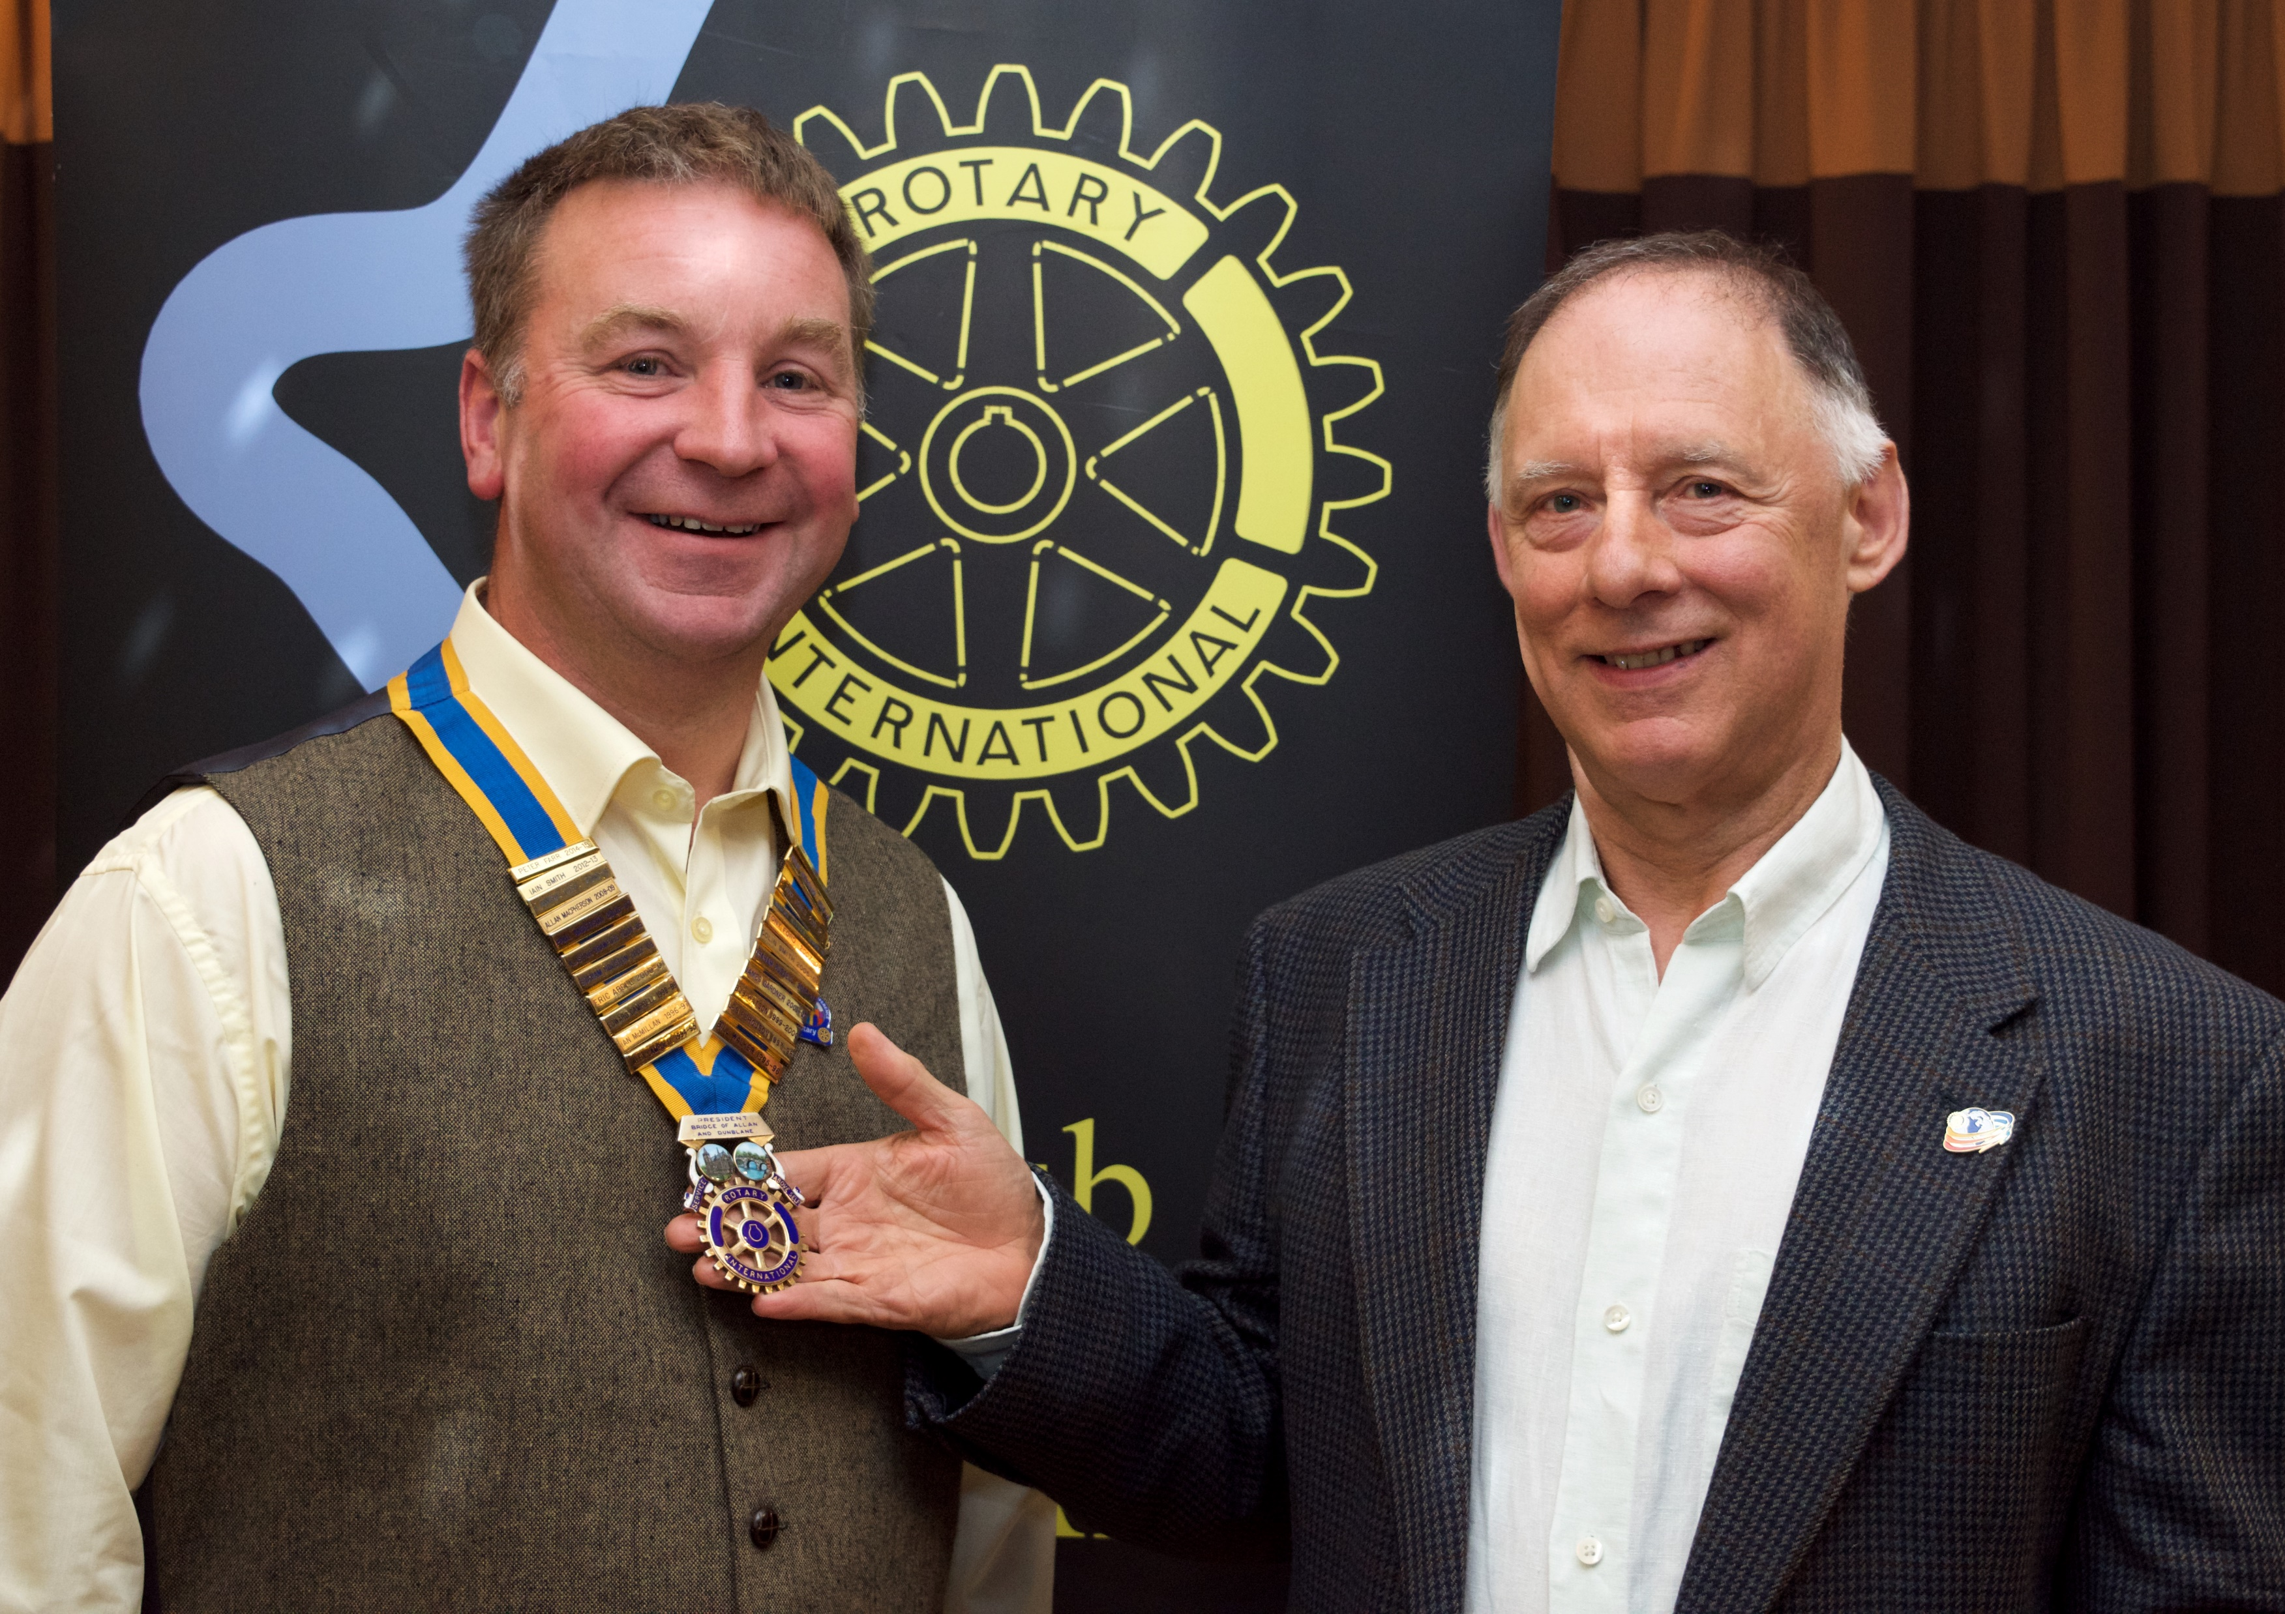
Press Report from Last Week
Notices 13 July 2017
HANDOVER
The meeting of the Bridge of Allan and Dunblane Rotary Club on Thursday saw the formal handover of Presidency by President Nick Rawlings to his successor, George Morrison. Following this, John Kilby and Andrew Hilley took up their appointments as, respectively, President-Elect and President-Nominee.
In welcoming his successor, President Nick reflected on a busy and successful year’s activity. This success, he said, was a reflection of the willingness of members to give of their time to the various projects which had contributed to the local community and more widely. For this, he thanked members, and for the support which he had been given during the year.

Slide 3
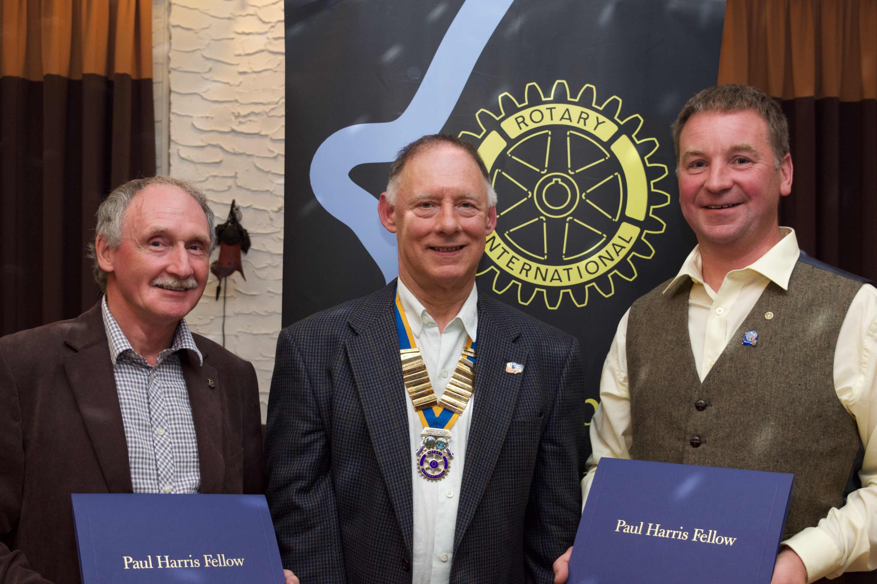
Notices 13 July 2017
That, however, was not the only accolade for George Morrison. Before passing the Presidency to him, President Nick had the pleasure of presenting Paul Harris Fellowship Awards to him and to Jim Gardner. The Paul Harris Fellowship, created in memory of the founder of Rotary, is a particularly auspicious recognition of service to Rotary. George’s tireless work in support of Rotary programmes, and his care and oversight of Rotary equipment were particularly commended. The recognition of Jim Gardner, President in 2001/2, reflected his enormous contribution to Rotary, most notably through the success of the Am-Am golf competition which, annually, raises some £14,000 for Strathcarron Hospice. As reported elsewhere in the meeting, this year’s Am-Am has continued that success, attracting 55 teams of four to the competition.
.

Slide 4
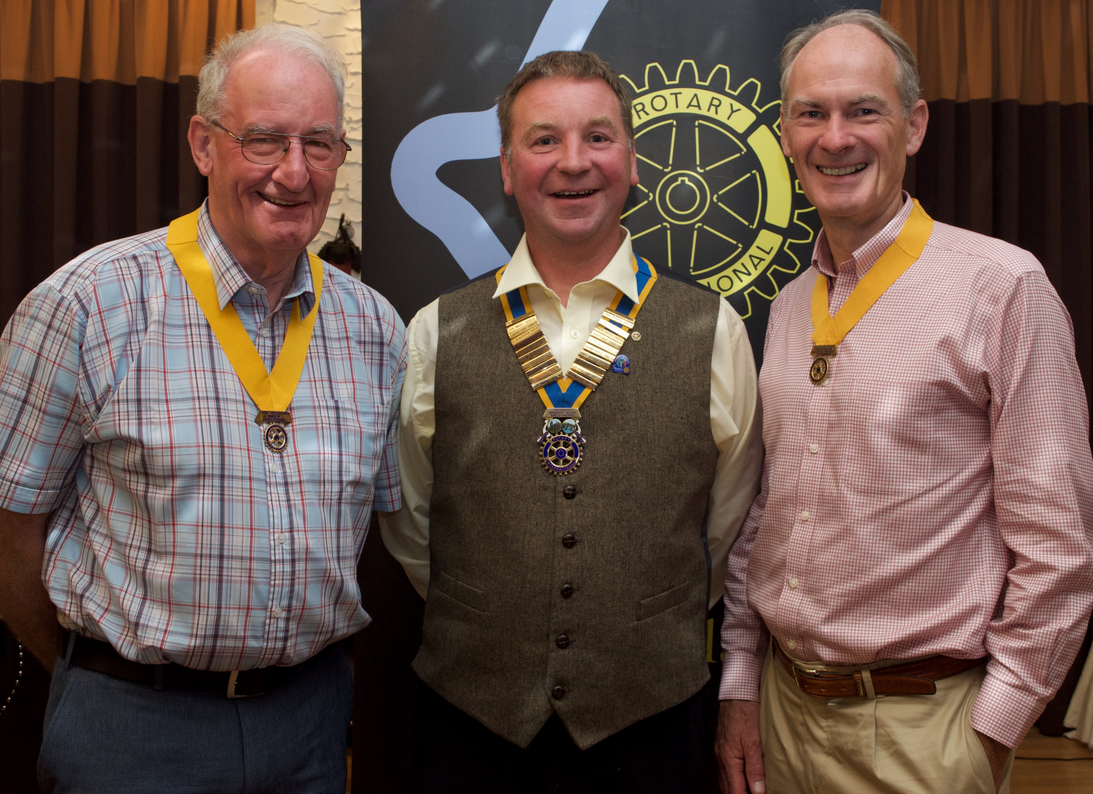
Notices 13 July 2017
Following the handover, President George was warmly welcomed by members. He reflected on the contribution by members to the various good causes supported by Rotary. His theme for the year would be Teamwork makes a dream work. This approach would be the means of the Club working to fulfill the President of Rotary International’s commitment to Rotary Making a Difference. Suggested as one element of this is the proposal for a tree to be planted for each member of Rotary worldwide – some 1.2 million trees - as a means of supporting the steps to reduce global warming. Alongside this commitment, and the many activities proposed for the year, he hoped members would continue to value and enjoy the fun and friendship that are important parts of Rotary membership

Slide 5
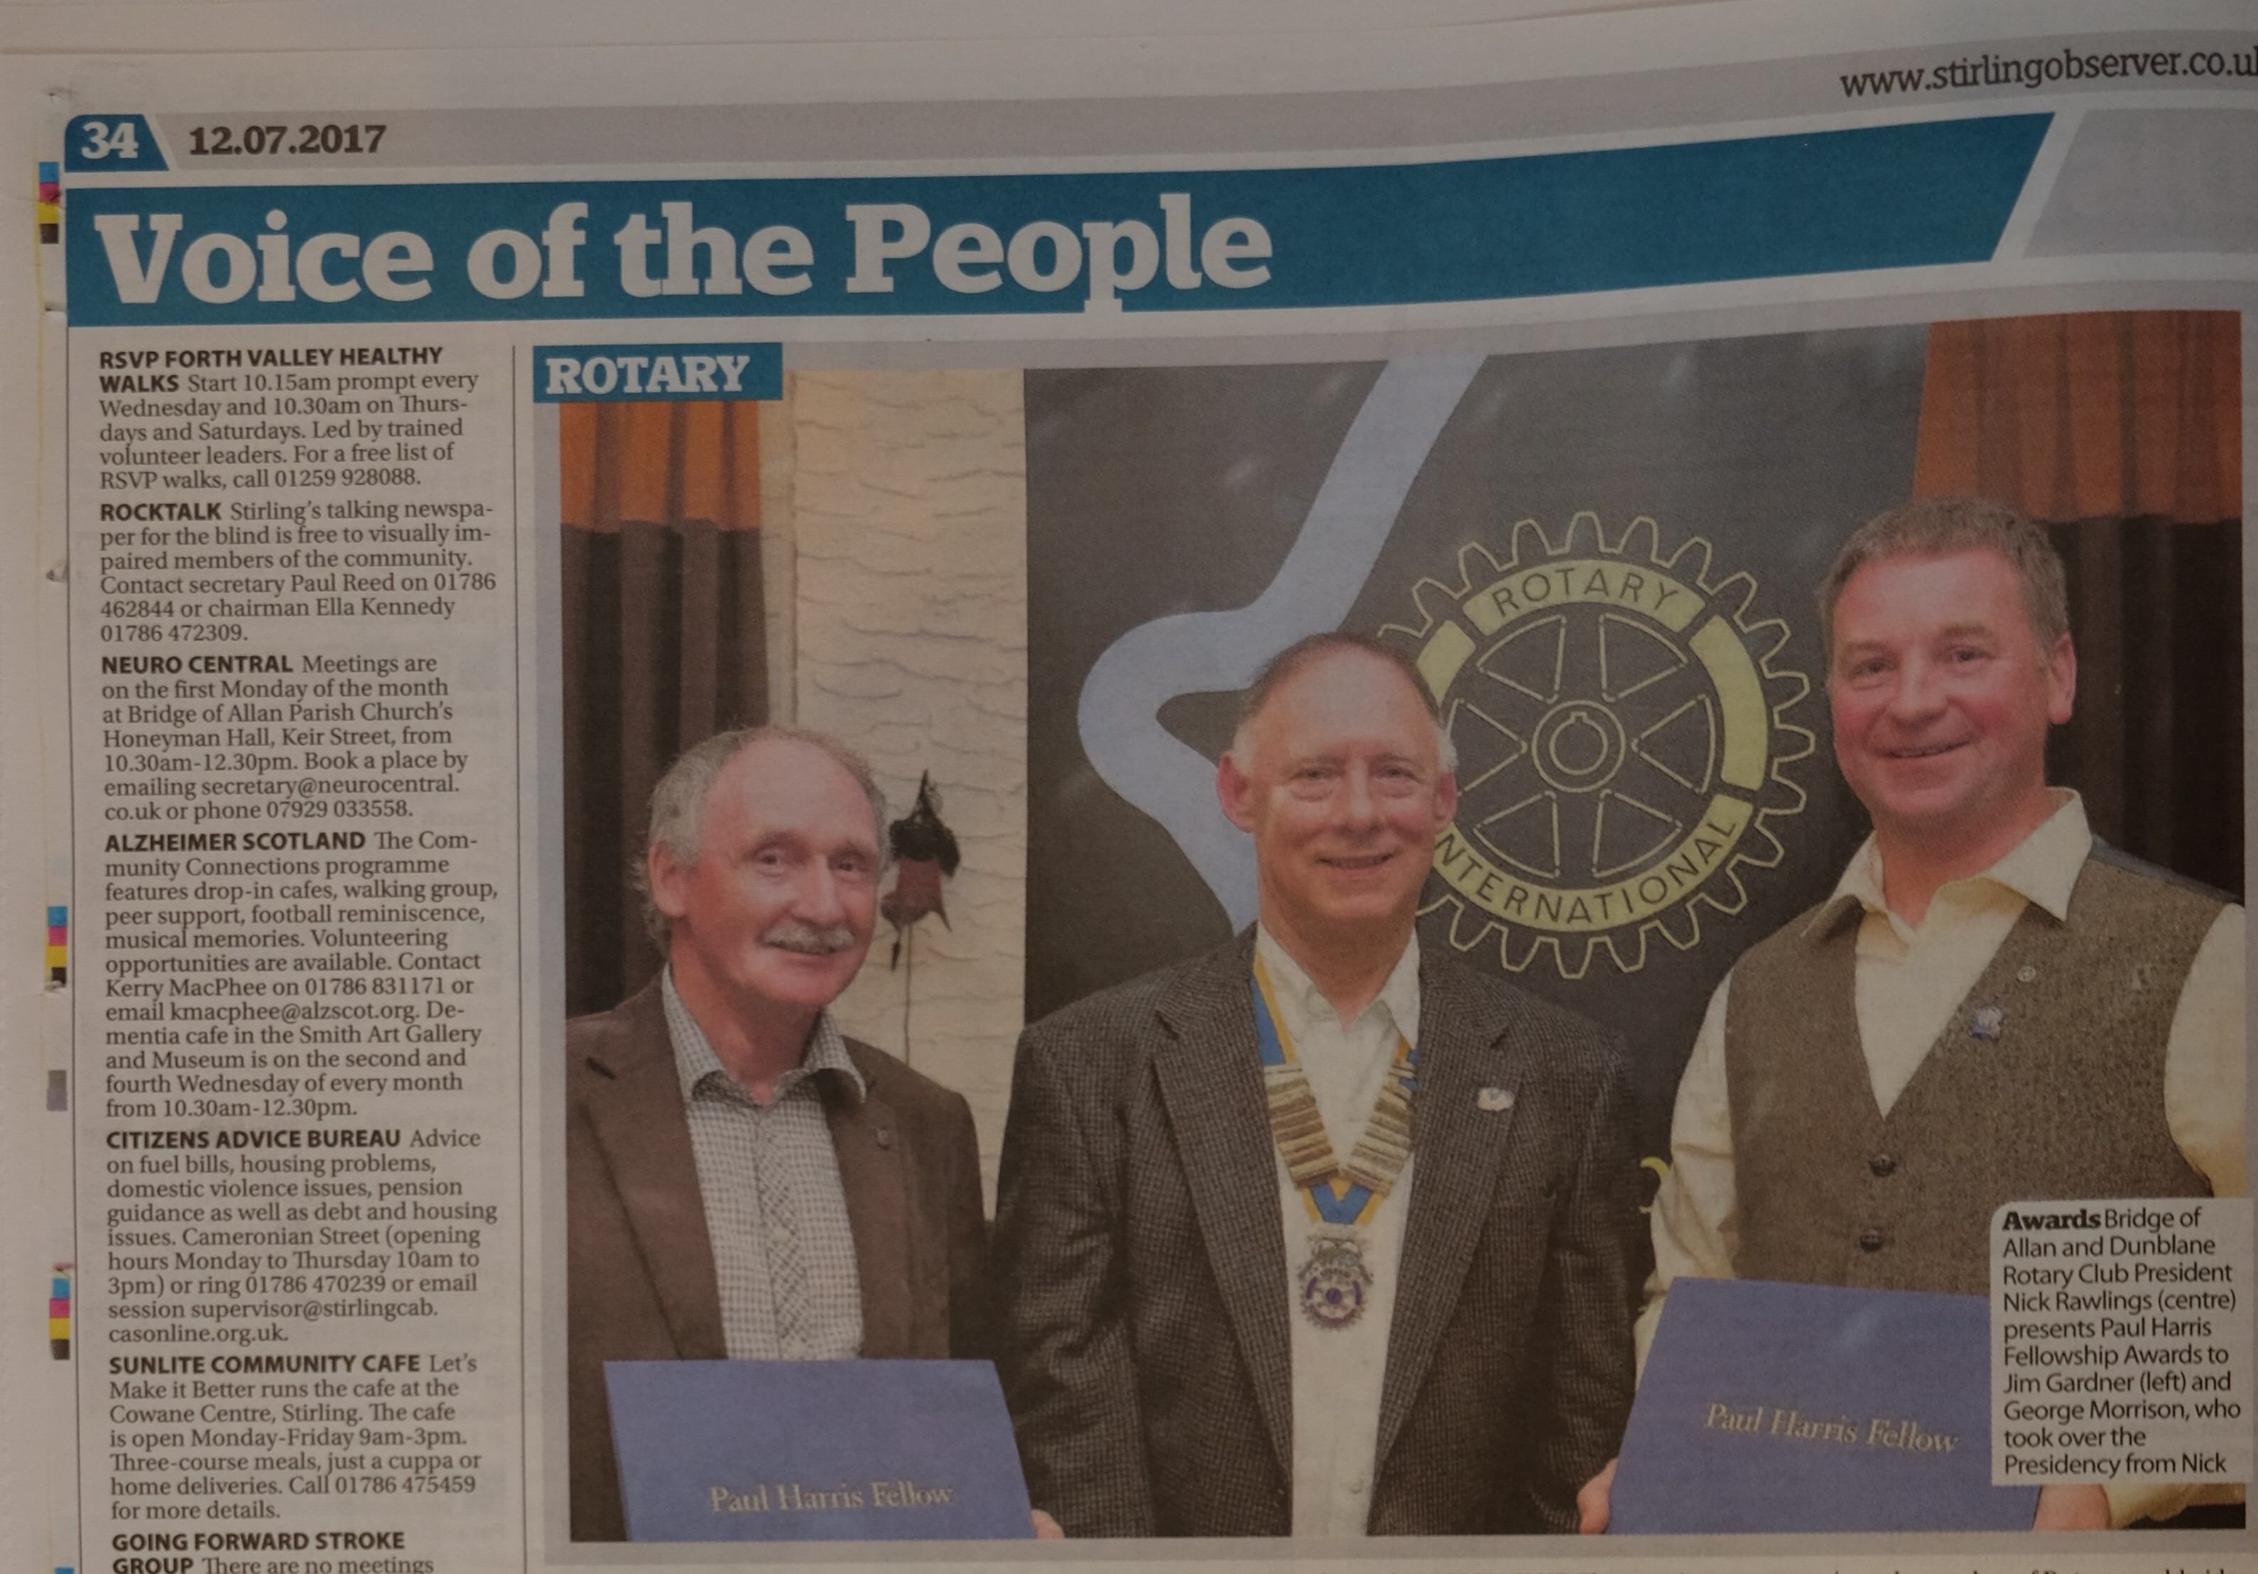
Notices 13 July 2017

Slide 6
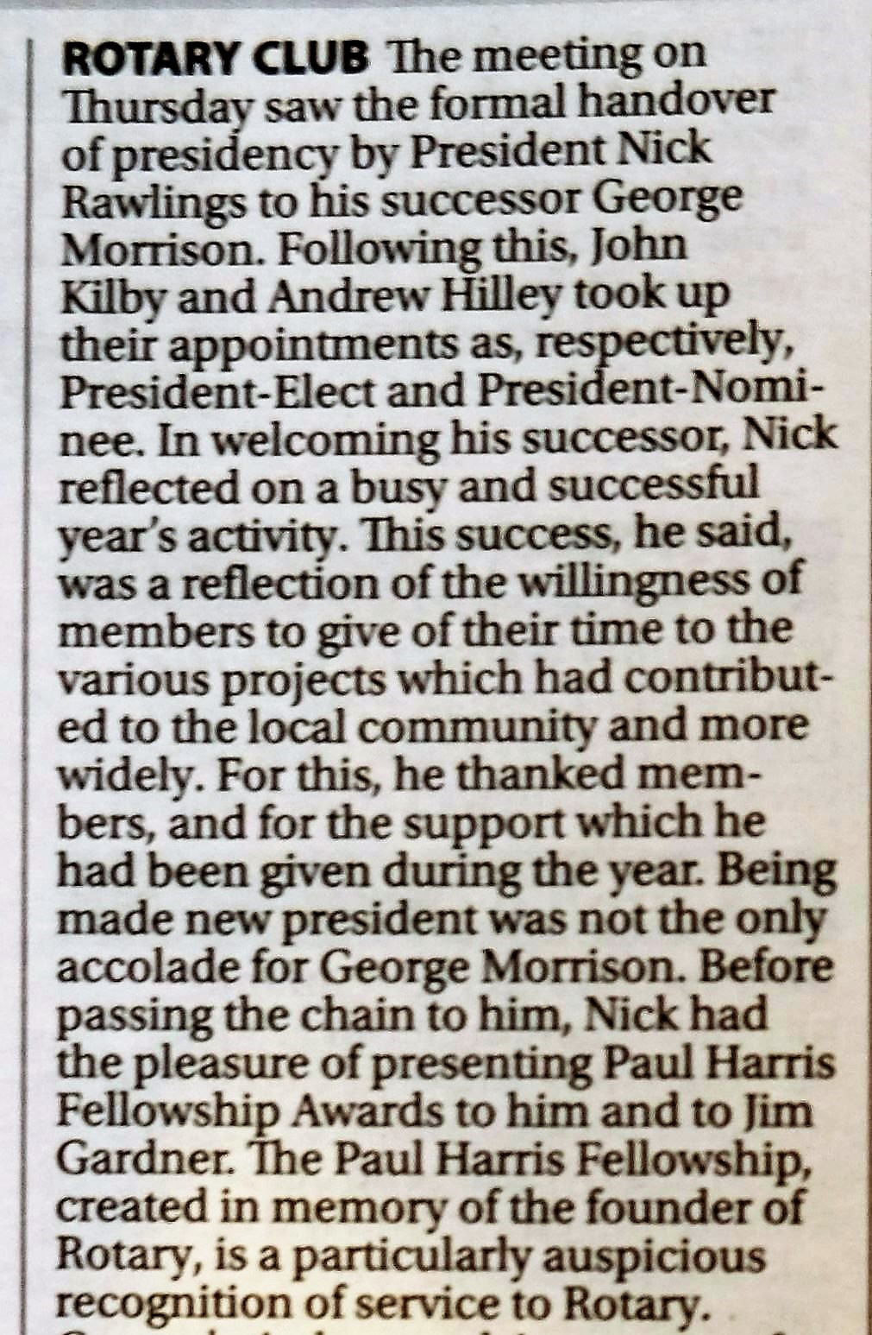
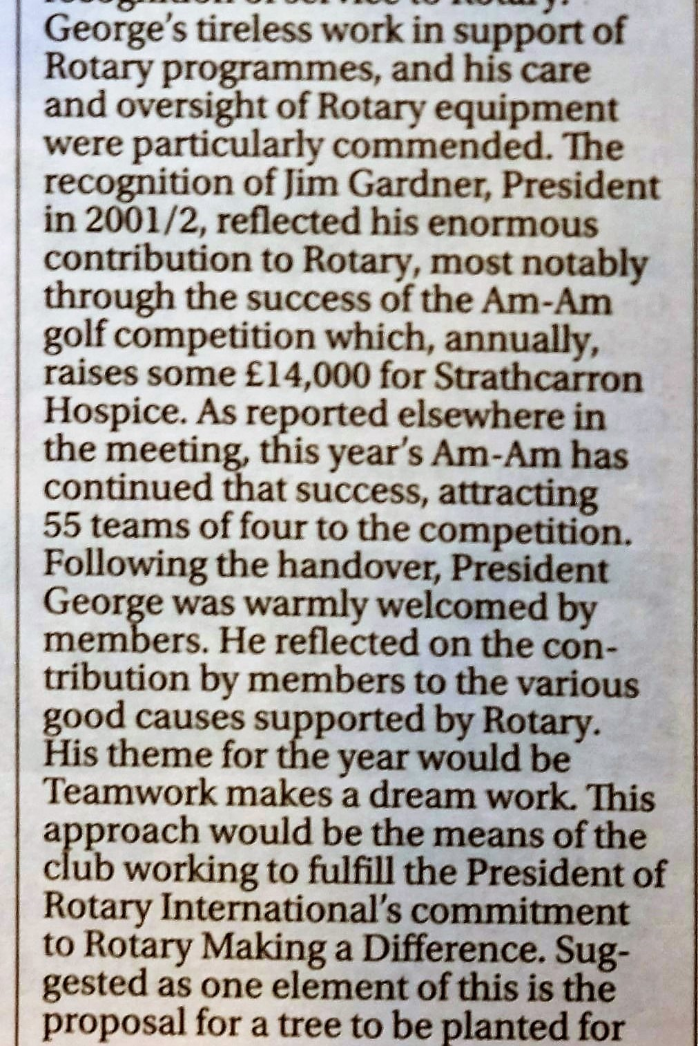
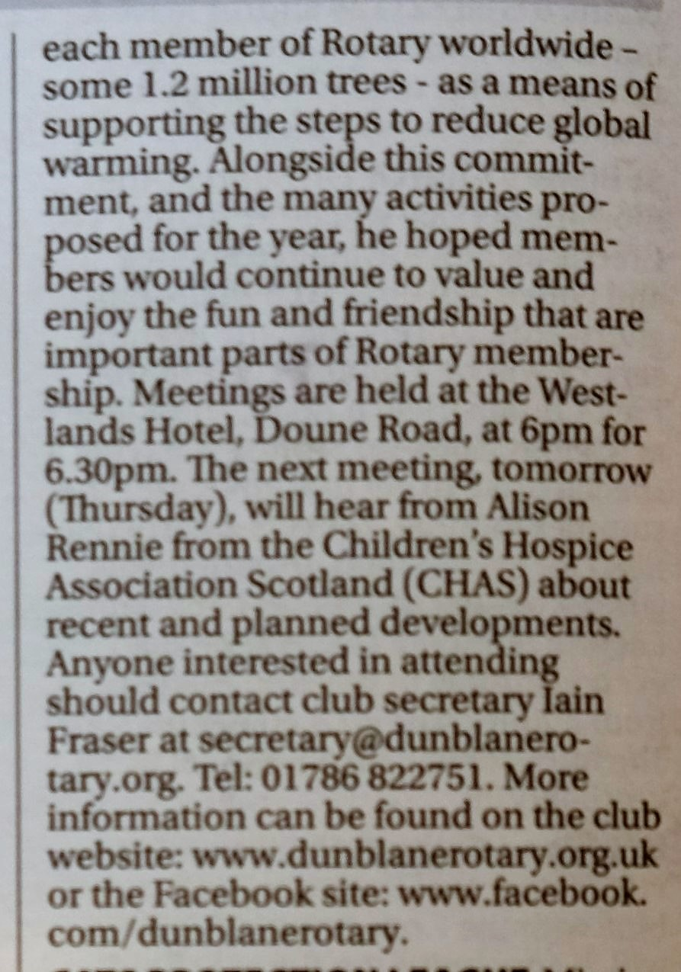
Notices 13 July 2017

Slide 7
Notices 13 July 2017
Diary Dates 2017 – 2018
Thursday Meetings |  | Speakers Host | Visitor Host | Door & Set up | Events & District Meetings
2017 |  |  |  | Bill Kelso Weekly
Jul -13 | Latest developments in CHAS – Alison Rennie | Rod Jones | Glen Montgomery | Ivor Butchart Peter Farr
Jul - 20 | Business Meeting |  | Kenneth Murray | Les Ferguson Russell Clarke
Jul - 27 | Dementia Friendly Dunblane – Breda Seaman & Bonnie McDowell | John Kilby | Lawrie Orr | Mary Fraser Audrey Cooper

Slide 8
Notices 13 July 2017
Diary Dates 2017 – 2018
Thursday Meetings |  | Speakers Host | Visitor Host | Door & Set up | Events & District Meetings
2017 |  |  |  | Bill Kelso Weekly
Aug - 3 | Visit of District Governor Graeme Archibald | Alan Lee | Billy Phillips | Jim Gardner Andrew Hilley | 5 August 6 August | Judy Murray Family Tennis Competition - BoA Highland Games - BoA
Aug - 10 |  | Alasdair Mackie | Nick Rawlings | Peter Hill Peter Holmes
Aug -17 | Business Meeting |  | Gordon Robb | Rod Jones Graham Houston
Aug - 24 |  | Hugh McCrea | Graham Russell | John Kilby Alan Lee | 20 August | Strathcarron Hospice Swamp Challenge - Banknock
Aug - 31 | Fun Evening | Allan Macpherson | Ranald Shepherd | Alasdair Mackie Lawrie Orr

Slide 9
Notices 13 July 2017
22 Members have completed the Club Survey closing this weekend

Slide 10
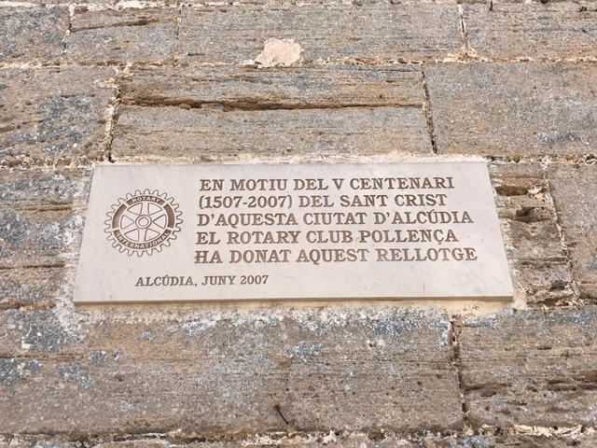
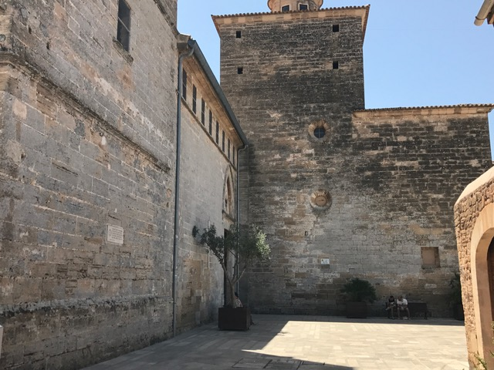
Notices 13 July 2017
Spotted by Jonathan Marshall in Alcudia earlier today.

Slide 11
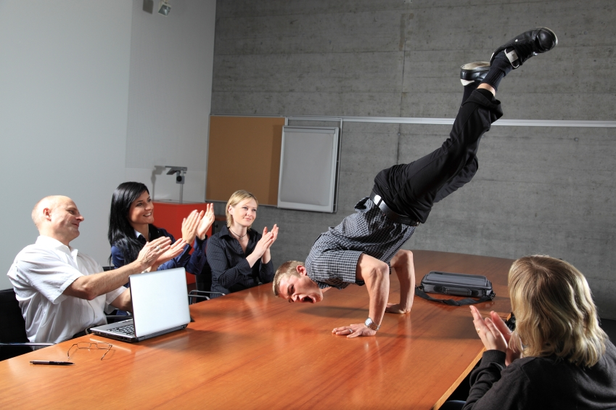
Notices 13 July 2017
Next Weeks Meetings
Business Meeting

