Slide 1
Ajaz Ahmed Khan, Senior Microfinance Adviser, CARE International
Presentation given to Rotary, District 1180, Nantwich, Cheshire, 1 May 2018
Speaker:-

Slide 2
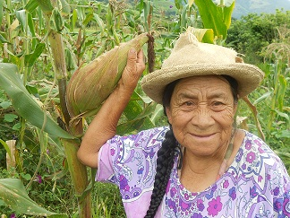
What is Lendwithcare?
Lendwithcare is a crowdfunding platform that supports businesses in low-income countries
Rather than charity or handouts, micro, small and medium sized (SME) businesses are given loans to help establish or develop their economic activities
The focus is on creating employment and income earning opportunities and encouraging (some) people to work their way out of poverty
We started in 2010 and now work through 14 local partners in 11 countries (Zambia, Malawi, Rwanda, Zimbabwe, Philippines, Cambodia, Vietnam, Pakistan, Palestinian Territories, Ecuador and Peru)
We always work through local partners who are either co-operatives, credit unions or non-governmental organisations in which profits are shared between members or re-invested in the organisation
70% of the loans made through Lendwithcare go to women who, research indicates, spend a greater proportion of their income on the welfare of the family.

Slide 3
How does Lendwithcare work?
You visit the website – www.lendwithcare.org - and select a person to lend to. You can lend as from a minimum of £15 to the full loan amount.
100% of the loan goes to the borrower and you can as a lender, if you wish, make a voluntary donation
Borrowers repay the loan monthly and your account is credited
As the loan is repaid you can, if you wish, lend it out again. Or you can withdraw the money from your account.
You can see who your money has helped and receive updates on their progress
All our partner organisations provide clients with extensive training and technical assistance as well as other financial and non-financial services

Slide 4
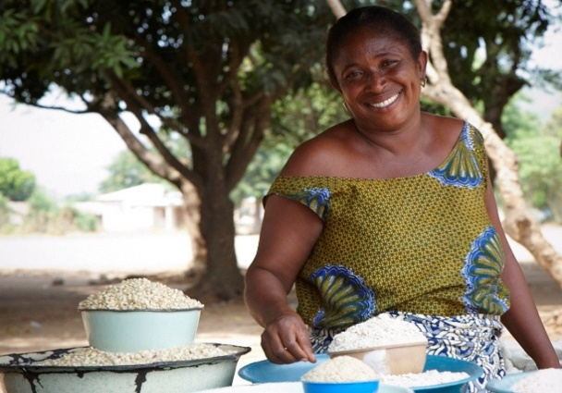
What are the benefits?
We support small businesses in order to create employment, increase incomes, generate wealth and build assets. We promote self-reliance and independence in poor communities – it is a ‘hand-up’ rather than a ‘hand-out’.
If all goes well (repayment is 99.7%), lenders receive their money back and they can withdraw their funds or choose to re-lend. In theory, the mone can simply keep revolving and continuing to help people indefinitely.
Transparent – you can see where your money goes. All funds go to the borrower, we do not charge interest or take anything in administrative costs.
Experience over the last 40 years has shown that poor people (especially women) are in fact a very good credit risk

Slide 5
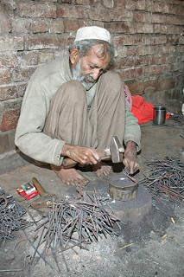
What are the challenges?
Selecting appropriate local partner organisations with whom to work since they are the ones who receive and appraise all loan applications. They decide what is a feasible business proposal or not. It is extremely difficult selecting the ‘right’ partner organisation.
Do they possess a strong social development mission as well as being financially sound? We undertake a lengthy process of due diligence on each partner.
Covering our operating costs – because all of the loan monies go to support borrowers – we take nothing
We work in fragile environments so adverse weather, natural disasters and diseases all regularly impact on operations – we have had to re-schedule loans on several occasions.
In Pakistan we also fund ‘liberation loans’ to assist people who are heavily indebted to local moneylenders, and sometimes even trapped as bonded labourers

Slide 6
What is our strategy?
We only fund loans for business and production – we do not fund consumption
We adhere to an ethical lending policy – we do not support loans for environmentally unsustainable practices and in fact actively promote initiatives that encourage cleaner energy and reduce pollution such as solar energy, fuel efficient cooking stoves, and less polluting rickshaws
About 10% of loans are directed at SMEs as these are the most likely to create waged employment opportunities for the poorest.

Slide 7
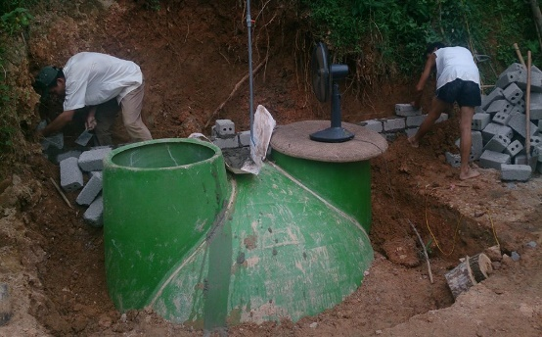
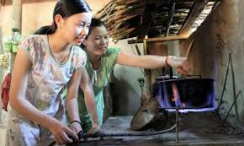
Promoting cleaner energy in Vietnam
We have provided loans to build several hundred household biogas plants that accept animal manure and other organic waste. After it decomposes it produces biogas that can be used for cooking, lighting and heating
Households no longer need to pay for electricity (some households were not even connected to the grid in any event) nor collect firewood
Households save money and (women’s) time and other benefits include reducing deforestation, illnesses, environmental pollution and carbon emissions
We also support many loans for improved water and sanitation

Slide 8
Increasing fair trade links
Can we find markets for some of the items produced by borrowers?
Would lenders be interested in buying these items?
Linking with online retailers such as http://www.khama.co.uk/ to market some of the items.

Slide 9
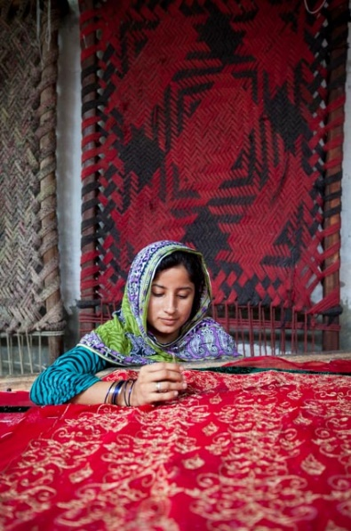
What about impact?
We have undertaken rigorous research with the University of Portsmouth over the past three years in Pakistan and Zimbabwe.
Data has shown increases in borrowers’ incomes and a reduction in poverty levels as compared with non-borrowers
In Pakistan, on average, clients personal and household monthly income increased by 20% while monthly expenses increased by only 2.5%.
23% of clients reported purchasing household assets in the previous 12 months in 2017 compared to only 10% in 2015
74% of clients reported increased sales and 34% reported an increase in business assets
The proportion of clients identifying lack of capital as the main limitation decreased from 77% to 20%
There was a positive impact on employment. Whereas 69% of clients reported working alone in 2015, this proportion had fallen to 54% in 2017

Slide 10
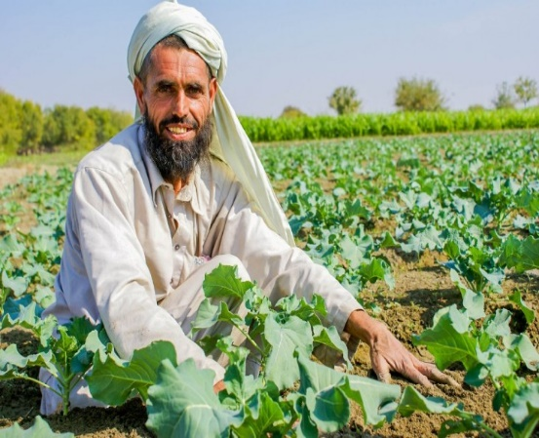
How have we done so far?
We have more than 48,000 lenders (95% are from the UK) and this includes groups as well as individuals. We attract around 500 new lenders each month
Raised over £20 million in loan capital (the average loan size is around £375)
Funded 84,910 small businesses. Since we are growing exponentially we expect to have funded over 100,000 small businesses at some point during late 2018 or early 2019
99.7% on time repayment
As well as consolidating the employment of borrowers and their immediate families, we have also helped to create 17,334 new jobs by these businesses taking on new workers
We usually re-schedule loans when borrowers livelihoods are impacted by events beyond their control such as typhoons and flooding.

Slide 11
Rotary International Support
We have 203 Rotary Clubs from throughout the UK lending regularly
Rotary Club of Nantwich joined Lendwithcare in May 2013. So far it has loaned £12,531 and received £9,524 in repayments. It has supported 201 small businesses. It has never withdrawn any funds, rather it re-invests any repayments it receives.
Other Rotary clubs from District 1180 include Ormskirk Clocktower, Flint and Holywell, Bangor, South Sefton, and Tarporley.
Rotary’s support has been instrumental in the success of Lendwithcare through both lending and generating publicity
In the spirit of Rotary International we aim to help those less fortunate than ourselves and by helping this cause we are giving these people a chance to help themselves improve their circumstances with dignity.

Slide 12
Thank you! Khan@careinternational.org
At a time when about half the world’s population lives on the equivalent of US$2 a day, the critical role that jobs play in advancing development cannot be overstated. For a country, jobs bring economic and ultimately political stability. For an individual, a job means more than an income. A job brings self-respect, independence and choices. A job brings family stability. And a job brings empowerment, especially for women and young people.

