Slide 1
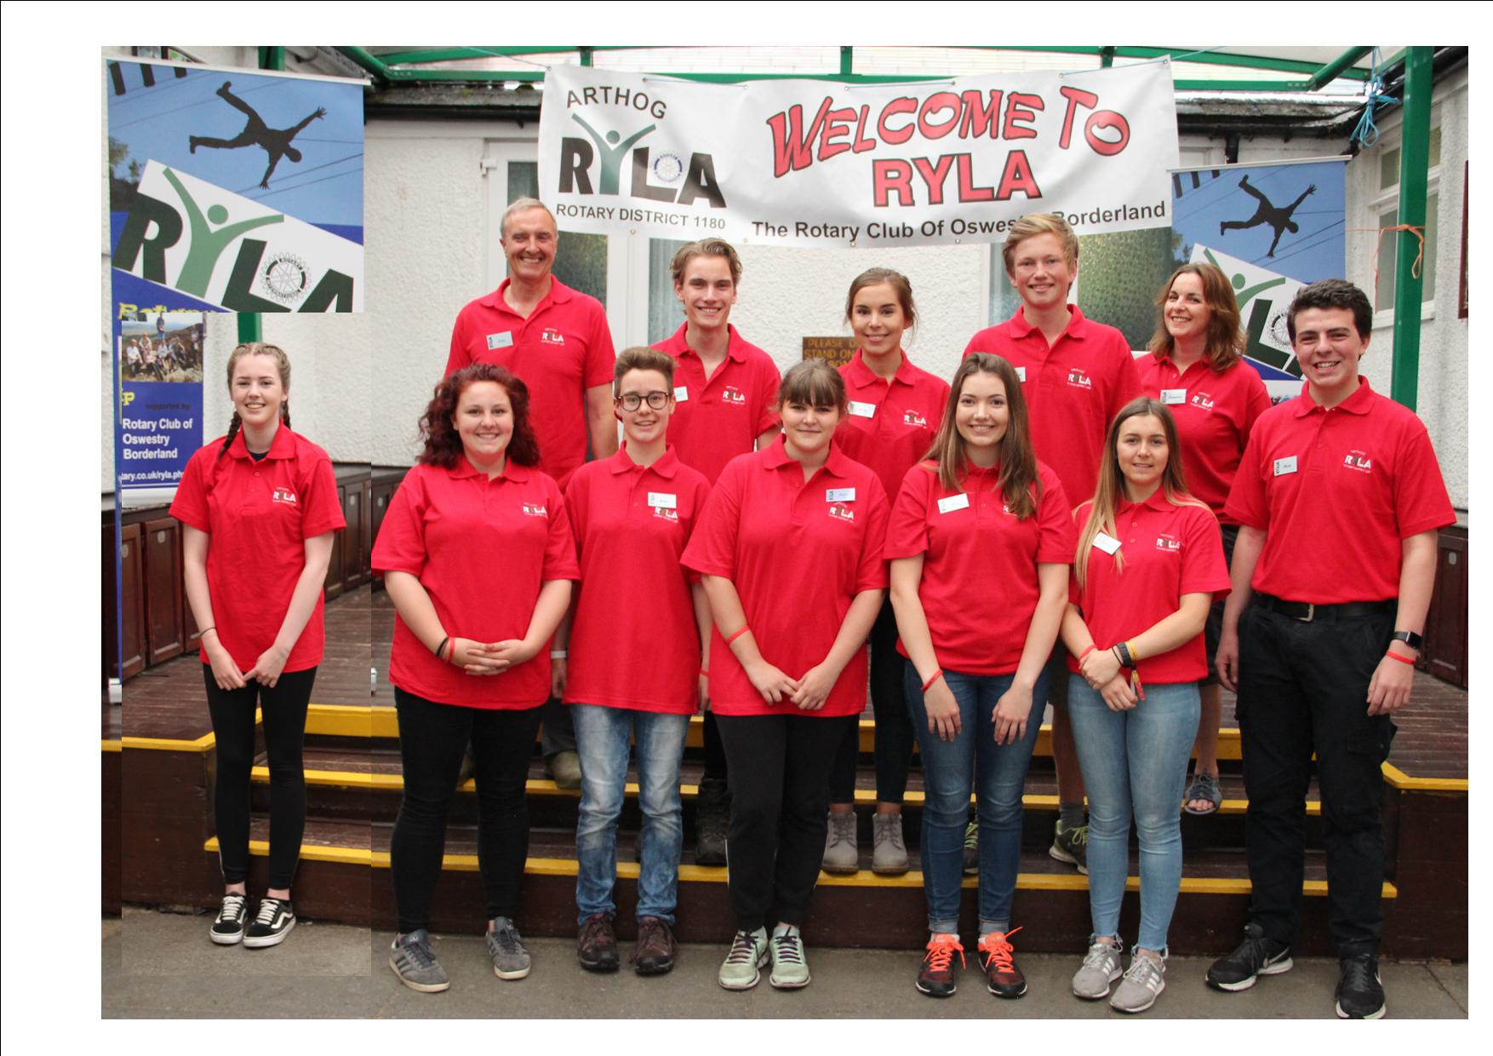
My RYLA Experience
By Alya McLean

Slide 2
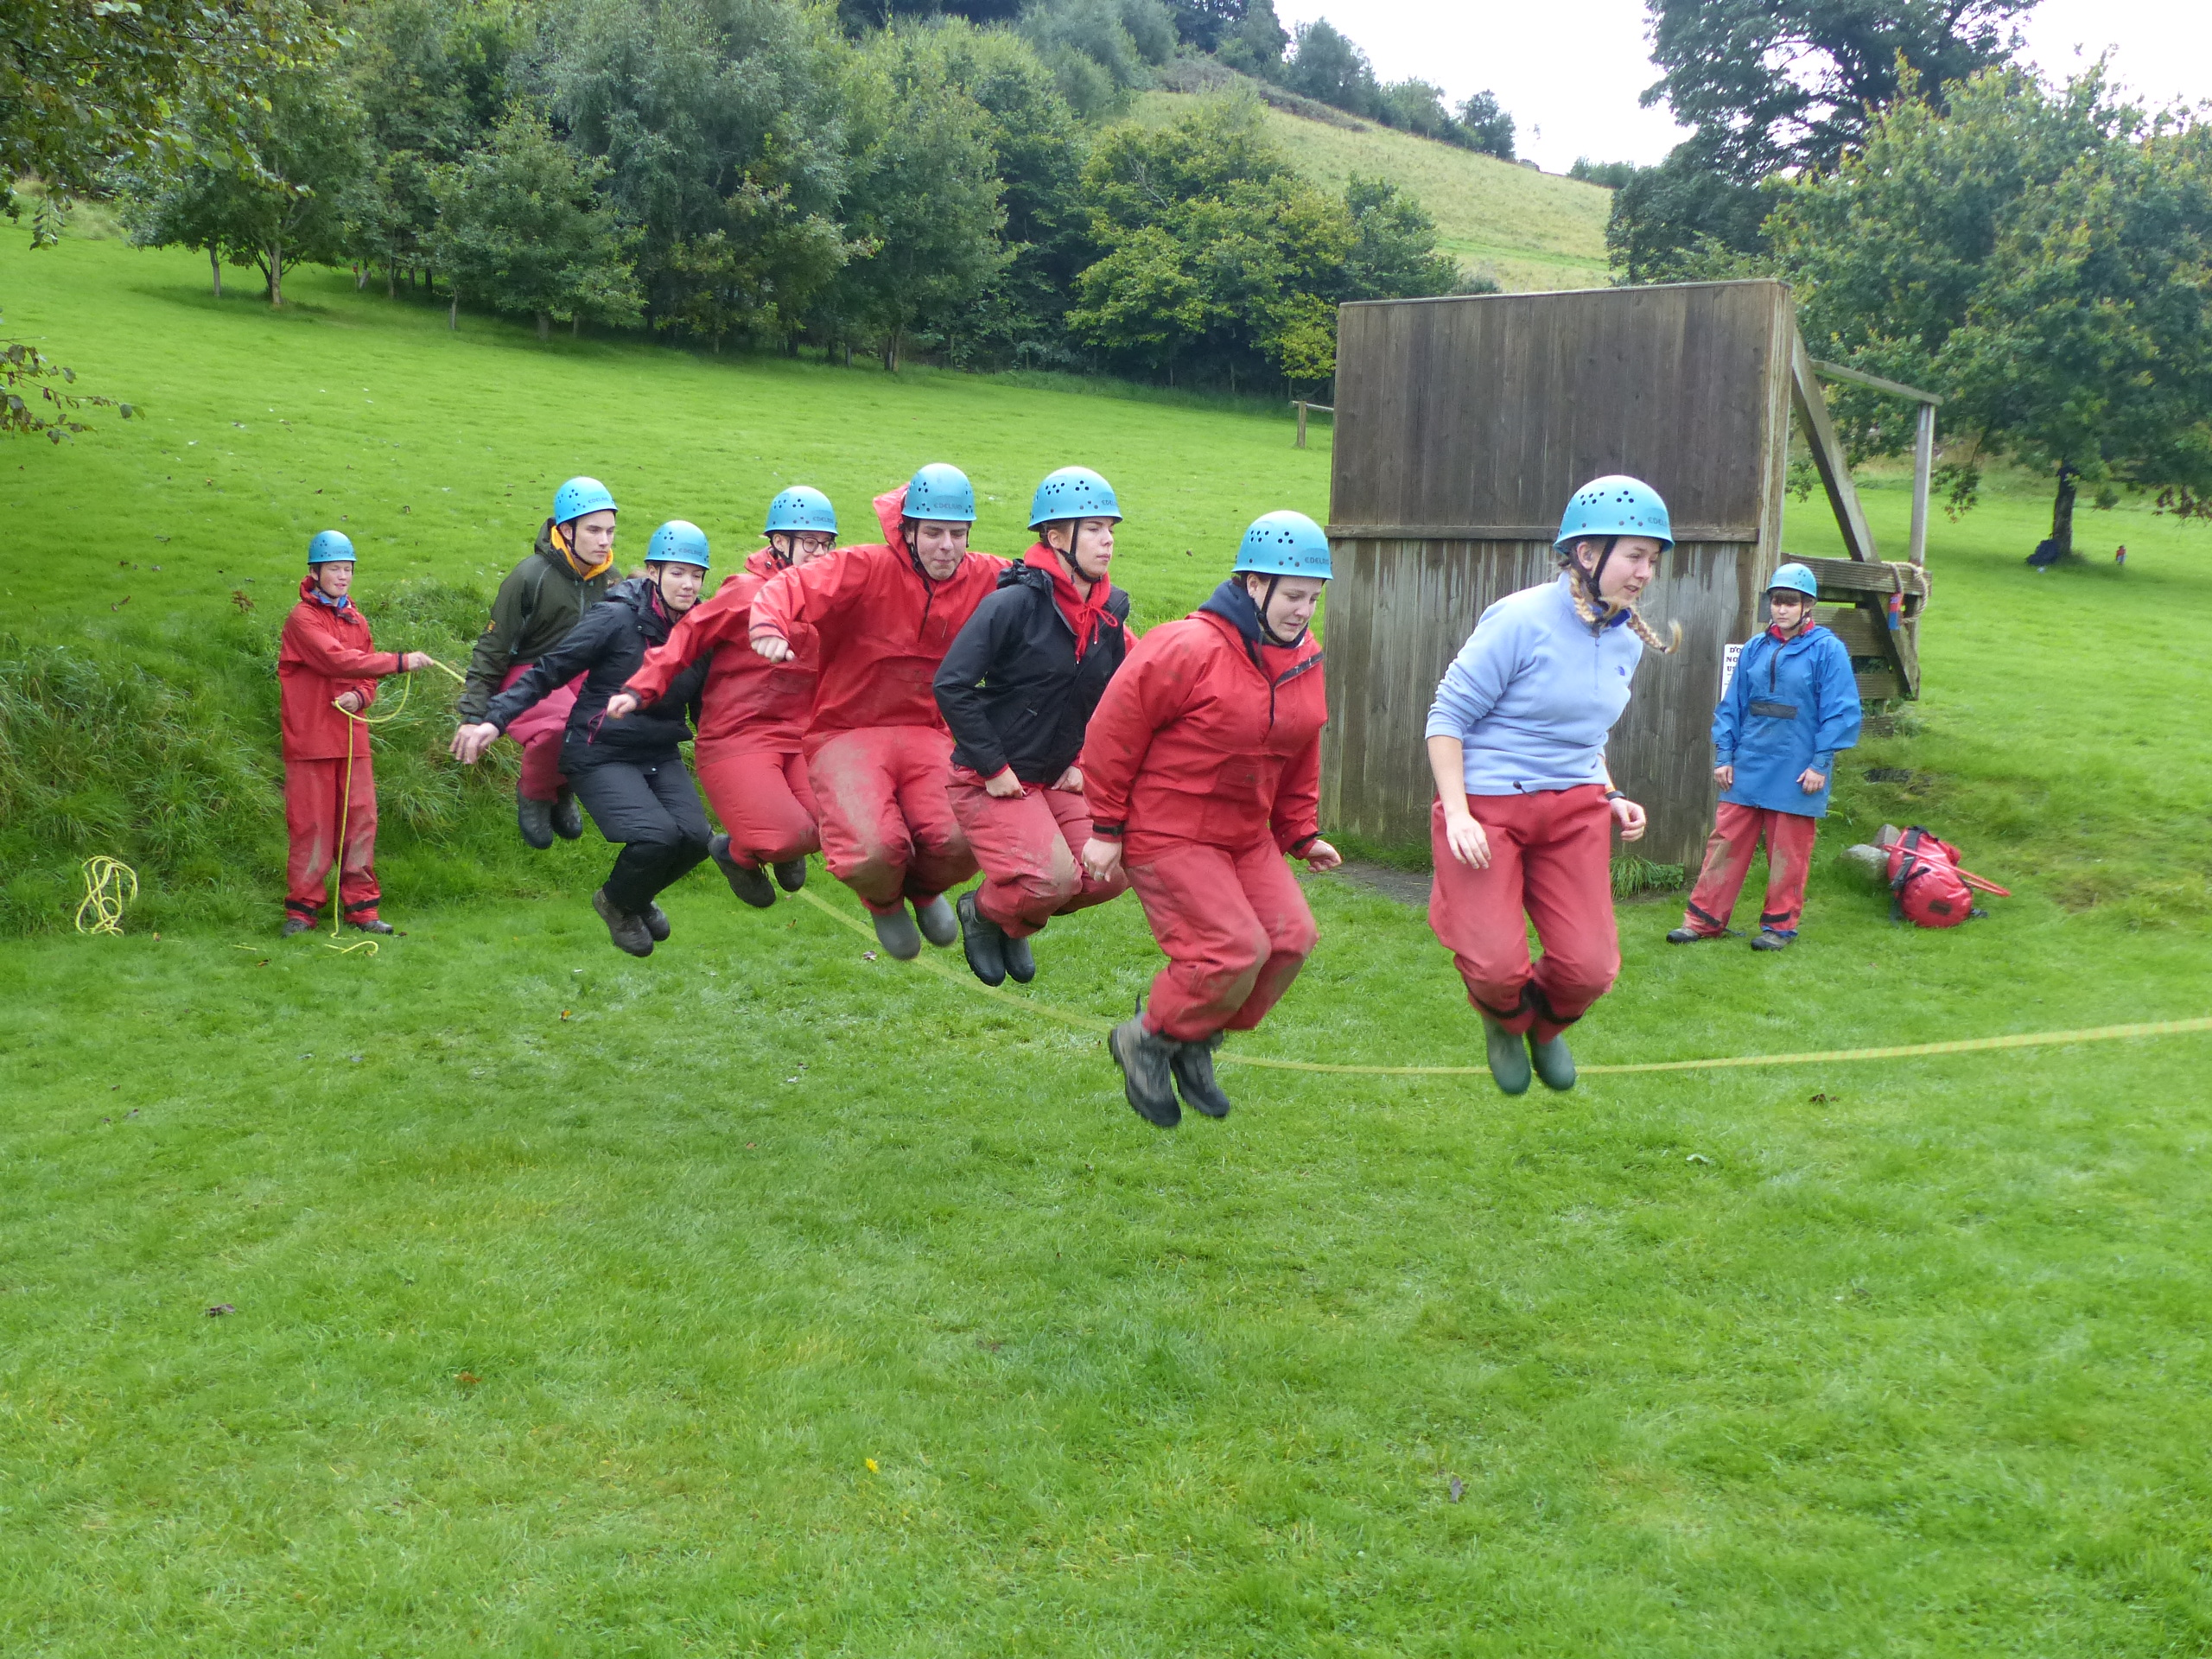
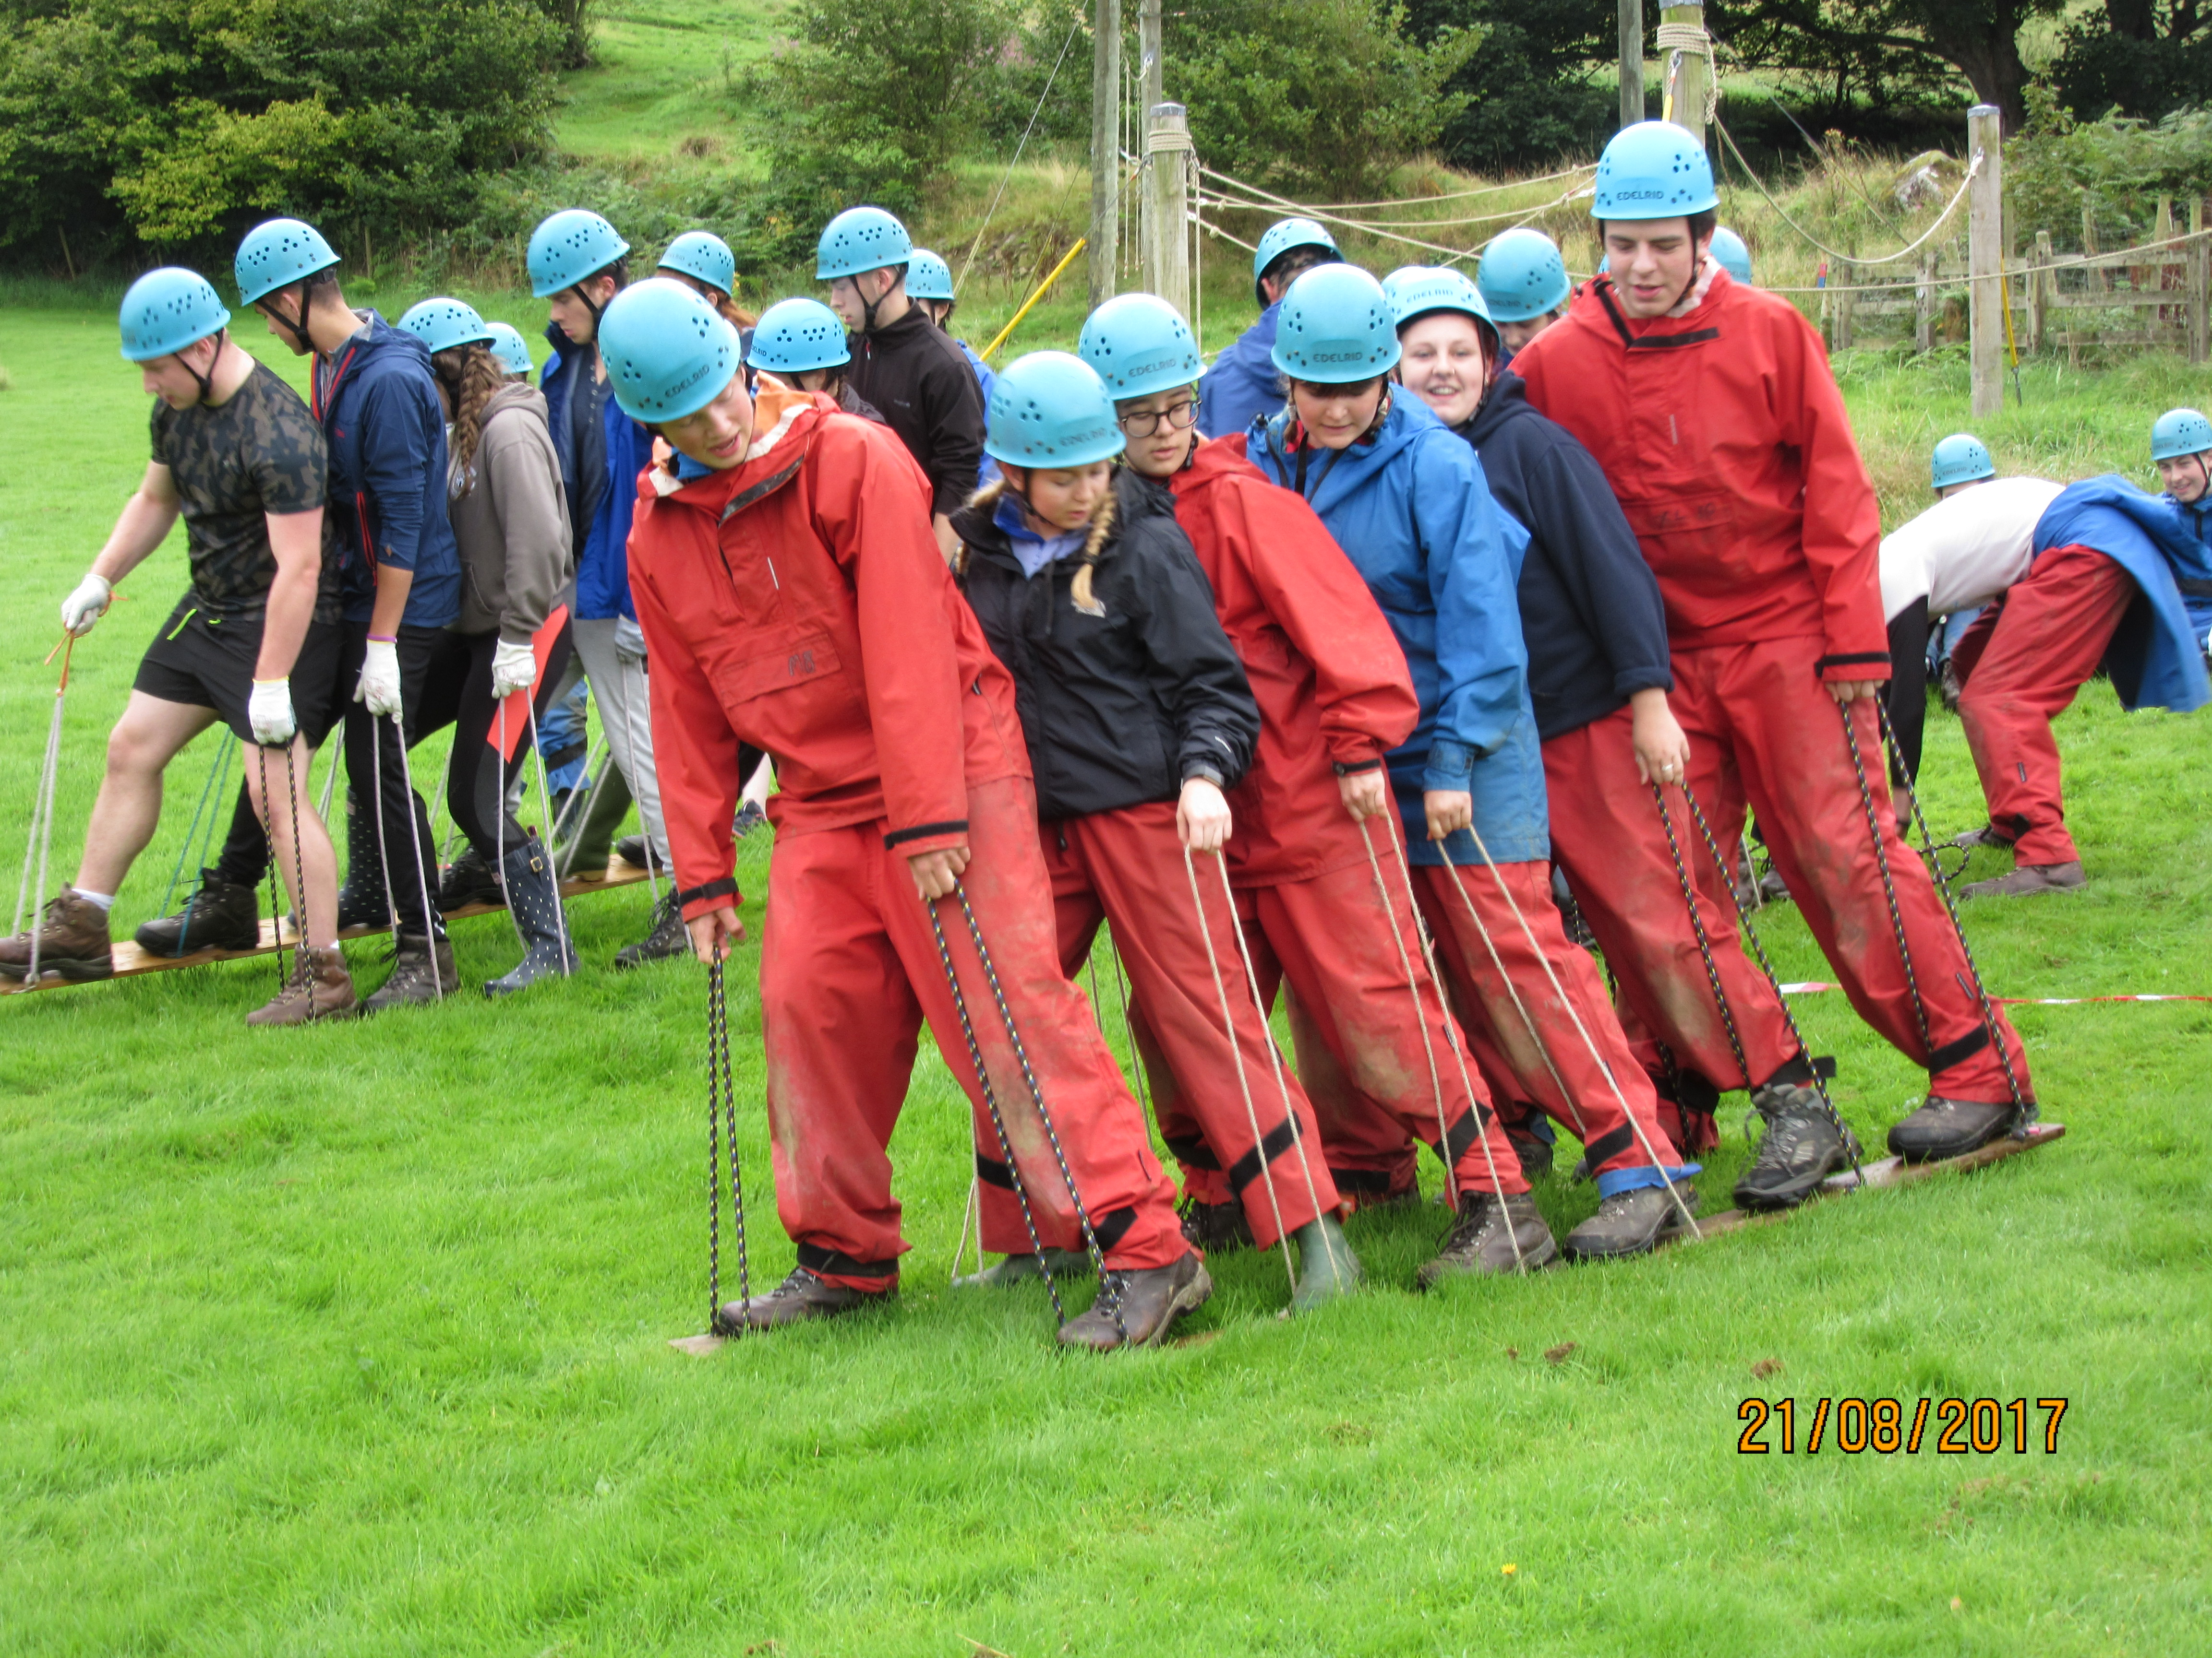
Activities
Over the week I engaged in multiple activities from mental challenges in the mornings, to Command tasks midday and challenges such as the Arthog Castle in the afternoons. Each of these activities had the shared goal of developing my ability to be a leader as well as a team player.
My first Command task was to get my team to all jump in unison in a skipping rope. Although my team was successful and beat a supposedly long-held record for the number of skips, I didn’t feel as though I had properly been able to be the leader due to my own shyness as well as the fact that I had only met these people hours before hand.
I was quickly asked to lead another task, the Army wall. This time I was challenged to get my whole team up and over the wall without any one else taking control or overpowering me and my voice. This was a real personal challenge that I had to overcome as I am not the most out spoken person, but my team went on to complete this challenge successfully and quickly too under my guidance.

Slide 3
How I approached the RYLA Course
I knew that this course involve me looking at myself as a leader. I also knew that this meant I would have to work out what my weaknesses as a leader were.
One night the Red Team came together and wrote down what it was we wanted to achieve from RYLA in terms of leadership. My goal was to make sure that my voice was heard within a group as well as ensuring my ideas were considered.
Establish weakness
Work out how to change this
Put this into practice
Get feedback
Do this for others

Slide 4
Leadership Learning
Another method of strengthening our blossoming leadership skills was to get members of each team to learn about a different activity to later teach to the rest of their peers during the final raft race. I put myself forwards to learn about Canoeing and how to build a canoe raft. We then were taught how to properly navigate our canoes as well as how to keep in time with our partner.
Me and my partner Ceri then participated in games in our canoe on a small pond, after canoeing up a large lake. We played a version of tag with forfeits such as balancing on the edge of the canoe without falling in.

Slide 5
The Raft Race
On our final full day the moment we had built up towards was the Raft-race it was each member of the teams chance to lead the others in their skill, in order to complete challenges and build the best raft and win the race. Throughout the entire week, in the evenings, we were involved in a dragons-den styled activity in which our successes in each day’s challenges and activities won us cash which was then used to buy materials to build our raft. In order to have a comleted raft there was a minimum amount of equiptment needed so that each team could compete in the final race. However, the real challenge was to build your raft for the least amount of money possible whilst still having money left over at the end. This meant that tactics were needed.

Slide 6
After the Race- the final day
We were going to find out who had won the raft race, who had won the overall competition and when we were going to be able to shower in peace again.
Our team leaders/ supervisors had worked out the scores which were converted into cash.
This then left each of the 4 teams in a position 1st to last
The utlimate goal was to have managed your accounts correctly so that you had the most money at this point . And the winners were…..

Slide 8
What I feel I have gained from RYLA
A sense of confidence
An ability to lead a team
The skills to make my voice heard
A chance to make friends in such as short space of time
A feeling of accomplishment

Slide 9
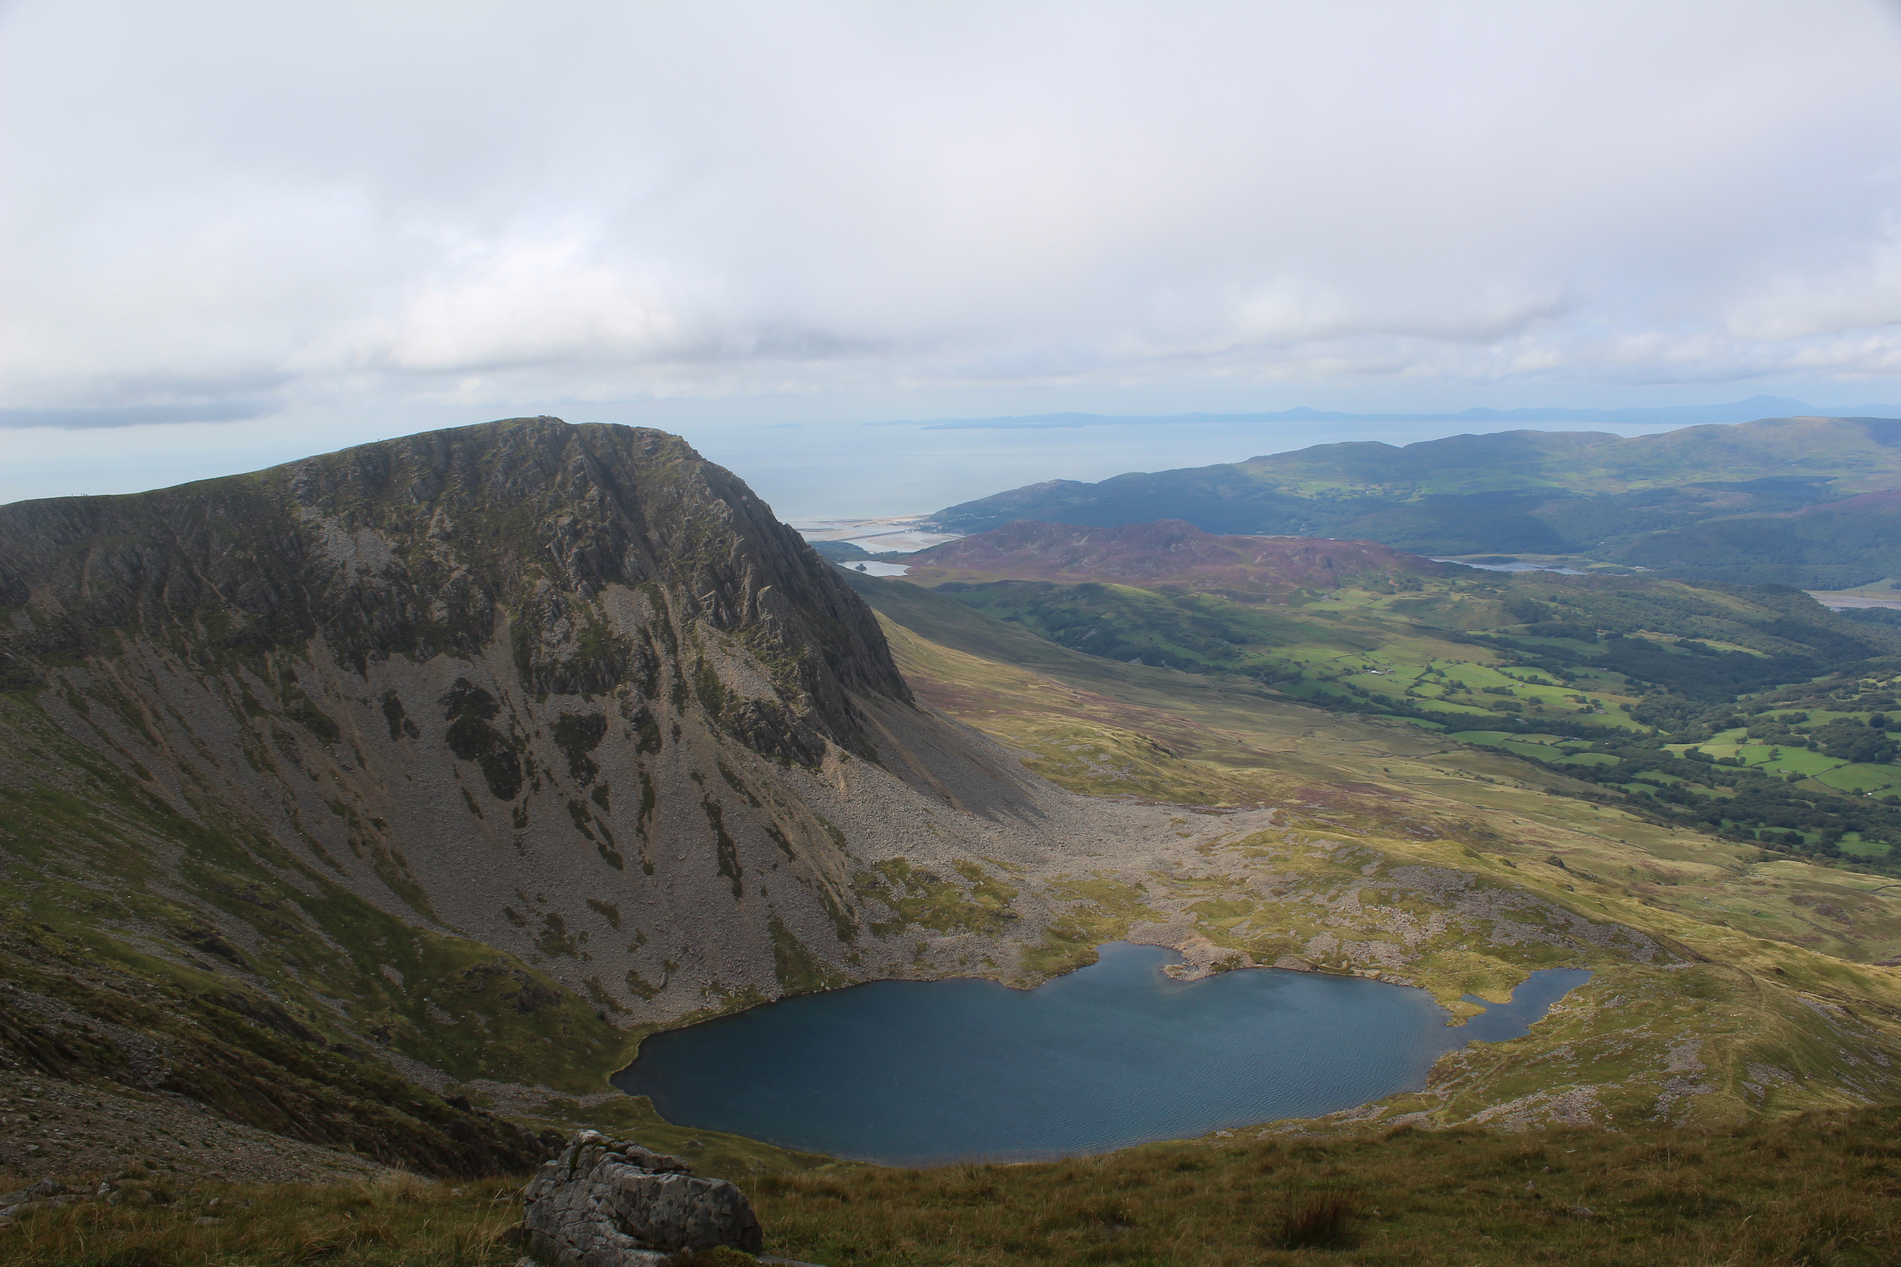
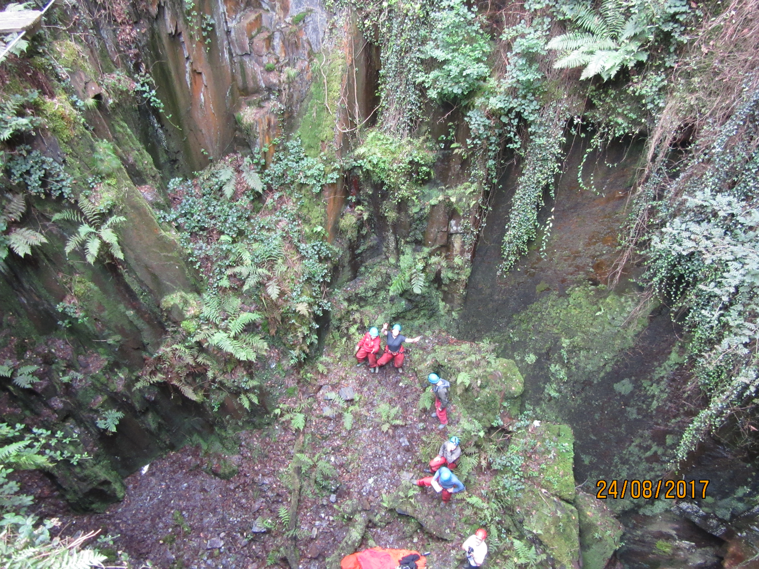
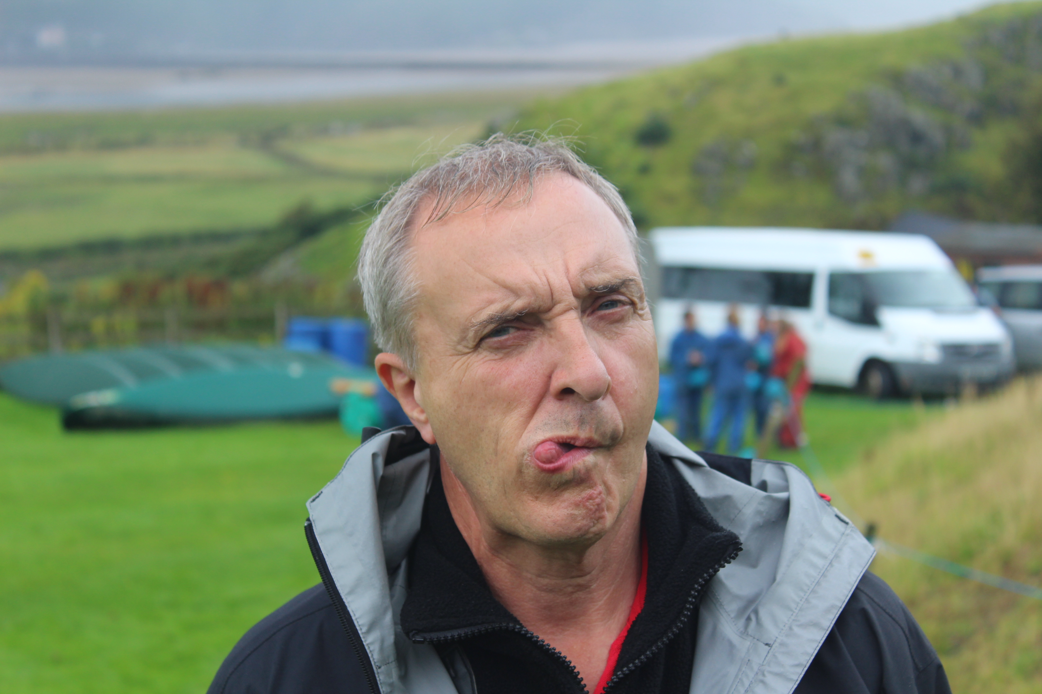
Thank you

