Slide 1

Kenilworth
PHOTOGRAPHIC COMPETITION 10 February 2020

Slide 2
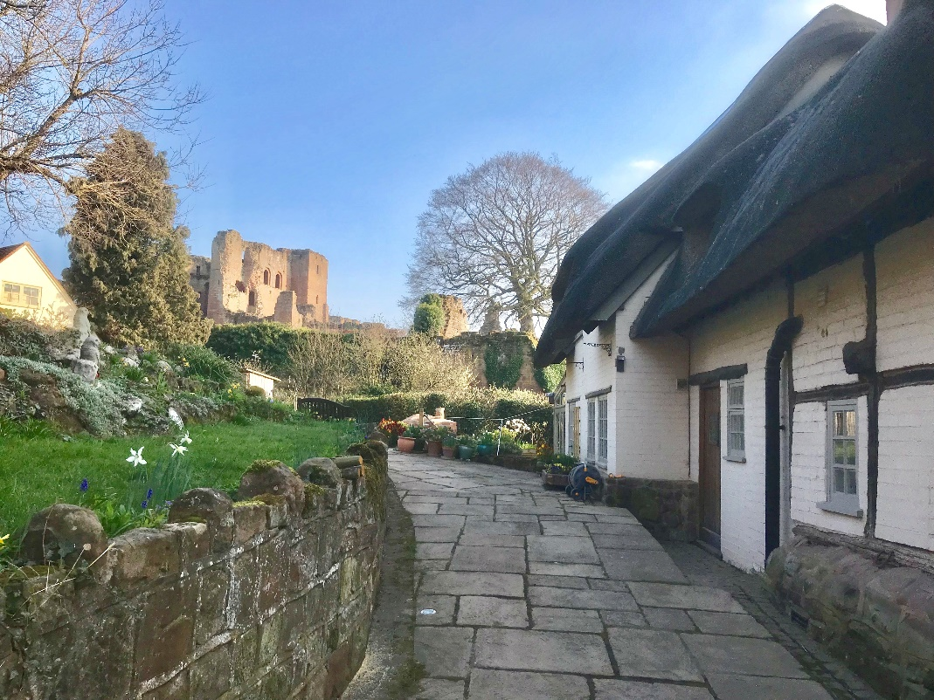
Just around the corner
A

Slide 3
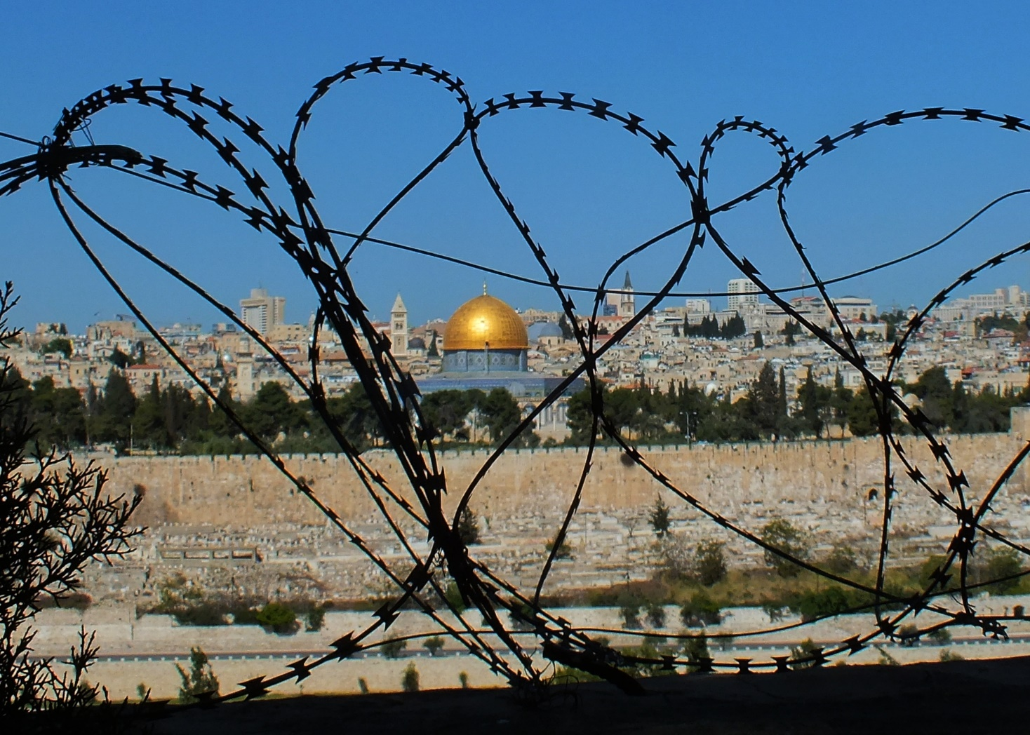
Wire, Walls and Why?
B

Slide 4
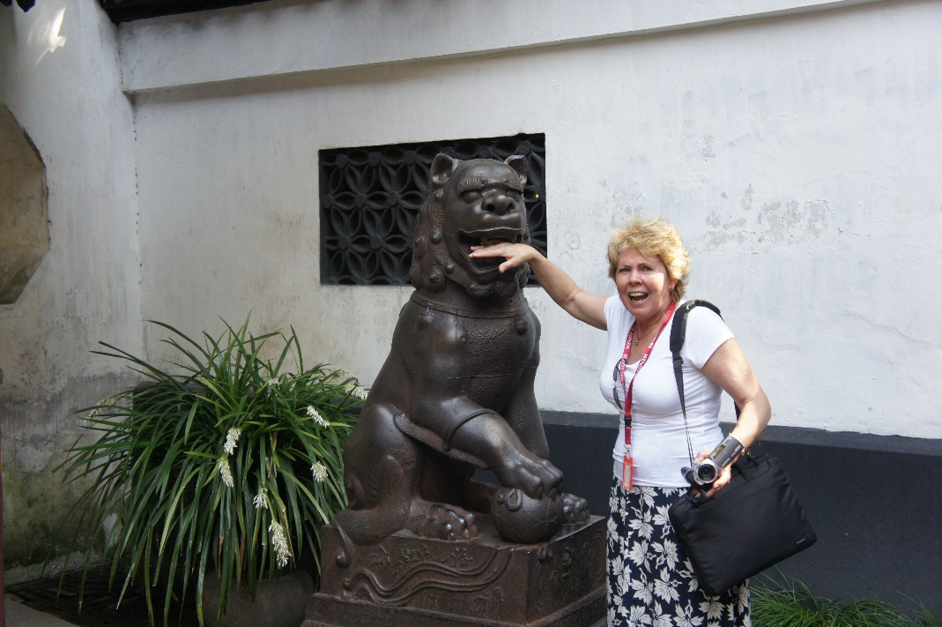
Ouch !
C

Slide 5
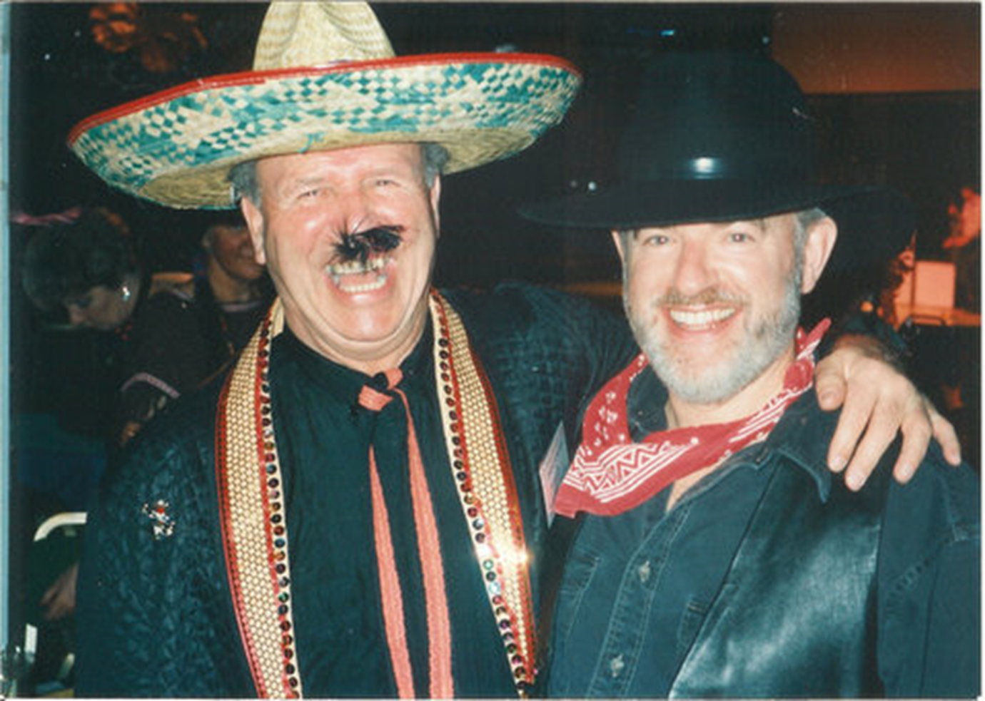
Mehican
Moth ?
D

Slide 6
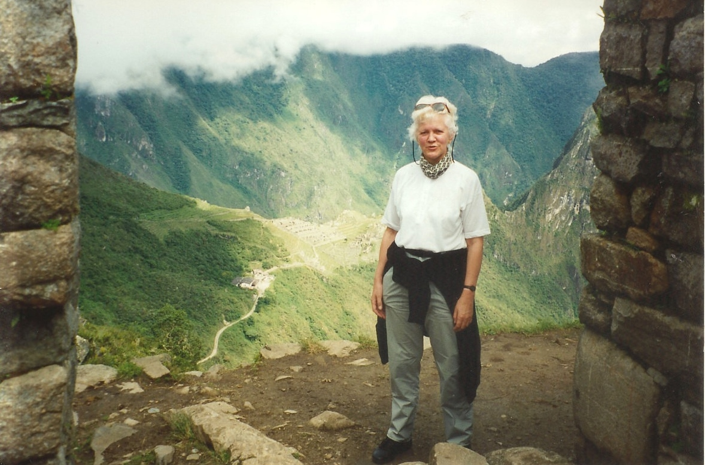
The Sun Gate
E

Slide 7
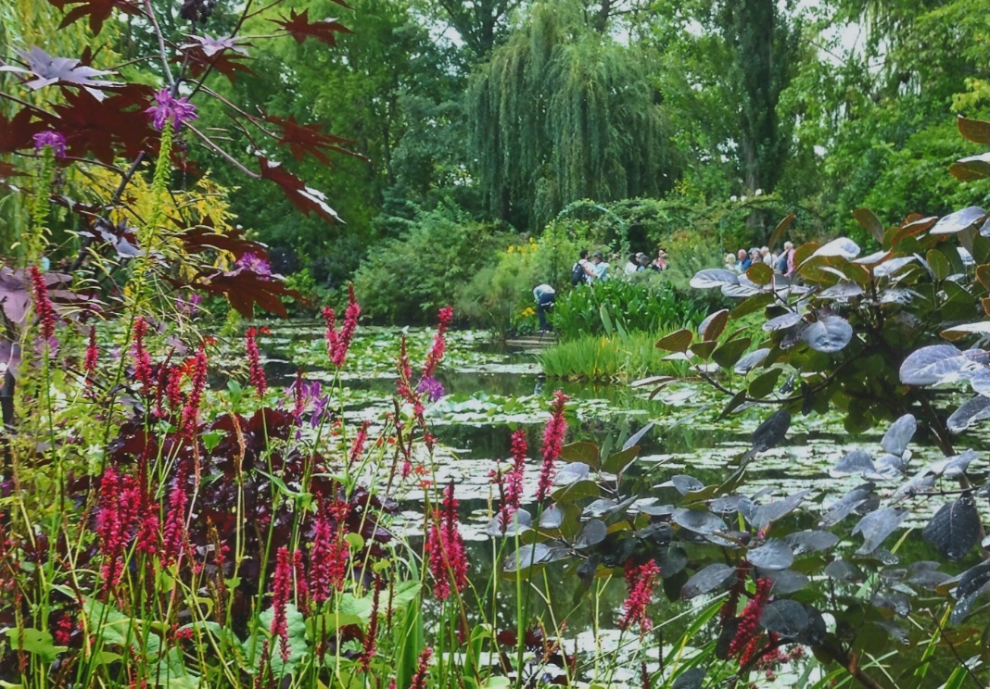
Aquatic beauty
F

Slide 8
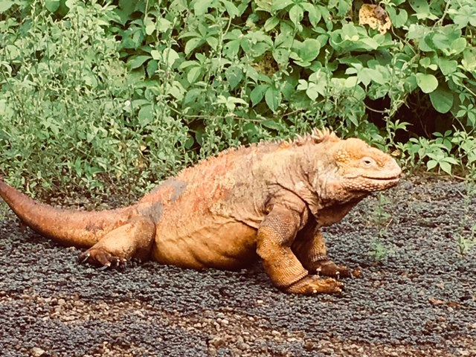
Who`s a pretty boy
G

Slide 9
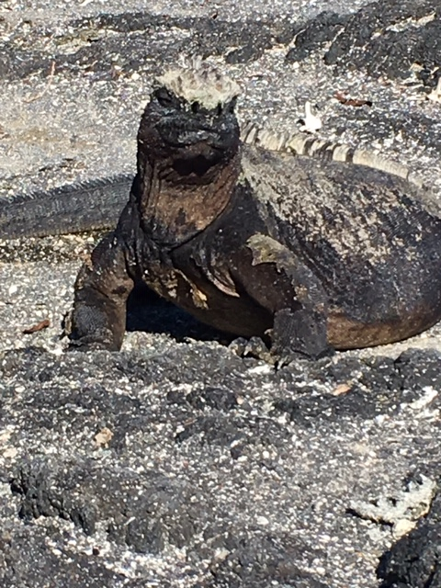
Who`s Not
H

Slide 10
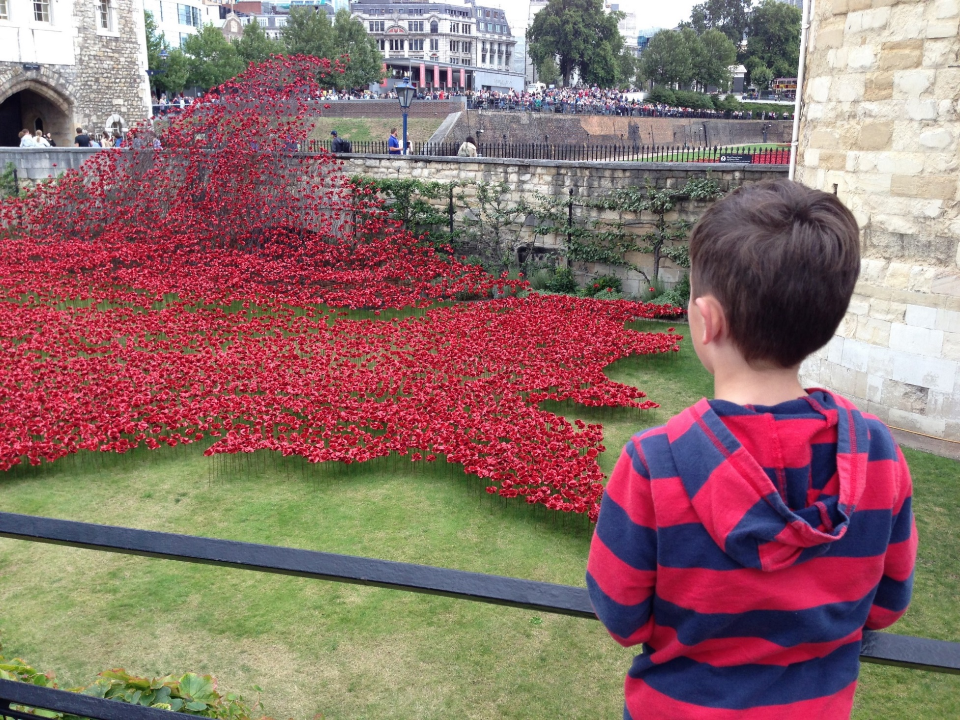
What is he thinking ?
I

Slide 11
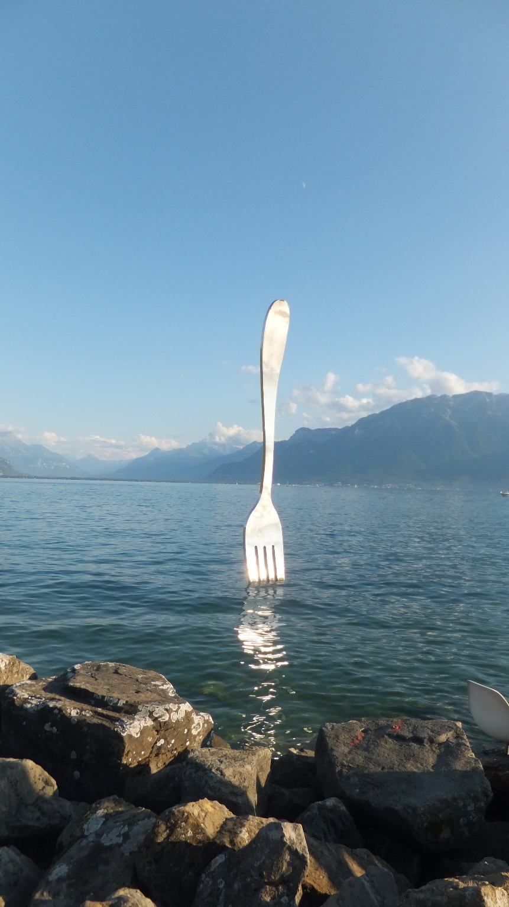
Obvious
J

Slide 12
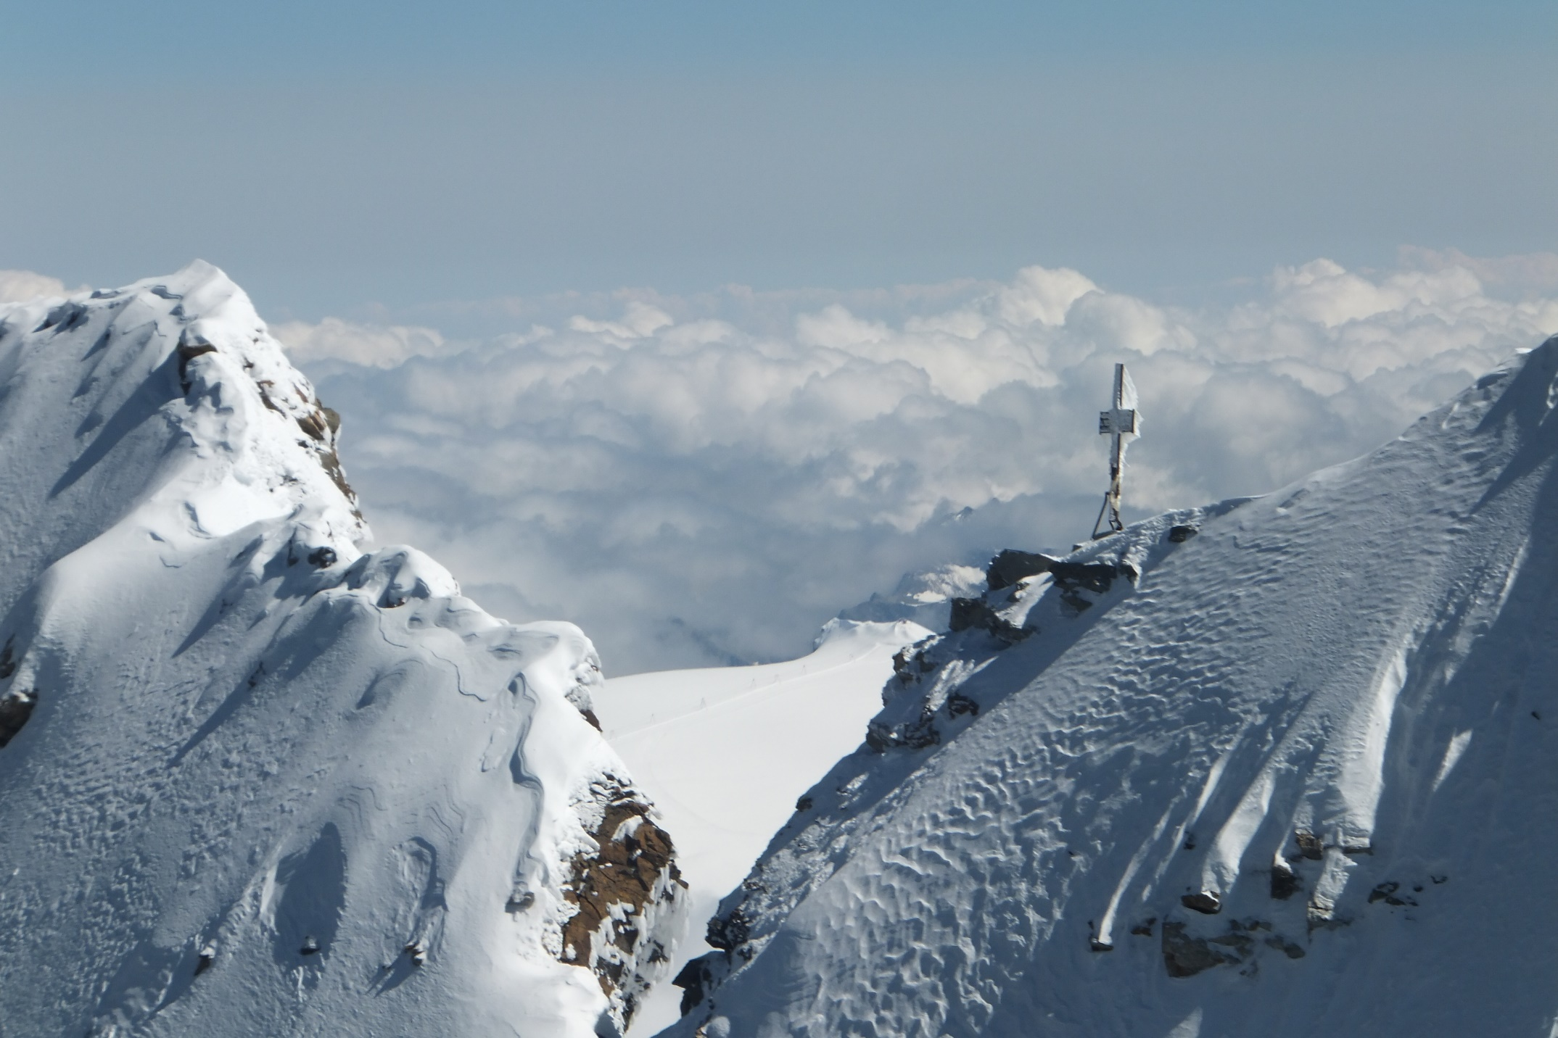
Matterhorn
K

Slide 13
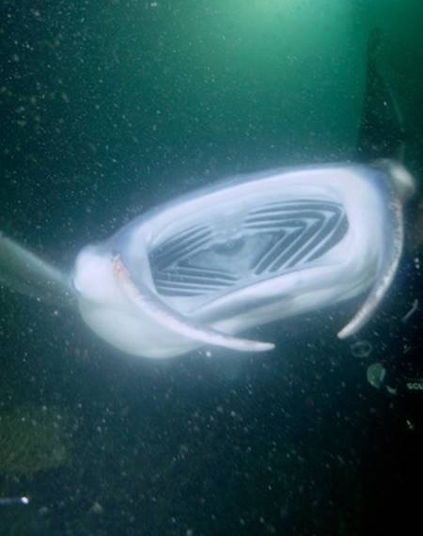
Ray/duck
L

Slide 14
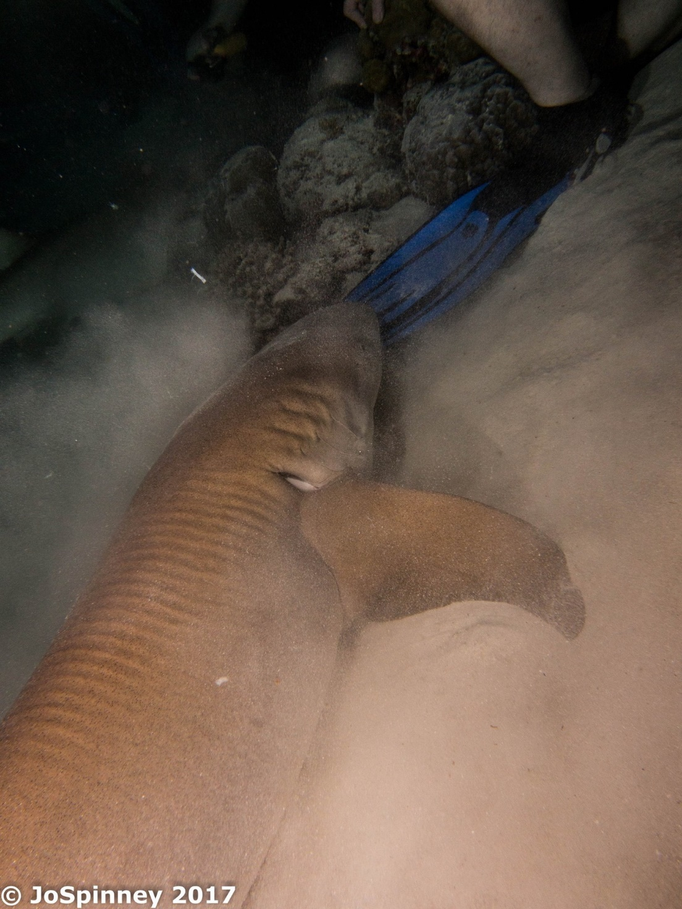
Shark / Fin ?
M

Slide 15
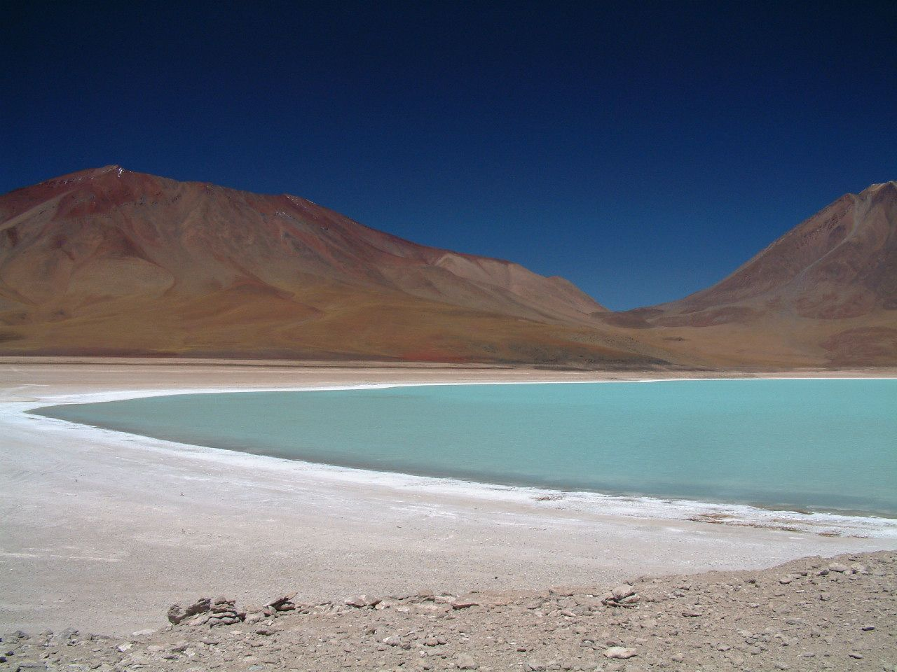
Blue Lake
N

Slide 16
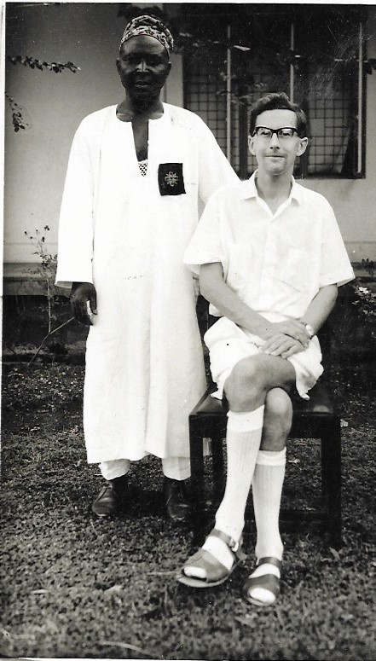
Shortest Shorts ?
O

Slide 17
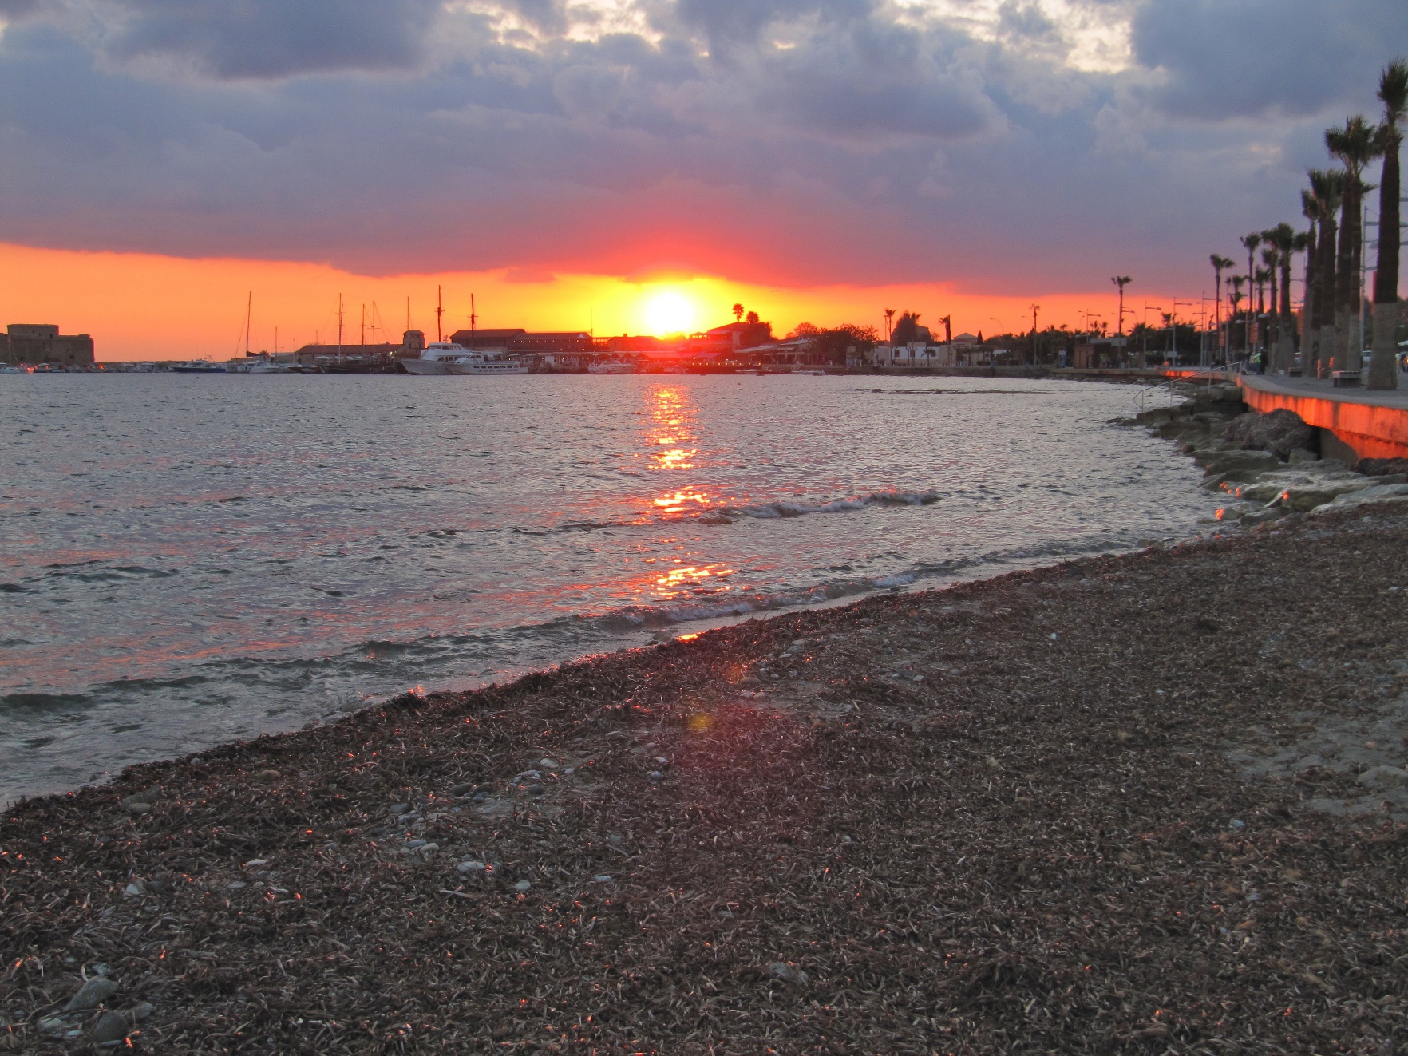
Maltese
Sunset
P

Slide 18
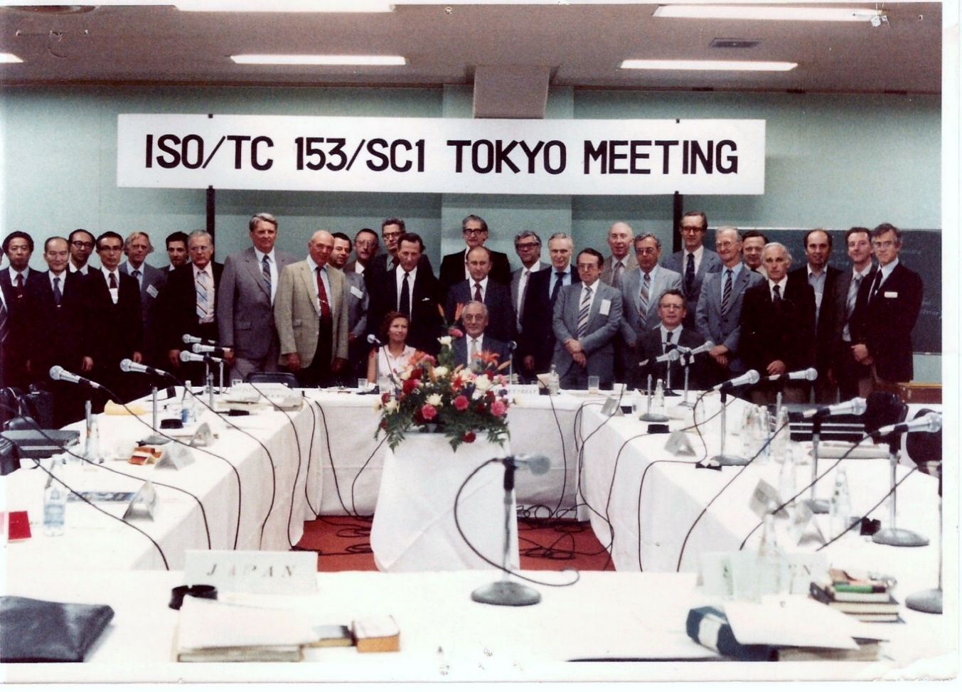
Tokyo
Q

Slide 19
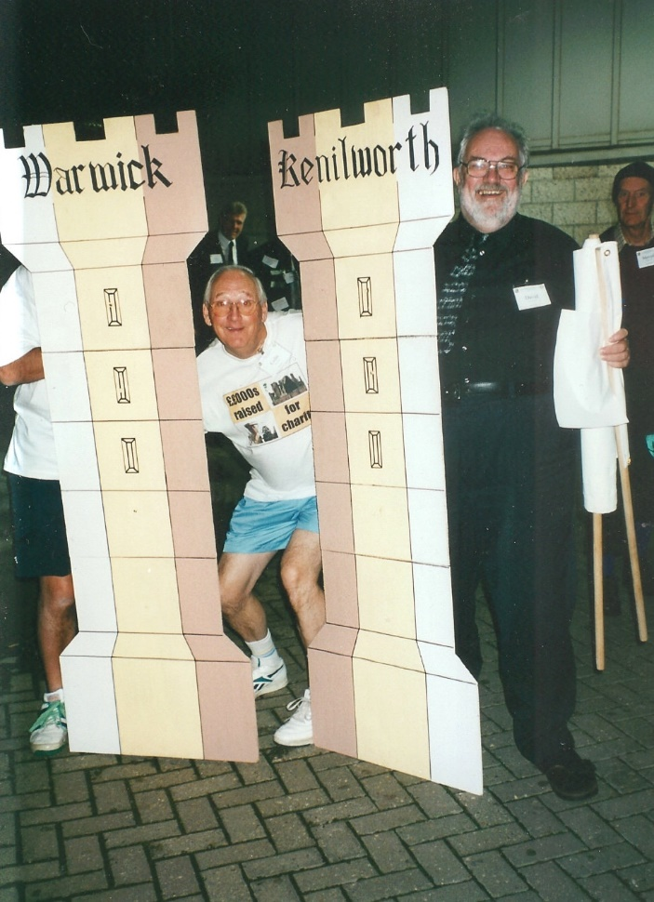
TWO
CASTLES
R

Slide 20
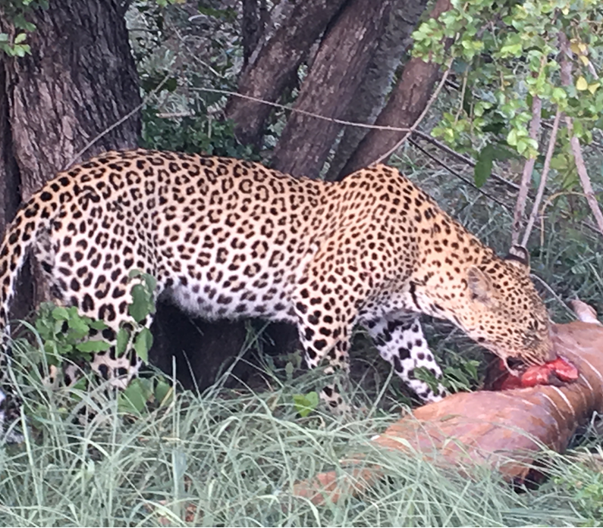
Big
Cat
S

Slide 21

You are the judges.
Decide which photos you want to vote for
TICK THE BOXES
Initials |  |  | 26
Enter the letter on the picture
Your winning picture
Runner up
Unusual or odd

Slide 22
The end
THE
E
N
D

