Slide 1
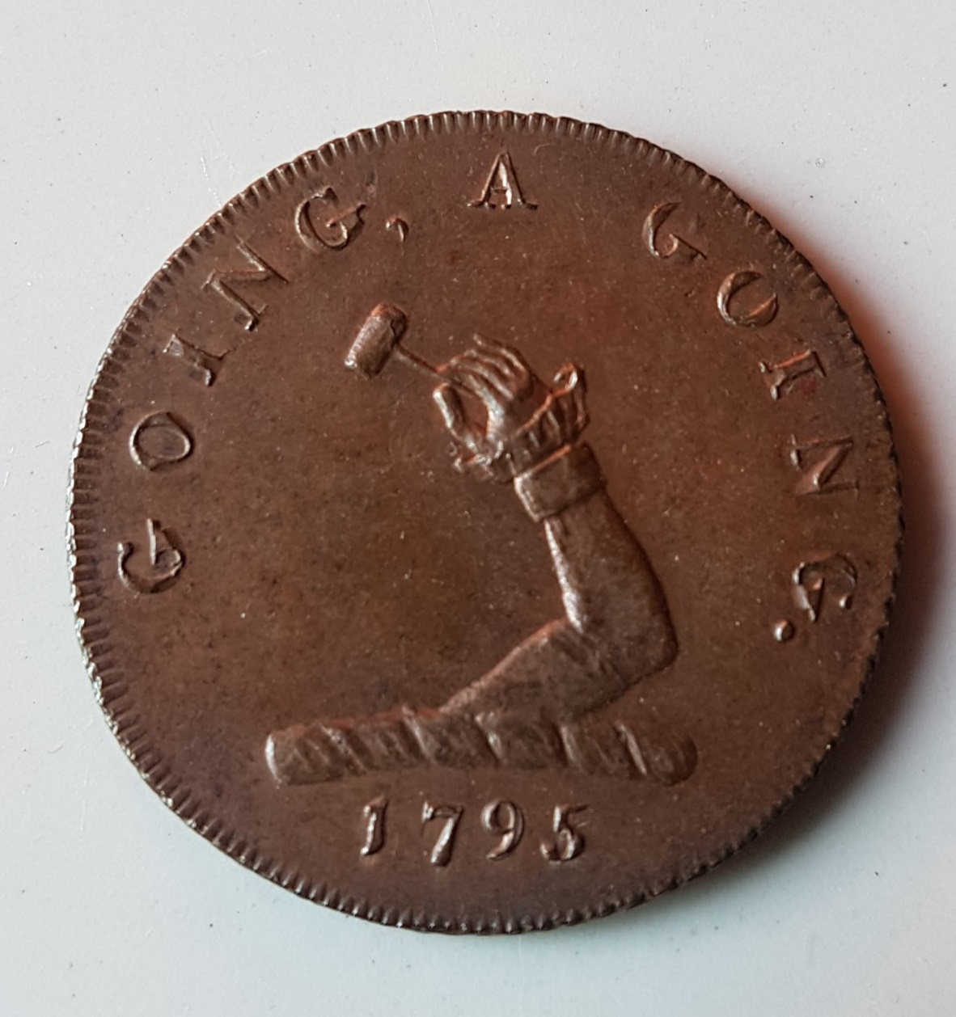
A Few of my Favourite Things
The Rotary Club of Bedford Castle
September 2017

Slide 2
FURNITURE AND ARCHITECTURE

Slide 3
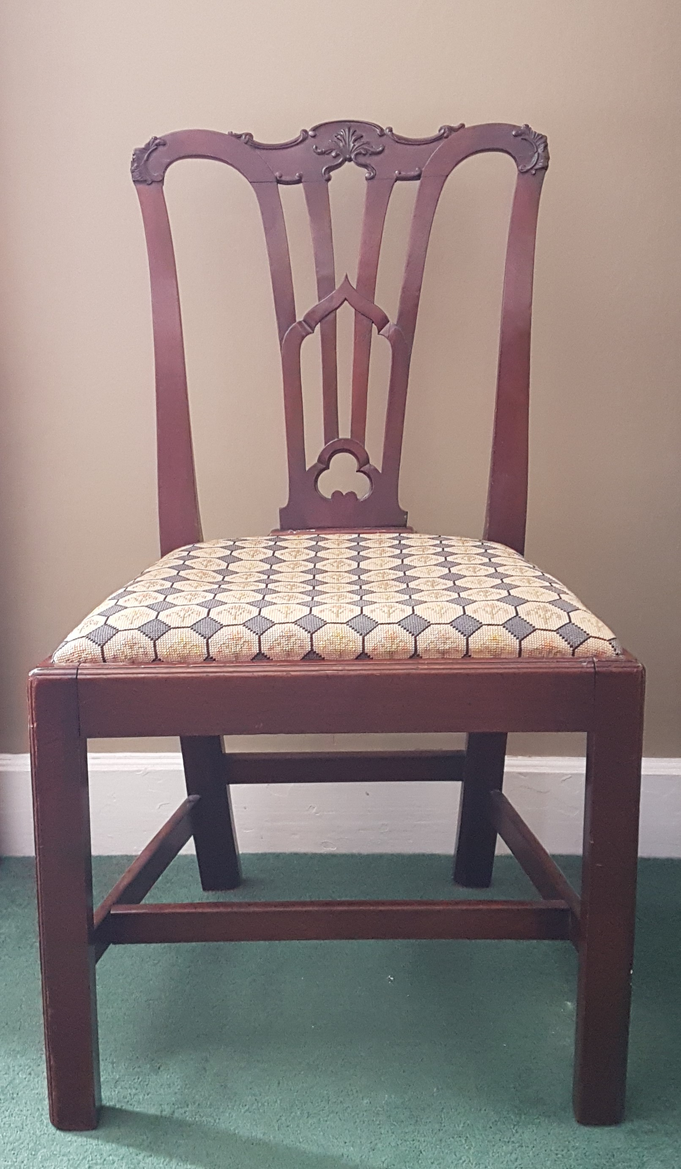
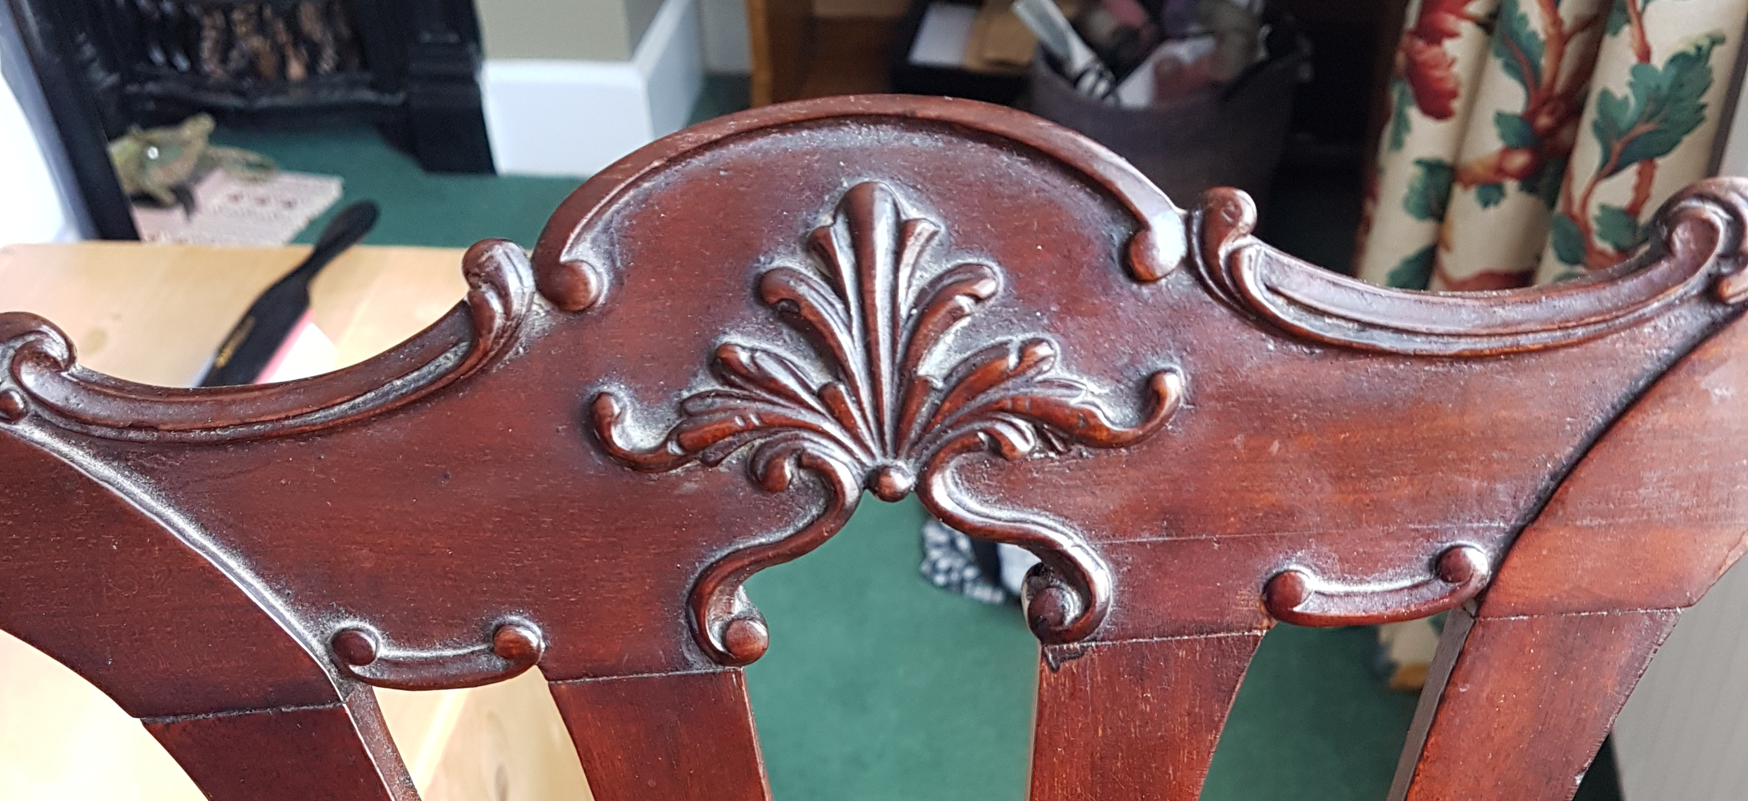
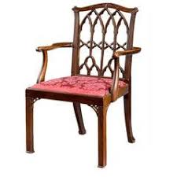
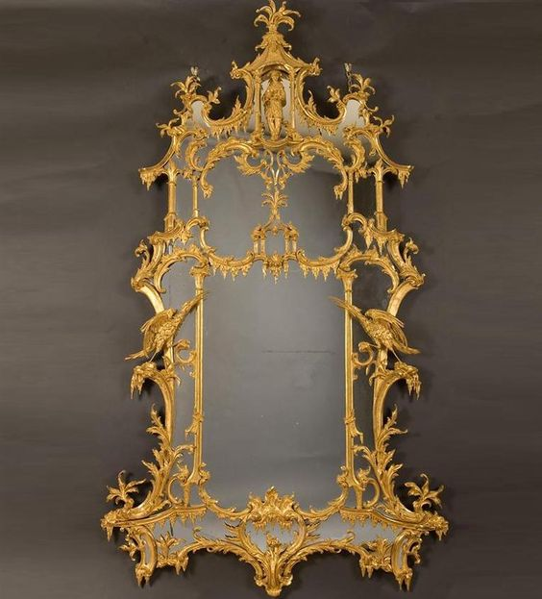
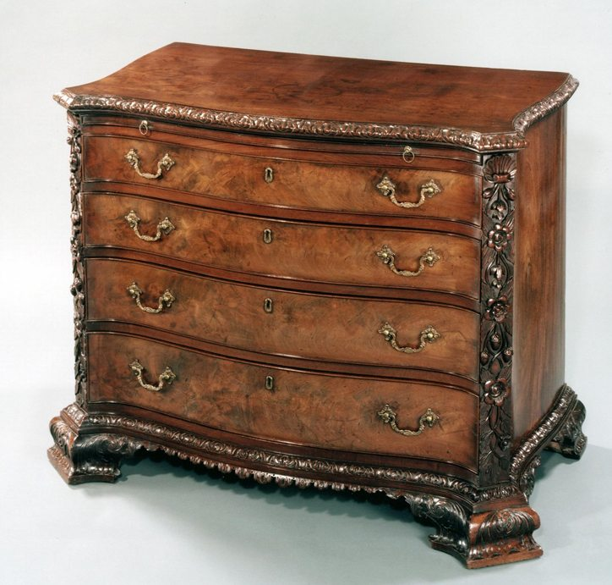
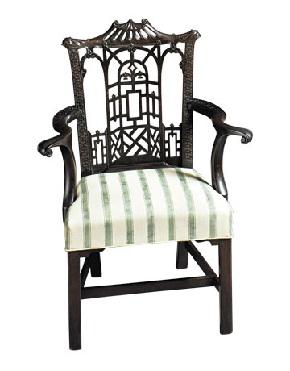
Thomas Chippendale 1718-1779
The Gentleman and Cabinet Maker's Director 1754

Slide 4
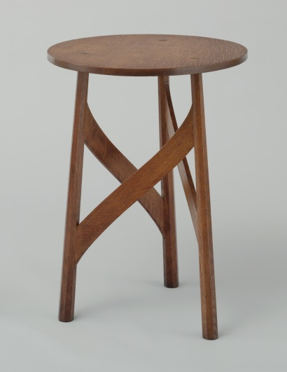
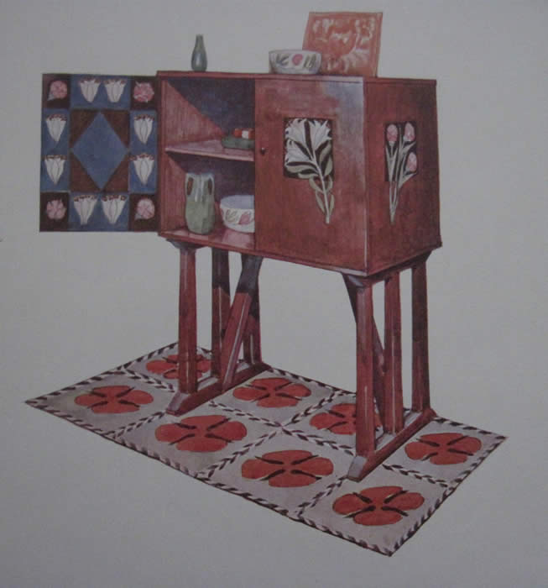
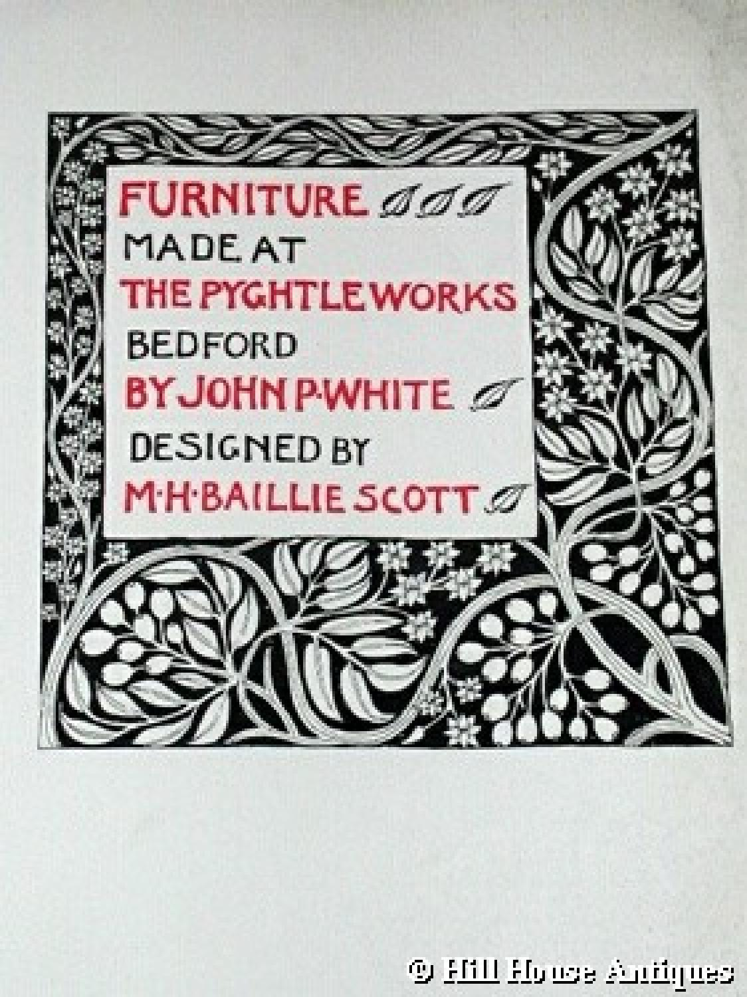
J P White of Bedford

Slide 5
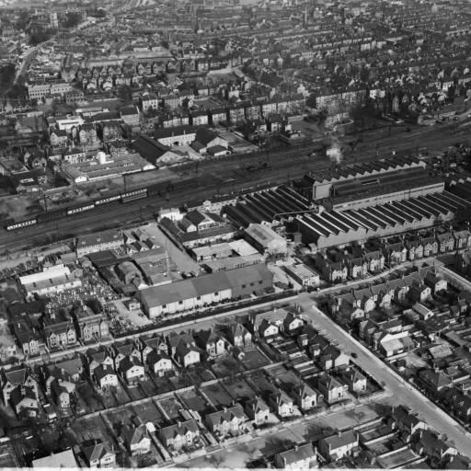
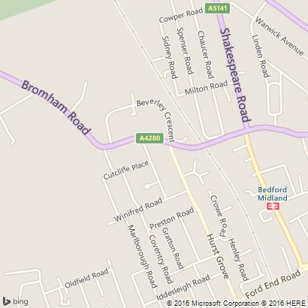
Winifred Road

Slide 6
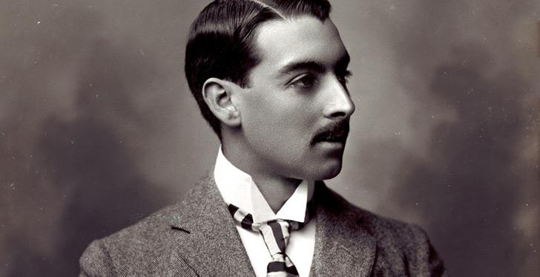
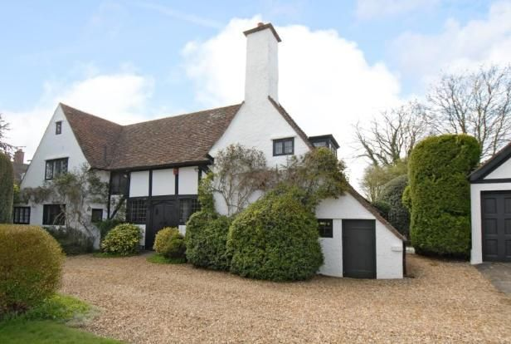
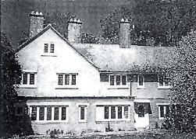
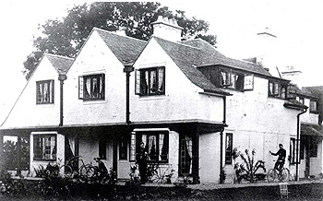
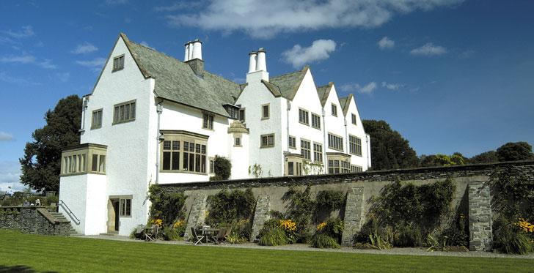
Mackay Hugh Baillie Scott (1865 - 1945)
Right (upper)
Mackay Hugh Baillie Scott
King’s Close, Biddenham, 1907
For Mr Salmon
Right (Lower)
Mackay Hugh Baillie Scott
Blackwell House, Windermere, 1901
For Sir Edward Holt
Far Right (upper)
Charles Edward Mallows
(1864-1915)
9 Main Road, Biddenham,1899
For John White (son of J P White)
Far Right (lower)
Charles Edward Mallows
(1864-1915)
17, Biddenham Turn, 1900,
For H J Peacock Esq

Slide 7
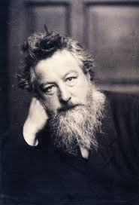
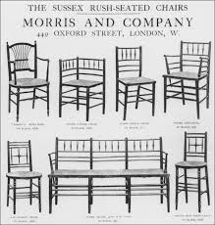
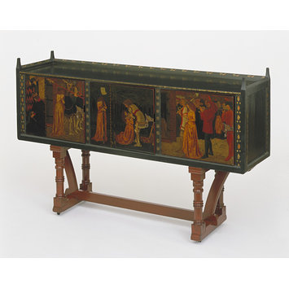
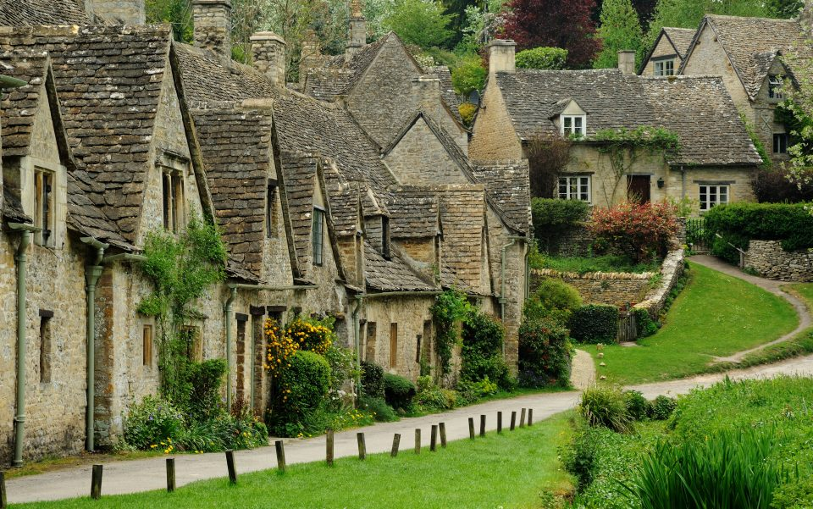
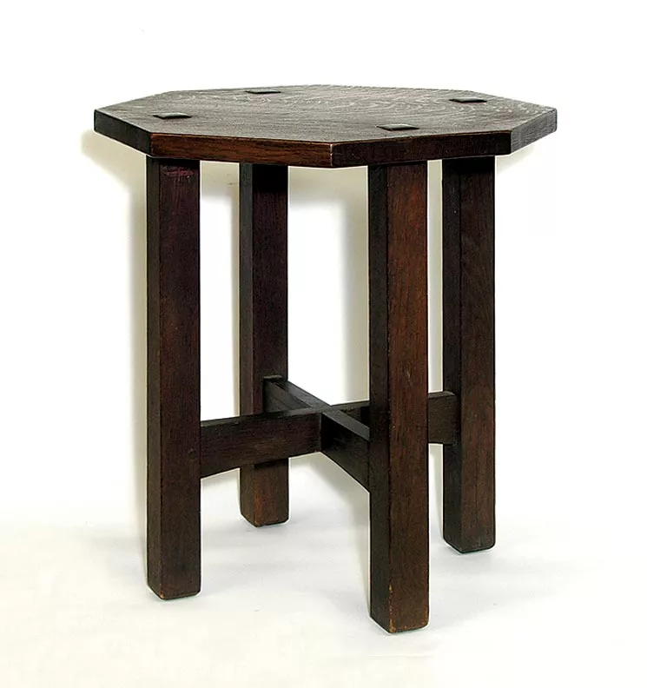
The Arts and Crafts Movement
Clockwise
William Morris c.1834-1896
(2) Morris and Co. catalogue, c. 1900
(3) St. George cabinet. William Morris and
Philip Webb, c.1862
(4) Oak stool, c.1900 ‘Honesty of construction’
Bibury

Slide 8
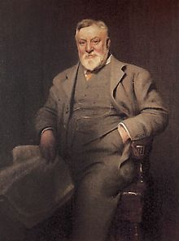
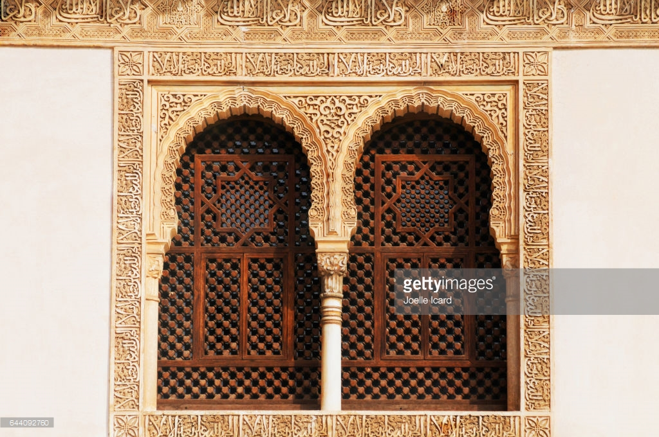
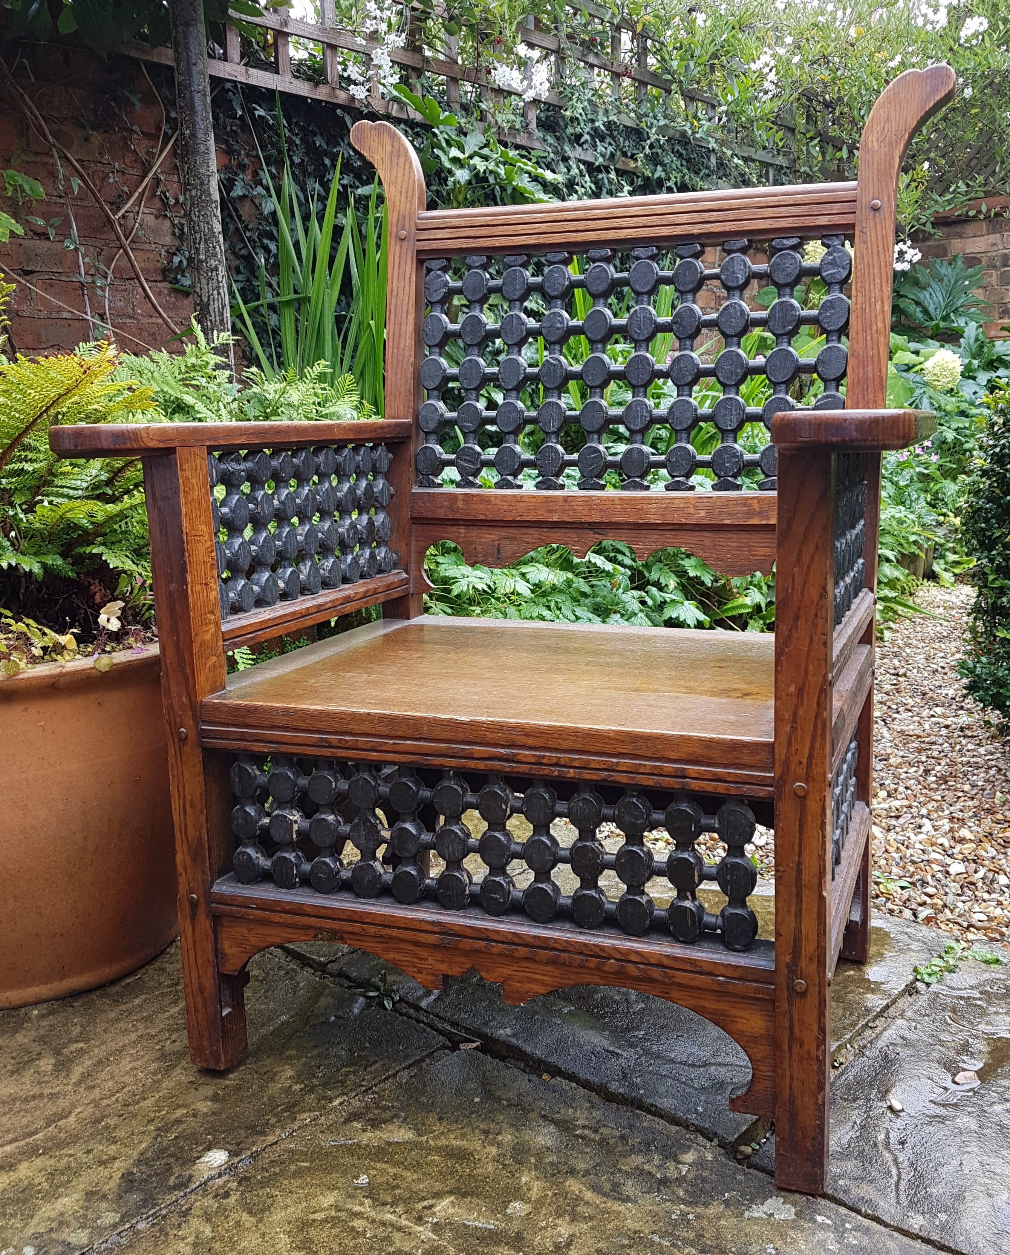
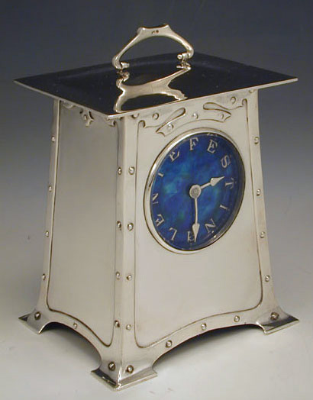
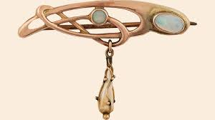
Liberty and Co

Slide 9
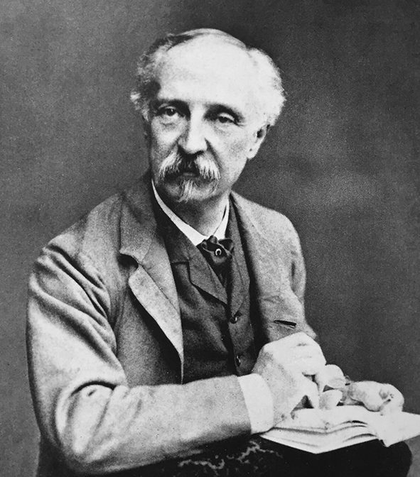
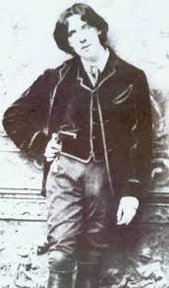
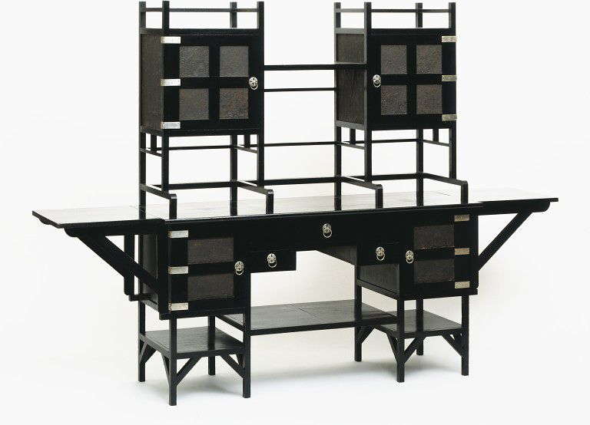
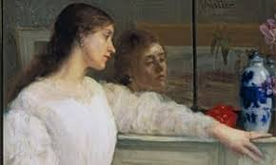
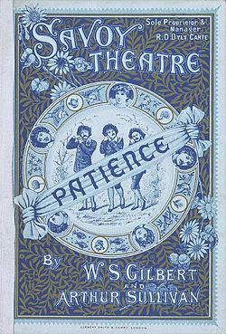
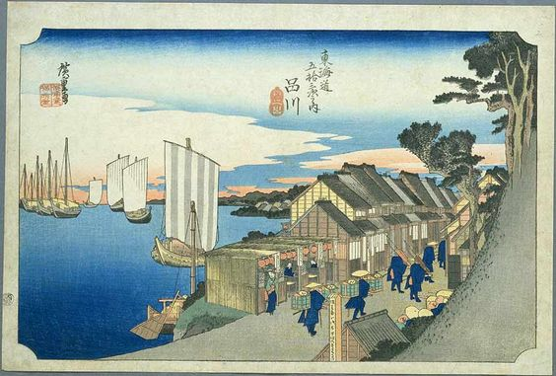
Edward William Godwin (1833 – 1886) The Aesthetic Movement ‘Anglo Japanese’ ‘Aesthetic Movement’
James Mcneill Whistler (1834-1903)
Hiroshige “The Fifty-three Stations of the Tōkaidō, Kanagawa” Godwin for Willaim Watt 1867 V and A Museum ‘Patience’ Gilbert and Sullivam 1881

Slide 10
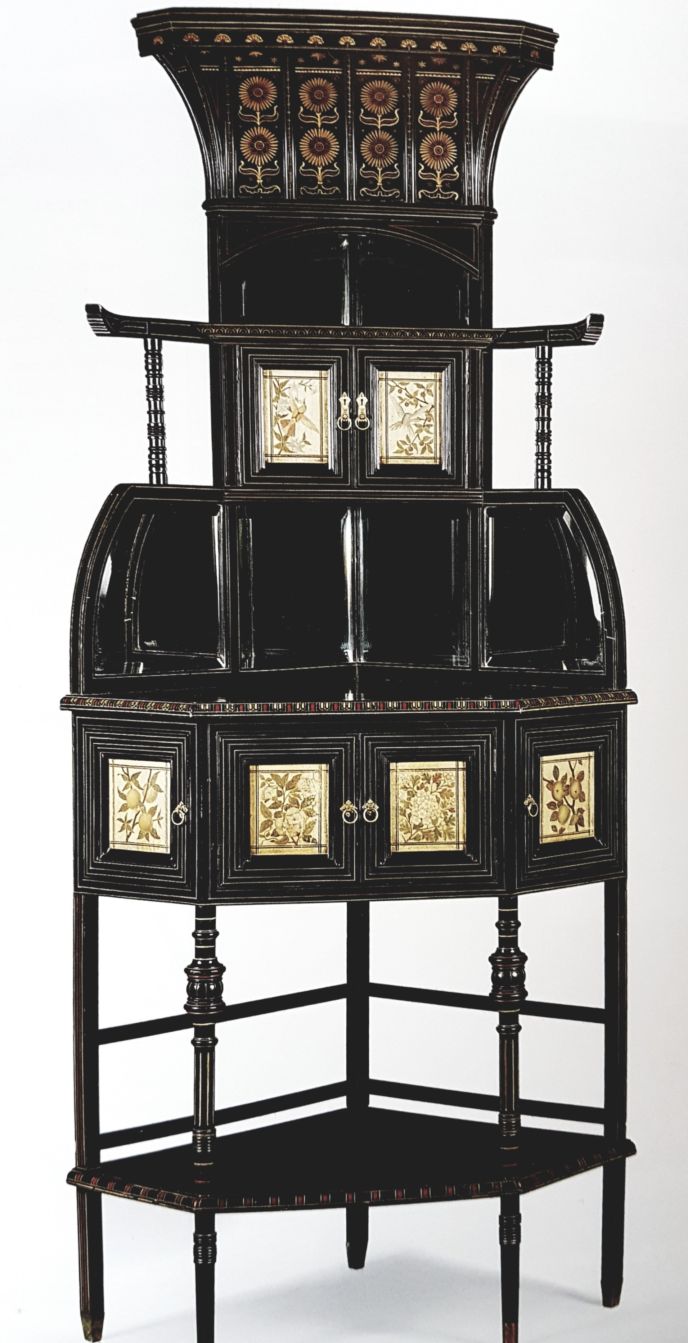
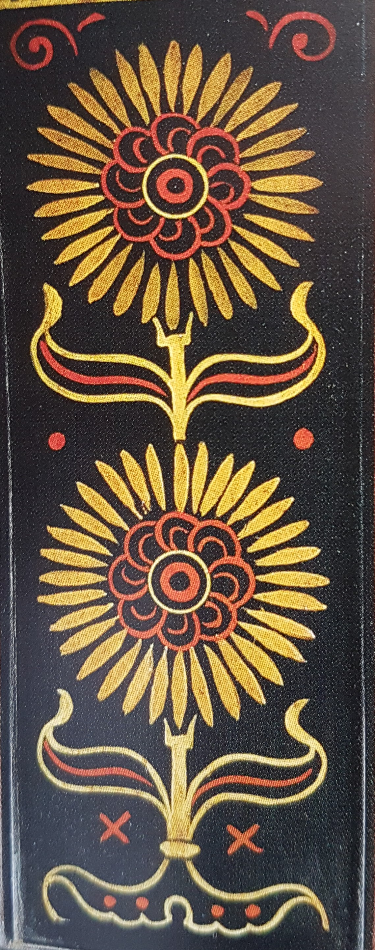
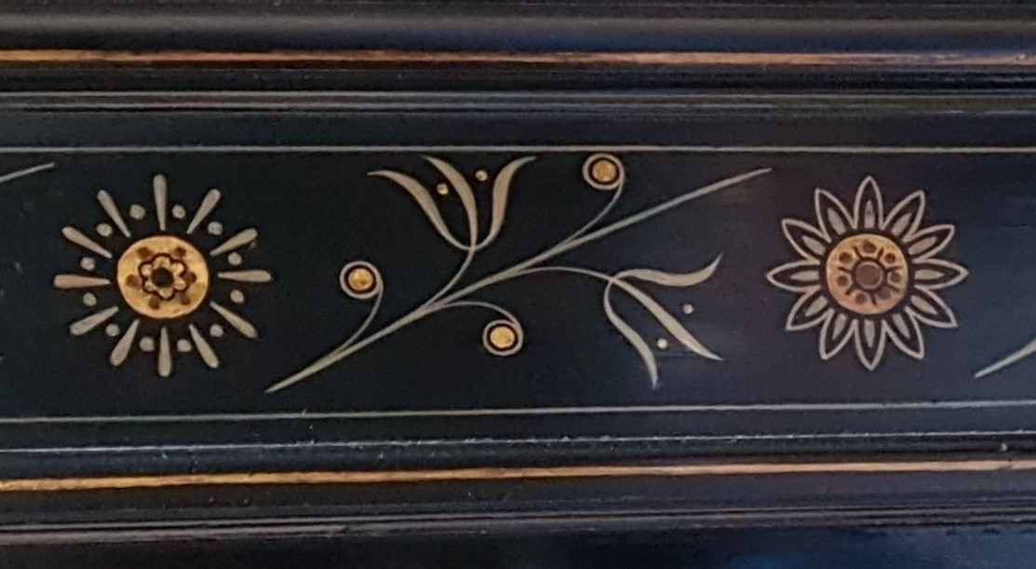
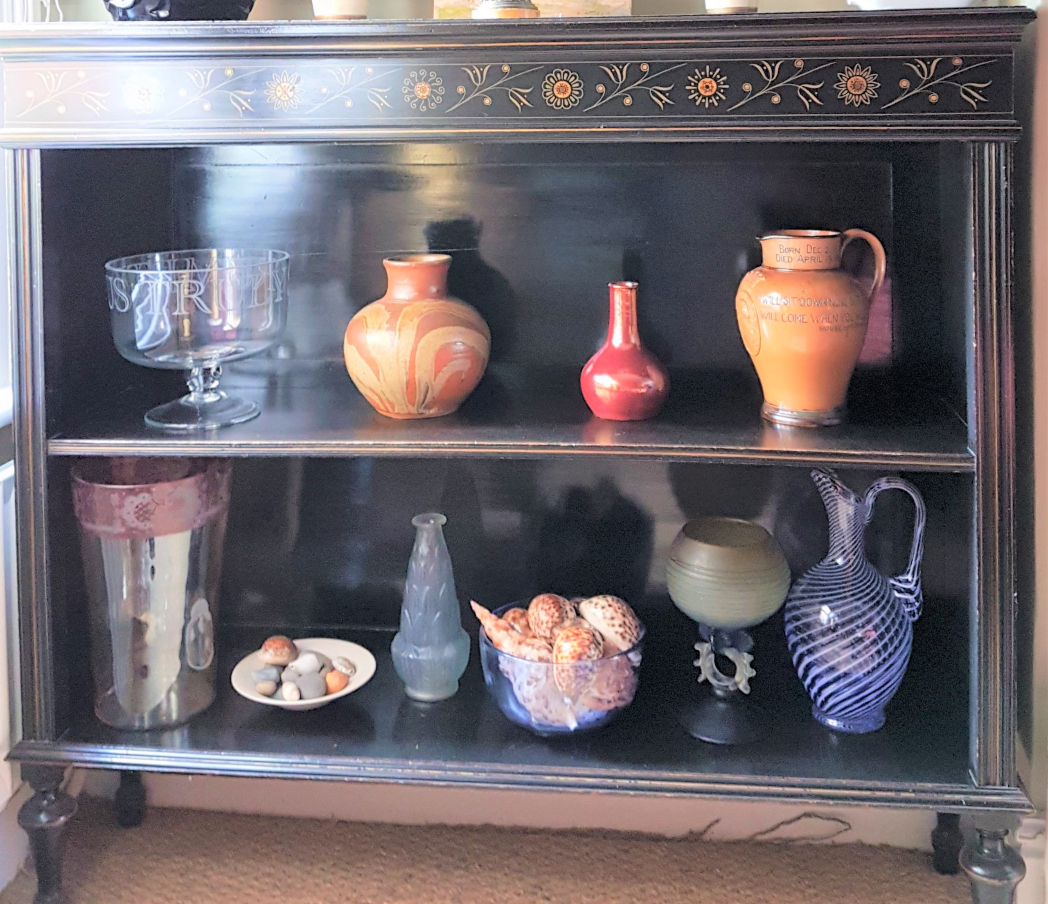
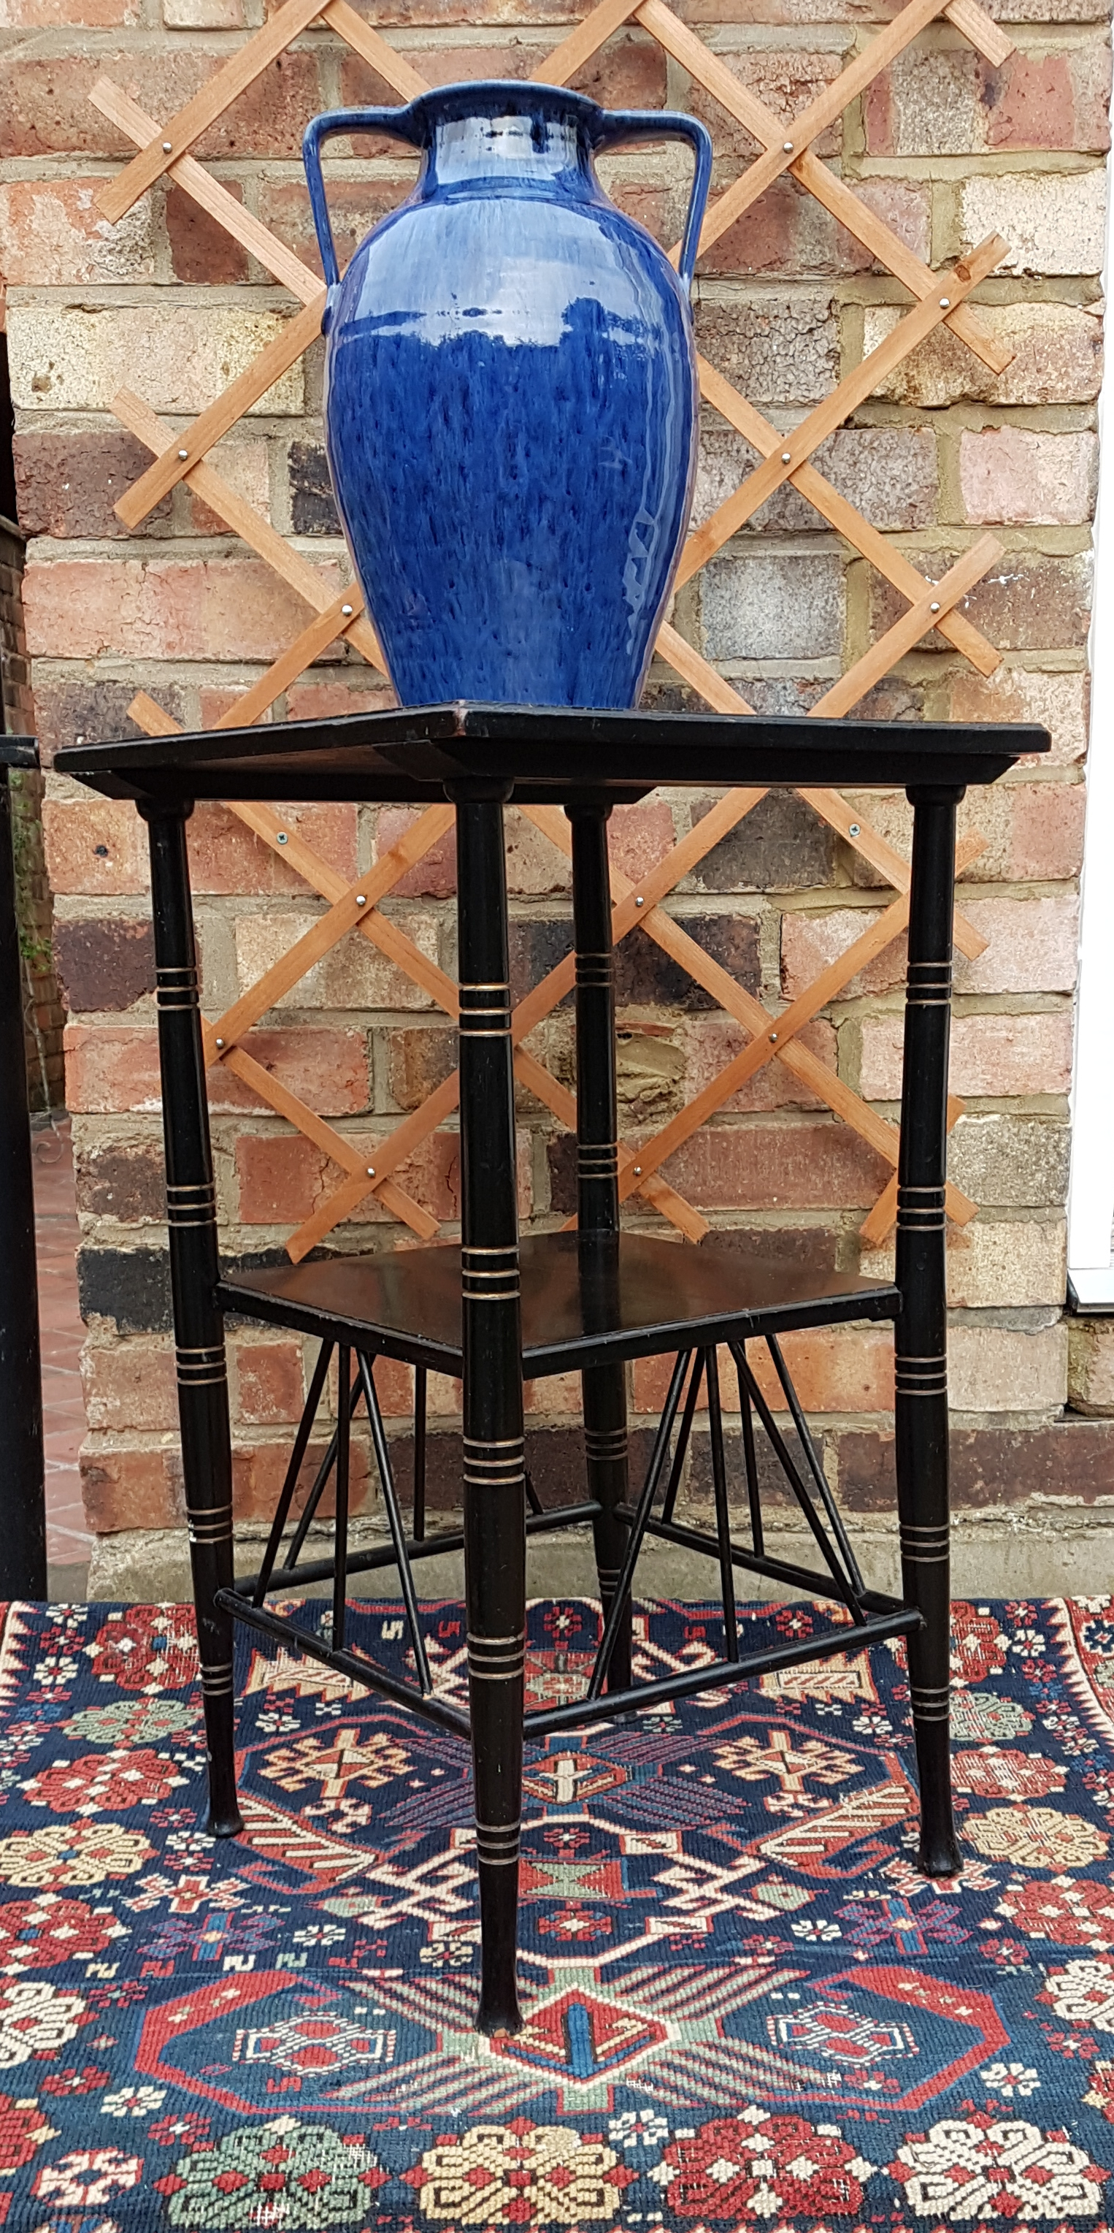
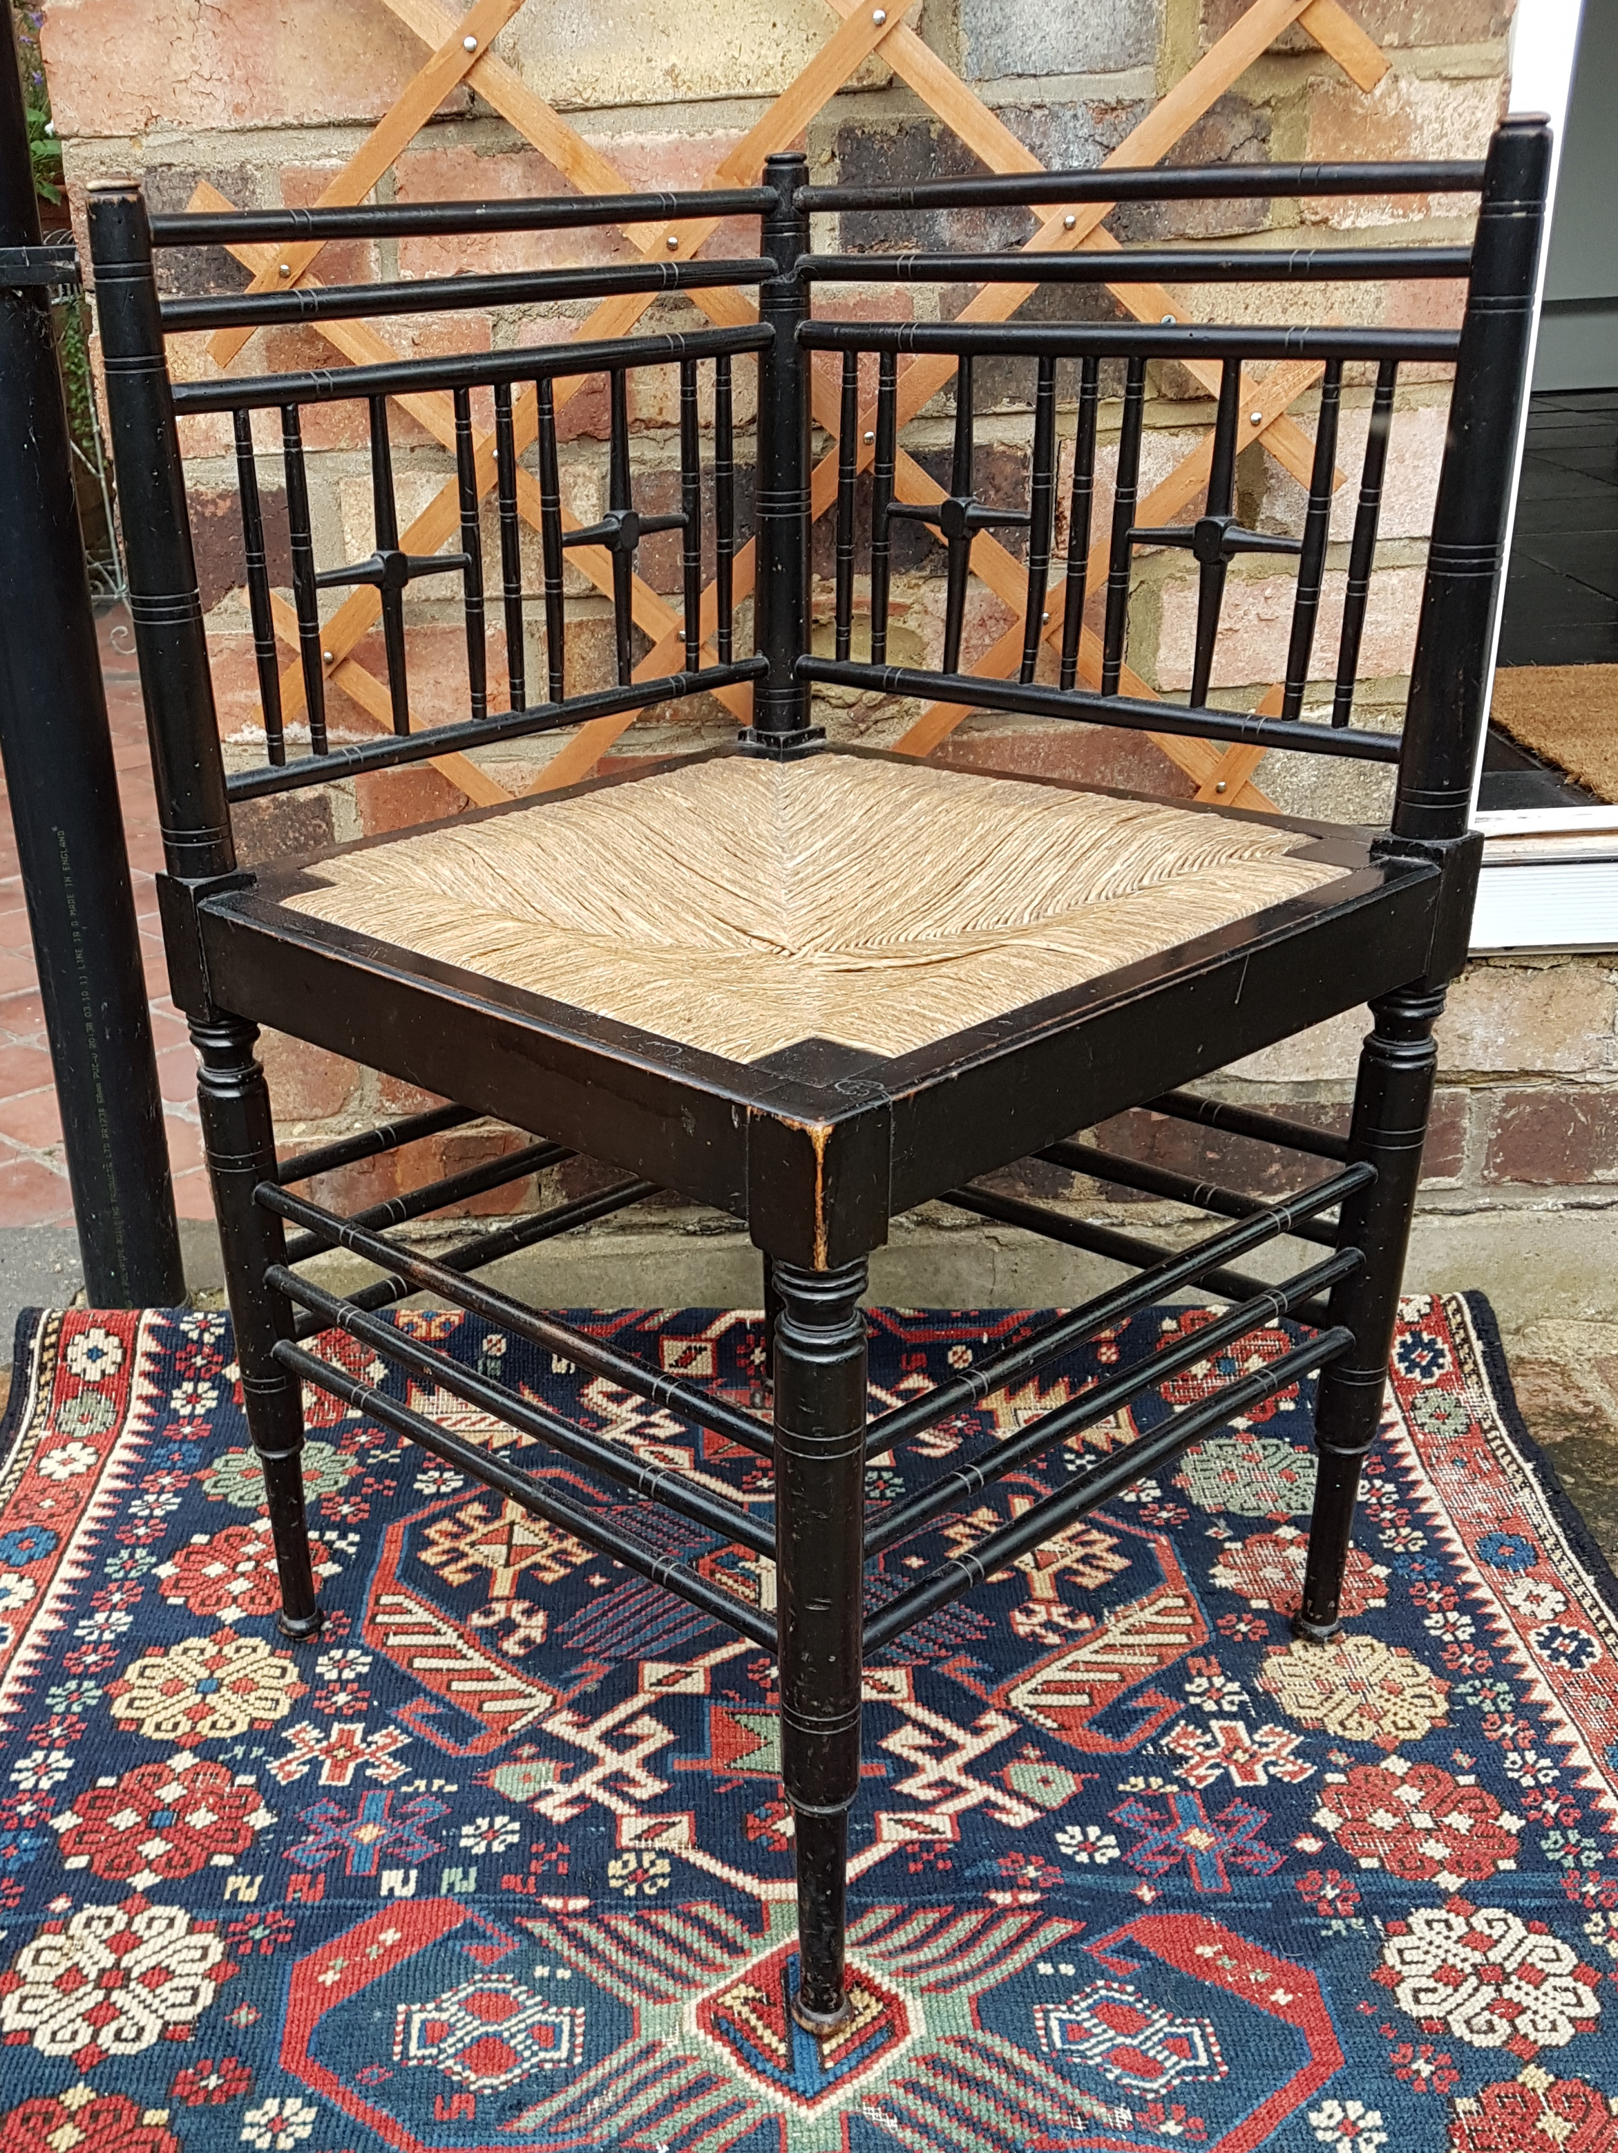
E W Godwin (II)
Corner cabinet by Godwin for Collinson and Lock c.1870 (£35,000)

Slide 11
CERAMICS AND SILVER

Slide 12
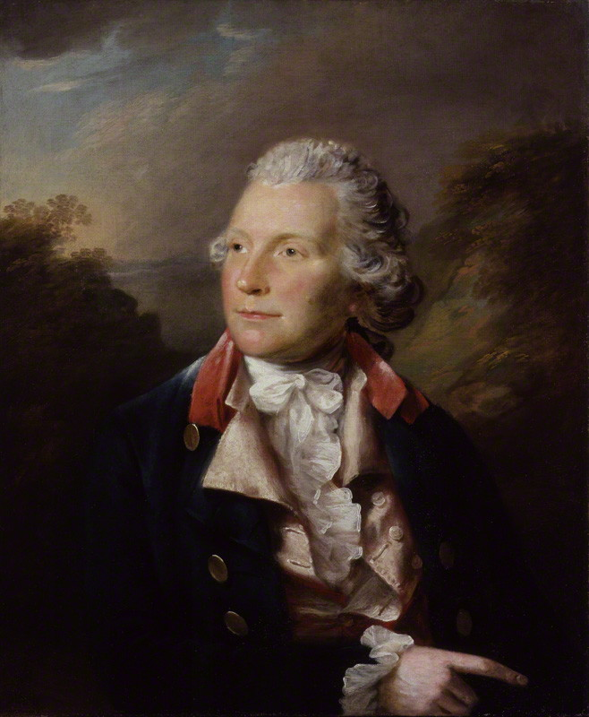
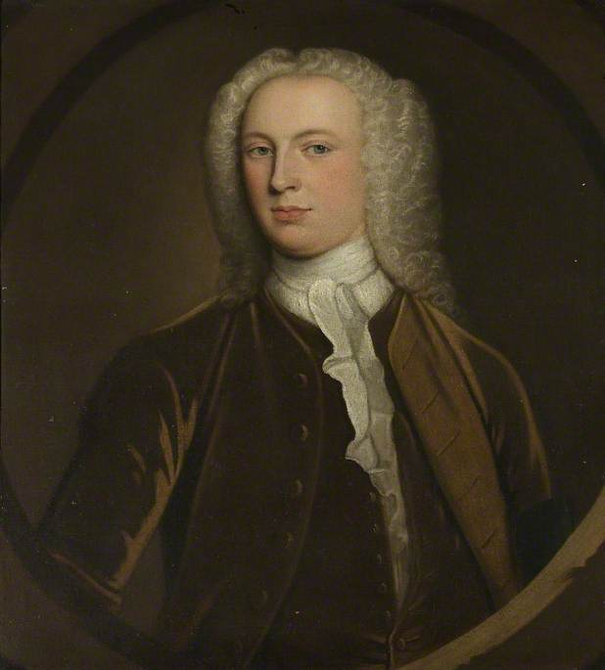
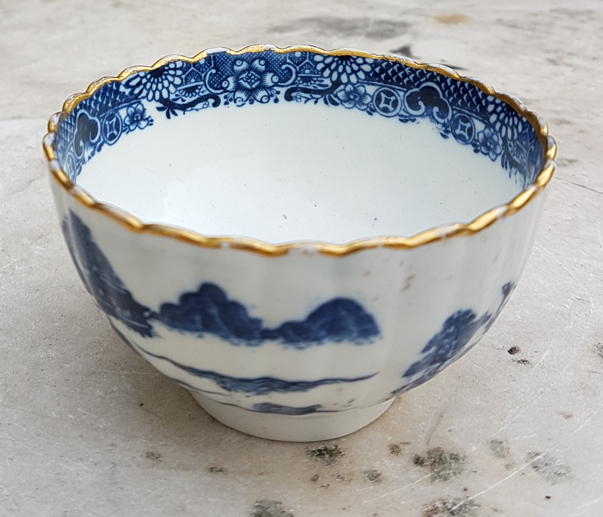
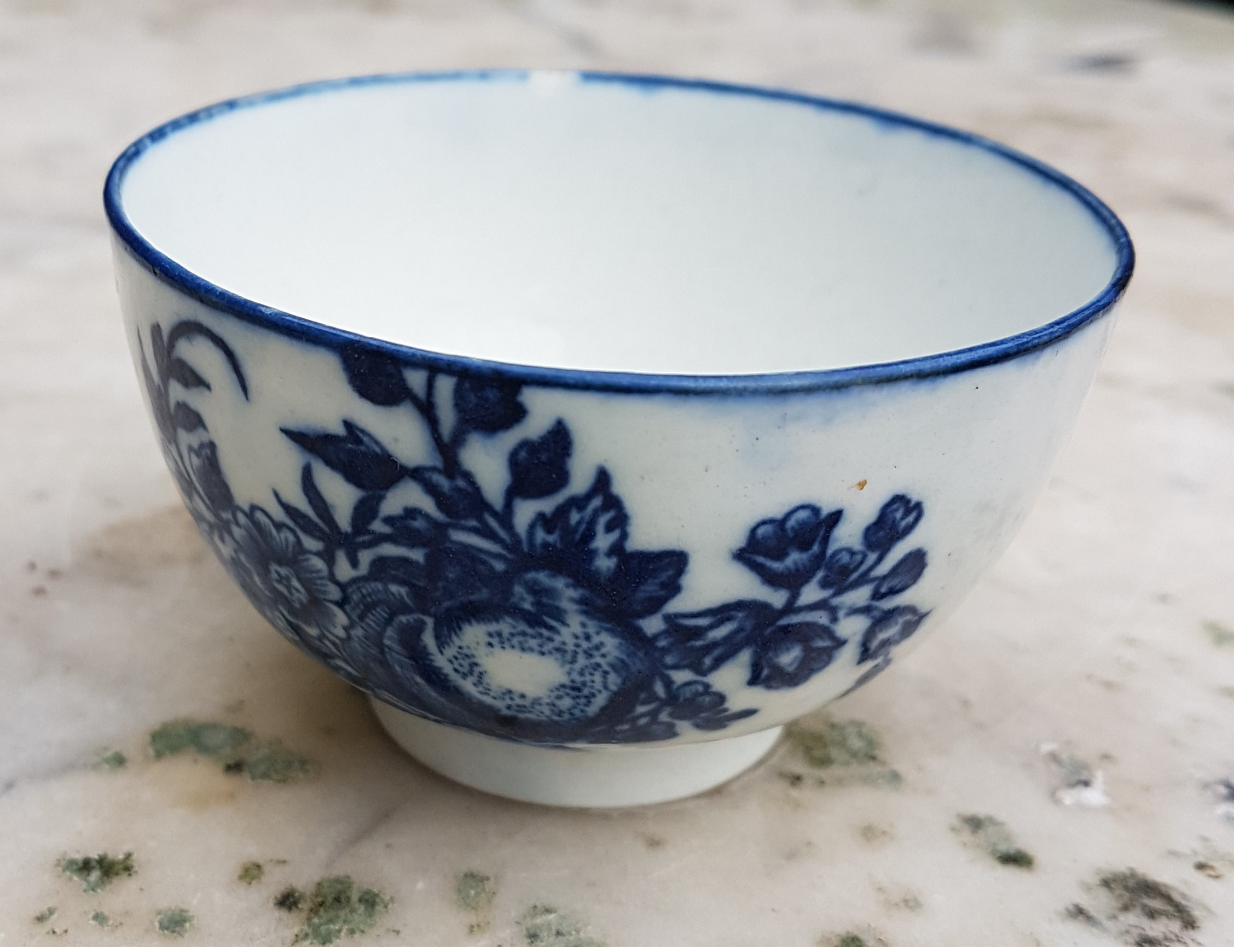
Caughley tea bowl c.1775 (founder Thomas Turner) Worcester tea bowl 1751 (founder Dr Wall)

Slide 13
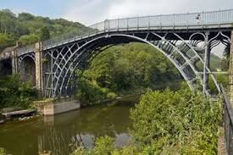
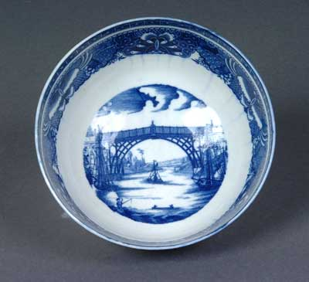
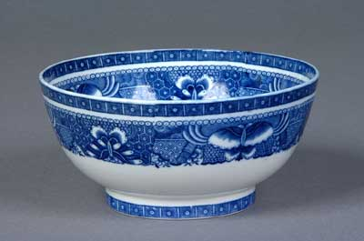
Iron Bridge, Coalbrookdale opened 1779

Slide 14
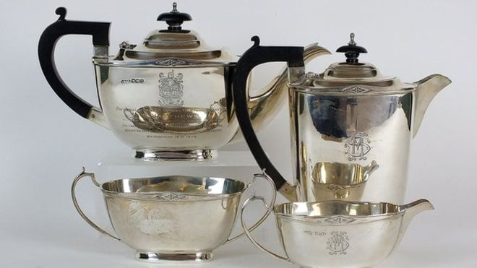
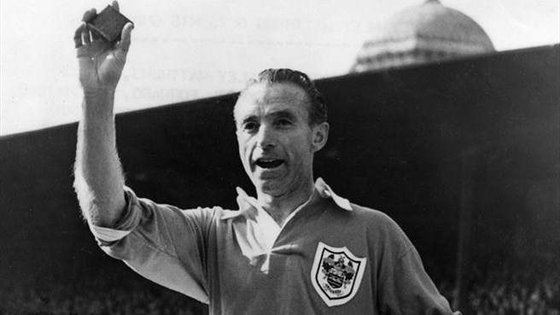
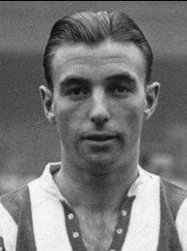
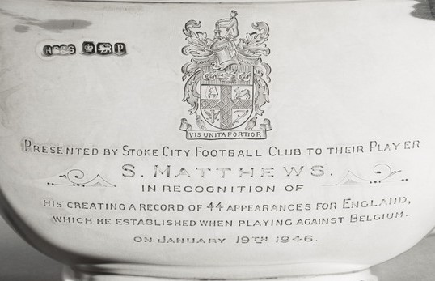
A four piece silver tea set presented to Stanley Matthews, H Pidduck & Sons Sheffield, 1932, S M monogram, inscribed with the Stoke City arms, and the dedication ‘Presented by Stoke City Football Club to their player S Matthews in recognition of his creating a record of 44 appearances for England which he established when playing against Belgium on January 19th 1946’,

Slide 15
BEDFORD AND FAMILY

Slide 16
R101 9ct gold brooch by
John Bull 1930
The R101 slipped it mast on 4th October 1930 en-route to Karachi (then part of British India) via a refuelling stop at Ismaïlia. She initially headed northeast to fly over Bedford before making a 180° turn to port to pass north of Cardington. She crashed in Beauvais soon after 2am the following morning.

Slide 17
Norman Wilkinson
(1878 – 1971)
‘Bedford School’
Coloured lithograph, 75.5 x 113

Slide 18
Bedford School’s collection of Modern British print has its roots in a coming to terms with the fact that a very great deal of pictures had been lost in the fire of 1979. It has subsequently got together a collection of well over 120 original prints by artists including
Graham Sutherland, Barbara Hepworth, Julian Trevelyan,
Ceri Richards, David Hockney, Victor Passmore, Eric Gill
Patrick Heron and William Scott.
(right) Sir Terry Frost RA (1915 – 2003)
‘Red, Black and White’
Signed and inscribed in pencil artist’s proof
Lino cut, 31 x 17

Slide 19
William Scott CBE RA (1913-1989)
BLUE STILL LIFE, 1969-1970
oil on canvas signed, titled and dated
£145,000 euros Whytes Dublin 2017
William Scott (1913 – 1989)
A still life with frying pans and eggs
Signed in pencil 163/250
Screen print, 67 x 88.5

Slide 20
Stanley Anderson 1884-1966 Anderson was principally known for the series of highly detailed wood engravings of traditional British crafts that he produced between the Wars. His work typifies a post WWI view of life that was nostalgic and at odds with the Continental enthusiasm for the Modern Movement, represented by our 1930s love of ‘Stockbroker Tudor’

Slide 21
Julian Trevelyan RA (1910 – 1988)
Bedford School
Signed and inscribed in pencil, 89/100
Coloured lithograph, 48 x 50cm

Slide 22
Joyce Bidder (1906 – 1999)
‘Tackled’
Signed
Patintated bronze
42 x 40cm

Slide 23
Basil Mclear (1881-1915) Capped 11 times for Ireland 1905/7 Played against the first ever All Blacks Tourists, (below) lost 0-15, three caps v England, all won. At Bedford School 1893-99, killed in action at Ypres 24th May 1915. (Ireland jersey sold at Sothebys c.2010 For £2400)
Hastings Dasent (centre) was perhaps the most successful Bedford School rugby coach ever. At the end of another undefeated season (07/08) Dasent recorded:
‘We can see no deterioration in the play of our opponents, but their
style is out of date - it behoves us to be on the alert to find newer
methods still - in football, as in life, there is no finality’

Slide 24
My father, Murray Fletcher (1923 – 1997), who played over 100 times for Bedford between 1947 and 1951

Slide 25
My grandfather’s diary 1917, Bruce Bairnsfather (‘Old Bill’ bronze car mascot) My maternal great uncle’s ‘death penny’ (died Salonika 1918)

Slide 26
Former pupil and Head Boy of Bedford School, died of his wounds on 17th February 1917 at Boom Ravine on the Somme.
Temporary cross (Bedford School Chapel)

