Slide 1
Better Behaviour, Better Experience
Trauma-informed schools
Aidan Phillips, WAVE Trust

Slide 2
WAVE Trust
24 years of research and learning
How to prevent trauma from happening
How to mitigate/ heal its impact once it has
Consultants and advisors
UK Cabinet Office
Home Office
Dept. of Education and Health
Scottish, Welsh and Northern Irish Govt.
Campaigners and connectors
70/30 Campaign grassroots activists
Parliamentary groups
World Health Organisation taskforce
Notes:
We're also an official partner of rotary clubs nationwide.

Slide 3
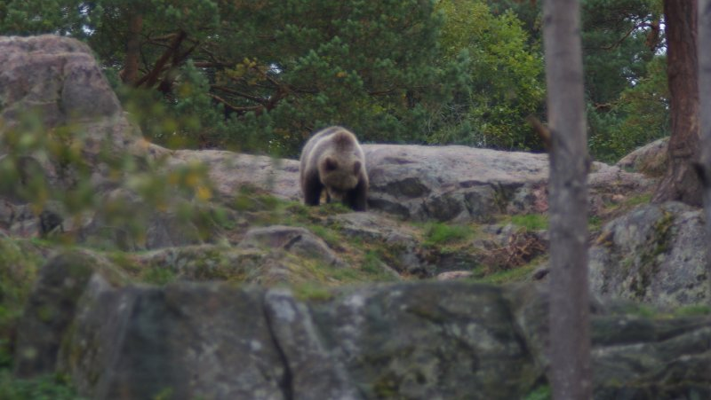
Trauma described
Notes:
I’m going to explain how the stress response system works using an example popularised by Doctor Nadine Burke-Harris, the Surgeon-General for California.
Imagine you’re walking in the forest, you look to your right and you see this - a bear.
What’s going to happen to you in this moment? Heart pounding. Chill running up your spine. Muscles tensing. Sharp intake of breath (do it).
That’s your stress response system kicking in. It’s your survival mode where your body prepares you to fight, run or freeze in response to a threat.
That’s what’s happening on the outside, but what does the inside look like?
First thing that happens when you see the bear is a part of your brain called the amygdala sounds the alarm. That’s a bear; we know from past knowledge that bears are dangerous; be afraid.
Your brain then activates two axes. One axis sends signals to the adrenal glands saying “make adrenaline”. Heart pumping faster, blood rushing to our muscles, airways opening. Ready for action.
Another axis activates some of the longer-term stress hormones, most notably cortisol. Your mood is destabilised, your blood pressure raised, your sleep disrupted – because if you’re going to be in a forest of bears for a while, it helps to be a light sleeper.
At the same time, your fear center dials the rational part of your brain way, way down. You need your instinct to react as quickly as possible.
Also, your immune system gets fired up in case that bear does manage to swipe you a couple of times, so it’s primed to send inflammation to those areas rapidly.
A good system. But here’s the problem – what happens if you go home that night and the bear is still there?
ENDS

Slide 4
‘Bears’ that can traumatise
Parental separation
Neglect
Alcoholic parent
Experience of conflict
Rape
Bullying
Domestic violence
Forced marriage

Slide 5
Definition of trauma
Source of trauma
Event, series of events or set of circumstances
How it happens
Experienced as physically or emotionally harmful, or threatening
How it impacts
Lasting adverse effects on functioning and physical, social, emotional, or spiritual well-being

Slide 6
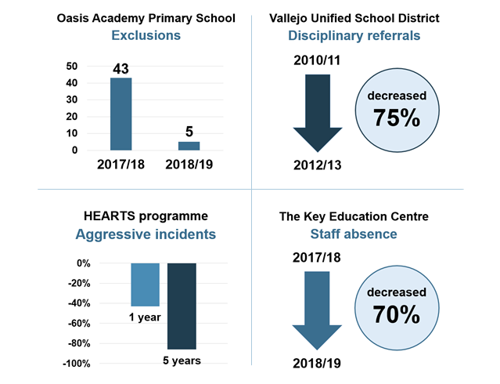
Notes:
Before talking about what trauma-informed schooling is, I need to make something clear. This is not just about being compassionate – it's about being effective.

Slide 7
Healing happens in relationships
Safety
Compassion
Respect
Trust
Collaboration
Control
Trauma-informed principles

Slide 8
What is a trauma-informed school?
“What’s wrong with you?”
“What happened
to you?”

Slide 9
Key messages
1
2
3
Prioritise relationship-building
Create a therapeutic environment
Unearth the root of the behaviour
4
5
6
Make discipline a learning experience
Provide students with a sense of control
Promote a supportive staff culture

Slide 10
Case studies
Pillgwenlly Primary School, Newport
Timeouts
Oasis Academy Primary School, Manchester
Therapeutic spaces
Pencoed Comprehensive, Bridgend
Activities
Notes:
Pillgwenlly: Instead of standing outside as “the naughty kid”, children are sent to another class, invited in without ridicule, retire to e.g. a book corner to calm down and, when that classrooms’ teacher is free, they discuss the matter with them.
Oasis: Dark room with fluorescent lights; light small room with tent and emotions charts; screaming room; and poofs outside of classrooms.
Pencoed: Taekwondo ; girls’ self-esteem workshops.

Slide 11
Questions
Pillgwenlly Primary School, Newport
How would you take the same approach Pillgwenlly use with timeouts for other disciplinary procedures?
Oasis Academy Primary School, Manchester
How could you design therapeutic spaces to fit your school’s needs and available spaces?
Pencoed Comprehensive, Bridgend
What other school activities could help students build resilience?
Notes:
The research provided an excellent overview of what it means to be a trauma-informed school. But for us, it also sparked a lot of questions about how to do a lot of this in practice.

Slide 12
Practical how-to guide
Take each principle we recognised through our last project and show how to do it in practice. For instance:
Send a copy to every school and local authority in the UK
Step-by-step guide to restorative conflict resolution
Descriptions of nurture room layouts
List of possible options for grounding activities

Slide 13
Practical how-to guide
If we raise £10,000, we’ll produce a guide covering tools, techniques and tips on how to:
Teach students how to self-regulate
Enable students to see school as a supportive place
Create a calm, productive environment
Adopt an empathetic, effective approach towards discipline
Enable students to feel empowered and confident
Enable staff to support one another
We also have a further aim of £15,000 which will enable us to cover even more topics

Slide 14
Any questions?
Email: aphillips@wavetrust.org

