Slide 1

District Conference
23rd – 25th October 2020
Congress Theatre & Welcome Building, Eastbourne

Slide 2
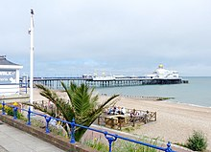

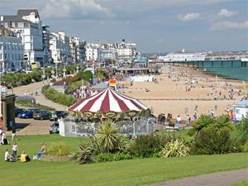

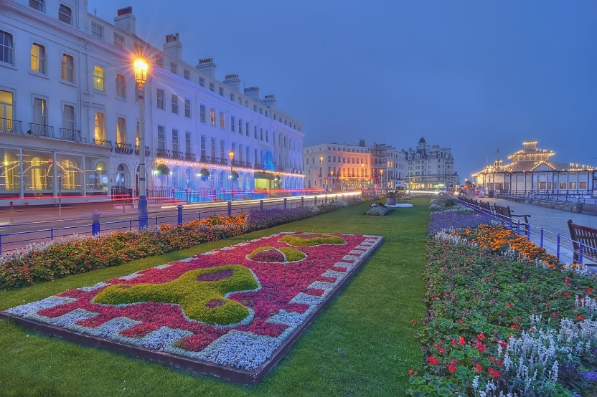
Eastbourne

Slide 3


The Welcome Building
Brand New Facility at the Congress

Slide 4
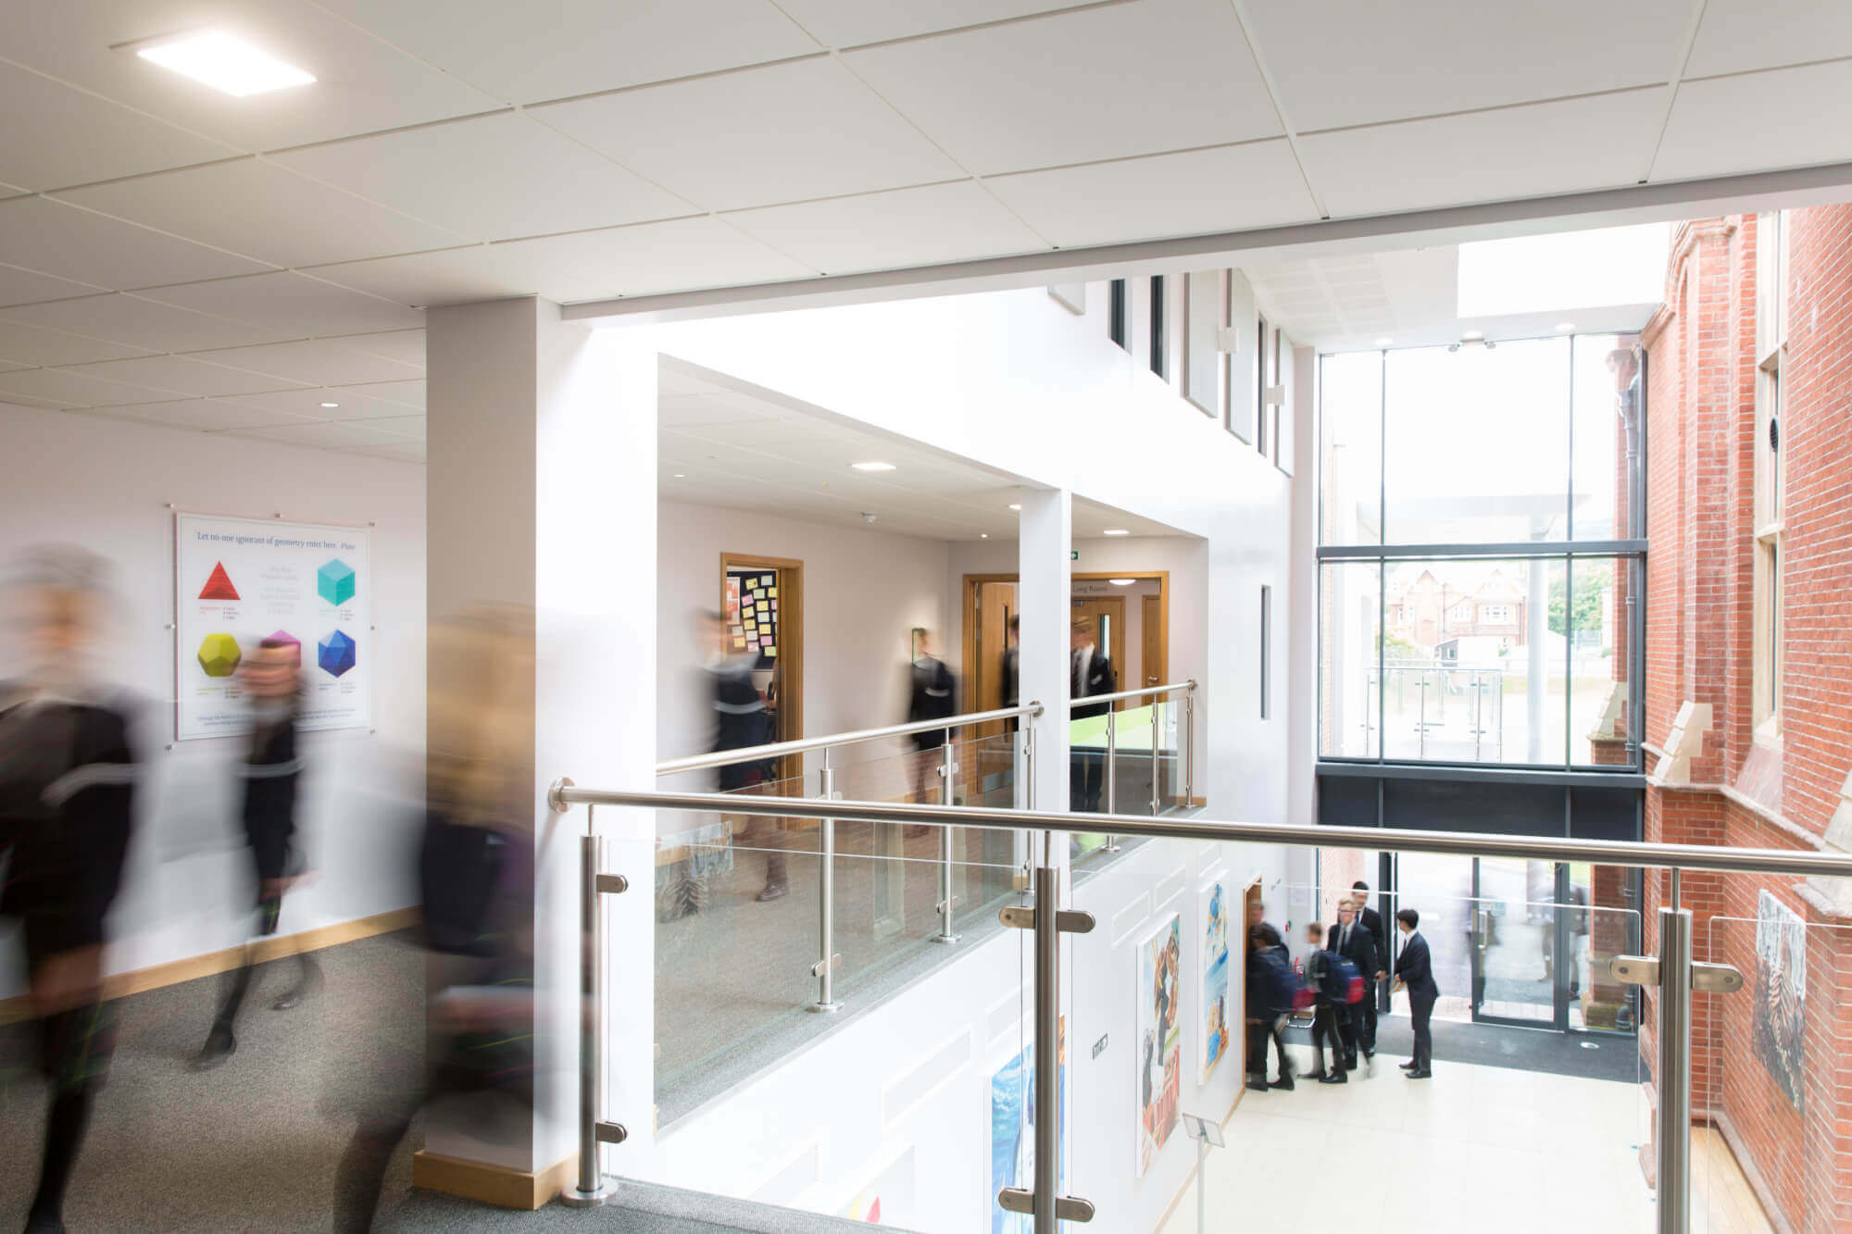
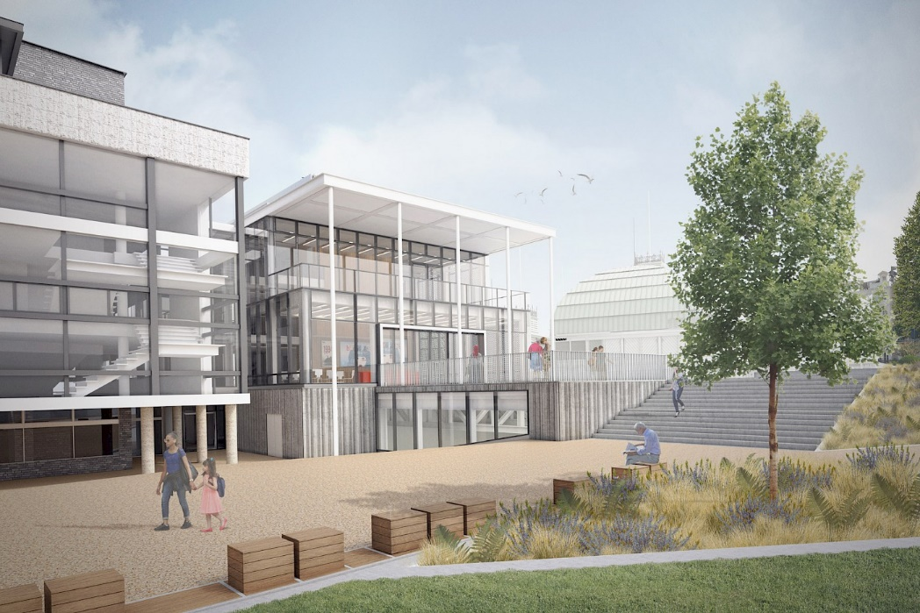
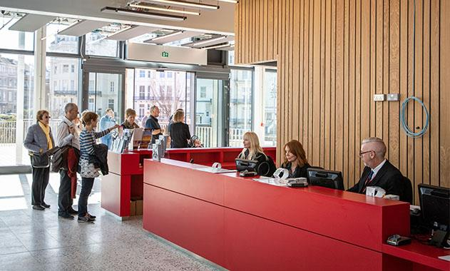
The Welcome Building
Brand New Facility at the Congress

Slide 5
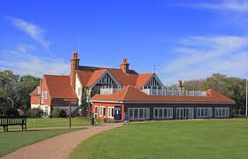

Golf
Date: Thursday 22nd October
Venue: Royal Eastbourne Golf Club
Cost: £38

Slide 6
Registration
Costs
3 day package £68
    Includes Saturday buffet lunch
2 Day package £55
    Includes Saturday buffet lunch
    1 day package £30
    All packages include Friday Night entertainment

Slide 7

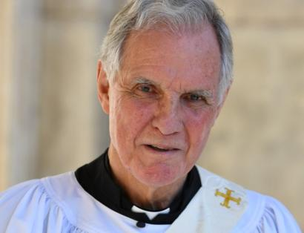

Speakers
Bonita Norris
    at 22 climbed Everest
Jonathan Aitken
    Politician, Prisoner,
    Priest
Jonathan Cavendish (Rotary Polio Ambassador)
    Producer of Breathe

Slide 8

Friday Night
Military Wives Choir

Slide 9
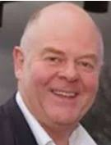
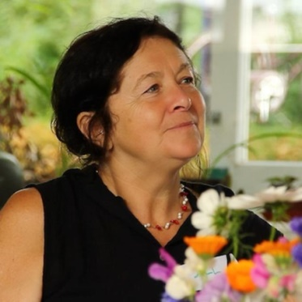

Saturday
Buffet lunch included
PDG Nick Corke
Hour Community
Dr Jill Lewis
Survived one world epidemic to fight another.
Rtn Tim Pare
Tea Leaf Trust
Delivering Peace & Reconciliation

Slide 10
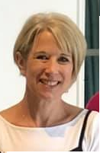
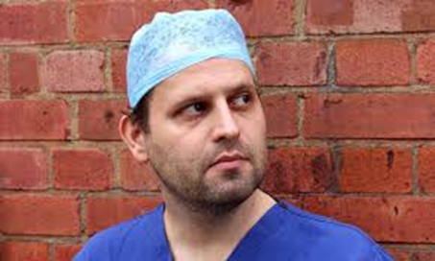
Saturday continued
Rtn Becky Bird
Frome Town Rotary
Adam Kay
  Author of This is Going to Hurt
  Performed at Prince Harry’s birthday party
Workshops
Foundation, Membership,
Inc. Becky Bird & Nick Corke

Slide 11

Gala Dinner
Cavendish Hotel
Entertainment
  Nick Bosworth
  Cost £39 per person
  Limited numbers, first come – first served

Slide 12

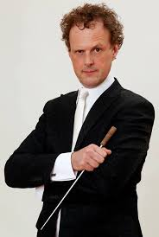
Sunday
Len Goodman (Tbc)
  Strictly Judge Demelza Patron
Mercy Ships
Rotary Global Grant
Rainer Hersch & his Orchestra
Comedian, Conductor, Musician

Slide 13
Registration
Online Registration will open on 1st March
Paper registrations will be available at PEPS

Slide 14
District 1120 Conference
Returns to Eastbourne
23-25 October 2020

