Slide 2
Meet our Club - Quick facts
Founded:
4th May 1925
President:
David Scott – chartered 4th May 2020
Meeting location:
Polish Centre, Kings Street, Hammersmith (Ravenscourt Park Tube Station)
Number of members:
28 members
Average age:
50 years
Men – Women ratio:
50 - 50

Slide 3
What did our club achieve this year?
New members:
9 members
Hours of service:
800 hours
Activities:
10 activities
Service activities:
17 activities
Amount raised:
£20,000
Actions done on Rotary Citation:
23 out of 25

Slide 4
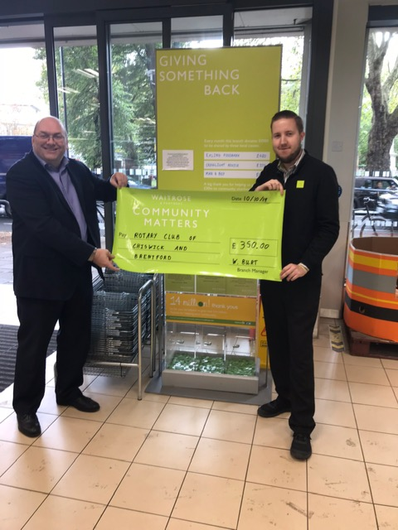
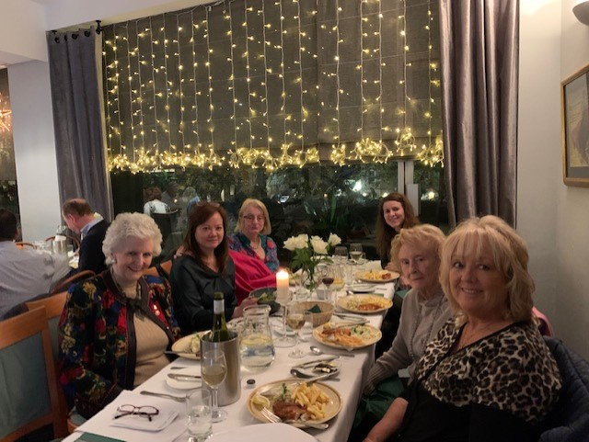
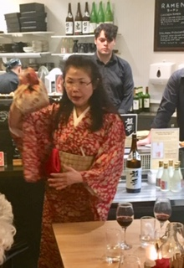
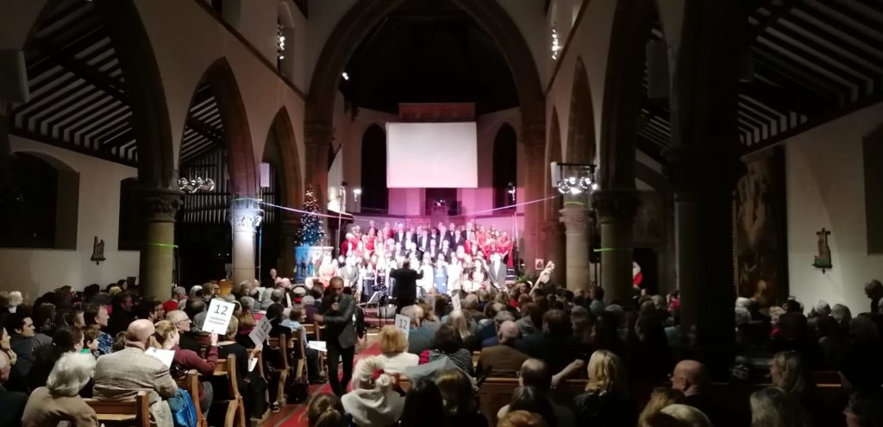
How did we raise our money?
Waitrose Chiswick Branch (2nd in their Charity of the Month)
Natwest
Kids Out
District Foundation Grant
Match for Aid for Japan (£750)
Match for Humla School (COVID 19 Famine Appeal £1000)
Christmas Event
Quiz Evening
Japanese Dinner Event
Area Quiz Meeting

Slide 5
Let’s take a peek at our Club’s activities this year

Slide 6
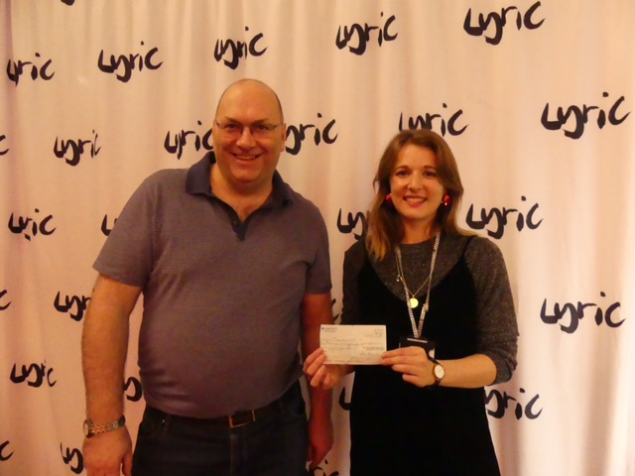
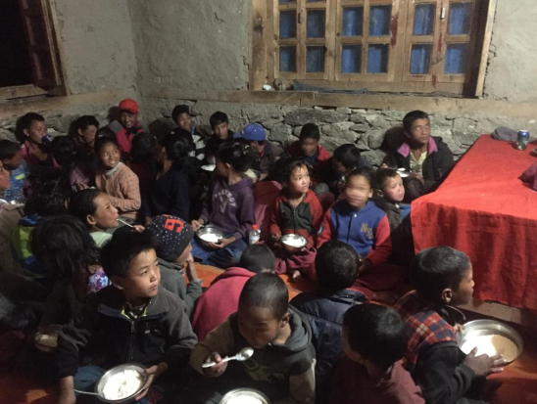
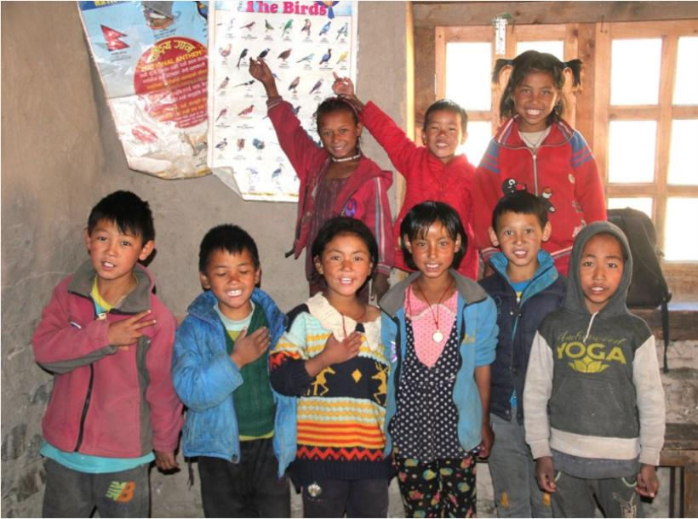
Community & International Service Activities
Hogarth Youth Club
Lyric Theatre
Chiswick School – Music Award
Hounslow Community Foodbox
Waitrose Chiswick
Event to raise money for local NHS & charities
Muchu School
Epilepsy in Action
Nepal – Rebuilt School & assisted recently in COVID-19 – preventing famine & sustainability in the school
West London Action for Children
Foundation in India
Humla
Aid for Japan
End Polio Now
Kharkiv Peace Project

Slide 7
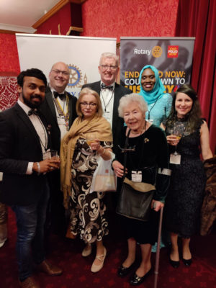
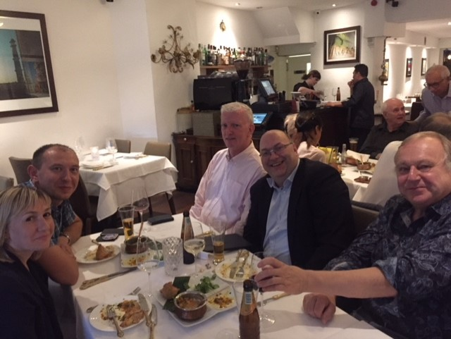
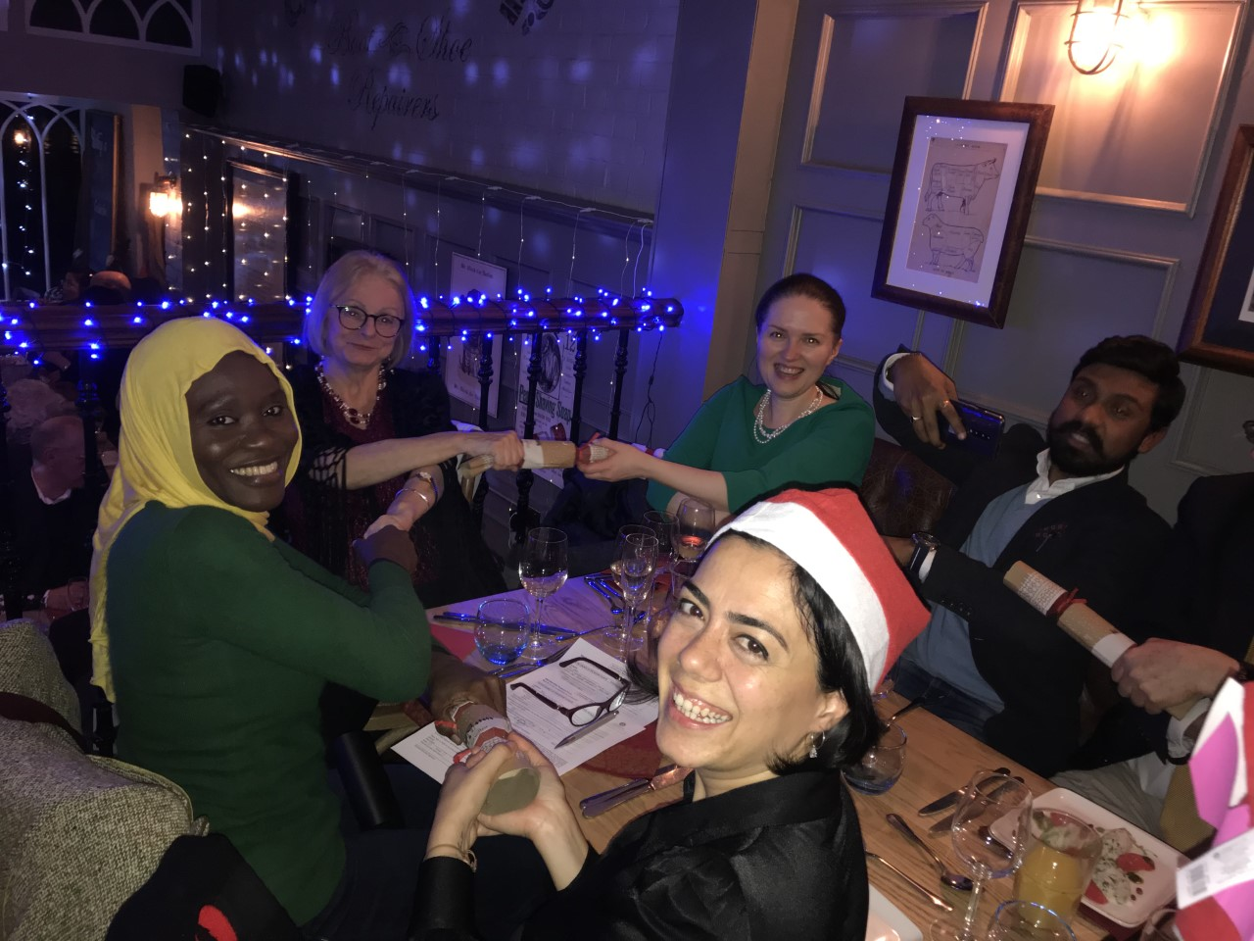
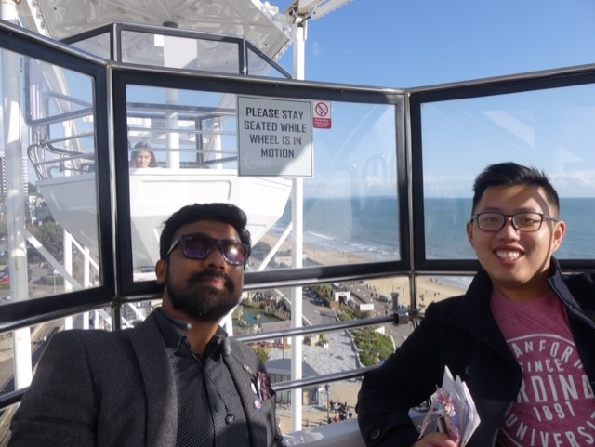
We are a social club
President’s birthday
District Conference
Quiz Night for Polio
District Foundation Evening
Christmas Dinner at the Bell & Crown Chiswick
Japanese Dinner Event
House of Lords Evening for Polio
Youth makes Music
Visit to Pakistan Embassy to eradicate Polio in presence of RI President

Slide 8
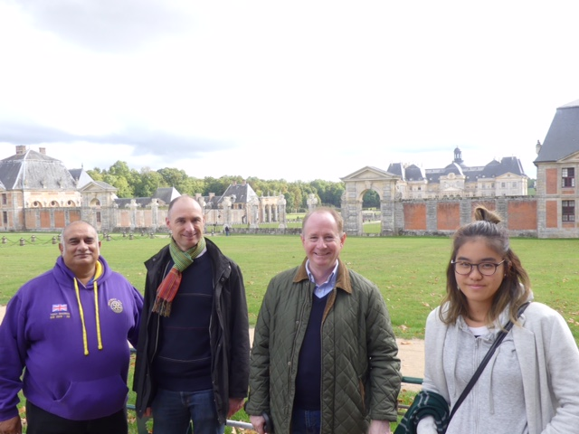
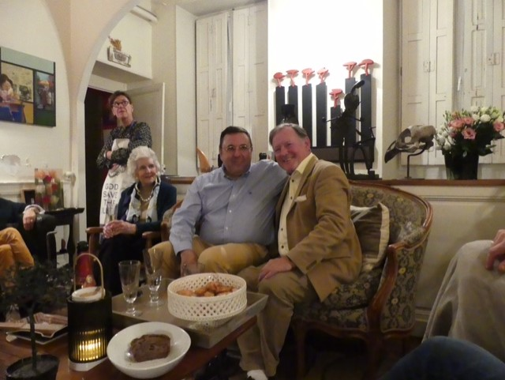
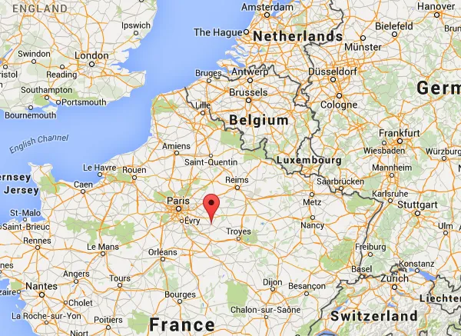
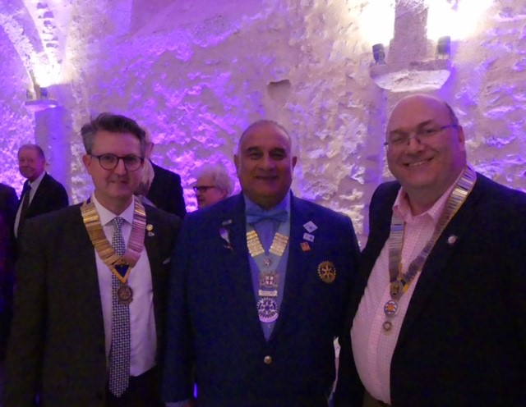
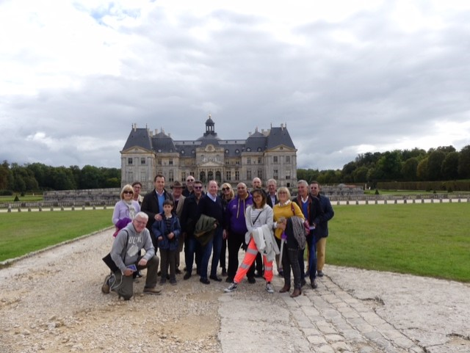
The Club’s international friends Provins Rotary Club (France)
Club visit 4th – 6th October 2019

Slide 9
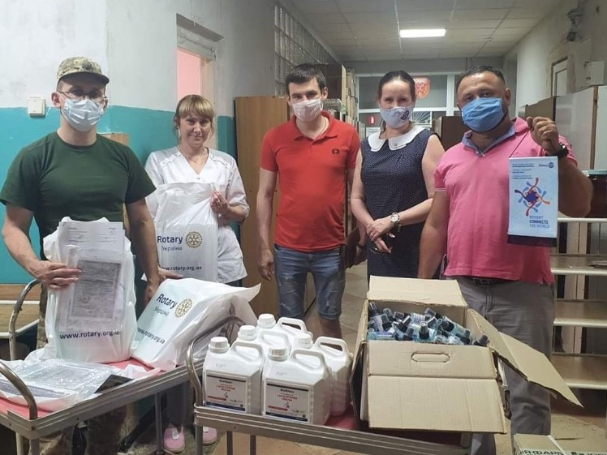
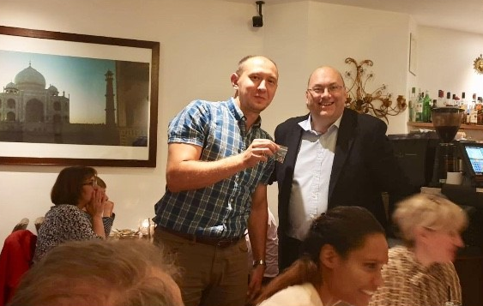
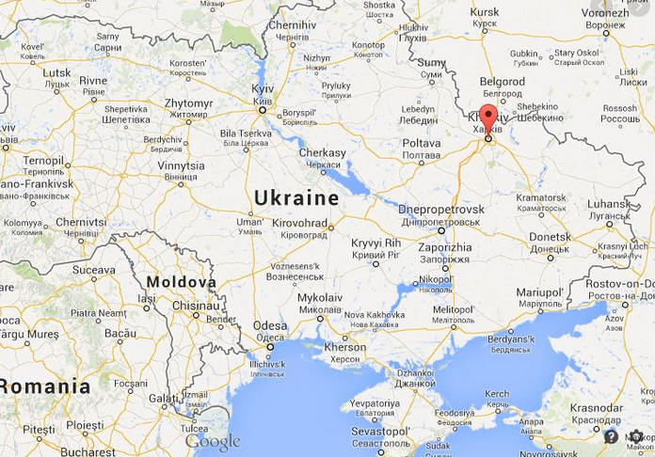
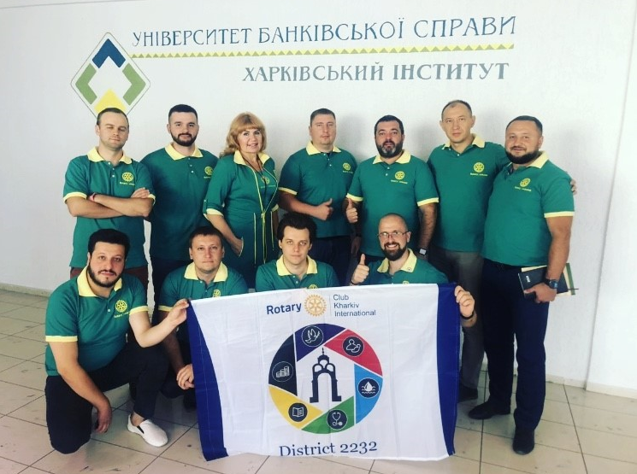
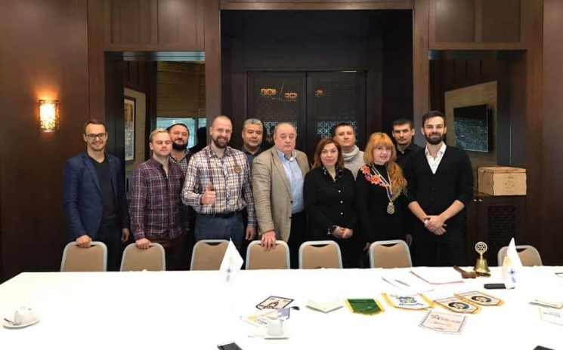
The Club’s international friends New Twin Club Kharkiv Rotary Club

Slide 10
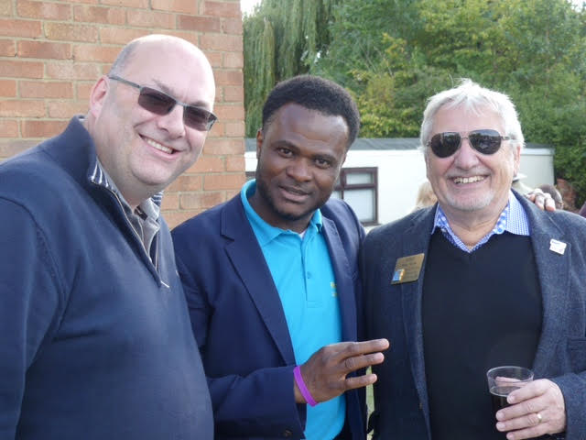
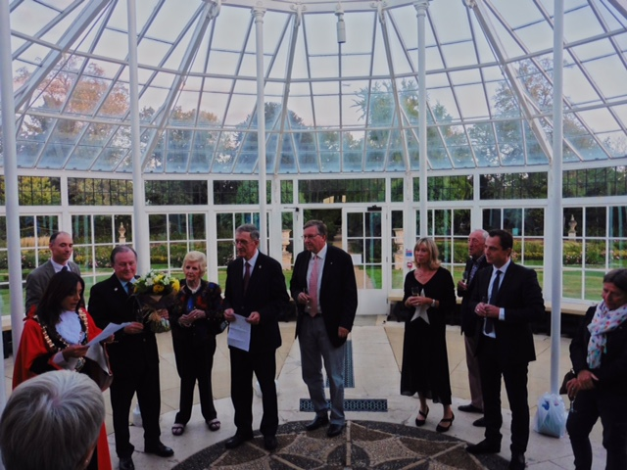
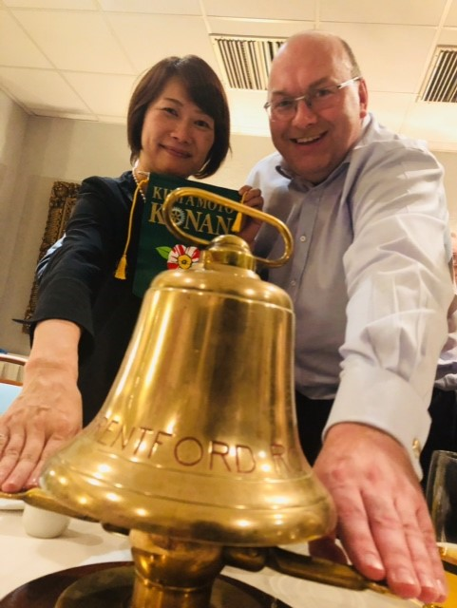
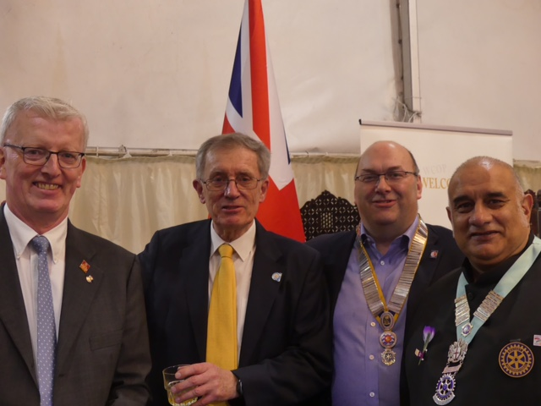
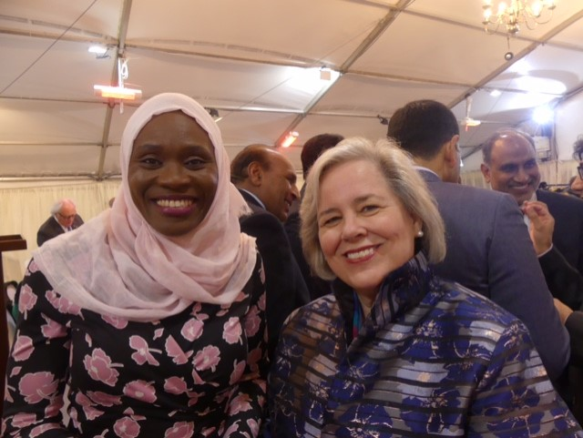
Our Club connected with the world
Rotary in District & RIBI
Rotary the World Over

Slide 11
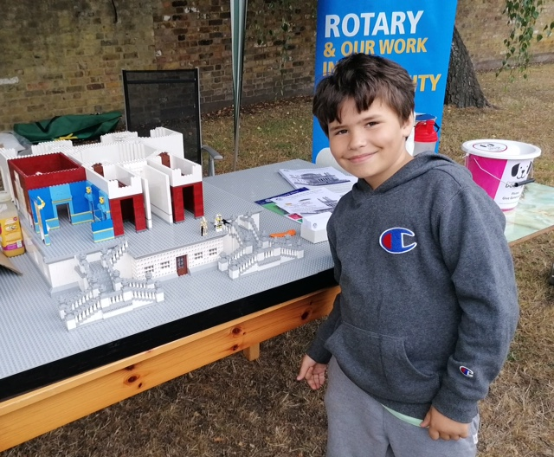
COVID-19 has not slowed us down
Despite COVID-19, our club continues to do its best, to adjust and pursue planned events & activities
Remote programme (Zoom) to keep the Club connected
Bi-weekly guest speaker
Bi-weekly social evening
Completing goals to achieve Citation this year
Joining District Conference digitally
District Foundation Evening
Joint Zoom meetings with Twin Clubs

Slide 12
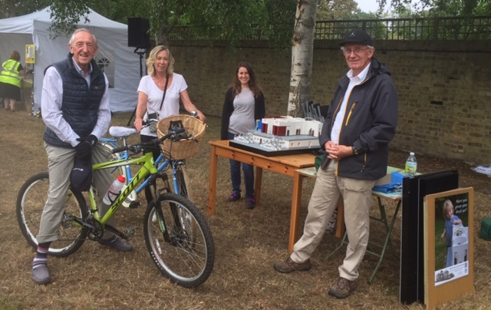
COVID-19 has not slowed us down
Ongoing service projects
Chiswick House & Gardens LEGO Fundraise
End Polio Bulb Campaign
Epilepsy in Action
West London Action for Children
Kid Out – Christmas Toy Box
British Polio
Street Kids
Reviewing plans for
Bingo Evening for Kids-Out Christmas Toy Box, and Street Kids
Race Night over Zoom
District Quiz
Christmas Celebration
Charity of the Month for October: Waitrose Chiswick

Slide 13
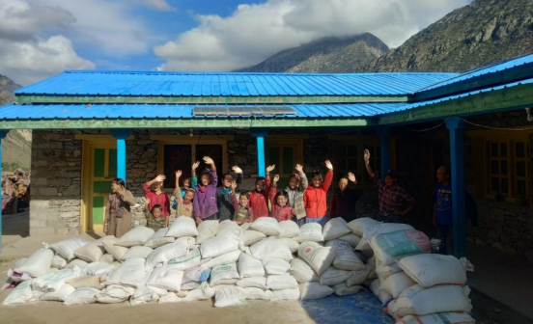
COVID-19 has not slowed us down
Joined Circle of the Centennial Rotary Action Group (New RAG Group)
Club attended an International Peace Meeting with people from 26 Clubs from 6 continents
Club has reclaimed two years’ gift aid on donations for large and small donations
Club will be able to donate more money to charity
Moved Club Website to Rotary Linked Website, accounts were digitalised, and Club set up contactless
Approached by Bolder Academy to start an Interact Club
Two new members joined

Slide 14
Rotary Club Chiswick & Brentford says: Thank you!

