Slide 1
Rotary in Epsom

Slide 2
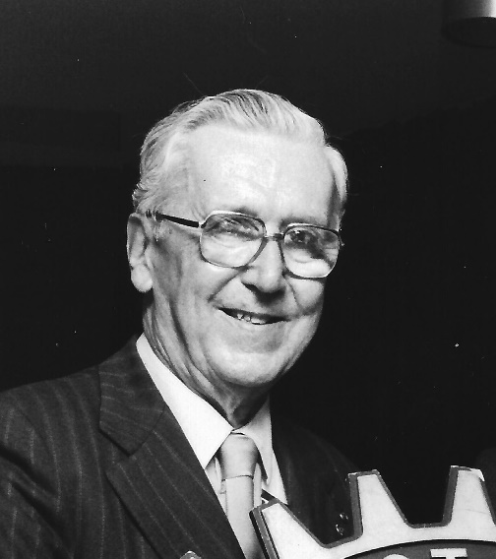
Bert Umpleby

Slide 3
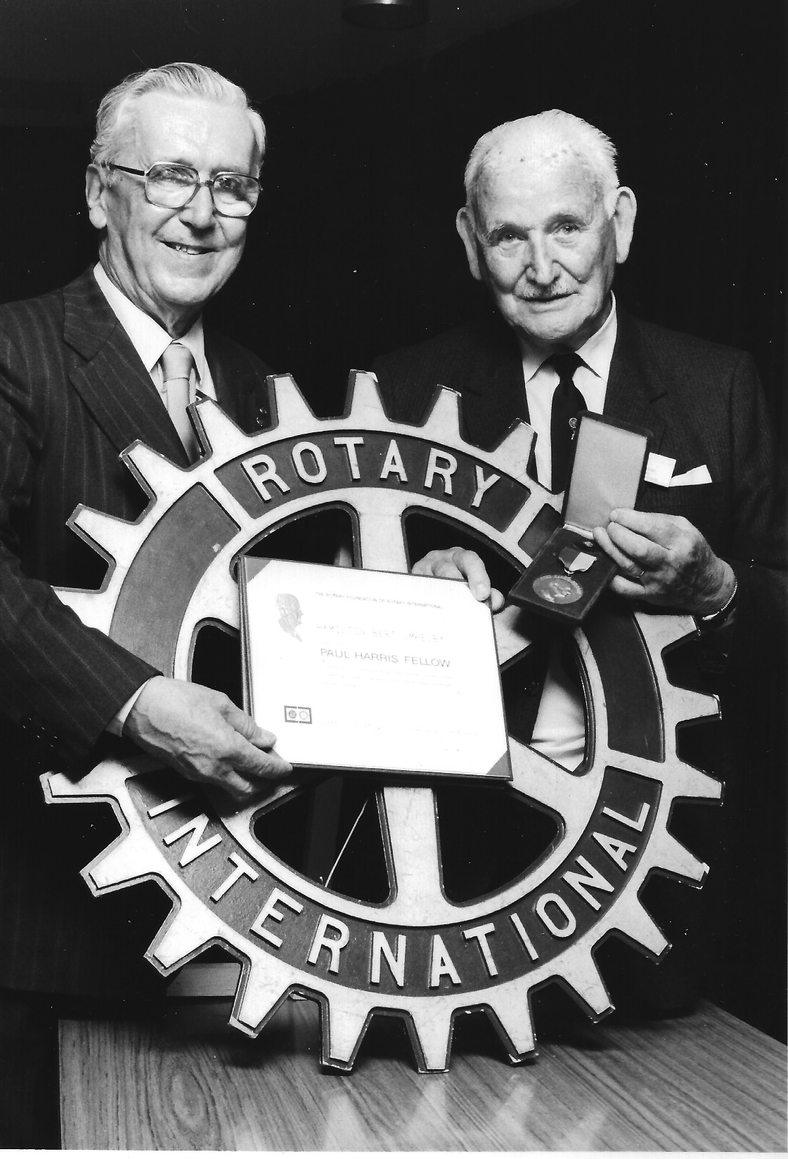
Bert Umpleby receiving Paul Harris Award

Slide 4
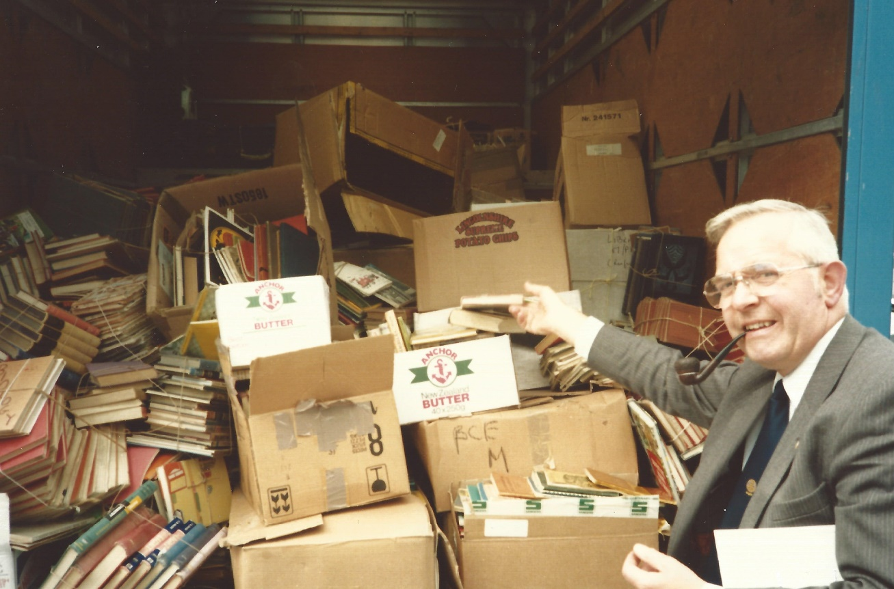
Book Collection 1985

Slide 5
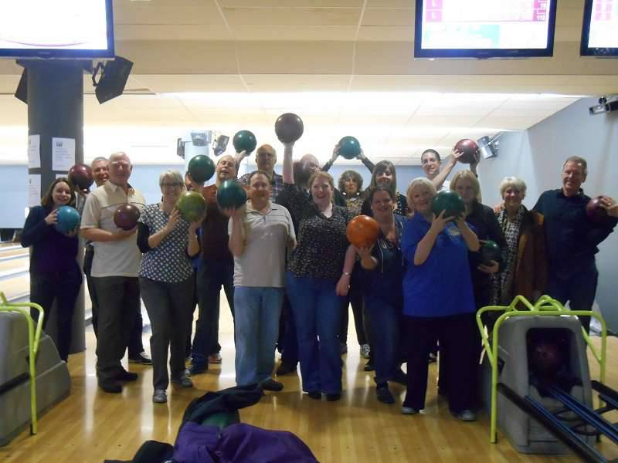
Bowling with Rotaract 2014

Slide 6
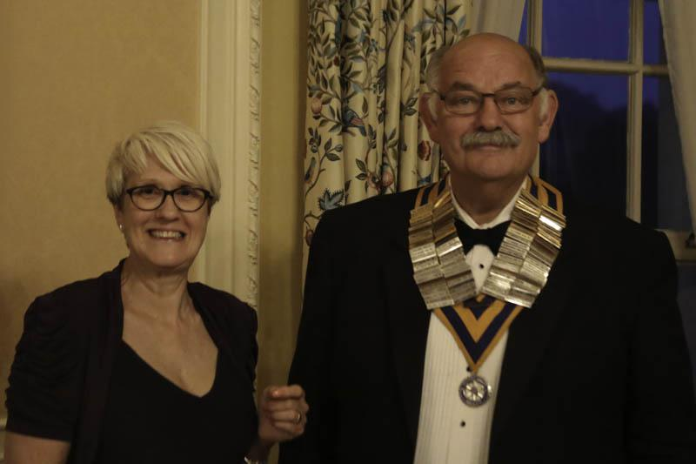
Carol Caiger and Incoming President Clive Smitherman

Slide 7
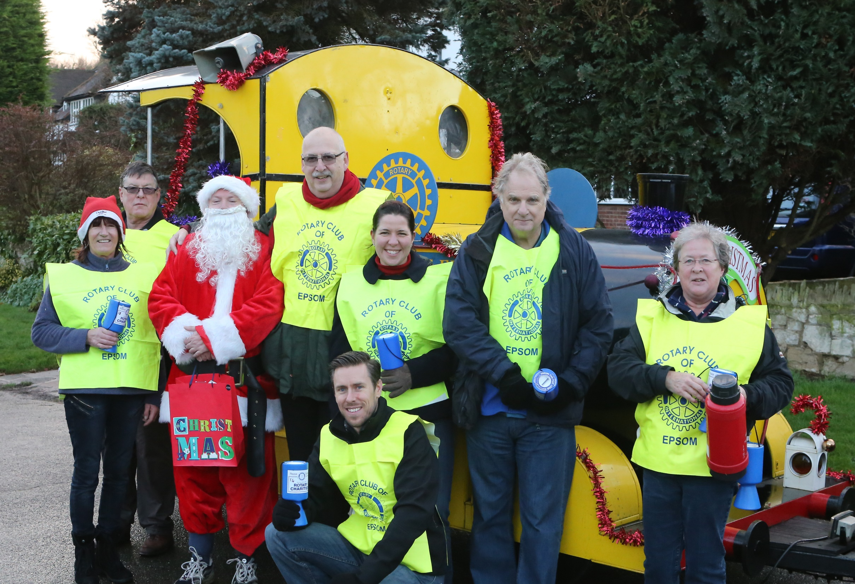
Christmas 2014

Slide 8
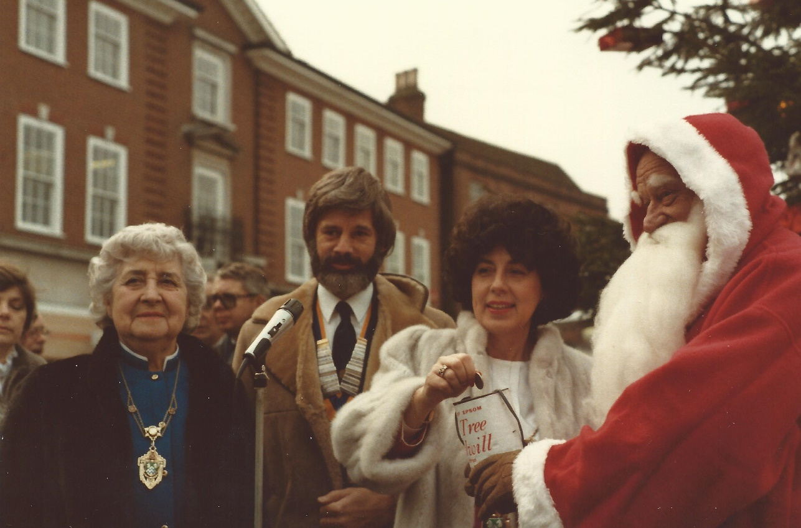
Christmas Collection 1984

Slide 9
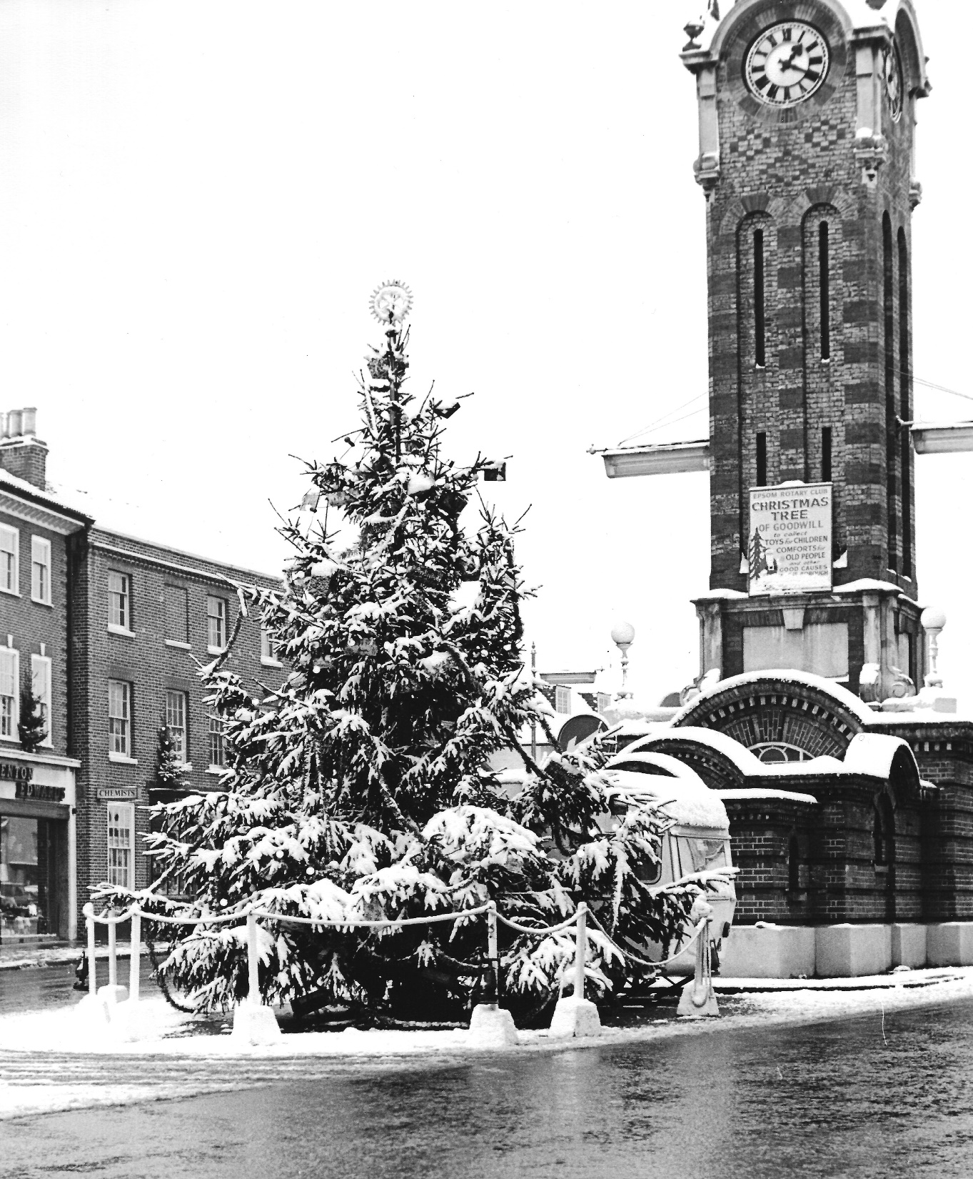
Christmas Tree of Goodwill

Slide 10
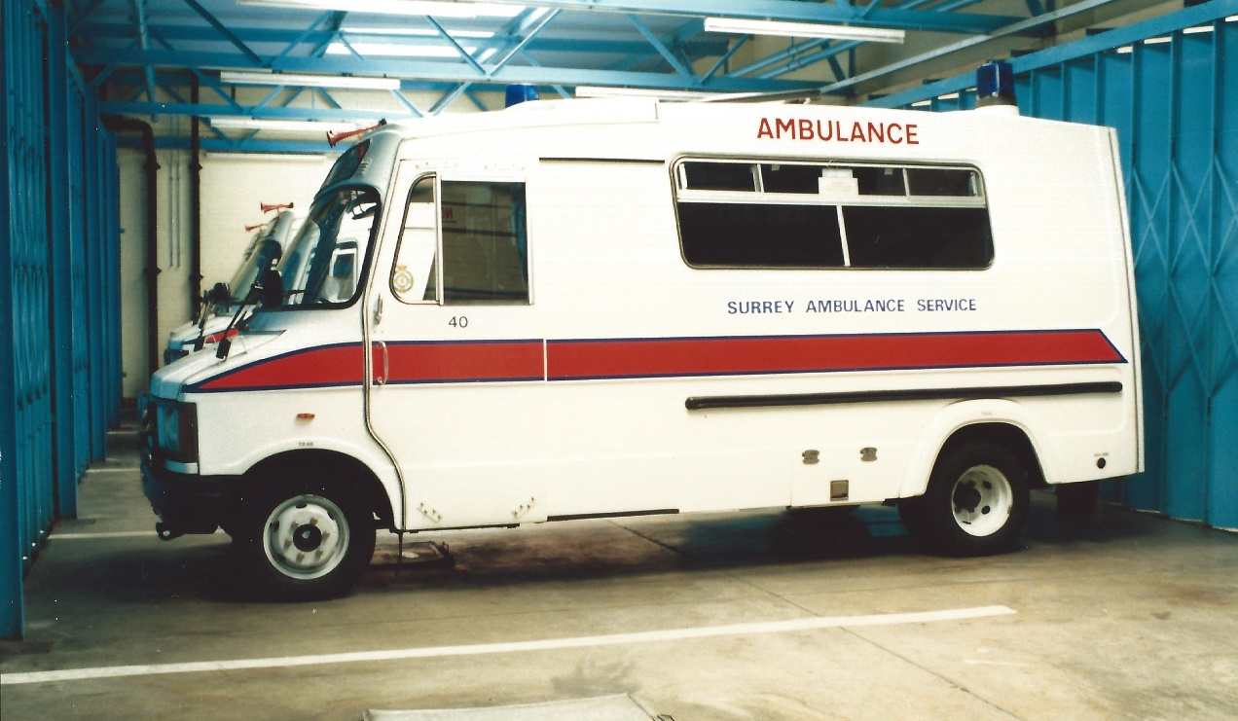
Defibrillators for the Ambulance Service

Slide 11
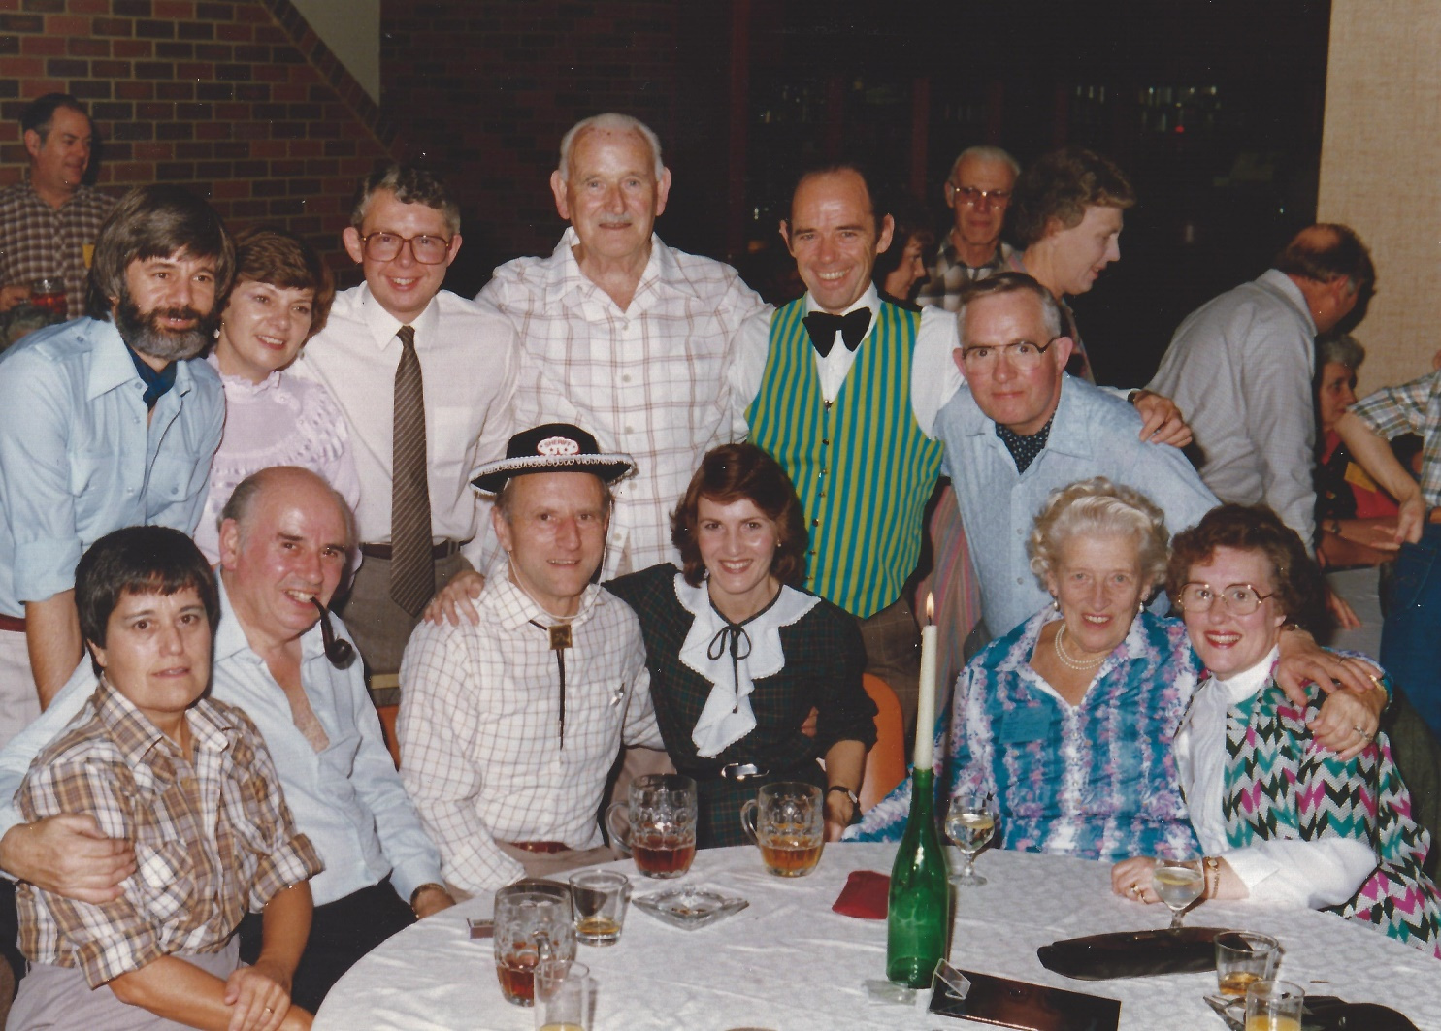
District Conference 1983

Slide 12
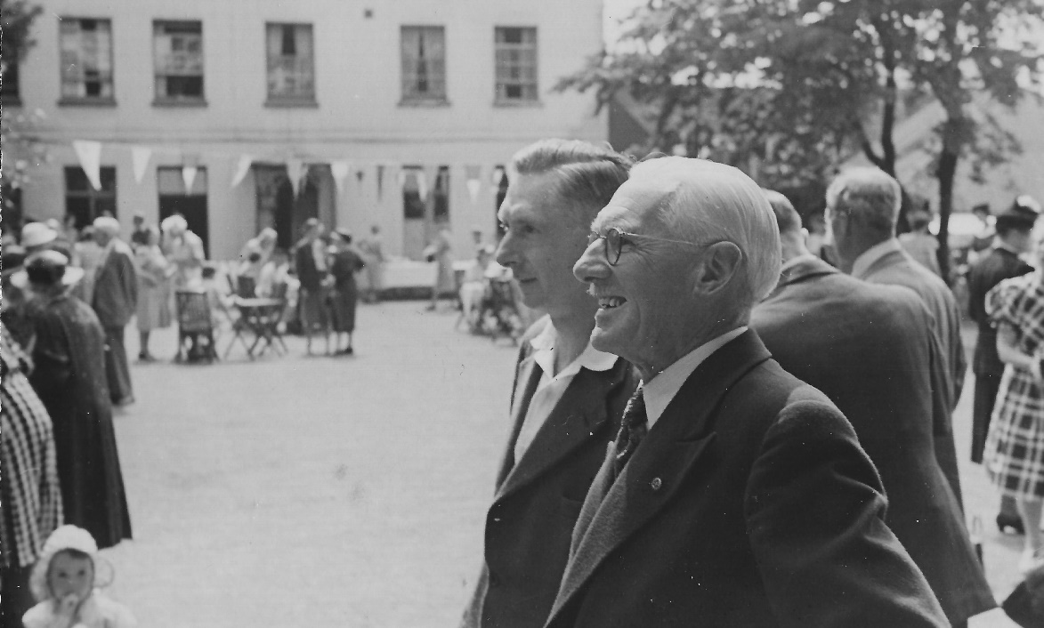
Dorset House and HH Reid

Slide 13
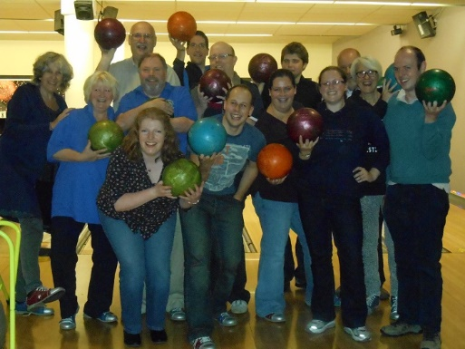
Bowling at Tolworth

Slide 14
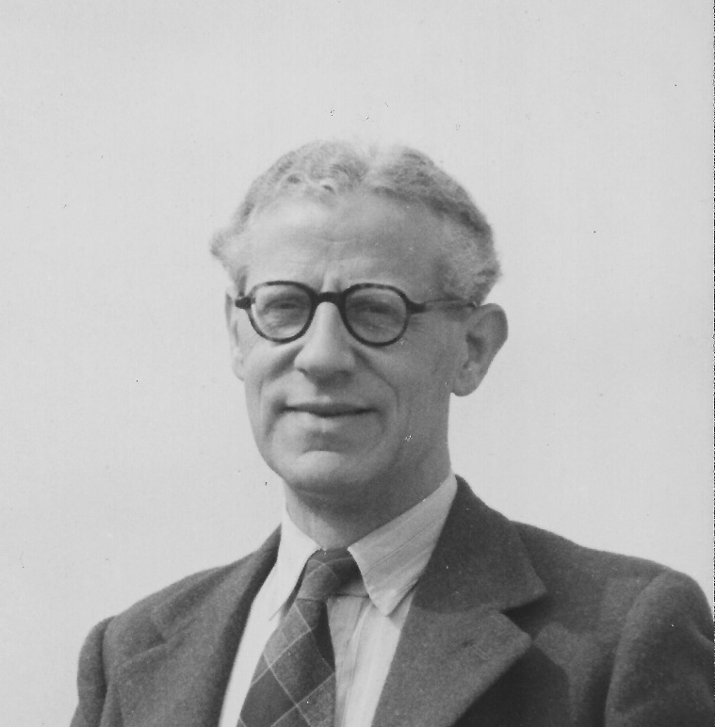
Fred Stevens

Slide 15
Epsom and Ewell Borough Family Fun Day 2012

Slide 16
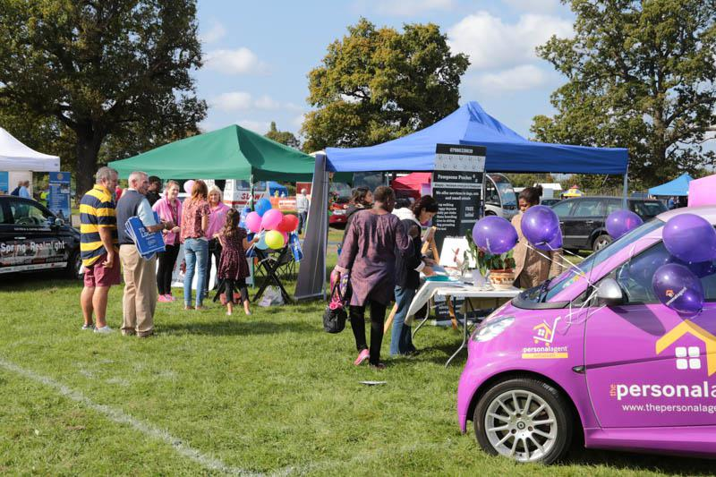
Epsom and Ewell Borough Family Fun Day 2014

Slide 17
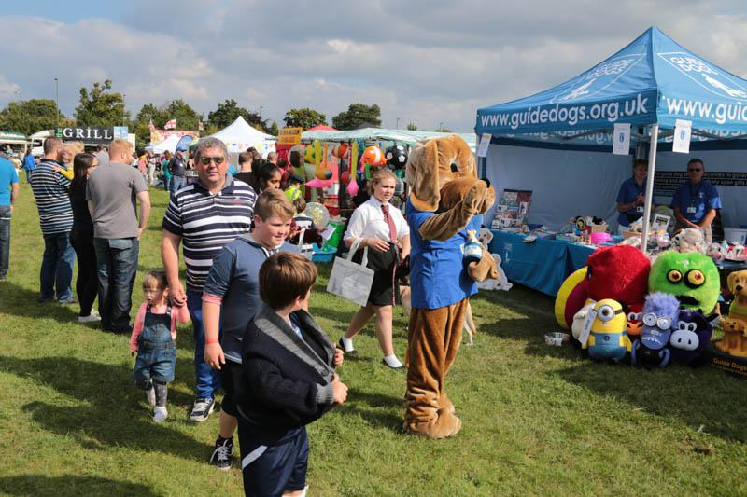
Epsom and Ewell Borough Family Fun Day 2014

Slide 18
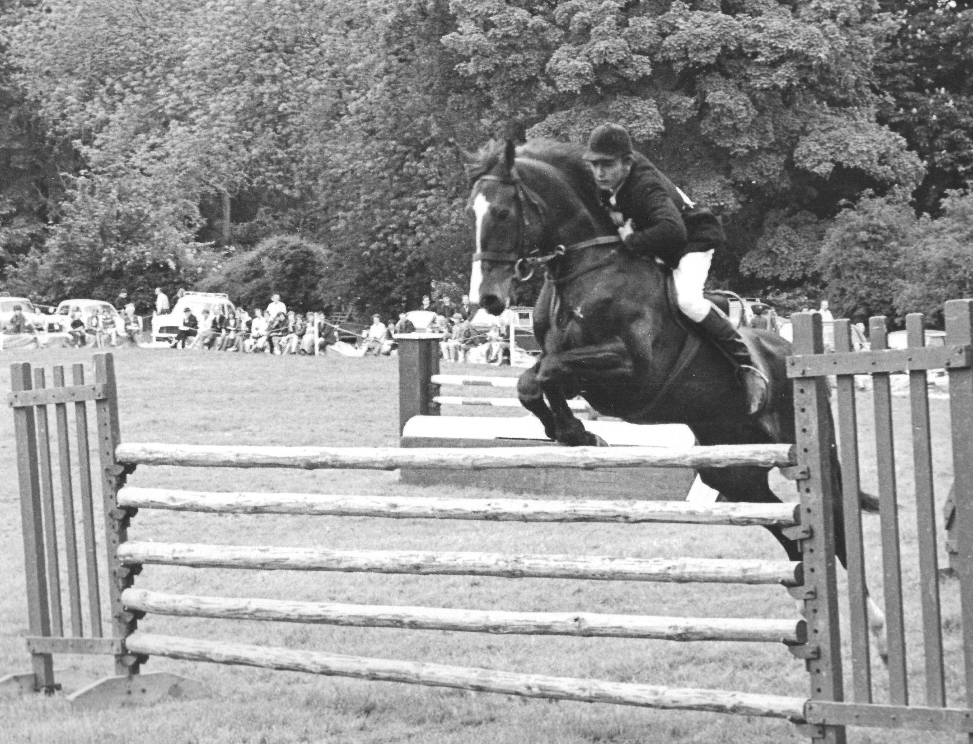
Horse Show 1966

Slide 19
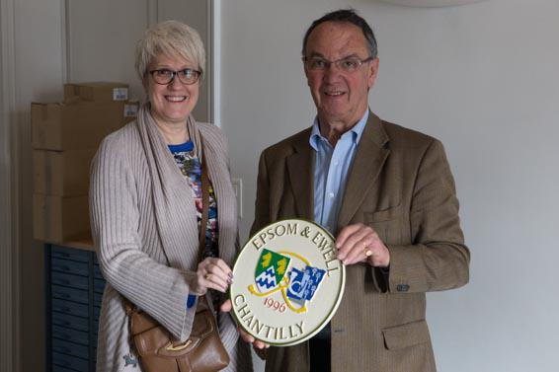
Carol Caiger presents plaque to Chantilly Deputy Mayor M. Charpentier

Slide 20
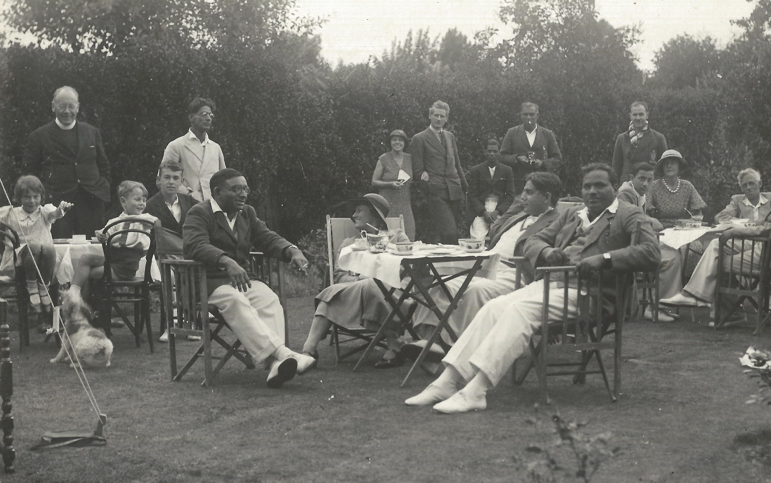
Indian Students 1933

Slide 21
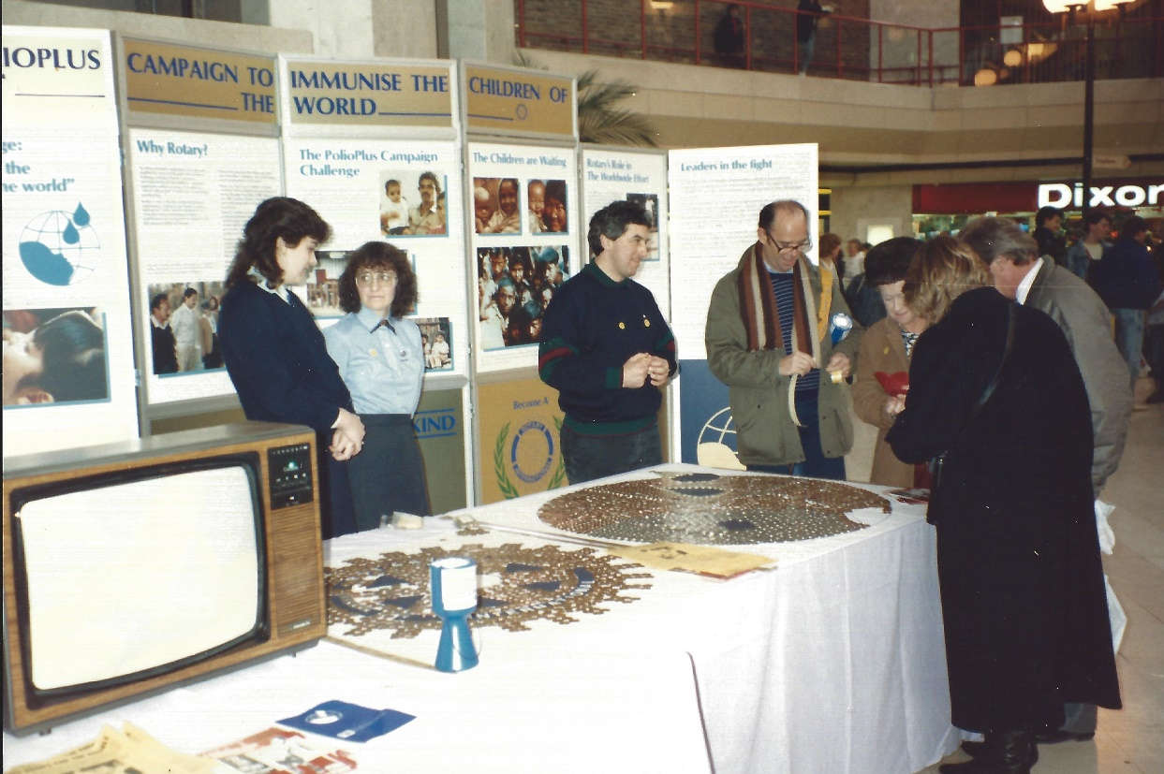
Mile of Pennies at the Ashley Centre 1988

Slide 22
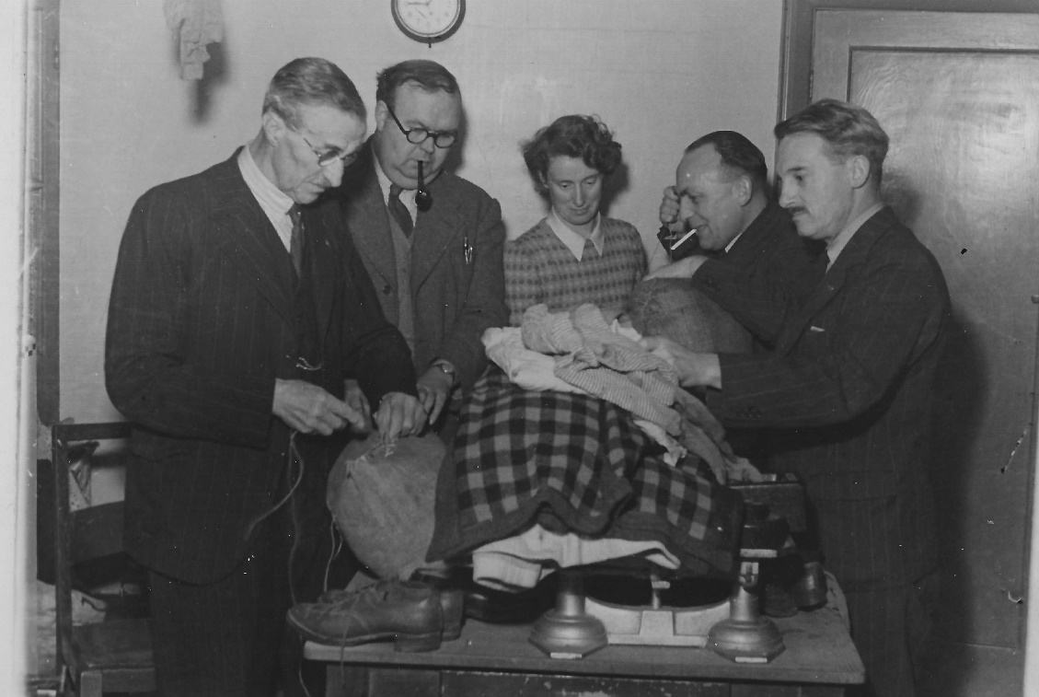
Packing Clothing for Germany 1948

Slide 23
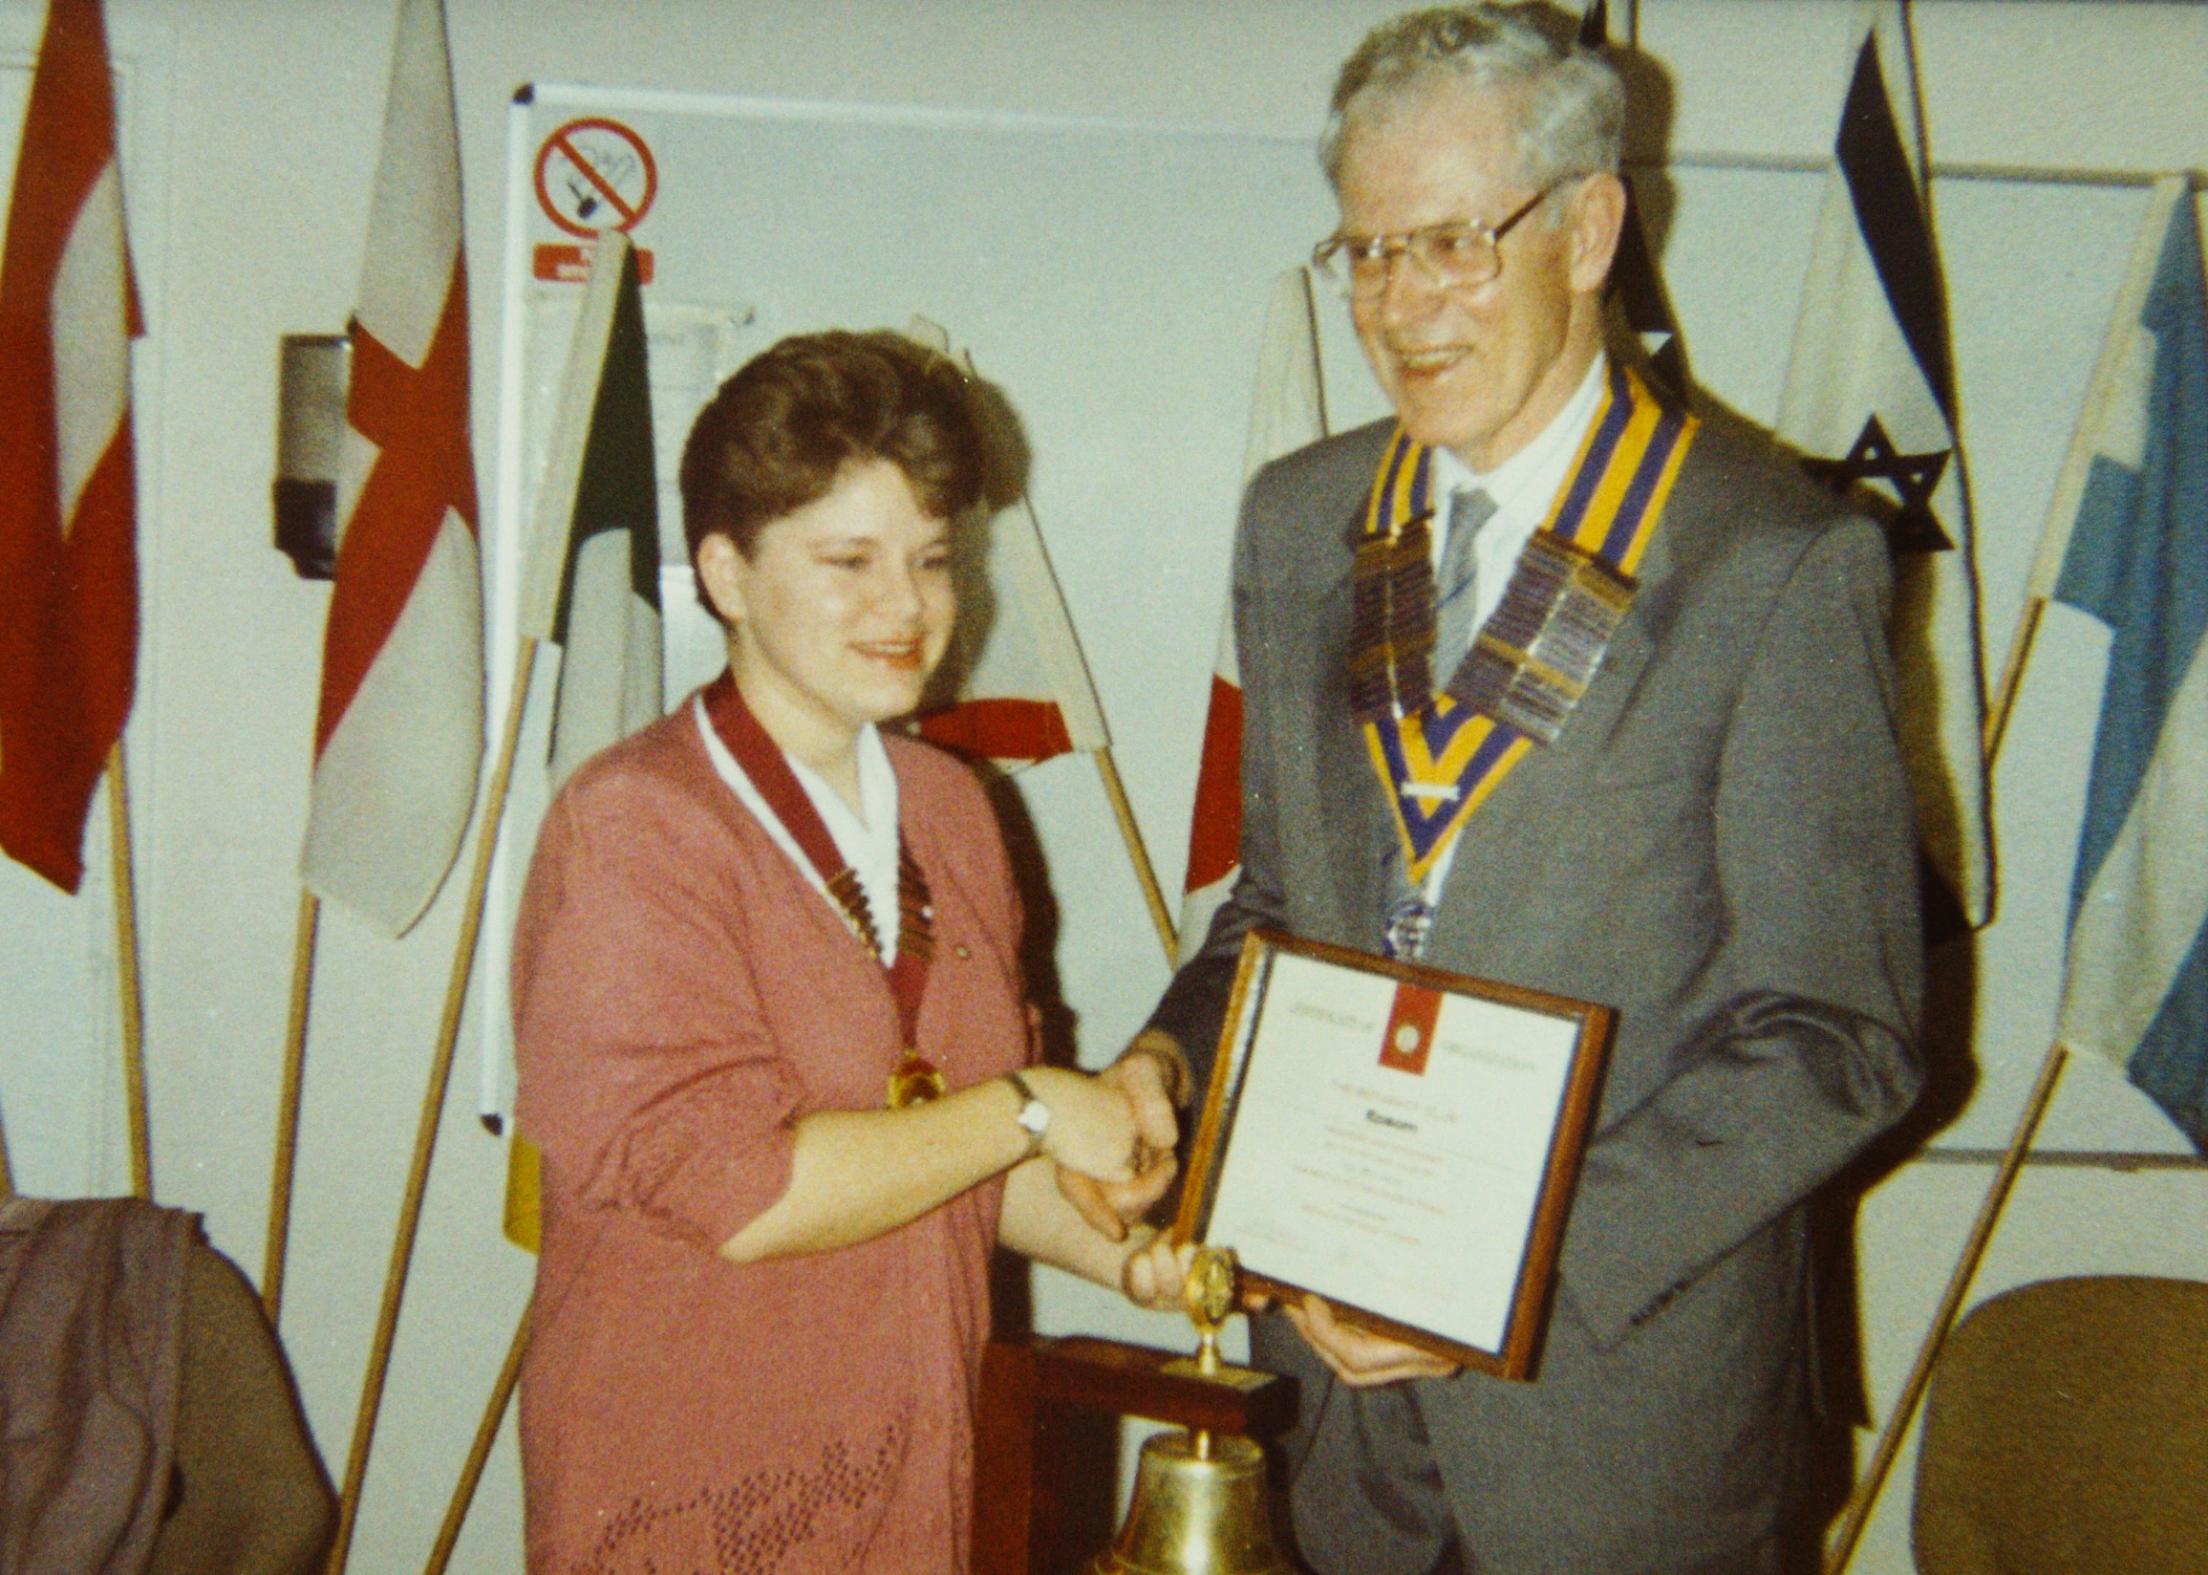
Foundation of Rotaract in Epsom, Sharon Maggs – first president

Slide 24
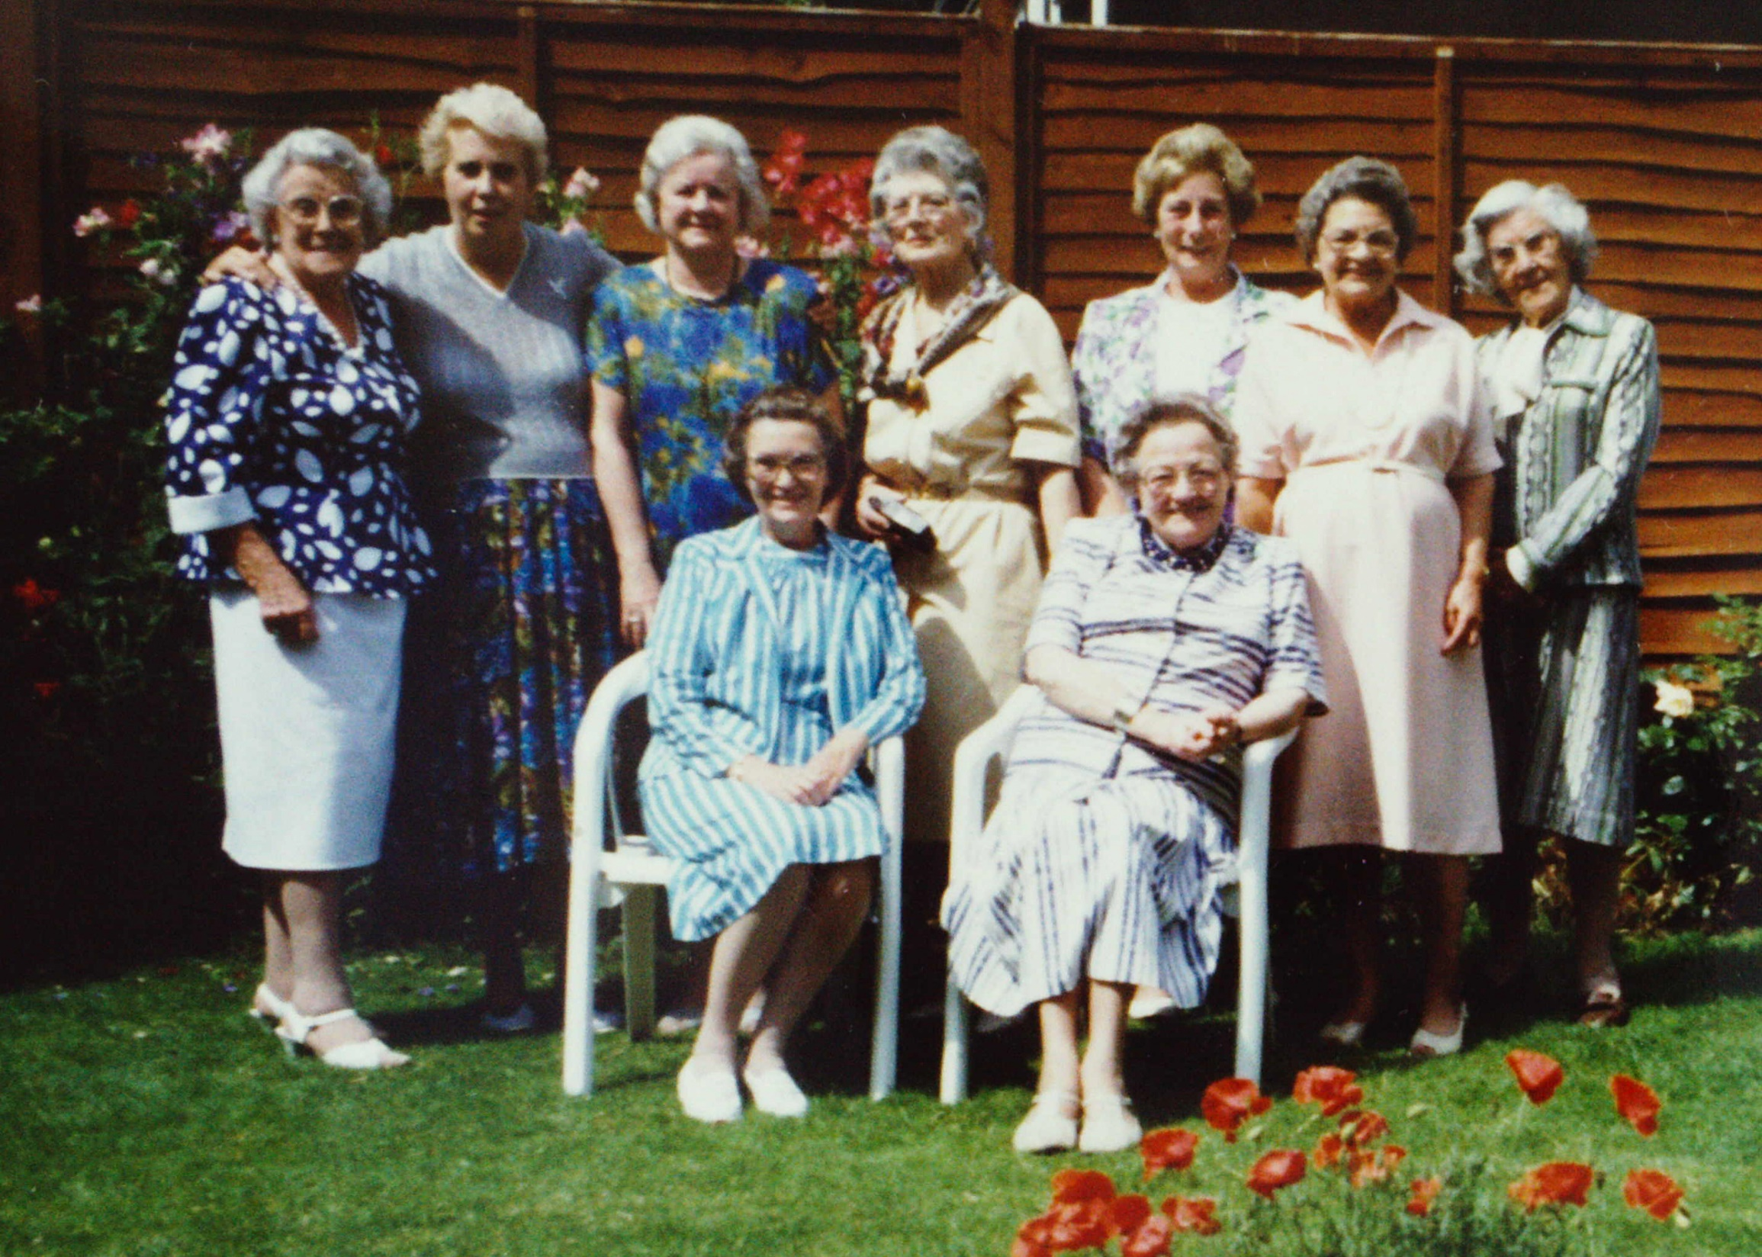
Inner Wheel Outing to Ruth Ludbrooks

Slide 25
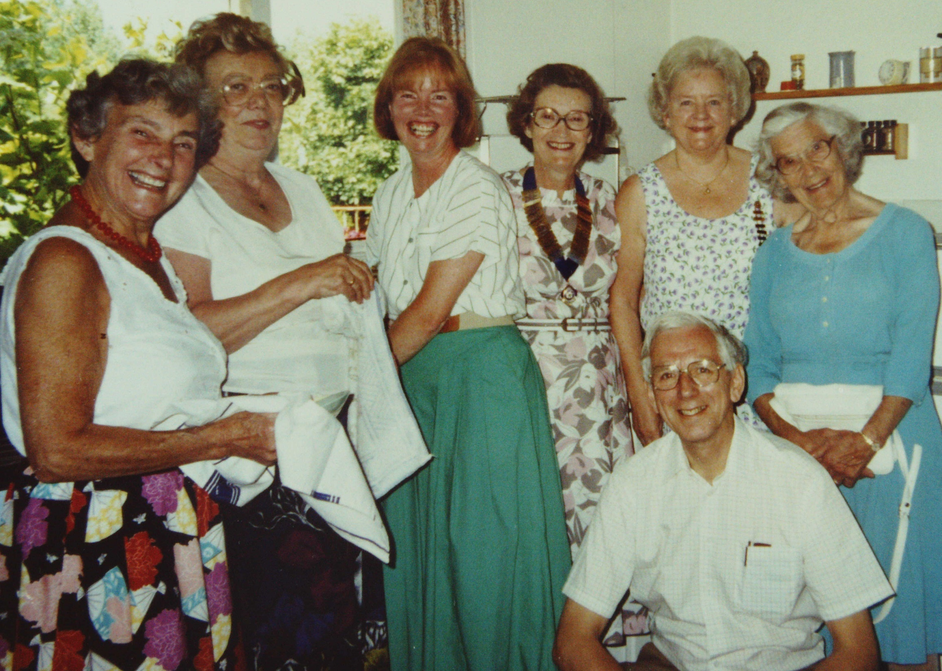
At Pres Maureen Corben’s home in Ewell Downs Road

Slide 26
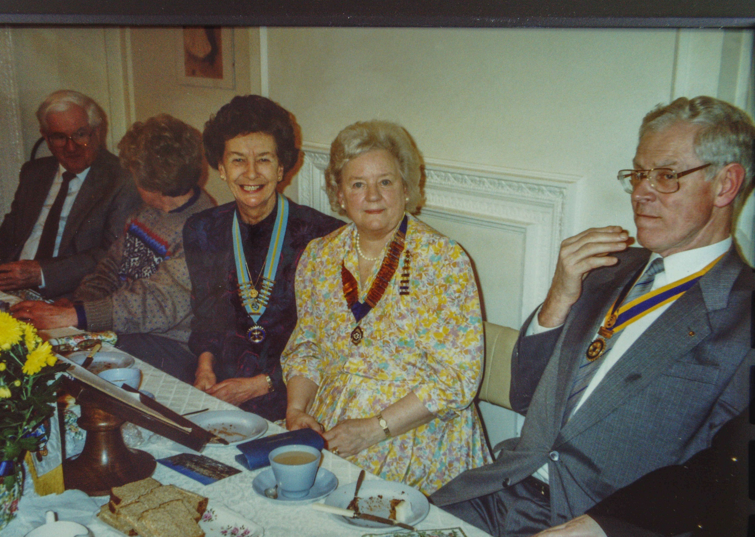
Tea Party Ewell Court – Roy Richmond, Pres Jill Munroe

Slide 27
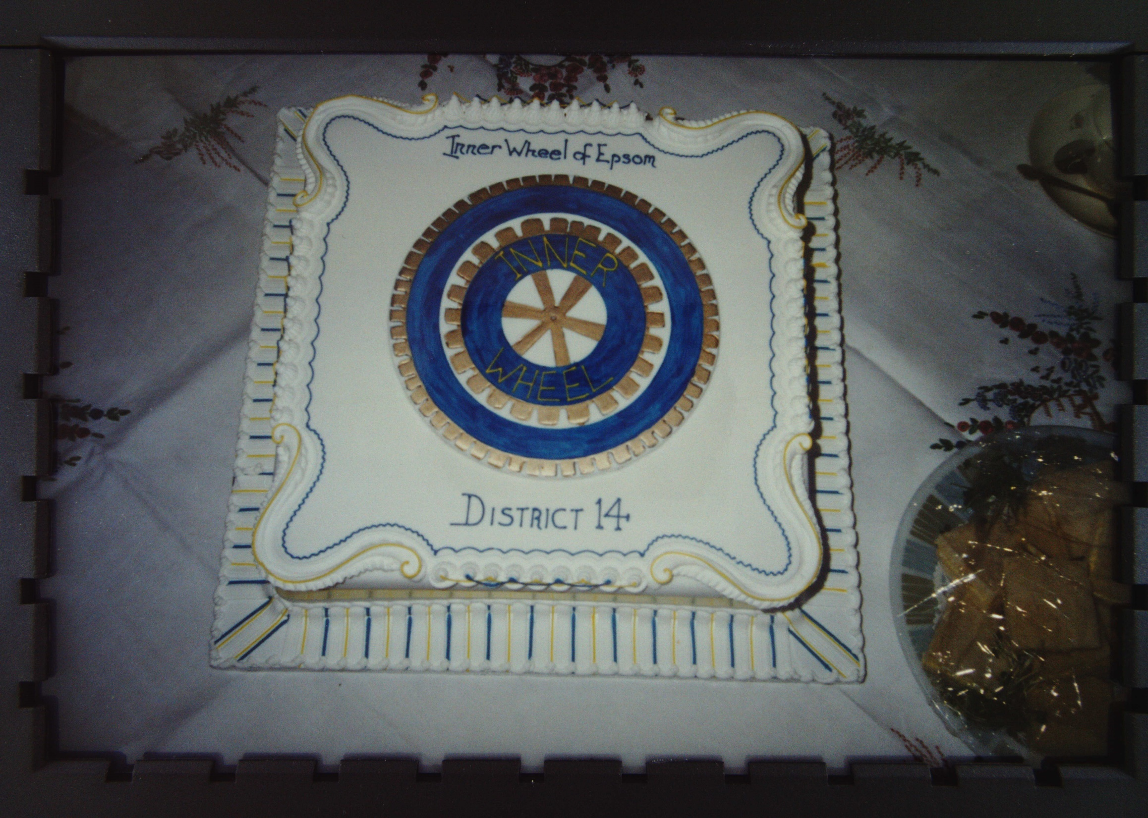

Slide 28
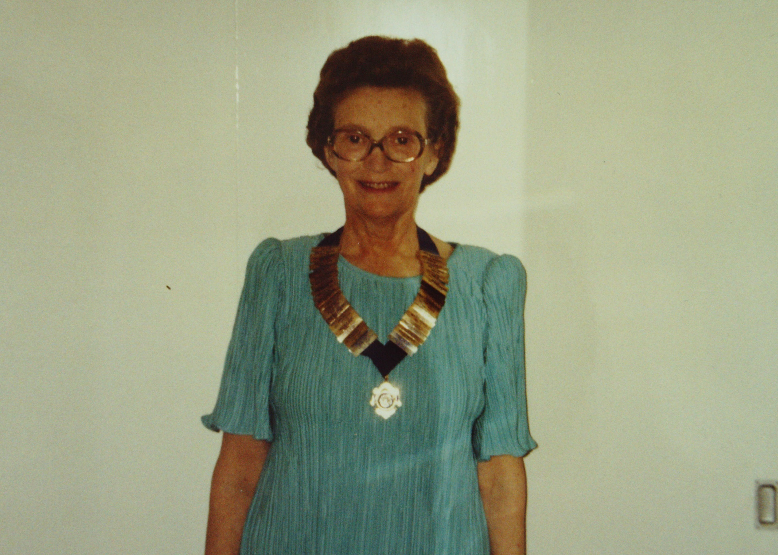
Maureen Corben, Inner Wheel President 4 times

Slide 29
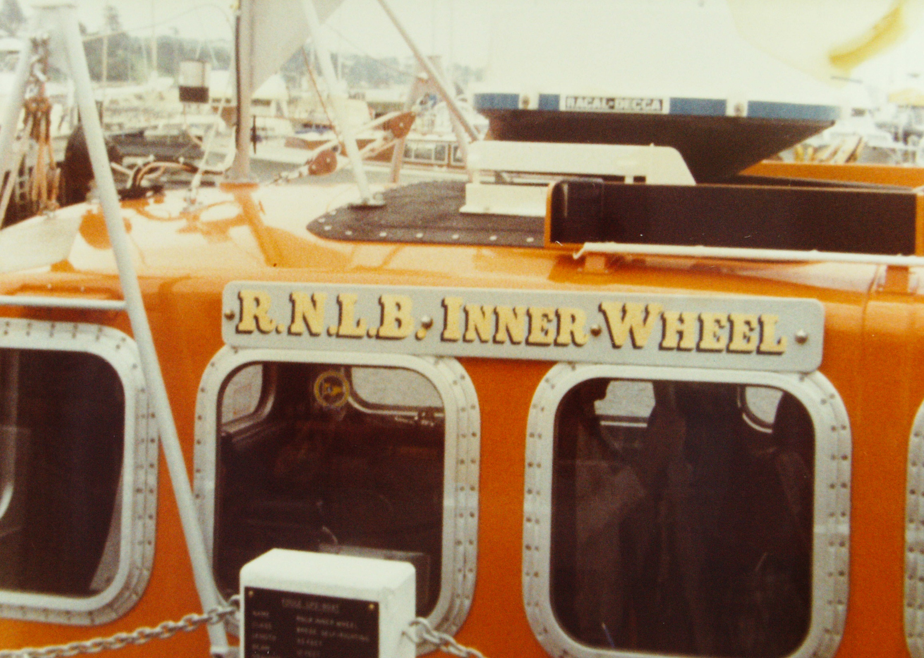
Inner Wheel Lifeboat

Slide 30
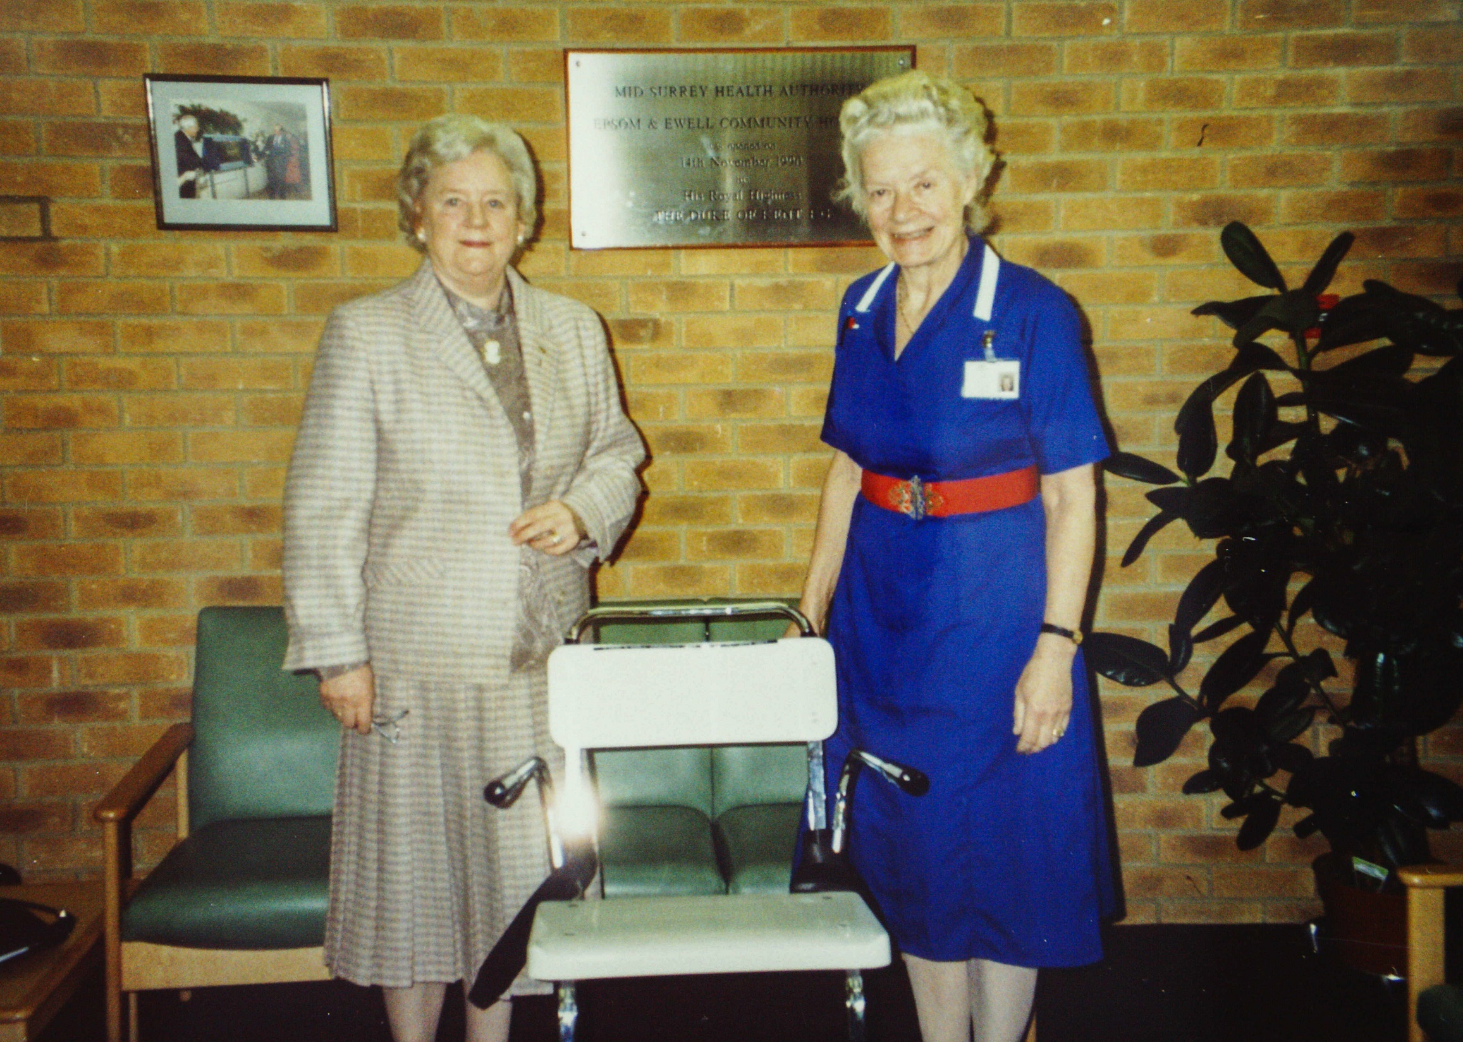
Jill Munro Medical Chair New Cottage Hospital

Slide 31
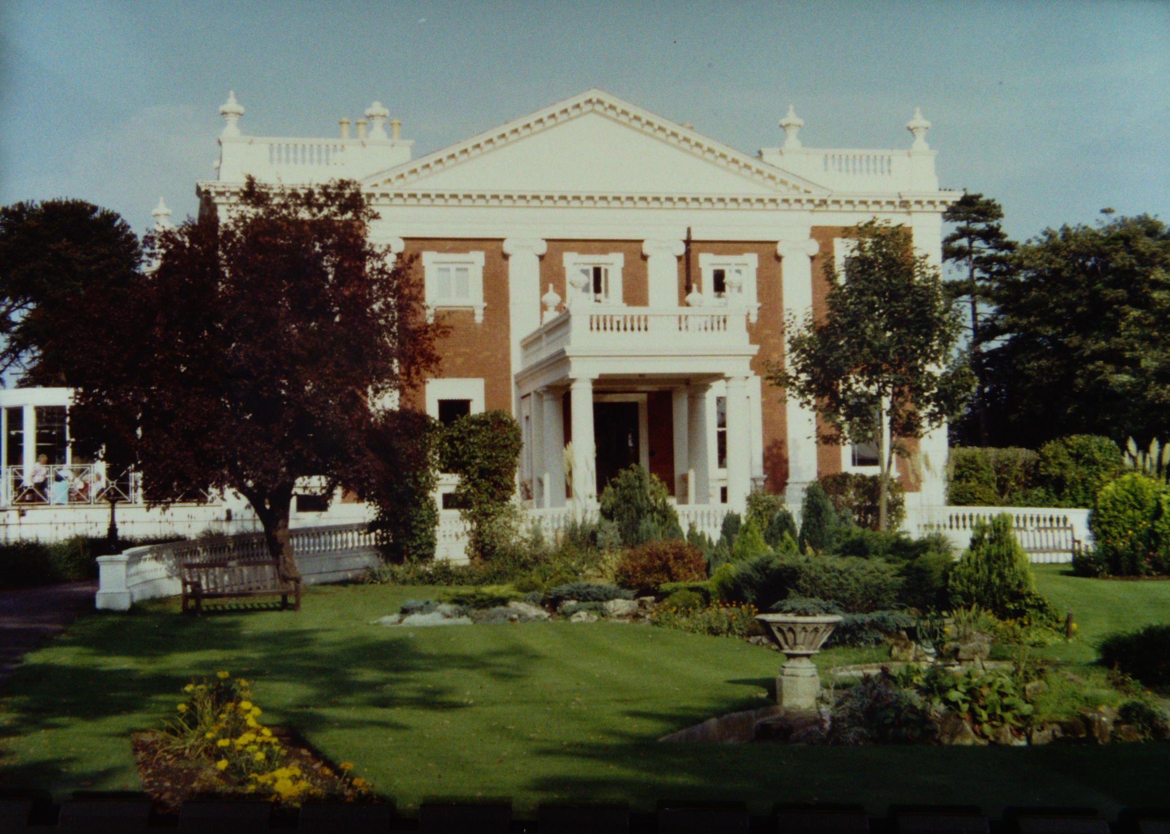
Mary Preston Hotel Sunbury SA 1992

Slide 32
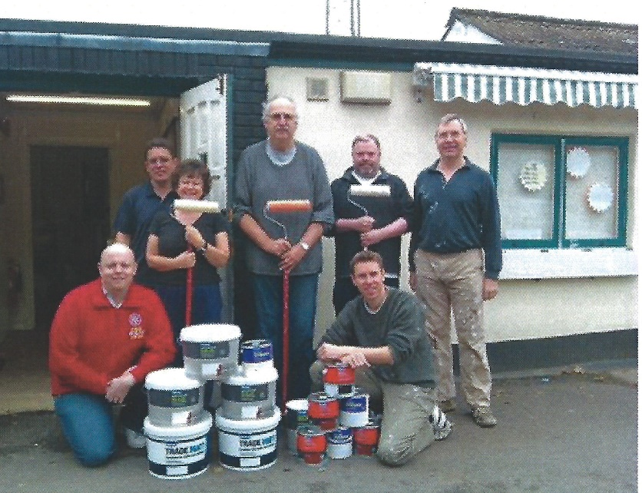
Pit Stop Working Group

Slide 33
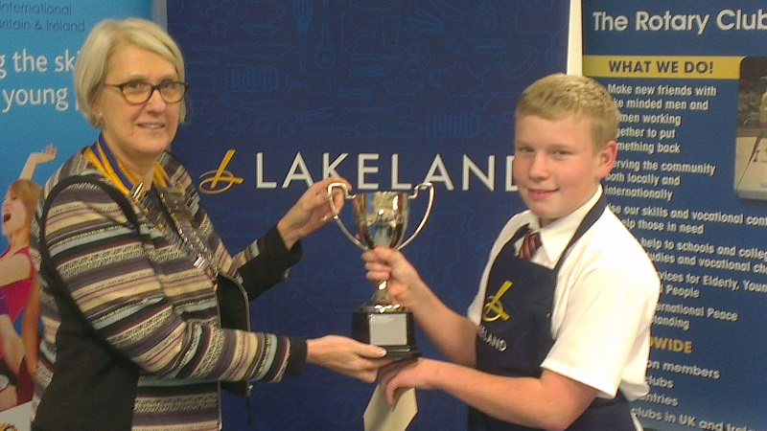
Pres Carol Caiger and Young Chef 2013

Slide 34
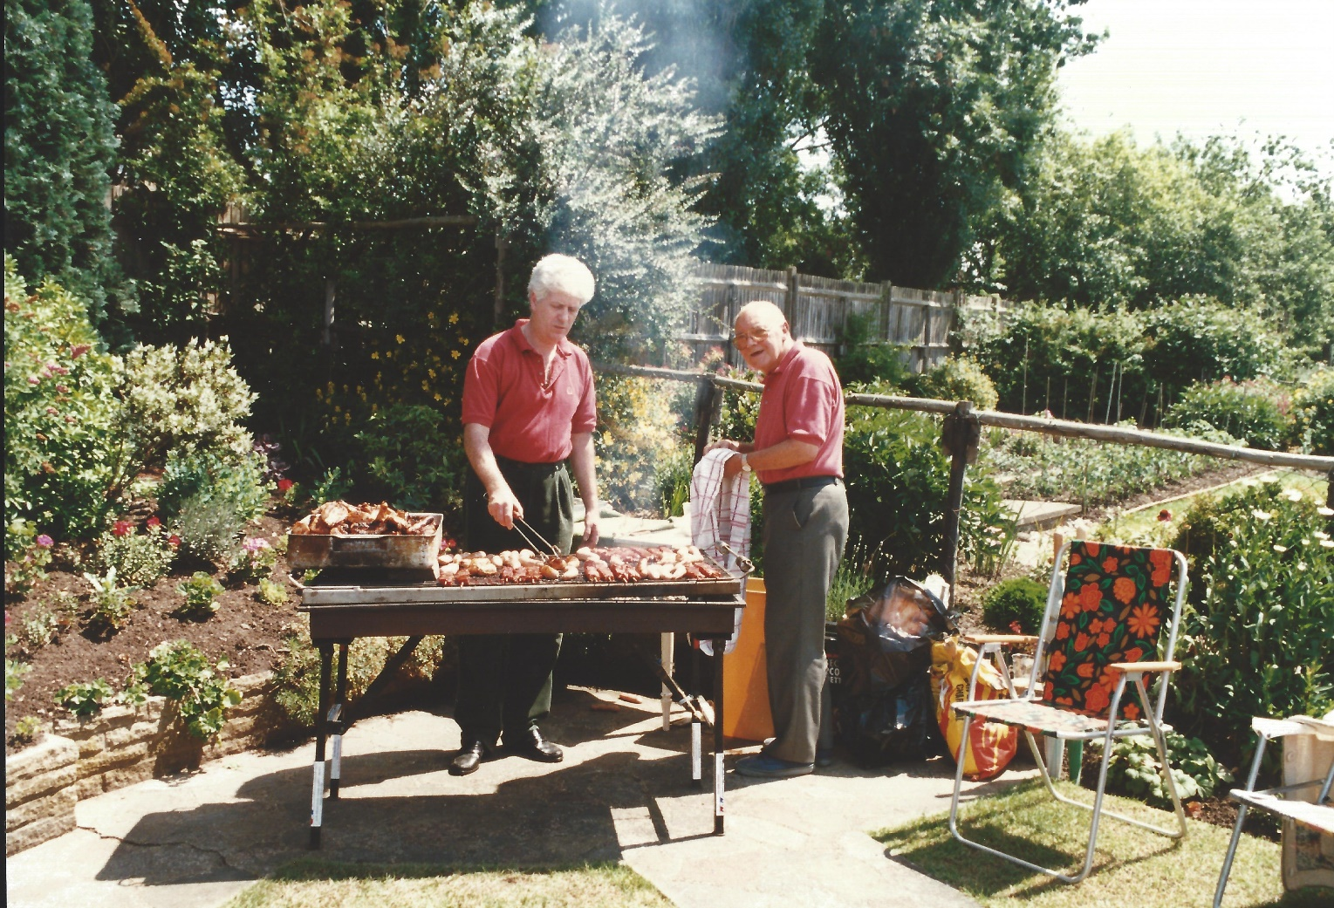
Presidents Barbecue 1997

Slide 35
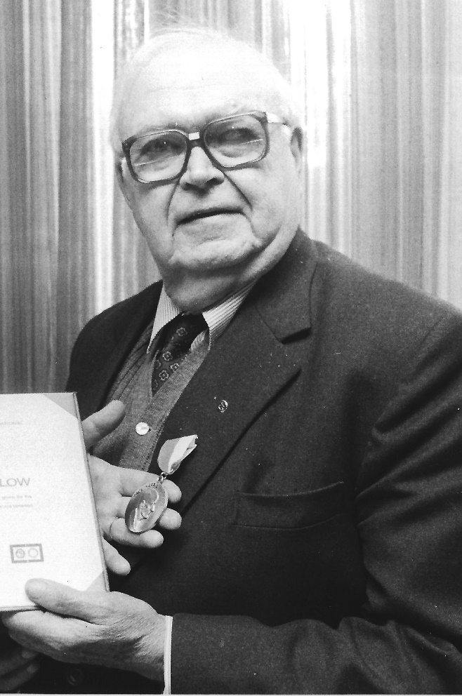
Ron Harwood

Slide 36
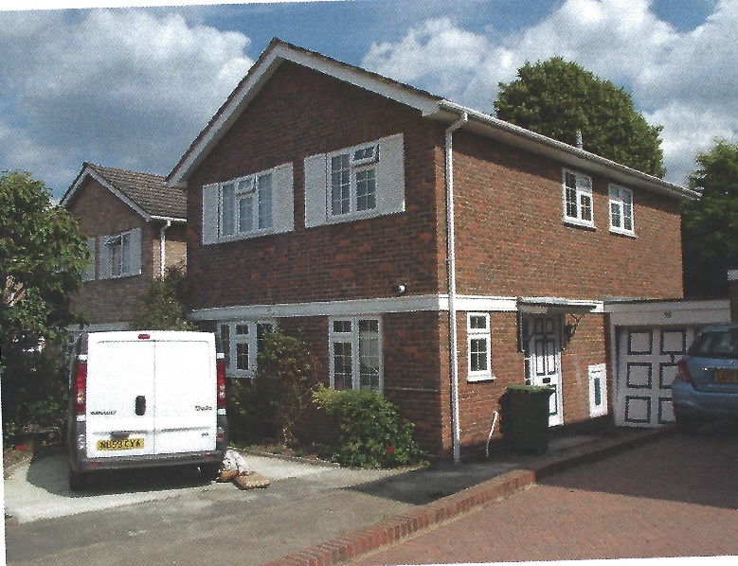
House at St Andrews Close

Slide 37
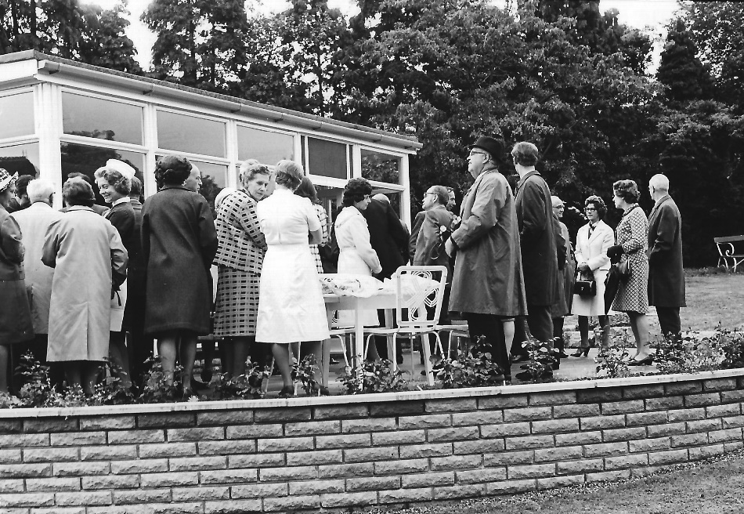
Sun Lounge at the Cottage Hospital 1972

Slide 38
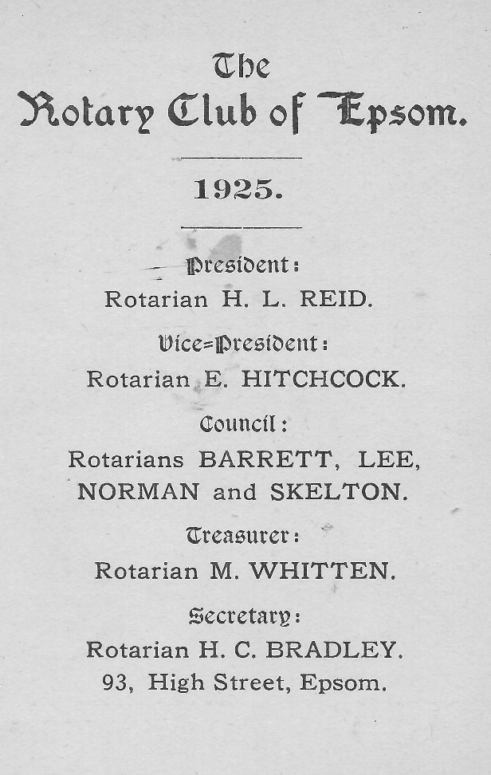
The First Membership Card 1925

Slide 39
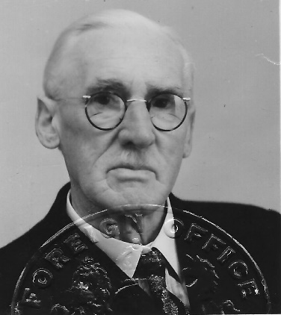
The first president HL Reid

Slide 40
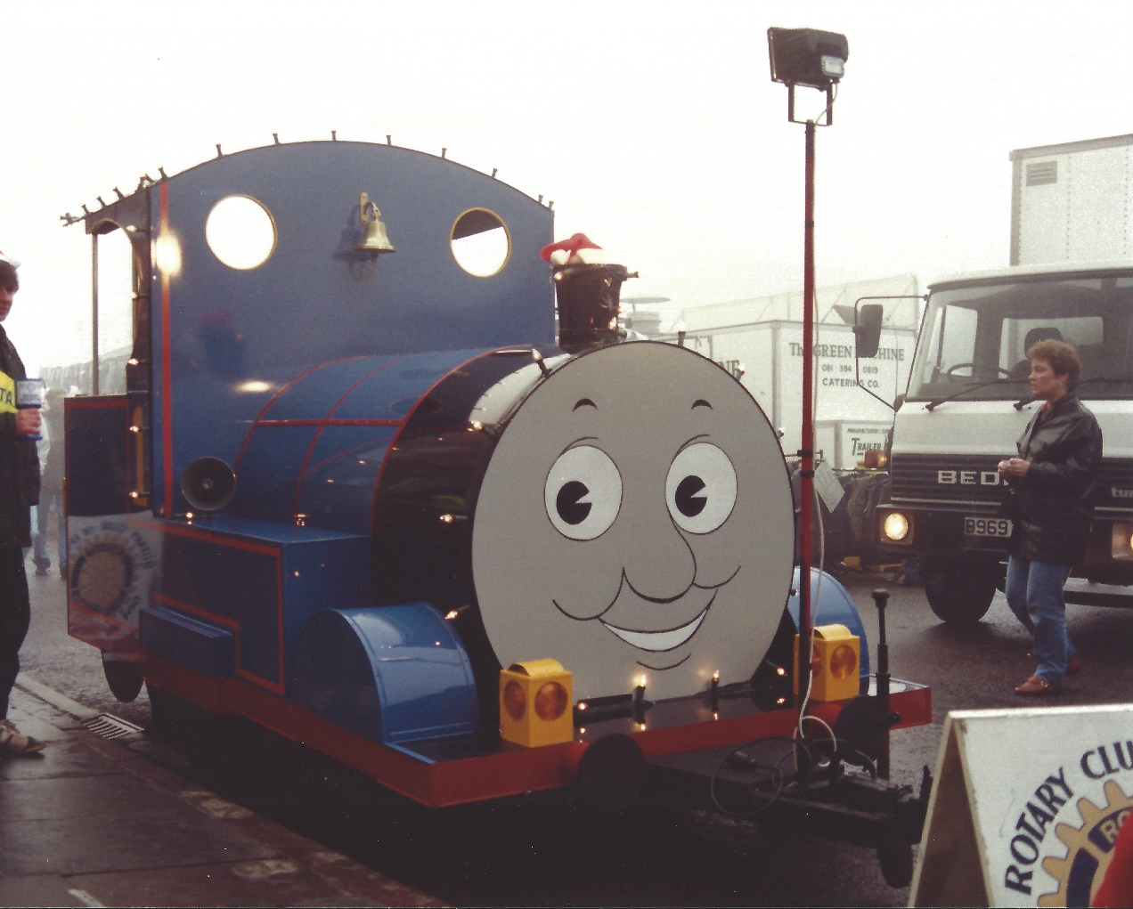
Thomas before his sex change

Slide 41
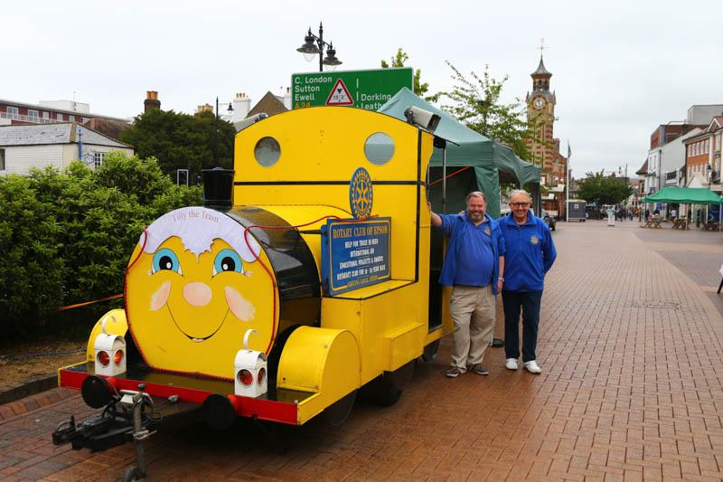
Tilly the train with Andy Ballard and Colin Peel

Slide 42
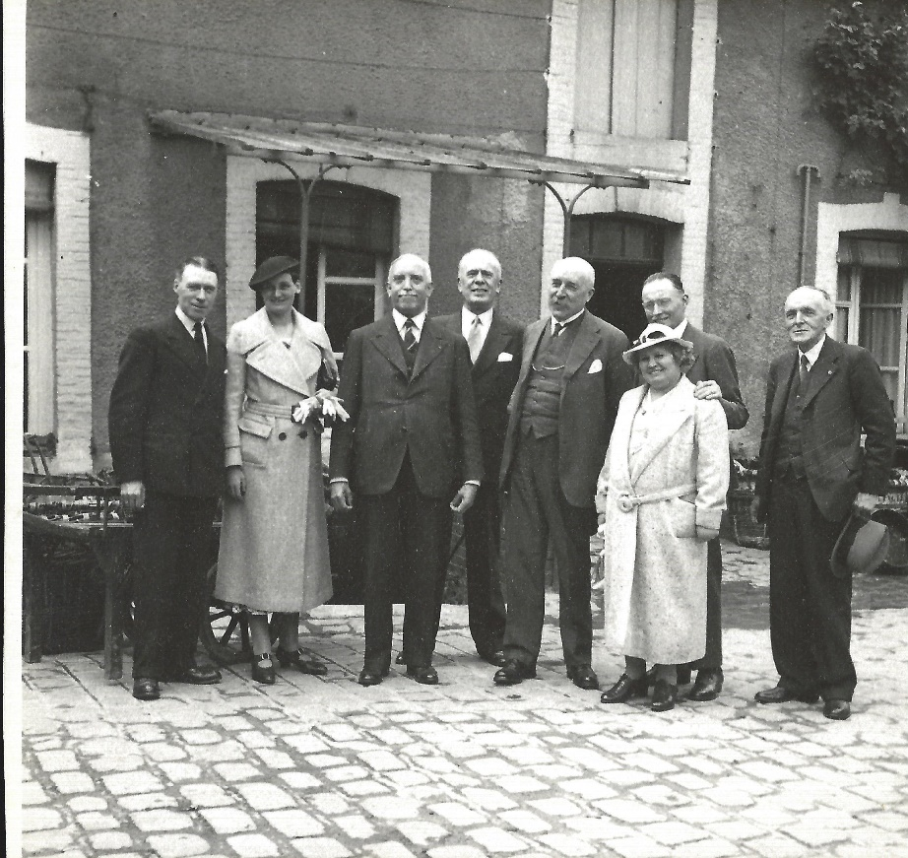
Visit to Rotary Club of Reims 1937

Slide 43
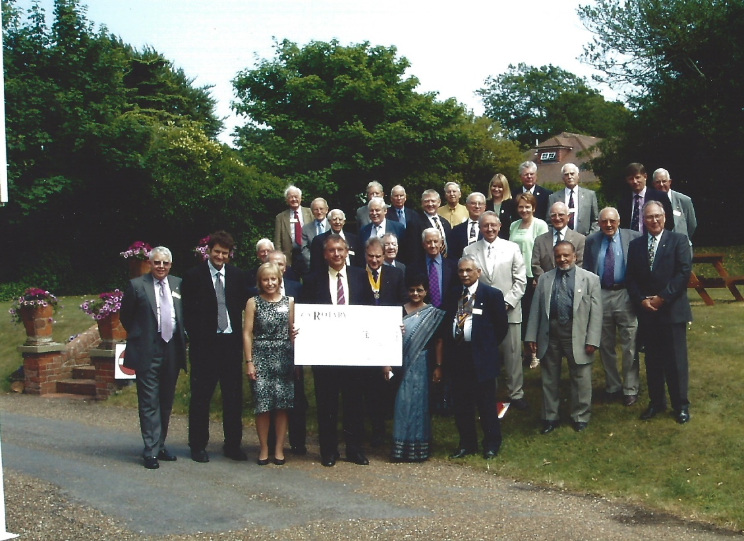
Water Aid presentation 2002

Slide 44
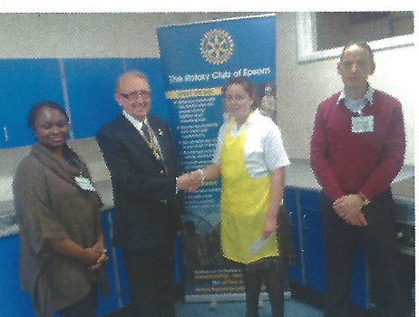
Pres Colin Peel and Young Chef 2012

Slide 45
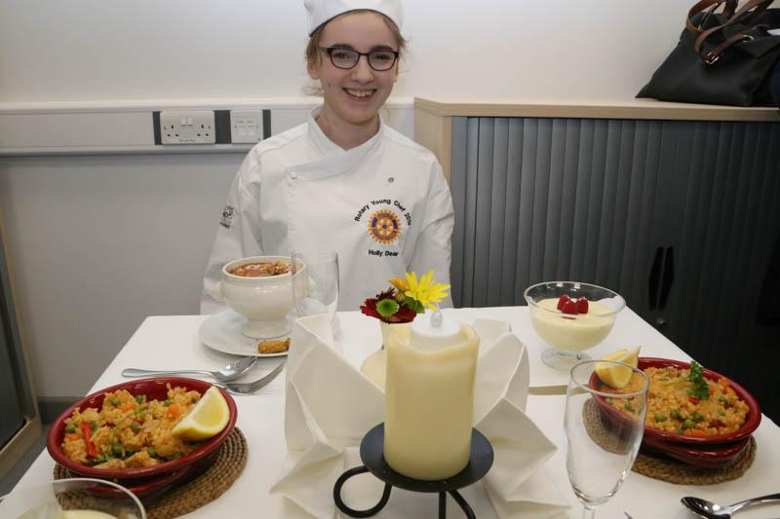
Young Chef 2014

