Slide 1
The Peace Project for District 1010
Working together to create the next leaders of the 21st Century, session 2

Slide 2
Leaders…..
“Leaders have to lead professional meetings”
“Talking is the foundation of a civil society, it is a major skill in conflict resolution meetings.”

Slide 3
Notes:
Your role as a Peace Advocate is to get people to talk freely about the conflict they find themselves in. If you were having problems and wanted to talk with someone, which one of these people would you feel most comfortable taking with based just on their body language and facial expression? Why? Discuss in small groups.
Discuss: What facial expressions and body language do you want to display when you’re talking with people as a Peace Advocate? What nonverbal signals would you want to be careful not to display?
Homework: Watch TV with the sound off. See if you can determine what the actors are “saying” just by watching their body language.
WRAP-UP: Which type of leader would you be more inclined to respect and to follow? One whose verbal and non-verbal communication is consistent or one who isn’t often consistent?
Today we’ve learned some skills important to becoming a leader in the 21st Century. You’ve also learned how your non-verbal communication is as important…even more important…than the words you use and how important it is to match your body language with your intent. So going forward, you need to check in with your body and be sure you’re sending the right message.

Slide 4
Learn the three major skills in Conflict resolution.
Collaborative Conversation
Purposeful Listening
Purposeful Speaking

Slide 5
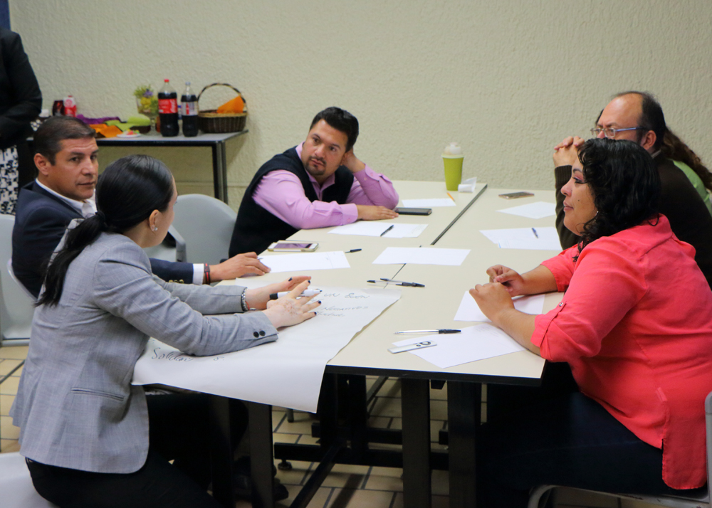
Collaborative Conversation (CC)
Nominate a recorder, to note down all thoughts. Leader talks through the structure.
Brainstorm
Clarification
Discussion
Conclusion
Notes:
This is the strategy which will be used at every meeting, whenever discussion is entered into. CC is a skill which needs to become a habit. It can be used in many different situations whenever there is any knod of conflict, personal or otherwise.

Slide 6
Collaborative Conversation {CC}
Nominate a recorder to write down all thoughts and lead discussion
Brainstorm—Everyone puts forward any nominations which come to mind, all well received
Clarify—Everyone expands upon the nominations as noted by the recorder
Discuss—Everyone has the opportunity to question others nominations
Conclude—Decisions are made as to next steps as agreed by the group

Slide 7
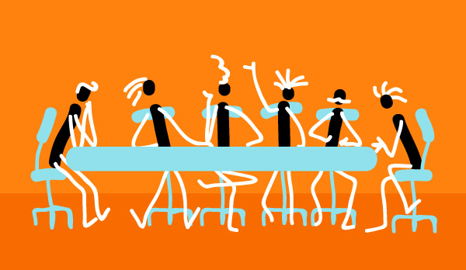
Use CC for the following activities
Develop a group name
Develop a group contract
Role play as Peace advocates

Slide 8
Third activity to practise CC
Scenario using role play.---
They are now Peace Advocates, they have placed a Problem Box in the school and asked that any worries be placed in it.
The Peace Advocates meet each week to review the Problem Box.
Before contacting the owner of the problem they work in groups to discuss the best course of suggested action.
Working in groups of 3or4, a problem is chosen.
Using the CC framework, a plan identifying how they will support the person will be decided upon.
Notes:
Youngsters really enjoy role play. They have now used CC in three different ways. It should be starting to become habit, ie whenever a problem arises or point of discussion they should automatically employ the CC strategy.

Slide 9
Sample Problems
Somebody has been sending abusive text messages and posting pictures on Facebook of me at a party.
If I want to be with my friends I have to steal from other classmates and show how tough I am by self harming.
I enjoy being at school and always like to work hard. Some people in my class are calling me names and threatening to hurt me if I carry on doing well in class.
Notes:
These problems can be used ort he group may wish to add their own. Leader observes the groups to ensure that they are using the framework of CC and that the group are adhering to the agreed group contract

Slide 10
Sample problems contd…
I am in a group of girls and one of them doesn’t like me. She gets the others to do horrible things to me.
I am not very sporty and don’t fit in with the others. They call me geek and other things.
The local gang follow me home every night and push and pull me about, sometimes they punch me.
Notes:
Leader asks each group to feed back to everyone. Leader asks each group how they found the CC structure working to help them stay on task and arrive at an opinion to help solve the problem. Leader ensures that the group understand that solving the problem is not the main aim of the task. The aim is to practise using CC and engaging in the agreed group contract.

Slide 11
Purposeful Listening Skill
Why is listening important in resolving conflict?
What else should we take note of when we are listening to people?
Does the young person of the 21st Century listen well?

Slide 12
Guide to Purposeful Listening
Leader shows the following Guide to PL
As a Peace Advocate you should:
listen without prejudice or pre-judgement ,(as a stranger)
not show any facial expression,
not interrupt,
not react if the person accuses or blames,
take notice of their body language and tone of voice.
Notes:
Discuss the slide and gather the groups thoughts.

Slide 13
Points to follow to become a Purposeful Listener.
1) Listen intently to speaker, full eye contact,
no movement from face or body
2) Repeat everything you have just heard, by saying, “ What I heard you say is---”
3) Include phrases such as, “ I notice you seem agitated at---- how does ----- make you feel”
4) Ask the speaker to repeat back to you what they have heard, including your interpretation of body language and tone of voice
5) Repeat until speaker and listener are in
agreement.
Notes:
This slide may take a longer time to discuss. It is a slide which can be referred to for the following activities.

Slide 14
Use PL strategy for your next activities.
How well are you listening?
Problem box activity, as role play.
Peace advocates facilitate a solution to a problem

Slide 15
Second Activity to practise PL
Scenario using role play
As Peace Advocates, they have progressed from the Problem Box, to having meetings for people with problems.
Working in groups of 3, 2 people are Peace Advocates, (listeners) and the third person is owner of the problem(speaker)
Problems can be used from previous CC activity, this can be helpful as they already have some ideas of how to deal with the problem.
Notes:
This activity builds on CC role play. It is easier to use previous problems as they have already got some ideas.

Slide 16
Second PL activity, contd
Scenario using role play, contd.
1)Using the PL 5 point structure the listeners invite the speaker to discuss the problem. 2)When Listener and speaker are in agreement that PL has been achieved, they continue.
3) Listeners guide the speaker through the CC structure, encouraging speaker to come to their own solution.
4) Listeners do not provide a solution. They encourage confidence in the speaker to take control of the problem for themselves.
Notes:
This activity brings together the two skills, CC and PL and shows how they work together to give a comprehensive framework for conflict resolution.

Slide 17
Scenario Skill Practice

Slide 18
Monitoring roles

Slide 19
Unit 2C Learning Intention Learning the third skill ,Purposeful Speaking(PS)
Recap from previous meetings, concerned with CC and PL.
Leaders have to be able to lead professional meetings Purposeful Speaking(PS) is the third skill to ensure this happens.
“For me, words are a form of action, capable of influencing change” Ingrid Bengis
Discuss this quote use CC and PL strategies.
Notes:
The third skill is an awareness raising skill. It involves youngsters becoming fully aware of the words they are using and developing an understanding of how these words are perceived by others.

Slide 20
Activity to practise PS---
Using CC and PL discuss the following ---
“Sticks and stones may break my bones but words can never hurt me”
Do you think words can/cannot hurt you?
“Think before you speak”
Which “words” should we consider in our daily conversations.
Spend a day consciously using “thinking time”. Wait several seconds before speaking to people
Followed by an assessment of your words.
Notes:
This needs to be practised outside of the meetings, at home, in the playground etc.

