Slide 1



Primary Schools Quiz
Sample Quiz 2026

Slide 2
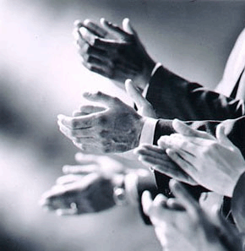

Let’s welcome all the school teams!

Slide 3
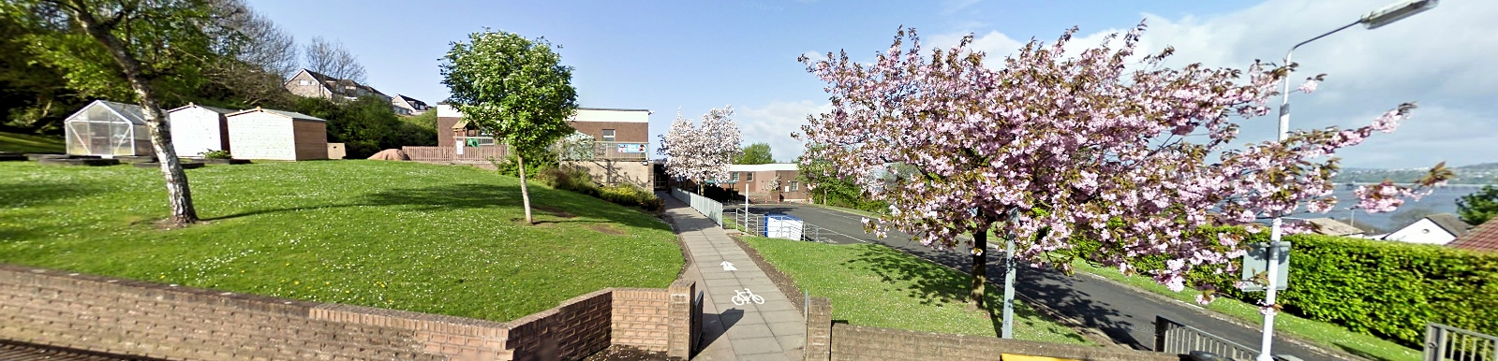
School Names
School 1
School 2
School 3
School 4
School 5
School 6
School 7
School 8
School 9
School 10
School 11
School 12

Slide 4
Quiz Subjects
Round 1 Alphabet Quiz
Round 2 Geography
Round 3 Technology
Round 4 Mathematics
Round 5 Science
Round 6 Music
Round 7 The Written Word
Round 8 General Knowledge
Round 9 Art
Round 10 Pictures

Slide 5
Competition rules
Please ensure mobile phones or any other device are turned off for the duration of the competition.
Supporters, please ….no shouting out, PLEASE do not even whisper - let’s be fair to all.
There are 6 questions in each of the 10 rounds.
Your answer sheets will be collected and scored at the end of each round.
To give the markers time, questions for Rounds 1 and 2 will directly follow each other.
After round 2, you will be given the answers to round 1. After round 3 you will be given the answers to round 2 and so on.

Slide 6
And ……
Should there be a draw after all 10 rounds there will be a Tie Break round for those schools tied. If there is still a draw, then we will move on to the Sudden Death questions!
All correct answers will be awarded 2 points (or 1 point for each correct answer in some questions).
If an answer is considered close, then 1 point may be awarded – but only at the discretion of the Head Marker.
The Head Marker is the Adjudicator.
Tables are provided for the team reserves at the back of the room, and they can also answer the questions – but just for fun!

Slide 7
Round 1 – Alphabet Quiz
What R is moisture coming down from the sky?
What O is the fastest running bird?
What T is a form of transport run on rails?
What A is the name of an angle between 0 and 90 degrees?
What R is the name given to a dried grape?
What Y is a length equal to 36 inches?

Slide 8
Round 2 - Geography
Name the capital city of Canada?
Which ocean in on the west coast of the USA?
What is the name of the longest mountain range in the world, which is situated in South America?
In which sea would you find the island of Malta?
What is the name of the largest Loch in Scotland by volume?
How many Kelpies are there near Falkirk?

Slide 9
Answers for Round 1- Alphabet Quiz
What R is moisture coming down from the sky?
    Rain
What O is the fastest running bird?
    Ostrich
What T is a form of transport run on rails?
    Train (or Tram)
What A is the name of an angle between 0 and 90 degrees?
    Acute
What R is the name given to a dried grape?
    Raisin
What Y is a length equal to 36 inches?
    Yard

Slide 10
Round 3 – Technology
What is stored on a memory stick?
Where is the recording device known as a “black box” normally found?
In computing language, what does RAM mean?
What name is given to a mobile phone that performs most of the functions of a computer?
What short-range feature allows mobile devices to communicate and exchange data without cables?

Slide 11

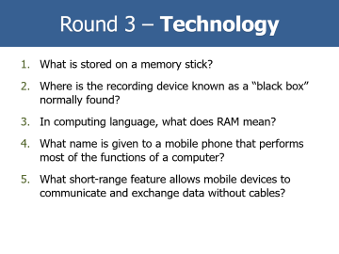
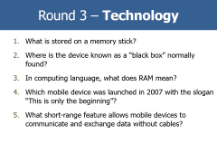
Round 3 – Technology
What is stored on a memory stick?
Where is the recording device known as a “black box” normally found?
In computing language, what does RAM mean?
What name is given to a mobile phone that performs most of the functions of a computer?
What short-range feature allows mobile devices to communicate and exchange data without cables?
Which computer company is known by the symbol ?

Slide 12
Answers for Round 2 - Geography
Name the capital city of Canada?
    Ottawa
Which ocean in on the west coast of the USA?
    The Pacific
What is the name of the longest mountain range in the world which is situated in South America?
    The Andes Mountains
In which sea would you find the island of Malta?
    Mediterranean Sea
What is the name of the largest Loch in Scotland by volume?
    Loch Ness
How many Kelpies are there near Falkirk ?
    Two

Slide 13

Round 4 - Mathematics
What is the formula for the area of a circle relative to its radius?
Write down the number 26 using roman numerals?
Calculate the area of a triangle with base length of 10cm & height of 5cm.
What do you call a regular shape that has 10 equal sides?
What number is the square root of 121?
If a watch is showing a time of 5:33pm, how many minutes until 6:10pm?

Slide 14
Answers for Round 3 – Technology
What is stored on a memory stick?
    Data – 2 points, (or Information for 1 point)
Where is the recording device known as a “black box” normally found?
    On an aeroplane
In computer language, what does RAM mean?
    Random Access Memory
What name is given to a mobile phone that performs most of the functions of a computer?
    Smartphone
What short-range feature allows mobile devices to communicate and exchange data without cables?
    Bluetooth
Which computer company is known by the symbol ?
Hewlett Packard

Slide 15
Round 5 – Science
What do solar panels generate and from what (1 point for each)?
What are the two main elements in steel (1 point for each)?
What is known as the red planet?
What natural resource is used to generate electricity in a hydro power station?
What is the term for animals that are only active at night?
What do you call a baby elephant?

Slide 16
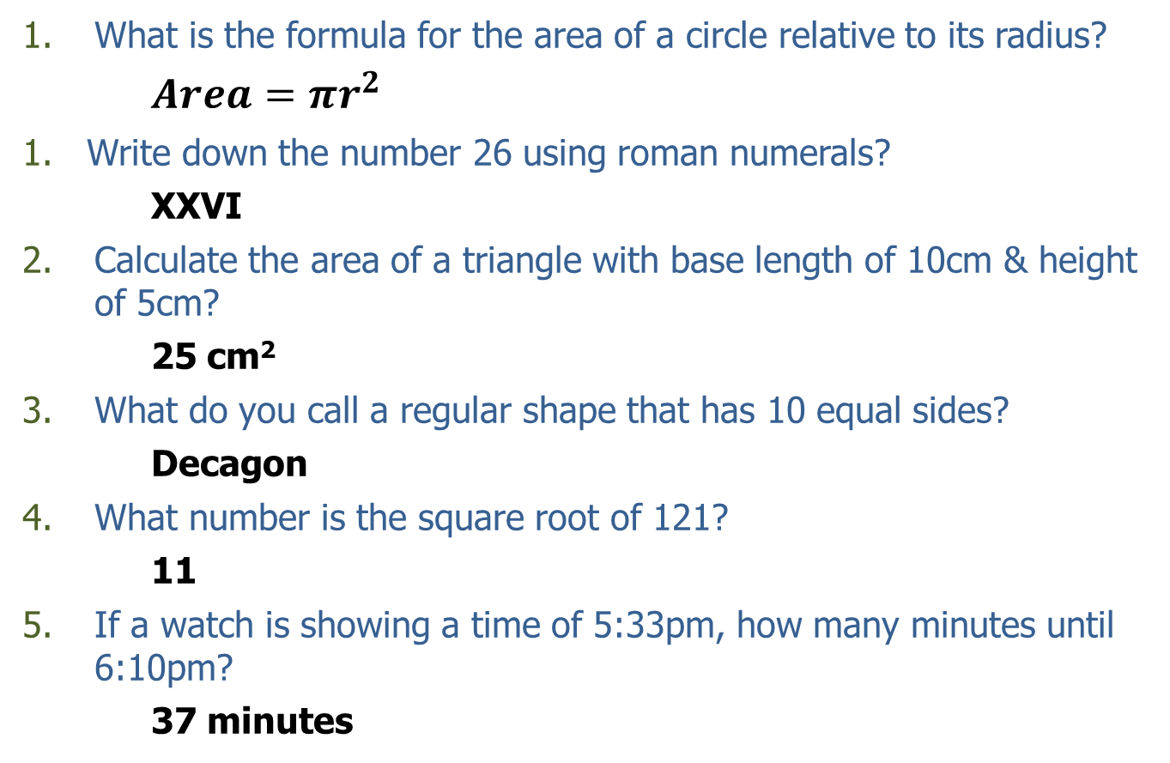
Answers for Round 4 - Mathematics
What is the formula for the area of a circle relative to its radius?
$Area=πr^{2}$
Write down the number 26 using roman numerals?
    XXVI
Calculate the area of a triangle with base length of 10cm & height of 5cm?
    25 cm²
What do you call a regular shape that has 10 equal sides?
    Decagon
What number is the square root of 121?
    11
If a watch is showing a time of 5:33pm, how many minutes until 6:10pm?
    37 minutes

Slide 17
Round 6 - Music
On a piano, how many notes are there in an octave?
What was Taylor Swift’s 2023 – 2024 tour called?
How many family members are in the song “Baby Shark”?
What movie musical did Ariana Grande appear in in 2024?
Which album featured a picture on the sleeve of the four Beatles walking across a road?
Which pop star sang “The Edge of Glory”?

Slide 18
Answers for Round 5 – Science
What do solar panels generate and from what (1 point each)?
    Electricity from sunlight
What are the two main elements in steel (1 point each)?
    Iron and Carbon
What is known as the red planet?
    Mars
What natural resource is used to generate electricity in a hydro power station?
    Water
What is the term for animals that are only active at night?
    Nocturnal
What do you call a baby elephant?
    Calf

Slide 19
Round 7 – The Written Word
Complete the phrase “Curiosity killed the …..” ?
What is Charlie’s surname in the book “Charlie and the Chocolate Factory”?
Complete the book title “How the Grinch stole …..….”?
Who wrote the book “Cliffhanger”?
“Charlottes Web” is a story about a spider and which other animal?
What quiet word is an anagram of “LISTEN”?

Slide 20
Answers for Round 6 - Music
On a piano, how many notes are there in an octave?
    12 – made up of 7 white and 5 black notes
What was Taylor Swift’s 2023 – 2024 tour called?
    The Eras Tour
How many family members are in the song “Baby Shark”
    5 – Baby, Mommy, Daddy, Grandma & Grandpa
What movie musical did Ariana Grande appear in in 2024?
    Wicked
Which album featured a picture on the sleeve of the four Beatles walking across a road?
    Abbey Road
Which pop star sang “The Edge of Glory”?
    Lady Gaga

Slide 21
Round 8 - General Knowledge
What colour is an emerald?
What do you get when you freeze water?
In which season do leaves fall off trees?
What is the frequency of a leap year?
What do you call someone who studies rocks?
What food do pandas eat?

Slide 22
Answers for Round 7 – The Written Word
Complete the phrase “ Curiosity killed the …… “?
    Cat
What is Charlie’s surname in the book “Charlie and the Chocolate Factory”?
    Bucket
Complete the book title “How the Grinch stole ………………..” ?
    Christmas
Who wrote the book “Cliffhanger”?
    Jacqueline Wilson
“Charlotte’s Web” is a story about a spider and which other animal?
    A Pig
What quiet word is an anagram of “LISTEN”?
    SILENT

Slide 23
Round 9 – Art
What are the three primary colours? (2 points for all 3 colours, 1 point for 2 colours, 0 for only 1 colour)
What do you call a painting that contains the image of a person?
What is the name given to the sides of a stage?
What do you call paintings of inanimate objects?
What is the name of the building in which paintings are displayed?
What do you call the wooden stand used to support a painting?

Slide 24
Answers for Round 8 – General Knowledge
What colour is an emerald?
    Green
What do you get when you freeze water?
    Ice
In which season do leaves fall off trees?
    Autumn
What is the frequency of a leap year?
    Every 4 years
What do you call someone who studies rocks?
    Geologist
What food do pandas eat?
    Bamboo

Slide 25
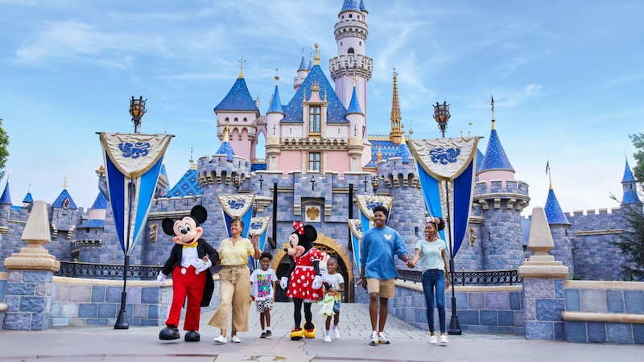
Round 10 - Pictures
What is the name of this theme park?

Slide 26
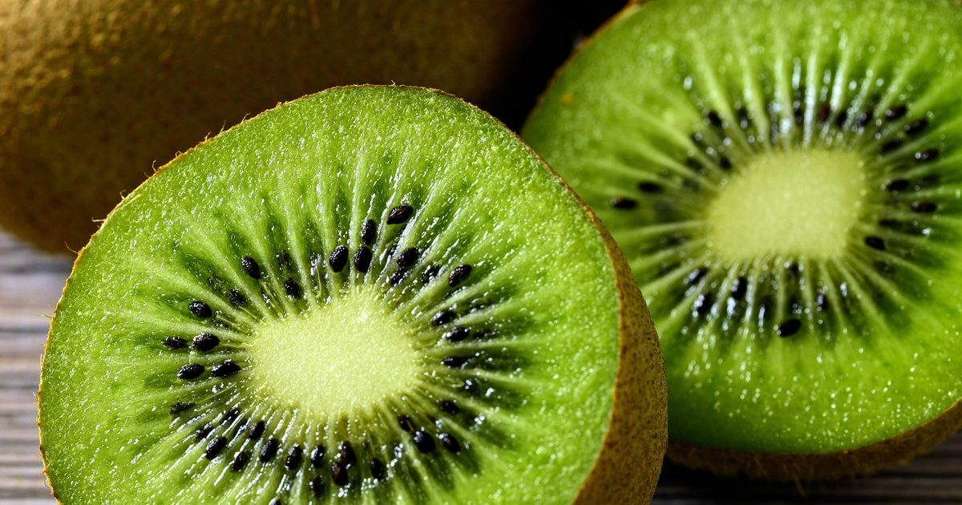
Round 10 - Pictures
In which country would you find a bird with the same name as this fruit?

Slide 27
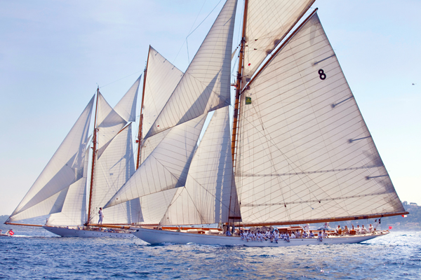
Round 10 - Pictures
What generally powers this type of boat?

Slide 28
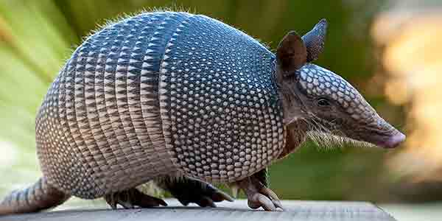
Round 10 - Pictures
What is the name of this animal?

Slide 29
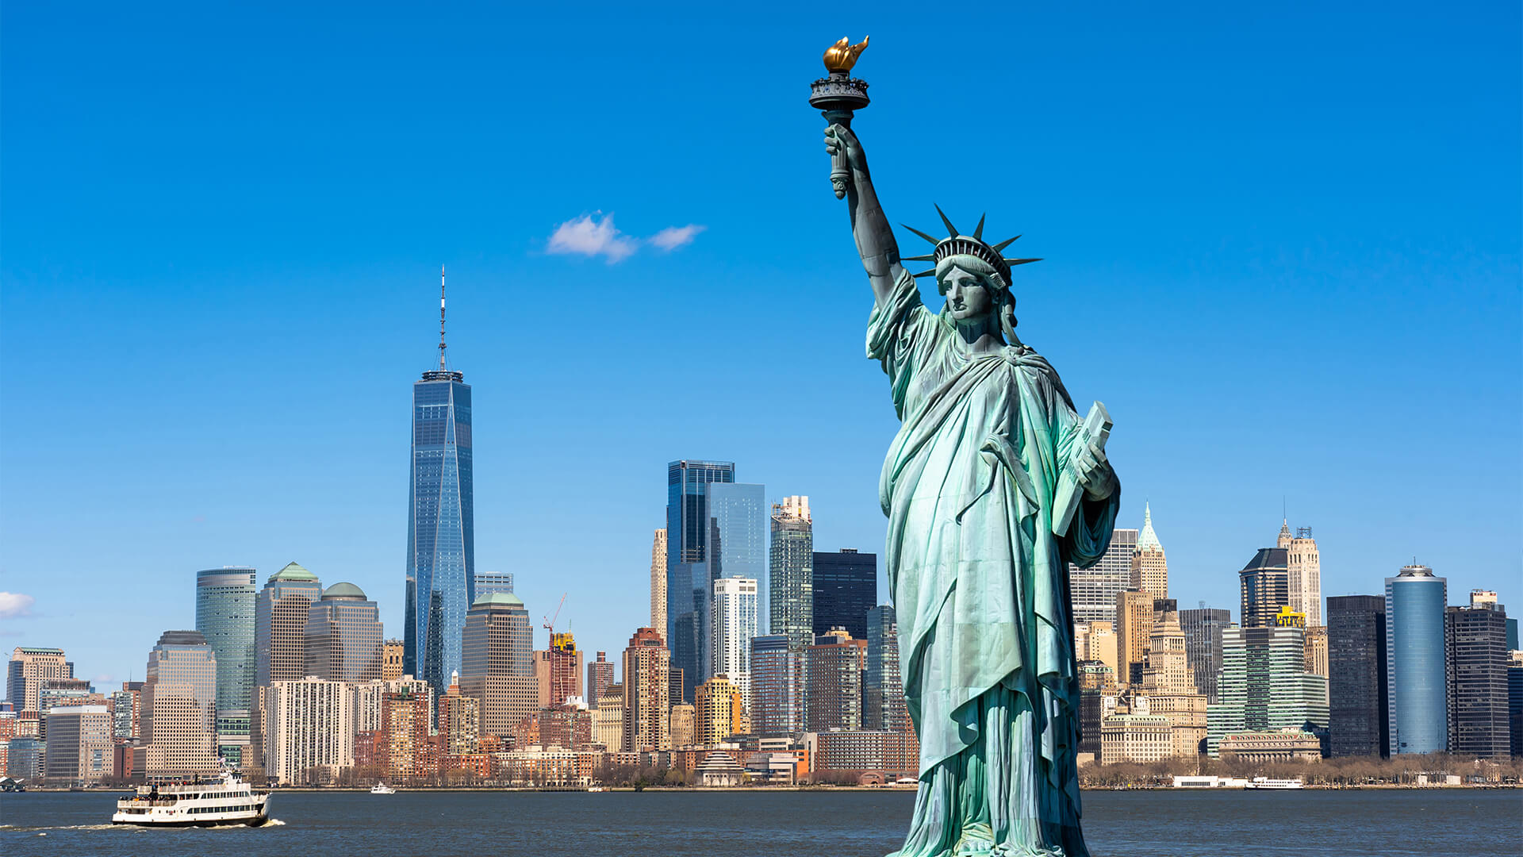
Round 10 - Pictures
In which American city would you find this landmark?

Slide 30
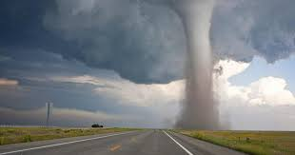
Round 10 - Pictures
What do you call this weather feature?

Slide 31
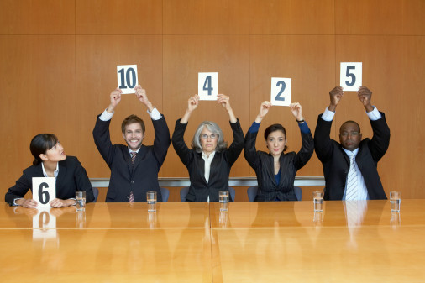
Scorers at work
No pressure guys!

Slide 32
Answers for Round 9 - Art
What are the three primary colours? (2 points for 3, 1 point for 2 and 0 points for only 1)
    Red, Yellow & Blue
What do you call a painting that contains the image of a person?
    Portrait
What is the name given to the sides of a stage?
    The Wings
What do you call paintings of inanimate objects?
    Still Life
What is the name of the building in which paintings are displayed?
    Art Gallery
What do you call the wooden stand use to support a painting?
    Easel

Slide 33




Answers for Round 10 - Pictures
What is the name of this theme park?
    Disneyland
In which country would you find a bird with the same name as this fruit?
    New Zealand
What generally powers this type of boat?
    Wind
What is the name of this animal?
    Armadillo
In which American city would you find this landmark?
    New York
What do you call this weather feature?
    Tornado

Slide 34
Rotary District 1010
Primary Schools Quiz 2026

Slide 35
We have a tie !!

Slide 36
Tie Break Round
What animal do the 4th, 15th and 7th letters of the alphabet spell?
How many are there in three dozen?
What is the name of the country to the north of the USA?
In which year was the Battle of Culloden fought?
What mythical animal is on the flag of Wales, and what is its colour? (1 point for each part)
Which film features Simba and Mufasa?

Slide 37
Answers for Tie Break Round
What animal do the 4th, 15th & 7th letters of the alphabet spell?
    D O G
How many are there in three dozen?
    36
What is the name of the country to the north of the USA?
    Canada
In which year was the Battle of Culloden fought?
    1746
What mythical animal is on the flag of Wales, and what is its colour? (1 point for each part)
    Red Dragon
Which film features Simba and Mufasa?
    The Lion King

Slide 38
Rotary District 1010
Primary Schools Quiz Final 2026

Slide 39
We still have a tie !!

Slide 40
Sudden Death
Maximum of three questions in this round.
First team to write down and hold up the correct answer wins.
If the first team gets the answer wrong, then the other team wins if their answer is correct.

Slide 41

Sudden Death 1
Write down what this road sign indicates?
Road Hump

Slide 42
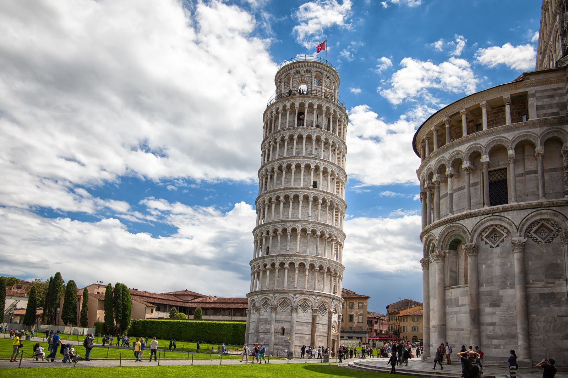
Sudden Death 2
Write down the name of the city in this picture?
Pisa

Slide 43

Sudden Death 3
Write down the name of this Japanese art form?
Origami

Slide 44
Rotary District 1010
Primary Schools Quiz 2026

