Slide 1
What is
The Rotary Foundation?
Notes:
The Rotary Foundation is Rotary’s own charity and all Rotarians are encouraged to donate to it.
The Rotary Foundation transforms our dreams into splendid realities
The Rotary Foundation is the economic engine for Rotary International.

Slide 3
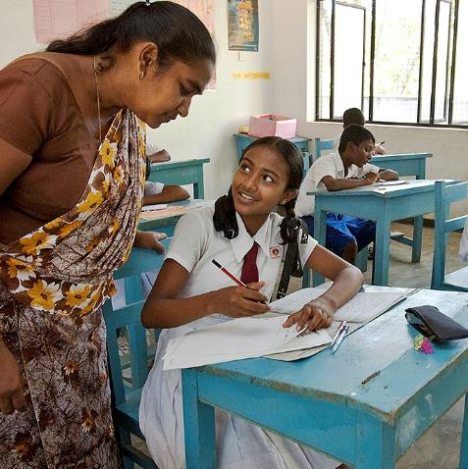
The Rotary Foundation – What is it?
Summary
The Rotary Foundation is Rotary’s own charity
Set up as an endowment fund to do good in the world
Since 1917 it has spent $4 billion on projects worldwide
Awards grants average $1 million per day
Has received 4**** rating every year since 2008

Slide 4
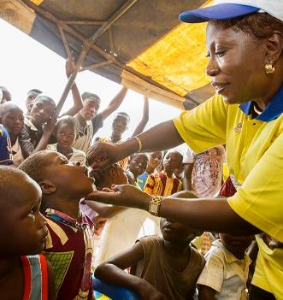
The Rotary Foundation
Mission statement
The Rotary Foundation enables Rotarians to advance world
understanding, goodwill and peace through the improvement of health, the support of education, and the alleviation of poverty.

Slide 5
Rotary’s Areas of Focus
Peacebuilding and Conflict Prevention
Disease Prevention and Treatment
Water Sanitation and Hygiene
Maternal and Child Health
Basic Education and Literacy
Community Economic Development
Environment

Slide 6
Polio Eradication
Summary:
Polio eradication is Rotary’s top philanthropic priority
Polio Plus launched in 1985
In 1988 over 350,000 polio cases in over 125 countries
Almost 3 billion children have been immunised against polio
Incidence of polio reduced by 99.9%
In 2021 Rotary’s contributions to the global effort, including funds from Gates Foundation, exceed $2 billion.

Slide 7
The Rotary Foundation – The Funds:
Annual Fund
For support today
Endowment
Fund
To secure tomorrow
PolioPlus Fund
End Polio Now

Slide 8
The Rotary Foundation - Grants
Global and District Grants
Global Grants
Projects with a minimum budget of $30,000
Funded by Club + District + World Fund
$40,000 + $40,000 + $32,000 = $112,000
or
Graduate-level Scholarships
Vocational Training Teams
District Grants
Projects with an average budget of $1500
Funded by Club & District – 50:50%

Slide 9
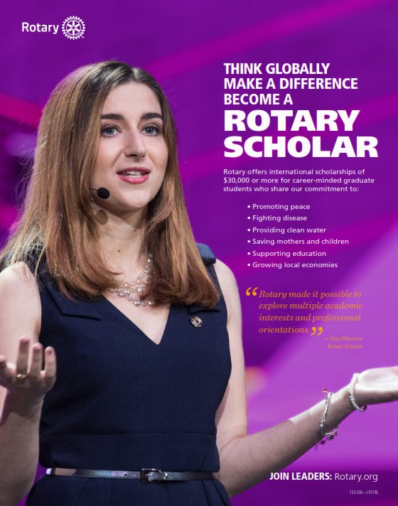
Funding for Global Scholars
350,000 Scholarships
have been awarded
by Rotary
$7.5million in Scholarships
are given out by Rotary
on average each year
Funded by
Rotary Global Grant

Slide 10
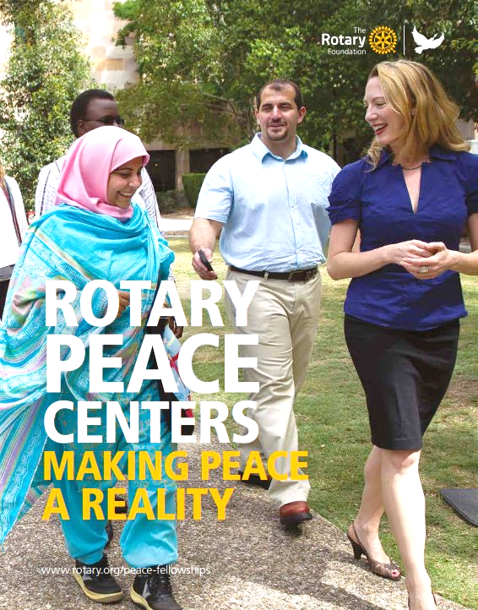
Rotary Peace Fellowships
Over 1600 alumni since programme started in 2002
Seven Rotary Peace Fellowship Centres worldwide
95% report current work to The Rotary Foundation
88% work in Peace & Conflict Prevention & Resolution or in
one of Rotary’s other Areas of Focus, in over 140 countries
Funded separately from Rotary Global Grants

Slide 11
The Rotary Foundation
Why support The Rotary Foundation over other charities?
Our administration costs are very low
All projects are in the hands of Rotarians
We can decide where our projects are situated
Rotarians decide how the funds are spent
Donations can go to the area of focus of our choice
The capital of an Endowment is never spent
Our Gifts can be contributed in many ways

Slide 12
How Does One Contribute to Rotary
Every Rotarian Every Year - EREY (any amount)
Sustaining member (>$100 to the Annual Fund)
Paul Harris Fellow ($1,000)
Paul Harris Society ($1,000 pa)
Benefactors ($1,000 to Endowment Fund)
Bequest Society (>$10,000 in estate plans)
Major Donors (>$10,000 outright or cumulative)
Arch Klumph Society (>$250,000)

Slide 13
Supporting The Rotary Foundation
The Rotary Foundation
Helps you to do good in the world,
now and forever
Notes:
Remember – By doing good in the world, you will receive so much more back.

