Slide 1

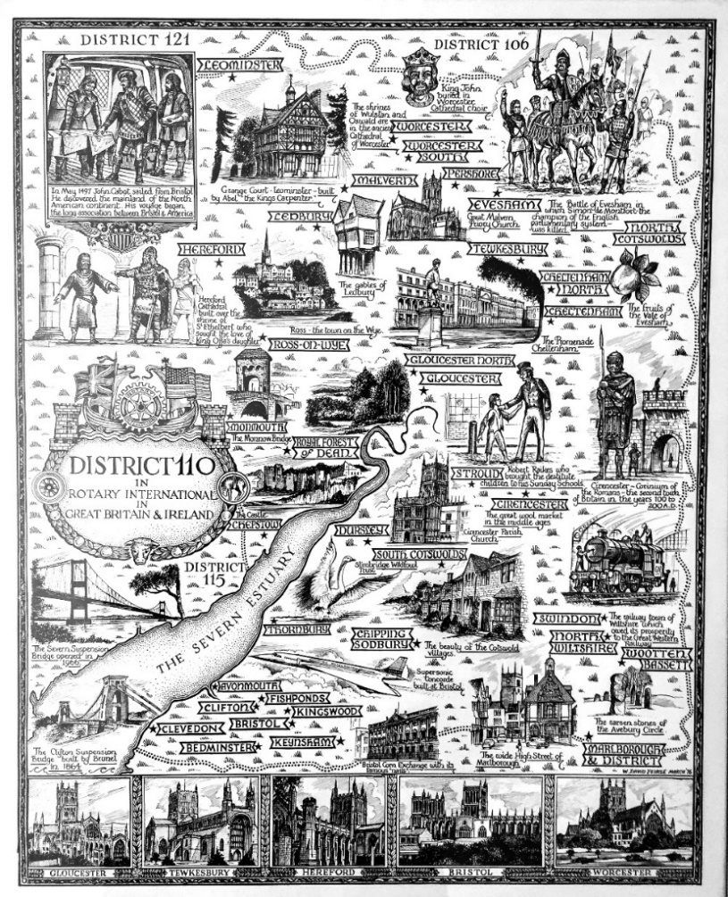


Slide 2
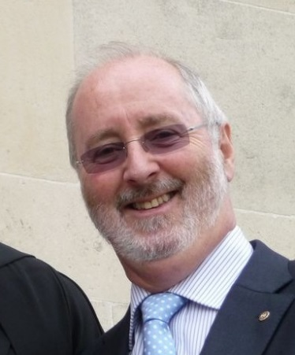
Rotary – Beyond Ourselves
Foundation
Peter Wells, Foundation Chair, EPN Officer D1100,
pjwells@ntlworld.com, mobile: 07970 850399, home: 01793 616654
The Rotary Foundation: Service above Self to the People of District 1100 and the World

Slide 3






Peace and conflict prevention/resolution
Disease Prevention and Treatment
The
Six
Areas
of
Focus
Water and Sanitation
Maternal and Child Health
Basic Education and Literacy
Economic and Community Development
Notes:
These are the six Areas of Focus and
your chosen project must fall under the umbrella of one of them!
Plus you must be
able to measure your projects impact,
determine that it is sustainable and
confirm that it meets community need via a community assessment.

Slide 4

Global Grants
Guidelines for 2019/20
Rotary – Beyond Ourselves

Slide 5
The lifecycle of a Global Rotary Grant
Draft | Authorization | Submitted | Approved | Completion
Rotary members plan a project or scholarship and build their grant application online | Club and District leaders review the application and authorize funding | The grant’s planners submit the application to The Rotary Foundation | If the grant is approved, the Foundation issues payment | Members carry out the project, reporting to the Foundation annually until the work or studies are finished and the grant is closed

Slide 6

http://shop.rotary.org/
A Guide to Global Grants
$1.00
Minimum Value
$30k
Project Value
$35k
Work with other clubs to raise $10k
Your donation
is matched at
50% by the World Fund =$15k
Request a $10k donation from the DDF
=$25k
The DDF is matched 100% by the
World Fund =$35k

Slide 7





Simple but ‘must do’
Create a team not a one man band
Get an international partner with whom you can communicate and trust
Choose one Area of Focus central to your project
Go to ’My Rotary’ and download key documents
Tell your DRFC and secure District understanding and support
The process is iterative and the list is not in rank order but you must put it in an order that works for you

Slide 8








Simple but ‘must do’
Prepare a Global Grant Template
Cover measurability, sustainability, community assessment
Think who you are trying to communicate with and see their point of view
Get to know and value your Rotary Foundation Officer in Evanston
Cross the ‘t’s and dot the ‘i’s, tick all the boxes
The process is iterative and the list is not in rank order but you must put it in an order that works for you
•

Slide 9
Key Documents
How to get there :
My Rotary >
The Rotary Foundation >
Global Grants >
Scroll down to:
Resources and reference
Areas of Focus resources
Resources and reference (14 links)
A Guide to Global Grants (printed version $1.00)
….. and more documents, XLS sheets, PDFs, etc.
Areas of Focus resources (7 links)
Areas of Focus Policy Statements (PDF)
  Basic Education and Literacy Guidelines for Global Grant Funding (PDF)
  Disease Prevention and Treatment Guidelines for Global Grant Funding (PDF)
  Economic and Community Development Guidelines for Global Grant Funding (PDF)
  Maternal and Child Health Guidelines for Global Grant Funding (PDF)
  Peace and Conflict Prevention/Resolution Guidelines for Global Grant Funding (PDF)
  Water and Sanitation Guidelines for Global Grant Funding (PDF)

Slide 10
District Grants
Guidelines for 2019/20
Rotary – Beyond Ourselves

Slide 11
The lifecycle of a District Rotary Grant
Draft | Authorization | Submitted | Approved | Completion
Rotary members plan a project and build their grant application online and gain Club agreement | District Grants Committee review the application and authorize funding on an annual basis circa June/July | The District Rotary Foundation Chair having gained agreement from the District Grants Committee submits the Distract Grant application to The Rotary Foundation | If the grant is approved, the Foundation issues payment and the District Rotary Foundation Chair issues the payments to Clubs who have made successful bids | Members carry out the project, reporting to District Rotary Foundation Chair who reports completion to The Rotary Foundation

Slide 12
Rotary – Beyond Ourselves
Timing
Deadline June 2020
Clubs complete District Designated Grant Application Form sending it to: District Foundation Chair via email.
[Club name, bank details and contact details, Brief project description circa 400 characters (RI), Amount – project total, grant requested – circa £750 maximum]
August 2020
District Applies for District Grant
August – mid Autumn
Due Diligence from Evanston

Slide 14
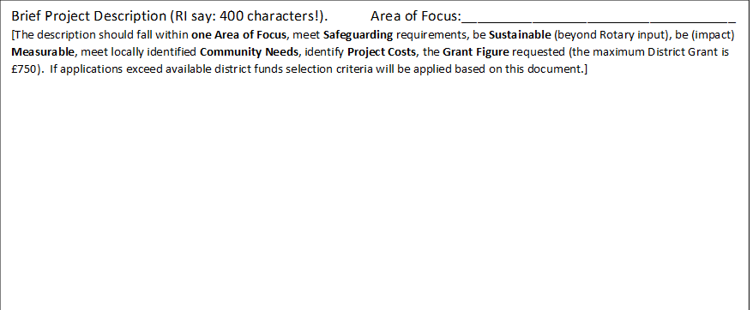
One Area of Focus
Safeguarding
Sustainable
Measurable
Community Need
Project Cost
Grant Request

Slide 15
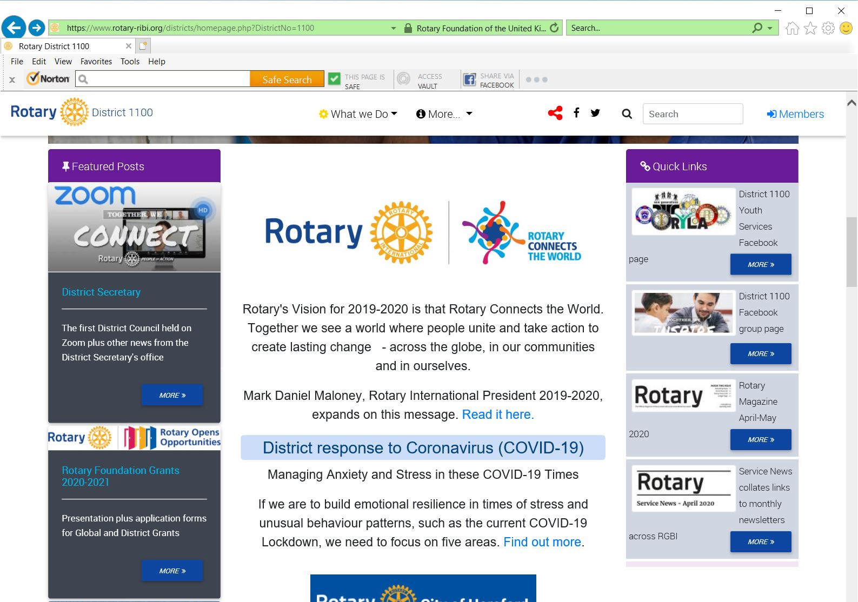
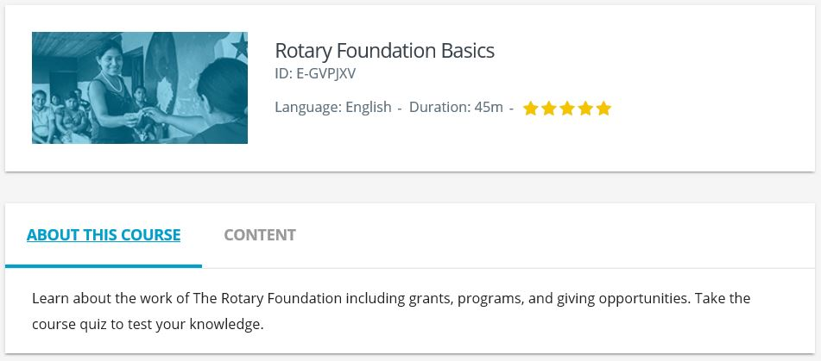
D1100 Rotary Foundation Grants 2020
Go to D1100 Home Page, Look for Featured Posts, Click on “More >”
As required:
Download Application Form
Download MoU
Download this Qualification PowerPoint
The Rotary Learning Centre

Slide 16
Rotary – Beyond Ourselves
Foundation
Peter Wells, Foundation Chair, EPN Officer D1100,
pjwells@ntlworld.com, mobile: 07970 850399, home: 01793 616654
The Rotary Foundation: Service above Self to the People of District 1100 and the World

