Slide 1
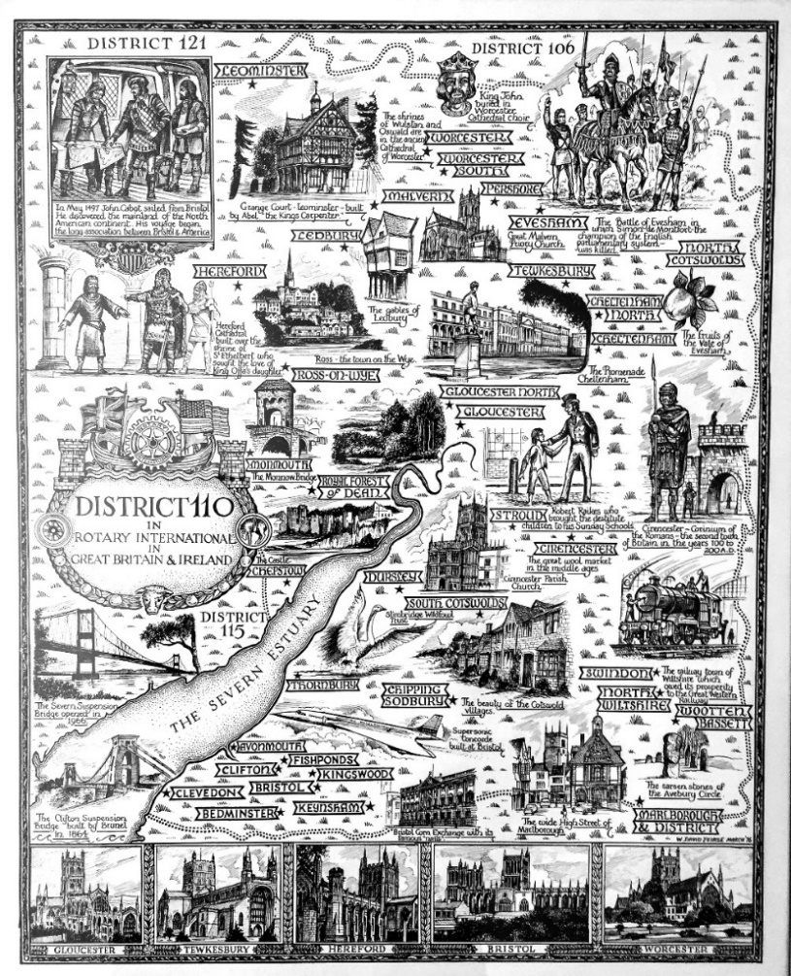



Slide 2
Club Qualification
When applying for a Global Grant or District Grant the Qualification is the same
This is an annual mandatory requirement of Rotary International
For the first year, Qualification is achieved by at least one member of your Club completing
Grant Management Seminar
For the second year the same person must complete the
Grant Management Recertification
The following slides take you through the Club Qualification process
So, go to the Rotary Learning Center to get started
Rotary Learning Center

Slide 3
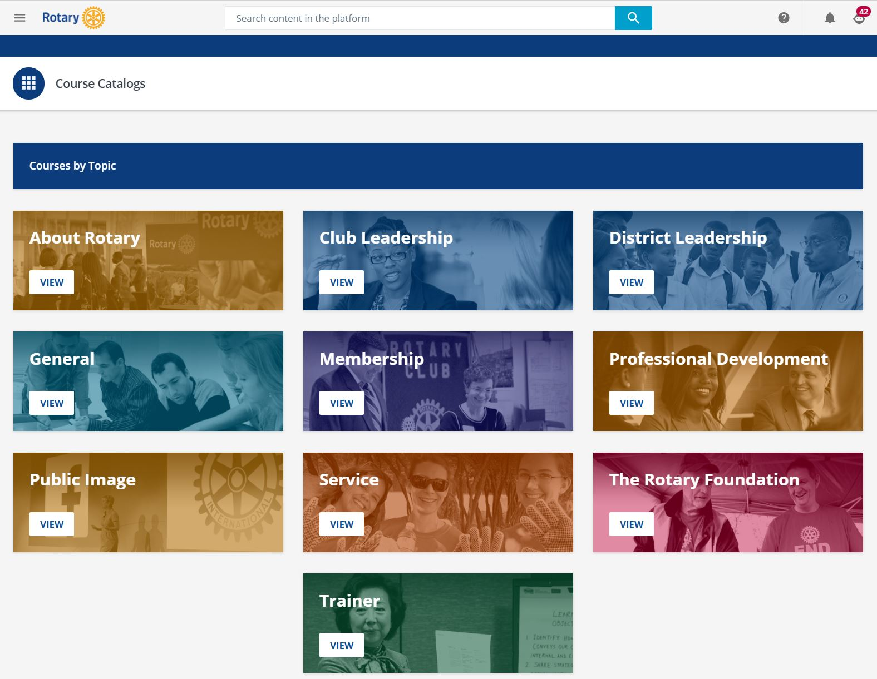
This is the Learning Center screen which the link should take you to

Slide 4
Click on
The Rotary Foundation
button
VIEW

Slide 5
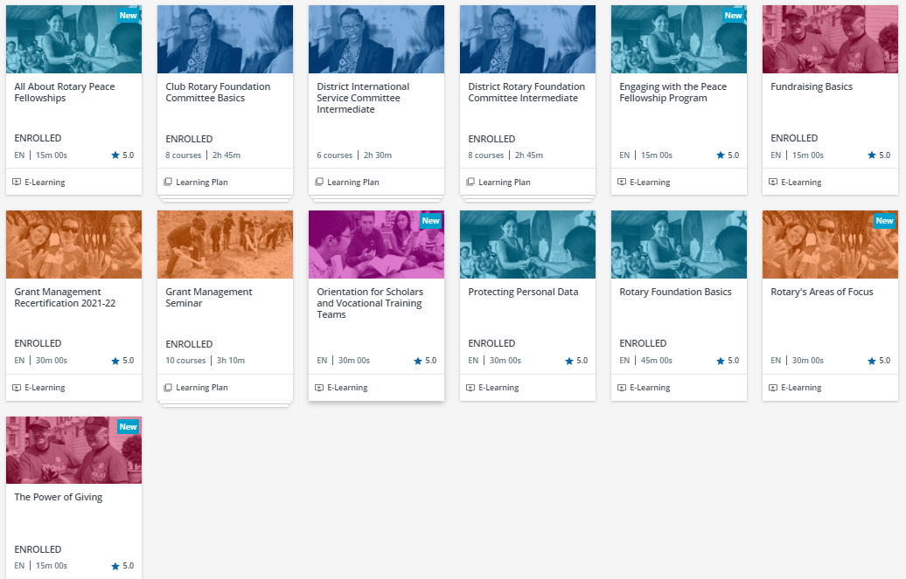
This screen shows the 13 Foundation courses on offer.
Choose the Grant Management Seminar or the Recertification

Slide 6
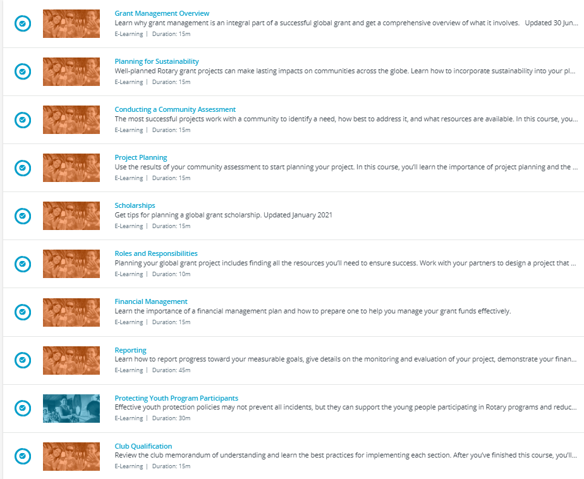
There are 10 sections in the Grant Management Seminar and they can be completed at your own pace. Each includes a short multiple choice memory test which you can resit, so you cannot fail. It should take 2-3 hours to complete.

Slide 7
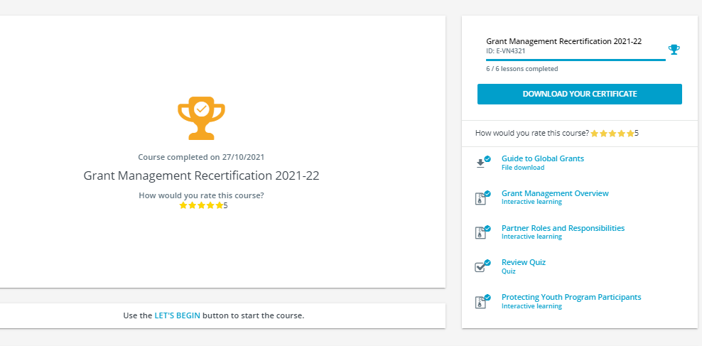
There are five elements in the Grant Management Recertification which should be completed within 30 minutes.

Slide 8
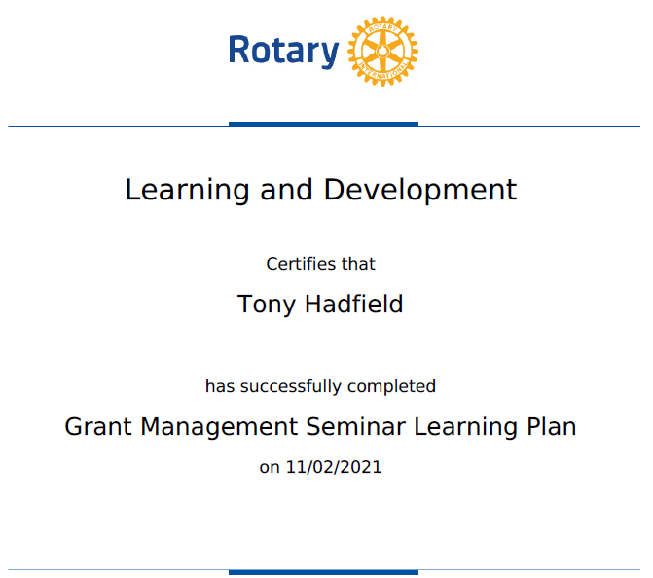
At the end of each course you will get a Certificate confirming that you have successfully completed it. This is dated and entered into your RI training record.
The District Rotary Foundation Chair will be able to see these completion records which show your name, district, club and ‘completion’ or ‘in progress’ as a percentage.
Once completed you and your club can apply for a Global or District Grant.

Slide 9


Global Grant
Guidelines for 2021/22

Slide 10
Global Grant Funding
The route to a Global Grant is much the same as in previous years
But the funding is different and The Rotary International allocation is less
Global Grants have a minimum budget of $30,000 and a maximum World Fund award of $400,000
Grant sponsors can use a combination of cash, District Designated Fund, gifts and endowment earnings to fund the Grant
For example:
If your Club raises $11,000
District 1100 contributes $11,000 from its District Designated Fund
Rotary International will match 80% of the District contribution $8,800
Total allocation for the Global Grant is therefore $30,800

Slide 11
The lifecycle of a Global Grant
Draft | Authorization | Submitted | Approved | Completion
Rotary members plan a project or scholarship and build their grant application online | Club and District leaders review the application and authorize funding | The grant’s planners submit the application to The Rotary Foundation | If the grant is approved, the Foundation issues payment | Members carry out the project, reporting to The Rotary Foundation annually until the work or studies are finished and the grant is closed

Slide 12
District Grant
Guidelines for 2022/23

Slide 13
District Grant Funding
This maximum size of a District Grant in 2021-2022 was £750
It is hoped to maintain that ceiling for 2022-2023 but it will depend on the number of District Grant Applications received
An example:
Your Club has a project in mind with a cost of £1,500 or more
The project needs to be completed within 12 months
To achieve that figure your Club needs to raise at least £750
If the Application is approved D1100 will matched funding of £750 from District Designated Funds (DDF)

Slide 14
The lifecycle of a District Grant
Draft | Authorization | Submitted | Approved | Completion
Rotary Club plans a project and builds their Grant Application online and gains Club agreement | District Grants Committee reviews the Application and authorizes funding on an annual basis circa June/July | The District Rotary Foundation Chair submits the District Grant Application to The Rotary Foundation | If the grant is approved, The Rotary Foundation issues payment and the District Rotary Foundation Chair forwards payment to relevant Club | Club carries out project, reporting to District Rotary Foundation Chair who reports completion to The Rotary Foundation

Slide 15
District Grant Application Process
Deadline 30th June 2022
Club completes District Designated Grant Application Form sending it to District Rotary Foundation Chair via email
August 2022
District Grants Committee reviews all District Grant Applications
District Rotary Foundation Chair applies for all District Grants at the same time
August – October 2022
Rotary Foundation in Evanston, USA, review all District Grant Applications
When all Applications have been approved, payment to D1100 is made

Slide 16
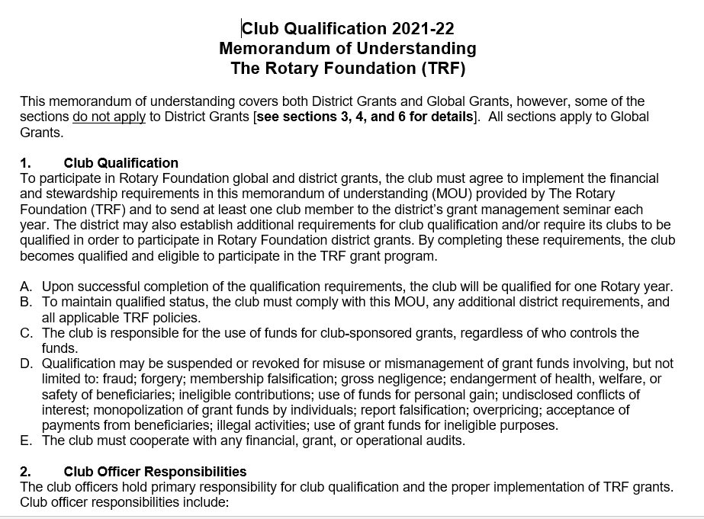
The Memorandum of Understanding must be completed annually, and submitted to the D1100 Rotary Foundation Chair at the same time as a Global or District Grant Application

Slide 17
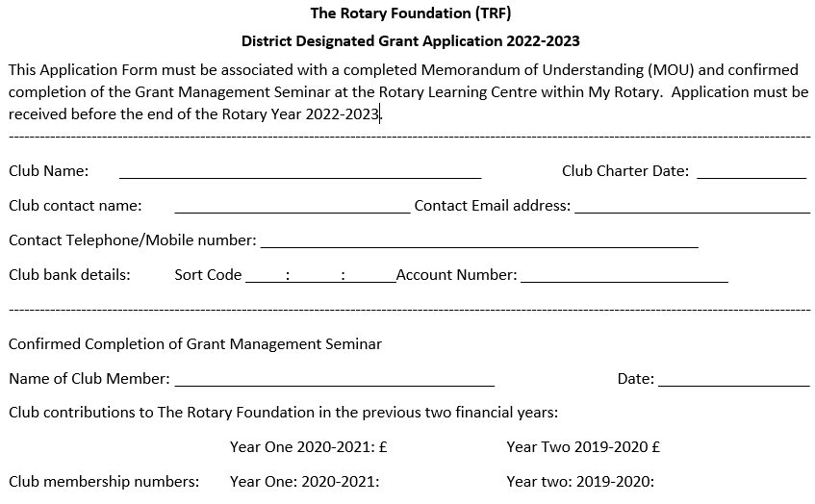
The District Designated Grant Application form for 2022-2023 must be completed for District Grant Applications, and sent to the D1100 Rotary Foundation Chair by email before 30th June

Slide 18
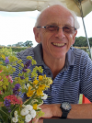
The Rotary Foundation
I look forward to receiving your Global and District Applications, and helping you to
obtain grants for your projects.
Tony Hadfield, D1100 Rotary Foundation Chair
bthadfield@btinternet.com

