Slide 1
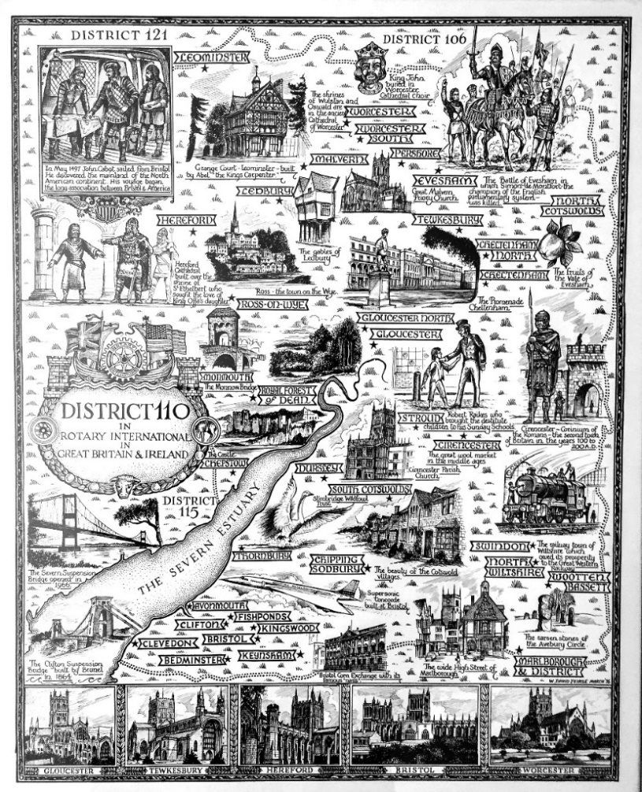


Slide 2
Club Qualification
When applying for a Global Grant there is an annual mandatory requirement
for at least one member of your Club:
For the first year to complete -
Grant Management Seminar
For the second year the same person must complete the
Grant Management Recertification
Both of these courses are on the Learning Centre on MyRotary
Rotary Learning Center

Slide 3
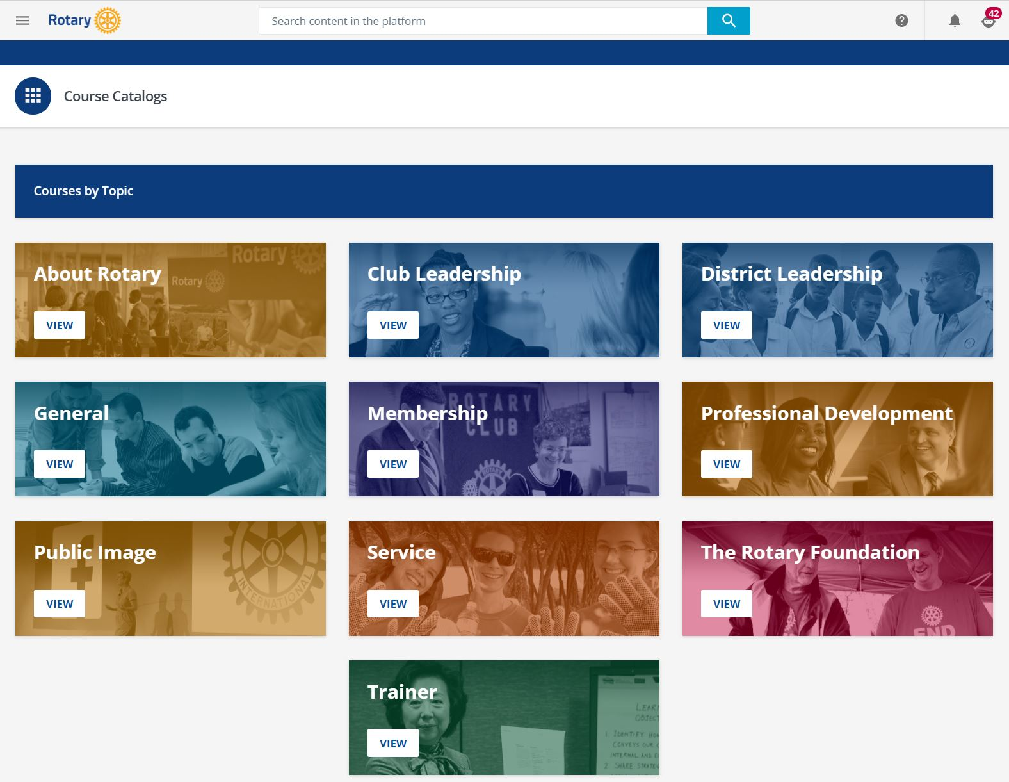
Global Grants
From this screen on Learning Centre select
The Rotary Foundation
On the next screen select Grant Management Seminar
– or –
Grant Management Recertification 2023-24

Slide 4
Club Qualification
When applying for a District Grant there is an annual requirement
for at least one member of your Club
for the first year to complete on Learning Centre
Rotary Foundation Basics Course
For subsequent years the same member of your Club must complete
any updates to this course,
or a different club member must complete the course.
Rotary Learning Center

Slide 5
District Grants
From this screen on Learning Center select
The Rotary Foundation
On the next screen select
Club Rotary Foundation Committee Basics
On the next screen select
Rotary Foundation Basics

Slide 6
Global Grant Funding
The route to a Global Grant is as follows:
Global Grants have a minimum budget of $30,000 and a maximum World Fund award of $400,000
Grant sponsors can use a combination of cash, District Designated Fund (DDF), gifts and endowment earnings to fund the Grant
For example:
If your Club raises $11,000
District 1100 contributes $11,000 from its District Designated Fund (DDF)
Rotary International will match 80% of the District contribution $8,800
Total allocation for the Global Grant is therefore $30,800

Slide 7

The life cycle of a Global Grant
Draft | Authorization | Submitted | Approved | Completion
Rotary members plan a project or scholarship and build their grant application online | Club and District leaders review the application and authorize funding | The grant’s planners submit the application to The Rotary Foundation | If the grant is approved, the Foundation issues payment | Members carry out the project, reporting to The Rotary Foundation annually until the work or studies are finished and the grant is closed

Slide 8
District Grant Funding
This average size of a District Grant in 2022-2023 is £800
An example:
Your Club has a project in mind with a cost of £1,500 or more
The project needs to be completed within 12 months
To achieve that figure your Club needs to raise at least £750
If the Application is approved D1100 will match funding of £750 from District Designated Funds (DDF)

Slide 9
The lifecycle of a District Grant
Draft | Authorization | Submitted | Approved | Completion
Rotary Club plans a project and builds their Grant Application online and gains Club agreement | District Grants Committee reviews the Application and authorizes funding on an annual basis circa June/July | The District Rotary Foundation Chair submits the District Grant Application to The Rotary Foundation | If the grant is approved, The Rotary Foundation issues payment and the District Rotary Foundation Chair forwards payment to relevant Club | Club carries out project, reporting to District Rotary Foundation Chair who reports completion to The Rotary Foundation

Slide 10
District Grant Application Process
Deadline 30th June 2024
Club completes District Grant Application Form and Club Qualification Memorandum of Understanding (MOU) and sends them to District Rotary Foundation Chair (DRFC) via email
July - August 2024
District Grants Committee reviews all District Grant Applications
District Rotary Foundation Chair aims to apply for first batch of District Grants at the same time
September 2024
Rotary Foundation in Evanston, USA, reviews all District Grant Applications
When all Applications have been approved, payment to D1100 is made, and grants are distributed to relevant clubs

Slide 11
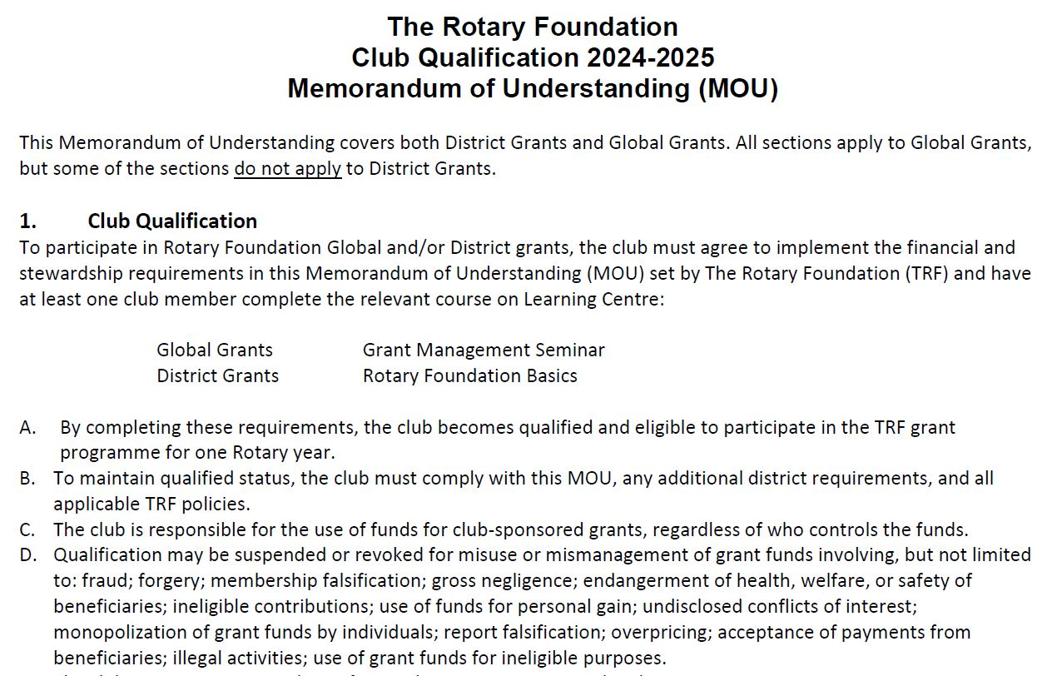
The Memorandum of Understanding (MOU)
must be completed and
sent to the D1100 Rotary Foundation Chair by email at the same time
as a Global or District Grant Application form as it applies to both Grants.

Slide 12
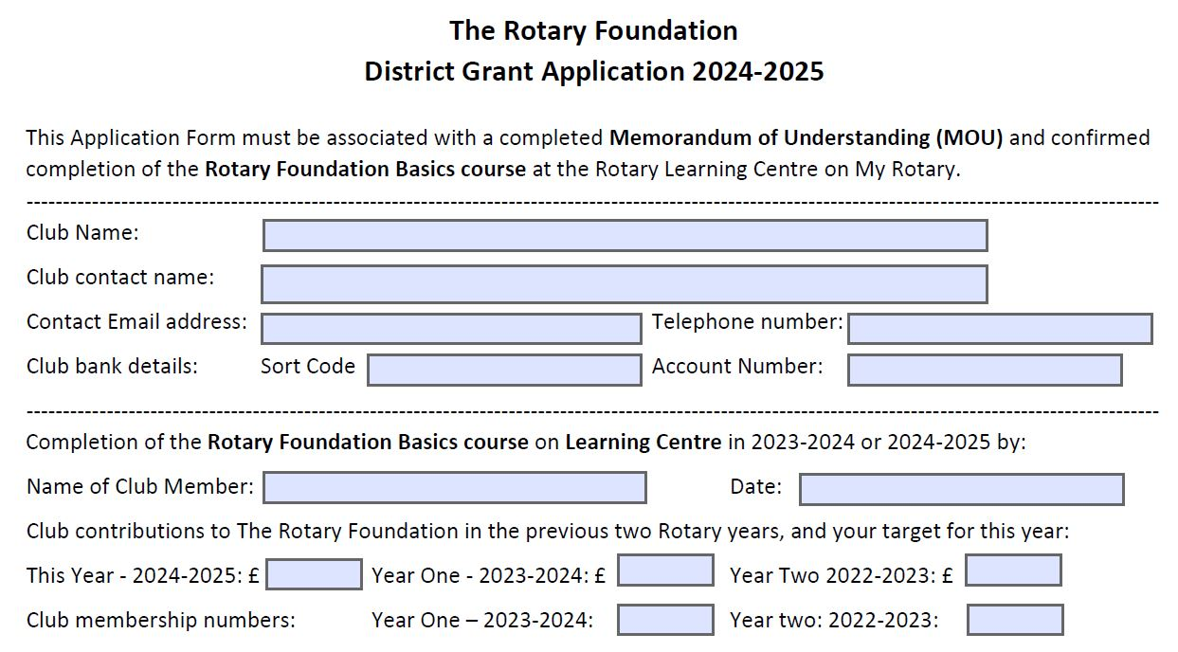
The District Grant
Application form for
2024-2025 must be completed and sent
to the D1100 Rotary Foundation Chair
by email.

Slide 13

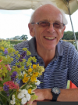
We look forward to receiving your Global and District Applications, and helping you to obtain grants for your projects.
Tony Hadfield
D1100 Rotary Foundation Chair 2021-2024
foundation@rotary1100.org

