Slide 1
STATE OF ROTARY MEMBERSHIP
As of 1 January 2019
Paul Hickson
District Membership Team Leader
Notes:
NOTES TO SPEAKER: This presentation can be given as is or customized to meet your region’s needs. You will, however, need to customize these slides:
Slide 1: Insert your name and the date.
Slide 4: Where you see Xs, replace them with data from Rotary Club Central, or delete them. Unhide the slide (use the Slide Show menu) so it’s visible during the presentation. Draw comparisons between regional and global trends, and add them as your observations.
You can find more images to highlight People of Action (slide 15) on the Brand Center. Go to the Materials menu, then Toolkits.
SPEAKER:
Rotary’s members are our greatest assets: When our membership is strong, our clubs are more vibrant, Rotary has greater visibility, and our members have more resources to help communities flourish.
At this point in the Rotary year, many clubs around the world are seeing growth because people are looking for new ways to give back. But if we hope to create lasting change in our communities, our world and ourselves, we need to continue to grow Rotary: to grow our service; to grow the impact of our projects; but, most importantly, to grow our membership so that we can achieve more.
Keeping Rotary relevant and thriving into our second century while continuing to enhance our members’ lives takes a willingness to be innovative, seek out diversity, and adapt to changing needs. It starts by understanding where we are halfway through the 2018-2019 Rotary year and knowing what resources and tools are available to help us accomplish our goals.

Slide 2
MEMBERSHIP OVERVIEW
 | 1 January 2019 | Change since 1 July 2018
Members | 1,206,501 | +11,394
Rotary Clubs | 35,663 | -18
% Women | 23% | +1%
Ages 50-69 | 28% | --
Under 40 years old | 5% | --
Notes:
As of 1 January, we had:
1,206,501 ROTARIANS, which is an increase of 11,394 members since 1 July.
35,663 CLUBS (down 18 from 1 July). Starting new clubs expands our reach and increases our capacity for service around the world. We know that for many clubs, flexibility has proven a great way to address the varied needs of club members.
Women now make up 23 percent of our membership, an increase of about 1 percent since 1 July.
The information in Rotary Club Central suggests that the majority of our members are between ages 50 and 69, though accurate percentages are hard to gauge because 41 percent do not include their age in their membership profiles.
How are we doing compared to 1 January 2018, one year ago?

Slide 3
ANNUAL TRENDS: CLUB INVOICING (JULY & JANUARY)
2014-15
2015-16
2016-17
2017-18
2018-19
JULY
JULY
JULY
JULY
JULY
-10,528 MEMBERS
From 1 January 2018
Notes:
This graph shows the cyclical nature of our membership count over the past five years. During the first five months of each year, member numbers grow. That’s followed by a slight dip just before the 1 January club invoice, when clubs are likely to report membership changes. Membership increases again through May, only to drop before the 1 July club invoice, as clubs update their membership records.
Compared to last January, we have about 10,000 fewer members.
It’s important that we understand this cycle and plan our efforts accordingly. We will likely see growth through May, and based on this pattern, can expect another drop in July. To expand our clubs from one year to the next, we should aim to achieve a membership level 3 to 5 percent higher than the previous year between July and May.
NOTE TO SPEAKER: Check Rotary Club Central to get the current global count.

Slide 4
≈ 80,000 PEOPLE JOINED
1 JANUARY MEMBERSHIP
1,206,501
≈ 67,000 MEMBERS LEFT
> 1 year | 22%
1-2 years | 30%
3-5 years | 17%
6-10 years | 12%
10+ years | 19%
LENGTH OF MEMBERSHIP
Notes:
Rotary clearly has a lot to offer to the over 80,000 people who have joined so far this year: the opportunity to create positive change around the world, take action in their communities, make new friends, and develop skills.
But an almost equal number of members have already left. Of the members who leave our clubs, 52 percent were in their clubs less than two years.
Members are particularly vulnerable during two phases: before their third year and again after their tenth. But members can leave or become unhappy in Rotary at any time. Rotary offers countless opportunities for involvement at all levels, whether it’s serving on a committee, joining a Rotarian Action Group or Rotary Fellowship, mentoring, or doing hands-on service. What we need to do is make sure we’re connecting each member with the parts of Rotary that mean the most to them and allow them to pursue their passions. Keeping our members actively involved is our best engagement strategy.

Slide 5
Too expensive/ too much time
Club environment
Unmet expectations
WHY DO MEMBERS LEAVE?
31%
21%
15%
43%
Would NOT recommend their club
35%
Would NOT recommend Rotary
Notes:
Here’s what we know about the members who are leaving Rotary.
The majority gave one of three reasons for leaving: cost or time demands, general club environment, or unmet expectations. The expectations that aren’t met include volunteering and community involvement, friendship, networking, and service projects and events.
When we surveyed former members, 43 percent said they would not recommend their former clubs, and 35 percent said they would not recommend Rotary at all.
The three things that Rotarians value most are community service, networking, and friendship. Many prospective members are also seeking global service opportunities. If they don’t get those things from Rotary, they might leave.
To ensure that the club experience remains relevant and worthwhile to members, many clubs are shifting their emphasis from perfect attendance to perfect engagement. To support clubs in this effort, the Membership Team at Rotary International recently asked club leaders about their biggest membership challenges.

Slide 6
MEMBERSHIP CHALLENGES: CLUB LEVEL
ATTRACTING NEW MEMBERS
EMBRACING CLUB FLEXIBILITY
FILLING LEADERSHIP POSITIONS
ROTARY.ORG/MEMBERSHIP
Notes:
Forty percent of respondents told us that attracting new members is their biggest membership challenge. Many also said that accommodating the varied needs of members, and getting members to participate, volunteer or serve in leadership roles were also challenges they faced.
There is no one approach to membership that works for all clubs, but Rotary International offers tools and strategies for keeping our clubs relevant throughout our second century of service. If you’re not sure where to start, check out the resources on Rotary.org/membership. You’ll find materials to help you engage current members, connect with prospective members, and make new members feel welcome. The following slides will highlight ways clubs can address these three specific challenges.

Slide 7
IS YOUR CLUB HEALTHY?
ROTARY.ORG/MEMBERSHIP Rotary Club Health Check Membership Assessment Tools
ROTARY.ORG/LEARN Is Your Club Healthy? Enhancing the Club Experience Diversify Your Club Improving Your Member Retention
Notes:
Declining membership is usually not the problem, but a symptom of a larger issue that needs to be addressed. A vibrant, innovative club that’s making a difference in the community will attract prospective members.
One of the most important things that can be done at any point in the year is a club assessment. Ask yourselves: Does the makeup of our club reflect our community? Are we doing projects that serve and inspire our communities? Are we having fun? Are our current members satisfied? And why do members leave?
My Rotary offers club assessment tools, online courses, and webinars to help you answer these questions and learn what’s working in your club and what needs improvement.

Slide 8
5 REASONS TO CHECK YOUR MEMBERSHIP LEADS
19,500 + | Leads per year
50% | Have a personal connection to Rotary
64% | Are under age 40
35% | Are women
58% + | Are NEVER contacted
MY.ROTARY.ORG → MANAGE → CLUB & DISTRICT ADMINISTRATION
Notes:
In places that experienced the highest decline in membership, an equally high percentage of membership leads were never contacted. Membership leads are prospective members who visit rotary.org/join and use Rotary’s online form to express interest in joining a club. Last year, 19,500 people contacted Rotary this way.
In the US, for example, membership declined by around 4,800 members in 2017-18. In the same time period, the US received 7,640 membership leads. Imagine what our overall membership would look like if we followed up on every lead. Although not every one of these prospective members will be a viable prospect, each one provides an opportunity to identify the value they might bring to the Rotary.
When prospective members express interest in joining, a notice of the membership lead is sent to a district through the Manage Membership Leads page of My Rotary. District and club leaders can track all of their prospective members right on that page. It’s an efficient and transparent way to keep everyone updated on the status of potential members. Having a clear process in place and making it part of the routine, will make managing prospective members less of a chore and more of an opportunity.
Unfortunately, as far as we can tell, clubs contacted less than half of the prospective members assigned to them last year. When we don’t respond to inquiries, we miss more than just opportunities to expand our clubs — we miss a chance to build goodwill in the community and a positive impression of Rotary.

Slide 9
EMBRACING CLUB FLEXIBILITY
MEETING FORMATS
MEETING TIMES & FREQUENCY
ALTERNATIVE:
MEMBERSHIP TYPES
ROTARY.ORG/FLEXIBILITY
Notes:
The second challenge noted by club leaders was embracing flexibility as a way to accommodate the varied needs of its members. Clubs actually have more freedom than ever to create a club experience that works for everyone. You can decide how, when, where, and how often your club meets, as well as which membership types to offer.
Clubs all around the world are becoming more flexible in three main ways: Some are using alternative meeting formats, some are changing or varying how often and when they meet, and some are offering additional membership types to allow more people in the community to become part of the family of Rotary. You can find more information at rotary.org/flexibility.
Here are some ways your club can accommodate the diverse needs of your members and community:
If you have qualified people who can’t attend your club’s meetings, start a satellite club to give them a chance to join Rotary.
Change how, when, and how often your club meets. For example, you can decide to meet just twice a month or switch from a sit-down meal to a less formal (and likely less expensive) gathering. You could also replace one of your regularly-scheduled meetings with a social event or service project.
Offer a new membership type. For example, you can offer a corporate membership to attract multiple members of the same company, or an associate membership for younger professionals who want an option that costs less or requires less time.
Recognize the potential of online meetings to attract members who can’t attend in-person meetings every time.
You can even consider developing a cause-based club to attract and engage members who are passionate about water, peace, or some other issue.

Slide 10
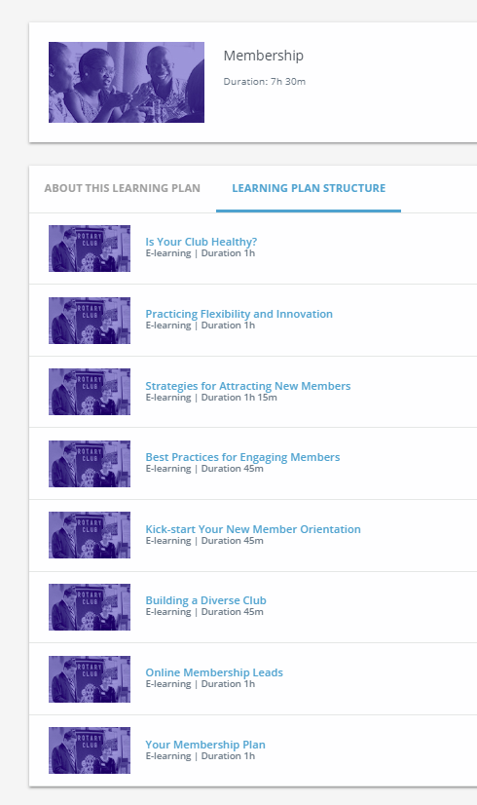
PROFESSIONAL DEVELOPMENT
In-person training events Mentoring Leadership in Action Service projects Learning center Webinars
ROTARY.ORG/LEARN
Notes:
Finally, for those leaders who said that getting members to participate, volunteer or serve in leadership roles was a challenge, here are some questions to ask:
Are our members seeking professional growth and networking?
Does our club offer opportunities for professional development?
Do we want to develop leaders who can shape the future of our club and community?
Membership in a Rotary club offers opportunities to connect with other professionals who aren’t afraid to lead and are dedicated to making a difference. But a member doesn’t need to serve in a leadership role to be a leader. They can recommend service projects, connect with or become a mentor, organize a club event, or participate in club and district training events.
One important resource to share with members is the Learning Center. The courses are interactive and can be taken by Rotarians at any level and are a wonderful member benefit for personal and professional development. There are also a number of webinars for viewing at rotary.org/webinars. Topics include managing your membership leads, crafting your member experience, new club development, and membership models for the future of Rotary.

Slide 11
Notes:
Our members are our greatest assets: a diverse group of professionals who share the drive to give back. And together, we see a world where people unite and take action to create lasting change — across the globe, in our communities, and in ourselves.
Thank you.
Are there any questions I can answer?
NOTES TO SPEAKER:
E-mail MembershipDevelopment@rotary.org with any questions.
More global trends can be found in the July 2018 update

