Slide 1
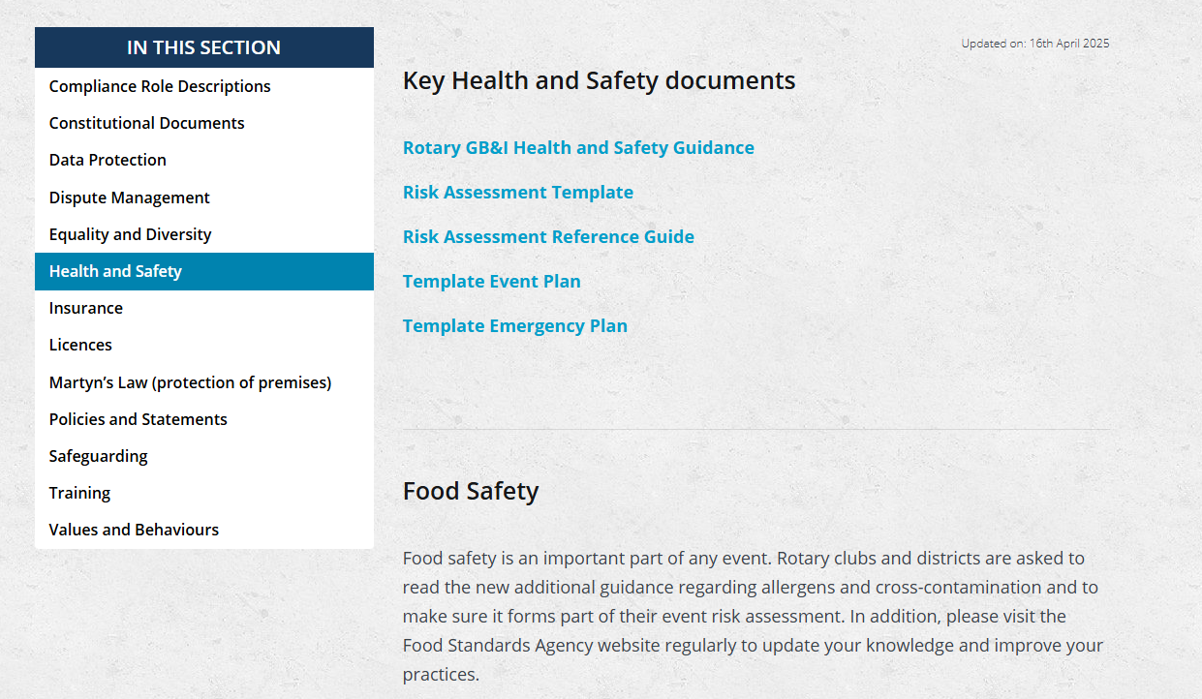

Slide 2



IN ANY ROTARY EVENT PLAN WE MUST UNDERTAKE THE FOLLOWING PREPARATIONS
AND IN THE EVENT OF AN ACCIDENT DILIGENTLY RECORD THE INCIDENT
Accident Recording Book

Slide 3
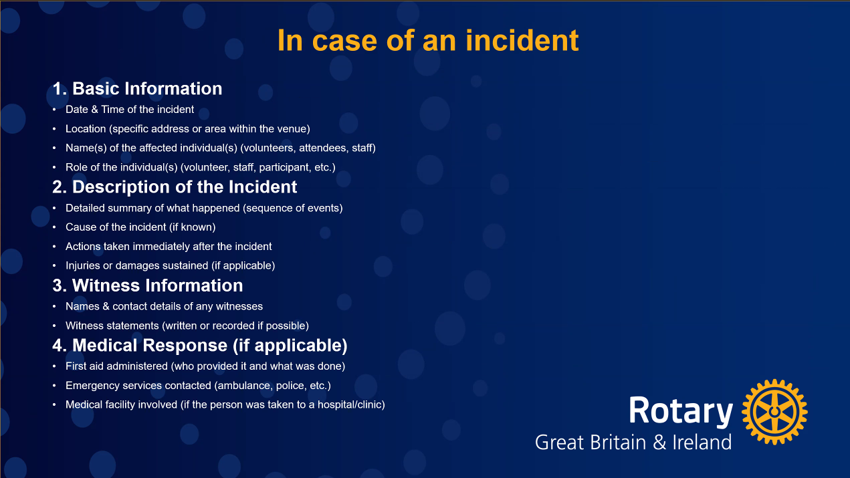
Accident Book to
accompany Rotary
Organised Events
(H&S)

Slide 4
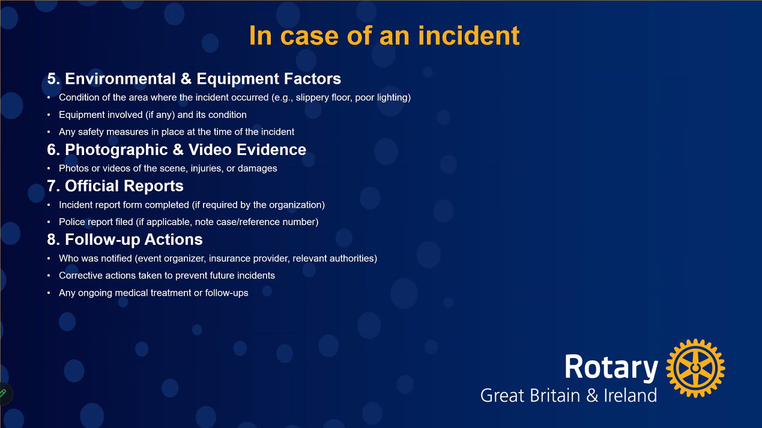
ENSURE YOU HAVE THE NESCESSARY RISK ASS /EVENT PLAN AND EMERGENCY PLAN

