Slide 1
There are THREE overwhelming reasons
why we as clubs and rotarians
Need to actively practice DUE DILIGENCE
in engaging COMPLIANCE
1)Protect our Rotarians in the public activities we pursue.
2)Protect the people with whom we engage.
3)Protect the image of Rotary.

Slide 2
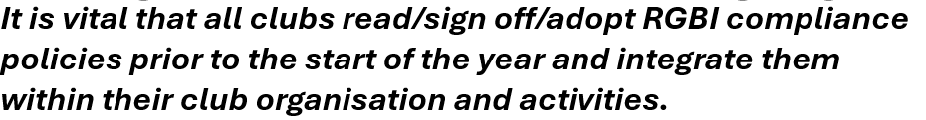


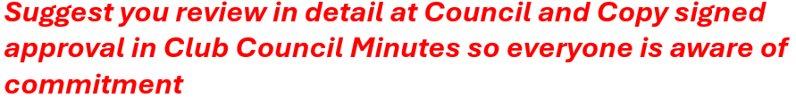


Slide 3
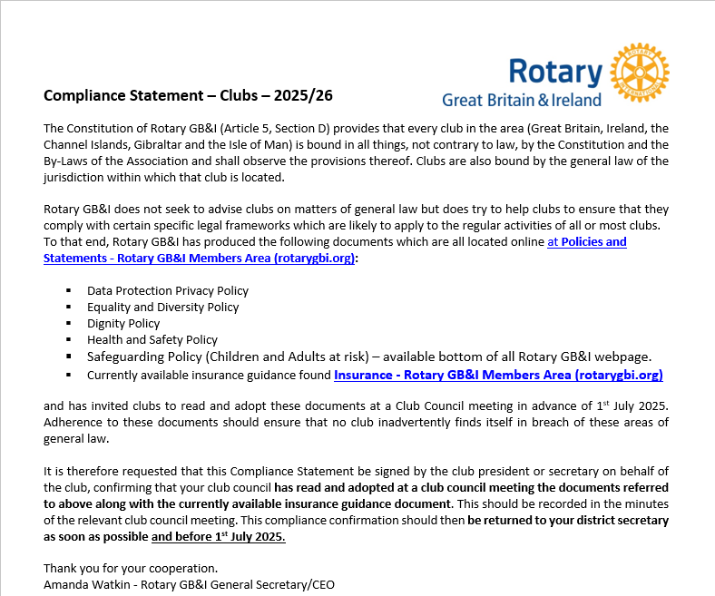
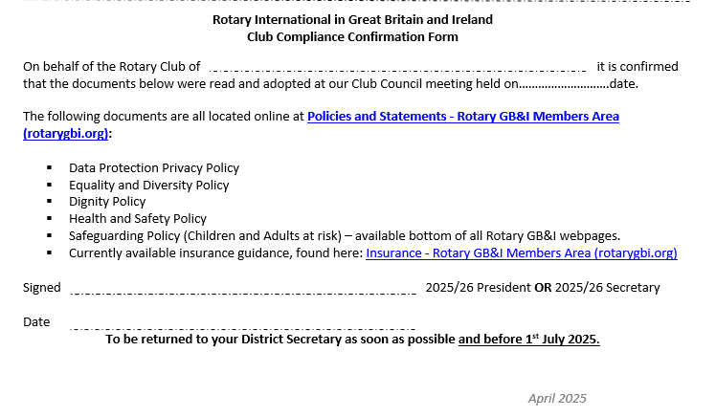
CLUB COMPLIANCE APPROVAL FORM

Slide 4
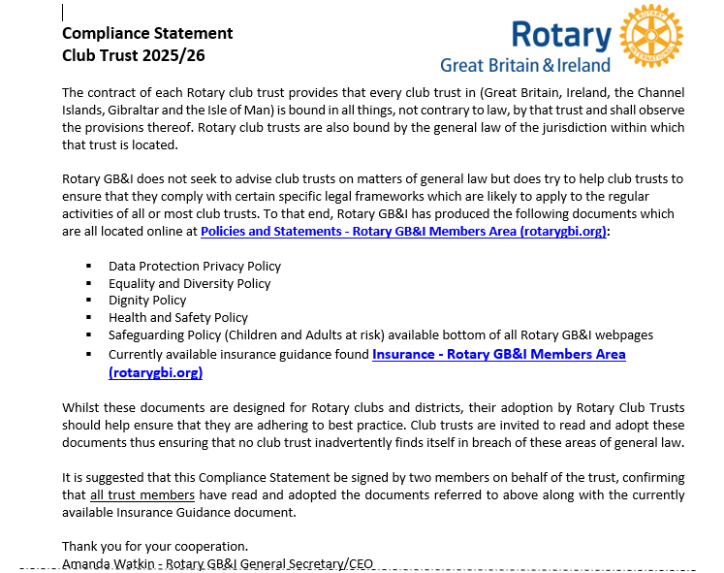
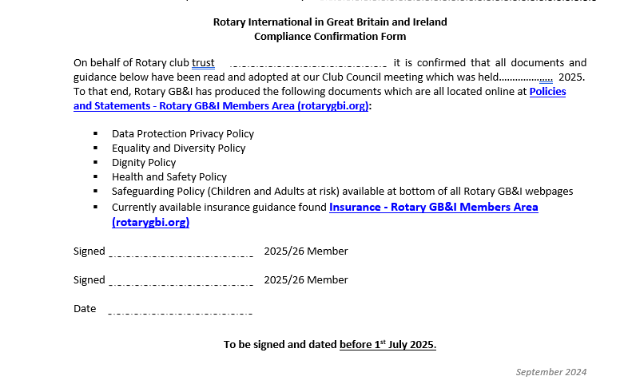
CLUB TRUST COMPLIANCE APPROVAL FORM

Slide 5
COMPLIANCE IS SEGMENTED INTO FIVE CATEGORIES
HEALTH AND SAFETY
SAFEGUARDING
GDPR
General Data Protection Legislation
EQUALITY DIVERSITY INCLUSION
& EQUITY
DISPUTE MANAGEMENT
HOW OFTEN ARE WE LIKELY TO ENCOUNTER COMPLIANCE EXPECTATIONS?
ALL ACTIVITIES WITH
VULNERABLE PEOPLE
(CHILDREN AND ADULTS AT RISK)
ALL ROTARY ORGANISED
EVENTS
ANNUALLY OR BY AGREED FREQUENCY
OR CONTRACT
ALL PERSONAL
OR GROUP INTERACTION
INFREQUENTLY /
AS AND WHEN REQUIRED

Slide 6
WHERE IS YOUR DETAILED REFERENCE LIBRARY?
1)RGBI WEBSITE
2)MEMBERS AREA
3)CLUB AND DISTRICT TOOLS
4)COMPLIANCE

Slide 7
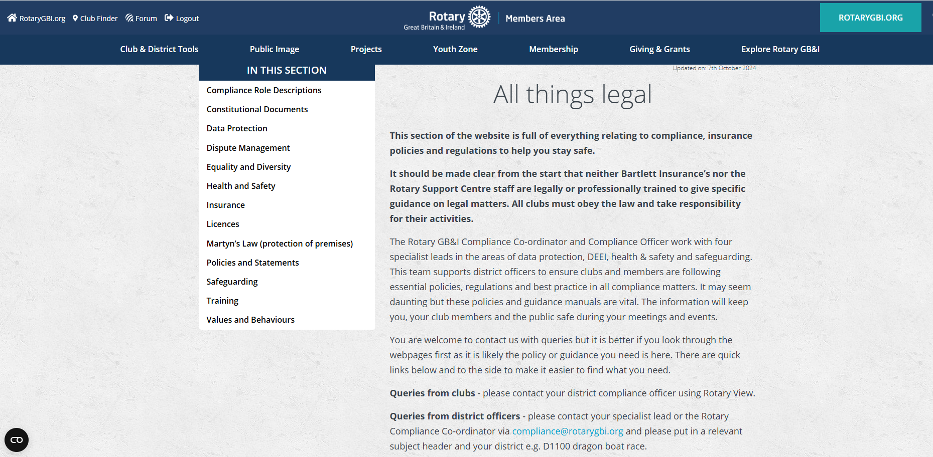
ComplianceData Protection
Equality and Diversity
Health and Safety
Safeguarding
Values and Behaviours
Insurance
Policies and Statements
Compliance Role Descriptions
Dispute Management
Constitutional Documents
Licences

Slide 8
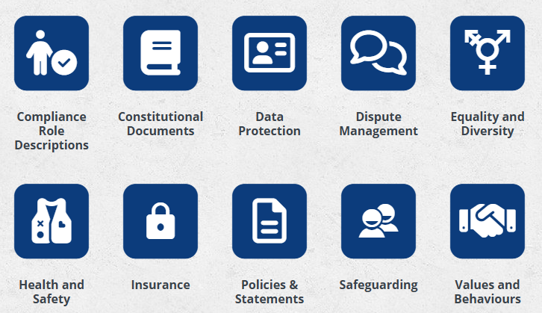
COMPLIANCE information GUIDELINES AND KEY RESPONSINILITIES ARE SUB SET INTO SEVERAL AREAS

