Slide 2
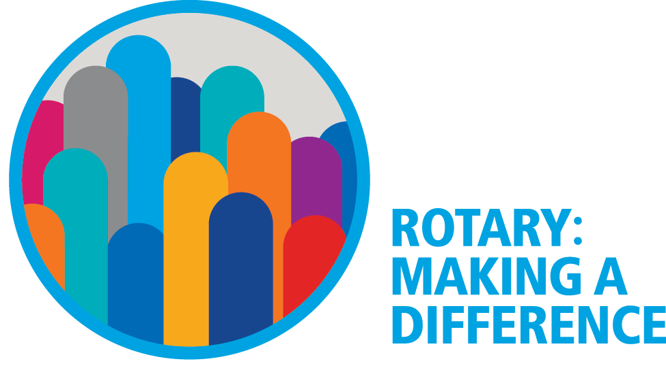

Slide 3
District Training Assembly

Slide 4
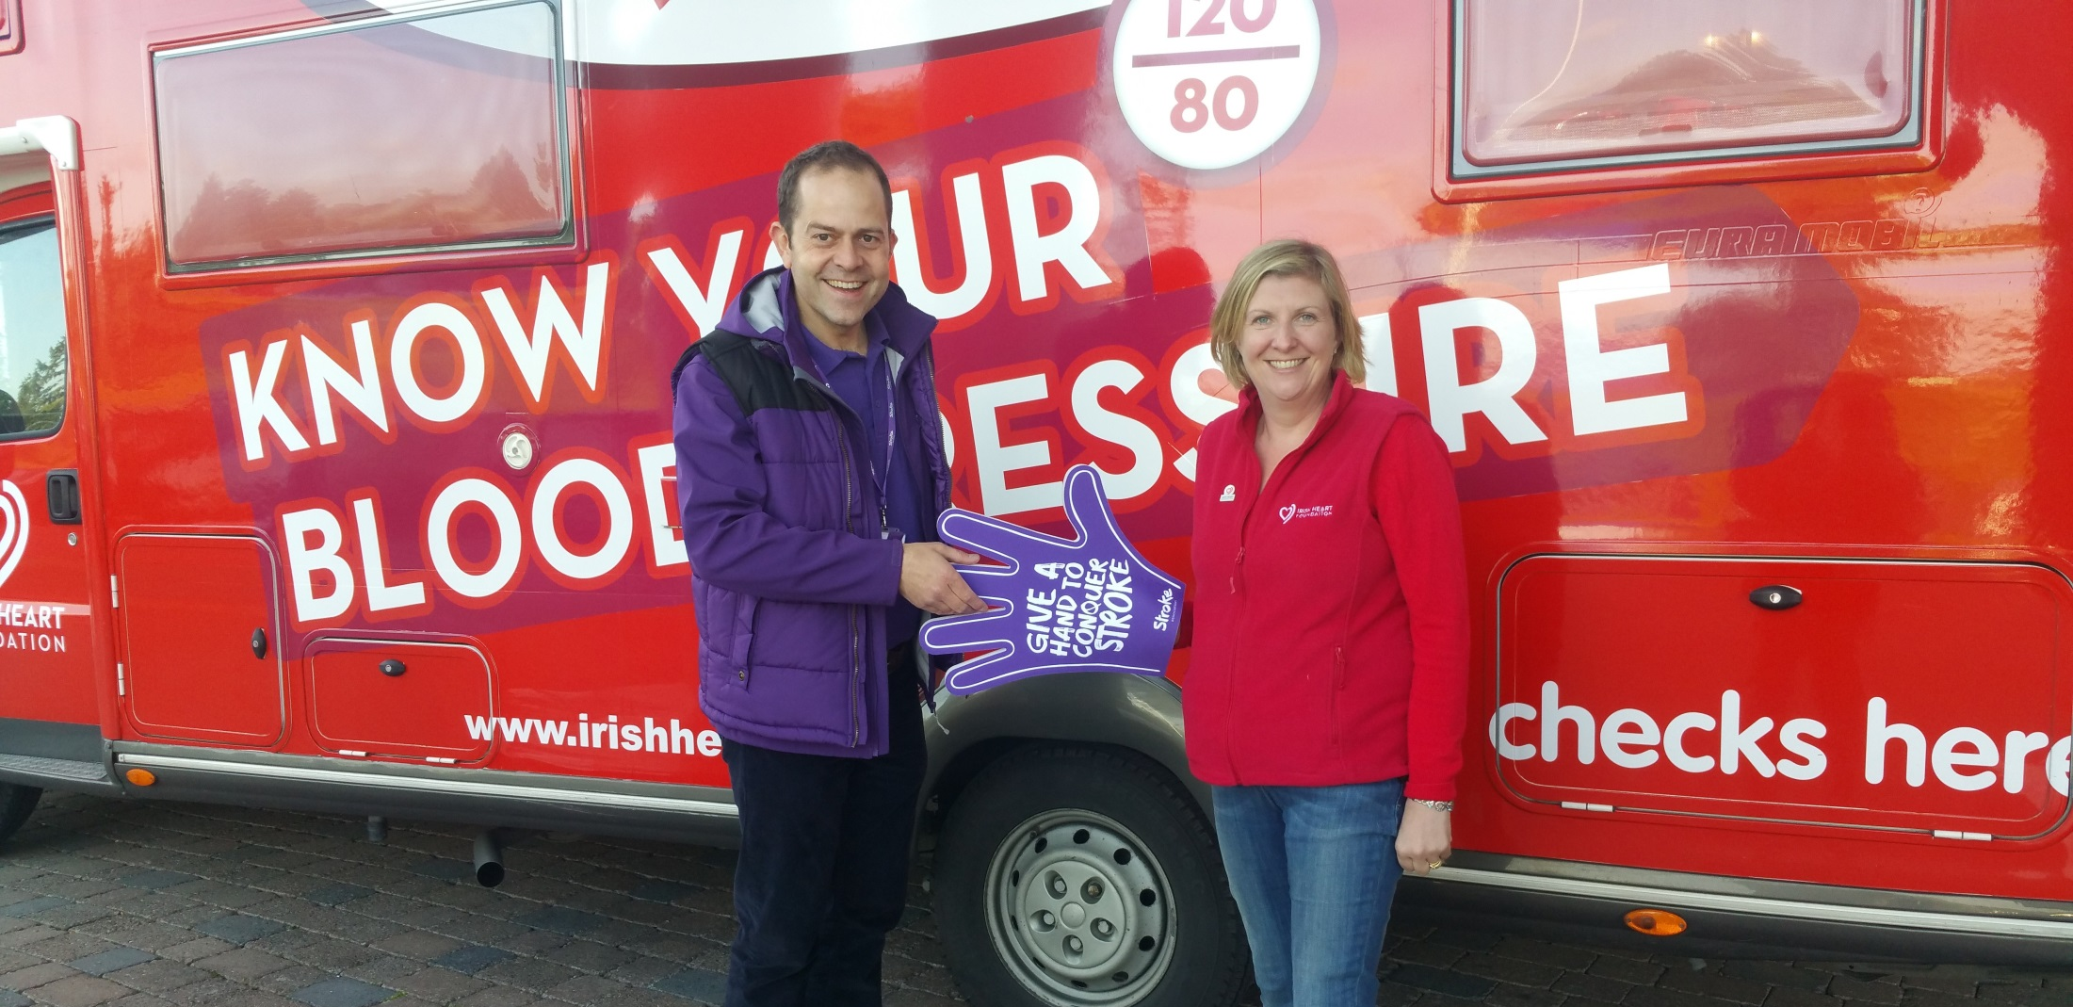
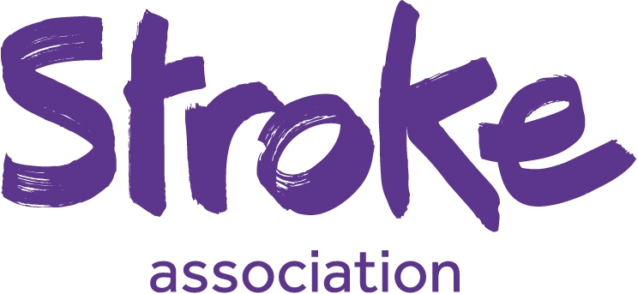
Know your blood pressure

Slide 5
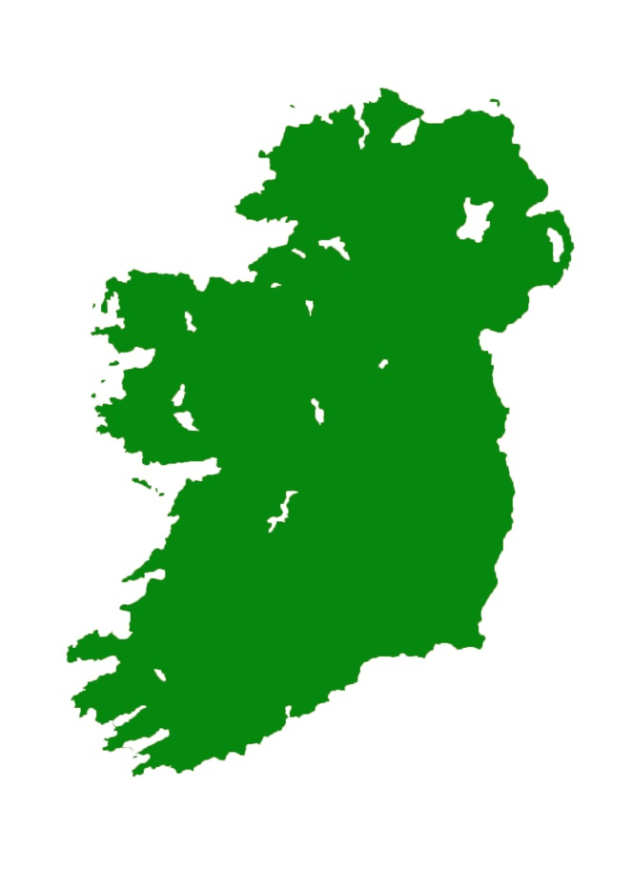
High blood pressure and stroke
20% of people in Ireland have high blood pressure.
High blood pressure contributes to around half of all strokes.
High blood pressure can be identified and treated.
Notes:
Over 14,000 strokes every year.
100,000 stroke survivors.
There are about 4,400 strokes each year in Northern Ireland.
There are about XXXX strokes each year in the Republic of Ireland.
There are over 35,000 people living with the effects of stroke in Northern Ireland.
There are over XXX,XXX people living with the effects of stroke in the Republic of Ireland.
20% of people in Ireland have high blood pressure (SAFE Burden of stroke report, May 2017) – it can be treated

Slide 6
Impact of stroke
Stroke is a leading cause of disability – almost two thirds of stroke survivors leave hospital with a disability.

Slide 7
Impact of stroke
of stroke survivors have visual problems immediately after their stroke.
stroke survivors have aphasia.
Notes:
Every year, thousands of stroke survivors are left with life changing disabilities.
It isn’t just the visible effects.
Around one in three have trouble speaking or understanding after a stroke. This can be terrifying and isolating.

Slide 8
Prevention
Around 40% of all strokes could be prevented if people with high blood pressure were identified and treated.
That’s why the Stroke Association and the Irish Heart Foundation are working with Rotary Ireland to take action on stroke.

Slide 9
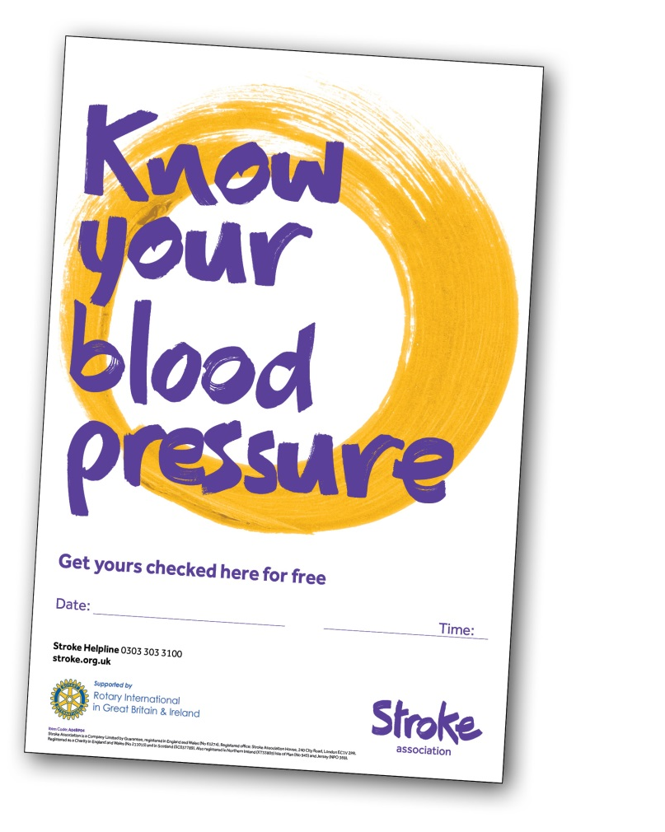
Stroke Association and RIBI
Relationship dates back 15 years.
Clubs throughout GB and Ireland support our community work in a variety of ways, mainly through Know Your Blood Pressure events.
We recognise the need and opportunity for an all Ireland approach.
Notes:
RIBI took over 23,000 blood pressures in 2016.
Almost 25% of those tested were advised to discuss their reading with their GP.

Slide 10
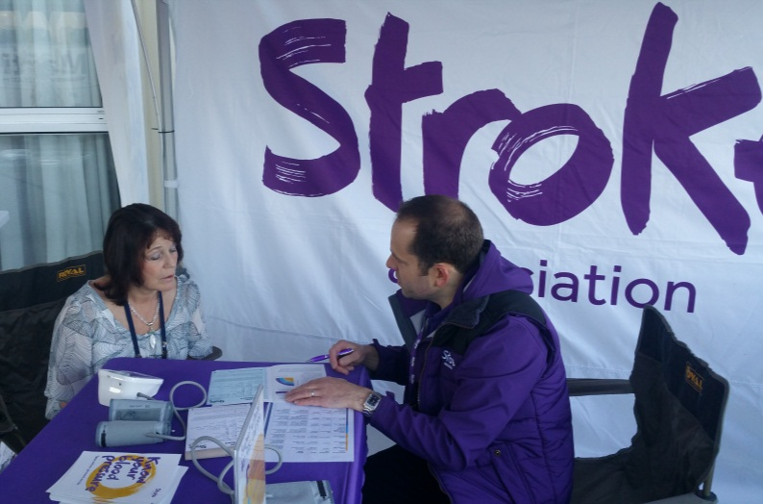
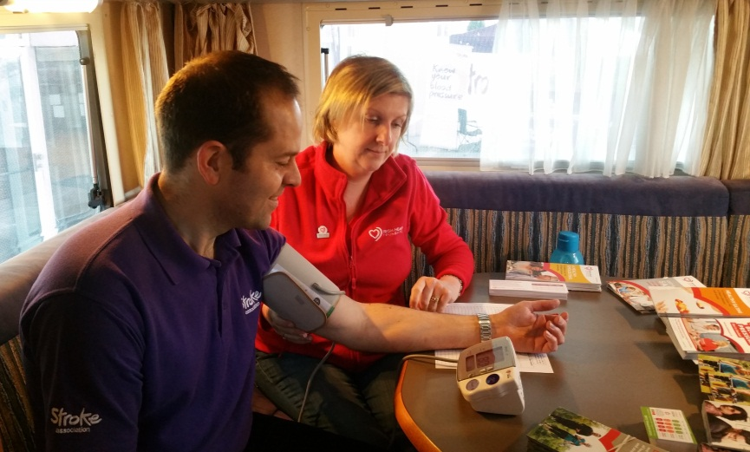
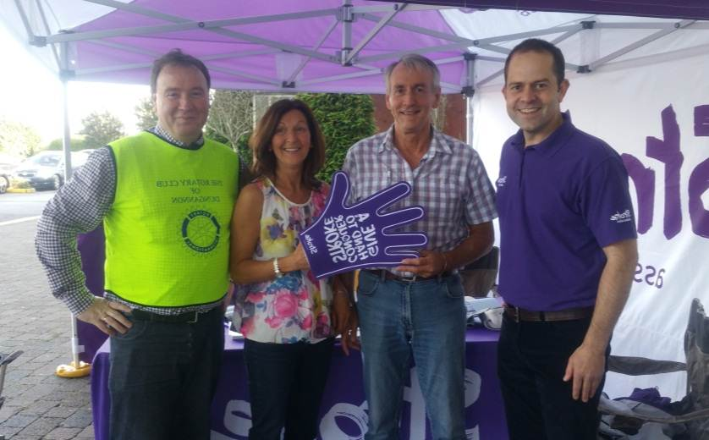
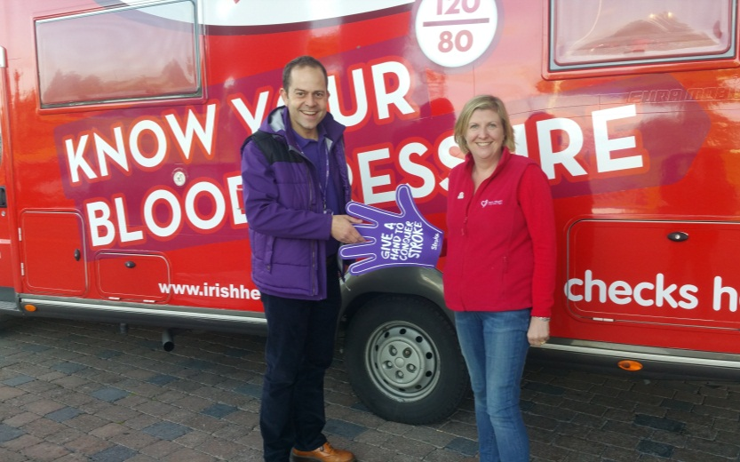
Stroke Association and Irish Heart

Slide 11
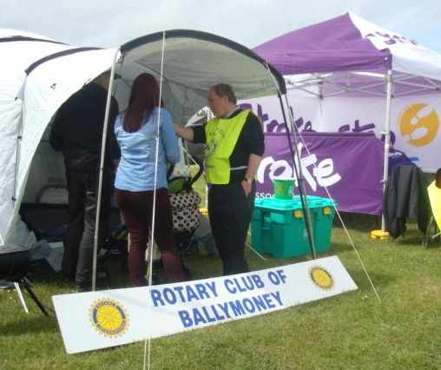
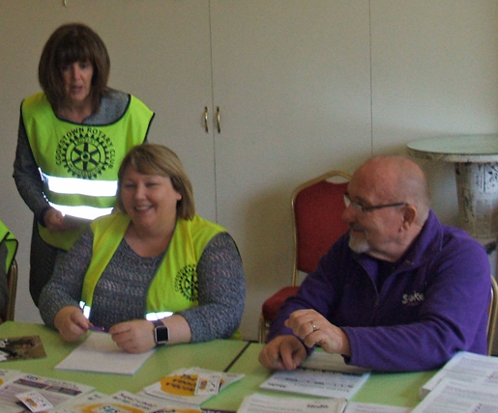
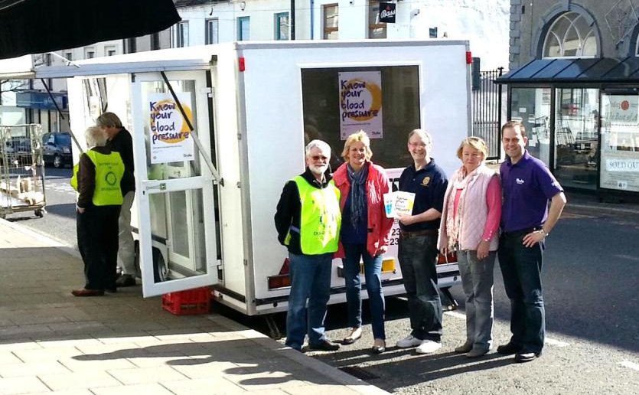
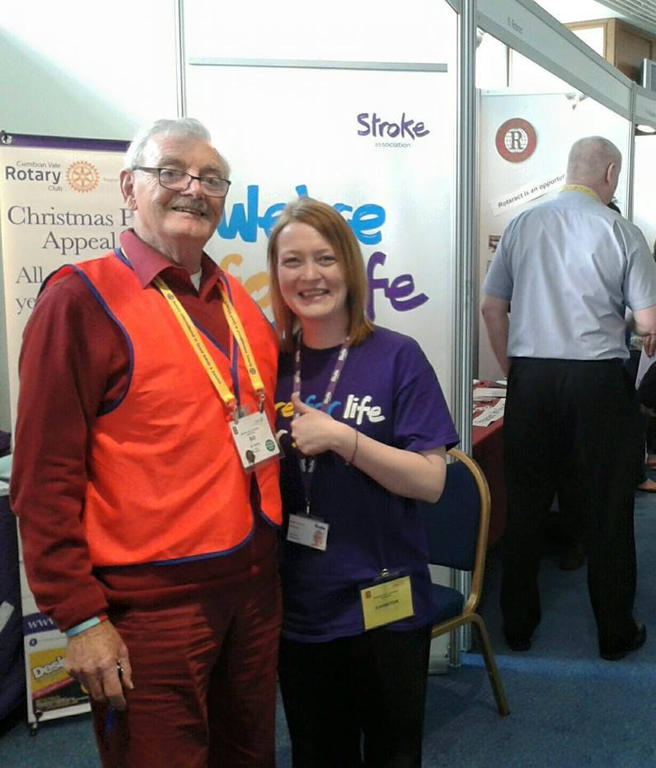
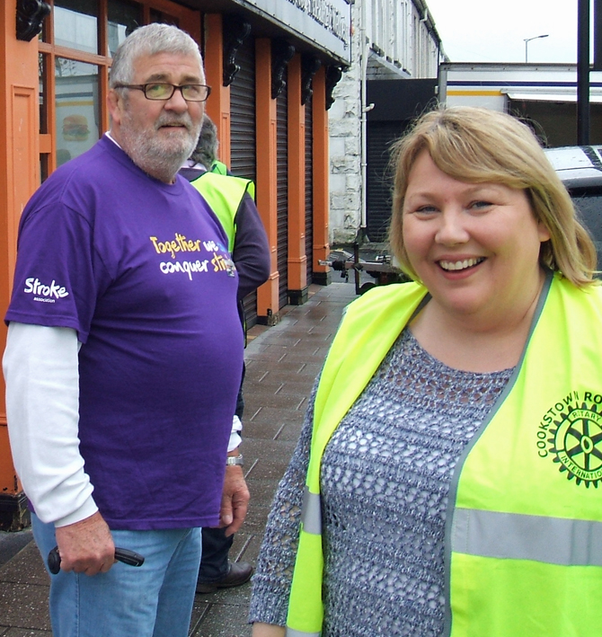
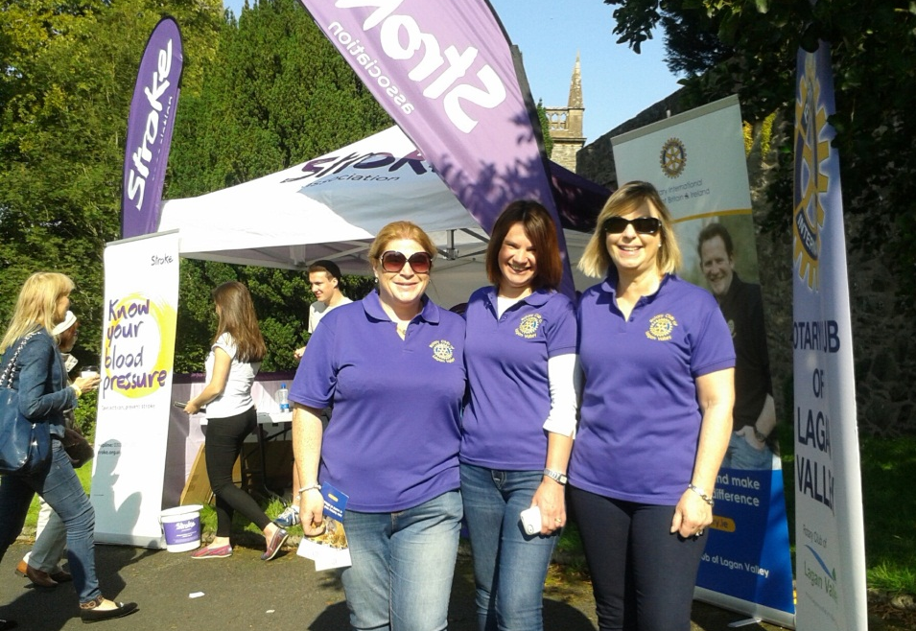
Rotary Ireland blood pressure events
Notes:
180 were tested on 22 April in Cookstown, at an event organised by the local club. 35 were advised to discuss their test results with their medical practice.

Slide 12
How your club can get involved
In Northern Ireland:
Visit stroke.org.uk/rotary to find out more about Know Your Blood Pressure and register your event.
You’ll find advice and support on how you can organise your event within your local community, supported by local health professionals and the Stroke Association team.

Slide 13
How your club can get involved
In the Republic of Ireland:
Help Irish Heart set up a Know Your Blood Pressure check in your community, as part of their health checks run by nurses.
Contact +353 1 668 5001 / info@irishheart.ie to suggest a location and work together to deliver the event.

Slide 14
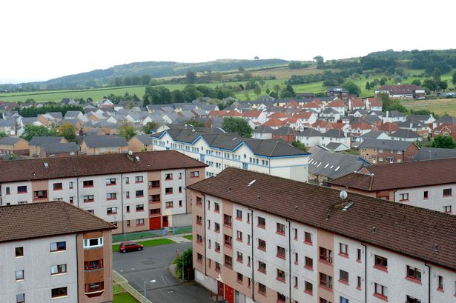
Targeting communities at risk
It’s important to target at risk communities, so we’d ask you to consider how you would reach:
working age men
people over the age of 55
people living in socially deprived areas
black and minority ethnic audiences

Slide 15
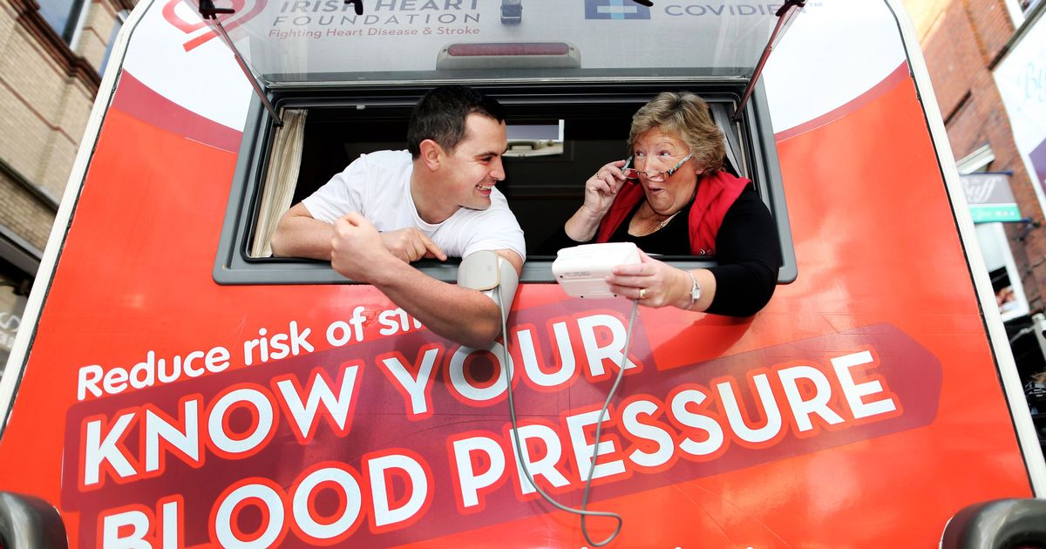
Partnership for community service
This is a partnership between the Stroke Association, Irish Heart and Rotary Ireland.
It’s a partnership based on community service.
If “Know your blood pressure” doesn’t fit your club, please do consider other ways of supporting the charities – through volunteering or fundraising.
We always need help, however you can offer it.

Slide 16
