Slide 3
District Training Assembly

Slide 4
Council on Legislation (COL) 2016
Council on Legislation (COL) 2016
Outcomes Impacting on Membership

Slide 5
Council on Legislation (COL) 2016
To Be a Member
An adult of good character
A good reputation in their business or community
Willing to serve the community

Slide 6
Council on Legislation (COL) 2016
To Be a Member
DUAL MEMBRSHIP
Rotaract and Rotary

Slide 7
Council on Legislation (COL) 2016
MEETINGS
Flexibility in meeting frequency, format, and attendance
Count service projects or social events as meetings

Slide 8
Council on Legislation (COL) 2016
MEETINGS
Gather in person
Meet online
Alternate between online and in-person meetings

Slide 9
Council on Legislation (COL) 2016
November 2016

Slide 10
Council on Legislation (COL) 2016
Club health not only about attendance
our service
value added to our communities at home and abroad
our fellowship and friendship
are what makes Rotary.

Slide 11
Council on Resolutions
Rotary must receive proposed Resolutions for the 2017
Council on Resolutions by
30 June 2017
Meets online October 2017

Slide 12
Council on Legislation
Rotary must receive proposed Enactments for the 2019 Council on Legislation by
31 December 2017
Meets in Chicago April 2019

Slide 13
Council on Resolutions & Legislation
An opportunity to exercise our individual and Rotary Ireland’s voice and make a contribution to the future of Rotary in its second century of service.

Slide 14
Finding New Members
A club plan – yearly GOALs*
Membership Chair reporting at club Board monthly meetings
Individual responsibility - GOAL
Use COL flexibility measures (money)

Slide 15
Finding New Members
An individual prospect list! 8-10
Diversity - age, gender, ethnicity
COL Flexibility measures – The Friday Lunch???
Cost to new members?

Slide 16
Finding New Members
Know what you will say
Talk practically about Rotary
Practice – prepare to sell!
Ask for help - invite to an event/activity
Follow up

Slide 17
Finding New Members - Resources
Experienced club members
Rotarians - District experience
New Rotary Clubs: Informational Meetings www.rotary.org)
The administration of a new member

Slide 18
Finding New Members - Resources
Mentoring resources (Introducing New Members to Rotary: An Orientation Guide www.rotary.org 414-EN—(816))

Slide 19
Finding New Members - Resources
The Mentoring process (Orientation Programmes For New members www.rotary.org 414-EN—(816))

Slide 20
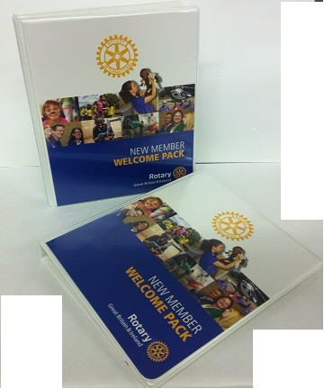
Finding New Members - Resources
RIBI New Member Welcome Pack

Slide 21
Finding New Members - Resources
The Rotary Effect

Slide 22
Finding New Members - Resources
The Rotary Effect

Slide 23
Finding New Members - Resources
Use Rotary Club Central (RCC)
to support your
membership development work.
Tell your club’s story - online

Slide 24
Finding New Members
Value proposition(s)
A promise of value to be delivered
The primary reason a prospective member should join your club

Slide 25
Finding New Members
Value propositions for:
Younger professionals
People under forty
Rotary alumni (incl. Rotaractors)
Family members of alumni YLDC

Slide 26
Finding New Members
Value propositions for:
Women
Recent retirees
Ethnic groups unrepresented
Trades and professions

Slide 27
Getting Help
People in your club
Your Assistant Governor
District Officers – past & present
Rotary Ireland website
www.rotary.ie www.rotary.org www.rotarygbi.org

Slide 29
Rotary Club of Kilkenny Open Day Rothe House 21.3.15
Sharing the experience

Slide 31
Why did we have an open day ?
Objective set by the RI President Gary C.K. Huang as part of the theme ‘Light up Rotary’
To dispel myths and raise the profile of the Rotary Organisation in our community
To attract new members

Slide 32
How did we do it ?
Committee to organise began 6 months before
Club, District and stakeholder buy in and support
Communication with the people of Kilkenny City & County

Slide 33
Format of Day
An informal ‘drop in’ event lasting only 4 hours on a Saturday
As much interaction and theatre as possible
A ‘hook’ for visitors to take away allowing further contact

Slide 34
Promotion of event
Flyers for all members to distribute
Flyer and invitation sent to most businesses and organisations in Kilkenny
Flyer and invitation sent to all speakers, causes and visitors that attended the club over the years
Media
Local Press adverts
Kilkenny.com
KCLR radio interview a two days before the event

Slide 35
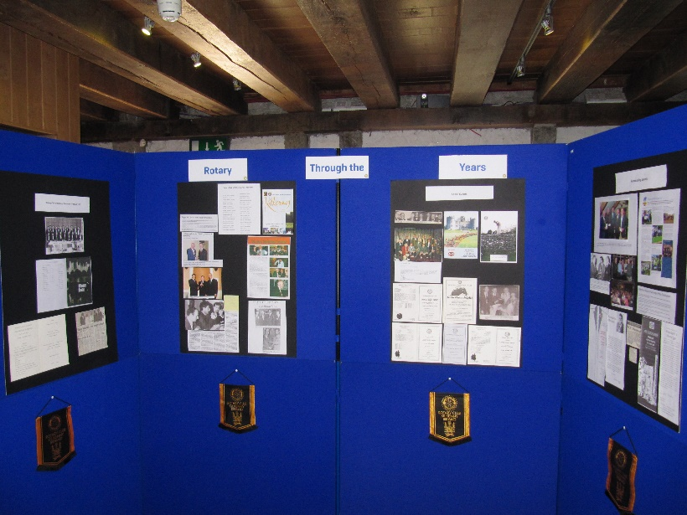
The location framing the event
Rothe House
Well known large public venue in the city centre
Heritage value and visitor destination
Display boards with articles, items and pictures covering
Welcome
History of Rotary
Community
International
Youth
Club – Social
Club – History

Slide 36
The ‘theatre’ giving life to the event
Opening address by Mayor introduced by Rotary President
Hourly speakers introduced by Rotarian Service Chair
From organisations that had worked with or are working with Kilkenny Rotary
In between District, RIBI and RI video clips shown on loop
Demonstration of a Shelter Box

Slide 37
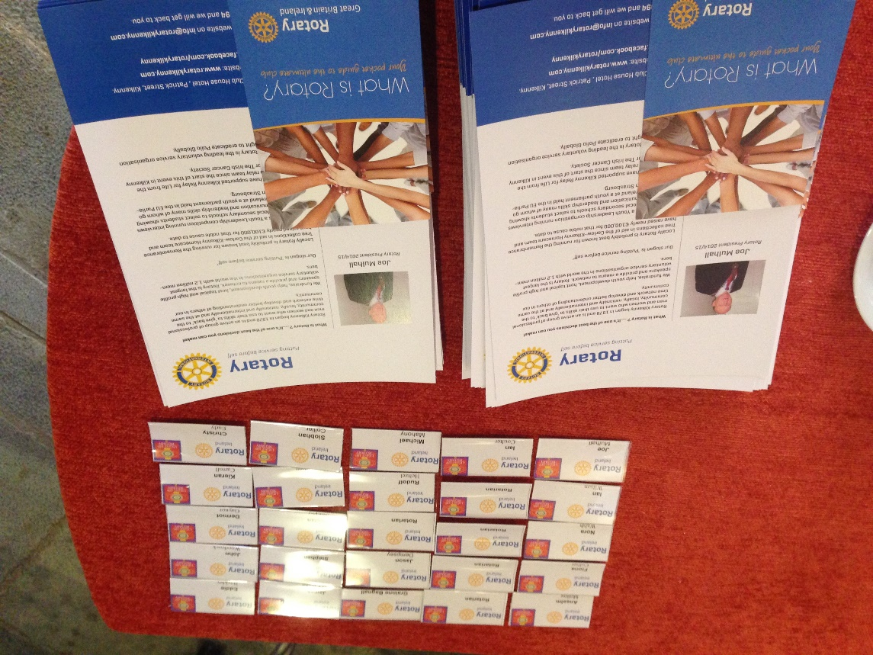
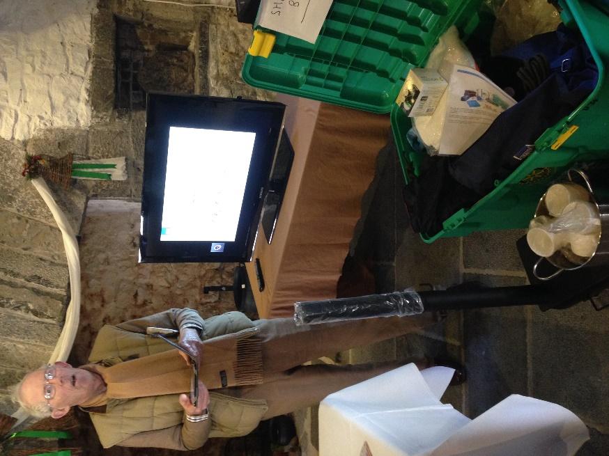
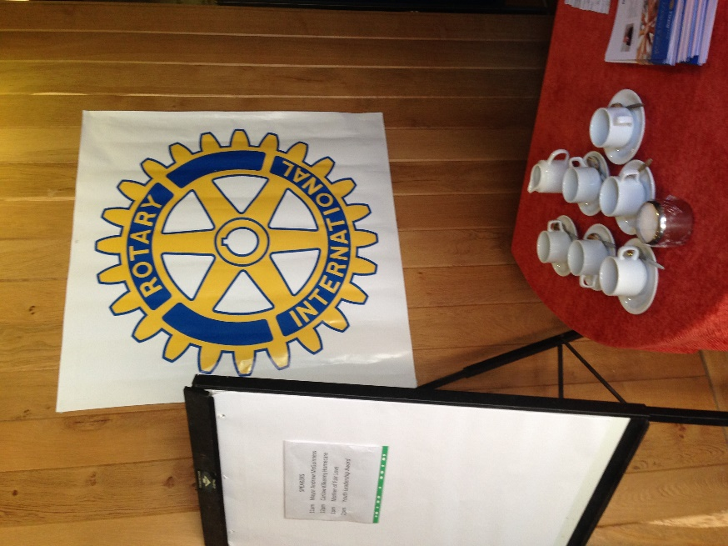

Slide 38
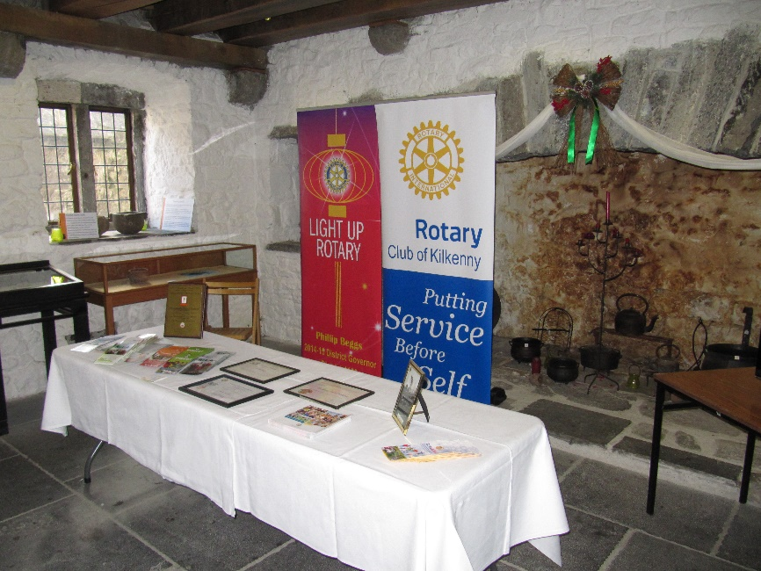
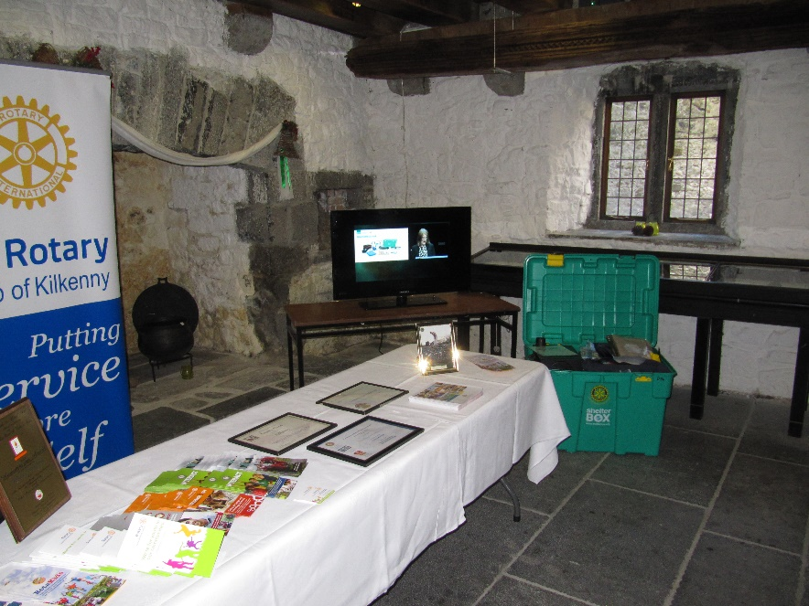
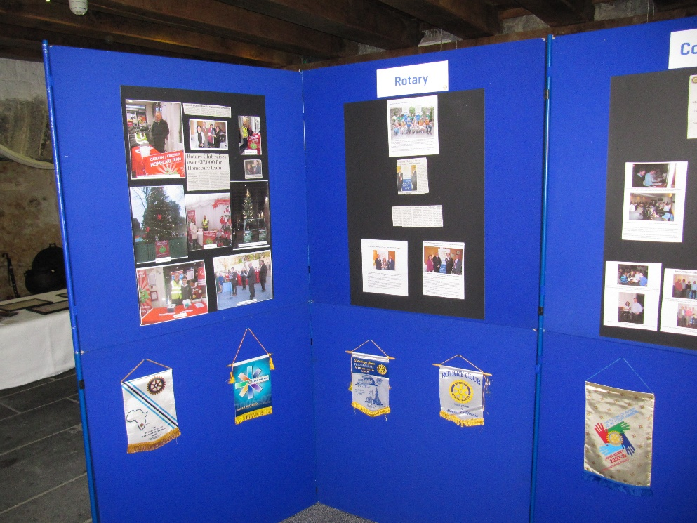

Slide 39
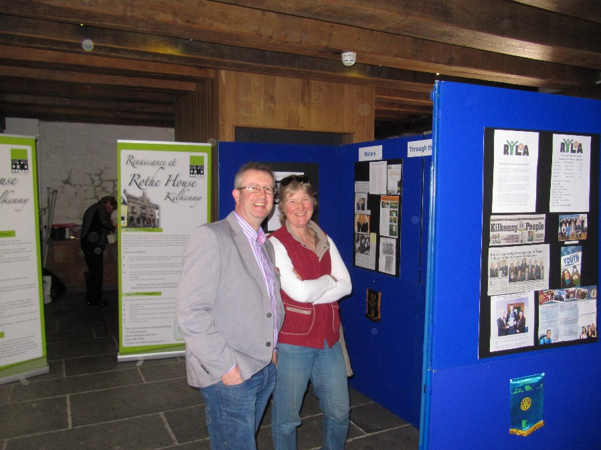
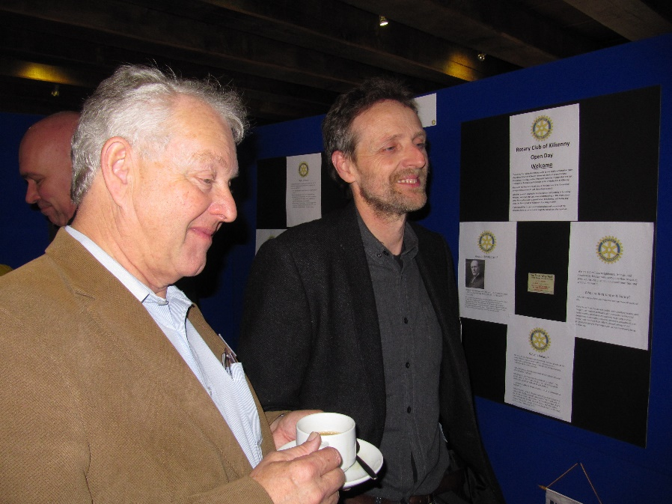
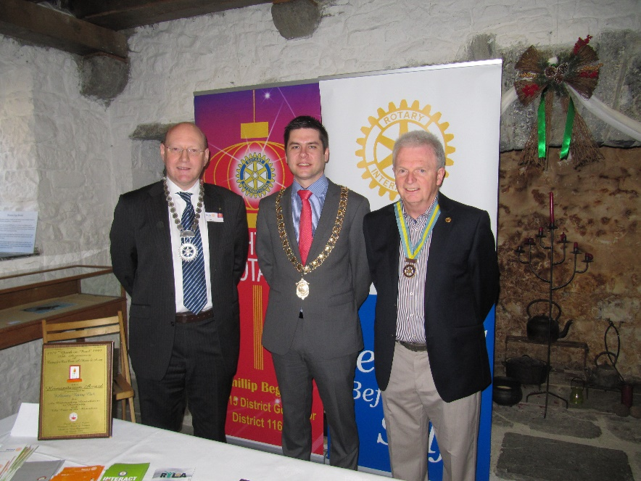
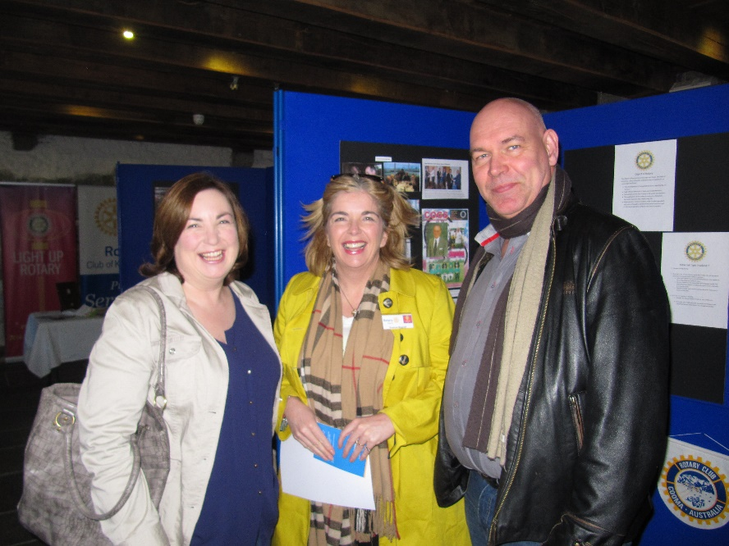
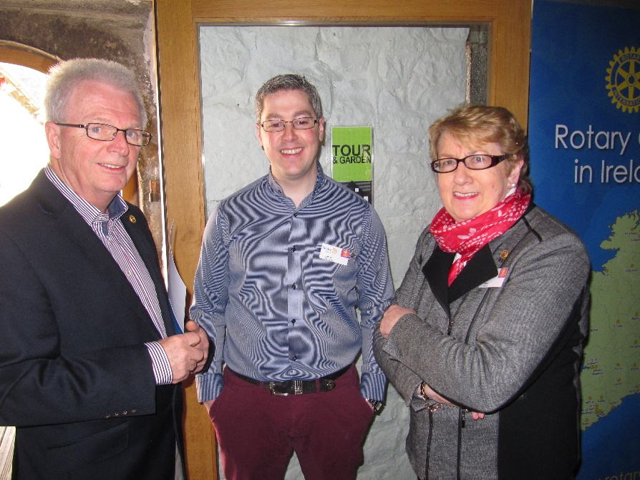

Slide 40
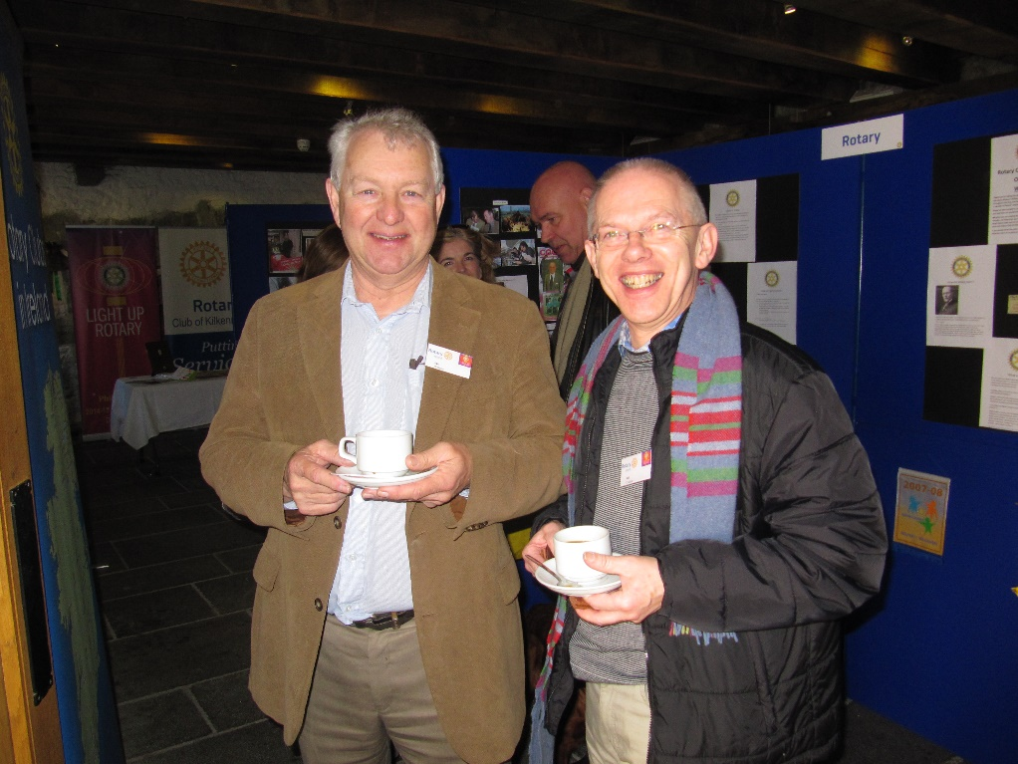

Slide 41
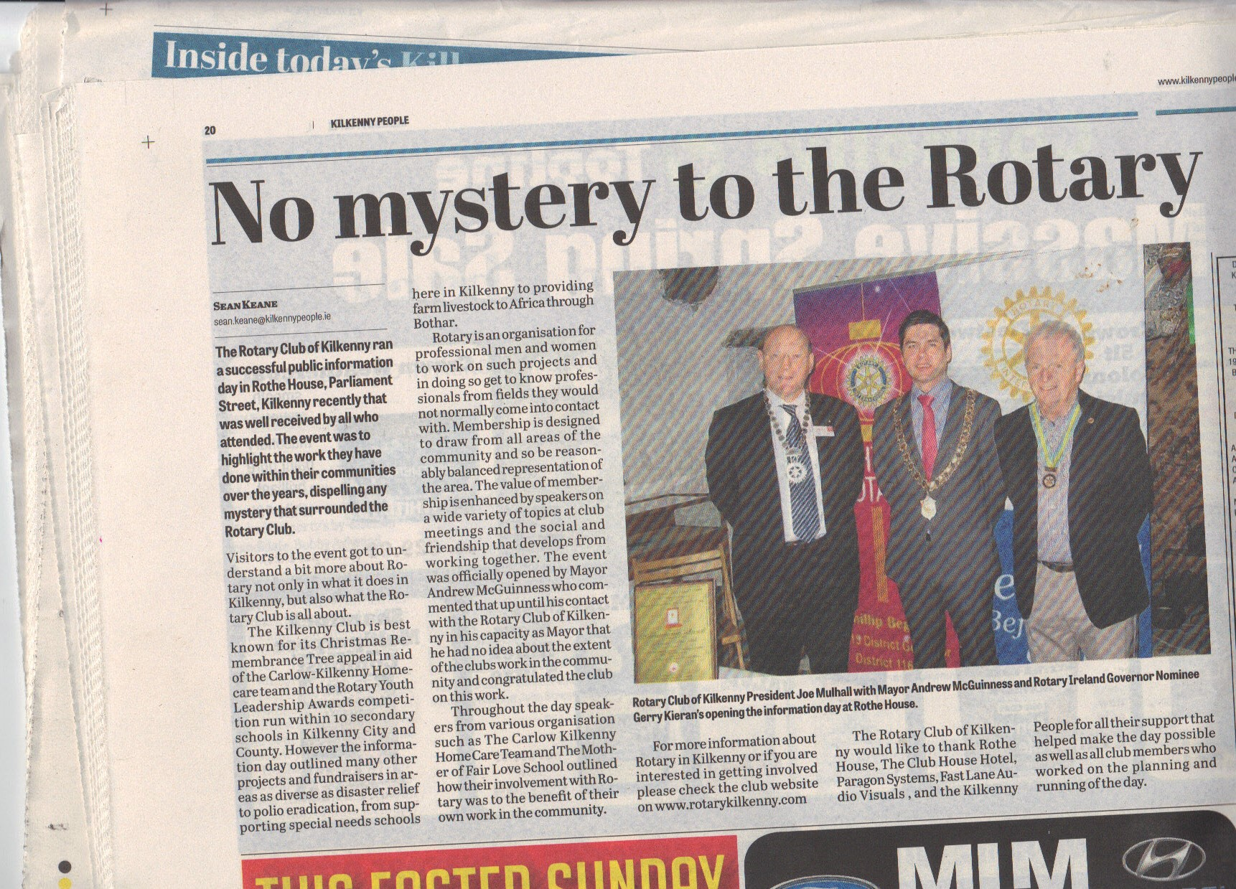

Slide 42
Benefits of the open day- obvious
Raised the profile of the club with the community
In advance promoting the event
On the day with visitors
Post event media publicity

Slide 43
Benefits of the open day
New Members from the day ?????
None on day
Decision to join is a more complex & personal process

Slide 44
Benefits of the open day- less obvious
Forced us as a club to get things done !
Web site
Facebook Page (social media)
Develop closer ties with local media
Re-engage with organisations and causes from the past !

Slide 45
Benefits of the open day
ENERGISED THE ENTIRE CLUB MEMBERSHIP
Established & Founder Members recalled memories and achievements
New members learned about Rotary and the achievements of the Rotary Club of Kilkenny
We all developed a bit more pride in being a Rotarian !

Slide 46
Benefits of the open day
THE REAL BENEFIT WAS IN –
The preparation & involvement of all members.
the sub committee
the building & presentation of the ‘story boards’ at club meetings
the day itself
and the media reporting after the event
No coincidence that since that day we have had 8 new members join the Rotary Club of Kilkenny!

