Slide 3
District Training Assembly
Public Image Chair
Pat Leogue
leogue@gmail.com

Slide 4
The Challenge
Make our media output look more professional and polished, while showing a consistent image style to both members and the outside world.

Slide 5
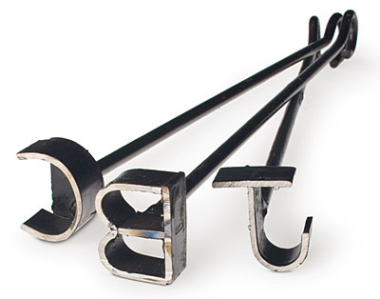
Our Brand
What is “Brand?”

Slide 6
Our Brand
Just Coffee?

Slide 7
Our Brand
Just Shoes?

Slide 8
Our Brand
What is “Brand?”

Slide 9
Our Brand
Rotary as a brand

Slide 10
Type speech topics here

Slide 11
Our Brand

Slide 12
Type speech topics here

Slide 13
Public Relations

Slide 14
PR Activity - May and June
Young Citizens’ Award
Young Musician of the Year
Project Ciara
Project 538
The Rotary Foundation Centenary

Slide 15
Rotary News
Re-launch to be announced soon

Slide 16
District Database / Directory
The new database system was launched to clubs on 22nd April at District Council
Full details emailed to Club Presidents, Presidents Elect and Club Secretaries on 23rd April
Deadline for updating Club and Member data is 21st May for inclusion in the 2017/2018 printed Directory

Slide 17
Public Image
I am looking for volunteers who have skills and experience in the following disciplines and would be prepared to work with me in a District officer role.
Website updating and maintenance
Social Media development and use
Editor – Rotary News

Slide 18
Thank you for your attention
Public Image Chair
Pat Leogue
leogue@gmail.com

