Slide 3
PRESIDENTS ELECT PREPARATION SEMINAR
TITLE
WELCOME
PDG PHILLIP BEGGS
DISTRICT TRAINER

Slide 4
HOUSE KEEPING

Slide 5
Notes:
100 Years video

Slide 6
DISTRICT TEAM
INTRODUCTIONS
Notes:
TED NEXT

Slide 7
"In just 4 months you will be club president”
“How ready are you?"
Notes:
Table Exercise

Slide 8
HOPES AND FEARS
What are your expectations from PEPS?
Notes:
Table Exercise

Slide 9
Rotary Club Central
Notes:
Welcome to Rotary Club Central. This is not difficult honest. Please listen with open mind this is useful for all of us.

Slide 10
What is it?
Online tool
Set Goals
Track Achievements
Visioning
Members
Hours
Money
Notes:
Ok so what the hell is it? But we do that already with treasurers reports at AGM and stuff. Ok maybe you do but can you remember what goals you have as a club, what you have done, how much time you have spent. Ever thought that things may need looking at that what you have done for a while no longer seems to be working but you have no data to back it up. Useful to be able to say how many hours we worked on something. Its not all about money. Its about being able to find out how many hours and time we are investing in projects. More later

Slide 11
Who can edit?
President
Past President
President Elect
Secretary
Treasurer
Executive Secretary
Notes:
These can add and edit. The new role is Executive Secretary. This does not have to be the treasurer or secretary but someone else who may want to have a club role. It is not difficult to do. But it is up to you as a club who does it. The most impt bit is coming.

Slide 12
Who can View
Every member of the Rotary Club
Notes:
Every member of the club can see and view the clubs, goals, time spent, trends, funds raised.

Slide 13
How to Access Rotary Club Central Go to rotary.org/myrotary and click on Sign in/Register. Or go to www.rotary.org/clubcentral
Notes:
You need to be registered. It does not take long. Normally your login and password for your own District site will work.

Slide 14
MY CLUB SNAPSHOT CLUB NAME
Eyemouth & District WEBSITE
http://www.rotary-ribi.org/clubs/homepage.php?ClubID=81
MEETING LOCATION Eyemouth Golf Club Gunsgreenhill, Eyemouth, Scottish Borders, TD14 5SF, Scotland
MEETING DATE AND TIME
Thursday 7:00 PM
MEMBERS 18
CHARTER DATE 13-Jun-1972
CLUB PRESIDENT Jim Hettrick
CLUB GOALS SET: 0%
CLUB GOALS ACHIEVED: 0%
SERVICE GOALS SET: 0%
SERVICE GOALS ACHIEVED: 0%
FOUNDATION GIVING GOALS SET: 0%
FOUNDATION GIVING GOALS ACHIEVED: 0%
ROTARY CLUB CENTRAL
VIEW GOALS
Notes:
You can view your club snapshot. This is my own club before we have entered information. Need to then go to Rotary Club Central view goals.

Slide 15
Three areas
Your Club
Service
Foundation Giving
Notes:
3 areas come up as above

Slide 16
You need to click on one of the tabs.
Be Patient it takes a while to load !

Slide 17
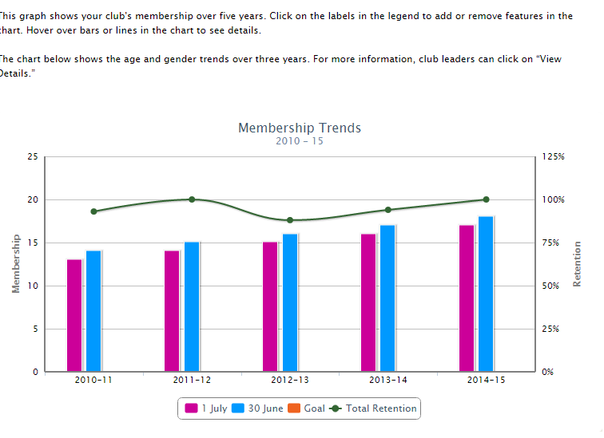
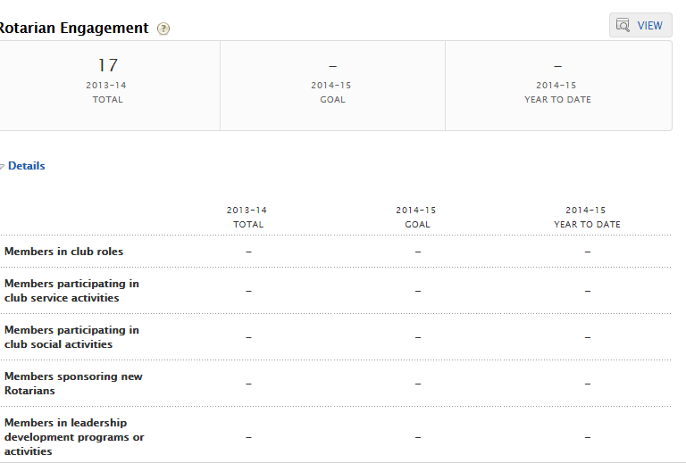
Notes:
This is in my club section

Slide 18
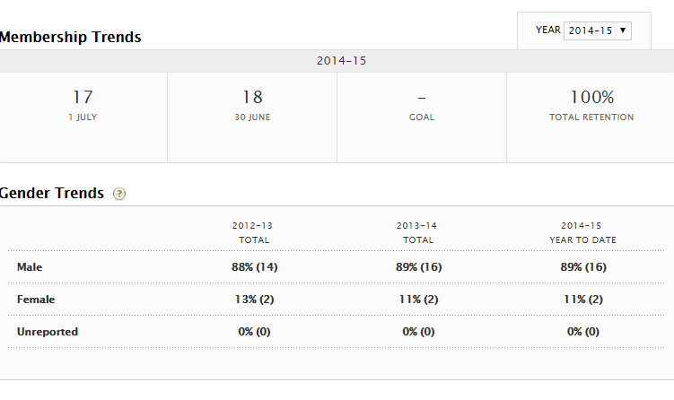
Notes:
Shows trends, but really need dates of birth or year of birth to help with ages of rotarians in RIBI.

Slide 19
Goals and Progress
Notes:
There is a goals and progress section. How did we do last year, what the hell did we do last year as I cant remember. This helps.

Slide 20
Rotarian Engagement
Notes:
Is everyone engaged?

Slide 21
Club Communication
Notes:
Are we doing what we need to do?
Could we use this to “shout about “ what we do? Is this a marketing/ new members tool. We are NOT just a bunch of boring old farts we do x y and Z

Slide 22
Public Relations

Slide 23
Service Projects and Activities
Notes:
This is the screen to show what projects we have done and are doing. How many hours have we donated to a project? What about Christmas activities. We all do them, how many hours? This was Eyemouth before we started using it
How much have we raised for a project?
Did we get any in kind value

Slide 24
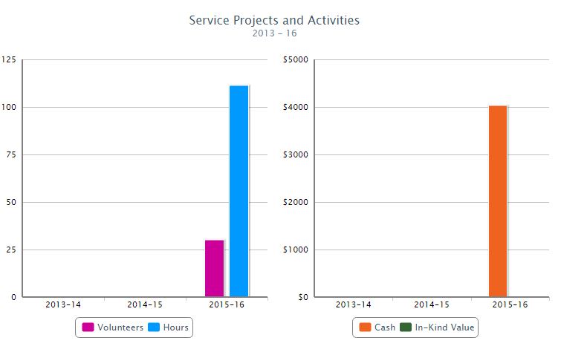
Notes:
After we started using it.

Slide 25
Easy to add details click on Edit
Notes:
Click on Edit.

Slide 26
Duck race project
Notes:
Gives you more details on projected resources and then you can add actual resources used.
Projects can be shared on the Showcase. So if you wanted to run a duck race it will take you about 75 hours for 1,000 ducks to try and raise £2K. Mind you in Eyemouth the ducks went backwards up the river due to the tide !

Slide 27
Foundation Giving
Notes:
This is OUR charity. Its not just End Polio.

Slide 28
District View Annual Fund
$83,254
Notes:
You can view District trends. How are we doing as a whole?

Slide 29
Global View
Notes:
How are we doing globally?

Slide 30
Reports
Notes:
Reports can be issued
Why?
Because we are the worlds largest service organisation. When the RI or RIBI president says we donate so much time to x Y and Z he can then say correctly clubs in RIBI or RI have spent so many hours doing literacy projects, offering support in emergency situations etc

Slide 31
Rotary Club Central is a tool, not only for RI & RIBI but for us
If you have the data on the projects and events you have done as a club, could you not use this to encourage new members, raise your profile.
Look at what other clubs have done on the showcase. Don’t reinvent the wheel?

Slide 32
BUT RI/RIBI Big Brother
Each Club is unique
What can they really do to you?
We need to capture what we are doing?
Why Not use it?
Try it?
You can also use it to see what other clubs have done on a project

Slide 33
WHAT IS ROTARY CLUB CENTRAL?
It is a tool that enables clubs to set goals and track achievements

Slide 35
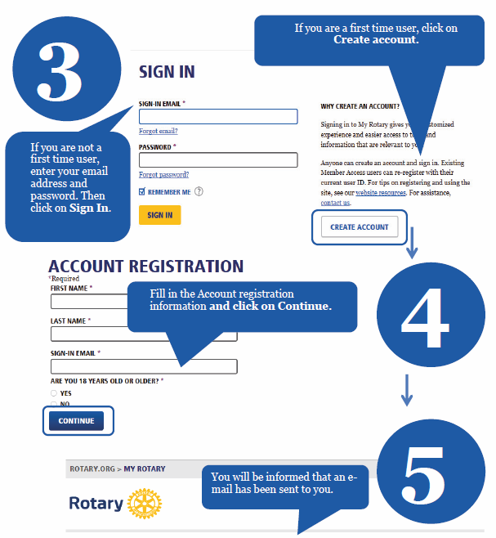

Slide 36
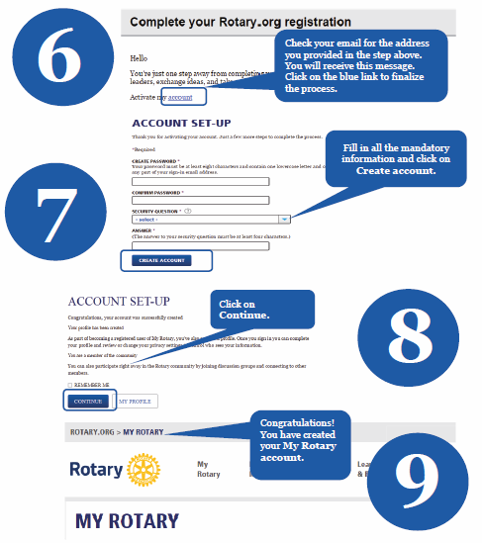

Slide 37
HOUSE KEEPING

Slide 38
PRESIDENTS ELECT PREPARATION SEMINAR
TITLE
PDG PHILLIP BEGGS
DISTRICT TRAINER

